Slide 1
SLHC, the high-luminosity upgrade
Public Event
SPS Upgrade
26 February 2009
E. Shaposhnikova (CERN/BE/RF)
for SPSU Study Team
Motivation for SPS upgrade
SPSU activities
SPS limitations and proposed actions

Slide 2
Present LHC upgrade scenarios
F. Zimmermann et al.
Parameter |  | Nominal | Ultimate | ES & FCC | LPA
bunch intensity | 10¹¹ | 1.15 | 1.7 | 1.7 | 4.9
transv. emitt. | μm | 3.75 | 3.75 | 3.75 | 3.75
bunch spacing | ns | 25 | 25 | 25 | 50
beta* at IP1&5 | m | 0.55 | 0.5 | 0.08 | 0.25
crossing angle | ^{μrad} | 285 | 315 | 0 & 673 | 381
peak lumi ℒ average ℒ (turnaround time 10h) | 10³⁴ cm⁻²s⁻¹ | 1.0 0.46 | 2.3 0.91 | 15.5 2.4 | 10.7 2.5
event pile-up |  | 19 | 44 | 294 | 403

Slide 3
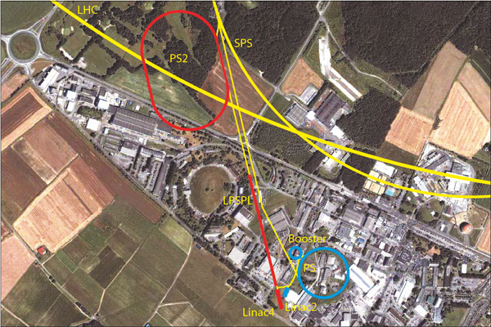
LHC injectors: present and future
UNOSAT

Slide 4
SPS: present achievements and future needs
Parameters | PS2 offer per cycle at 50 GeV |  |  | SPS record at 450 GeV |  | LHC request at 450 GeV
 | 25 ns | 50 ns | FT | 25 ns | FT | 25 ns | 50 ns
bunch intensity /10¹¹ | 4.4 | 5.5 | 1.6 | 1.2 | 0.13 | 1.7 | 5.0
number of bunches | 168 | 84 | 840 | 288 | 4200 | 336 | 168
total intensity /10¹³ | 7.4 | 4.6 | 12.0 | 3.5 | 5.3 | 5.7 | 8.4
long. emittance [eVs] | 0.6 | 0.7 | 0.4 | 0.6 | 0.8 | <1.0 | <1.0
norm. H/V emitt. [μm] | 3.5 | 3.5 | 15/8 | 3.6 | 8/5 | 3.5 | 3.5
→ SPS upgrade is necessary

Slide 5
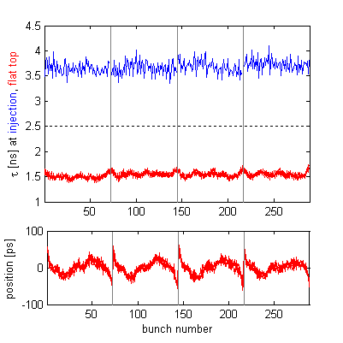
SPS: today’s status of nominal LHC beam
bunch intensity: 1.15 x10¹¹
4 batches of 72 bunches spaced at 25 ns
bunch length: 1.6 ± 0.1 ns
bunch position (FT) < 100 ps
longitudinal emittance:
0.6 ± 0.1 eVs
transverse normalised emittances:
  H-plane 3.0 ± 0.3 μm
  V-plane: 3.6 ± 0.3 μm
beam loss ~ 10%
Bunch length and position over 4 LHC batches at injection and flat top
G. Papotti et al., 2008

Slide 6
SPS → SPSU(pgrade) http://paf-spsu.web.cern.ch/paf-spsu/
SPSU Study Team (exists since March 2007):
G. Arduini, F. Caspers, S. Calatroni, P. Chiggiato, K. Cornelis, E. Mahner, E. Metral, G. Rumolo, E. Shaposhnikova, M. Taborelli,
C. Yin Vallgren, F. Zimmermann + J. Bauche, P. Costa Pinto,
G. Vandoni, N. Gilbert + R. Garoby, M. Jimenez + guests (Y. Kadi,
M. Barnes, …)
Main tasks
Identify limitations in the existing SPS
Study and propose solutions
Design report in 2011 with cost and planning for proposed actions
~12 (formal) meetings per year + informal discussions and meetings

Slide 7
SPSU activities in 2007-2009 (1/2)
24 Nov 2008
7
SPS beam dump
  beam dump - TIDVG
    improved spare or a new one?
  - beam dump kickers – MKDV, MKDH
    impedance issues (no transition pieces)
    heating with 75 ns spaced beam
    outgassing with 50 ns spaced beam – limitation, MDs in 2008
MKE kickers
  impedance issues, heating: shielding or a new design?
SPS impedance budget
  search for missing transverse impedance

Slide 8
SPSU activities in 2007-2009 (2/2)
24 Nov 2008
8
e-cloud:
  simulation studies
  e-cloud mitigation options and their possible implementation
  experimental set-up in the SPS
  measurements with beam during scrubbing runs and long MDs (special ‘MD cycle’ in 2007)

Slide 9
SPS: known intensity limitations
Single bunch effects:
  space charge
  TMCI (transverse mode coupling instability)
Multi-bunch effects:
  e-cloud
  coupled bunch instabilities at injection and high energy
  beam loss (7-10% for 25 ns bunch spacing and 5% for 50 ns bunch spacing and nominal bunch intensity)
  beam loading in the 200 MHz and 800 MHz RF systems
  heating of machine elements (MKE, MKDV kickers, …)
  vacuum (beam dump and MKDV outgassing), septum sparking

Slide 10
SPSU: possible actions and cures
Higher injection energy: 25 → 50 GeV with PS2
e-cloud mitigation
Impedance reduction (after identification!)
Damping of instabilities:
  active: upgrade of beam control (transverse and longitudinal feedbacks)
  “passive”: due to increased nonlinearity
    800 MHz (4th harmonic) RF system
    increased longitudinal emittance (more losses at capture in LHC)
Hardware modifications: injection kickers, RF system, beam dump system, beam diagnostics, radioprotection…
New hardware: collimation?

Slide 11
SPS with PS2 and 50 GeV injection
Sufficient improvement for space charge tune spread up to bunch intensity of 5.5 x10¹¹
Increase in TMC instability threshold by a factor 2.5
Shorter injection plateau (2.4 s instead of 10.8 s) and acceleration time (10%) – shorter LHC filling time (and turnaround time)
No transition crossing for all proton beams and probably light ions
Easier acceleration of heavy ions (lead):
  smaller tune spread and IBS growth rate,
  smaller frequency sweep - no need for fixed frequency acceleration
Smaller physical transverse emittance – less injection losses

Slide 12
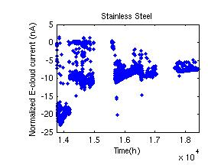
SPS limitations: e-cloud
pressure rise, septum sparking, beam dump, MKDV outgassing
beam losses on flat bottom
transverse emittance blow-up and instabilities:
  coupled bunch in H-plane
  single bunch in V-plane
Today’s cures
high chromaticity in V-plane
transverse damper in H-plane
scrubbing run (from 2002):
SEY decrease 2.5 → 1.5
x 10²
G. Arduini
M. Taborelli

Slide 13
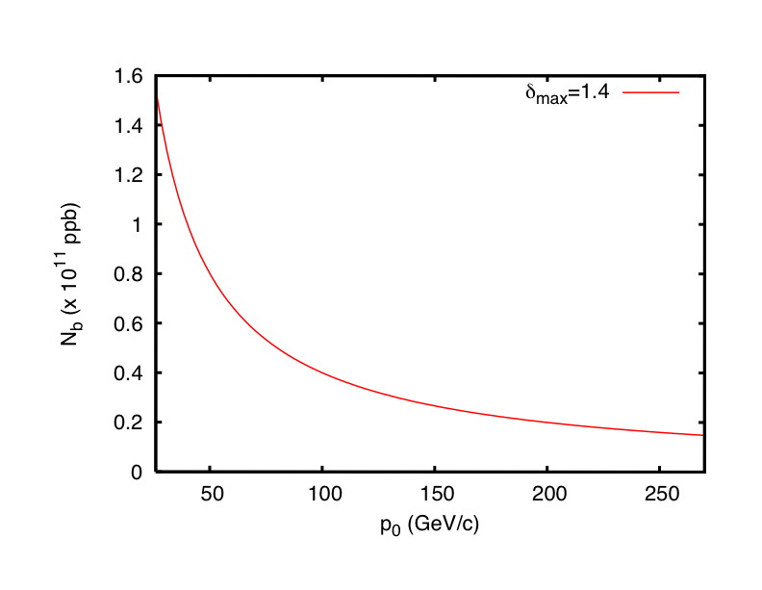
SPS limitations: e-cloud
Scaling with beam energy
V-plane: instability threshold is decreasing with energy γ (constant emittances, bunch length and matched voltage)
HEADTAIL simulations
e-cloud build-up threshold
E-cloud build up threshold
1/γ
H-plane: e-cloud instability
growth time ~γ
Experimental studies of the scaling law in the SPS:
2006: measurements at different points during ramp with reduced
chromaticity and damper gain – difficulties in interpretation
2007: special cycle with flat portion at 55 GeV/c, dependence on transverse size was confirmed (G. Rumolo et al. PRL, 100, 2008)

Slide 14
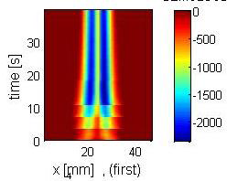
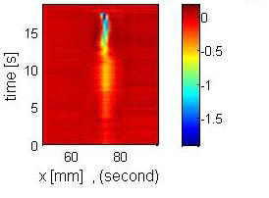
e-cloud mitigation
Stainless steel
surface treatment: in-situ, no aperture reduction, no re-activation (S. Calatroni, P. Chiggiato, M. Taborelli, C. Yin Vallgren…)
  carbon based composites, SEY<1 obtained, - ageing problem (with venting)
  rough surfaces – 2 layers
  electromagnetic roughness (F. Caspers)
clearing electrodes (F. Caspers et al.)
active damping system in V-plane
  (W. Hofle + LARP)
grooves - 35% reduction was measured in lab (for Al) (M. Pivi – SLAC, M. Taborelli)
a-Carbon C-8
M. Taborelli

Slide 15
SPS experimental set-up for e-cloud studies in 2008
B. Hervist
3 strip-line monitors: stainless-steel, a-C coating, NEG → 4 in 2009!
clearing (enamel) electrodes with button PUs
C - magnet with exchangeable samples → 2 magnets in 2009
3 RF antennas for microwave transmission measurements (at 2.8 GHz)
6 RF antennas in 2009 around coated and uncoated magnets

Slide 16
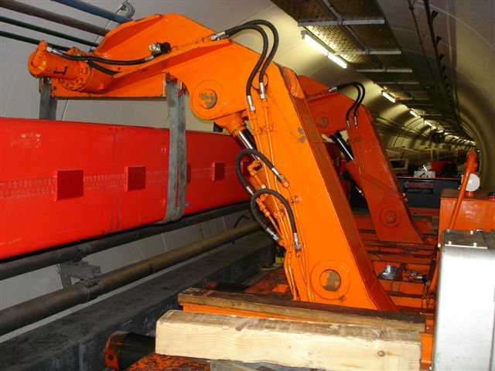
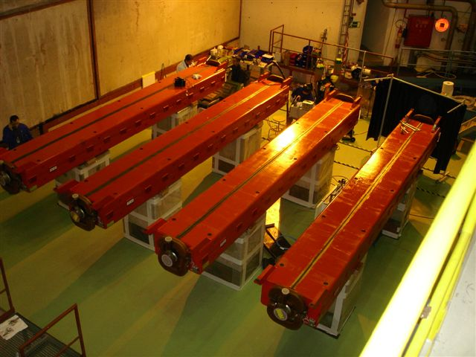
Possible vacuum chamber modification for e-cloud mitigation
Implementation in the SPS tunnel (J. Bauche, D. Tommasini, P. Costa Pinto, S. Calatroni et al.)
Experience due to installation of RF shields (1999-2001) and ongoing refurbishing of the cooling circuits of dipoles (2007-2009)
Infrastructure: ECX5 cavern – ø20 m
750 dipoles can be coated in 120 days → 2-3 shutdowns (48 h/magnet, 6/day, 2 Dumont machines and 2 coating benches)
Plans for 2009: 3 MBB spare magnets coated and installed in SPS test area with microwave and vacuum diagnostics

Slide 17
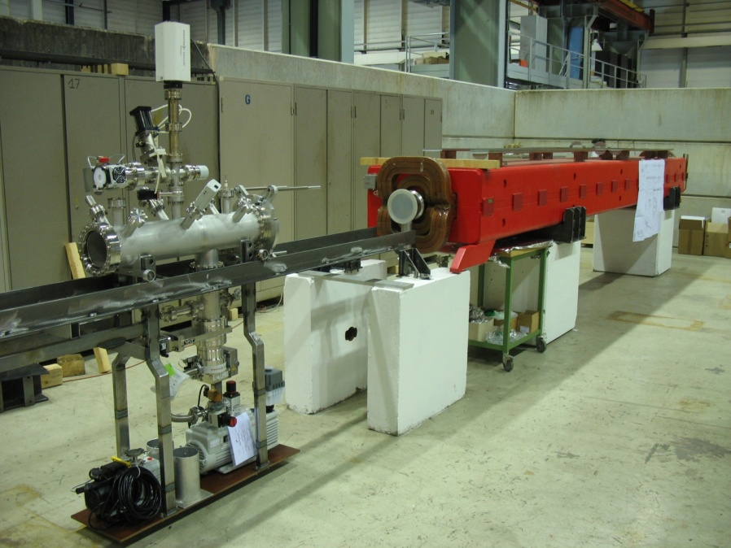
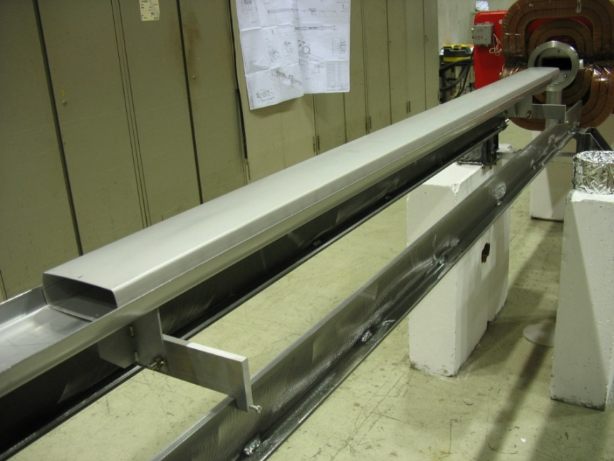
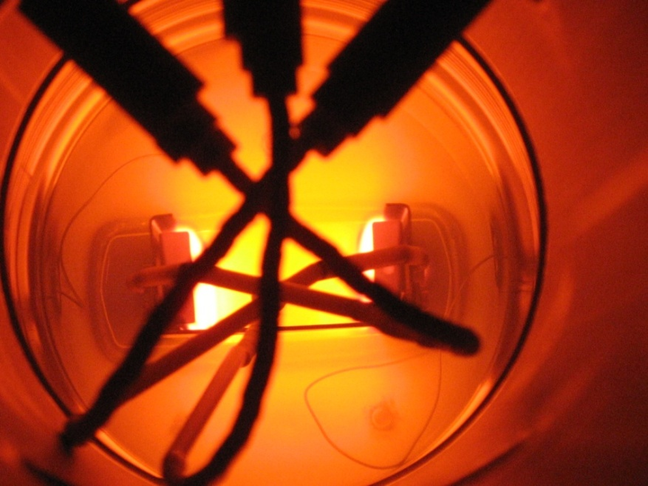
2 m liner
coating bench in bld. 867
Special coating system (1mx6)
using dipole magnetic field designed
(P. Costa Pinto et al.)
After initial tests on liner, the first SPS MBB magnet was successfully coated with amorphous Carbon this week - due to efforts of many people from different departments and groups!
2 MBB till the end of the next week

Slide 18
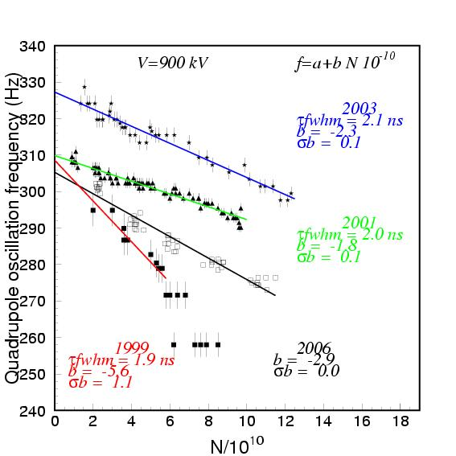
SPS limitations: impedance
1999-2001: SPS impedance reduction in preparation for nominal LHC beam → no microwave instability
2003-2006: impedance increase, mainly due to re-installation of 8 MKE (extraction kickers for LHC)
Only 50% of SPS transverse impedance budget is known
→ search for the rest
Shielding of the known impedance sources (MKE, MKDV...)
Active damping of the 800 MHz impedance (FB and FF)
Quadrupole oscillation frequency as a function of bunch intensity
Im Z_{eff} ~ slope
Similar measurements in V-plane (H. Burkhardt et al.)

Slide 19
SPS limitations: impedance
MKE kicker shielding
Longitudinal Re[Z]
Printed strips in MKE-L10
Imaginary part of Z
Interdigital comb structure 20mm spacing surface discharge
Transverse Re[Zh]
F. Caspers, T. Kroyer,
M. Barnes , E. Gaxiola

Slide 20
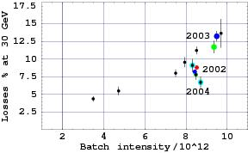
SPS limitations: beam losses
Strong dependence on batch intensity, less on total (number of batches)
Reduction of losses in 2004 with new working point and RF gymnastics (2 MV → 3 MV)
Much smaller relative losses for 75 ns and 50 ns bunch spacing for the same bunch intensity:
(5-7 % in 2008)
To have the same absolute losses relative losses should be reduced for higher intensities!
LHC beam (25 ns bunch spacing): relative capture loss for different batch intensities

Slide 21
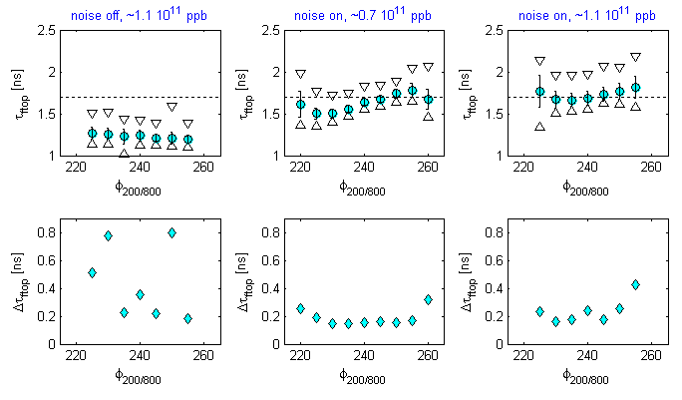
Coupled bunch instabilities
Bunch length (av., max-min)
Beam stability
G. Papotti et al.
Cures: 800 MHz RF system in bunch-shortening mode and
controlled emittance blow-up → 0.6 eVs (0.9 eVs for upgrade intensities)

Slide 22
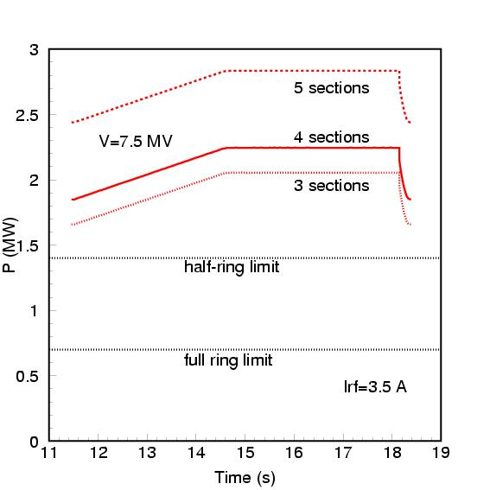
RF systems upgrade
200 MHz RF power
(max LHC upgrade intensity)
Coupled-bunch (long.) instability threshold ~1/5 nominal intensity
Larger emittance needed for higher intensities ( ε~√N)
The 200 MHz RF system limits:
  Voltage 7.5 MV
  Power 0.7 MW for full ring
(3.3-4.5) MW/cavity (200 MHz) for max PS2 intensity
→ The 200 MHz and 800 MHz power plant should be increased
→ R&D for re-design of couplers and coaxial lines
→ Cavity length (200 MHz) could be optimised (5 → 3 sections)

Slide 23
SPS upgrade: potential for other (fixed target, CNGS) beams
with PS
with PS2
←one PS cycle→ ←one PS cycle→
←one PS2 cycle (5-turn extract.) →
Potential proton flux with maximum PS2 intensity for
  200 days of operation,
  80% beam availability,
  45 (85)% beam sharing
6.0 s cycle: 1.0 (2.0)x10²⁰ pot/year → RF power upgrade
4.8 s cycle: 1.3 (2.5)x10²⁰ pot/year → + new RF (voltage)
M. Meddahi, E.S., 2007
Main intensity limitations:
beam losses (transition crossing,
no bunch-to-bucket transfer)
beam control
RF voltage and power
Flux: 0.6 (1.0)x10²⁰ pot/year for intensity of 6x10¹³ and 6 s cycle

Slide 24
Planning and milestones
  (before 19 September 2008)
Project proposal for LP-SPL, PS2 and SPSU: 2011
Project start: 2012
LPSPL and PS2 commissioning: 2015 – 2016
SPS commissioning: 2017
Nominal LHC beam for physics with new SPS injectors: 2017
Ultimate beam from SPS: 2018
High intensity beam for physics: depends on the SPS upgrade
→ More reliable operation, shorter LHC filling time with higher intensity, high proton flux from SPS to CNGS-type users
→ Potential for DLHC with SPS+ (new magnets 50 GeV → 1 TeV)

Slide 25
Summary
The upgraded CERN injectors should produce high intensity beam with high reliability both for LHC and other users
All machines in the LHC chain will be replaced by new ones except the SPS, which will profit from a higher injection energy
The SPS upgrade is a key element for the LHC to benefit fully from new upstream machines
Some measures proposed for the SPS upgrade would help for the operation with nominal and ultimate LHC beams and can be implemented earlier (e-cloud mitigation, impedance reduction)

Slide 26
Acknowledgments and references
PAF (Proton Accelerators for Future) WG: http://paf.web.cern.ch/paf/
R. Garoby, M. Benedikt, O. Bruning, M. Meddahi, R. Ostojic,
W. Scandale, E. S., F. Zimmermann
SPS Upgrade WG:
http://paf-spsu.web.cern.ch/paf-spsu/
Members: G. Arduini, F. Caspers, S. Calatroni, P. Chiggiato, K. Cornelis, B. Henrist, E. Mahner, E. Metral, G. Rumolo, E. S., M. Taborelli, C. Yin Vallgren, F. Zimmermann + many others
RF: T. Bohl, E. Ciapala, T. Linnecar, G. Papotti, J. Tuckmantel

