Slide 1
Automatic Test Equipment
Development with C-ON
Seo Dong Gon
Yonsei University

Slide 2
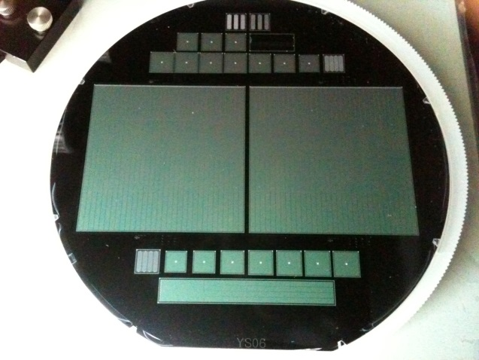
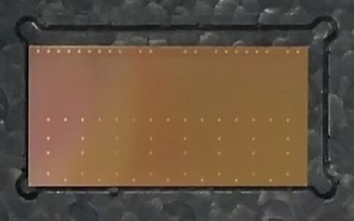
Introduction
We strive to build the infrastructure for the sensor test for ITS4 chips upgrade now.
It was proceeding on the basis of accumulated experience in the development and testing of silicon sensors used for the MPC-EX detectors, through the process in the past.
I have been doing the job for the system design for ALICE chip probe station and the environment tested on silicon sensors from last August.
In particular, let's talk about the situation and progress in the preparation for Automatic Test Equipment designs that we aim in our laboratory.
In this process, C-ON corporation’s technology, has significant advantages in automation machinery manufacturing, in need will be technical assistance to achieve the final results through collaboration in the future.
Frequently, visiting the C-ON Company, we has conducted a consultation.
Notes:
We strive to build the infrastructure for the sensor test for ITS4 chips upgrade now.
It was proceeding on the basis of accumulated experience in the development and testing of silicon sensors used for the MPC-EX detectors, through the process in the past.
I have been doing the job for the system design for ALICE chip probe station and the environment tested on silicon sensors from last August.
In particular, let's talk about the situation and progress in the preparation for Automatic Test Equipment designs that we aim in our laboratory.
In this process, C-ON corporation’s technology, has significant advantages in automation machinery manufacturing, in need will be technical assistance to achieve the final results through collaboration in the future.
Frequently, visiting the C-ON Company, we has conducted a consultation.

Slide 3
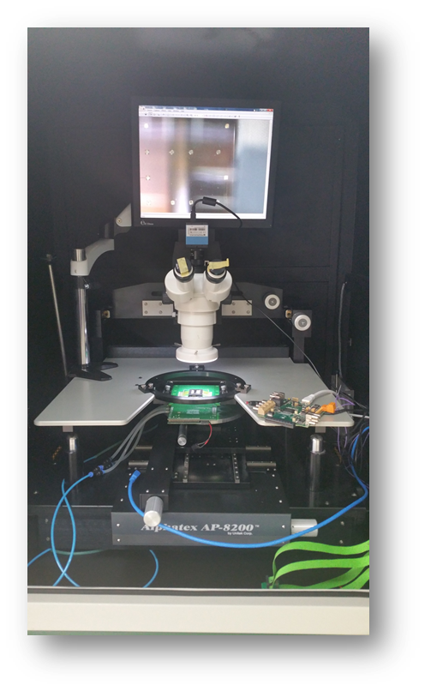
Test System Upgrade
1. Vision system
2. Fine adjustment
3. Communication
4. Contact
Notes:
The figure on the left shows a diagram for the current probe station for testing ALICE chip. In this test system, the four kinds of significant upgrades have done.
The first is vision system upgrade. The size of the MPC-EX silicon sensor measurements in the past has been replaced by the size of the smaller ALICE chip. Since, it needs to monitor in detail by changing from microscope to an imaging sensor. The changes above are the foundation in the automatic fashion to check the alignment and status of the sensor and location information from probecard equipment.
The second, for probecard alignment between the needle and the sensor pads, the linear stage unit was added to the system. It can be moved micro meters per a rotation.
The third, the probecard connected to a computer to obtain the necessary information from half a million pixels.
The fourth, it is not easy for the probecard to contact the sensor due to its very thin size 50um while the space is wide. Chuck is modified that allows for tilt adjustment and a sophisticated rotation so that the needles of the probe card reach to pads totally.

Slide 4
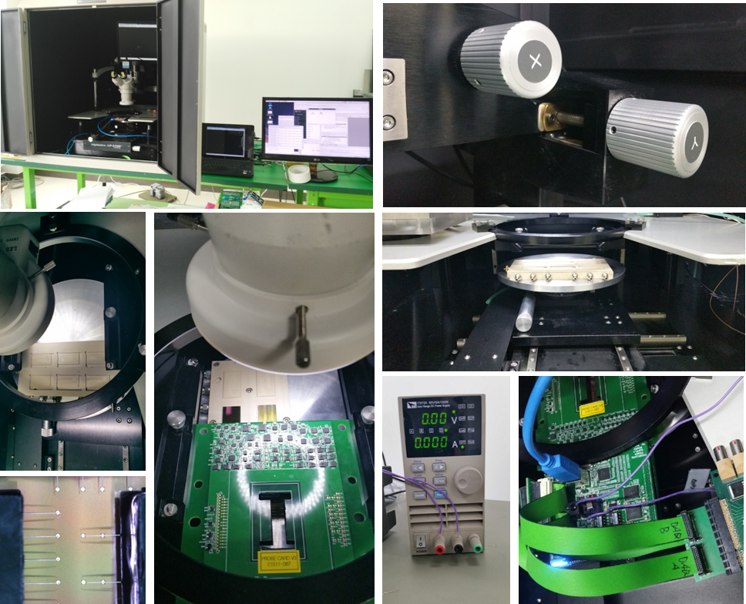
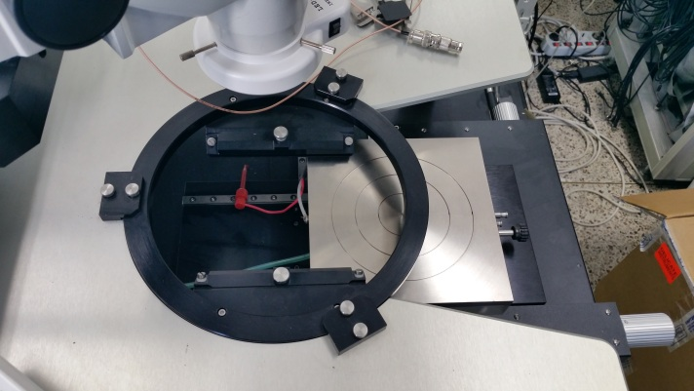
System configuration
1. Warpage of chips
2. Tilt for chuck
Notes:
The following is Chip test system configuration.
The frame received from CERN has been set to chuck. ITS chips are fixed on the frame through an air suction. Any mounting of the chip through the framework, the problem of distorting the chip was detected. The size of the hole is not enough and it did not have a large number of air suction sufficient. In further Automatic Test Equipment systems development, the frame would be designed that the size of the holes is in the 2um radius and the number of the holes are going to increase to be fully adhered to the chuck.
Through linear stages operation, we perform validation of alignment for probecard and pads and tilt of the chuck.
Work to ensure the flatness of a chuck is a very sophisticated operation. There are three screws fixed to the triangular structure. They will adjust the slope of the form to pool or fasten the screw. Because the thickness of sensors is thin, contacting needle of probecard with sensors, then deviations or the risk of damage may occur and there is a possibility it does not work properly.
The power supplies via the DAQ board. This connects to the computer via an Usb connecter and is capable of communicating with the state of the current board.
You can verify whether the contact is fine made with Led on / off check of the board.
Through this process it will be completed readiness for the test.

Slide 5
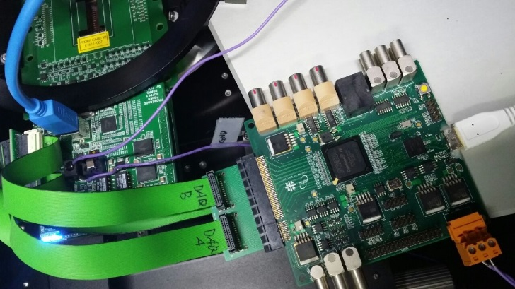
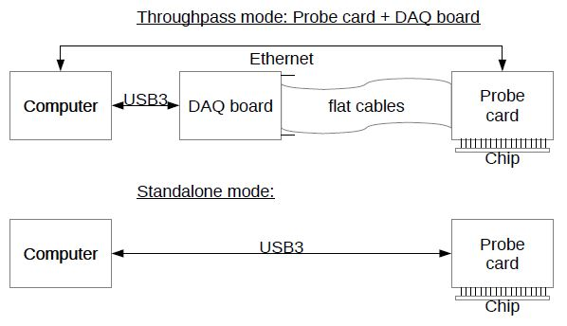
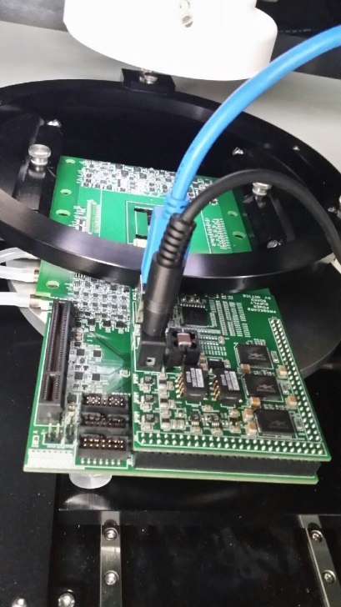
System configuration
Notes:
컴퓨터와 통신하는 방법에는 두가지 mode가 있습니다. Throughpass mode와 standalone mode입니다. Throughpass mode는 probecard와 컴퓨터 사이에 DAQ보드를 연결하는 방식이고, standalone mode는 컴퓨터를 probecard에 바로 연결하는 방식입니다.
50만 개 픽셀에 Charge injection을 통해 정해준 threshhold값 보다 높은 수치를 나타낼 경우 이를 digit number로 읽을 수 있도록 구성했습니다.
두 가지 방식의 차이점??
현재 첫번째 방식으로는 DAQ 보드의 component와 통신이 가능한 상태이며 두번째 방식에서는 probecard와 sensor 사이에 contact 상태를 확인 가능한 상황입니다.

Slide 6

Automatic Test Equipment
In the framework of the ALICE ITS upgrade, the University of Yonsei is responsible for the series test of the pixel sensors (about 60,000 chips for Korean groups).
The test covers the visual inspection and electrical test of each individual sensor.
This activity is planned to start in September 2016 and continue till end of 2017.
The series test is to be carried out by an Automated Test Equipment in a fully automated fashion.
Due to very large dimensions and ultra-low thickness(50$μm$) of the sensor, which makes it very brittle, the machine has to fulfill very demanding requirements concerning the gripping and handling of the sensors.
15mm
30mm
Notes:
In the framework of the ALICE ITS upgrade, the University of Yonsei is responsible for the series test of the pixel sensors (about 60,000 chips for Korean groups).
The test covers the visual inspection and electrical test of each individual sensor.
This activity is planned to start in September 2016 and continue till end of 2017.
The series test is to be carried out by an IC Automated Test Equipment in a fully automated fashion.
Due to very large dimensions and ultra-low thickness(50$μm$) of the sensor, which makes it very brittle, the machine has to fulfill very demanding requirements concerning the gripping and handling of the sensors.

Slide 7
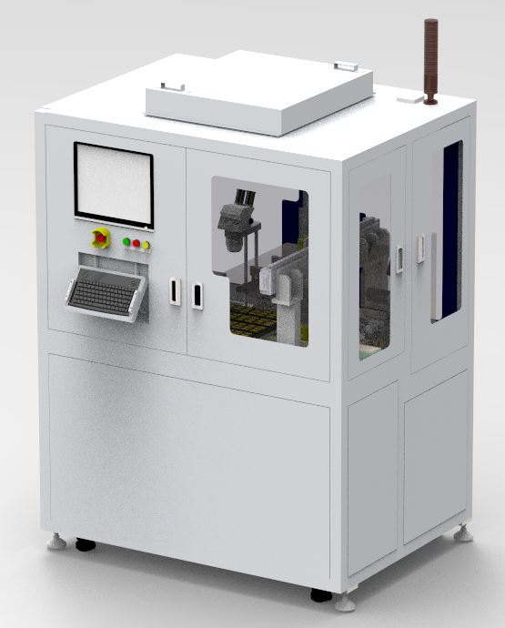
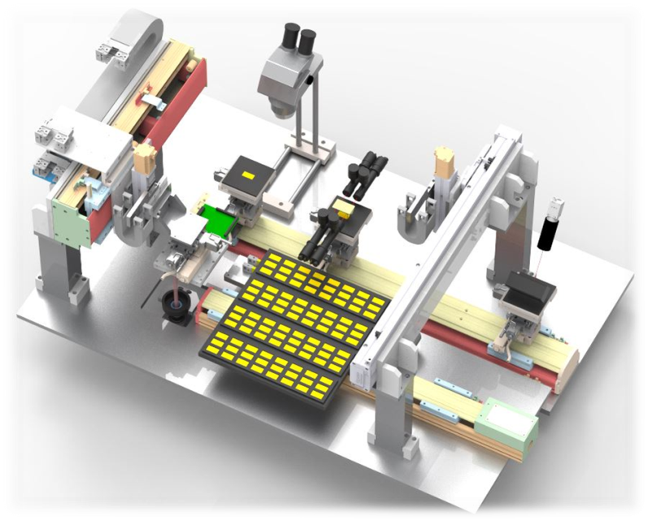
Automatic Test Equipment
The model Corea-YS-01 is the first prototype of Automated Test Equipment dedicated to academic research.
Notes:
The model Corea-YS-01 is the first prototype of Automated Test Equipment dedicated to academic research.
It is optimized to cover the electrical test and visual inspection of very large (30mm x 15mm) and ultra-thin CMOS sensors (50$μm$ thick) as those developed by the ALICE experiment for the ITS upgrade project.
For each operation cycle, Corea-YS-01 picks up a sensor from the pre-defined sensor tray and position it onto the chuck, with tiny vacuum holes, with an accuracy better than 30 $μm$.
It then performs a visual inspection of the sensor by means of a line scanner. The information related to the visual inspection is exported to an external database.
Then, Corea-YS-01 moves the chuck to the probing area and lowers the probecard with 5 $μm$ precision until it contacts the sensor.
Once contact is established, the electrical test is carried out. When the electrical test is completed, the sensor is repositioned into the tray.

Slide 8
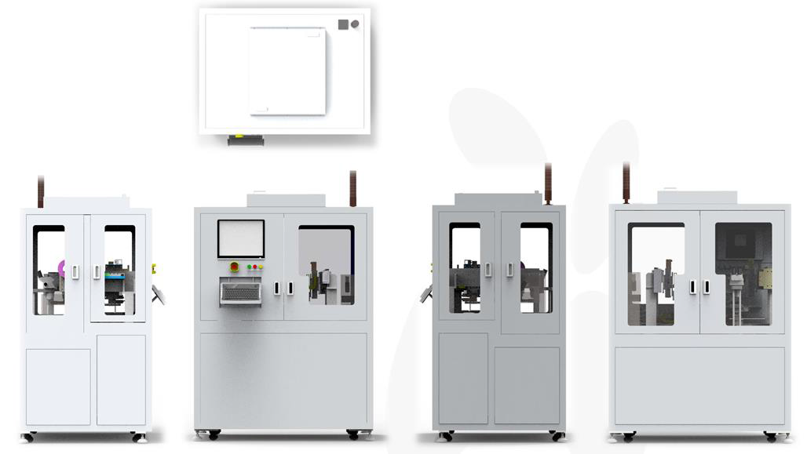
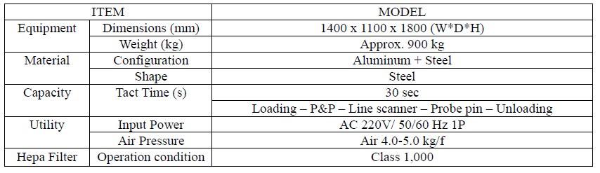
Automatic Test Equipment

Slide 9
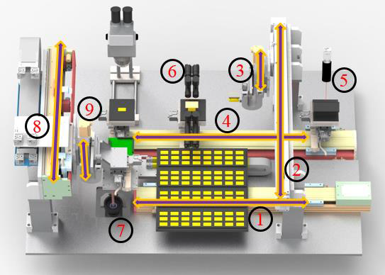
Automatic Test Equipment
· Flow
Step 0(Initial calibration) : Probecard needle alignment(microscope 7)
Step 1: sensor index (linear stage 1 & 2)
Step 2: Sensor pick-and-place (linear stage 3, grip, and chuck)
Step 3: Sensor movement to visual inspection (linear stage 4)
Step 4: Visual inspection (line scanner 5)
Step 5: Sensor alignment (vision 6)
Step 6: Sensor movement to probing position (linear stage 4)
Step 7: probecard placement (linear stage 8 & 9)
Step 8: Once full contact is established, hand over the control to the data acquisition PC and wait for the completed test signal by the data acquisition PC
Completed test signal will be defined by CERN
Step 9: When completion signal arrives, resume control and return the tested sensor to the tray and repeat step 1- step 9 cycles for the remaining sensors in the loaded trays
<Components & Specification>
Notes:
Step0: It is pre-focused for a given probecard needle position. By monitoring needle tip image, user can correct for the needle position offsets. After corrected for the offset, the needles will be in contact with the pre-positioned sensor pads within 5 microns of x,y and z.
Step1: Linear stage 1&2 positions grip for sensor pick-up.
Step2: Grip is made with the soft material not to scratch sensors. Grip&chuck are made with antistatic materials and treated for the build-up of static electricity. Chuck is made with the micro-holes of 2micron diameter distributed uniformly.
Linear stage 3 positions the grip 50 micron away from the sensor on tray within 5 micron accuracy. Sensor is picked up by the air suction of the grip.
Sensors are positioned 100 micron away from the chuck within 5 micron accuracy, and grip releases the sensor. Air suction through the micro holes on the chuck is controlled such that gradual increase of the contact area between sensor and the chuck occurs from the contact point after sensor establishes a contact with the chuck.
Step3: Linear stage 4 positions chuck for the visual inspection.
Step4: Line scanner recognizes metal patterns on sensor and inspects damaged sensor edges up to the accuracy of 5 microns. Detected damages must be logged into the database.
Step5: Linear stage 4 positions sensor for the alignment vision 6. Vision 6 detects the sensor offset with respect to the nominal position up to the accuracy of 2.5 microns in x,y,& $θ$. Offset is corrected by moving chuck.
Step6: Linear stage 4 positions sensor at the nominal probing position within the accuracy of +-25 micron in x&y. Sensor flatness is maintained.
Step7: Linear stage 8&9 make probecard needles contact the given sensor within +-30 micron in x&y with 5micron flatness in z. CERN will offer software to define needle contacts. Linear stage 9 makes vertical movements by 2.5 micron in each step while checking reported contact status up to the maximum of 50 microns beyond the nominal contact position.

Slide 10
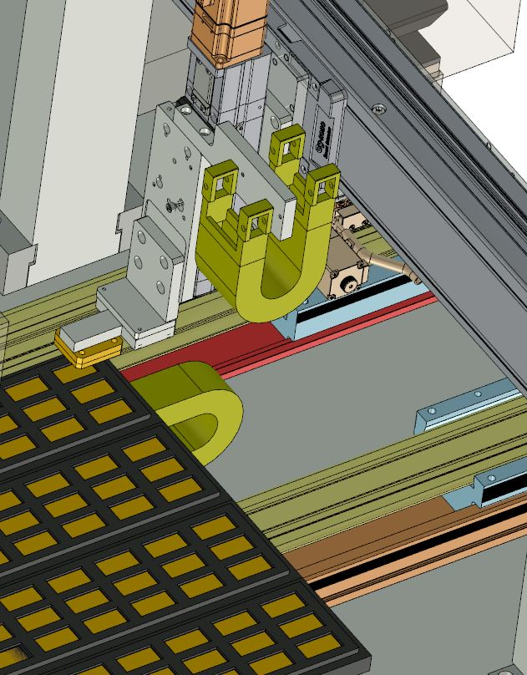
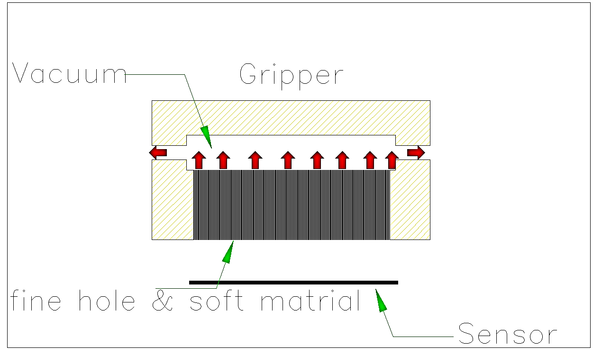
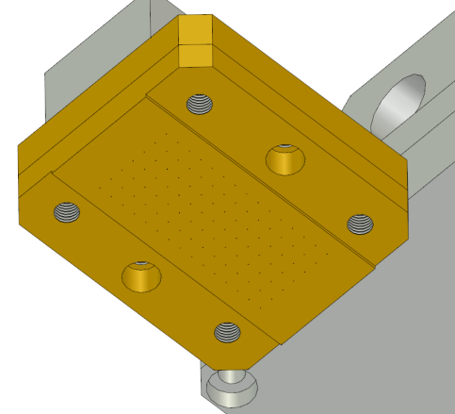
Gripper
Sensor P&P
Tray
Prevent warpage by using the gripper
The tray index is moved to the pick-up position.
The gripper head moves to sensor tray.
The gripper head is picking up the sensor(vacuum on)

Slide 11
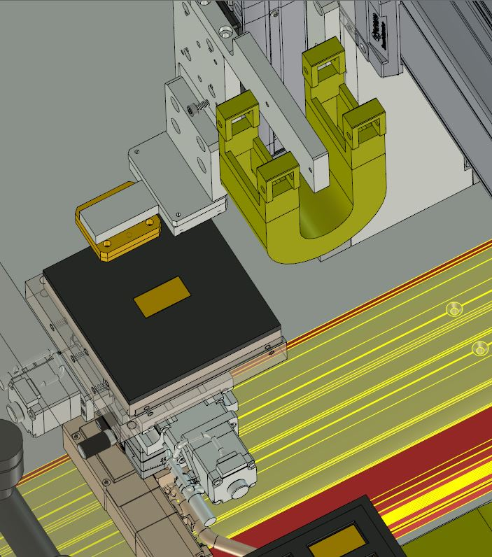
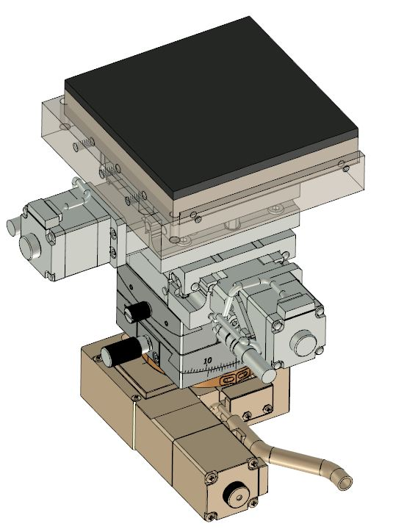
Vacuum chuck
Sensor P&P
Vacuum chuck
Work Index Stage
X-Motorrized
Y angle-Motorrized
X angle-Motorrized
Y-Motorrized
Rotary-Motorrized
The work Index is moved to the P&P position.
The gripper is placing the sensor on the vacuum chuck.
At the same time sensor is placed, the vacuum chuck is turned on.( Gripper vacuum off , chuck vacuum on)
Stage

Slide 12
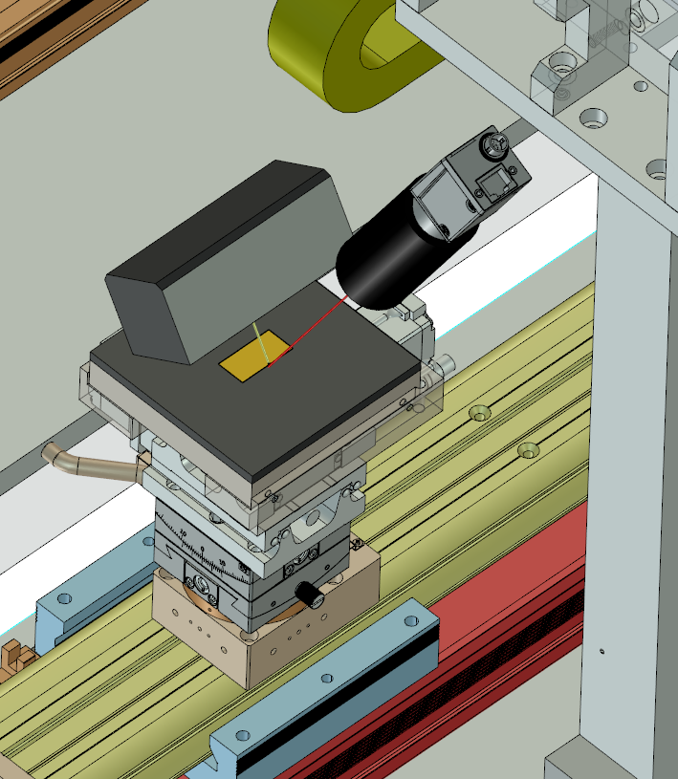
Line scanner
Line Scanning
Vision
Light
The work index is moved to a line-scan position to inspect the face of sensor.
2. Start the line scan.

Slide 13
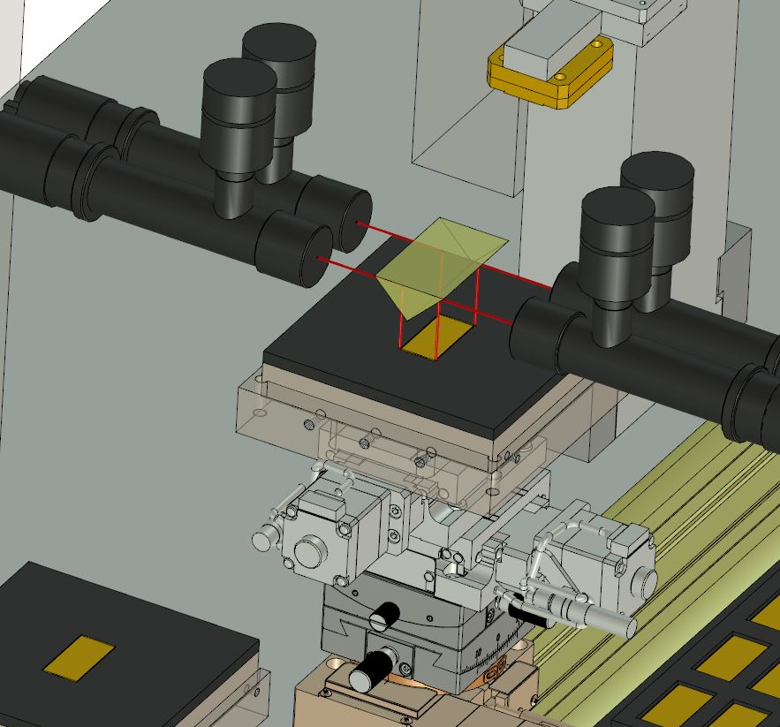
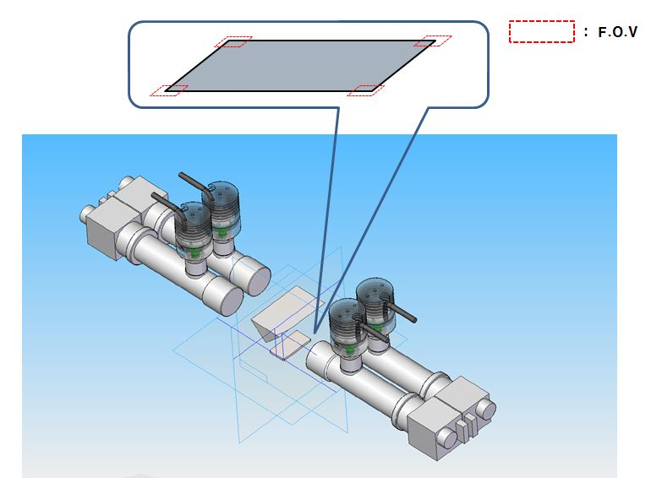
Align vision for sensor
Align Vision
Mirror
The work index is moved to inspection area.
Four vision observes the corners of sensor.
Use information from the vision to adjust the position of the sensor.

Slide 14
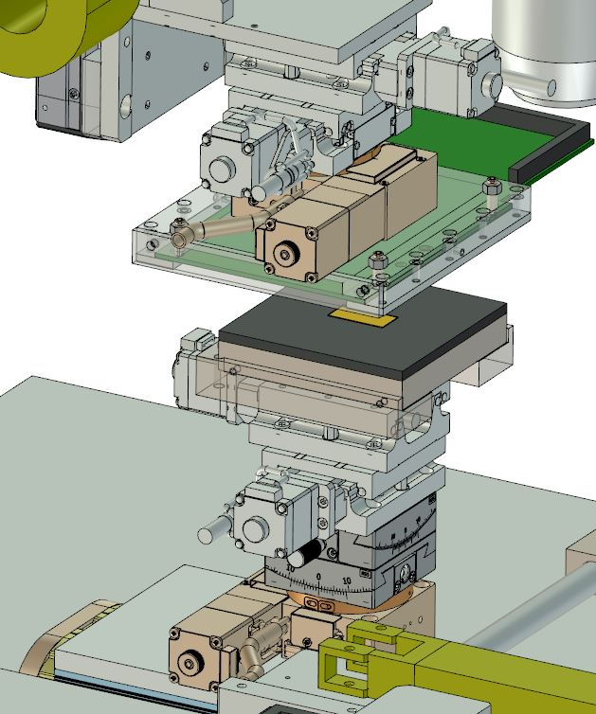
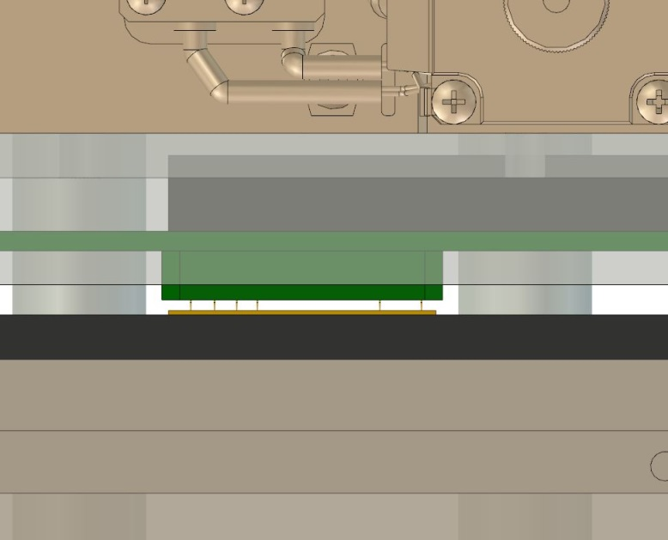
Chip inspection
Probe Card
Sensor
The probe card is moved downward into contact with the sensor.
When finished, the process proceeds in the reverse order.

Slide 15
Conclusions
C-ON is ready to fabricate the ATE COREA-YS-01 after 8 months of operation once order is made.
The ATE, which will be a property of the ALICE Collaboration, will be installed and operated at the Yonsei University for the period needed to complete the series test (2016-2018)
1) Continuous communication with C-ON
2) Liaison for ATE
Notes:
The ATE, which will be a property of the ALICE Collaboration, will be installed and operated at the Yonsei University for the period needed to complete the series test.
앞으로 해야 할 일은 C-ON과 실제적으로 제품을 개발하기 위해 협업을 진행할 것 입니다. 설계와 제어 관련해서 C-ON 회사 직원들과 같이 개발에 참여할 것으로 보입니다.
ATE가 개발된 후 시스템 유지 및 보수를 담당할 것 입니다.
센서 테스트를 위한 프로그래밍에는 참여하지는 않을 것 같지만 프로그램을 활용하여 센서를 테스트하고 특성을 파악하는 작업을 계속 할 것 입니다.

