Slide 1
ALICE ITS Upgrade : Pixel chip design
TowerJazz 0.18um CMOS Image Sensor Process
2016. APR. 10
Seongjoo Lee
(Dongguk & Yonsei Univ.)

Slide 2
Outline
1. pALPIDE-2(2014)
2. pALPIDE-3(2015)
3. ALPIDE(2015 – 2016)
4. Conclusion & Future plan

Slide 3
1. pALPIDE-2(2014)
1.1 4-b IDAC for the MLVDS and DTU block : Design
MLVDS
DTU – LVDS Driver
DTU – PLL
- Implementation of the MLVDS block(design by A. Lattuca, INFN Torino) on pALPIDE - 2
- Test chip of the PLL(design by G. Mazza, INFN Torino) and LVDS Driver(design by A. Lattuca, INFN Torino) block
=> Requirement of the current mirror : 4-b IDAC(able to control current source of each block)

Slide 4
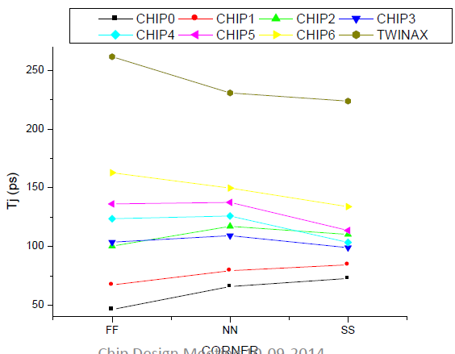
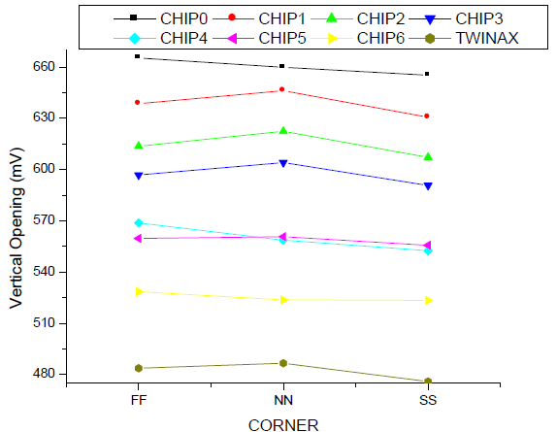
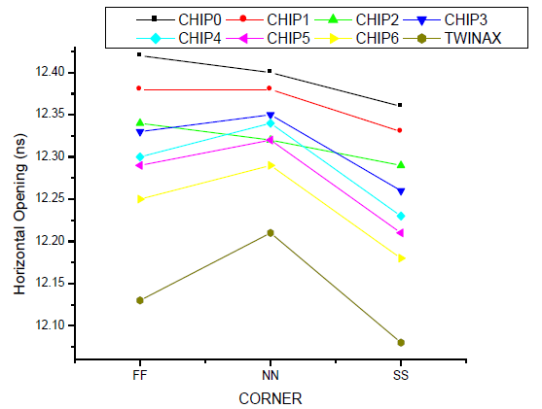
1. pALPIDE-2(2014)
1.2 MLVDS Driver : performance check
- Verification with 4-b IDAC.
=> Performance was satisfied with our goal.

Slide 5
2. pALPIDE-3(2015)
2.1 4-b IDAC for the MLVDS and DTU block : Resistor implementation
Resistor(Current source)
- Checking sheet resistance, variation and mismatch of a resistor(Iout is depending on a resistor value) : meet target
- Optimization of power connection(Analog power or Digital power) for reduction of noise

Slide 6
2. pALPIDE-3(2015)
2.2 Front-end : Power Supply Rejection Ratio(PSRR) simulation
VDD, VSS or PW
Variables : Power node, Vp, Freq. and shape
_{Nominal} _{setting} | Q_{in} | I_{leak} | V_{reset} | I_{bias} | I_{thr} | V_{casp} | V_{casn} | I_{db}
 | 0e⁻ | 400fA | 1.4V | 20nA | 0.5nA | 0.6V | 0.4V | 10nA
PSRR simulation - Filtering 100kHz to 1MHz noise on power( Vp : up to 50mV)
Checking mismatch & noise simulation

Slide 7
3. ALPIDE(2015 – 2016)
SEU on a sensitive node
3.1 Power-on Reset : Reduction of Single Event Upset(SEU) sensitivity
Vref- > Vref+
VDD
DVDD
Vramp
Vref+
Vref+
Vref-
Vref+
Iramp
Vref+
+
RESET
RESET
+
C_RST
Vramp
RESET
1u/10u
Vref-
-
C
-
MD
DVSS
RESET
718nA
1.5µA
1nA
(PoR out)
Original design by Yavuz Degerli (CEA/IRFU,Centre d'etude de Saclay Gif-sur-Yvette)
Reset : enabled
Filtering capacitor
(CAP1 & CAP2)
Critical nodes
< First gain stage >
=> Addition of filtering capacitors & duplication the cell to reduce SEU sensitivity

Slide 8
3. ALPIDE(2015 – 2016)
3.2 DTU – LVDS Driver : Optimization of the power consumption
- To optimize power consumption of 2 STDs,
=> Single-ended To Differential buffer(STD) : Stages and size ↓
=> MAIN Driver & P-E Driver : Input transistor size(Load cap) ↓
(Reduced driving capability of 2 STDs => Load capacitor↓)
- Common mode voltage(VCM)
1.1V => 0.9V (EDR recommendation)
2 MUXs
2 STDs
DPE
pALPIDE3
ALPIDE
Original design by Alessandra Lattuca (Universita e INFN Torino)
pALPIDE3 | 2 MUXs | 2 STDs | DPE
Static power (DC) | 3.1 nW | 17.7 nW | 13.1 mW
Average power (Static + Dynamic) | 2.4 mW | 9.8 mW | 13.2 mW
Performance : Better than pALPIDE3 results & Power : 26.9% decrease (@ Nominal corner)

Slide 9
4. Conclusion & Future plan
4.1 Conclusion
pALPIDE – 2
- 4-b IDAC : satisfying target
- MLVDS verification with 4-b IDAC : satisfying target
pALPIDE – 3
- Resistor implementation on 4-b IDAC : satisfying target
- PSRR simulation for the Front-End circuit : Filtering 100kHz to 1MHz & Vp = up to 50mV on Power
ALPIDE
- Power-on Reset : Reduction of Single Event Upset(SEU) sensitivity : addition of filtering capacitor &
duplication the cell
- Power optimization of the LVDS Driver : 27% decrease & better performance than pALPIDE - 3

Slide 10
4. Conclusion & Future plan
4.2 Future plan
- 2016
=> Course work
=> 4월 – 9월(?) : New project – CMOS Image Sensor(CIS)
=> 9월(?) – 12월 : CIS 측정 준비
- 2017
=> CIS 측정 및 측정 결과로 졸업 논문 작성, 졸업 시험, 영어 시험

Slide 11
Backup slides

Slide 12
Backup slides – 4-b IDAC(pALPIDE-3)
To separate Full-analog(8-bit Current DAC & Voltage DAC), Current Mirror is changed.

Slide 13
Backup slides – 4-b IDAC(pALPIDE-3)
pALPIDEfs_V2 Current Mirror for the MLVDS block
pALPIDEfs_V3 Current Mirror for the MLVDS block

Slide 14
Backup slides – 4-b IDAC(pALPIDE-3)
NAME | Ω/□
mr23t | 2kΩ/□
rm1 | 80mΩ/□
rm2 | 80mΩ/□
rm3 | 80mΩ/□
rm4 | 80mΩ/□
rm5 | 80mΩ/□
rmL | 40mΩ/□
rnlpoly2t | 6Ω/□
rnlpoly3t | 6Ω/□
rnmpoly2t | 400Ω/□
rnmpoly3t | 400Ω/□
rnplus2t | 70Ω/□
rnplus3t | 70Ω/□
rnplus_sal2t | 7Ω/□
rnplus_sal3t | 7Ω/□
rnwell_AA2t | 450Ω/□
rnwell_AA3t | 450Ω/□
rnwell_STI2t | 1kΩ/□
rnwell_STI3t | 1kΩ/□
rphpoly2t | 1kΩ/□
rphpoly3t | 1kΩ/□
rplpoly2t | 5Ω/□
rplpoly3t | 5Ω/□
rpmpoly2t | 310Ω/□
rpmpoly3t | 310Ω/□
rpplus2t | 120Ω/□
rpplus3t | 120Ω/□
rpplus_sal2t | 5Ω/□
rpplus_sal3t | 5Ω/□
Width = 2um
Length = 710um
Width[um]

Slide 15
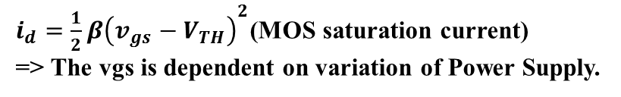
Backup slides – 4-b IDAC(pALPIDE-3)
1
2
$i_{d}={\frac{1}{2}β\left(v_{gs}−V_{TH}\right)}^{2}$(MOS saturation current)
=> The vgs is dependent on variation of Power Supply.
3

Slide 16
Backup slides – 4-b IDAC(pALPIDE-3)
△I[uA]
△V[V]
△I[uA]
△V[V]

Slide 17
Backup slides – 4-b IDAC(pALPIDE-3)
I[mA]
I[mA]
4-bit IDAC_CODE
 | Driver pmos |  | Driver nmos |  | Receiver pmos |  | Receiver nmos
 | σ_{Id} | σ_{Id}/Id | σ_{Id} | σ_{Id}/Id | σ_{Id} | σ_{Id}/Id | σ_{Id} | σ_{Id}/Id
FF | 0.26μA | 0.61% | 0.76μA | 0.88% | 0.27μA | 0.63% | 0.52μA | 1.20%
SS | 0.15μA | 0.65% | 0.42μA | 0.92% | 0.15μA | 0.67% | 0.29μA | 1.24%
TT | 0.19μA | 0.64% | 0.57μA | 0.93% | 0.2μA | 0.66% | 0.39μA | 1.28%

Slide 18
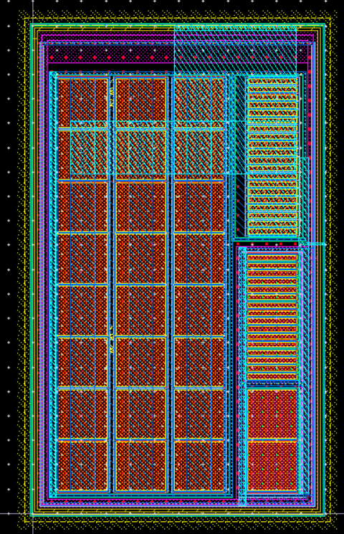
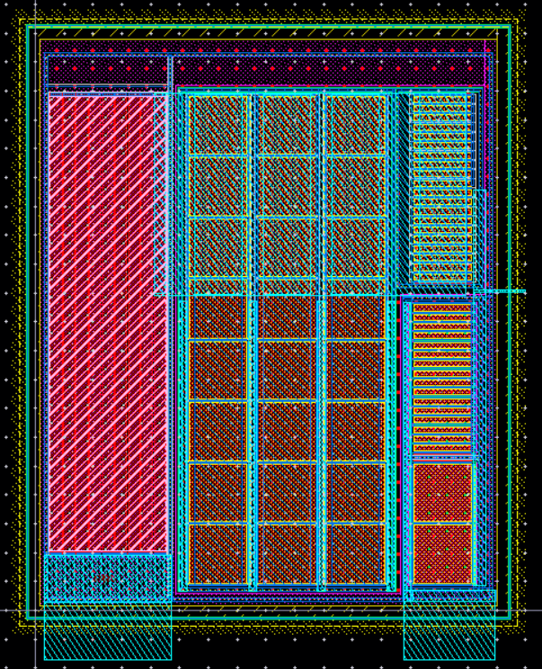
Backup slides – 4-b IDAC(pALPIDE-3)
Width = +24um
108um
R = ρ(L/W)
ρ=400ohm/□
L=2um
W=709.695um
(max. height=120um)
Resistor
65um
< Resistor >
89um
< Before >
< After >
Number of segments = 9(series)

Slide 19
Backup slides – LVDS Driver(ALPIDE)
①
②
VOH - VOL = I_{S}·2·R_{T}
INPUT
OUTPUT
①
②
①
②
①
VDD
①
②
①
②
①
VSS
Voltage swing : VSS to VDD
Voltage swing : VOL to VOH

Slide 20
Backup slides – LVDS Driver(ALPIDE)
- To optimize power consumption of 2 STDs,
=> Single-ended To Differential buffer(STD) : Stages and size ↓
=> MAIN Driver & P-E Driver : Input transistor size(Load cap) ↓
(Reduced driving capability of 2 STDs => Load capacitor↓)
- Common mode voltage(VCM)
1.1V => 0.9V (EDR recommendation)
2 MUXs
2 STDs
DPE
pALPIDE3
ALPIDE
Original design by Alessandra Lattuca (Universita e INFN Torino)
pALPIDE3 | 2 MUXs | 2 STDs | DPE
Static power (DC) | 3.1 nW | 17.7 nW | 13.1 mW
Average power (Static + Dynamic) | 2.4 mW | 9.8 mW | 13.2 mW

Slide 21
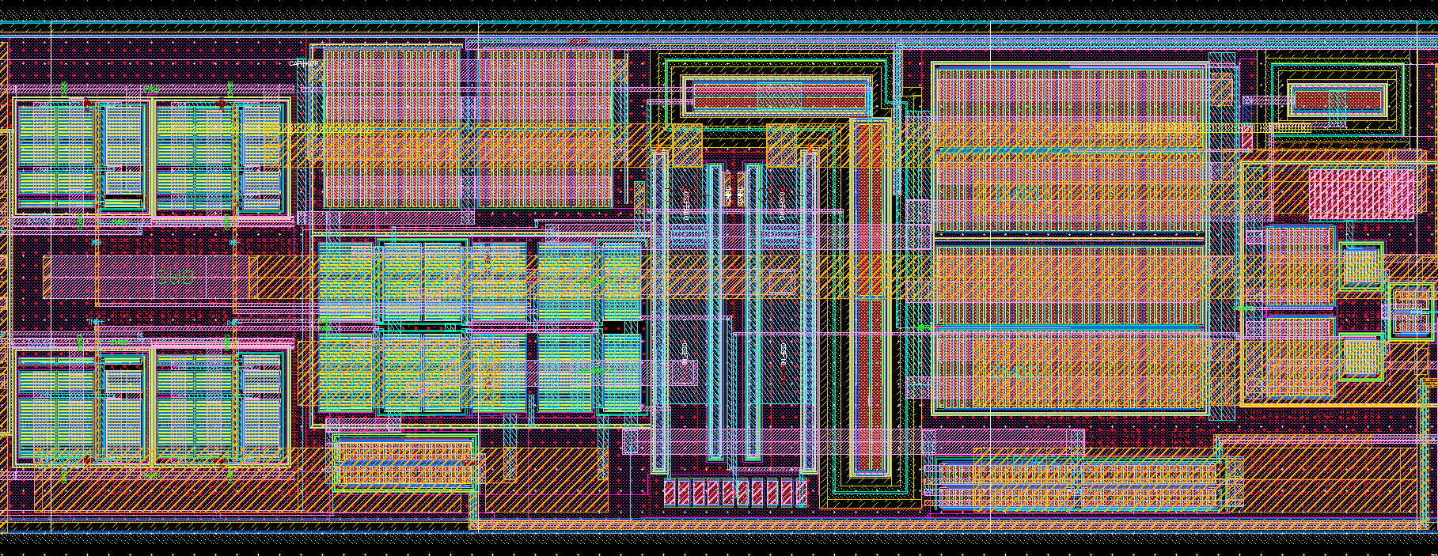
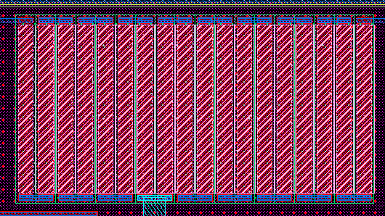
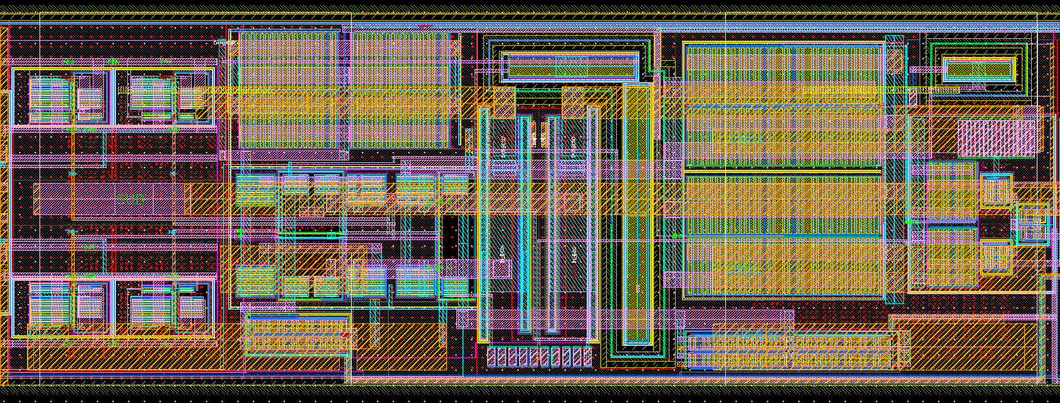
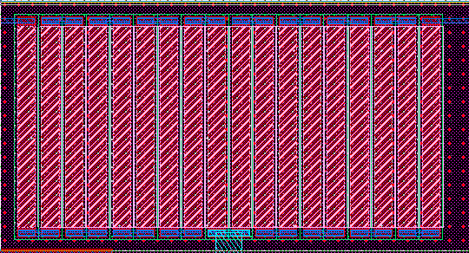
Backup slides – LVDS Driver(ALPIDE)
RES
pALPIDE3
2 STDs
Resistor(VCM = 1.1V)
MAIN & P-E
Input TR
Reference voltage
RES
ALPIDE
2 STDs
MAIN & P-E
Input TR
Resistor(VCM = 0.9V)
Reference voltage

Slide 22
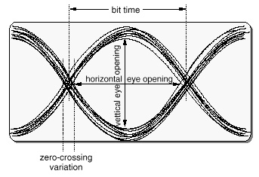
Backup slides – LVDS Driver(ALPIDE)
 | Slow | Nominal | Fast
Corner | SS | TT | FF
VDD | 1.62V | 1.8V | 1.98V
Temp. | 85℃ | 27℃ | -40℃
p-p jitter
PRBS = 1.2Gbps Driver CODE = 9 P-E Driver CODE = 9 | Slow |  | Nominal |  | Fast
 | pALPIDE3 | ALPIDE | pALPIDE3 | ALPIDE | pALPIDE3 | ALPIDE
Horizontal opening [ps] | 741.8 | 769.6 | 759.5 | 778.4 | 736.1 | 772.8
Vertical opening [mV] | 373.2 | 399.6 | 470.6 | 504.7 | 591.9 | 632.9
Jitter(p-p) [ps] | 134.8 | 107.6 | 107.7 | 73.5 | 97.1 | 57.4
Average power [mW] | 18.8 | 13.1 | 26.4 | 19.3 | 37.0 | 28.7
Simulation : Better than pALPIDE3 results
Power : 26.9% decrease (@ Nominal corner)
VCM : 1.1V => 0.9V

Slide 23
Backup slides – Power-on Reset(ALPIDE)
Vref- > Vref+
VDD
DVDD
Vramp
Vref+
Vref+
Vref-
Vref+
Iramp
Vref+
+
RESET
RESET
+
C_RST
Vramp
RESET
1u/10u
Vref-
-
C
-
MD
DVSS
RESET
718nA
1.5µA
1nA
(PoR out)
Original design by Yavuz Degerli (CEA/IRFU,Centre d'etude de Saclay Gif-sur-Yvette)
Principle
- The first gain stage discharges the capacitor C through the transistor MD at the beginning of every ramp.
- Vref+ and Vref- cross each other after some time, MD turns off and ramp of Vramp is initiated
- When Vramp becomes larger than Vref+, reset is disabled.

Slide 24
Backup slides – Power-on Reset(ALPIDE)
SEU on a sensitive node
Vref- > Vref+
VDD
DVDD
Vramp
Vref+
Vref+
Vref-
Vref+
Iramp
Vref+
+
RESET
RESET
+
C_RST
Vramp
RESET
1u/10u
Vref-
-
C
-
MD
DVSS
RESET
718nA
1.5µA
1nA
(PoR out)
Original design by Yavuz Degerli (CEA/IRFU,Centre d'etude de Saclay Gif-sur-Yvette)
Reset : enabled
Filtering capacitor
(CAP1 & CAP2)
Critical nodes
< First gain stage >

Slide 25
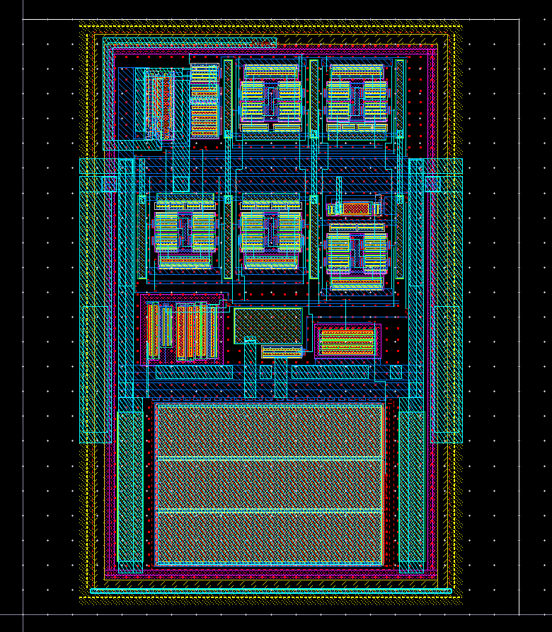
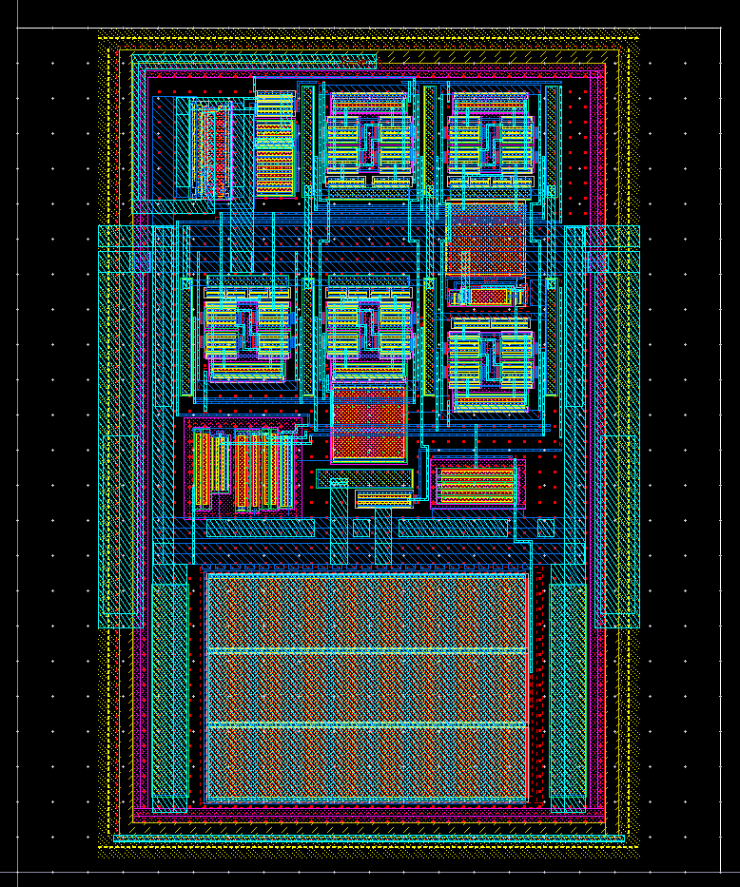
Backup slides – Power-on Reset(ALPIDE)
CAP2
120um
CAP1
120um
pALPIDE3 : PoR
ALPIDE : PoR
80um
80um
Reduction of SEU sensitivity (addition of capacitance on critical nodes)
Other nodes : No problem
Duplication of cell in ALPIDE with logic “OR” to further reduce probability of upset

