Slide 1
Yonsei Activities
Ju Hwan Kang
KoALICE National Workshop 2016
April 8 – 10, 2016

Slide 2
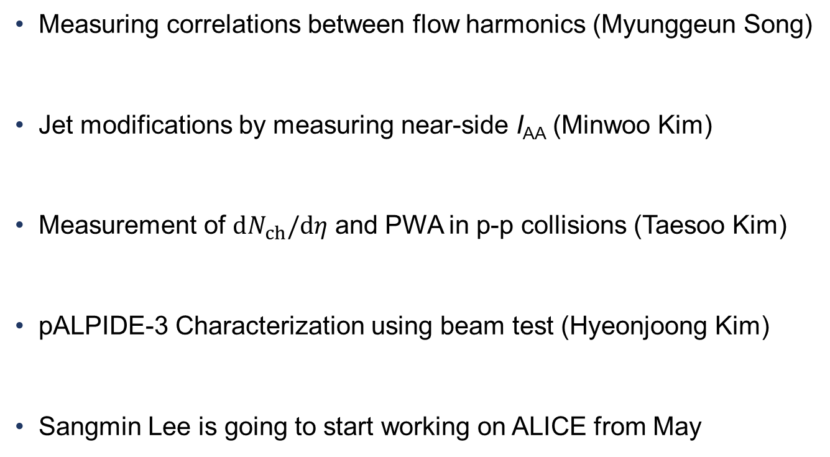
Yonsei Activities
Measuring correlations between flow harmonics (Myunggeun Song)
Jet modifications by measuring near-side I_{AA} (Minwoo Kim)
Measurement of $dN_{ch}/dη$ and PWA in p-p collisions (Taesoo Kim)
pALPIDE-3 Characterization using beam test (Hyeonjoong Kim)
Sangmin Lee is going to start working on ALICE from May

Slide 3
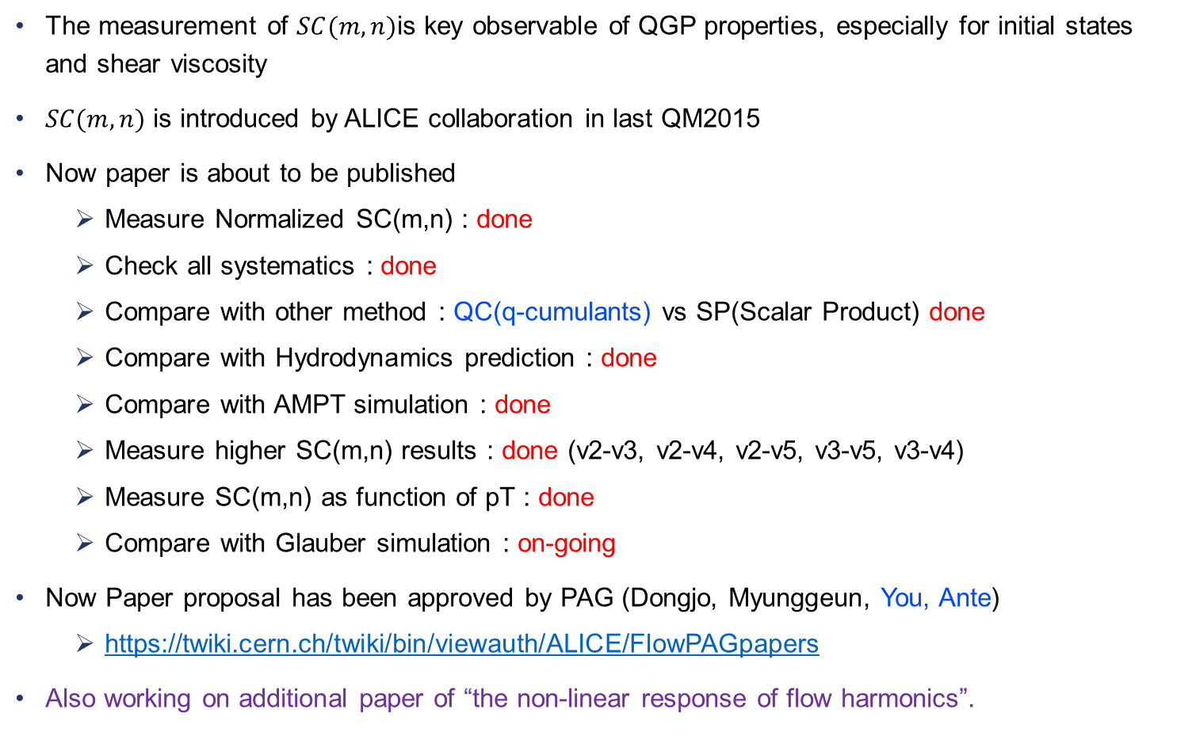
Measuring correlation between flow harmonics (Current Status)
The measurement of $SC(m,n)$is key observable of QGP properties, especially for initial states and shear viscosity
$SC(m,n)$ is introduced by ALICE collaboration in last QM2015
Now paper is about to be published
  Measure Normalized SC(m,n) : done
  Check all systematics : done
  Compare with other method : QC(q-cumulants) vs SP(Scalar Product) done
  Compare with Hydrodynamics prediction : done
  Compare with AMPT simulation : done
  Measure higher SC(m,n) results : done (v2-v3, v2-v4, v2-v5, v3-v5, v3-v4)
  Measure SC(m,n) as function of pT : done
  Compare with Glauber simulation : on-going
Now Paper proposal has been approved by PAG (Dongjo, Myunggeun, You, Ante)
  https://twiki.cern.ch/twiki/bin/viewauth/ALICE/FlowPAGpapers
Also working on additional paper of “the non-linear response of flow harmonics”.

Slide 4
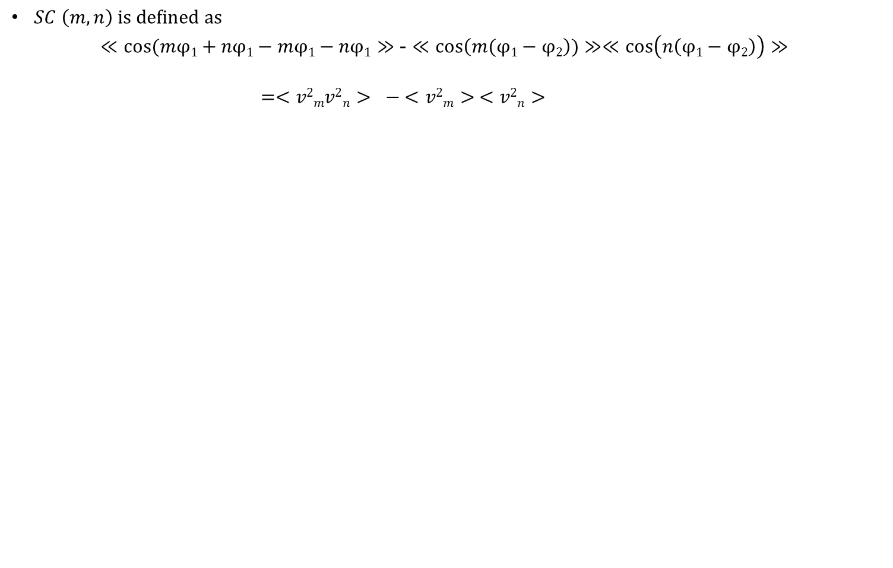
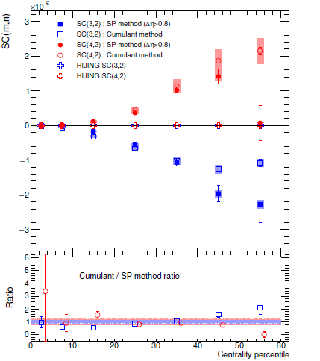
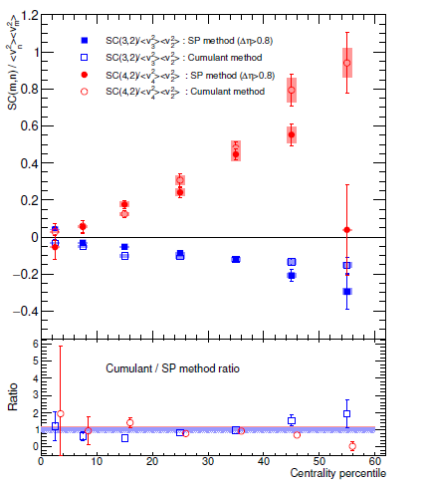
Definition of SC(m, n)
    It is non-zero if the event-by-event amplitude ﬂuctuations of v_{n} and v_{m} are (anti-)correlated.
The positive values of SC(4,2) and negative SC(3,2) are observed for all centralities
suggests a correlation between v₂ and v₄, and an anti-correlations between v₂ and v₃.
indicates ﬁnding v₂ > ‹v₂› in an event enhances the probability of ﬁnding v₄ > ‹v₄ › and ﬁnding v₃ < ‹ v₃ › in that event.

Slide 5
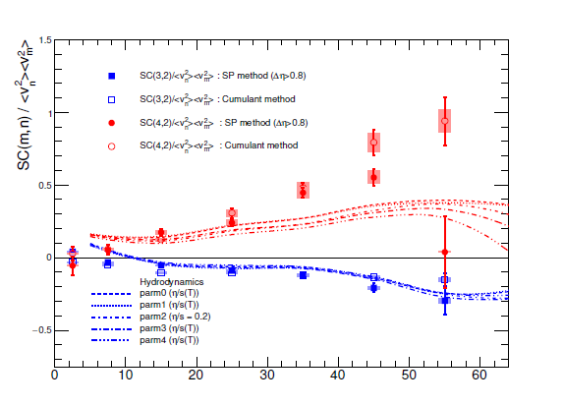
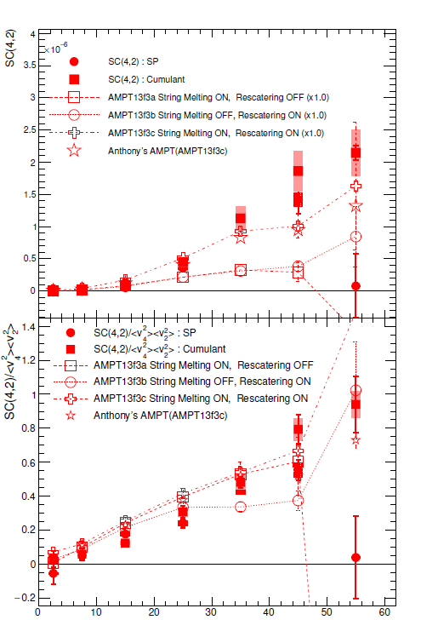
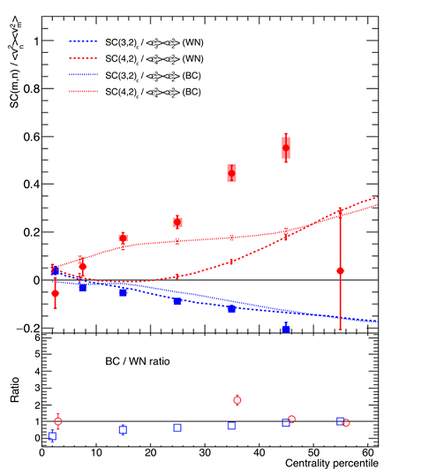
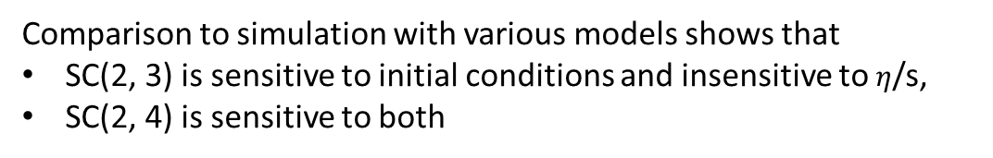
Comparison to Hydrodynamics / AMPT / Glauber
Comparison to simulation with various models shows that
SC(2, 3) is sensitive to initial conditions and insensitive to $η$/s,
SC(2, 4) is sensitive to both
Figures on
Left : Comparison to Hydro
Middle : Comparison to AMPT
Right : Comparison to Glauber

Slide 6
Update on I_{AA} analysis & Current Status
I_{AA} Analysis with two-particle Correlations
• Analysis which has been done from 2015 ~ 2016
  - V_{2Δ} calculation to do cross-check with published points (Done)
  - Study of Peak shapes of jets with two Gaussian functions (Done)
    ; One sharp peak representing jet and the other showing tails
  - New methods for accurate background subtractions (Done)
    ; Residuals of flow from 1st subtraction and Flat backgrounds
  - I_{AA} vs. p_{T,assoc} for inclusive particles including low p_{T,assoc} (Done)
  - I_{AA} vs. p_{T,assoc} for In-plane and Out-of-plane classified by Event plane (Done)
  - Systematic study (nearly Done) ; checking additional feedbacks
  - Paper proposal (on-going)
• New results on I_{AA} analysis have been presented in PWG and in LHCC
• Paper proposal is under preparation with the draft

Slide 7
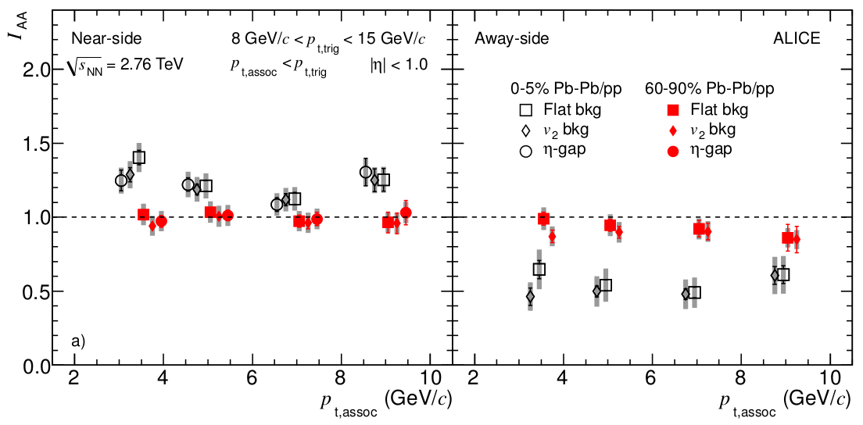
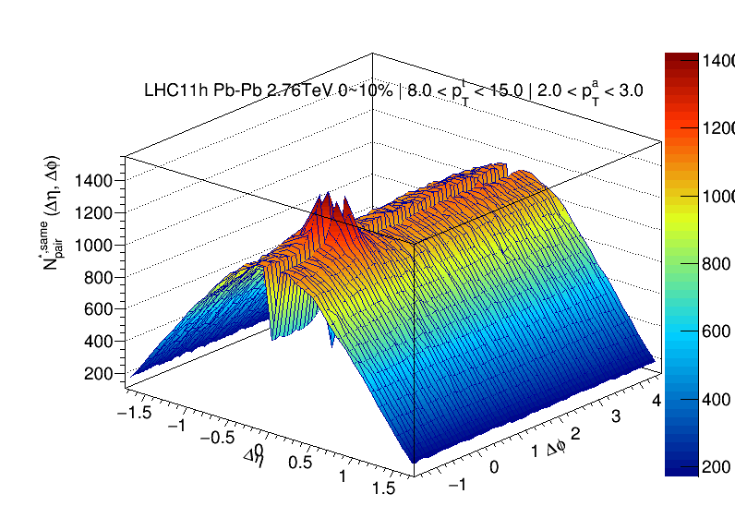
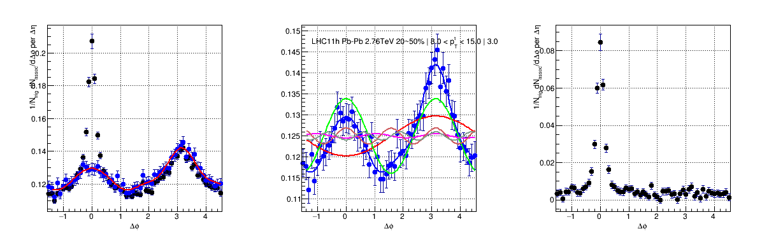
Motivation of I_{AA} analysis and Procedure
I_{AA} Analysis with two-particle Correlations
ALICE, PRL 108, 092301 (2012)
• Away-side suppressed (I_{AA} ~ 0.6) due to the strong in-medium energy loss
• Near-side enhancement (I_{AA} ~ 1.2) suggests that the near-side parton might be
also subject to medium effects
Δη-Δφ distribution
Projected dN/dΔφ
dN/dΔφ in large |Δη|
Subtracted Jet peak

Slide 8
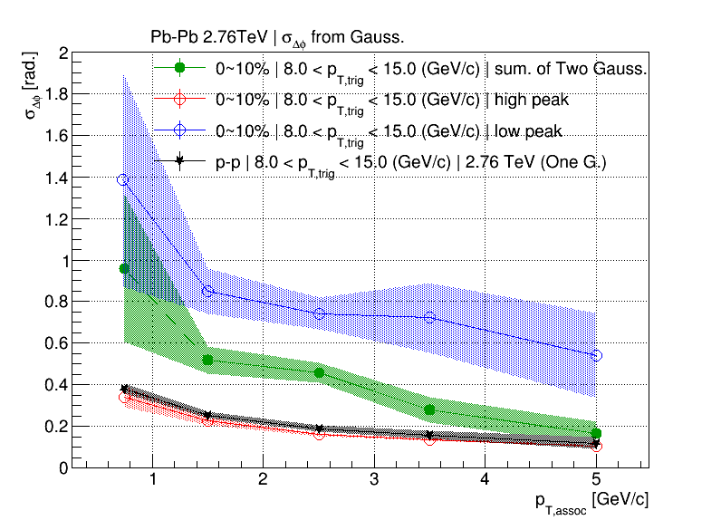
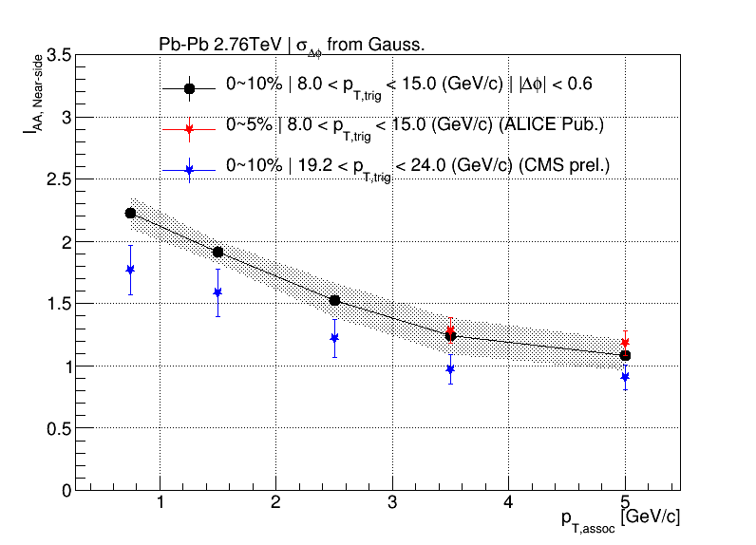
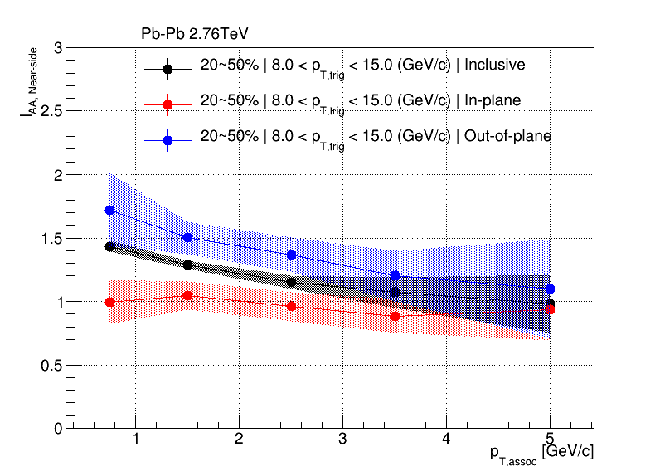
Peak-shape of Jets and I_{AA} vs. p_{T,assoc} analysis
I_{AA} Analysis with two-particle Correlations
(1)
(2)
(3)
(1) Peak shape of jets with two Gaussian
(2) I_{AA} vs. p_{T,assoc} in Inclusive central events
(3) I_{AA} vs. p_{T,assoc} in In- and Out-of-plane
Out
In
In
event plane
Out

Slide 9
Summary of activities (Taesoo Kim)
Design, assembling and installation of AD detector as service task : done
Measurement of $dN_{ch}/dη$ in p-p collisions at $\sqrt{s}=13$ TeV.
  Analysis note : done
    https://aliceinfo.cern.ch/Notes/node/420
  Publishing paper : done
    Phys. Lett. B 753 (2016) 319-329, arXiv:1509.08734
Analysis of central production at $\sqrt{s}=7$ TeV
  Study double-gap events with run quality : done
    Analysis note & Review paper proposal : on-going
    https://twiki.cern.ch/twiki/bin/view/ALICE/CentralExclusiveProduction
  PWA
    Monte Carlo study with different axes : on-going
    Apply to the data with different wave-set : on-going
    Analysis note & Short paper proposal : on-going
    https://twiki.cern.ch/twiki/bin/view/ALICE/CEPPWA7TeV
Analysis of central production at $\sqrt{s}=13$ TeV
  Study double-gap events and check mass distribution : on-going

Slide 10

Measurement of $dN_{ch}/dη$ in p-p collisions at $\sqrt{s}$ = 13 TeV
The measurement of $dN_{ch}/dη$ is key observable to characterize the global properties of the collision.
Cooperation with PWG-LF group, the ALICE carried out the results very fast.
Figure 1 shows comarison of $dN_{ch}/dη$ results with CMS, PYTHIA6, PYTHIA8 and EPOS.
  Helpful to tune the MC model.
Figure 2 shows comparison of $dN_{ch}/dη$ measured in $\left|η\right|<0.5$ with other experiments.
  Fit results can be used to estimate $dN_{ch}/dη$ for higher energy.
$←{6.46}_{−0.14}^{+0.2}$ (INEL>0)
$←{5.31}_{−0.18}^{+0.18}$ (INEL)
INEL: diffraction included (cental, single, double)
INEL>0: without diffraction ( INEL + at least 1 charged particle in $\left|η\right|<0.9$)
<Figure 1>
<Figure 2>

Slide 11
Analysis of central production
Central production in the ALICE
  We can’t measure outgoing particles in the ALICE due to the absence of Roman pot.
  How to select ‘central production’ events in the ALICE? $→$ Using Double-Gap(DG) topology.
  Using DG topology, we can select
  almost pure DPE events.
  Figure 4 shows unlike-sign mass distribution
  with DG (red) and No-gap (black) events.
    Clear signal of $f_{0}(980)$ and $f_{2}(1270)$
$$η_{p}=8\sim 10$$
Gap
$$η_{X}=0\sim 1.5$$
Gap
$$η_{p}=−10\sim −8$$
$$p$$
$$p$$
$$X$$
<Figure 4> Mass distribution of $π^{+}π^{−}$
$$p$$
$$p$$
clear signal of $f_{0}(980)$ and $f_{2}(1270)$
<Figure 3> Central production

Slide 12
Current Status report
ITS Chip Characterization
  Focusing on pALPIDE-3 software development and test-beam analysis
    EUDAQ & EUTelescope development
    PS & Frascati Test-beam shifts and analysis
  pALPIDE-3 other characterization
    Tests done at lab (pre-irradiation / post-irradiation characterization)
    Total Ionizing Dose Test at CERN
  Currently working with continuous readout software development
    Both for lab & test-beam
Will be focusing on physics analysis beginning at summer

Slide 13
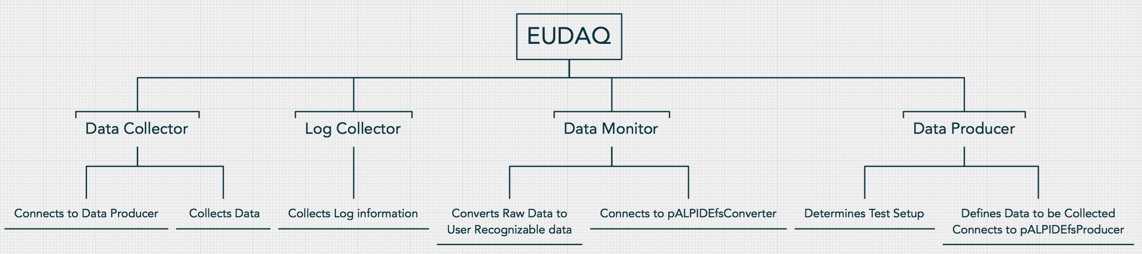
Software Developments for Test-beam
EUDAQ Framework used for Test-beam Data taking procedure
EUTelescope Framework used for Test-beam Data analysis
  For pALPIDE-3 chips, EUDAQ and EUTelescope modification was needed
  Backward compatibility for previous chips was added

Slide 14
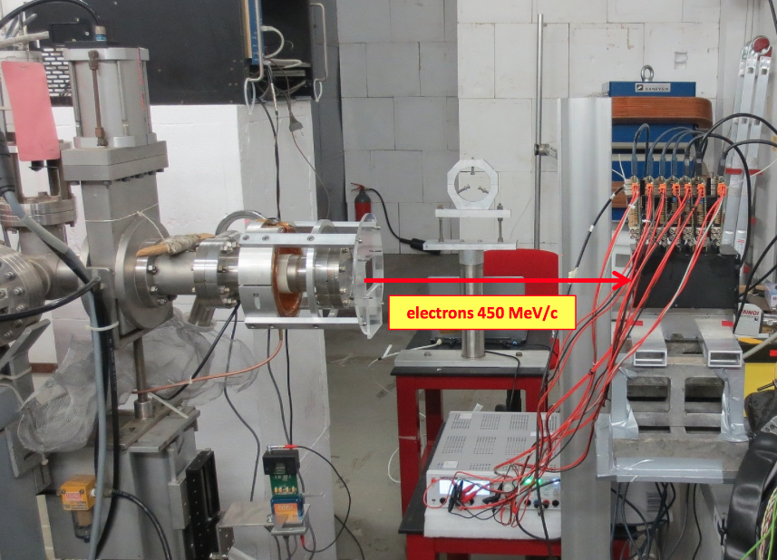
Test-beam Overview
Test-beam performed at PS and Frascati
  First commissioning of new developed software at PS
  Final version of software commissioned at Frascati, was successful
Telescope is composed with 7 planes
  6 layers of tracking plane and 1 DUT (Device Under the Test) plane
Readout and analysis is done using the
EUDAQ and EUTelescope Framework
Simple diagram
Tracking planes (pALPIDE-1)
DUT (pALPIDE-3)
Particle Track

Slide 15
Backups

Slide 16
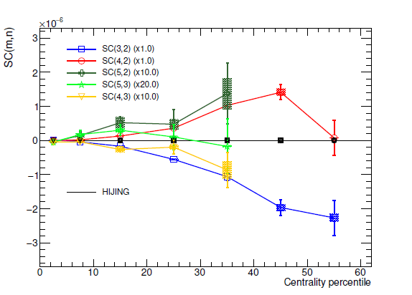
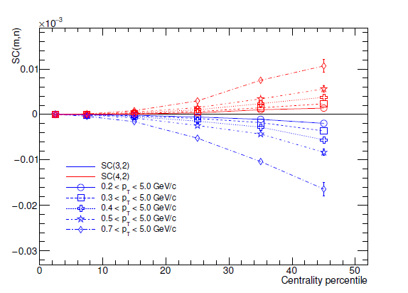
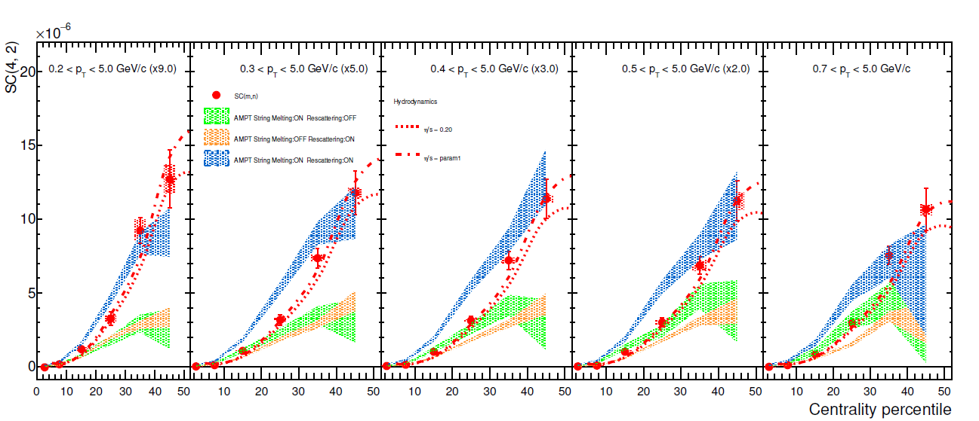
Hihger order SC(m,n) and SC(m,n) as function of p_{T}
Figures on
Left :
Correlation between higher harmonics
Right :
p_{T} dependence of SC
Bottom :
pT dependence of SC with various simulation

Slide 17
I_{AA} Analysis with two-particle Correlations
Geometrical setup for φ_{S} analysis
trigger particle
Out
φ_{S} = |φ_{trigger} – ψ_{EP} |
angle difference
between trigger and EP
M2
M1
φ_{S}
In
In
event plane
ψ_{EP, n} = tan⁻¹ (Q_{n,x} / Q_{n,y} ) / n
event plane angle
calculated by Q-vector (Scalar Product)
M1
M2
Out
In-plane : Close to EP (in case of the 2nd harmonics, ψ₂)
Out-of-plane : perpendicular to EP
Middle I / II : intermediate

Slide 18

$π^{+}π^{−}$ Partial Wave Analysis with ambiguous solution✝ (1/2)
We can get spin and parity of system
using PWA.
MC studies are done to confirm that
PWA is working or not in the ALICE.
3 GJ frames are used
  Beam Frame, Chung Frame♦ and
  Pomeron Frame
  Beam and Chung frame found
  spurious $D_{−}$ and $D_{+}$ waves.
The conclusion is that
  Perfect PWA can’t be done
  without measuring protons.
  But $Σ{\left|D\right|}^{2}$ can be useful to
  decompose with $S_{0}$.
    ✝S.U.Chung, “Techniques of Amplitude Analysis for Two-pseudoscalar Systems”, Physical Review D56, 7299, 1997
    ♦ S.U.Chung, “Central Production of Two- and Four-pion Systems at COMPASS and ALICE”, Internal note.

Slide 19
$π^{+}π^{−}$ Partial Wave Analysis with ambiguous solution✝ (2/2)
Apply to the real-data with alternative methods and get 2 ambigous solutions✝.
Change from solution 1 to solution 2 at 1.08 $GeV/c^{2}$ to get reasonable values.
$$f_{0}(980)$$
$$f_{2}(1270)$$
$$f_{2}(1270)$$
$${\left|S_{0}\right|}^{2}$$ | $${\left|D_{0}\right|}^{2}$$ | $${\left|D_{−}\right|}^{2}$$
$${\left|D_{+}\right|}^{2}$$ | $$Σ{\left|D\right|}^{2}$$
$$f_{2}(1270)$$
$$f_{2}(1270)$$
    ✝S.U.Chung, “Techniques of Amplitude Analysis for Two-pseudoscalar Systems”, Physical Review D56, 7299, 1997

Slide 20
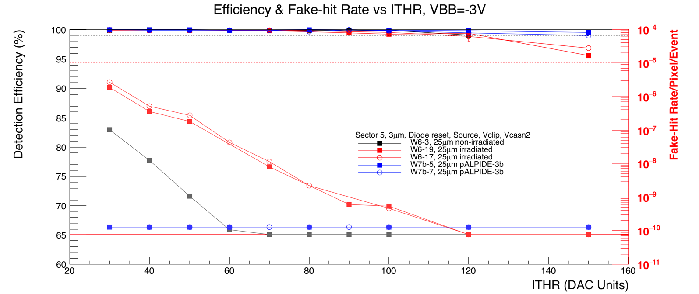
Test-beam Results for Sector 5, $V_{BB}=−3V$
Noisiest 0.015% pixels were masked for fake-hit rate measurement
Fake-hit Rate is very low (below sensitivity limit) for pALPIDE-3b chips
Have lots of margin for all chips, even at -3V of back-bias
Notes:
1.33/2.43

