Slide 1


KISTI-GSDC site report
KoALICE National Workshop
@ ARPINA, Busan, South Korea
8 April – 10 April 2016
Sang-Un Ahn
on the behalf of KISTI-GSDC
Notes:
Good Day Everyone.
I am Sang-Un Ahn,
and on behalf of the GSDC Tier1 Team,
I am going to talk about the status of KISTI Tier1
precisely the progress and the performance of our site
as a candidate of WLCG Tier1.

Slide 2
CONTENTS
KISTI GSDC Overview
Tier-1 operations
Network
KoALICE Support
Conclusion
Notes:
This is the outline of today’s talk.
Short introduction to the KISTI and GSDC,
Summary report on the operations of Tier1 and KIAF,
Current network configuration and future plan including OPN joining,
Milestones, and conclusion.

Slide 3
KISTI gsdc Overview

Slide 4
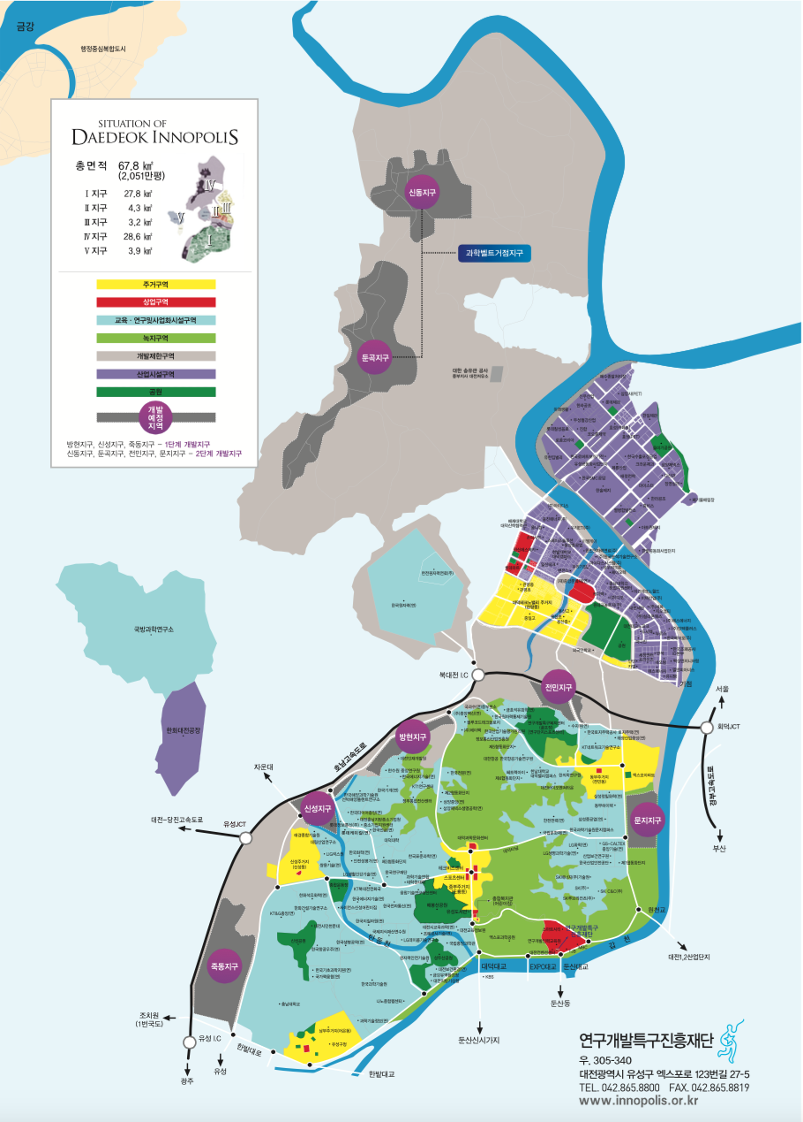
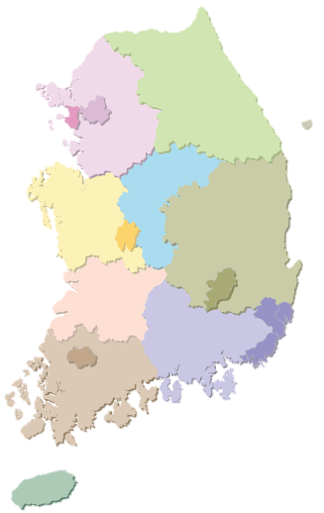
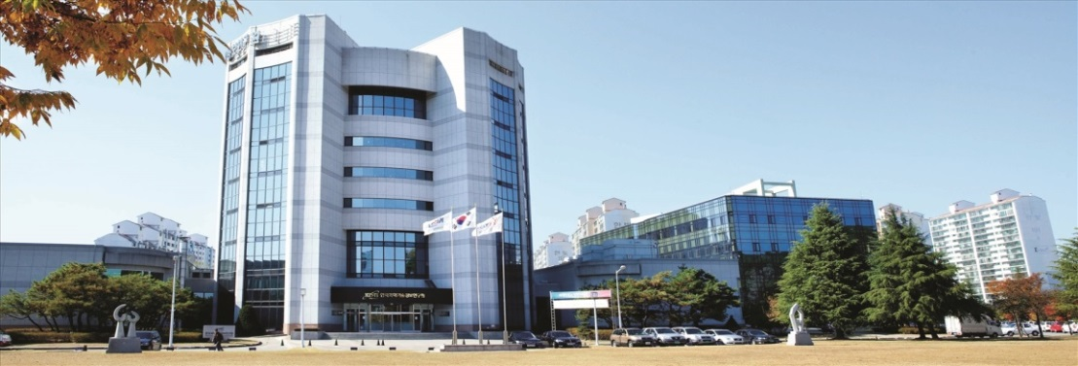
KISTI Location
Daedeok R&D Innopolis
South Korea
Seoul
Rare Isotope Accelerator
(To be constructed)
Incheon
Airport
2h by car
Daejeon
30 Government Research Institutes
11 Public Research Institutes
29 Non-profit Organizations
7 Universities
Daegu
Gwangju
Busan
Jeju Island
KISTI

Slide 5
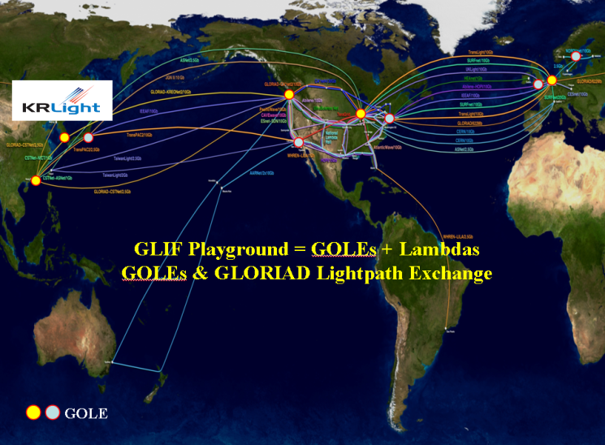
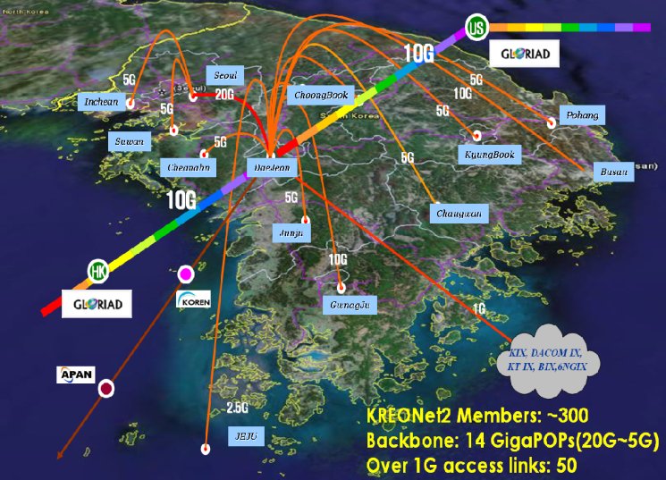
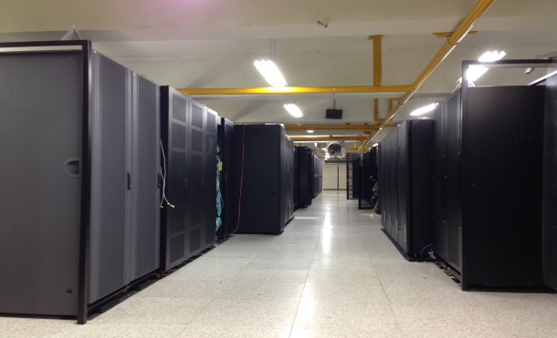
KISTI GSDC
KISTI (Korea Institute of Science and Technology Information)
Government funding research institute for IT founded in 1962
  600 people working for National Information Service(distribution & analysis), Supercomputing and Networking
  Operating Supercomputing and NREN Infrastructure
  Supercomputer: 307.4 TFlops at peak(14th ranked at Top500 in 2009; 201st now)
  NREN Infrastructure: KREONet2
    Domestic: Seoul ←(100G)→ Daejeon
    International: HK ←(100G)→ Chicago/Seattle(Member of GLORIAD)
GSDC (Global Science experiment Data hub Center)
Government funding project to promote research experiment providing computing power and storage
  HEP: ALICE, CMS, Belle, RENO
  Others: LIGO, Bioinformatics
Running Data-Intensive Computing Facility
  13 staffs: sysadmin, experiment support, external-relation, administration
  Total 7,900 cores, 6,000 TB disk and 1,500 TB tape storage
History of GSDC
ALICE T2 operation start
KISTI Analysis Facility
Full T1 for ALICE
GSDC Facility
2007
2009
2010
2011
2012
2013
2014
2015
Formation of GSDC
ALICE T2 Test-bed
ALICE T1 Test-bed
ALICE T1 candidate
Start CMS T3
10Gbps LHCOPN Established

Slide 6
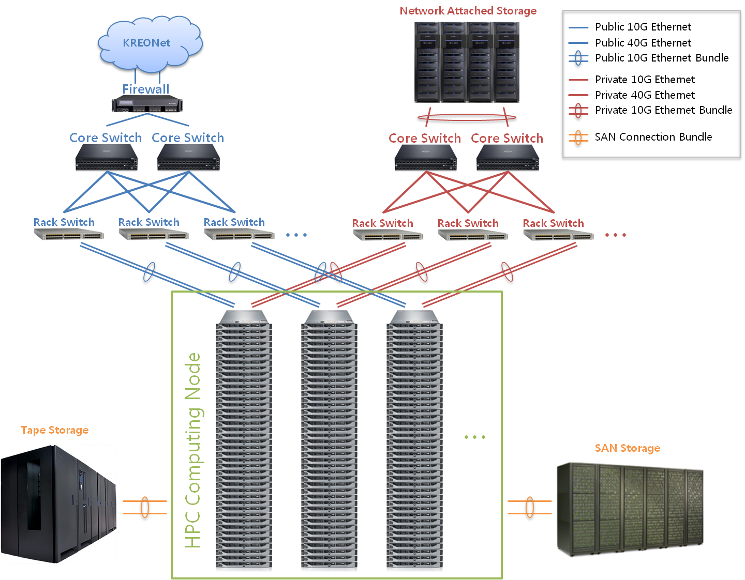


GSDC System Overview
Public
Private
4 Spine switches
74 Leaf switches
500+ Servers in 22 racks
14 Storage racks
4 tape frames
40 RACKS!!!!
HITACHI HNAS
EMC ICILON
2.5 PB
HTCondor
2,500 slots
CMS T3, LIGO, KIAF
Torque/MAUI
4,500 slots
ALICE T1, Belle, RENO
1.5 PB
3.5 PB
HITACHI USP/VSP
EMC Clariion/VNX
IBM TSM/GPFS

Slide 7










System Management
v3.7.4
Manifests
Profiles
Puppet code
management
(via Git)
Project
Issue tracking
Node definition
Provisioning
Documentation & Space
Services are defined at Puppet (manifests, profiles)
  Stash is used for Puppet code management
Nodes are created/provisioned via Foreman with Puppet classes
  Any VMs are managed by the Red Hat solution
Centralized authN/authZ are provided via IPA (SSO to be implemented)
JIRA helps to track issues and to manage project
Confluence is a useful tool for documentation and sharing

Slide 8
Tier-1 Operations
Notes:
Operations.

Slide 9


RAW Data Flow
Physical Machine
Batch System: Torque/MAUI
Grid Middleware: EMI
Job Flow
ALICE
Virtual Machine
isolated
xrootd
WLCG Mesh
apmon
Xrootd RDR
perfSONAR
ALICE::KISTI_GSDC::SE2
10G
64G
xrootd
/data
apmon
1.5PB
Xrootd Servers
emi
SAN
alien
squid
VOBOX
apmon
cvmfs
xrootd
Xrootd RDR
apmon
ALICE::KISTI_GSDC::TAPE
emi
xrootd
srm
emi
apmon
SE
gridftp
CEs
cream
Xrootd Servers
frm
torque
tsm
SAN
400TB
/data
TSM Server
200TB
/gpfs[01..08]
emi
gpfs
emi
qlexec
tsm
Worker Nodes
cvmfs
EMC isilon
1.5PB
siteBDII
bdii
GPFS Servers
torque
SAN
PS, Proxy, SE, BDII
Computing Resources (3488 core)
Storage Resources (3.1PB)

Slide 10
Pledges
2016 pledges are fulfilled
 | 2014 | 2015 | 2016
CPU(HS06) (Installed) | 25,000 (28,800) | 28,000 (28,800) | 31,000 (38,200)
Disk(TB) (Installed) | 1,000 (1,000) | 1,000 (1,000) | 1,500 (1,500)
Tape(TB) (Installed) | 1,500 (1,000) | 1,500 (1,500) | 1,500 (1,500)
ALICE Only

Slide 11
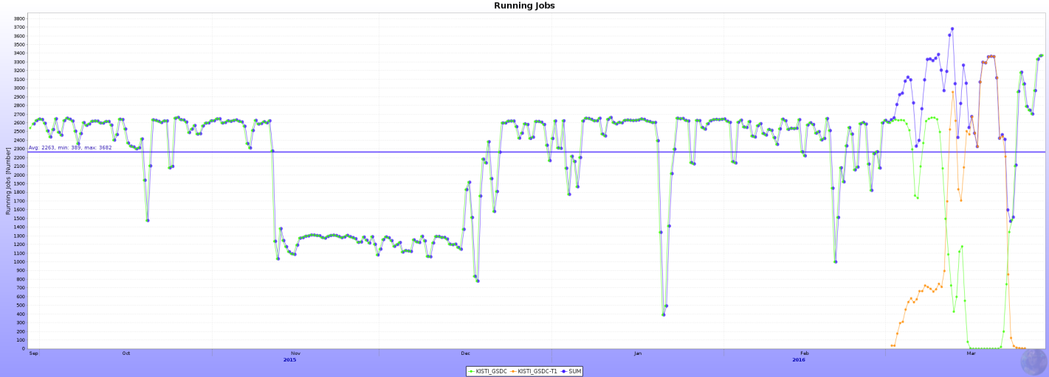
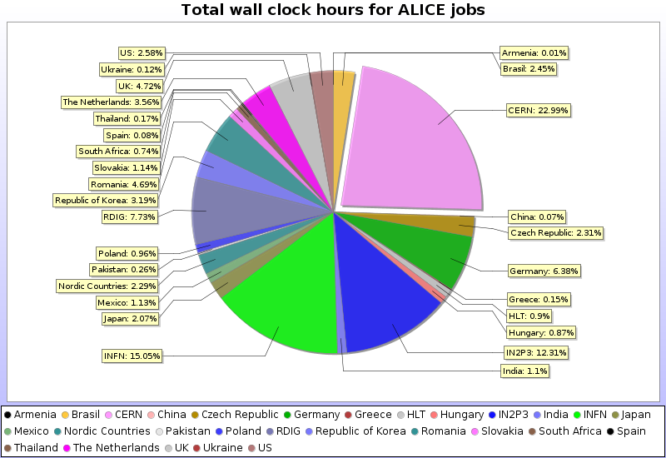
Jobs
Stable and smooth running
Participating in HI Reco Run at the end of 2015
261M jobs done for the last 6 months
Maximum 3,402 concurrent jobs = 37 kH06
(84 nodes x 32 (logical) cores + 20 nodes x 40 (logical) cores)
KISTI, 3.19% = 2.6M jobs for the last 6 months
~ 3300
~ 2500
~ 1300
Sep 2015
Mar 2016
Maximum 1,344 concurrent jobs (84 nodes x 16 cores)
> 5GB memory available per job
For HI Reco Run ~ Feb 2016
ALICE Only
Notes:
Concerning jobs, we have eighteen hundred job slots for ALICE.
Current performance for high energy physics job processing is about sixteen k-HepSpec.
Including computing power of KISTI Tier2, our share for ALICE jobs is three point six percent.
The pledges for this year is twenty five k-HepSpec with two thousand cores.
And this will be fulfilled by the end of November.
There has been several issues on operations but overall site performance has been gradually getting better as you can see in the bottom plot.
I am not going into details on this plot.

Slide 12
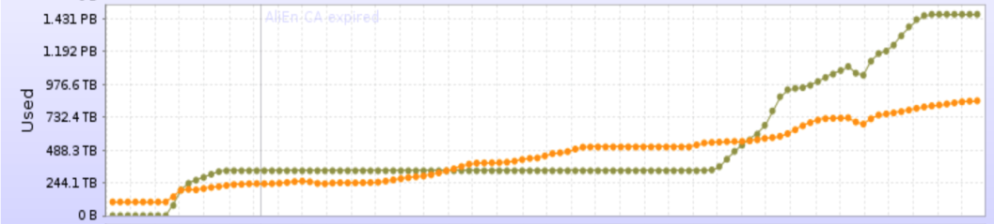
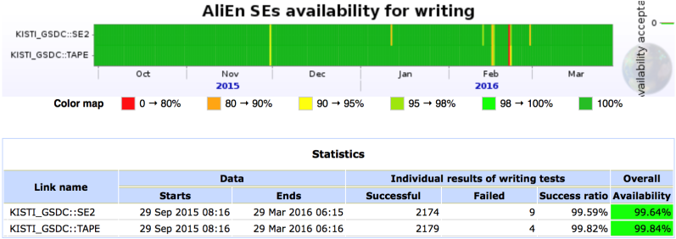

Storage
1.465PB ALICE RAW Data Transferred
99% Storage Availability for the last 6 months
← May 2013
May 2015
1,465 TB Used (Tape)
Jun 2013
3 Yrs Use History
Tape
855.6 TB Used (Disk)
Disk
Run2 Data Taking
400TB Disk buffer for helping fast access to data archived
ALICE Only
99% Storage Availability of R/W for last 6 months
Notes:
Storage.
One petabyte of disk has been allocated for ALICE which fulfilled the pledges for two thousand thirteen,
And one petabyte of tape has been installed
together with a disk buffer of four hundred seventy five terabytes.
By the end of this year, disk pool for tape will be expanded up to six hundred
to have higher availability as well as better performance on throughput.
One of the milestones for Tier1, to be explained in the later, is to achieve more than 90% (ninety percent) of availability of storage for at least two months.
On the left plot, for more than six months, KISTI storage has shown higher availability than the requirement.

Slide 13

Site Availability/Reliability
99.8% Reliable for the last 6 month (from Sep-2015 to Feb-2016 )
  Monthly Target for Reliability of ALICE test: 97%
  Less than 10 days of yearly downtime
On track for a stable and reliable site
  Participating in weekly WLCG operations meetings(1 times (Mon) per week): reporting operation-related issues
  24/7 monitoring & maintenance contract
  2 persons responsible for on-call
$$Reliability = \frac{T_{UP}}{T_{UP} +(T_{DOWN}−T_{SCHED_DOWN})}$$
$$Availability = \frac{T_{UP}}{T_{UP} +T_{DOWN}}$$
< Monthly Availability/Reliability (%) >
 | Sep | Oct | Nov | Dec | Jan | Feb
Reliability | 100 | 100 | 100 | 100 | 100 | 99
Availability | 100 | 100 | 100 | 95 | 100 | 99
ALICE Only
Notes:
In this slide I summarized our site availability based on WLCG monthly report.
Monthly target for reliability is ninety seven percent.
The red line on the bottom plot represents the monthly target,
and you can see the history of KISTI Tier1 site availability and reliability,
of OPS and ALICE VO on every months since March two thousand twelve.
As you can see, it has shown gradual increase of overall availability.
In particular, for the last year, mostly we achieved the monthly target in spite of a few unscheduled downtime.

Slide 14
Network
Notes:
Operations.

Slide 15
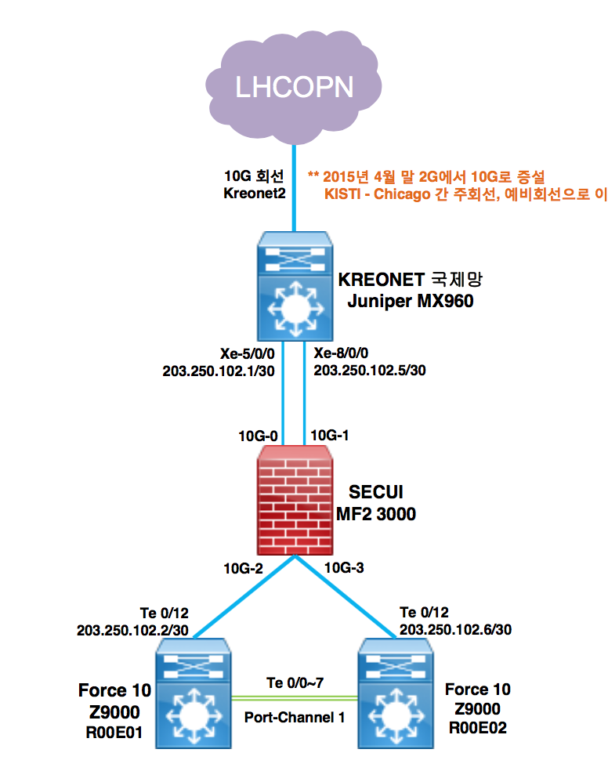

KISTI Domain Network for T1
Backbone Router
Physical Firewall
2 Core Switches

Slide 16
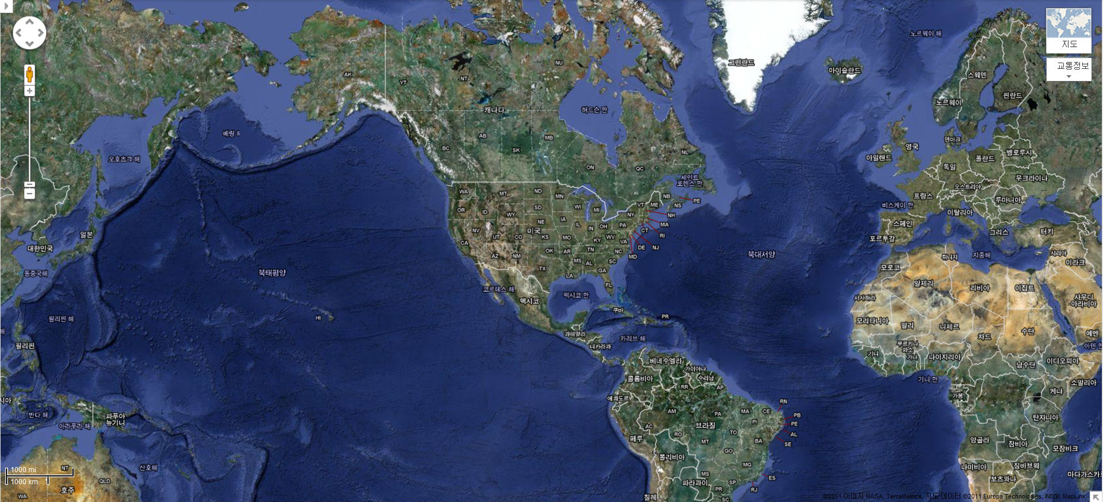



KISTI-CERN Network (LHCOPN)
10Gbps Upgrade done by 31st April 2015
NetherLight
@Amsterdam
KRLight
@Chicago
GSDC/KISTI
@Daejeon
Seattle
SURFnet (SURFnet)
SKB(EAC+PC-1)
SKB(Level3)
SURFnet
(CANARIE)
SURFnet (SURFnet)
SKB(EAC+UNITY)
SKB(Level3)
New York
LA
CERN
@Geneva
KREONET
SK Broadband (~’16.8)
SURFnet

Slide 17
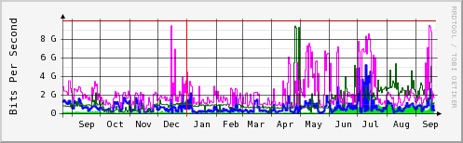
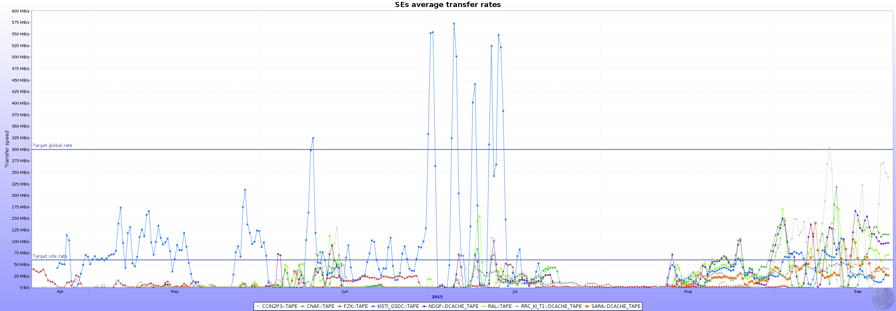
Performance
CERN→KISTI
CERN→KISTI (5 min)
MRTG @ MX960
> 9Gbps peak (~ 1GB/s) observed
  CERN IT provided a gateway, 500 parallel transfers
    xrd3cp crashed with Xrootd v3.3.4 (fixed @ v4 or later)
  Max 1GB/s peak @ alimonitor.cern.ch
  Confirmed full capacity
CERN IT Gateway
Multi-stream: 500
Max peak: 1GB/s
KISTI-GSDC
10G enabled
Average: 65 MB/s
alimonitor.cern.ch

Slide 18
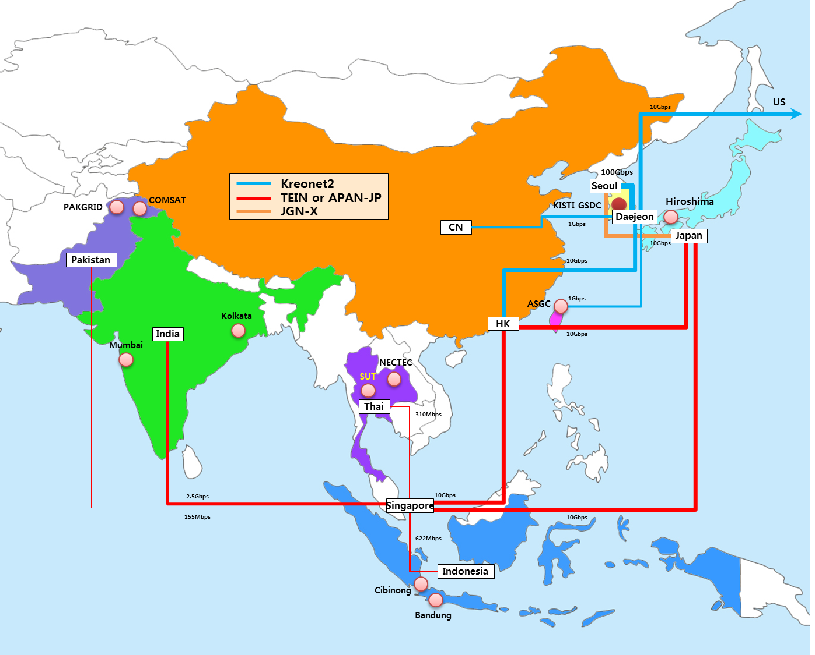
KISTI-ASIA
Tsukuba
Wuhan
Connected to JP, US, CN, TW(ASGC) and HK
  via Kreonet2
  JP connected through APAN
Not connected to TEIN @ HK
Asian Tier sites are well connected

Slide 19
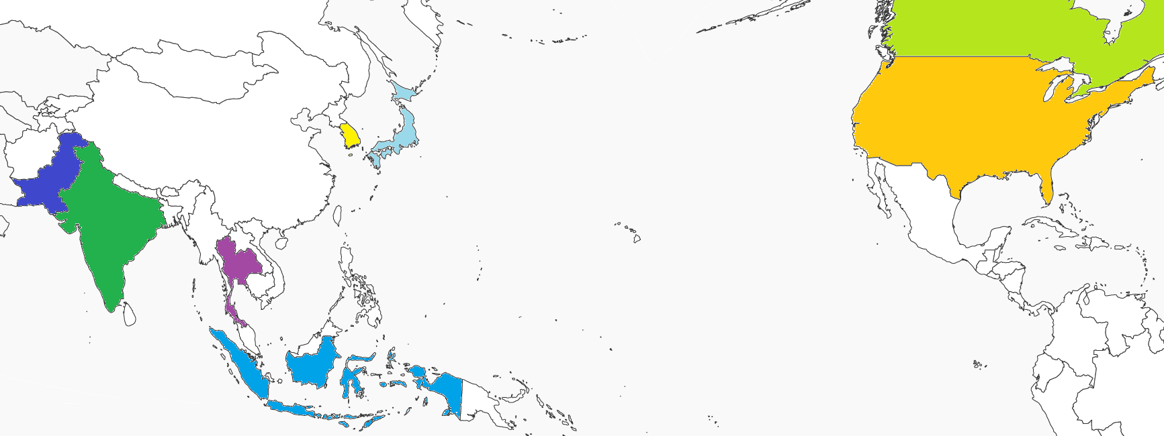
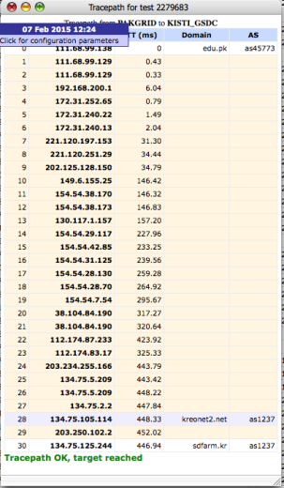
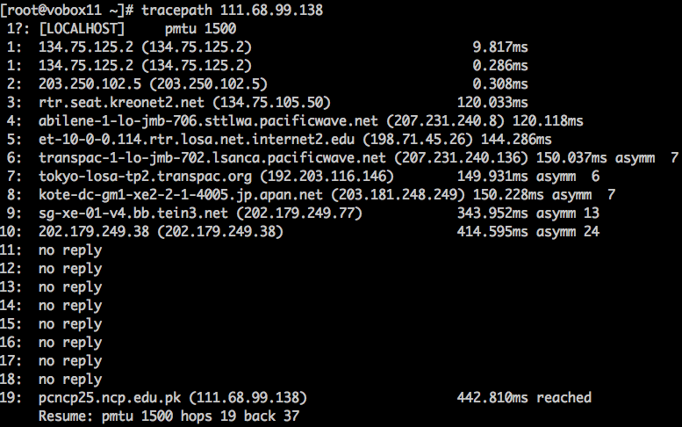
Example: Current Status
KISTI(KR) ↔ COMSATS(PK)
KREONET
Seattle
COMSATS
Islamabad
KISTI
Daejeon
PACIFICWAVE
Tokyo
TRANSPAC
LA
HK
APAN-JP
TEIN
Singapore
30 hops
Tracepath
over 400ms latency
KISTI-CERN 250ms latency

Slide 20
Asia Tier Center Forum
Motivation
Improving network environment among Asian Tier Centers
At first, for only ALICE sites: KISTI T1 <-> ALICE T2 in Asia
Note that T2s in Asia quite well connected via TEIN and APAN-JP
KISTI has its own backbone called KREONET, partner of GLORIAD
Natural to think of taking the shortest route from T2 to T1 or vice versa
Geographically close but technically far
Current situation: occasionally CERN or European site or US sites are effectively closer than KISTI T1 for ALICE T2 in Asia
Inefficient routing paths
  Best effort among possible paths instantaneously
  Long distance -> more hops

Slide 21
Asia Tier Center Forum
Goal
The aim of this forum is to discuss on the possible solutions for the improvement of connectivity among Asian Tier sites and their status of domestic network environment and
To monitor periodically the state-of-art of the established network environment through this forum and to organize a body with a broader agenda embracing not only the network but also common issues that could be arisen among Asian Tier sites.
The target of this forum is mostly Asian Tier sites, however, the forum is open to every interested parties, in particular, distributed computing co-ordinations of LHC experiments and network experts on OPN/ONE.

Slide 22

Asia Tier Center Forum
1st Asia Tier Center Forum @ KISTI, Daejeon, South Korea
22 - 24 September 2015
10 Site reports with domestic/campus network status
T1: ASGC (TW), KISTI (KR)
T2: Tsukuba (new T2 for ALICE, JP), Wuhan (CN), Bandung (ID), TIFR (CMS T2, IN), Kolkata (IN), COMSATS (PK), SUT (TH), Hiroshima (JP)
3 LHCONE related talks
LHCONE Status (by Edoardo Martelli, CERN)
US implementation (by William Johnston, ESnet)
Guidelines for site configuration (by Michael O’Connor, ESnet)
Joint session of TEIN & KREONET
Asia implementation (by Edoardo Martelli, CERN)
TEIN (by Patch Lee, TEIN*CC) and KREONET (by Buseung Cho, KISTI) preparation for LHCONE
Current activity on TEIN-GLORIAD connection
http://www.atcforum.org

Slide 23
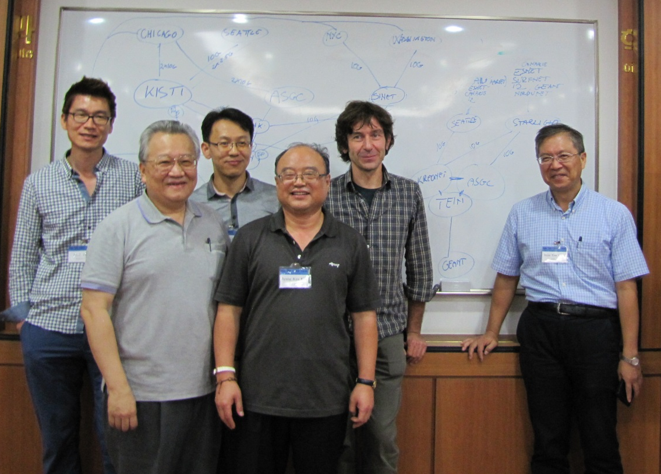
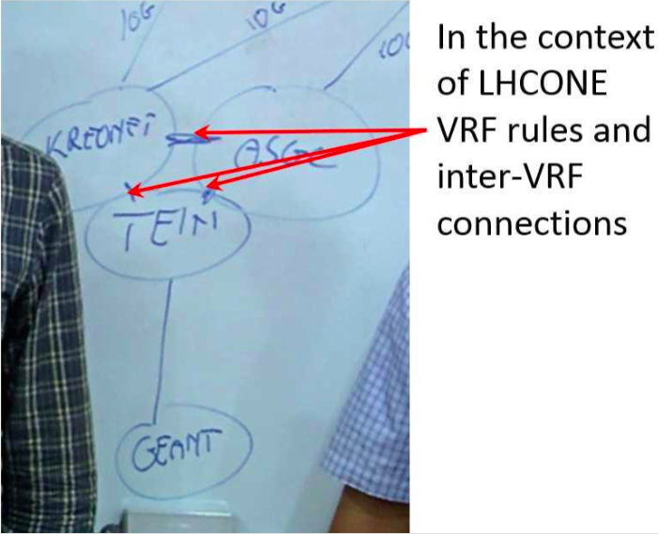
Asia Tier Center Forum
Agreed to implement LHCONE VRF in their networks,
to interconnect the VRFs in HK and to give transit each other their peering links to GÉANT(TEIN), STARLight(KISTI, ASGC), and Seattle(KISTI)
KREONET (KISTI)
ASGC
TEIN

Slide 24
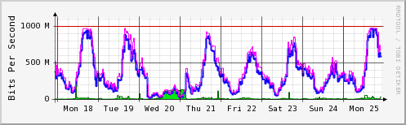
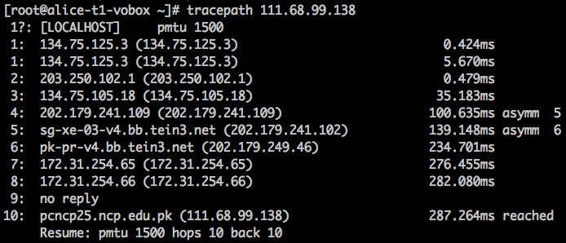
Result
KISTI(KR) ↔ PAKGRID (PK)
KISTI
Daejeon
KREONET
Seattle
PAKGRID
(PK)
PACIFICWAVE
Tokyo
TRANSPAC
LA
HK
APAN-JP
Connection test (1Gbps)
TEIN
Before path (2015)
Singapore
After path (2016)
Before
After
Latency : -155.546 ms
Hop : -10
Tracepath test condition
Source: KISTI-GSDC (134.75.125.152)
Destination: Pakgrid (111.68.99.138)
287.264ms
Tier centers in ASIA use abnormal routing path.
(example test: Parkgird)
442.810ms
Tier centers in ASIA use optimal routing path through GSDC Tier 1 center.

Slide 25
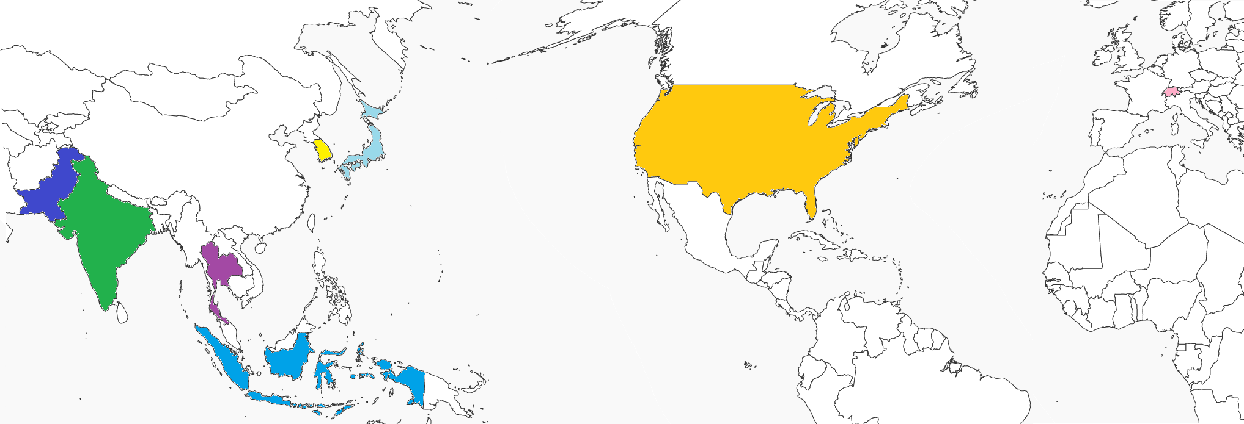
TEIN-GLORIAD-KR
100Gbps
10Gbps
Amsterdam
10Gbps
Seattle
KISTI
GSDC
Chicago
CERN
10Gbps
Pakistan
10Gbps
JP
10Gbps
IN
HK
KISTI-CERN LHCOPN
GLORIAD-KR
TEIN
TH
SG
1 ~ 10Gbps
Indonesia

Slide 26

2nd Asia Tier Center Forum
October 2016 @ SUT, Thailand
Thanks to Prof. Chinorat Kobdaj

Slide 27
KoALICE Support

Slide 28
MoU Summary
Purpose
  Collaborating to promote heavy-ion research and user community in Korea by using computing infrastructure and technology
Resource
  ALICE Tier-1 + KIAF
  Adjustable depending on funding and request from user community
 | 2014 | 2015 | 2016
CPU core (Physical) | 150 | 300 | 450
Storage (TB) | 200 | 200 | 200
Contact
Role | Name | Institute
KoALICE Representative | In-Kwon Yoo | PNU
KISTI Representative | Haeng Jin Jang | KISTI
ALICE Software Support | Jihye Song | PNU
ALICE Technical Support | Sang-Un Ahn | KISTI
Etc.
  Co-hosting KoALICE-KISTI Workshop
  Collaboration on establishing computing infrastructure and computing project in ALICE

Slide 29


KIAF System
PROOF on Demand enabled based on HTCondor
  Total 192 workers with 173TB storage
User authentication @ https://kiaf.sdfarm.kr:8443/auth
  Proxy valid for 1 hour (requires user certificate)
Submission Node
Central Manager
PROOF Master
XRootD Header
SSH(Private Key)
ROOT
pod-submit …
condor_submit …
22TB
afmaster01.sdfarm.kr
(kiaf.sdfarm.kr)
8 nodes
Execution Node
PROOF Salve
XRootD Server
22TB
22TB
kwn1001.sdfarm.kr
kwn1008.sdfarm.kr
ALICE software deployed via CernVM-FS
Dataset management via XRootD

Slide 30
How to use KIAF: brief summary
SSH connection with private key after obtaining a proxy(1h) @ https://kiaf.sdfarm.kr/auth
$ ssh -p4280 -i $HOME/.globus/userkey.pem kiaf.sdfarm.kr
Environment setup
$ source /pool/podenv
PoD start
$ pod-server start
$ pod-submit -r condor -n 10
$ pod-info -n
10
$ root -l
root[0] TProof *p = TProof::Open(“pod://”)
…
If you are familiar with HTCondor batch system,
$ condor_status
$ condor_q
$ condor_submit myjob.jds
…

Slide 31
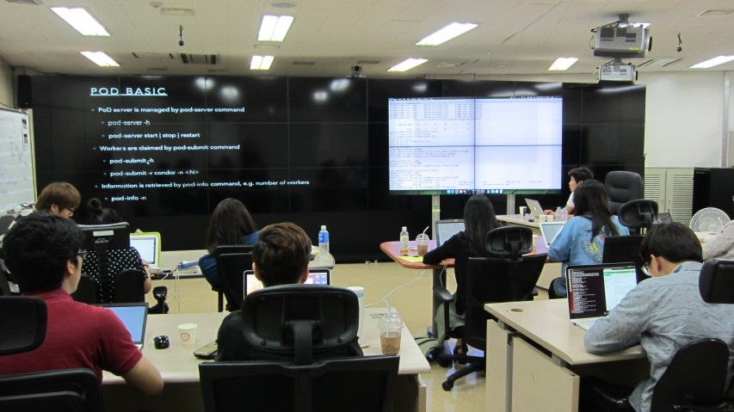
KIAF Activities
KIAF Tutorial (`15.07)
  9 participants (PNU 2, Inha 6, KU 1)
Sigma MC Production support (Dr. Borissov)
  JDL for HTCondor
  sim.C/rec.C for local cvmfs access
p-Pb analysis support (Inha Univ.)
2015. 07
User Accounts
Registered Datasets
PNU | Inha | Konkuk | Total
4 | 4 | 2 | 10
Data | Period | Run | Type | Pass | Datasets
Real | LHC13b | 195344-195483 | ESD | 3 | 13
Real | LHC13c | 195529-195677 | ESD | 2 | 15
Real | LHC10h | 137161-139510 | AOD | 2 | 155
Sim | LHC13d3 | 195389-195677 | ESD | - | 21
Sim | LHC11a10a_bis | 137161-139510 | AOD | - | 143
Sim | LHC11a10b_plus | 137161-139510 | AOD | - | 141
Sim | LHC13d3 | 195389-195633 | AOD | - | 16
Sim | LHC14g3a | 195389-195677 | AOD | - | 23
Sim | LHC14g3b | 195389-195677 | AOD | - | 20
Sim | LHC14g3c | 195831-195872 | AOD | - | 4
Job Accounting
(available since Sep 2014)
2014 | 2015 | 2016 | Total
101 | 3,703 | 1,239 | 5,043

Slide 32
KIAF Upgrade Plan
Providing opportunistic resources from KISTI Tier-1 in case of bursting (Up to 7,200 HS06 ~ 600 slots)
  Achieving better overall resource usage utilization for ALICE
  HTCondor + EMI test (or other combination)
Upgrading Operating System to SL6
  New XRootD has to be tested with Dataset Manager for KIAF
  HTCondor, CVMFS, PROOF on Demand are ready
End of This Year (2016)

Slide 33

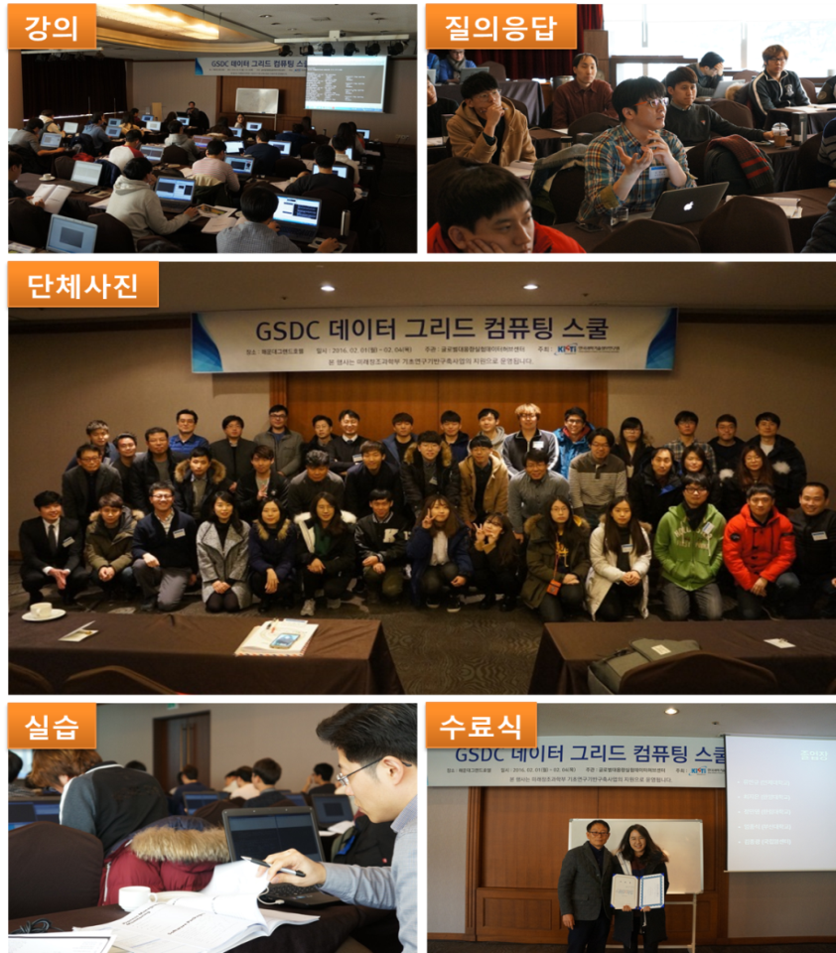

GSDC School of Computing
4 days program transferring computing knowledge
needed for data-intensive fundamental research supported by GSDC
(1st Feb ~ 4th Feb 2016)
31 Participants = 6 Seniors + 10 Graduated + 15 Undergrad
6 Lectures and Lab given by GSDC Staff and External Expert
  Grid Computing
  Networking
  Linux Administration
  Shell Scripting
  Batch System
  Security (NSR)

Slide 34
conclusion

Slide 35
KISTI contributes to Grid Computing for LHC specially ALICE with Tier-1
  Raw data reconstruction and preservation
  Mass MC production and User analysis via LEGO Train
  Chaotic User Analysis
KISTI is at your disposal for supporting any kind of issues related Computing
  User Analysis Facility and Technical Support
  Training program

Slide 36
감사합니다.
آپ کا شکریہ .
धन्यवाद।
ขอบคุณ
谢谢。
ありがとうございます。
Terima kasih .
Благодаря.
Dank u.
Ευχαριστώ.
Dziękuję.
Grazie.
Vielen Dank.
Dank je.
Merci.
Thank you.

