Slide 1

SLHC-PP annual meeting
Welcome and introduction
February 25th
L. Linssen

Slide 2
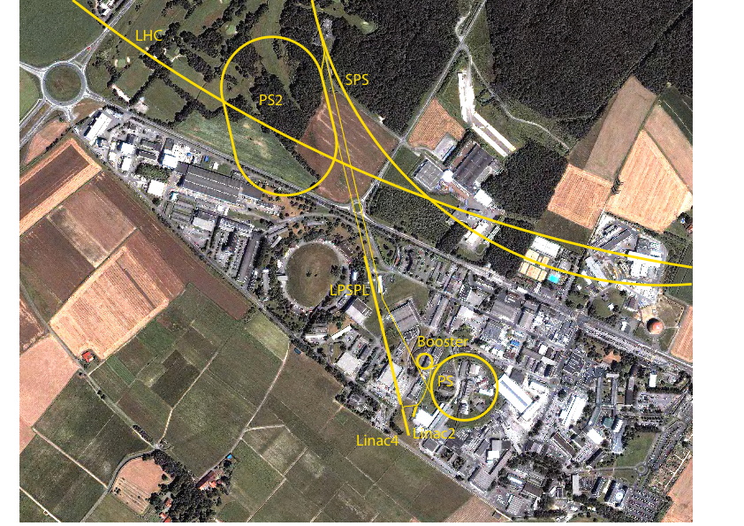
The past year….
The most important is the technical progress !!!

Slide 3
Some SLHC-PP dates …..
Kick-off meeting April 8 + 9, 2008
End April 2008:
  Grant agreement signed by both EU and CERN
End May 2008:
  Grant agreement signed by all partners
Beginning of June 2008:
  First installment sent to all beneficiaries
December 1st 2008:
  Official accession of RWTH Aachen as beneficiary (in WP8)
February 5th 2009:
Received official EU approval for accession RWTH Aachen (member as of 1/12/2008)

Slide 4
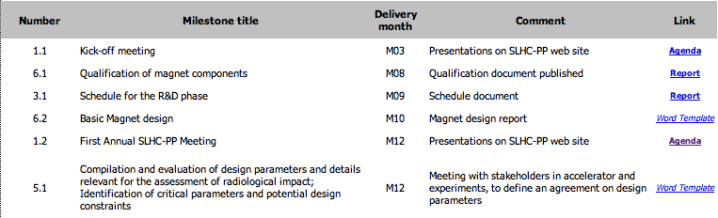
Milestones

Slide 5
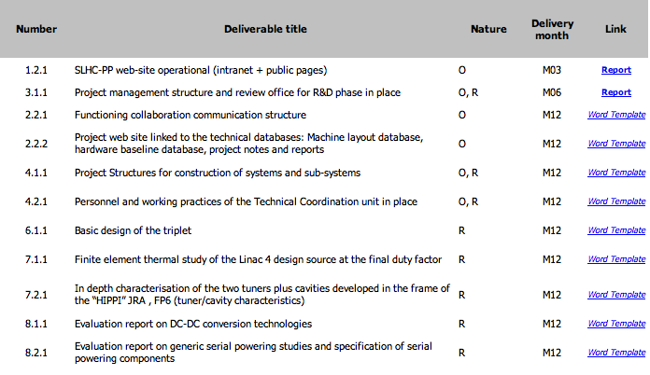
Deliverables

Slide 6
SLHC-PP Public Pages Project
Work by Colin Barras
Science Writer

Slide 7
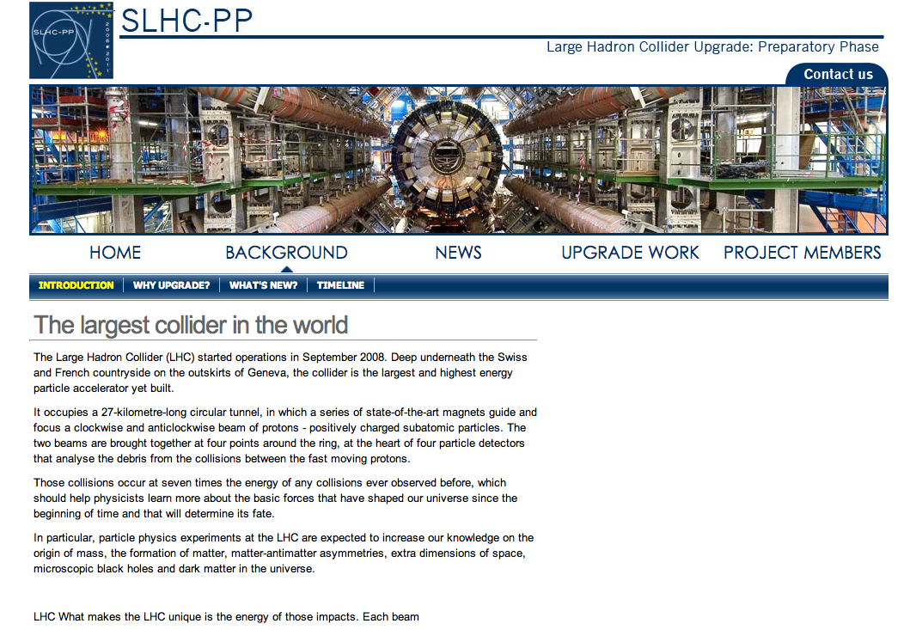
Background for General Public:
Why, What, When?

Slide 8
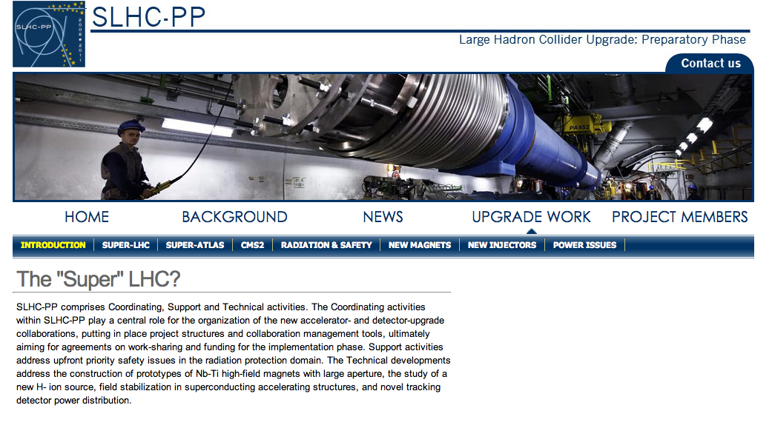
Technical Information for General Public
Work Packages

Slide 9
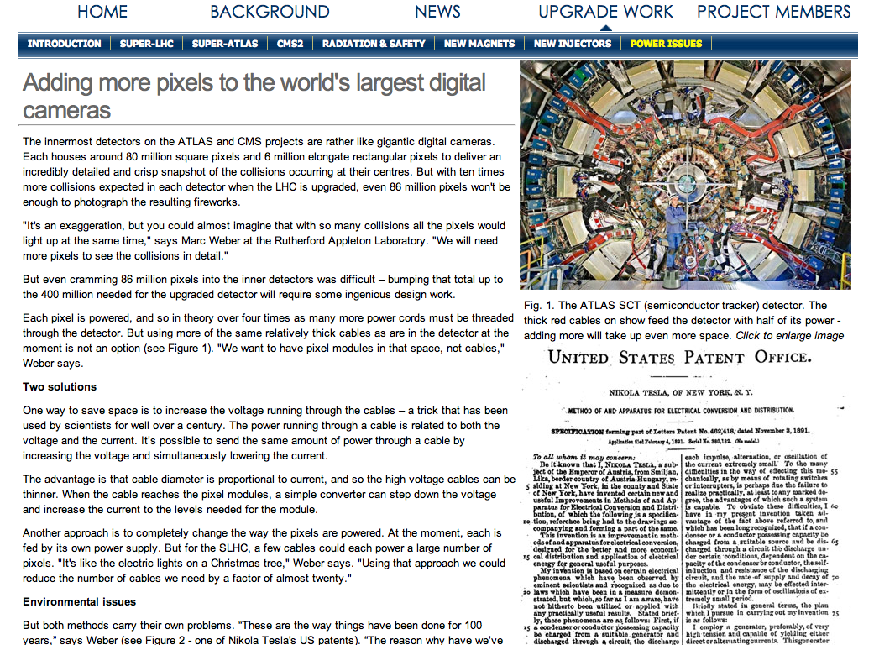
WP8: Tracking Detector Power Distribution converted to “Power Issues” >> thanks to M.Weber

Slide 10
Timescale
Collection of content by Colin Barras via phone interviews (15 min talking + one feedback call)
  WP leaders
  Partners
April: Content finished
Mid May: Pages available to general public

Slide 11
SLHC-PP Management Report
April 08 – January 09
M.Capeans, N.Knoors, C.Montagnier, K.Ross

Slide 12
SLHC-PP Membership
Registered in PPT: 99
CEA and CNRS do not report in PPT, but have provided estimates

Slide 13
Personnel Expenses
April 08 – Jan 09
PM from Worked Hours reported in PPT
Assumption: flat spending profile (year budget = total/3)
WP | P-M | P-M reported / P-M budgeted for Period1 | P-M reported / P-M budgeted for whole Project
1 | 13.7 | 84% | 28%
2 | 3.8 | 22% | 7%
3 | 31.1 | 92% | 30%
4 | 19.8 | 66% | 22%
5 | 21 | 55% | 18%
6 | 37 | 57% | 19%
7 | 24 | 39% | 13%
8 | 54.5 | 84% | 28%
SUM | 204.4 | 63% of Period1 budget | 21% of whole budget
Full SLHC-PP project has 976 PM in Annex-I

Slide 14
PM for RTD Activities (WP 6 ,7, 8)
April 08 – Jan 09

Slide 15
PM for Coordination Activities (WP 2, 3, 4)
April 08 – Jan 09

Slide 16
PM for Support Activities (WP5)
April 08 – Jan 09

Slide 17
PM for Management Activities (WP1)
April 08 – Jan 09

Slide 18
PM / Partner
Actual (10m) / Budget (3 y)

Slide 19
PM / Partner
Budget (3 y) VS Actual (10 m)

Slide 20
The annual meeting
Aim of the present annual meeting:
Discuss progress of the 1st year and plans for the 2nd year
Public SLHC outreach event (Thu morning)
Preparation for the first official annual report
  Presentations at the annual meeting form the seed material for the technical progress section of the annual report
  Information session this afternoon at 17:30 hrs

Slide 21
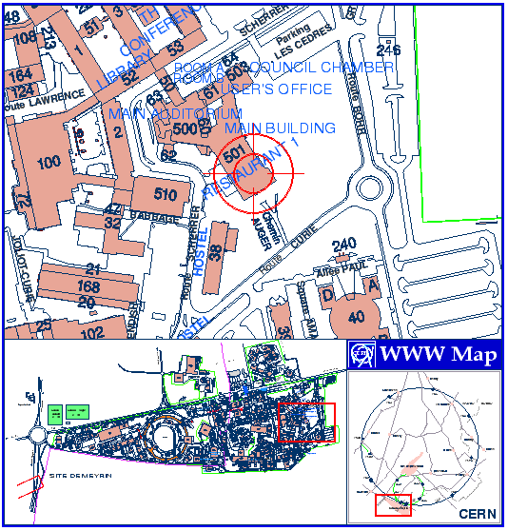
Invitation
This evening 18:30 hrs
Drinks and snacks
In the glass box
All are welcome
…even those who forgot to register…
have a nice meeting !

