Slide 1
RF tests of TRASCO cavities
E_{max} = 17 MV/m
B_{p} = 100 mT
E_{p} = 60 MV/m
Vertical cryostat
bare cavity
Equivalent
to TTF @
25-30 MV/m
Z501 – @ TJNAF 31/03/2004
Z502 – @ Saclay 24/06/2004
E_{p}/E_{acc} = 3.57
B_{p}/E_{acc} = 5.88 mT/(MV/M)

Slide 2
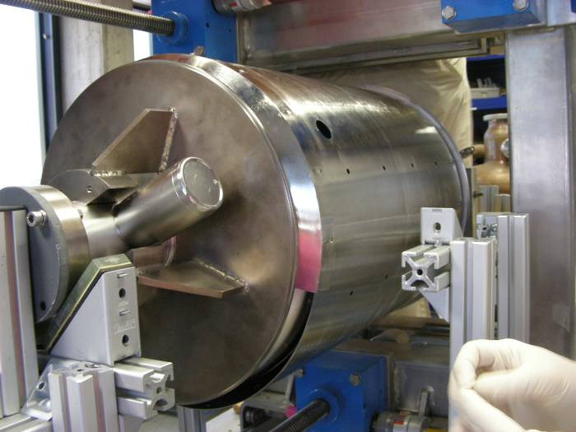
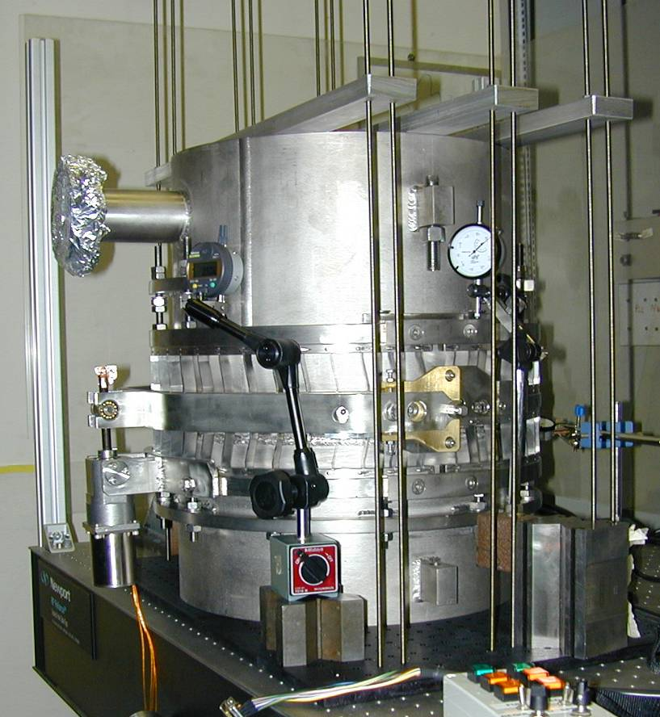
Progress during HIPPI
Tuner development
Magnetic shield inner to tank
He Tank integration
INTERNAL MAG SHIELD

Slide 3
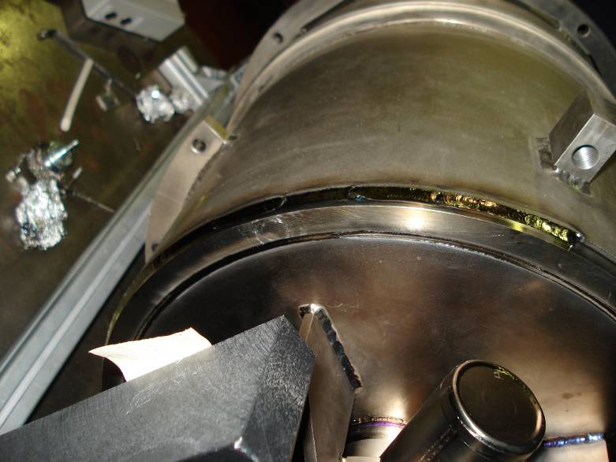
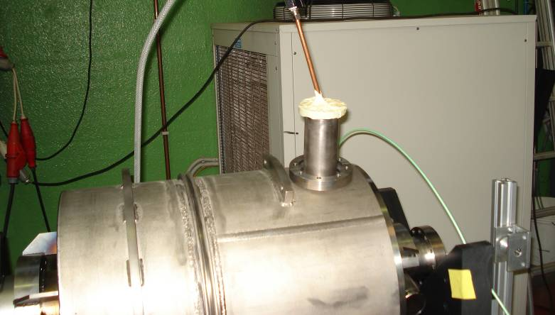
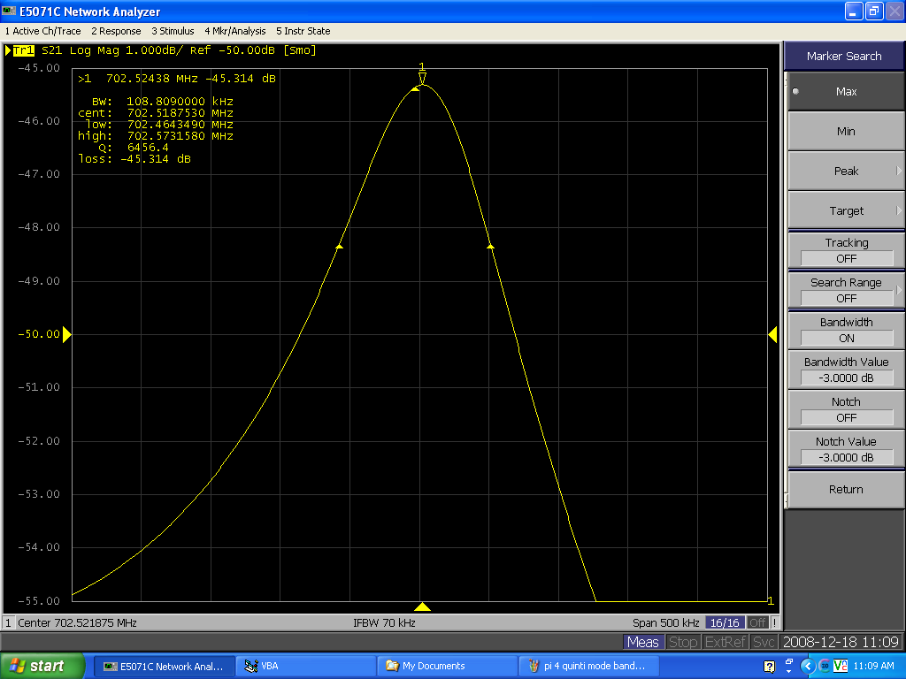
2008: preparation for horizontal tests
He Tank EBW and TIG seals
Next steps:
Warm check of dressed cavity at INFN (March)
Shipment to Saclay
702.5 MHz at RT in air

