Slide 1
WP6 status
Paolo Fessia

Slide 2
Summary
Status of the WP6 and change of WP coordinator
Lowβ quadrupole status
Corrector status
Cryostat status

Slide 3
Status and change of WP6 leader I
Milestones
  6.1 “ Component qualification” fulfilled
  6.2 “ Basic magnet design” in preparation (delay 1 month)
Deliverable
  6.1 “Basic Triplet Design” Main report written and published

Slide 4
Status and change of WP6 leader II
Stephan Russenschuck is taking over the responsibility in order to guarantee adequate follow up despite 3-4 consolidation activities
Due to the 3-4 incident 6 months delay have been matured up to now. It is very probable that with the partners we need to revise the plan for this work package according to the possible re-scheduling of project

Slide 5
Lowβ quadrupole
CERN CIEMAT STFC

Slide 6
Enhanced insulation
Courtesy D. Richter P. Paolo Granieri

Slide 7
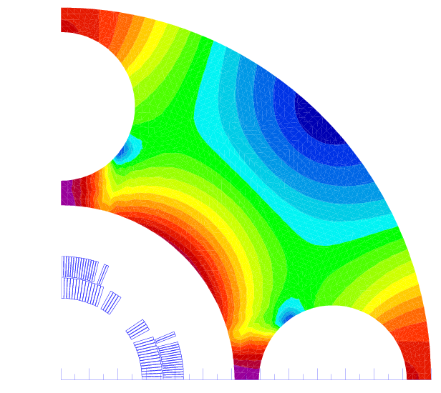
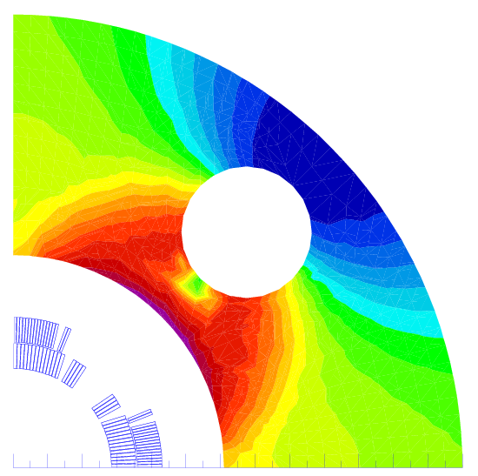
MQXC cross sections and iron yoke with heat exchanger(s)
Two possible solutions for heat exchanger proposed by the cryogenic team:
2 heat exchanger in parallel inner diameter 71 mm (1st eval. wall thickness 2.5 mm). Hole diameter 80 mm
1 heat exchanger inner diameter 100 mm (1st eval. wall thickness 3.5 mm). Hole diameter 110 mm
Both are large holes in the iron that affect transfer function and field quality
We can consider 2 possible configurations
Holes along the 2 mid-planes (larger effect on the transfer function)
Holes at 45 ⁰
We prefer solution with 1 heat exchanger on the vertical mid plane because of
Simpler interconnect
Standardization of cold masses respect 1 heat exchanger at 45 ⁰
Courtesy F. Borgnolutti

Slide 8
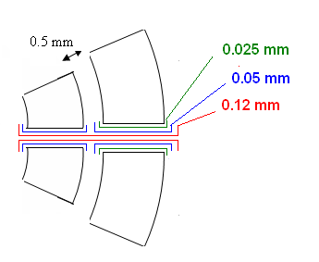
Cables and Insulations Dimensions
Cables dimensions
Critical current
  Cable 01 (inner layer): 14800 A @ 10T (4680 A/T)
  Cable 02 (outer layer): 14650 A @ 9T (4050 A/T)
Mid-plane and inter-layer thickness
  Inter-layer thickness of 0.5mm
  Mid-plane thickness
    Layer 1 : 0.220 mm
    Layer 2 : 0.245 mm
 | w (mm) | thick in (mm) | thick out (mm) | rad (mm) | az (mm)
cable 01 | 15.100 | 1.736 | 2.064 | 0.160 | 0.135
cable 02 | 15.100 | 1.362 | 1.598 | 0.160 | 0.145
az
Thick in
rad
Thick out
w
0.10 mm

Slide 9
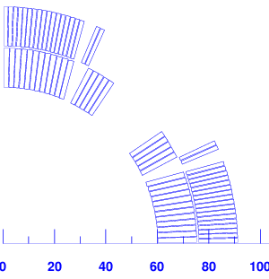
Coil Cross-Section
Coil blocks features
Angular position of the point 1 & 2
  (mechanical requirement: angles < 41º)
  Point 1: ~35º
  Point 2: ~26º
Block Nº | Nb Cond | r (mm) | φ (º) | γ (º) | cable type
1 | 12 | 60.00 | 0.2101 | 0.000 | Cable 01
2 | 5 | 60.00 | 25.728 | 27.757 | Cable 01
3 | 17 | 75.92 | 0.1849 | 0.000 | Cable 02
4 | 2 | 75.92 | 23.501 | 22.762 | Cable 02
1
2
MQXC V24
Courtesy F. Borgnolutti

Slide 10
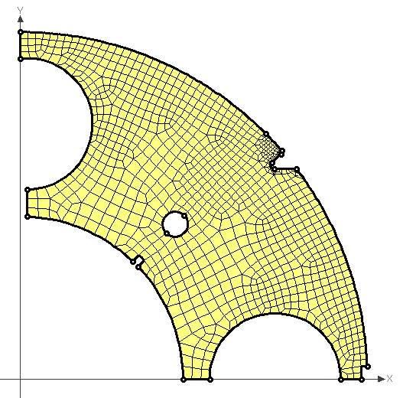
Effect of a slot in the iron on the magnetic field quality
Odd multipoles are not affected
Only even multipoles b₄, b₆, b₈ and b₁₀ are affected (multipole variation higher than 0.0001 unit)
gap
 | gap 1mm | gap 2mm | gap 3mm
Δ b4 | 0.0340 | 0.0656 | 0.0978
Δ b6 | -0.0174 | -0.0362 | -0.0536
Δ b8 | 0.0010 | 0.0020 | 0.0029
Δ b10 | -0.0002 | -0.0004 | -0.0006
Courtesy F. Borgnolutti

Slide 11
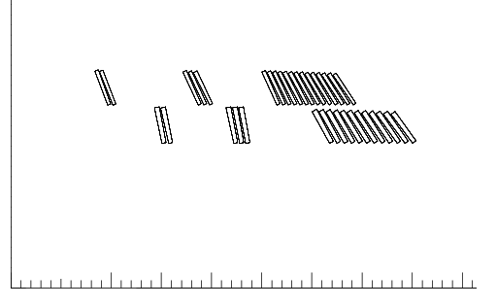
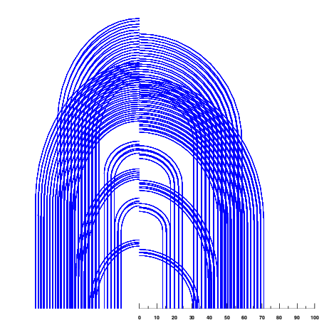
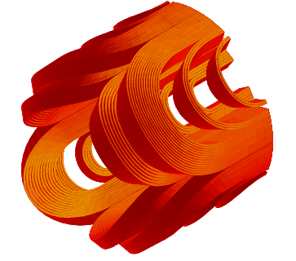
NCS head design

Slide 12
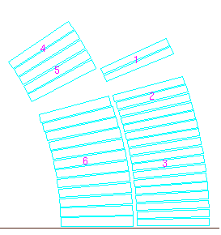
Peak field in the head,
30 mm of coil more and a lot more of margin in the head
 |  | straight part |  | head | B peak | ss field | % ss cur
no Iron Yoke | cable 01 | BS1 | 6.5 | 6.6 | cb01
 |  | BS2 | 7.3 | 7.4 | 7.4 | 9.6 | 77
 | cable 02 | BS3 | 5.7 | 6.1 | cb02
 |  | BS4 | 6.1 | 6.4 | 6.4 | 8.4 | 75
unsat Yoke | cable 01 | BS1 | 7.3 | 7.3 | cb01
 |  | BS2 | 8.1 | 8.1 | 8.1 | 9.9 | 82
 | cable 02 | BS3 | 6.4 | 6.7 | cb02
 |  | BS4 | 6.8 | 7.2 | 7.2 | 8.8 | 82
real Yoke | cable 01 | BS1 | 7.1 | 7.2 | cb01
 |  | BS2 | 7.9 | 8.0 | 8.00 | 9.8 | 81
 | cable 02 | BS3 | 6.6 | 6.6 | cb02
 |  | BS4 | 6.6 | 7.0 | 7.03 | 8.7 | 81
2
4
1
no yoke | unsat yoke | real iron
Lmag | 104 | 117 | 116
b6 | -2.9 | -2.8 | -2.8
b10 | -4.0 | -3.8 | -3.6
b14 | -0.3 | -0.4 | -0.3
Uncertainty: systematic coil length error 3 mm-> shift between heads->+/-0.9 Δb6
Random: variation coil length 1σ 2mm-> shift between heads->+/-0.6 Δb6
This gives an uncertainty of +/- 0.03 for a straight part of 7000 mm and a random of 0.02.
We will neglect it

Slide 13
Courtesy F. Borgnolutti

Slide 14
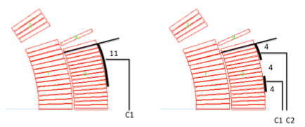
Protection Study
 |  | Nominal Current |  | Half Current
Setup |  | T peak | MIITs | T peak | MIITs
Dump resistor 40 mOhm, 10 ms delay |  | 117 | 33.6 | -- | --
 |  | 157 | 33.3 | 78 | 23.0
 | 20ms extra delay | 157 | 36.4 | 78 | 23.7 | Hot spot in outer layer
 | only half of the heaters | 220 | 38.1 | 103 | 27.5
 |  | 180 | 35.2 | 86 | 24.5
 | 20ms extra delay | 217 | 38.0 | 104 | 27.6
 | only half of the heaters | 221 | 43.4 | 102 | 30.8
 | + Dump Resistor | 118 | 29.4 | 50 | 15.2 | Hot spot close to heater
 | + Dump Resistor, half of heaters | 136 | 29.8 | -- | -- | Heater failure uncritical
Courtesy N. Schwerg

Slide 15

Collar thickness scaling based on MQXB
    Scaling based on radial collar displacement
    The collar width is obtained by solving:
Aperture radius [mm] | Collar thickness [mm]
55 | 35
60 | 39
65 | 42

Slide 16
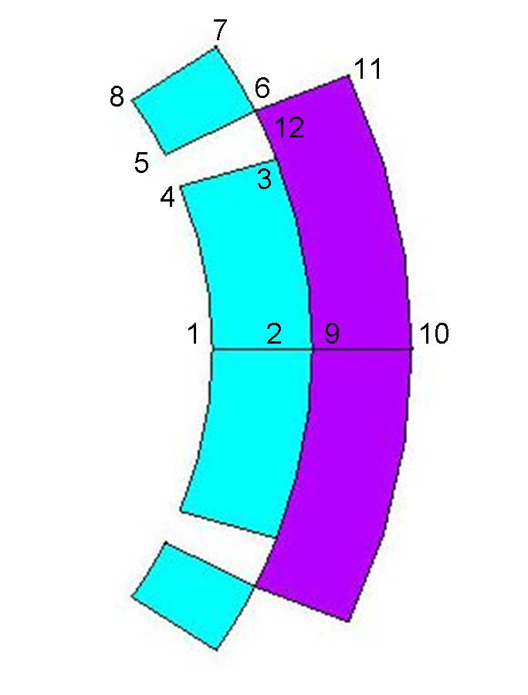
FE analysis – radial displacement
Courtesy F. Regis

Slide 17
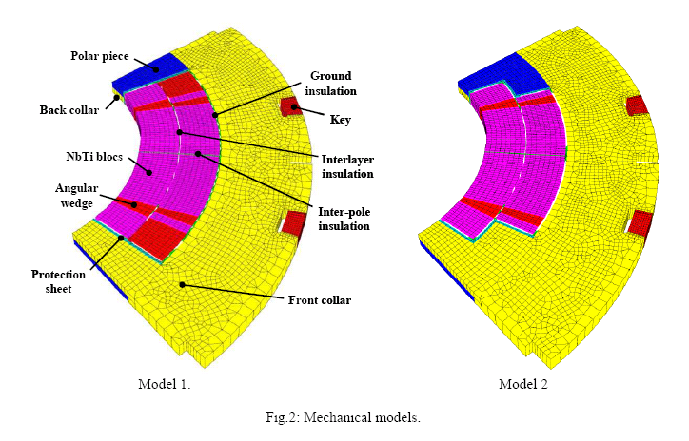
Studying options
Courtesy M. Segretti

Slide 18
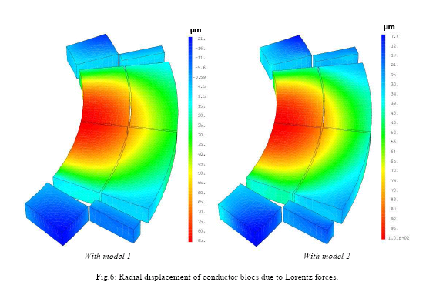
Confirming 1st analysis and going beyond
Courtesy M. Segretti

Slide 19
Correctors
CERN CIEMAT STFC

Slide 20
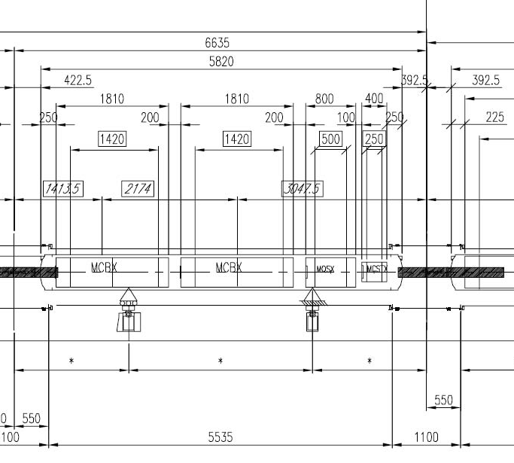
Corrector Package: Status
Courtesy M. Karppinen

Slide 21
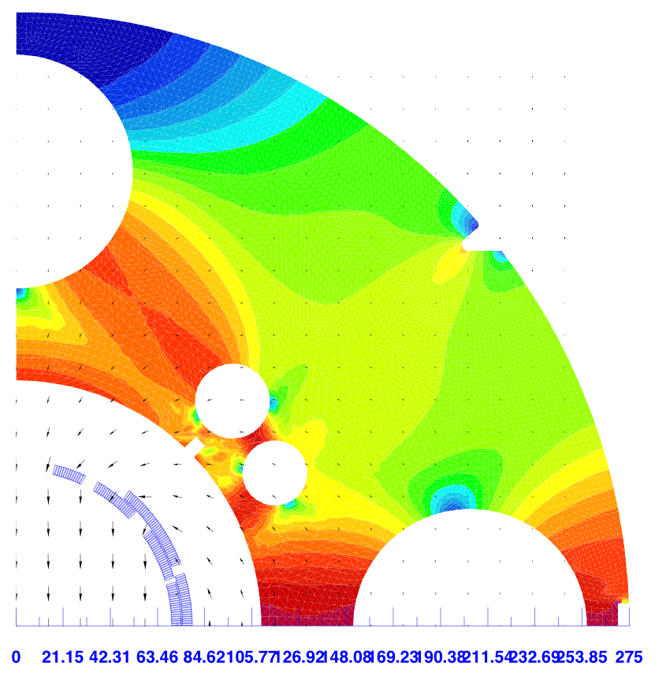
MCBX Parameters
 | Unit
Integrated field | Tm | 6
Nominal field | T | 4.2
Mag. length | m | 1.42
Nominal current | A | 2500
Stored energy | kJ | 240
Self inductance | mH | 77
Working point |  | <75%
Cable width/mid-height | mm | 4.37 / 0.845
Total length | m | 1.8
Aperture | mm | Ø140
Total mass | kg | ~2700
Cable:
18 X ø0.48 mm strand
ø6 µm filaments
Cu/Sc = 1.75
Polyimide insulation (80 µm)
Strand stock for 13-14 off magnets
Courtesy M. Karppinen

Slide 22
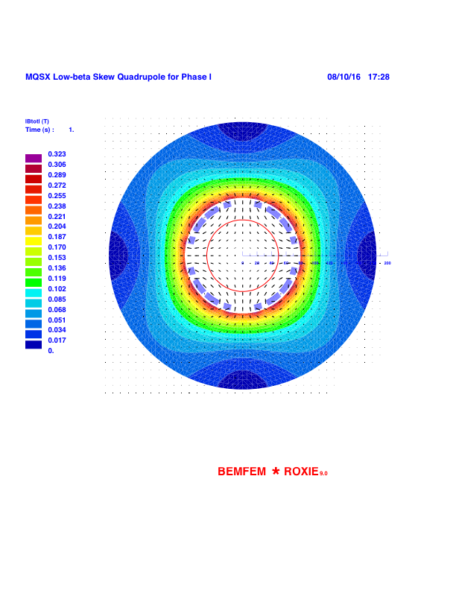
MQSX: Low current version
Field errors @ 40 mm | 10 % of I_{nom} | I_{nom}
a₆(units) | 0.007 | -11.9
a₁₀(units) | -0.002 | -0.210
a₁₄(units) | -0.076 | -0.050
Courtesy M. Karppinen

Slide 23
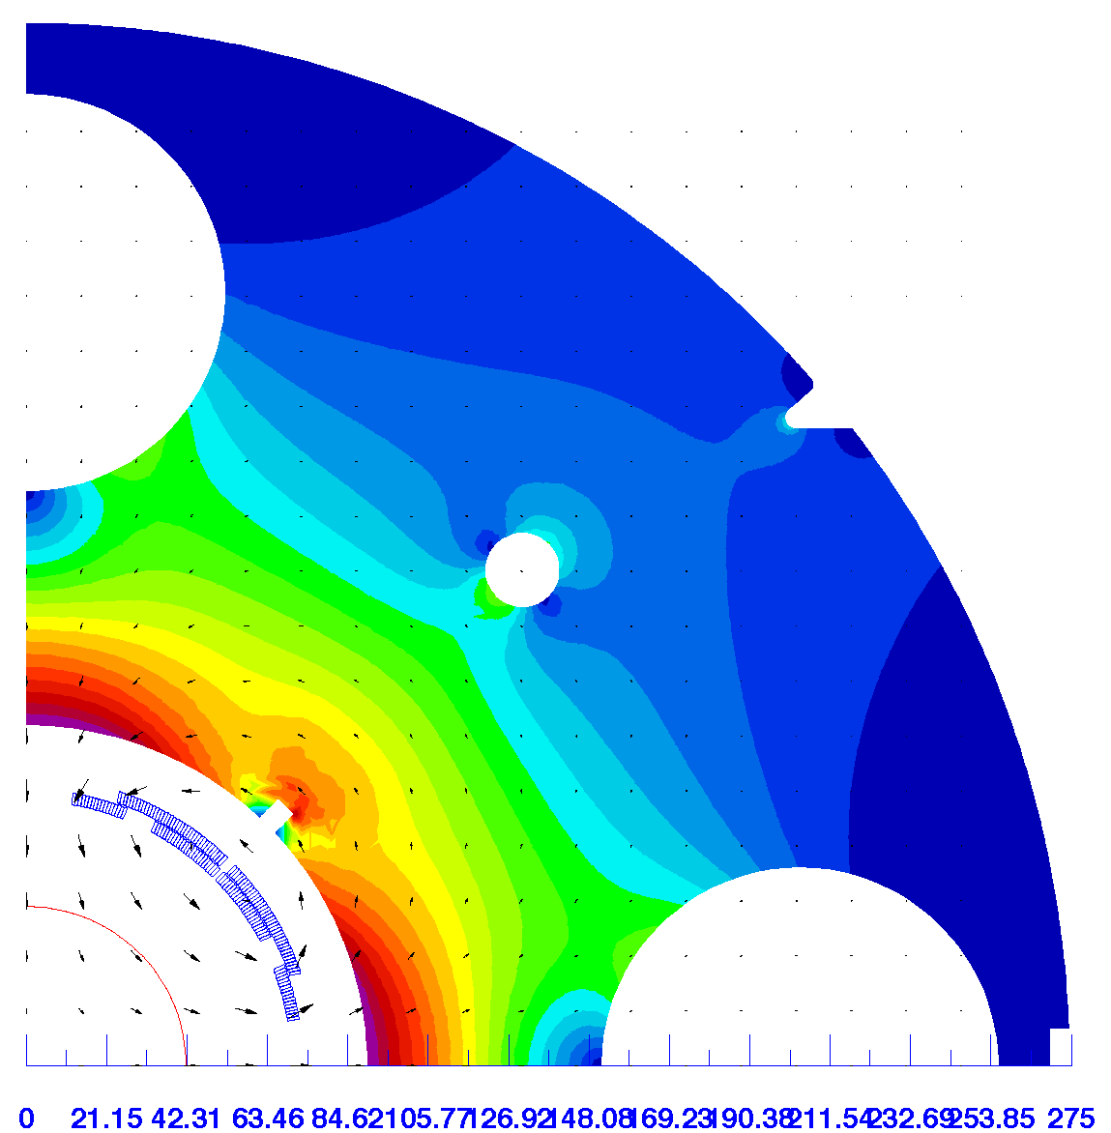
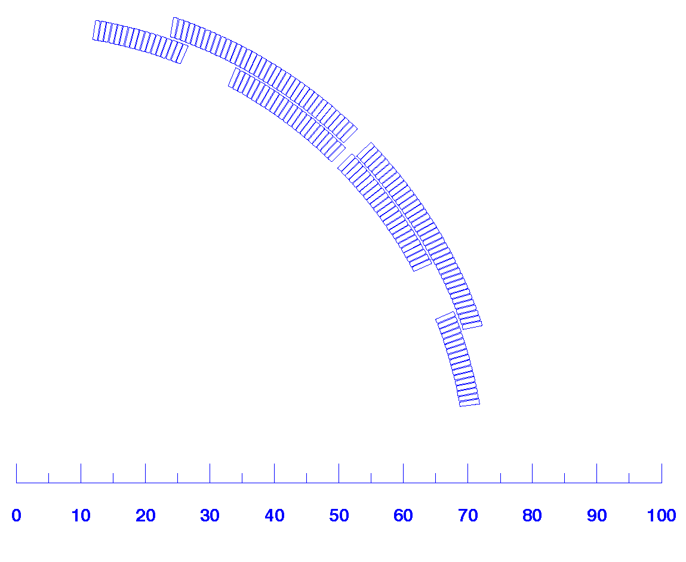
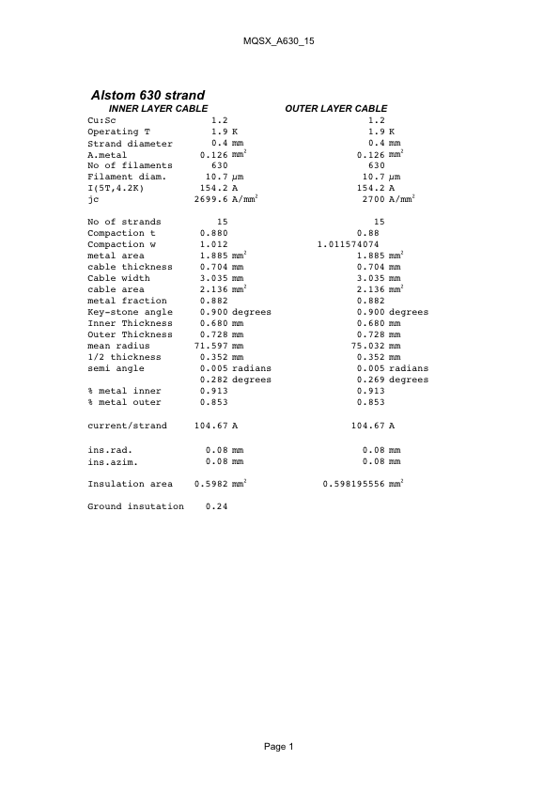
MQSX: High current version
Field errors @ 40 mm | 10 % of I_{nom} | I_{nom}
a₆(units) | 0.050 | -0.639
a₁₀(units) | 0.004 | -0.003
a₁₄(units) | -0.109 | -0.109
Courtesy M. Karppinen

Slide 24
Cryostat
CNRS CERN support

Slide 25
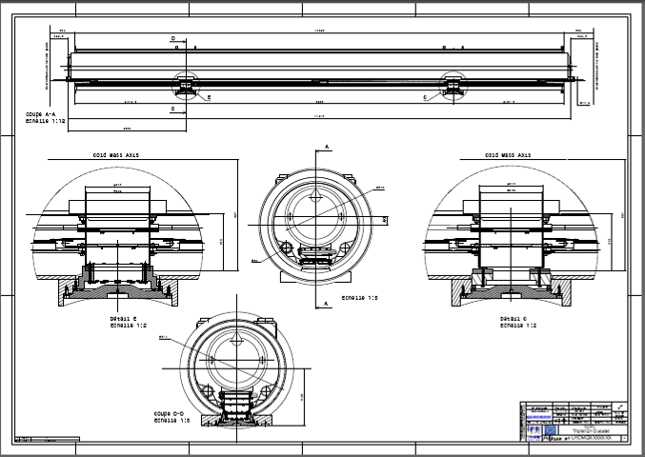
INNER TRIPLET QUADRUPOLE CRYOSTAT
First draft drawing from CNRS

