Slide 1
SPS intensity limitations
E. Shaposhnikova
LIU WG meeting
18 March 2016
With input from T. Argyropoulos, J. Esteban Muller, A. Lasheen, J. Repond

Slide 2
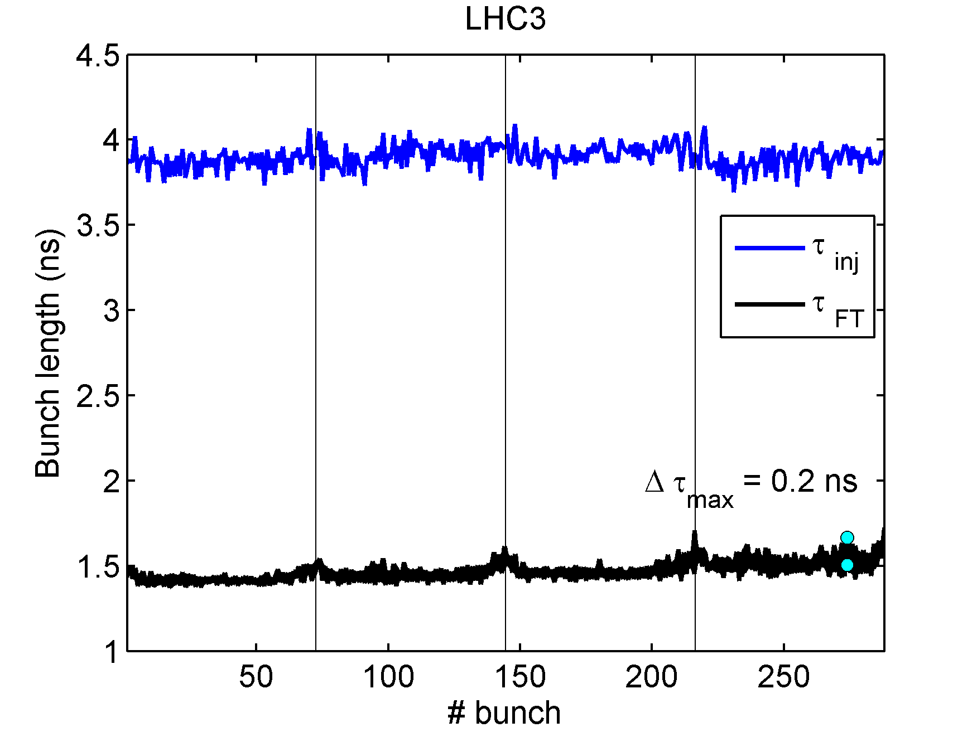
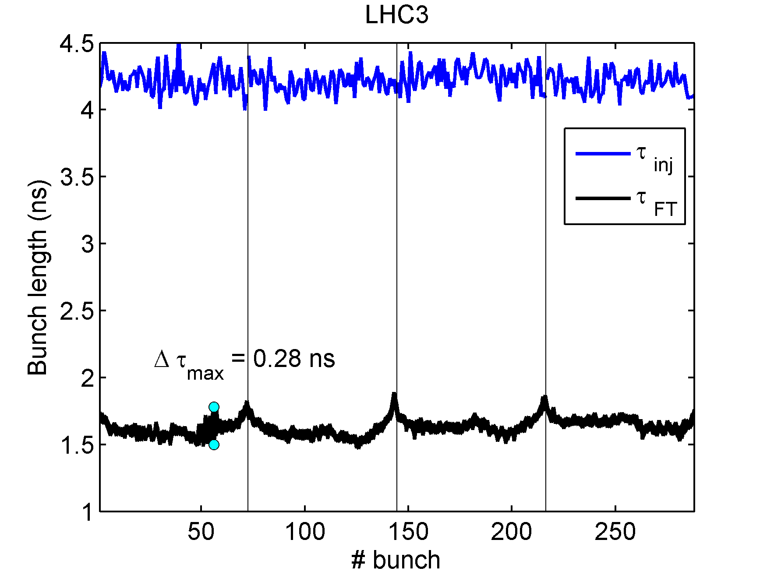
Bunch length on the flat top reference for the 25 ns beam in Q20
N_{p}~1.2x10¹¹ p/b
N_{p}~1.35x10¹¹ p/b
τ_{avg}=1.63 ns
τ_{avg}=1.47 ns
T. Argyropoulos et al.
Reference point: N_{p}~1.35x10¹¹ p/b (1.7 A), bunch length 1.7 ns

Slide 3
Voltage required for higher intensities
Voltage (V ~ ɛ²) to avoid
  loss of Landau damping (LD): N ~ ɛ^{5/2}/V^{1/4} and V~N
  microwave instability (MW): N ~ ɛ^{3/2} V^{1/4} and V~N
  experiment: τ~N (?)
Potential well distortion (PWD) due to induced voltage (~τ⁻³ for ImZ/n=3.5 Ohm and τ=1.7 ns
  parabolic bunch profile (μ=1)
  parabolic amplitude (μ=3/2)

Slide 4
The 200 MHz voltage after upgrade
After upgrade:
OK till 2.7 A (2.1x10¹¹)
10 MV for 3 A (2.3x10¹¹/bunch)
12.5 MV are required
(LD limit + PWD) => 1.8 ns

Slide 5
Summary for the 200 MHz upgrade scenarios
(flat top, 25 ns beam)
 | Maximum bunch intensity with
Scenario | no performance degradation | 10% longer bunches, more losses in LHC
4 cavities, 750 kW - now | 1.35x10¹¹ | 1.45x10¹¹
4 cavities, 1.05 MW pulsing, new LLRF | 1.5x10¹¹ | 1.7x10¹¹
4 cavities with 1.05 MW & 2 cavities with 1.6 MW, new LLRF | 2.1x10¹¹ | 2.5x10¹¹
Note: all estimations are done with simplified models and scaling from present experimental results

Slide 6
Present case: 24 and 72 bunches in single and double RF systems
24 b
Threshold decrease for 72 bunches in comparison with 24
Strong threshold increase in double RF
72 b
2 RF
reference point
measurements
24 b
1 RF
72 b
BLonD
simulations
A. Lasheen
J. Repond

Slide 7
Impedance reduction of HOM & VF:
72 bunches in a double RF system
HL-LHC
10 MV
Our present assumption
from scaling
7 MV
Our reference
BLonD simulations
A. Lasheen
J. Repond

Slide 8
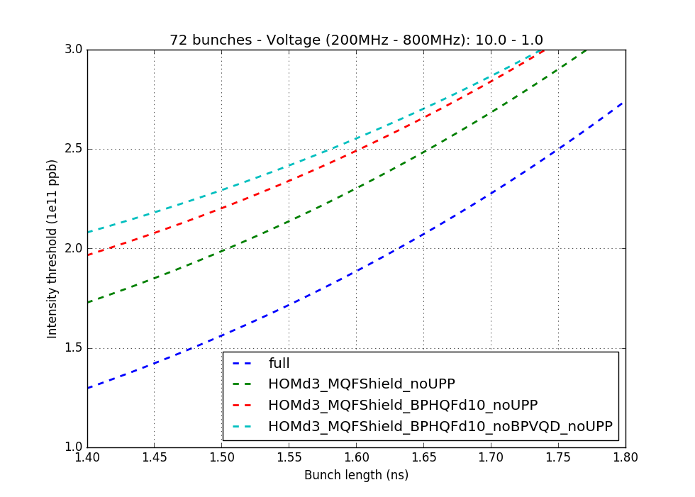
Impedance reduction of HOM & VF:
72 bunches in a double RF system
A. Lasheen
J. Repond

Slide 9
Impedance reduction of vacuum flanges:
72 bunches in a double RF system
24 b
2 RF
Threshold increase
is already sufficient,
but no margin
72 b
24 b
1 RF
72 b
A. Lasheen
J. Repond

Slide 10
Next steps for simulations
Further refinement of realistic impedance and its reduction (main RF impedance, HOMs, unshielded PP, correct Q,…)
Ramp simulation
Bunch-by-bunch intensity and length variation in the batch
Increased 800 MHz voltage (+FB): 10% => 20%
Bunch rotation (optimal minimum voltage)
…

Slide 11
200 MHz power requirements during ramp with emittance blow-up

Slide 12
200 MHz power requirements during ramp without emittance blow-up

Slide 13
Info source | Bunch spacing [ns] | N/ bunch pp | long. emit. eVs | bunch length [ns] | V 200 MHz [MV] | V 800 MHz [MV]
Meas. | 25 ns | 1.2x10¹¹ | 0.39* | 1.47 | 7.0 | 0.64
Meas. | 25 ns | 1.35x10¹¹ | 0.47* | 1.63 | 7.0 | 0.64
Assum. | 25 ns | 2.1x10¹¹ | 0.6 | 1.65 | 11.0** | 1.1
*emittance calculated for measured bunch length and requested RF voltage without PWD
**max value defined by beam loading for given beam current (after full RF upgrade)
***no performance deteration
****emittance defined by LLD

Slide 14
Summary
We should be able to obtain HL-LHC parameters after impedance reduction
Additionally we have bunch rotation on flat top
5% longer bunches already give good extra margin!
Further intensity increase will be limited by beam loading

Slide 15
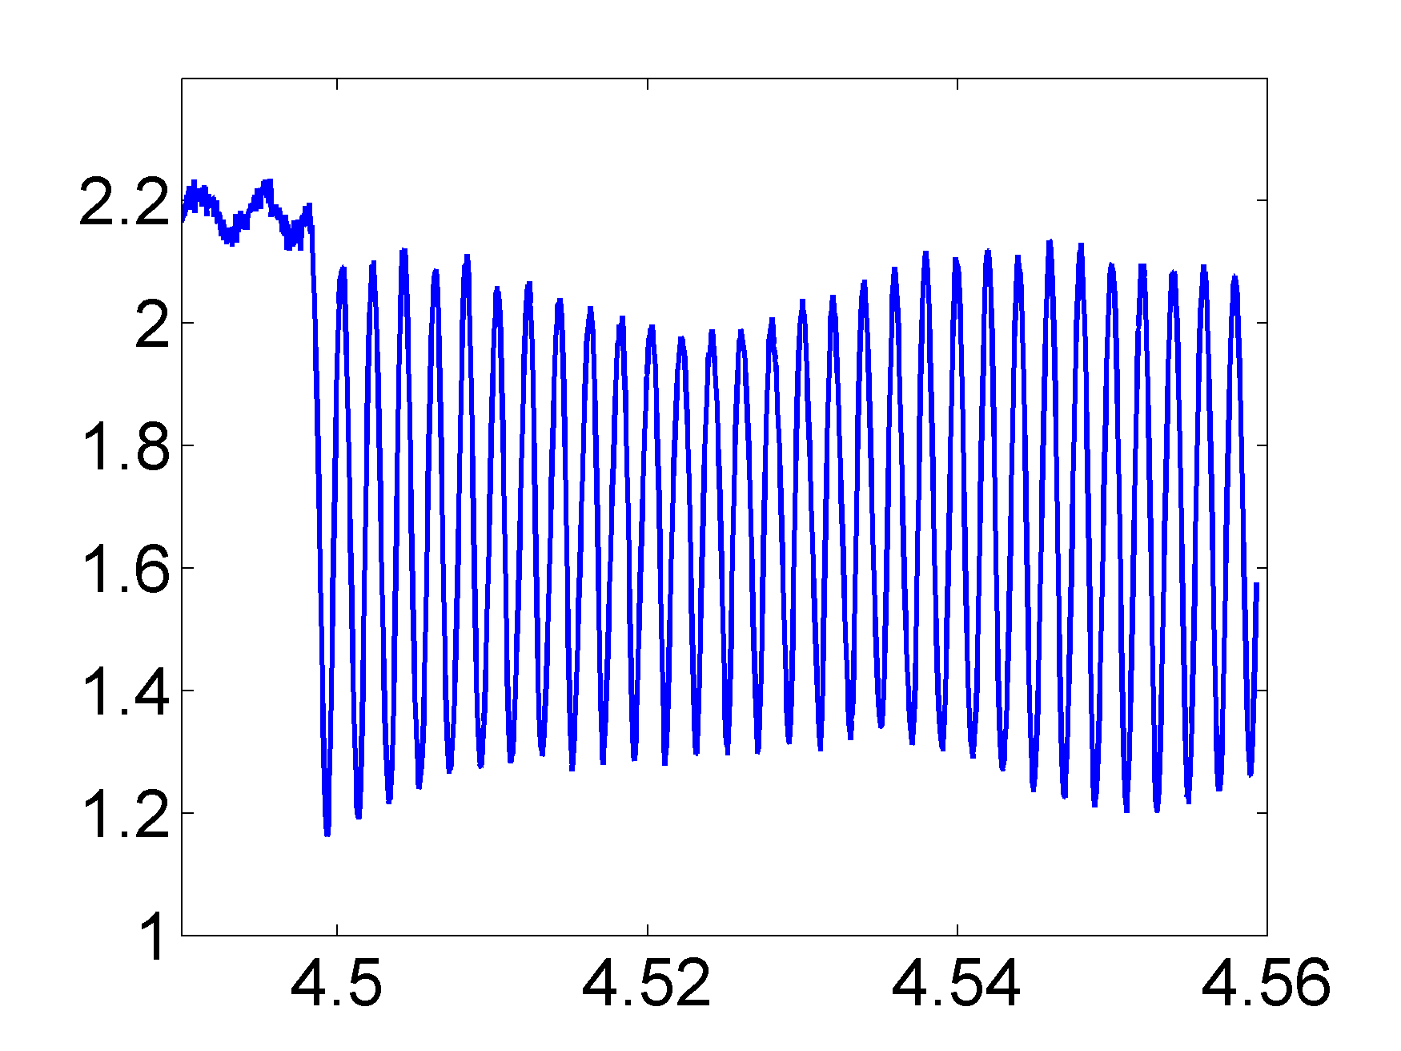
Bunch rotation at flat top (1/3)
Already tried successfully for single high intensity (~2.5 - 3.0 x10¹¹) bunches (MD for AWAKE), but for very small emittance (ε_{l}~0.3 eVs)
Single bunch in MD for AWAKE in 2012
N = 2.8x10¹¹
Bunch length (ns)

Slide 16
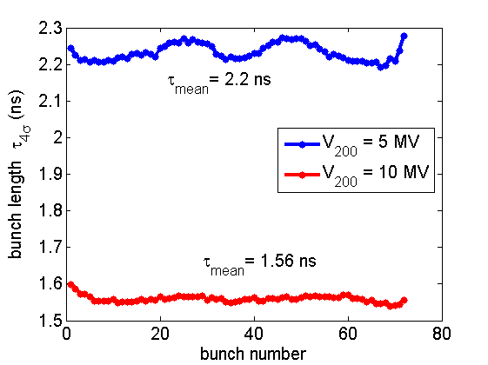
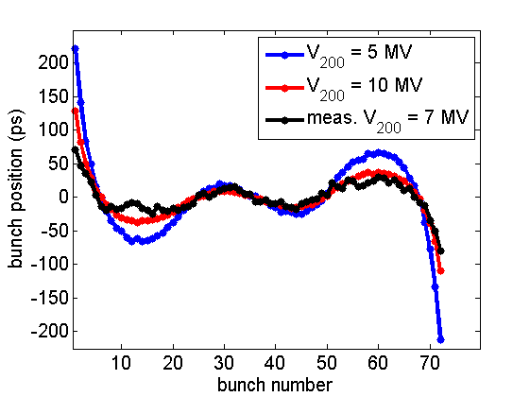
Bunch rotation at flat top (2/3)
Starting rotation from V₂₀₀ = 5 MV and assuming V₂₀₀ = 10 MV available at flat top (2.3x10¹¹ p/b and Q20 optics)
Simulations with the SPS impedance + FF & FB on the 200 MHz RF bunch position variation along the batch agrees with measurements
(T. Argyropoulos)
Bunch position variation along the batch
Measurements with half intensity
N = 1.3x10¹¹ p/b
Bunch rotation for LHC beam was tested in the SPS => limited by instabilities

Slide 17
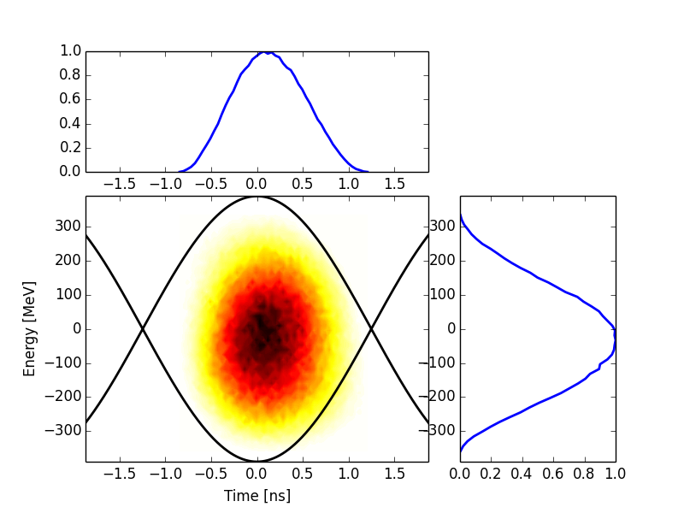
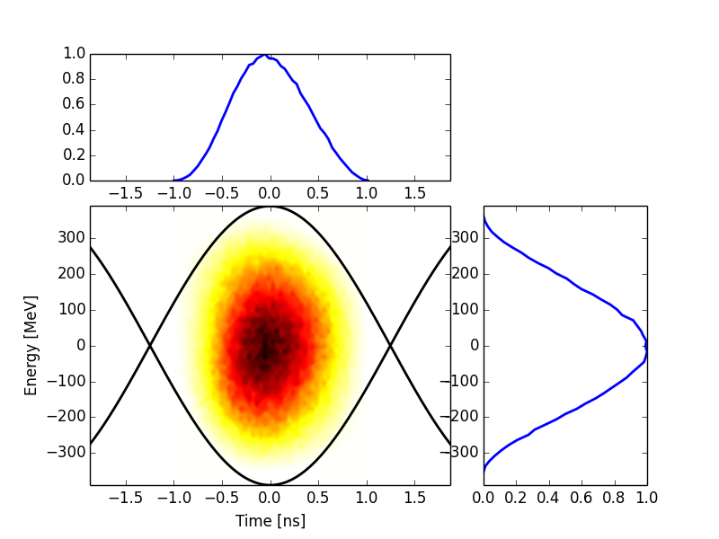
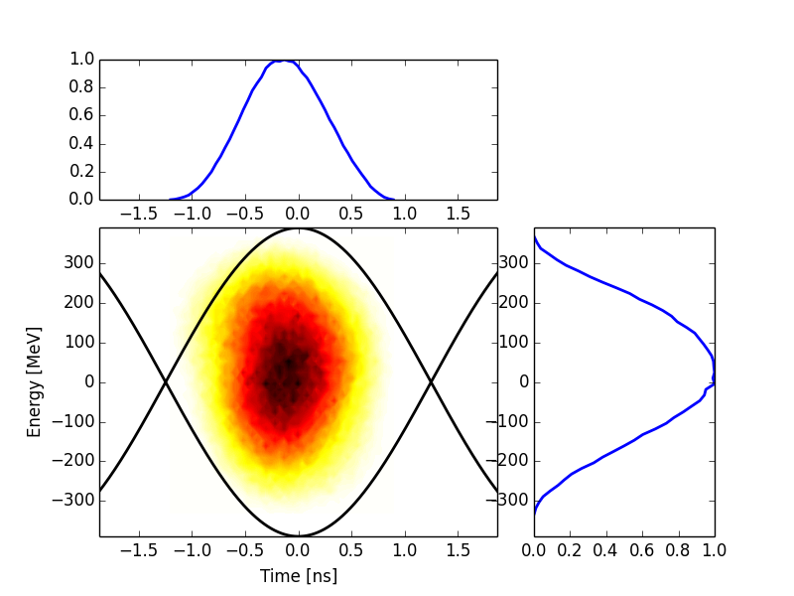
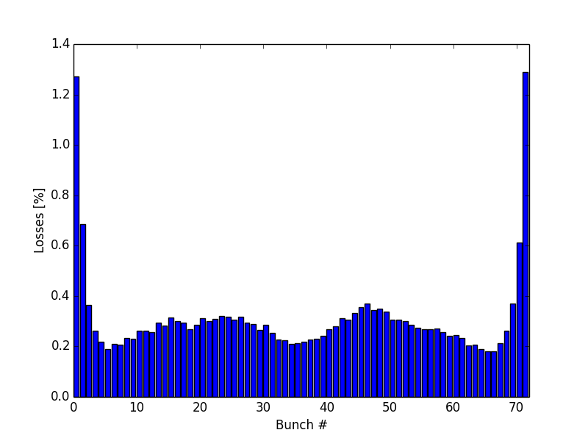
Bunch rotation at flat top (3/3)
LHC capture with 6 MV: simulated bunch position variation in the LHC Buckets (J. E. Muller)
Particle losses less than 1.5 %
per bunch (follow the beam
loading effect of the SPS
200 MHz RF) →
pessimistic estimations
Average bunch length 1.45 ns
Bunch 1
Bunch 72
Bunch 36
J. Esteban Muller

