Slide 1
PSB-PS transfer
W. Bartmann, J. Borburgh, H. Damerau, L. Ducimetiere, A. Ferrero, M. Fraser, S. Gilardoni, B. Goddard, J. Jentzsch, T. Kramer, L. Sermeus, G. Sterbini
LIU Beam Parameter Meeting, 18th March 2016

Slide 2
Outline
Kicker specifications
Rise time measurements/improvements on the HW
  BT.KFA10
  BT.KFA20
  KFA.45
Measurements with beam
Planned MDs

Slide 3
Kicker specifications
https://edms.cern.ch/document/1488286/3
Key parameters
  25 ns HL LHC beam with 211 ns (201 ns bunch length, 10 ns jitter)
  Bunch spacing of 316 ns for h=7
  Required rise time for recomb. and inj. Kickers at 2 GeV: 105 ns (2-98%)
  Flattop ripple: ±2%

Slide 4
Recombination kickers
Presentation by Luc Sermeus in LIU-PSB meeting, 19th Jan. 2016

Slide 5
BT.KFAs kicker rise time measurements
(December 2015)
L. Sermeus TE/ABT/FPS
LIU-PSB meeting, 19th January 2016

Slide 6
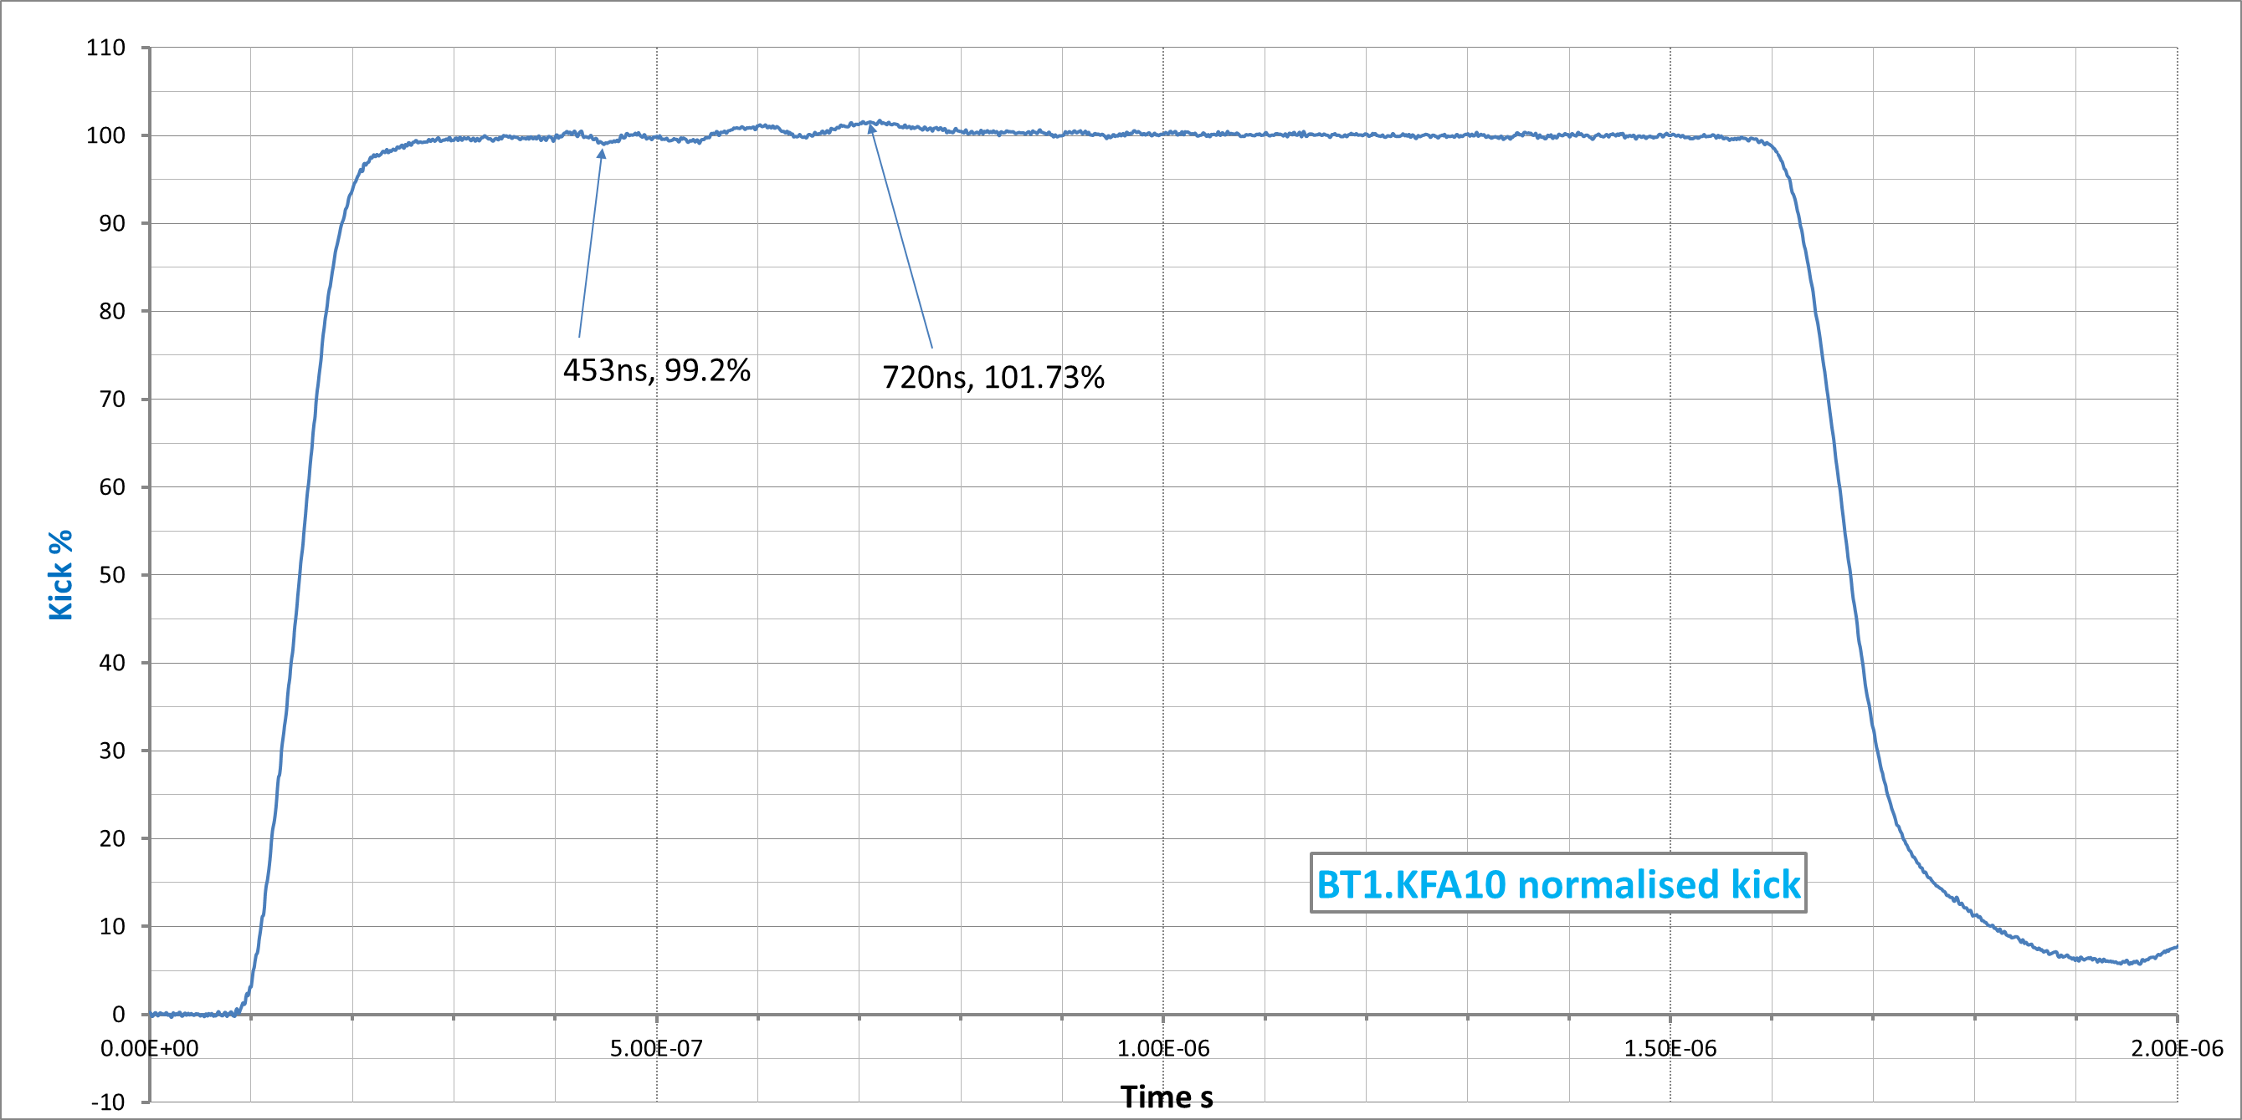
BT1.KFA10 kick (measured waveform at 50 kV)
Kick rise time: |  |  | (5-95)% | 102ns
 |  |  | (2-98)% | 134ns
 |  |  | (1-99)% | 164ns
Scope: 200MHz BW, 13 bits vertical resolution

Slide 7
BT1.KFA10 kick (Pspice calculated waveform)
From revised PSPICE model
Calculated
8C11 (green)
116ns
109ns
95ns
Calculated
4L1( orange)
133 122
103
Measured (red)
164
134
102
LIU (2GeV)
105ns
LIU (1.4GeV)
104ns
Rise (1-99)%
Rise (2-98)%
Rise (5-95)%
The actual ferrite grade is assumed to be 4L1. (must be replaced by 8C11)
Cable impedances are not exactly 25Ω. (variations from 24.8 to 25.5 for PFLs and Transmissions explain reflections)

Slide 8
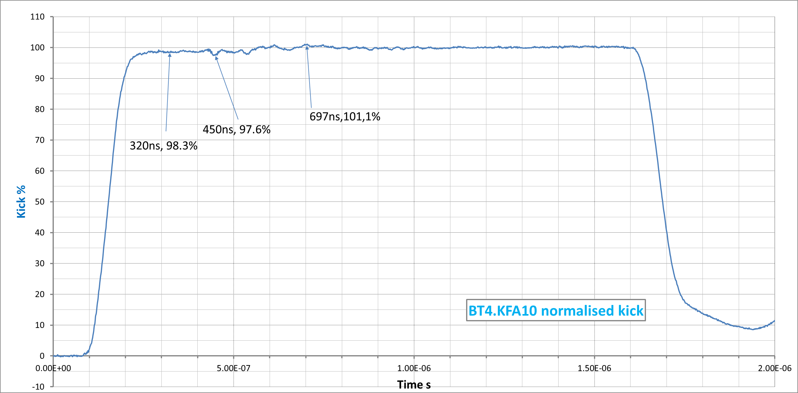
BT4.KFA10 kick (measured waveform at 50 kV)
Kick rise time: |  |  | (5-95)% | 116ns
 |  |  | (2-98)% | 138ns
 |  |  | (1-99)% | 186ns
Scope: 200MHz BW, 13 bits vertical resolution

Slide 9
BT4.KFA10 kick (Pspice calculated waveform)
Kick sum of 2 magnets (From revised PSPICE model)
Calculated
8C11 (green)
110ns
104ns
92ns
Calculated
4L1( orange)
113 107
96
Measured (red)
186
138
116
LIU (2GeV)
105ns
LIU (1.4GeV)
104ns
Rise (1-99)%
Rise (2-98)%
Rise (5-95)%
The actual ferrite grade is assumed to be 4L1. (must be replaced by 8C11)
Cable impedances are not exactly 25Ω. (variations from 24.8 to 25.5 for PFLs and Transmissions explain reflections)

Slide 10
BT1.KFA10 present system layout
One generator supplying two magnets in parallel.
Magnets equipped with their original glued ferrite blocks of assumed 4L1 type.

Slide 11
BT.KFA10 improvements for LIU
New vacuum tank with magnets equipped with “good” 8C11 or CMD5005 ferrite. (ready end 2017)
Tests in the laboratory on KFA20 spare (already equipped with CMD5005) in the same configuration as KFA10 to refine the Pspice equivalent circuit and simulate improvements to reach the specification.
Implementation in the lab to validate the model.(in 2016)
If proven to be efficient, rearrange present Tx-PFL pairs to reduce mismatches during the EYETS.
As a last resort, cut new transmission cables from the PFLs which are longer than necessary (or install new transmissions if we manage to obtain them) for a better matching.
If rise time can ultimately not be met, split magnets in two and build two new generators to supply them. (assuming we can buy SF6 cables)
This option is not presently funded nor staffed.

Slide 12
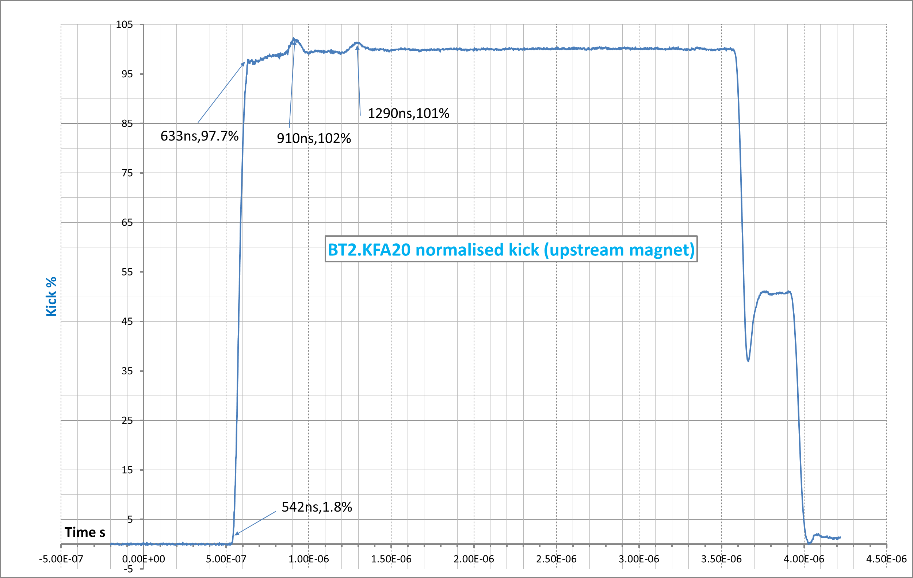
BT2.KFA20 kick (measured waveform at 27 kV)
Kick rise time: |  |  | (5-95)% | 78ns
 |  |  | (2-98)% | 94ns (LIU 104ns)
 |  |  | (1-99)% | 270ns
Scope: 200MHz BW, 13 bits vertical resolution

Slide 13
BT2.KFA20 present system layout
One generator supplying two magnets in parallel.
Magnets equipped with CMD5005 ferrite blocks.
Magnets are charged with the PFLs.

Slide 14
BT2.KFA20 kick (Pspice calculated waveform)
From revised PSPICE model
Calculated
8C11 (green)
91ns
83ns
70ns
Measured (red)
270
94
78
LIU (2GeV)
105ns
LIU (1.4GeV)
104ns
Rise (1-99)%
Rise (2-98)%
Rise (5-95)%
The present kick waveform complies with LIU specification without margin.
The overshoot is not present in the measured waveforms.
Cable impedances are not exactly 25Ω. (variations from 24.8 to 25.5 for PFLs and Transmissions explain the reflection bumps)

Slide 15
BT2.KFA20 improvements for LIU
Improve matching of cables to reduce the amplitude of the two bumps.
Improve filters (mainly on the main switch) to reach 100% earlier.
Reduce kick strength by a few % to reduce the magnet breakdown risk.
(studied by W. Bartmann)
If the new KFA10 is within specification, the KFA20 could then be reconfigured the same way to avoid magnet breakdowns.
No LIU work unit exists for this.

Slide 16
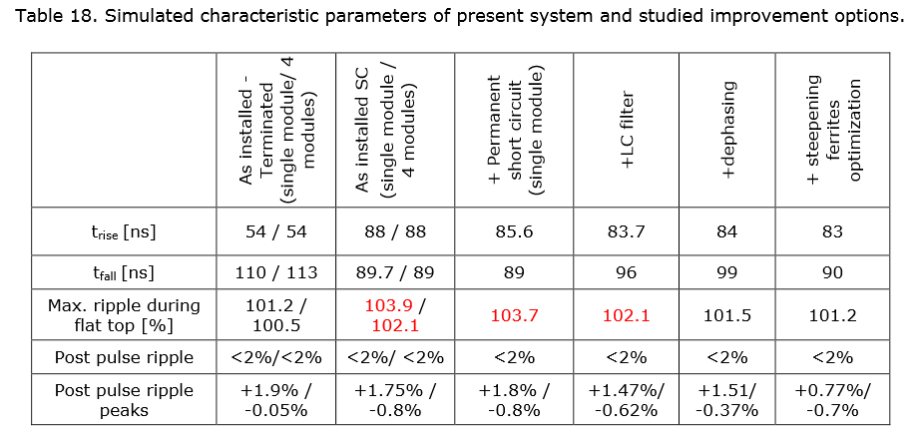
PS injection kicker KFA45
Analysis of the PS-Injection Kicker Performance, Improvements for and Impact on Operation with LIU beams
https://edms.cern.ch/document/1553576/0.4

Slide 17
KFA45
Dephasing measured during last TS – working OK
LC filter measured in 3 different configurations and working better than expected from simulations
Other improvements for EYETS
Field measurements important to reduce error bar and benchmark model
Feasibility of this measurement during the EYETS to be assessed

Slide 18
Measurements with beam

Slide 19
KFA45 MD
Aim is to measure emittance growth from KFA45 kicks
- Use LHC cycle over two BP with 2nd batch injeciton kick firing on 26 GeV flattop; one bunch injected, triple splitting, 3 bunches measured on flattop
- measured profiles before and after kick for different kick strength
- measured also in vertical plane which acts via coupling as telescope
- measured between 50 and 200 kV (nominal is around 300 kV at 1.4 GeV), the min of the PFN of 30 kV could not be reached due to Hiradmat taking beam
- profiles quite symmetric; for kicks above 100 kV tails get strongly populated and gaussian fits don't make sense anymore
- Preliminary result: see a correct qualitative behaviour of emittance blow up vs kick strength, to be analysed in detail

Slide 20
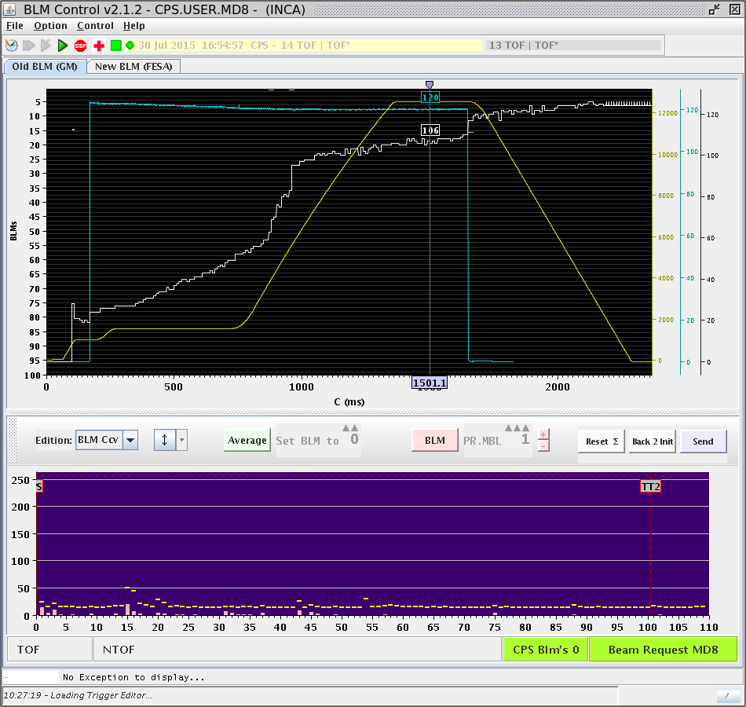
MD cycle

Slide 21
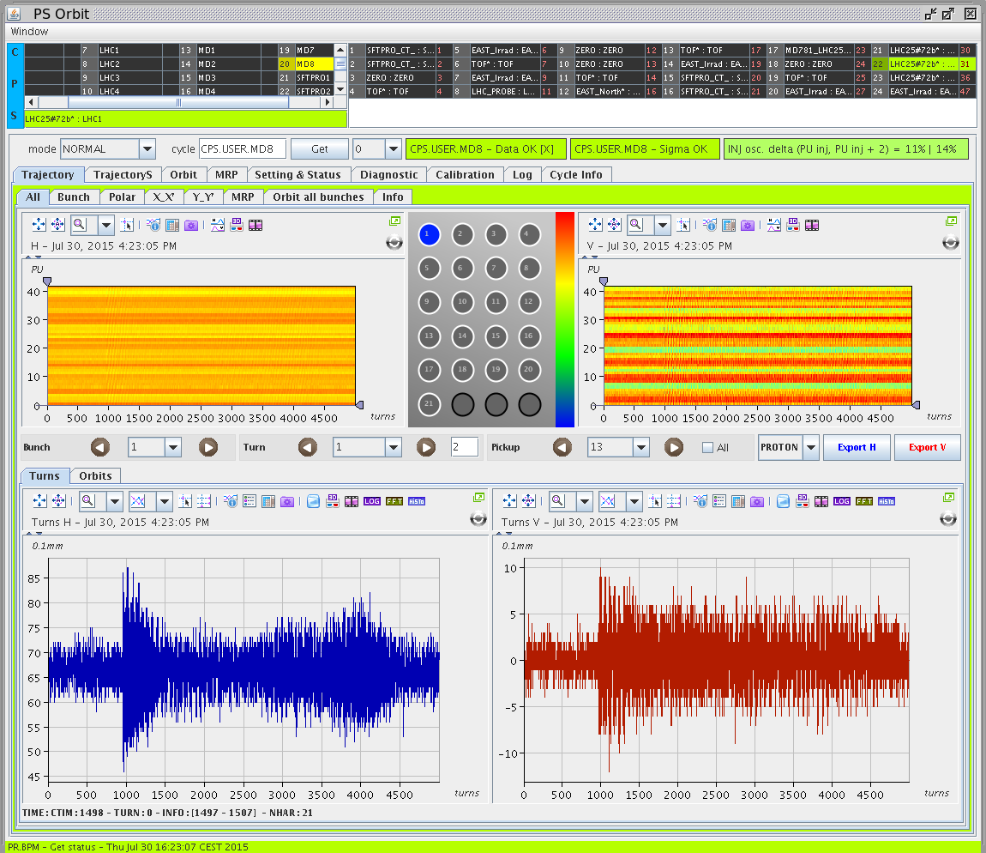
Coupling

Slide 22
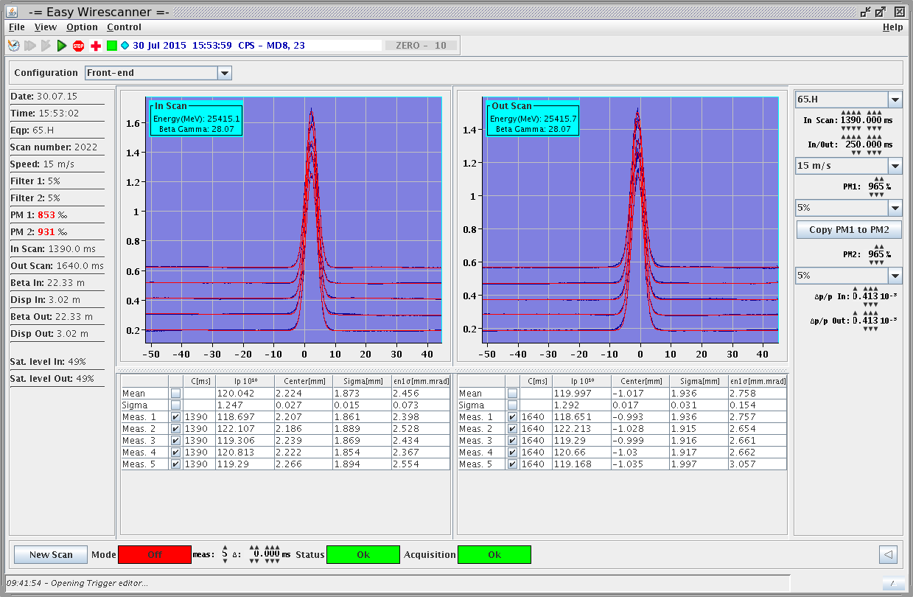
Wire scans before and after kick for 70 kV

Slide 23
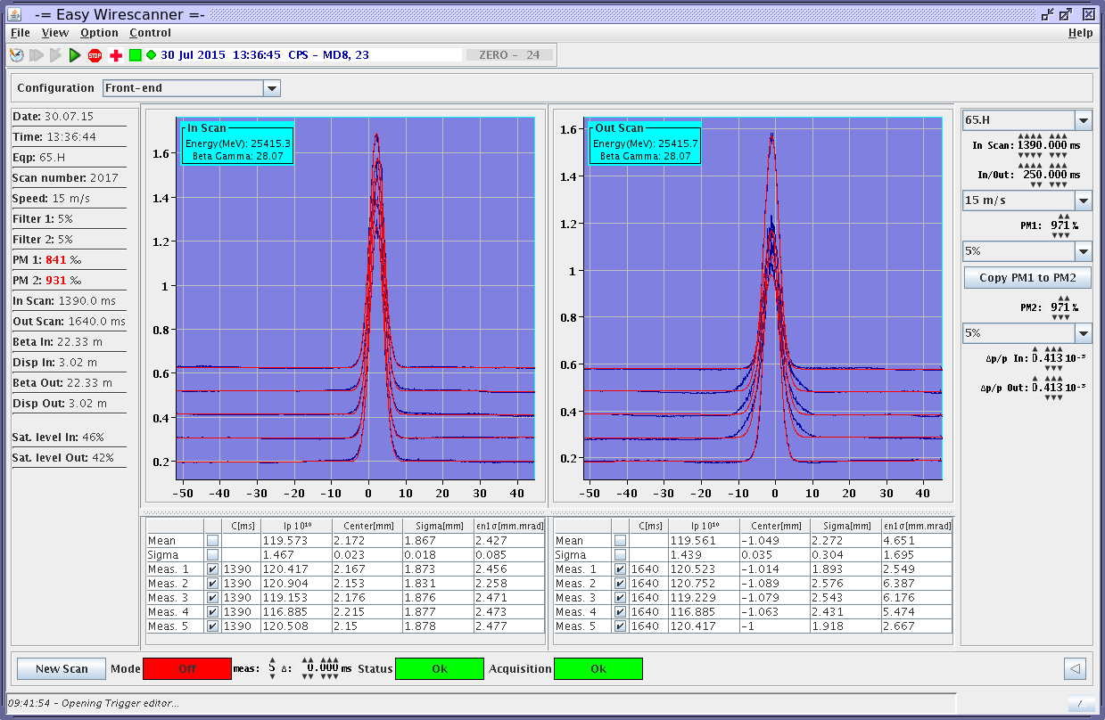
WS for 250 kV, tails getting strongly populated

Slide 24
Measured emittance vs. theoretical

Slide 25
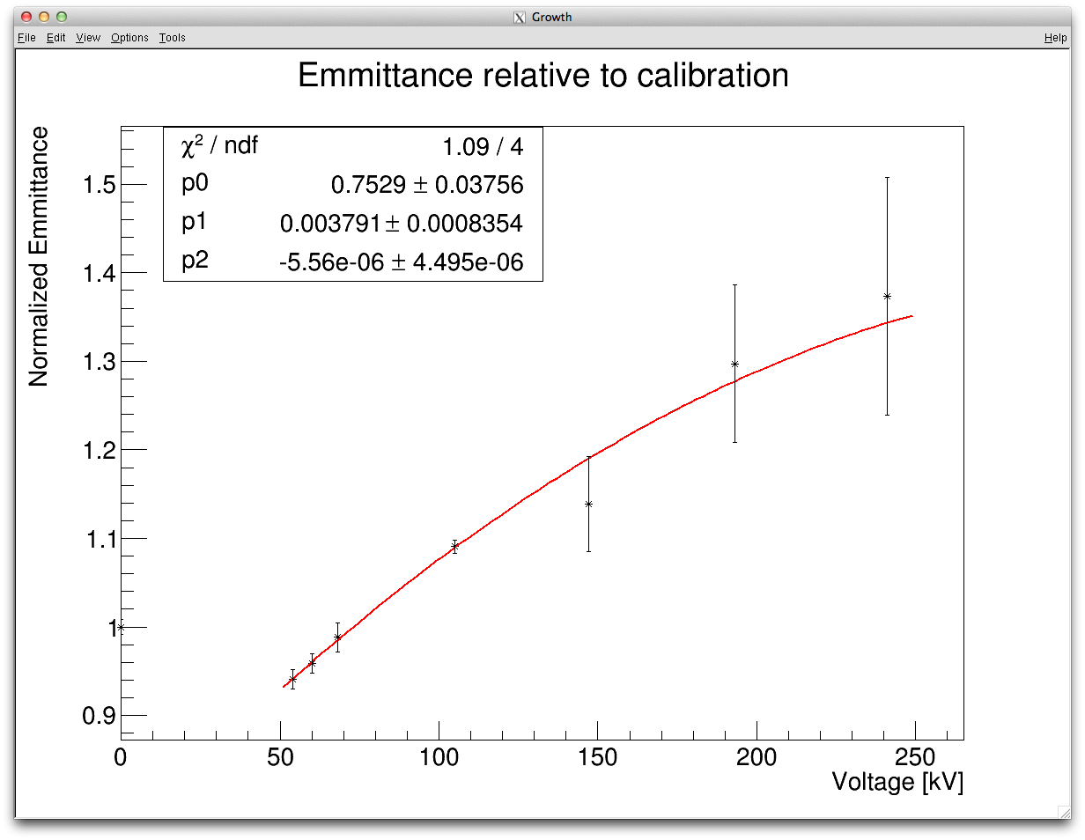
Jennifer fitting the data sets separately

Slide 26
Conclusions from beam measurements
Small emittance beams are difficult to measure in the PS
Improved MD setup (kicking at PS flattop, higher intensity, standard cycle) bring qualitatively correct emittance growth behaviour
Above 100 kV kick strength (80 urad) the tails get strongly populated and the Gaussian fit from the application does not make sense anymore, also the spread between measurements of one setting becomes significantly bigger
Below 100 keV there is a difference of ~40% between measured and theoretical data, the theoretical curve being more conservative, i.e. showing a higher growth for a given kick

Slide 27
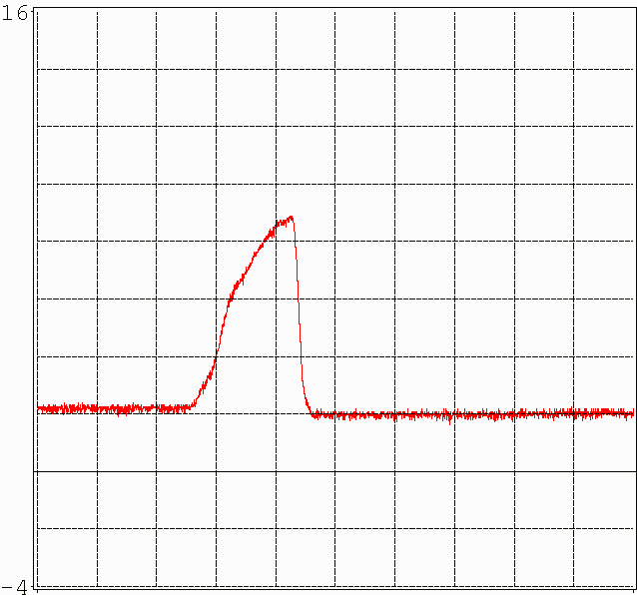
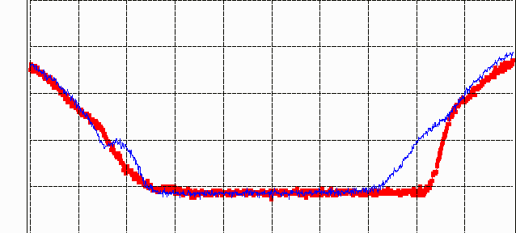
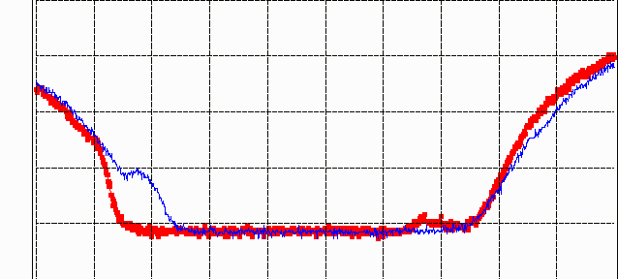
Wire scanner measurements
H. Damerau, S. Gilardoni, G. Sterbini
Approach long bunches from PSB and injected into h = 9 in PS
Bunch length at transfer ~170 ns (ε_{l} = 1.4 eVs) into buckets spaced 255 ns
Vertical emittance check:
  Even cut in half (!) by KFA10 ε_{V} grows by only ~10 % (?)
Not the right measure to quantify effect of bunch badly kicked (badly kicked beam lost?)
R3
50 ns/div
20 ns/div
20 ns/div
Cut by KFA10
R3
R4
R3
R4
Pure longitudinal measurements what suggest 85 ns minimum gap
Are bunches already badly kicked transversely before?

Slide 28
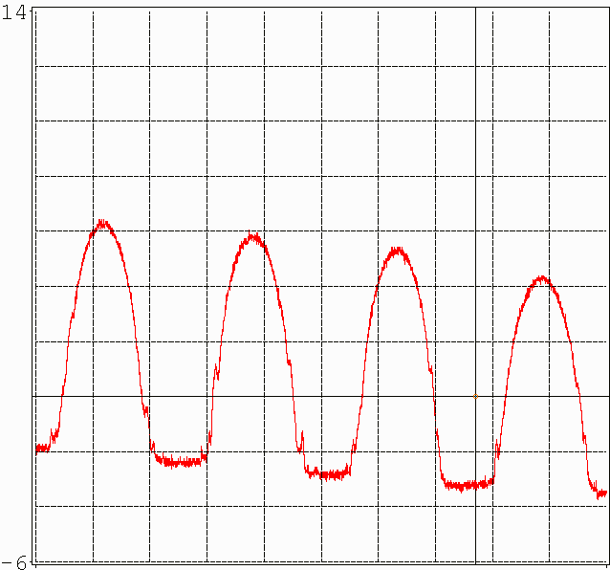
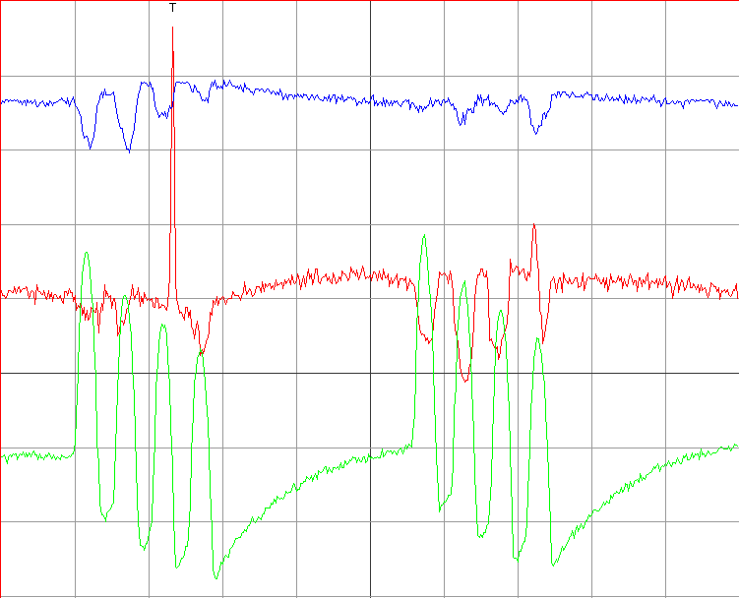
Badly kicked tails
H. Damerau, S. Gilardoni, G. Sterbini
Better observable: transverse wide-band pick-up, PU94
Thought the transfer seems fine longitudinally, but tails badly touched
First turn, WCM03
First two turns, WPU94
hor.
badly kicked
vert.
R3
R4
R2
R1
sum
100 ns/div
500 ns/div
First checks for KFA10 and 20, but no systematic measurements
Gap between bunches should be about 100 ns for clean transfer

Slide 29
MD Suggestion | Machine or Transfer Line Concerned | ABT Systems | Beam Spec. | Comment
Short bunches created with KFA.14 de-synchronisation for recombination kicker risetime measurements | PSB - BT | BT.KFA.10 BT.KFA.20 | 1.4 GeV single bunch, pilot | Can we shorten a bunch at PSB extraction by desynchronising the KFA.14 and sweeping over the septum. Objective is to allow only back of the bunch to escape septum and into BT giving a short bunch for KFA.10 and 20 rise-time measurements: limited by BTV intensity.
Short bunches from longitudinal shaving in PSB for recombination kicker risetime measurements | PSB - BT | BT.KFA.10 BT.KFA.20 | 1.4 GeV single bunch | Can we produce short enough bunches to resolve rise time directly? Are 10 ns bunches possible? No need for lots of intensity here, intensity limitation given by beam diagnostics, just short as possible.
PSB direct injection- extraction for PS-PSB recombination kicker risetime measurements | PSB – BT - BTM | BE.KFA.14 BT.KFA.10 BT.KFA.20 | 50 MeV linac pulse | A bit optimisitic this one but… Can we measure rise-time of recombination kickers using microbunches from the linac at 200 MHz? Depends if 200 MHz bunches are debunched after long journey LTB-BI-BR(one turn)-BT-BTP… to be checked. Can we use the wideband PU in BTP line to measure transverse kicks of microbunches as a function of time? Already foreseen to do inj-ext after LS2 at 160 MeV with charge-exchange injection to dump externally… might be good to see what issues we encounter at low energy in BT.

Slide 30
MD Suggestion | Machine or Transfer Line Concerned | ABT Systems | Beam Spec. | Comment
Transverse tomography for PS-PSB recombination kicker risetime measurements | BT - BTM | BT.KFA.10 BT.KFA.20 | 1.4 GeV single ring shots | Kickers will impart time dependent head-tail kick on “normal” bunch, which might be resolvable using grids in BTM. Suggestion here to use simple tomography to reconstruct KFA waveform. Could also commission new BTM optics.
PS KFA.45 injection waveform measurement | PS | KFA45 | 1.4 GeV, single bunch | Try and measure directly the waveform with short bunches… depends on what intenstiy we can extract and how we create the short bunches.
BTY optics model validation | BTY | BTY | Single bunch pilot | Check optics and validate optics model of BTY line with kick response measurements
Recombination kicker MD to get rid of dispersion contribution

Slide 31
Summary
Kicker rise time measurements on the HW for all three systems
  KFA10 and 20 were measured in field, KFA45 in current
  KFA10 not within spec, 138 ns vs 105 specified; steepening ferrites, cables, tests in the lab to gain confidence in the model;
  KFA20 within spec, several improvements foreseen, 2 GeV voltage too close to the breakdown, reduction of voltage and consequences being studied; if KFA10 modifications successful can configure KFA20 as KFA10 to reduce voltage;
  KFA45 with permanent short-circuit looks promising, parts of the planned upgrades already tested; further tests during the EYETS; field measurement would be good but very difficult
Kicker rise time measurements with beam
  Get only qualitative behaviour, much less accurate than HW measurements
Beam tests in the future
  Requested a list of MDs (short bunches, vertical plane without dispersion, grids instead of WS…) to understand better kicker impact on the beam

