Slide 1





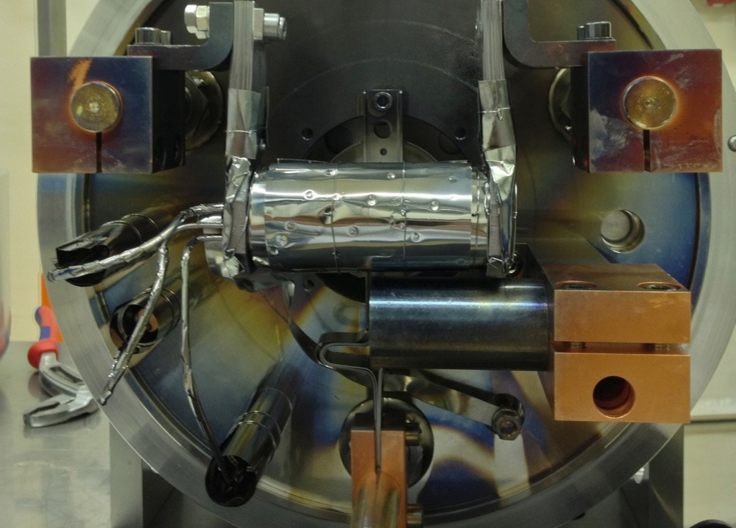
The nanoUC_{x} and the new ISOLDE n-converter: status and future developments
João Pedro RAMOS (CERN)
EN-STI-RBS
P. Bricault, A. Gottberg, W. Hwang, R. Luis, T.M. Mendonca, L. Popescu, T. Stora and others

Slide 2
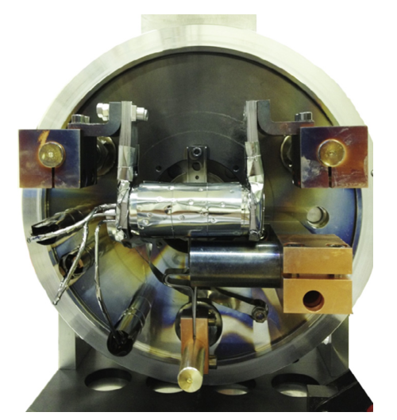
Outline
  New n-converter
Motivation
Design and simulations
Concept prototype
Future: design of the optimized n-converter
nanoUCx
Motivation
Material development
Prototype testing
Future: production upscaling
    Release fundamentals
(The new UO2 batch)

Slide 3
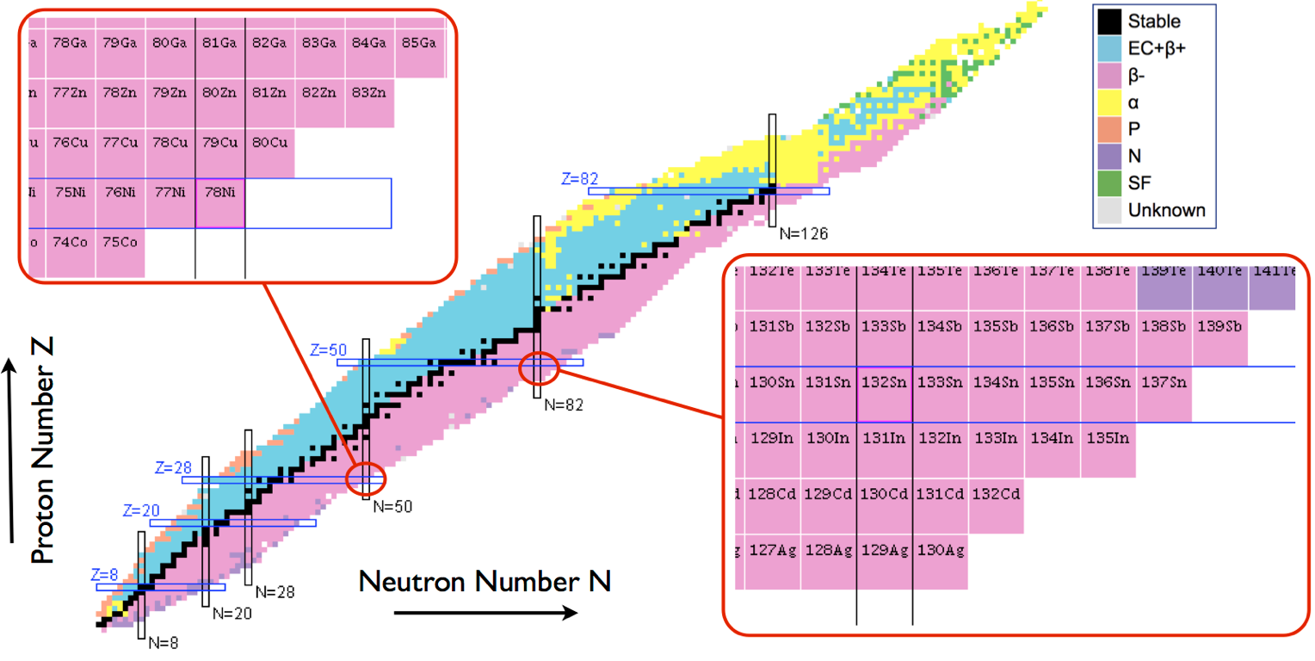
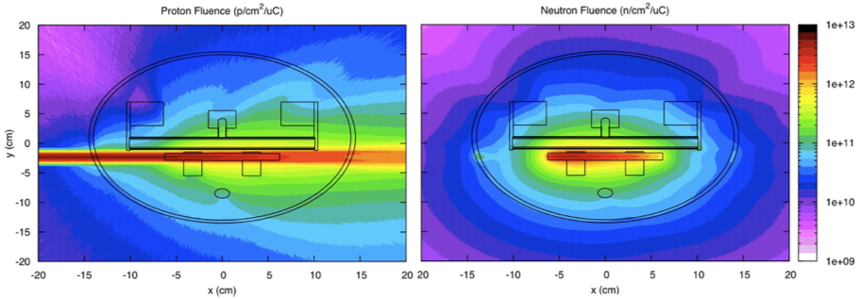
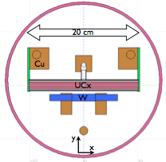
Motivation
Neutron-rich fission fragments are very important for physics research
  However they come with huge neutron deficient isobaric contaminations
Use neutron converter
  Suppression of isobaric contaminants (n-rich)
Geometry could be further optimized
  Important for all ISOL facilities
p beam
Pictures courtesy of Raul Luís

Slide 4
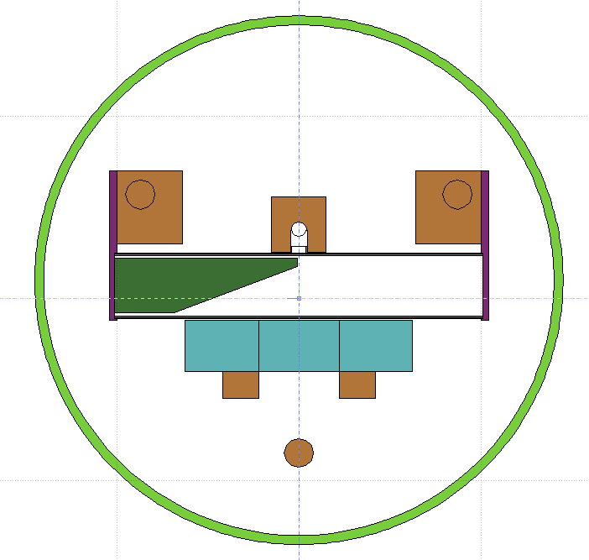
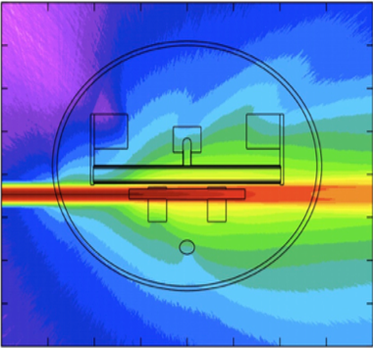

Design and optimizations
Shorter UCx target
to remove the region with
higher proton fluences
old length = 20 cm
new length = 10 cm
Diagonal cut in the
UCx Target
to avoid the highest proton fluences
Thicker UCx target
to increase the ²³⁸U mass
old radius = 0.7 cm
new radius = 1.5 cm
Thicker spallation target
to better “contain” the proton fluences
old radius = 0.6 cm
new radius = 1.4 cm
Slide courtesy of Raul Luís

Slide 5
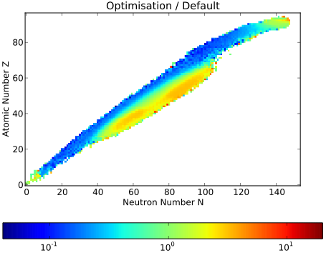
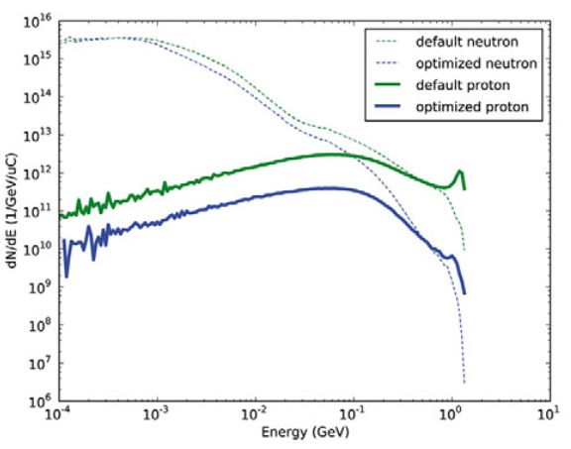
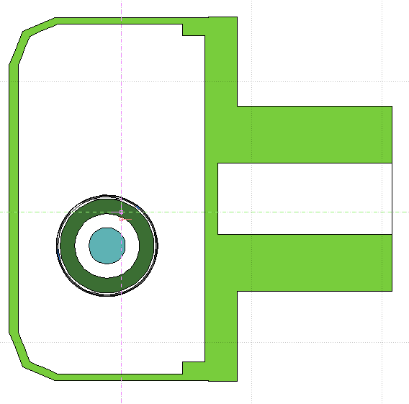
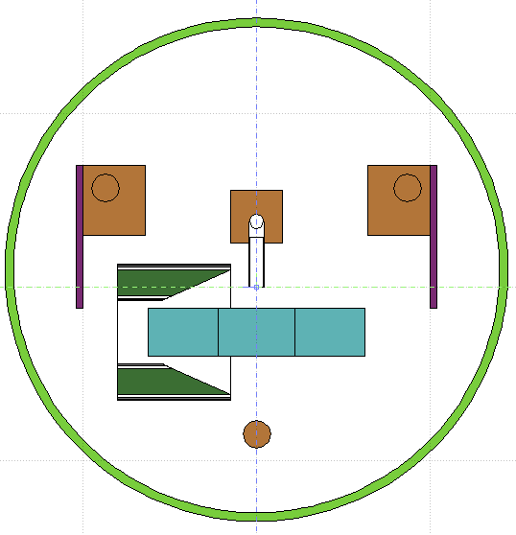
Design and optimizations
yield reductions in neutron-deficient isotopes
yield gains in neutron-rich isotopes
2nd optimized design
UCx target concentric to the converter:
Improve interaction probability with neutrons
Make target thinner (better for release efficiency)
Pictures courtesy of Raul Luís

Slide 6
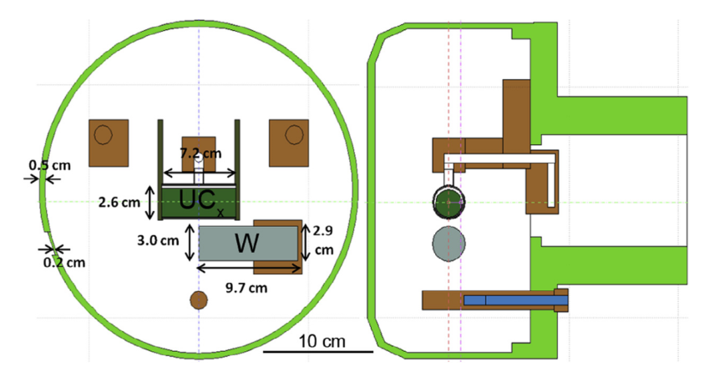
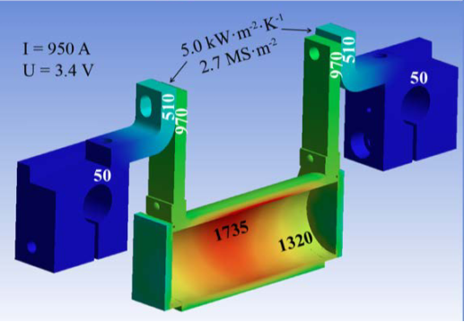
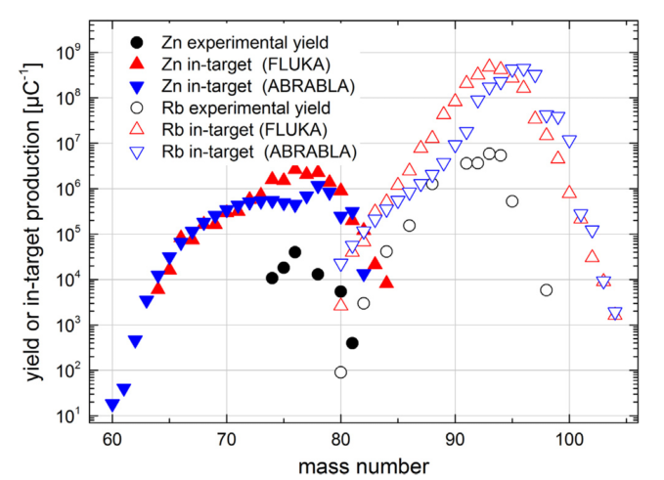
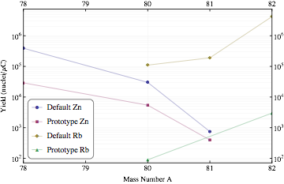
Concept prototype testing at ISOLDE
Simplified version of the optimized of the n-converter:
Case of 80Zn/80Rb ratio – 220
Simulations predicted ~ 20
Power supply limit 1000A
Limited target operation temperature to 1750ºC
  Standard operation 1950-2100ºC
Conventional
New
Zn
Rb
A. Gottberg, T.M. Mendonca, R. Luis, J.P. Ramos, C. Seiffert, S. Cimmino, et al.,NIMB 336 (2014) 143–148.

Slide 7
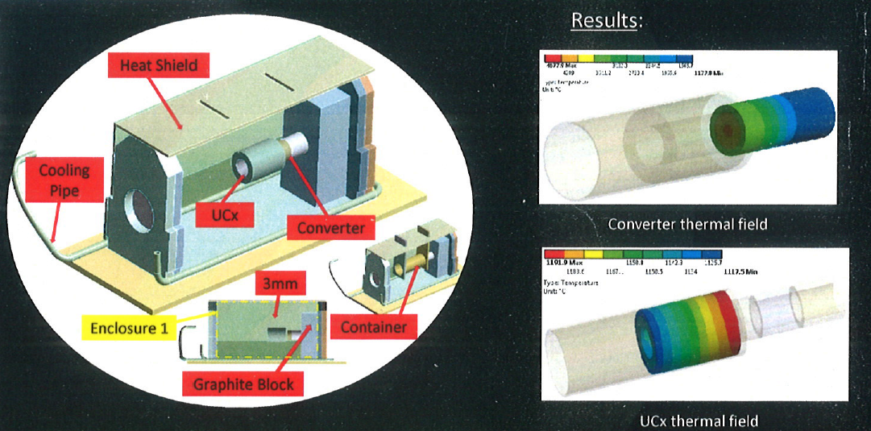
Future
Build the optimized converter for ISOLDE
  Engineering challenges that will have to be overcome
    ANSYS – thermal simulations
      Beam power deposition
      Oven - heating by Joule effect
    FLUKA
      Neutron and proton fluences
      Beam power deposition
      Isotope production
?
  Reproduction of converter in other ISOL facilities (TRIUMF and SCK-CEN):
  Cope with higher beam powers
  Different target and ion source systems
Pictures courtesy of S. Cimmino

Slide 8

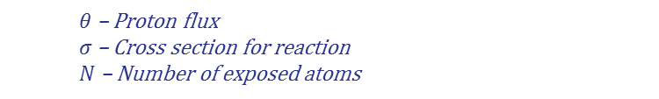

UC_{x} takes >70% of beam time
$θ$ – Proton flux
$σ$ – Cross section for reaction
$N$ – Number of exposed atoms
$$Yield=θ.σ.Ν.ε$$
$$ε={ε_{diff}ε}_{eff}{ε_{ion}ε_{sep}ε}_{trans}$$
Proton
nanoUC_{x}
1. Production
(Nuclear Reactions)
Ion Source
Status update
2. Diffusion
+/- 8V
3. Effusion
500 A
4. Ionization
Pulsed
Protons
+/- 9 V
1000 A

Slide 9
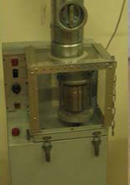

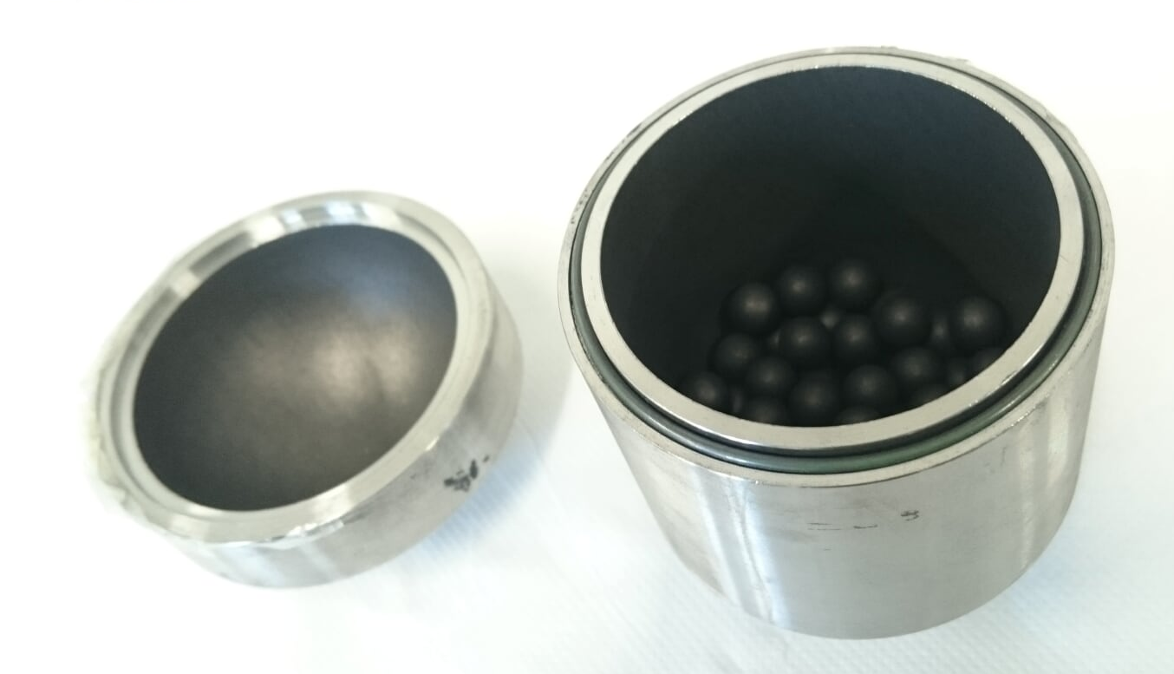
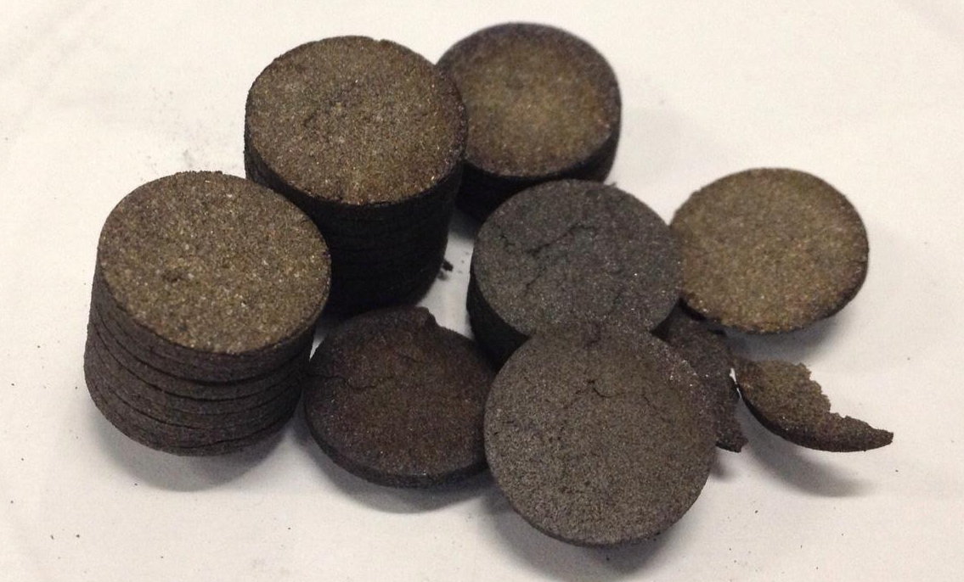
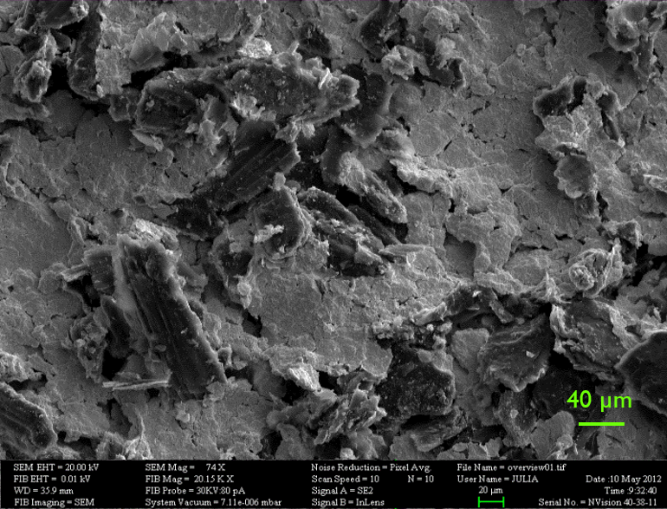
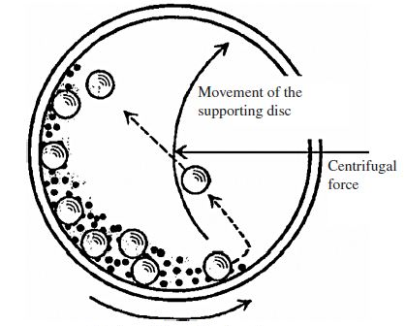

Production Procedure
Final material (UC_{x} + MWCNT)
22 m²/g and 75% porous pellets
Target – 11.4 g/cm² (0.6 g/cm³)
  Conventional is ~28 g/cm² (1.4 g/cm³) 2x more (actinide waste)
Powders Dry Mixing
Pressing porous compacts
𝑈𝑂₂+6𝐶→𝑈𝐶₂+2𝐶+2𝐶𝑂
Conventional UC_{x}
Vacuum
UO₂ (18 μm) + Graphite (30 μm)
87x smaller scale
 | Conventional UC |  | nanoUC_{x} |  | Factor
 | Before | After | Before | After
Surface A. (m2/g) | 5.2 | 0.1 | 30 | 22.1 | +220x
Porosity | 47% | 56% | 67% | 76% | +35%
Density (g/cm³) | 4.5 | 3.67 | 1.89 | 1.95 | -47%
400 nm
Wet Planetary milling
Pressing porous compacts
+
+
nanoUC_{x}
𝑈𝑂₂+6𝐶→𝑈𝐶₂+2𝐶+2𝐶𝑂
Vacuum
UO₂
(18 μm to 160 nm)
Isopropanol - IPA
Ultrasonication, mixing with MWCNT and drying
A. Gottberg, et al.

Slide 10
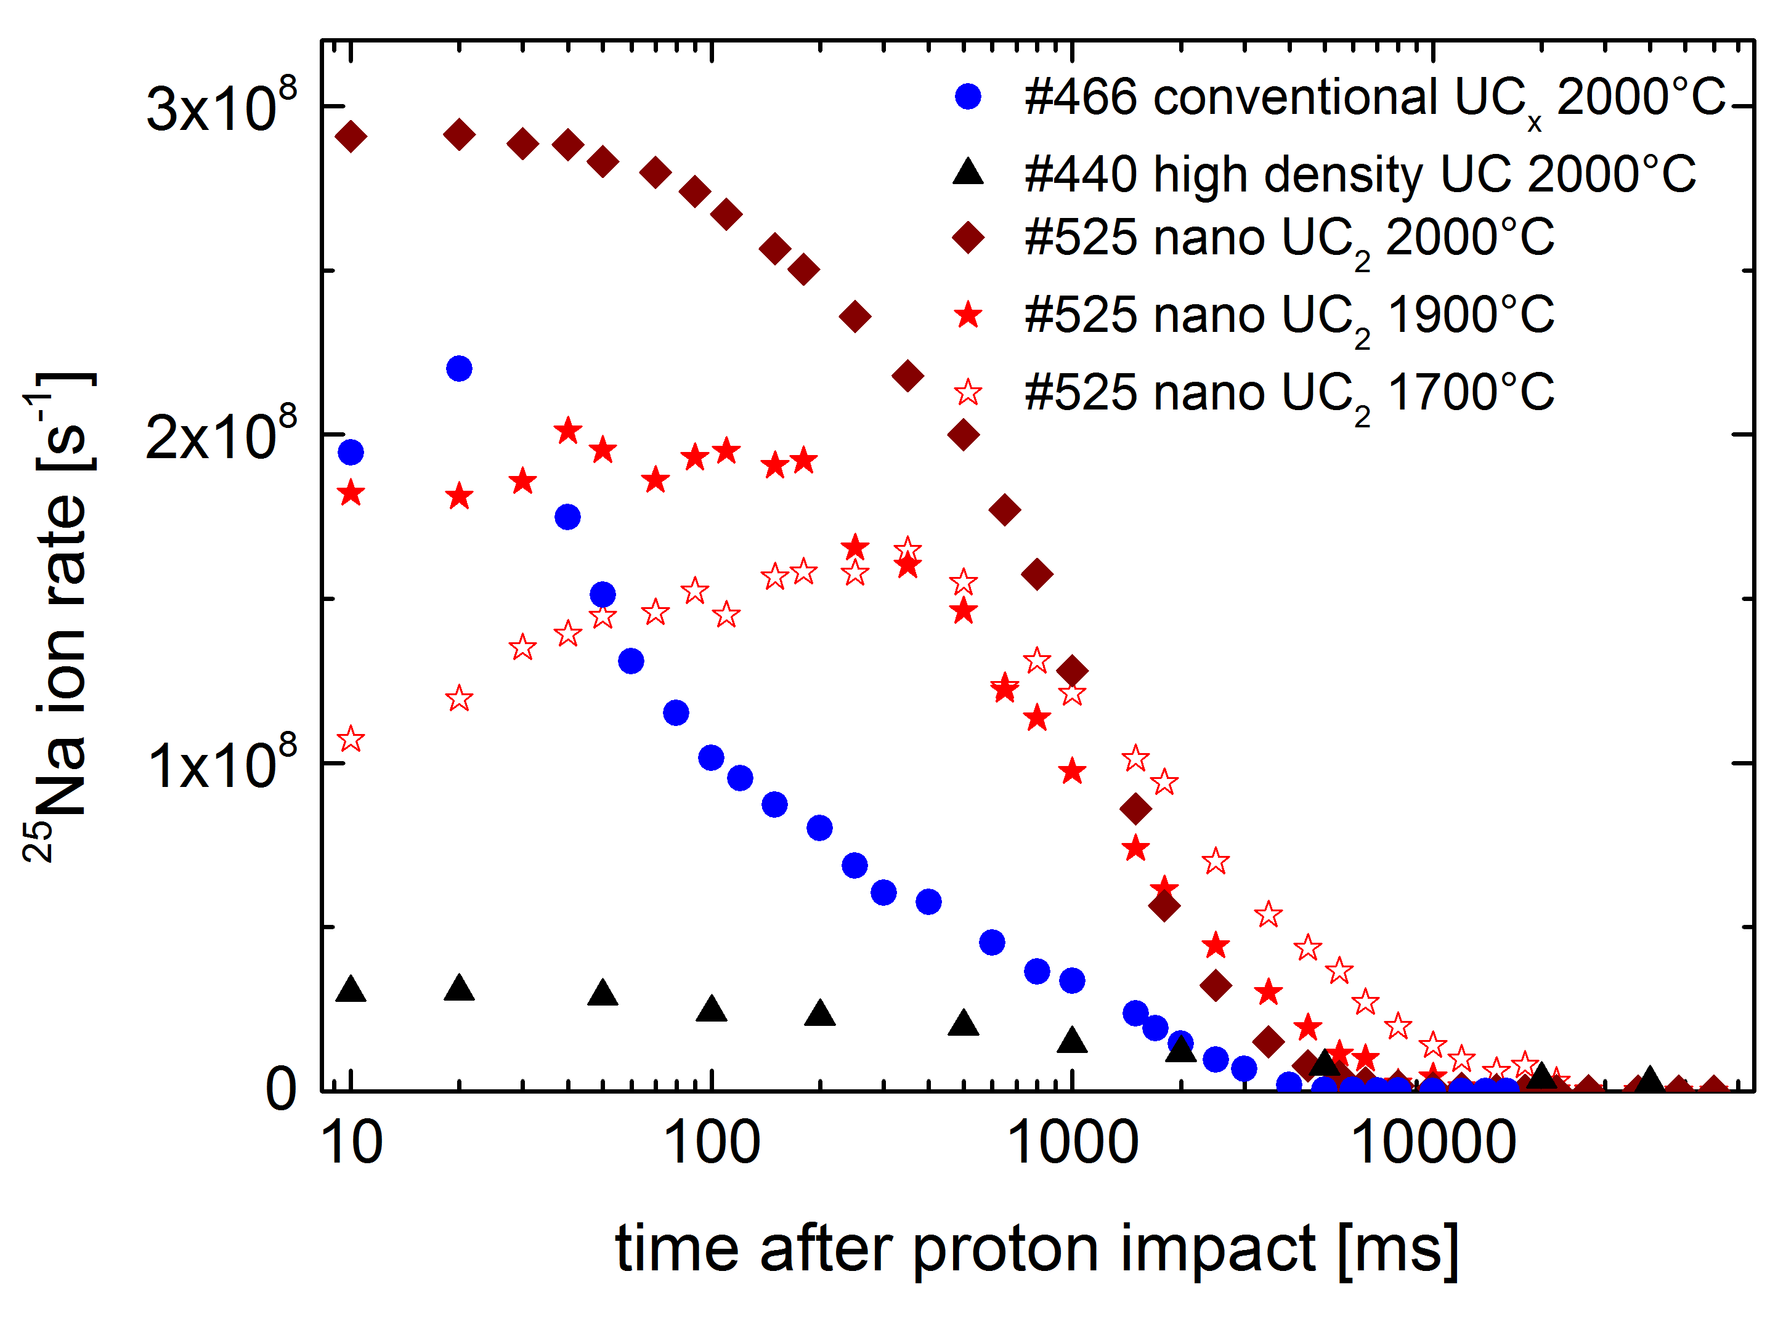
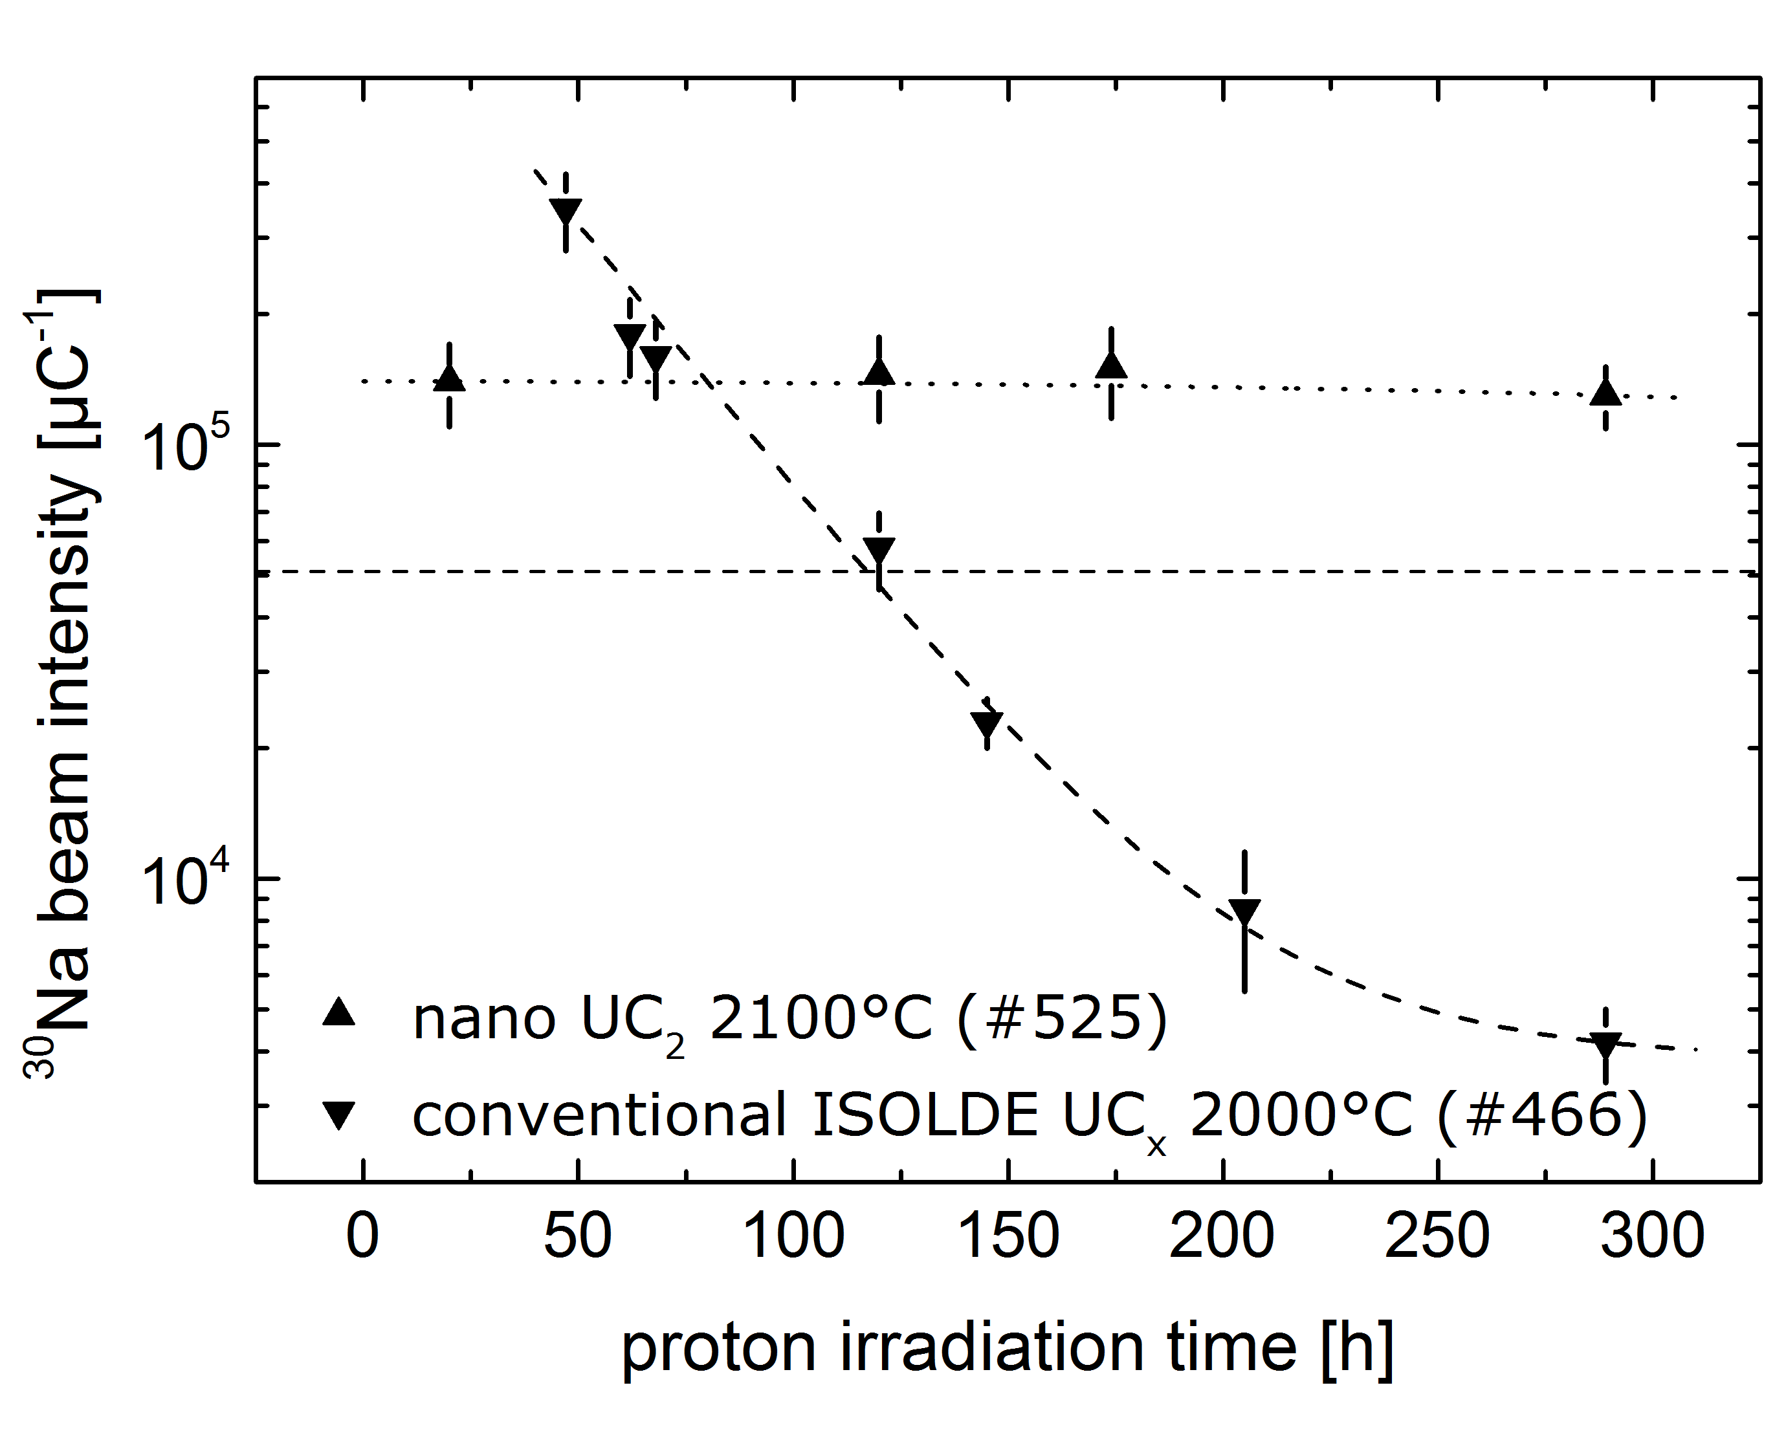








Nano Uranium Carbide Online at ISOLDE
T_{1/2}=48 ms
T_{1/2}=59.6 s
ActILab
59.6 s
17.8 m
9.3 m
178 ms
1.07 s
115 s
30 s
3.8 m
5.84 s
1.7 s
840 ms
32.6 s
4.58 h
14.8 s
1 s
13.9 s
1.22 s
48 ms
472 ms
0.20 s
A. Gottberg, et al.

Slide 11
The New UO₂ batch
#547 & #548
Small difference in impurities to old batch
To be done: Material characterization and comparison to old batch
56 ms
20 ms
Good Physics
Material generally operated at conservative temperatures!!
Margin for improvement!
 | μC⁻¹ | DB
30Mg | 2.3E6 | 6.0E5
30Al | 3.2E6 | 5.7E6
33Mg | 3.0E3 | 3.0E3
Yield Checks
IDS/ISOLTRAP
Ar Yields
ISOLTRAP | μC⁻¹ | DB
46Ar (7.8 s) | 1.3E4 – 1.3E5 | -
47Ar (1.23 s) | 7.2E2 – 1.4E3 | 9.6E3
#541
Database
Target at 1900-2000ºC
Ta source at 2000-2050ºC
Target at 1900ºC
Ion Souce at 1950ºC
Kr²⁺ impurities – 4 to 70x
#550
#543
Target at 1990ºC
Ta source at 1780ºC
Target at 2050ºC
Ta source at 2000ºC
Protons on converter
0.25 s
4.6 s
89 ms
162 ms
0.71 s
92 ms
Towards the end
64 ms
68 ms
28 ms
97 ms
Protons on target
No quartz
(quartz cold line reduces intensity down to 1/2)
Physics yields courtesy of IDS and ISOLTRAP

Slide 12
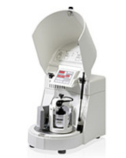
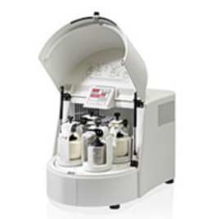
For the future
Current issues:
Milling results not exactly reproducible
Too much liquid involved to produce 1 target (7 L)
  CNT are the problem (5g need 1.4 L of IPA)
Old UO2 batch
+
₊
_{upscaling}
?
nanoUC_{x} v2.0
CNT
nanoUC_{x}
+
nanoUCx production:
2 persons, 1 month → 1 target
WANT: 1 person, 1 week → 1 target
FACTOR 8
New UO2 batch
Fundamental studies on the release of isotopes from UC_{x}
  Diffusion and effusion from nanomaterials
    A lot of data from UCx and now nanoUCx
  Target material physical-chemical and morphological properties influence on the yields and release time structure

Slide 13


End
Thank You!
Questions or comments?

Slide 14
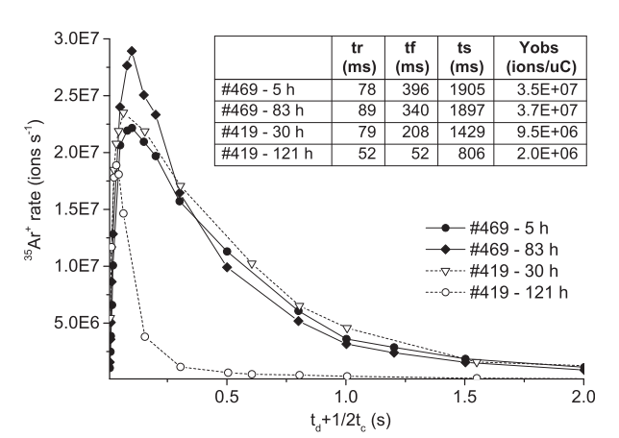
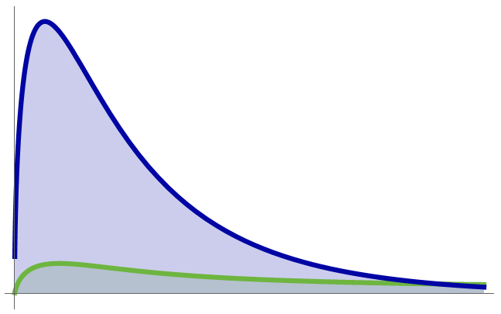
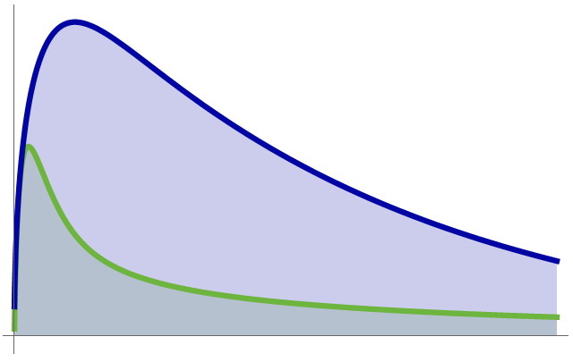
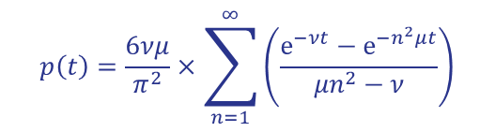
Effusion and Diffusion
$$p\left(t\right)=\frac{6νμ}{π^{2}}×\sum_{n=1}^{∞}{\left(\frac{ⅇ^{−νt}−ⅇ^{−n^{2}μt}}{{μn}^{2}−ν}\right)}$$
μ Diffusion
ν Diffusion
Diffusion limited vs. Effusion limited
Release time structure similar to many nanomaterial targets
ν₁= ν₂ = 5 s⁻¹ (200 ms)
μ₁ = 2 s⁻¹ (500 ms)
μ₂ = 0.02 s⁻¹ (50 s)
ν₁ = 0.8 s⁻¹ (1.25 s)
μ₁ = 10 s⁻¹ (100 ms)
D = constant
Reduction of 100x grain size
from μ₂ to μ₁
ν₂ = 20 s⁻¹ (50 ms)
μ₂ = 0.03 s⁻¹ (33 s)
Theoretically 5x more yield!
time after proton impact
time after proton impact

Slide 15
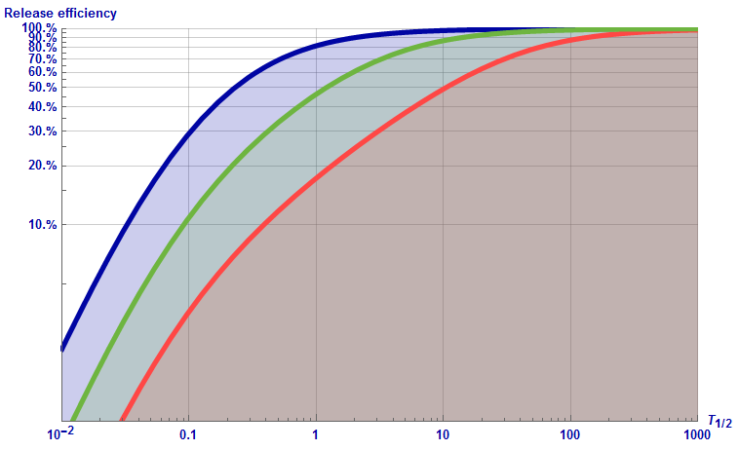
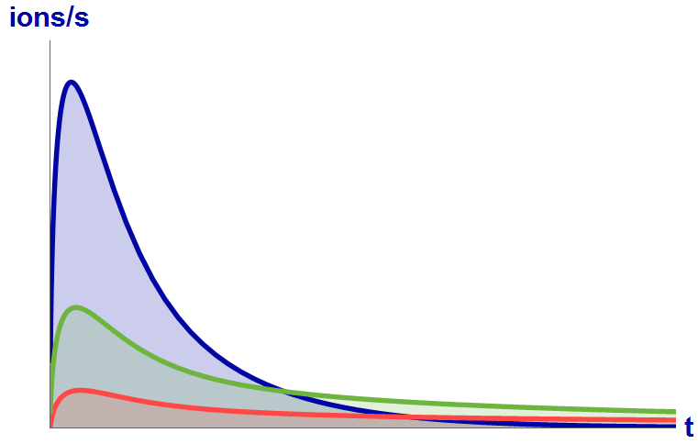
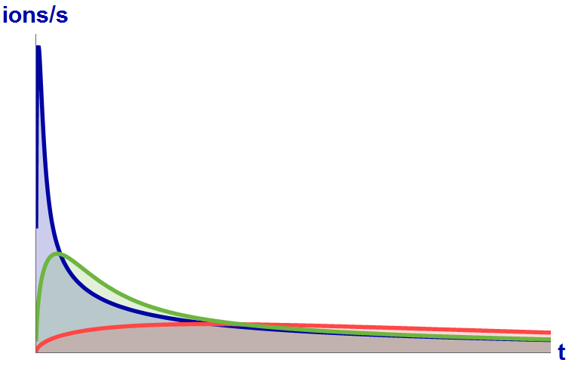
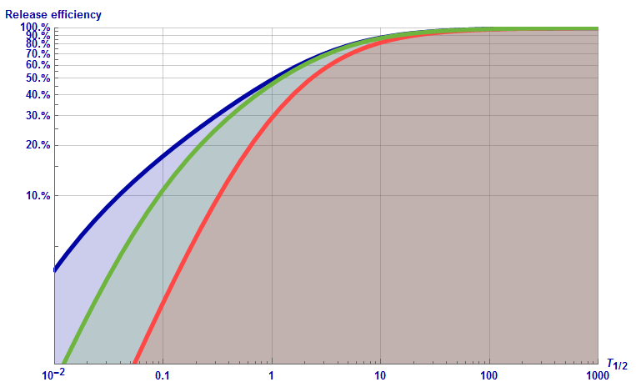




Effusion and Diffusion
Diffusion
(1 diffusion, 1 effusion time constants)
$$ν=10{ s}^{−1}$$
$$μ=0.03 s^{−1}$$
$$μ=0.3 s^{−1}$$
$$μ=3 s^{−1}$$
Grain size reduction
x100
$$2 s$$
Effusion
Diffusion and Effusion
$$μ=0.3{ s}^{−1}$$
$$ν=1 s^{−1}$$
$$ν=10 s^{−1}$$
$$ν=100 s^{−1}$$
$$2 s$$

Slide 16
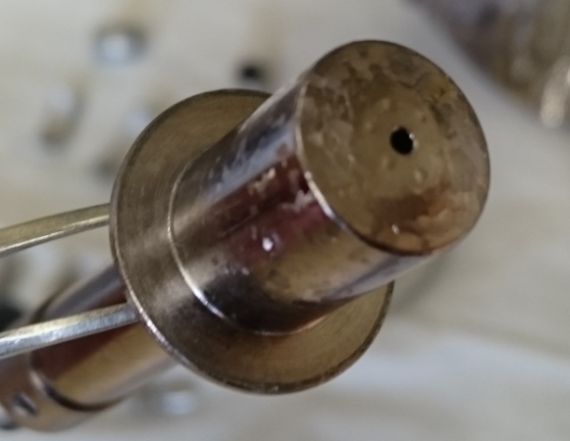
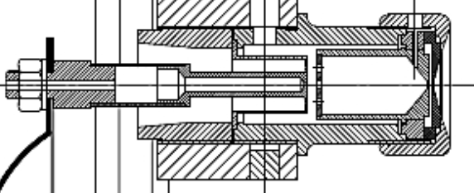
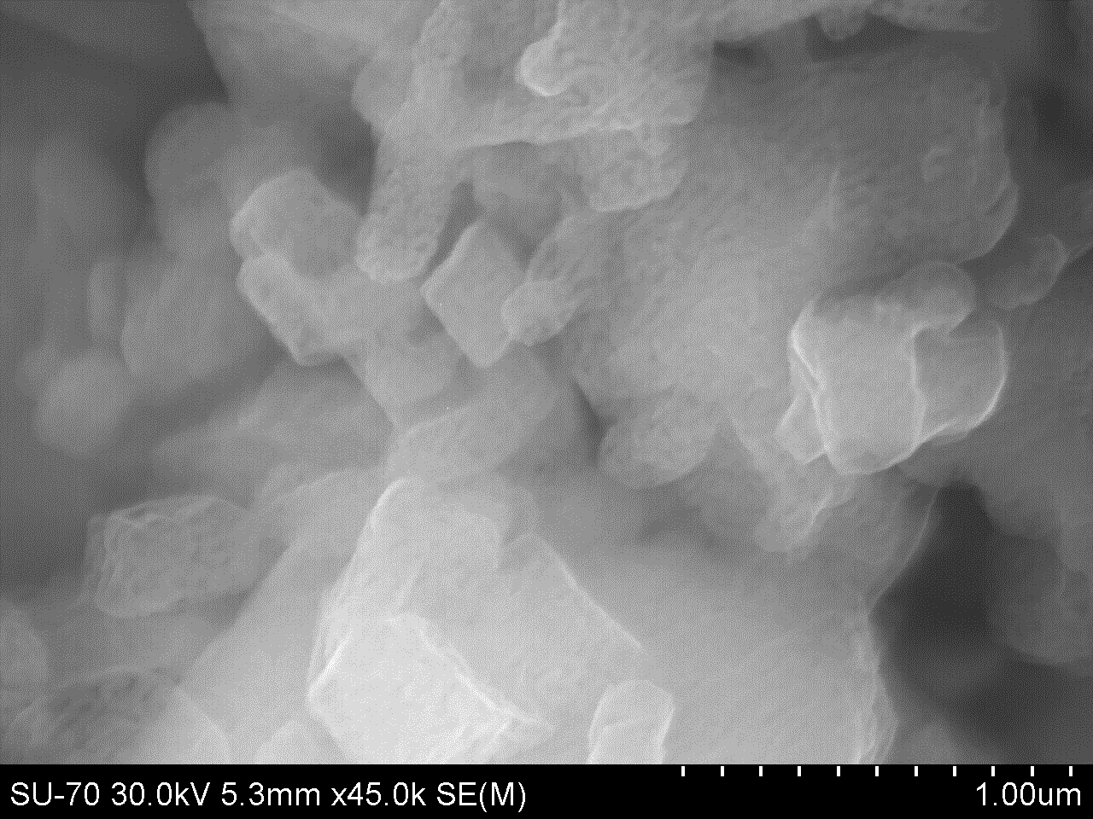
Possible problems (examples) – spare slide
Broken units during online period:
#524-UC-Ta (used)
#507-UC-W (used)
#511-Pb-VD7 (used)
Two used VADIS units failed this year
All used targets
2x, 3x
Anode photo after thermal cycle
Metal surface is initially smooth
Anode bends and touches other parts
Short circuit
Heat shields touching transfer line
Spontaneous oxidation!
COLLAPS run
UC_{x} + xO₂ →UO₂ + xCO₂
Ca A | (s⁻¹)
52 | 1.0E+03
53 | 2.5E+01
54 | >3.0E-01
In the frontend, heating
Temperature
UO₂ + 4C →UC₂ + 2CO
Should be at least x10
However not fully reversible
Irreversible changes to the microstructure!
#545
Too high temperature!
SSA = 38 m²/g
48h at 800ºC
SSA = 4 m²/g
48h at 1200ºC
400 nm
3 μm

