Slide 1
UR :
add longitudinal trench (LHC TUNNEL SIDE) : should use for “pc” cooling pipes ( ahu cooling )
add radial trench : should use : ahu cooling ; pc cooling ; cables
Junction to UL : increase section to leave more space for service.
CIVIL ENGINEERING
UR 55:
Add core for QXL (junction to USC55)
UA :
add safety exit at right side : coax position modified, rf layout inversed, shielding modified.
add longitudinal trench
add radial trench
UL :
increase dimension between cores (C.E. request) ,section last 5 m modified .
Uw : trench 13 x 10 x 0.8 m
US :
Trench :safety room
Trench :lift
Water :

Slide 2
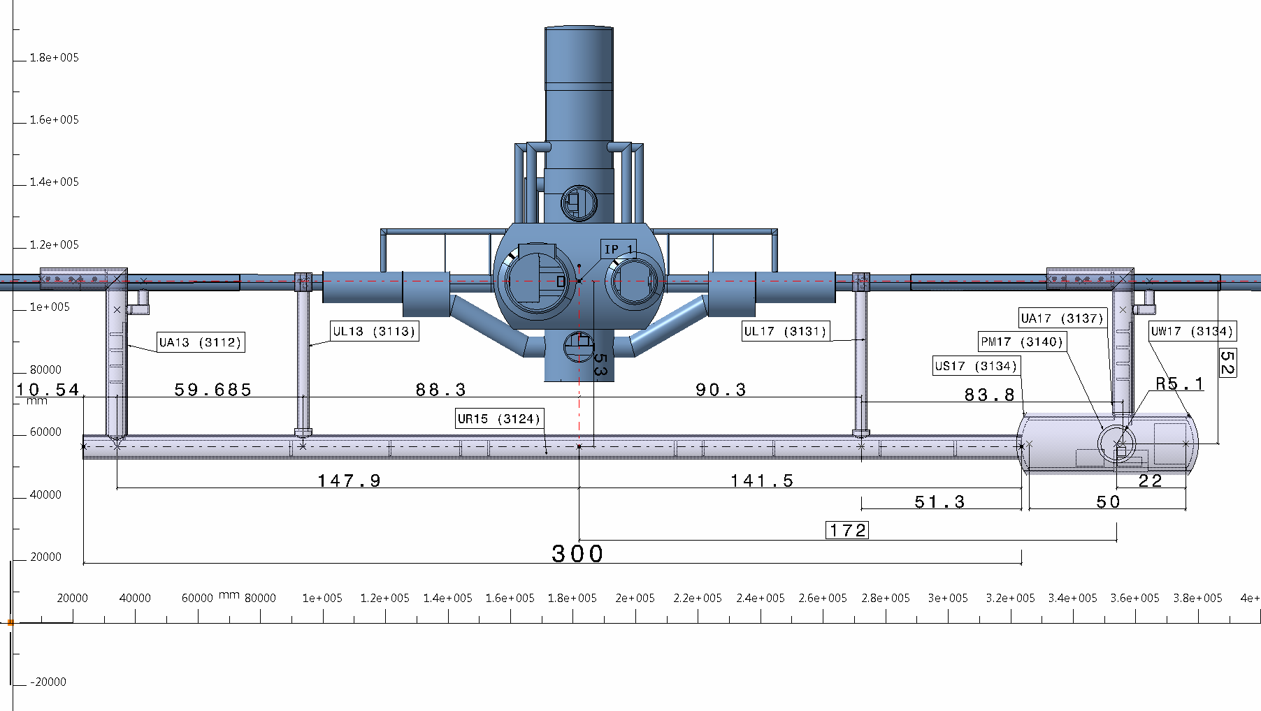

Slide 3
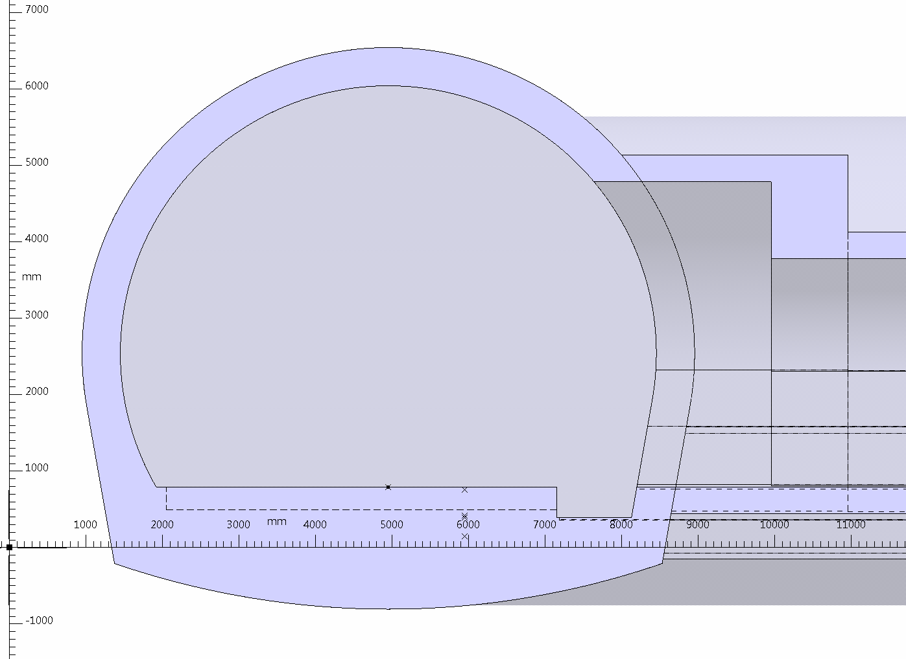
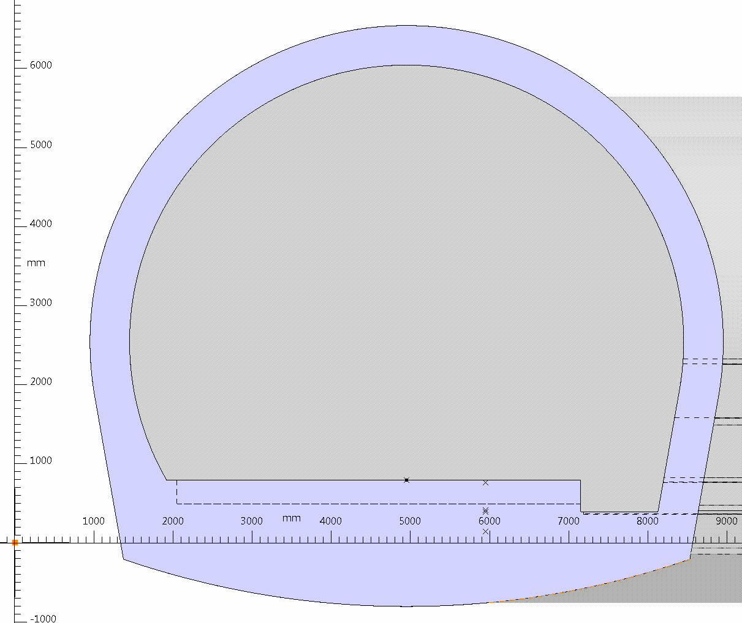
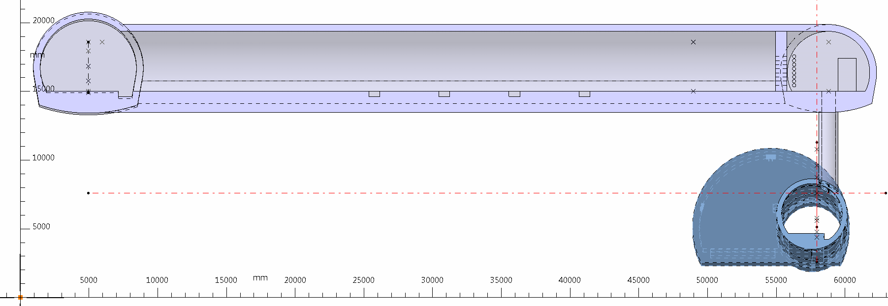
UL
UR
UR
UA

Slide 4
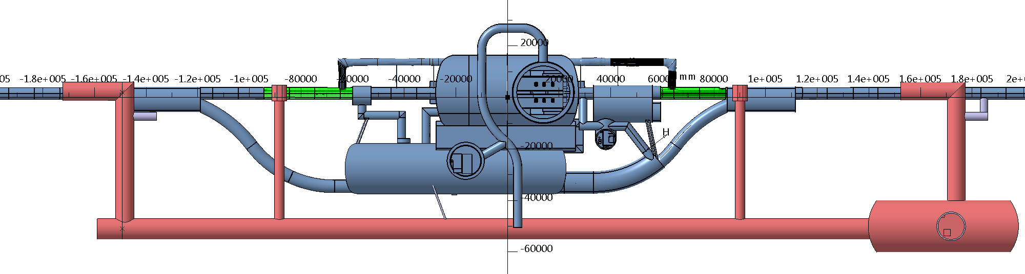
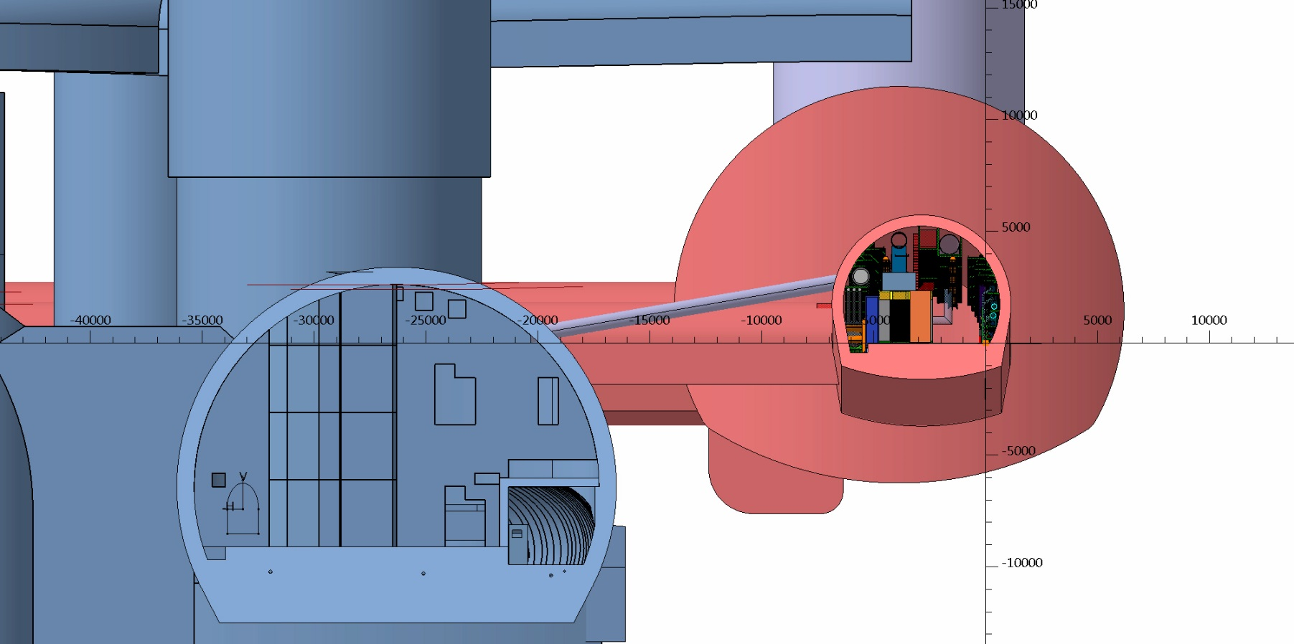

Slide 5
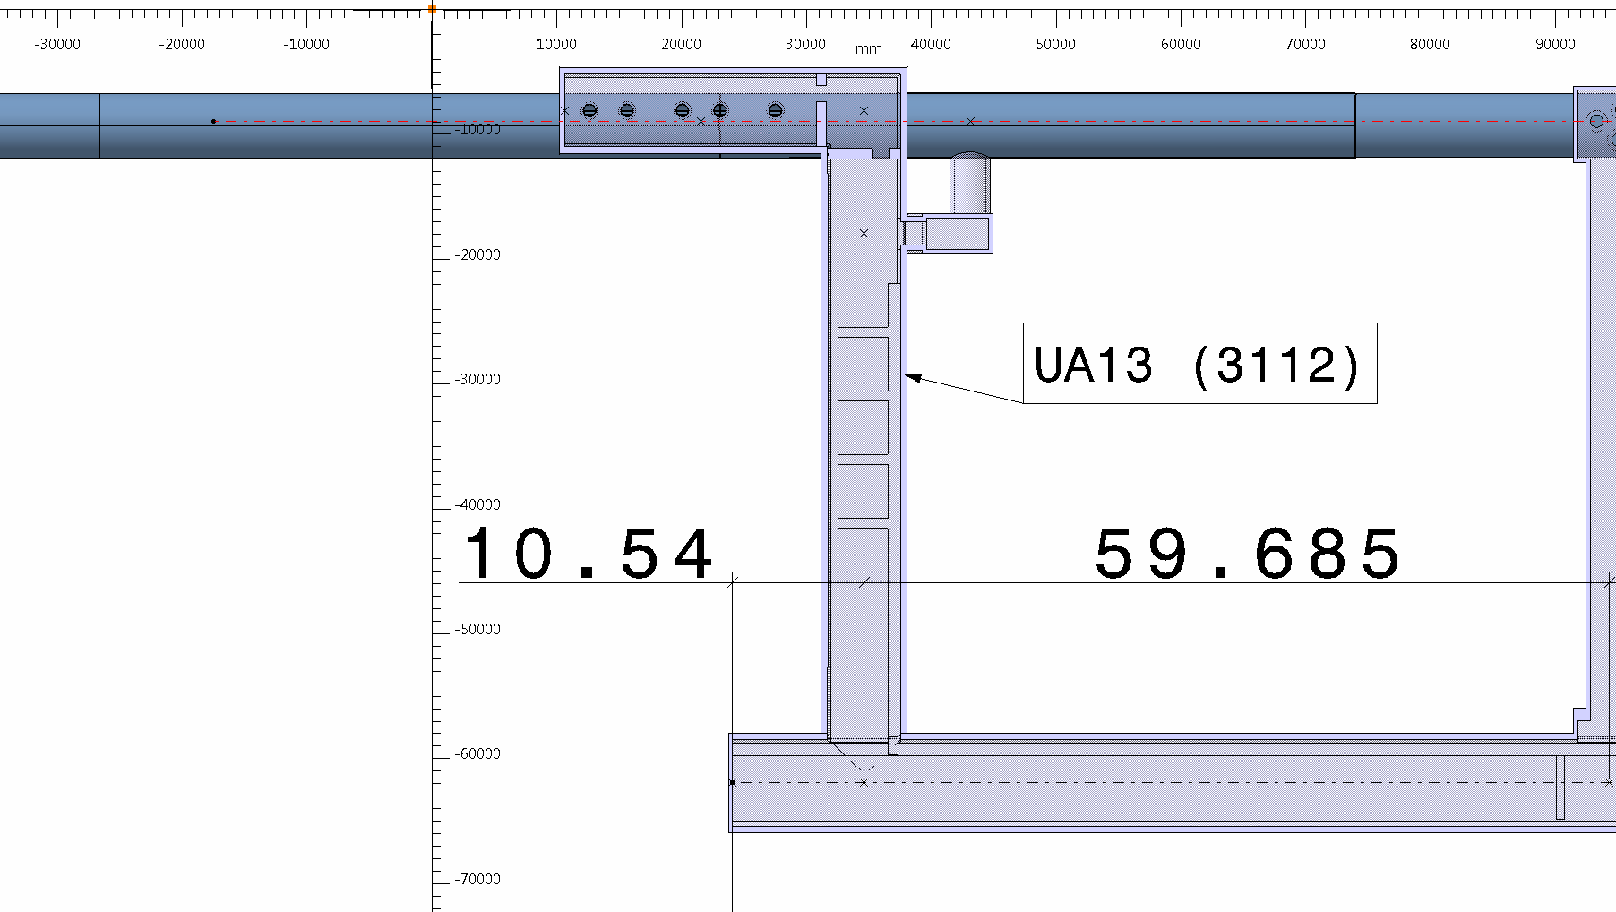
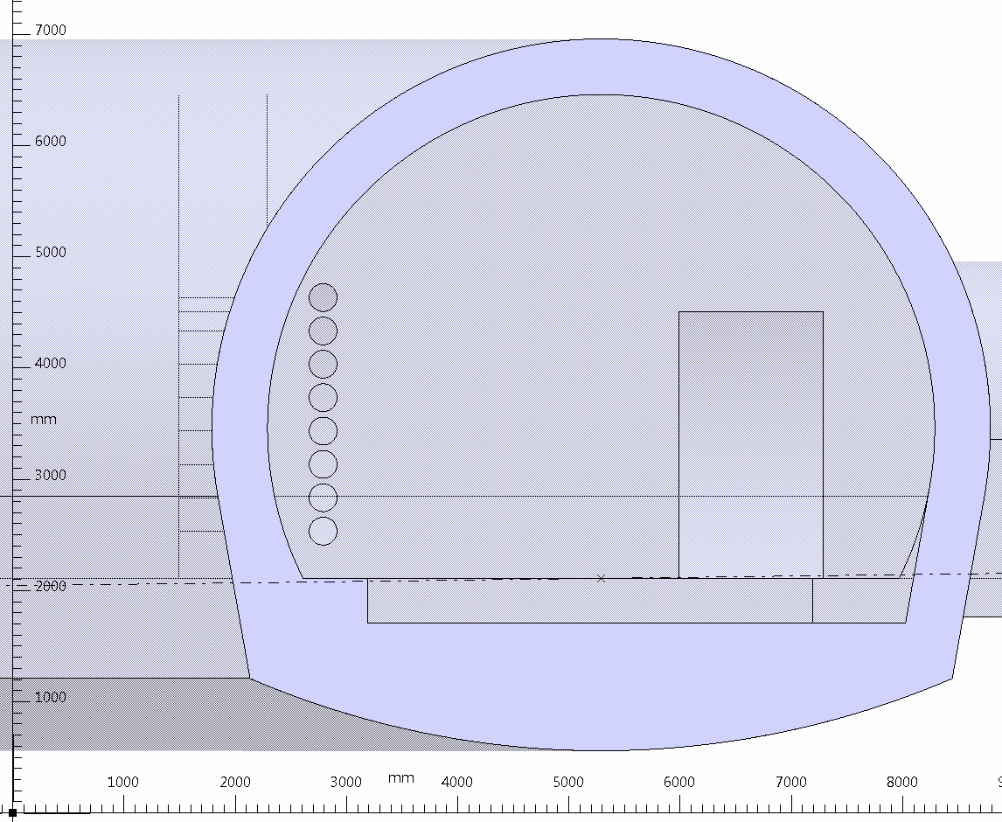
UA

Slide 6
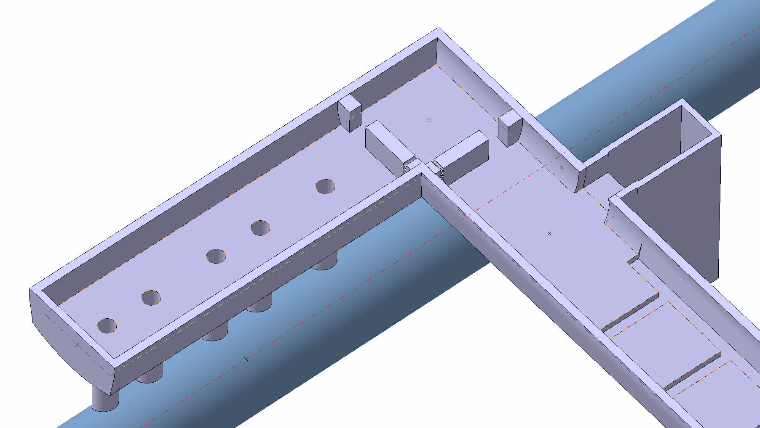
UA

Slide 7
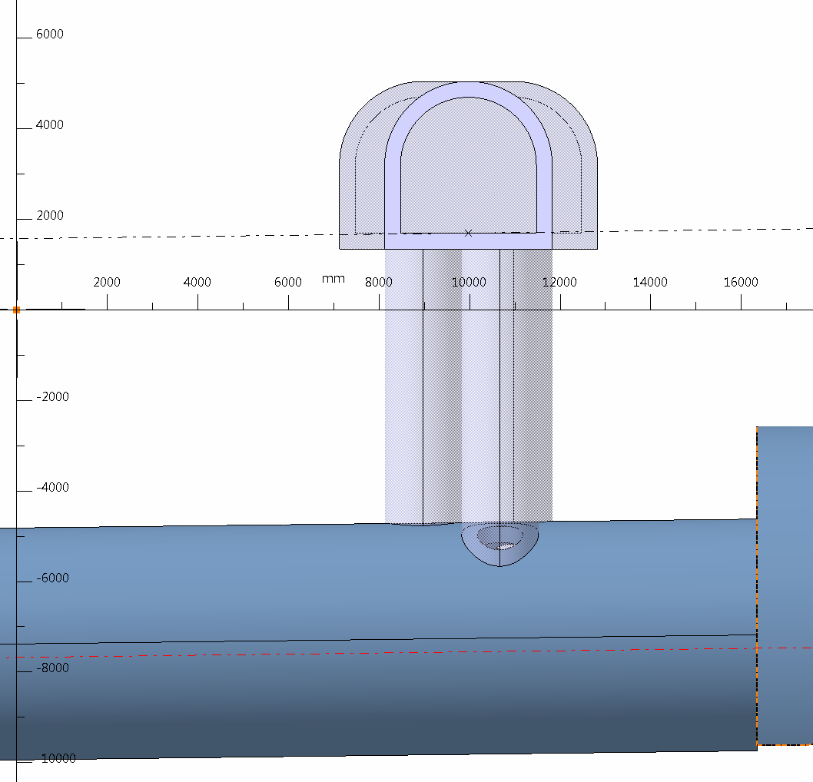
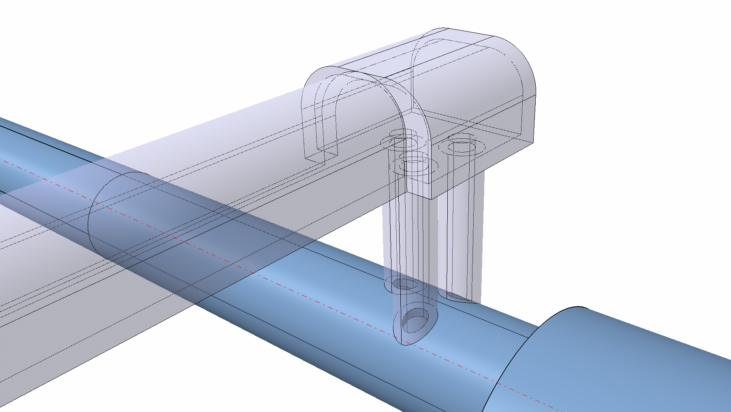
UL
UL
LHC TUNNEL

Slide 8
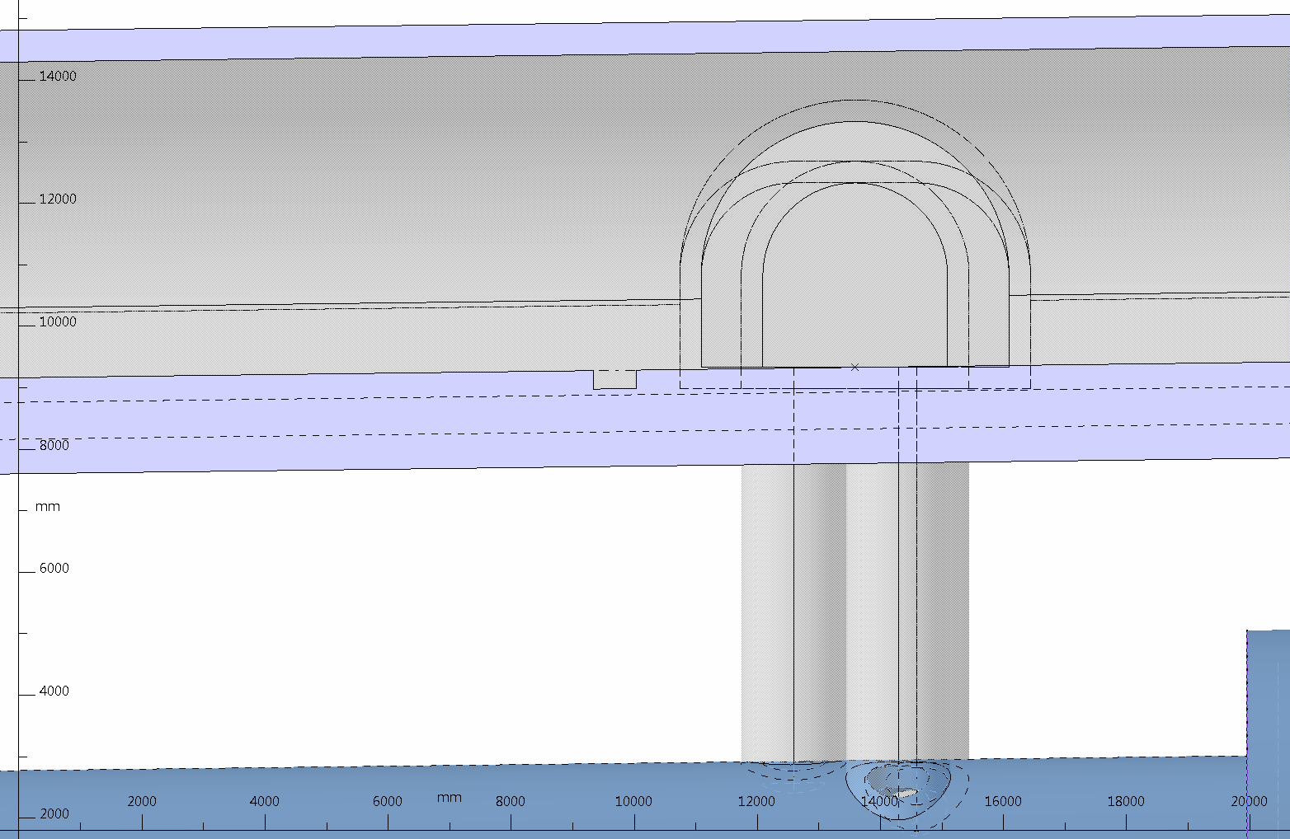
UR
UL

Slide 9
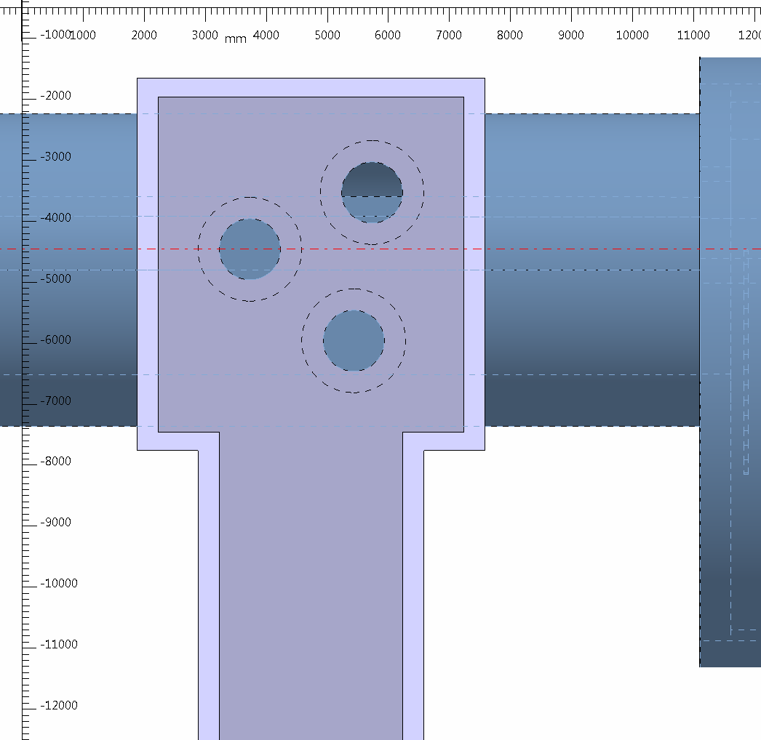
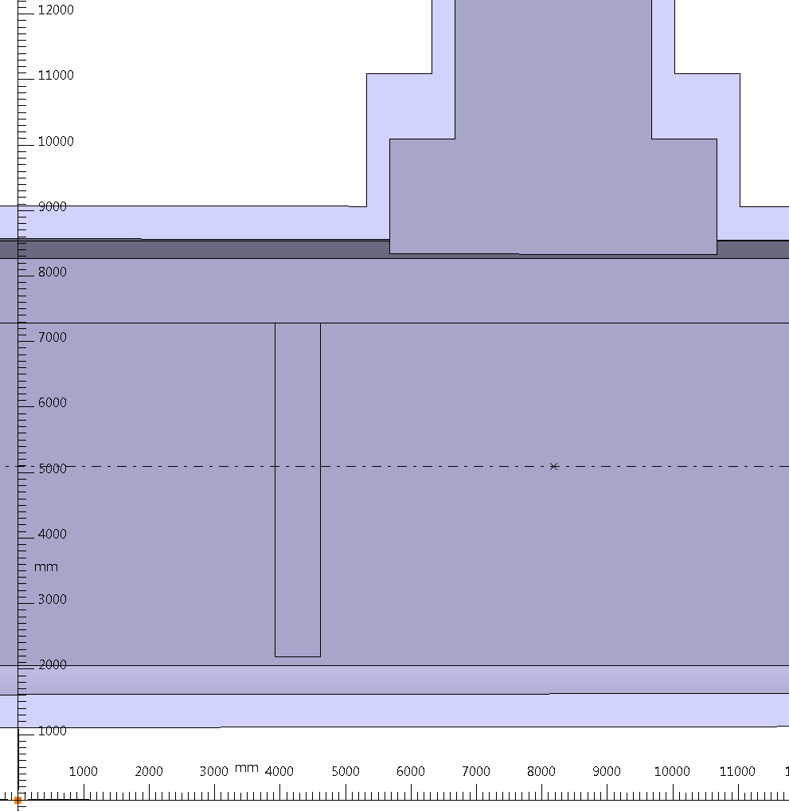
UL
UL
UR

Slide 10
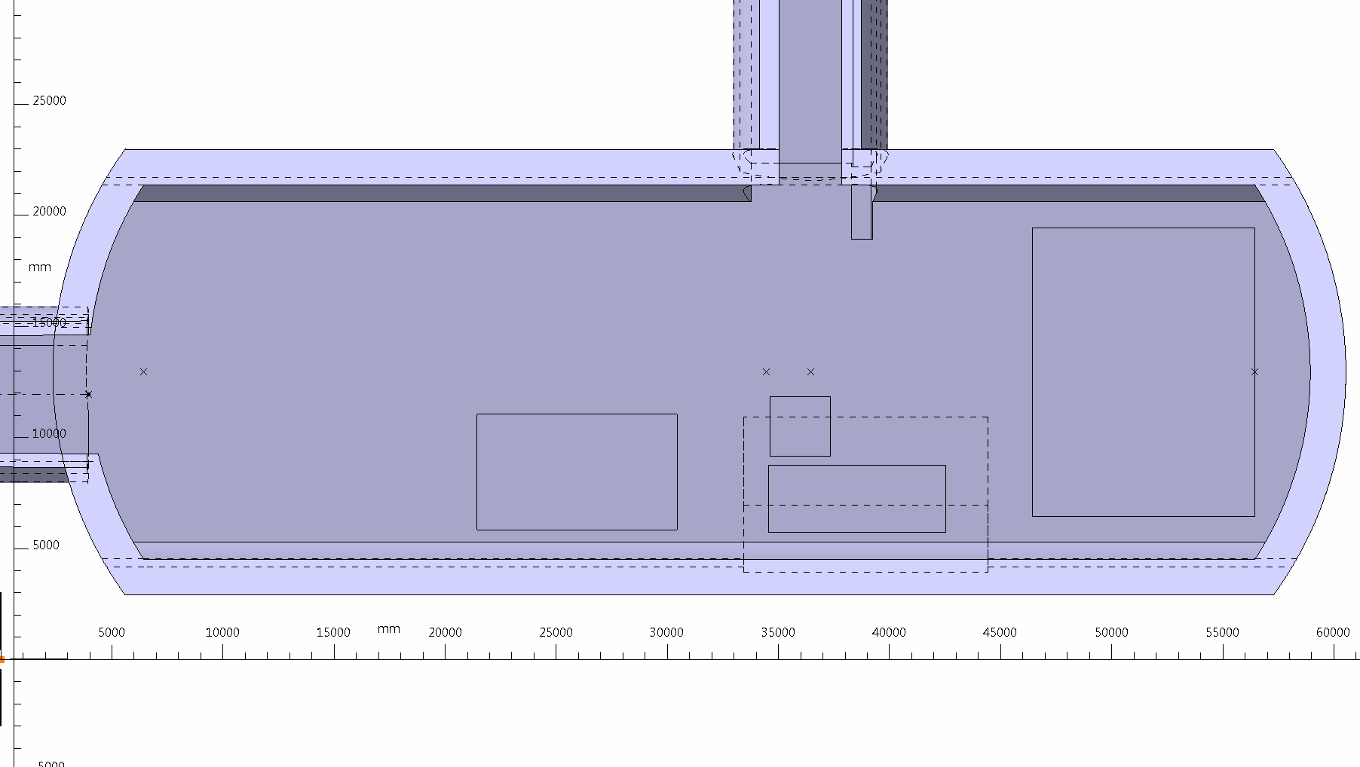
UA
US

Slide 11
INTEGRATION
UA :
Option to change shielding blocks in UA
US :
Change Sump position
Crinoline from the service stairs to the first floor
Cables trays
Cage faraday shorter
New transport area
SCLink drum

Slide 12
SUMP

Slide 17
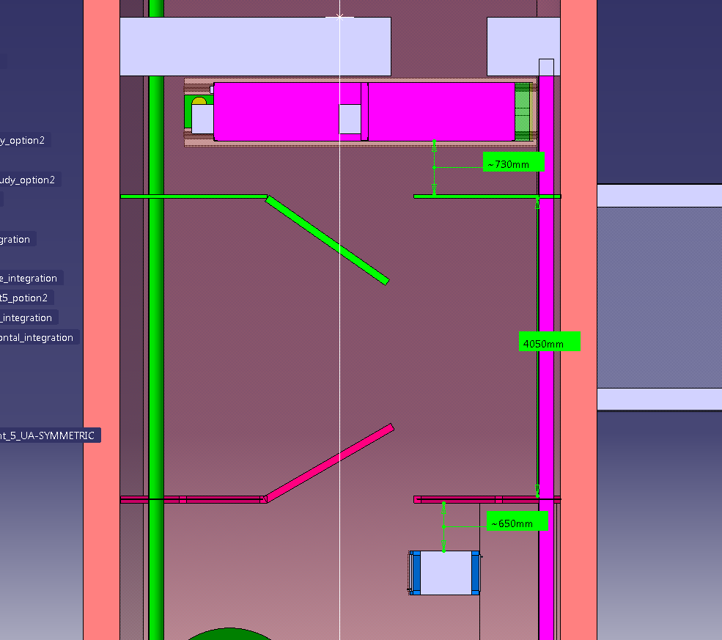
AFFECTED AREA

Slide 18
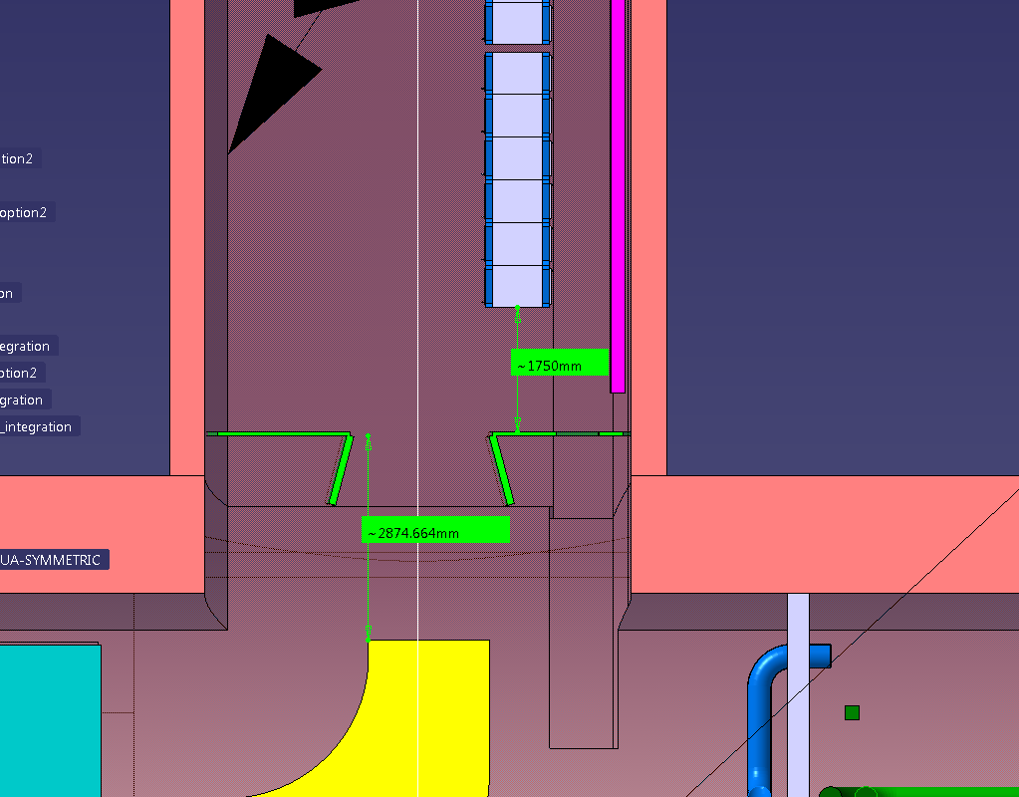
SOLUTIONS
1. Displace:
Racks + door+ safety exit

Slide 19
SCLink DRUM
2.7m
7m
TBD Stairs

Slide 20
1m
1.5m
Metallic Structure

