Slide 1
Technical galleries integration
Integration meeting

Slide 2
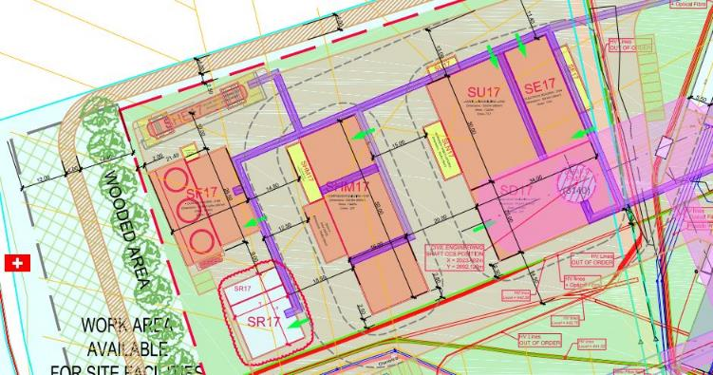
General Layout P1

Slide 3
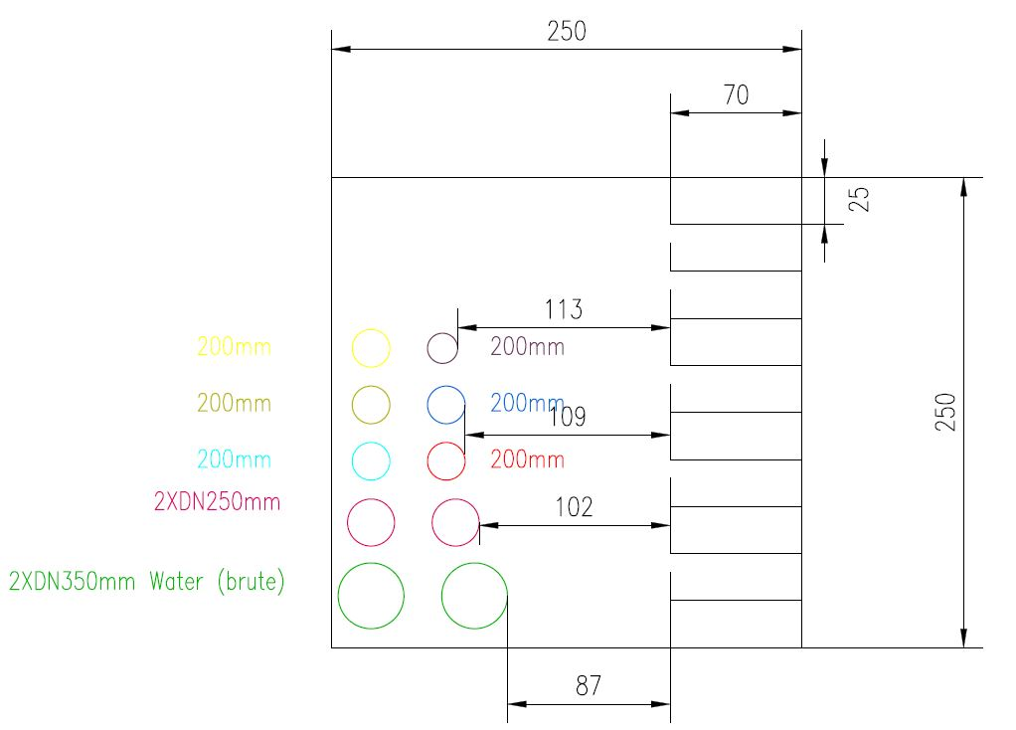
“Back bone section”

Slide 4
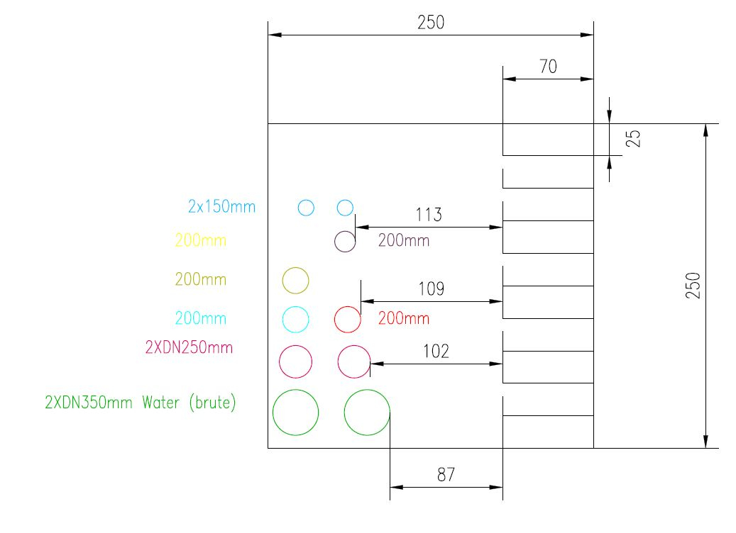
“Final section (to the PM17)”

