Slide 1
Avancement Design FCC-hh
23 Février 2016
Antoine CHANCE
FCC-Saclay group meeting

Slide 2
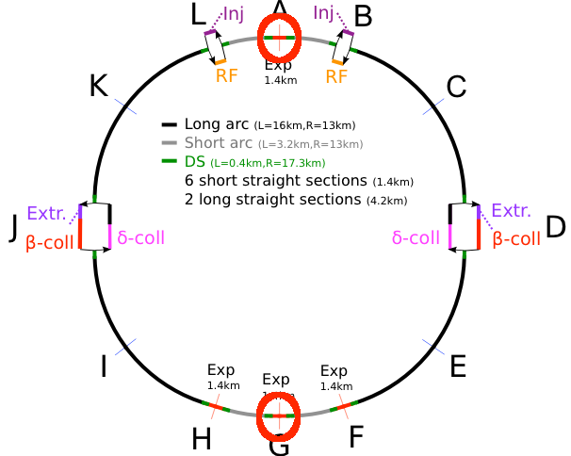
Généralités sur l’optique de FCC-hh
  2 experimental regions at high luminosity (low β*) : A and G.

Slide 3
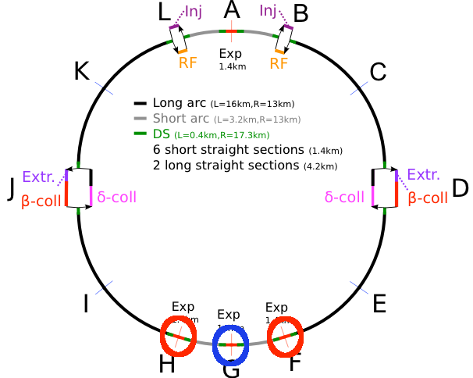
Généralités sur l’optique de FCC-hh
  2 experimental regions at high luminosity (low β*) : A and G.
  2 experimental regions at lower luminosity put in cluster : F and H.

Slide 4
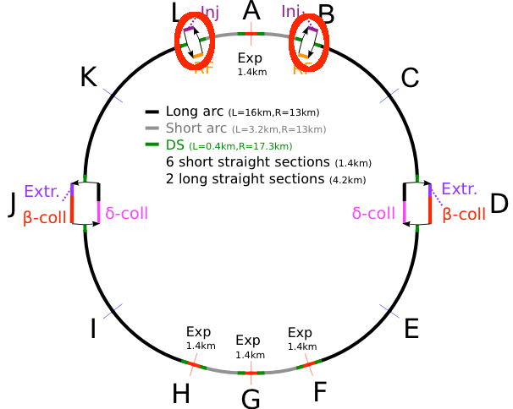
Généralités sur l’optique de FCC-hh
  2 experimental regions at high luminosity (low β*) : A and G.
  2 experimental regions at lower luminosity put in cluster : F and H.
  2 insertions for the injection and the RF : L and B.

Slide 5
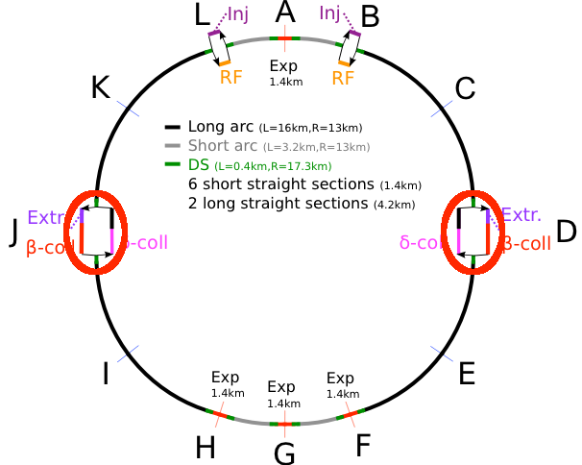
Généralités sur l’optique de FCC-hh
  2 experimental regions at high luminosity (low β*) : A and G.
  2 experimental regions at lower luminosity put in cluster : F and H.
  2 insertions for the injection and the RF : L and B.
  2 insertions for the beam cleaning and the extraction : D and J. Collimation after extraction to protect the ring from badly extracted beams.

Slide 6
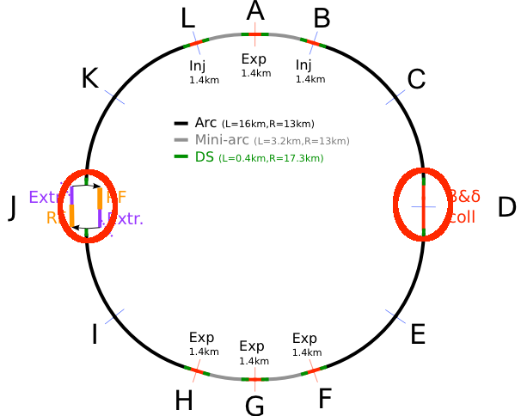
Généralités sur l’optique de FCC-hh
  2 experimental regions at high luminosity (low β*) : A and G.
  2 experimental regions at lower luminosity put in cluster : F and H.
  2 insertions for the injection and the RF : L and B.
  2 insertions for the beam cleaning and the extraction : D and J. Collimation after extraction to protect the ring from badly extracted beams.
  Other schemes to be studied (here : extraction of both beams in the same section).

Slide 7
Méthodologie utilisée
  A python script was written to generate the MAD-X file for the integration of the different lattices.
  We include the lattices made for the different insertions :
      Experimental insertions from WP3 : LSS-A and LSS-G.
      Other experimental insertions : LSS-F and LSS-H.
        No baseline scheme.
        Automatically replaced with simple FODO cells (phase advance of 90°).
      Injection and extraction sections : LSS-B and LSS-L.
        Automatically generated with FODO cells.
        Enhanced FODO cell length (300 m) to enable the injection
        Chicane to enable a larger beam separation
      Extraction section in ESS-D.
      Beam (betatron and momentum) cleaning sections in ESS-D and ESS-J.

Slide 8
Méthodologie utilisée (2)
  The FODO cells of the arcs are automatically generated according to some input parameters (e.g. range of the cell length, spacing between elements).
  The dispersion suppressors are automatically generated.
  The matching macros are automatically generated.
  Some matching sections between the dispersion suppressors and the insertions can be added (according to the user’s wish).
  More flexibility and adjustment of the insertion length to match exactly the target value.
  No matching quadrupoles for the experimental sections (matching sections optimized by WP3).
  The global tune is matched with the phase advance of the FODO cells in the long arcs.
  Phase advances of the FODO cells in the SAR : 90°.
  Phase advances of the FODO cells in the LAR : 90+ε_{x,y} °.
  The chromaticity is corrected by two sextupole families.
  Other more advanced correction schemes like in the ATS are under study. It is too preliminary to show them now.

Slide 9
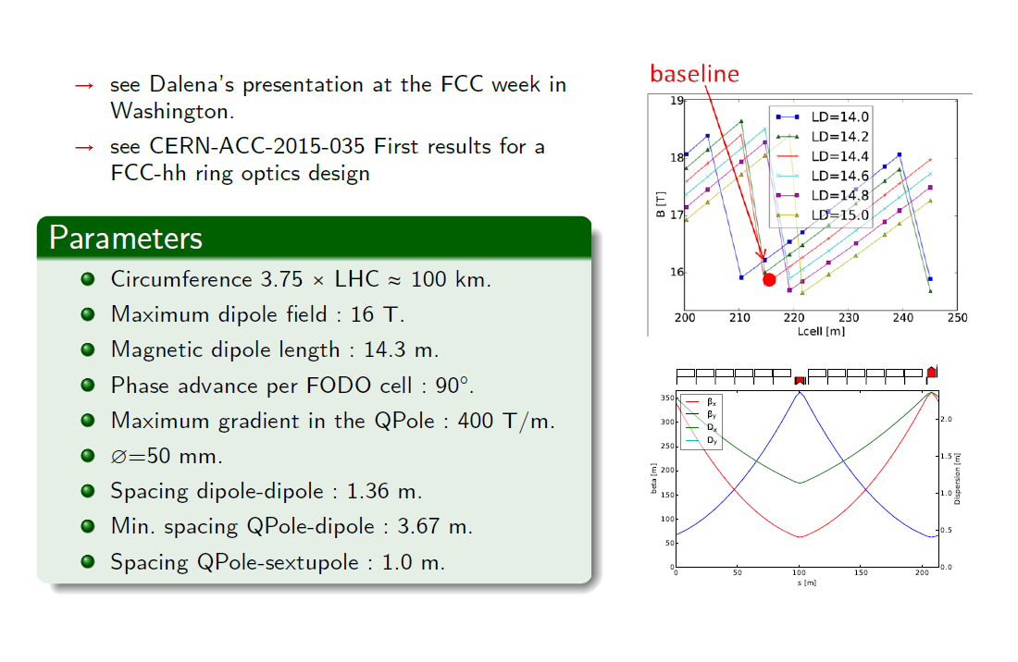
Choice of the arc cells

Slide 10
Arc design
 | Warnings
Cell length 213.895 m, main dipole field 15.93 T, distance between two adjacent dipoles 1.36 m | Distance between magnets not yet validated by magnet people*
Main quadrupole length 6.29 m, max gradient 370 T/m
Main sextupole length 0.5 m, max gradient 20000-30000 T/m² | Strength not yet validated by magnet people
Orbit correctors length 0.647 m, max strength 2 T.m misalignment 0.2 mm in both planes | Correction of main random b1 dipole errors not included.
Trim of main quadrupoles length 0.65 m, max strength 500 T/m | Not yet validated
Spool pieces to correct b3 require a max integrated strength twice higher than in LHC
Ex: a minimum distance between two adjacent dipoles of 2 m implies:
  cell length 220.732 m, dipole field 15.76 T, 1% more dipoles and 3.5 km longer arcs, in order to keep comparable β functions and dispersion (i.e. beam stay clear)
A FODO advance of 60° per FODO cell is now available.

Slide 11
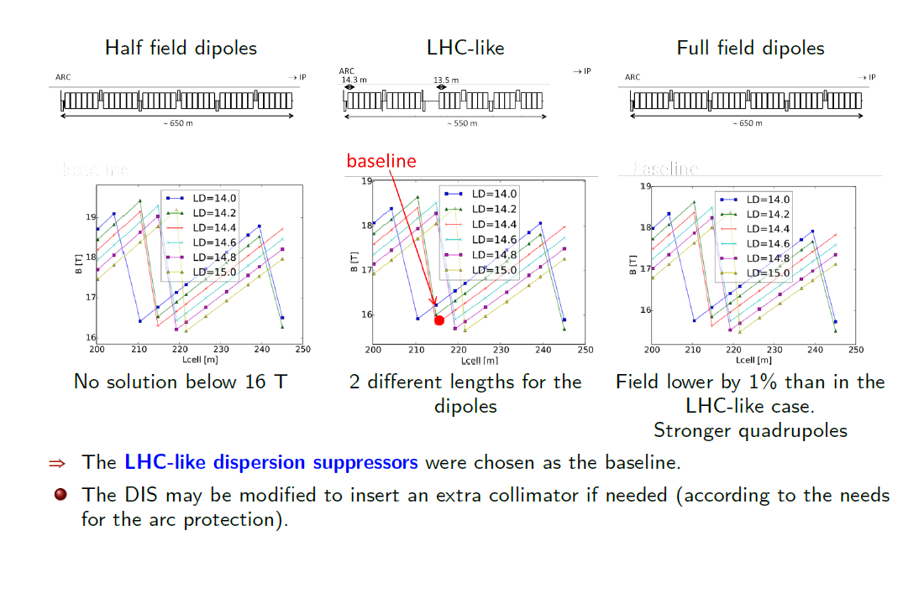
Choice of the dispersion suppressors

Slide 12
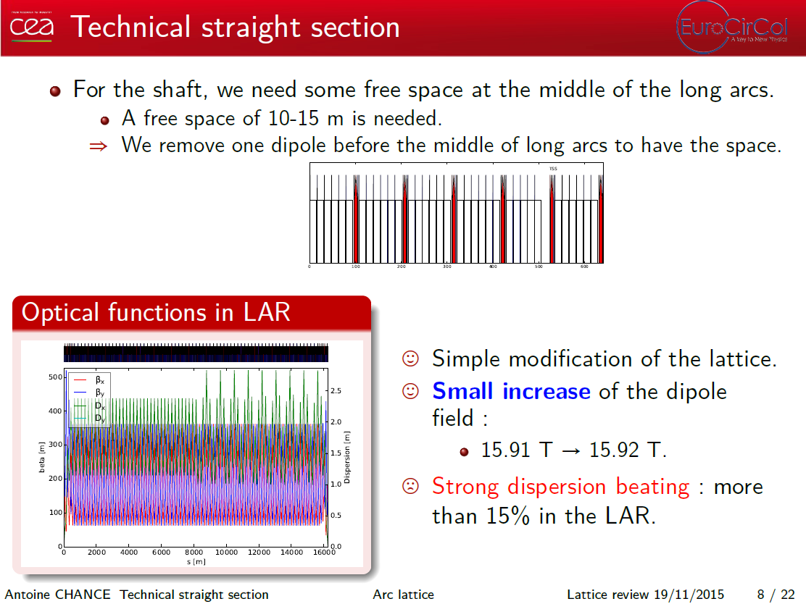
Technical straight sections

Slide 13
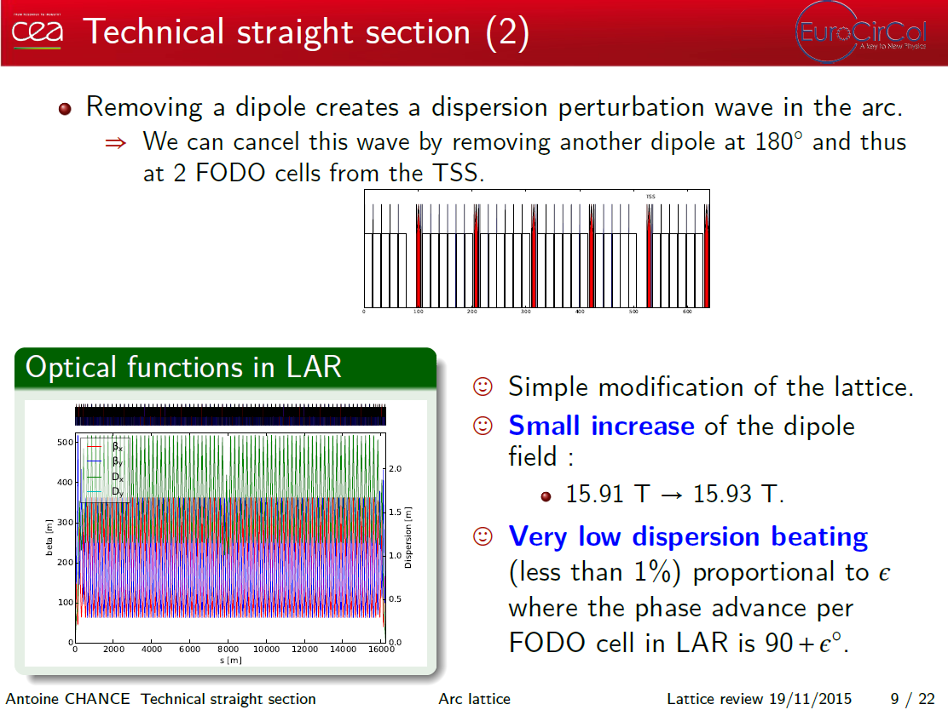
Technical straight sections (2)

Slide 14
Integration of insertions
 | Warnings
High luminosity IR version V4 L* = 36 m | Still to be checked Spurious dispersion due to Xing angle not yet corrected L* =45 m will be more likely the baseline value
Injection/RF: space reserved for injection kickers and RF cavities (LHC type) added, chicane to separate both beams by 0.42 m | Position of RF cavities may be not optimum
Extraction and betatron collimation scaled from LHC (same as FCC week 2015) | Space may be needed for cryocollimator in the DIS
Low luminosity IR simple fodo cell (same as FCC week 2015)
Energy Collimation with max dispersion of 5 m or 6 m, A version of the LHC-scaled collimation section has just been received (some checks are being done). | Difficult to integrate with extraction since it uses the dispersion of the arcs LHC scaled version of energy collimation not yet integrated.

Slide 15
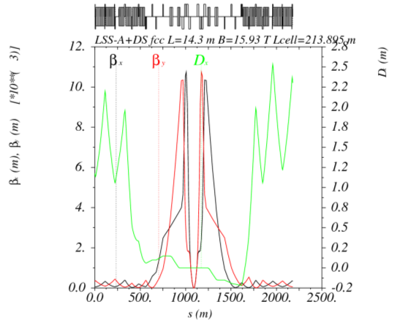
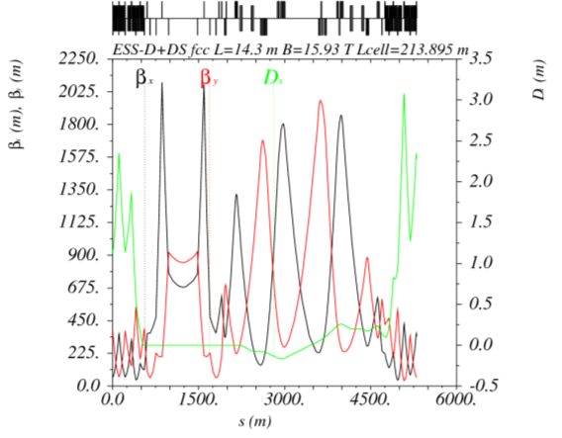
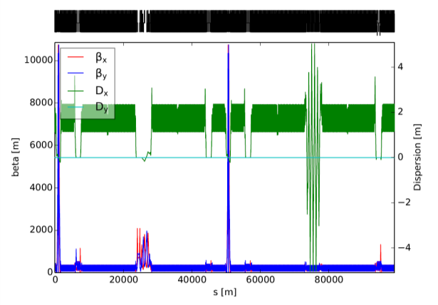
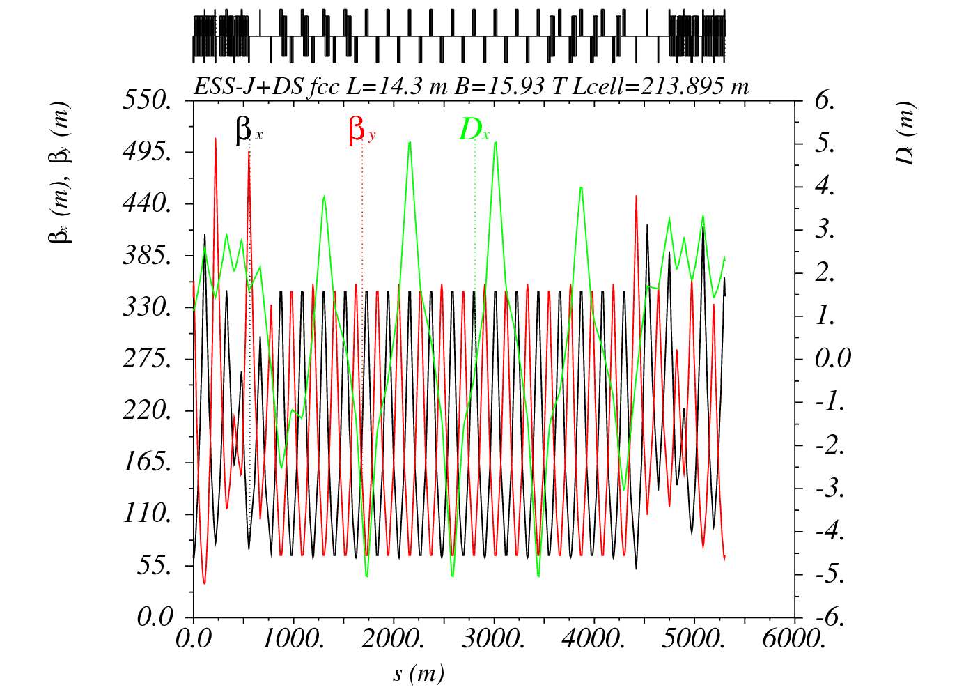
COLLISION OPTICS Integration
IR V4 β* = 1.1 m
Extraction + betatron collimation
Momentum collimation (not scaled from LHC)

Slide 16
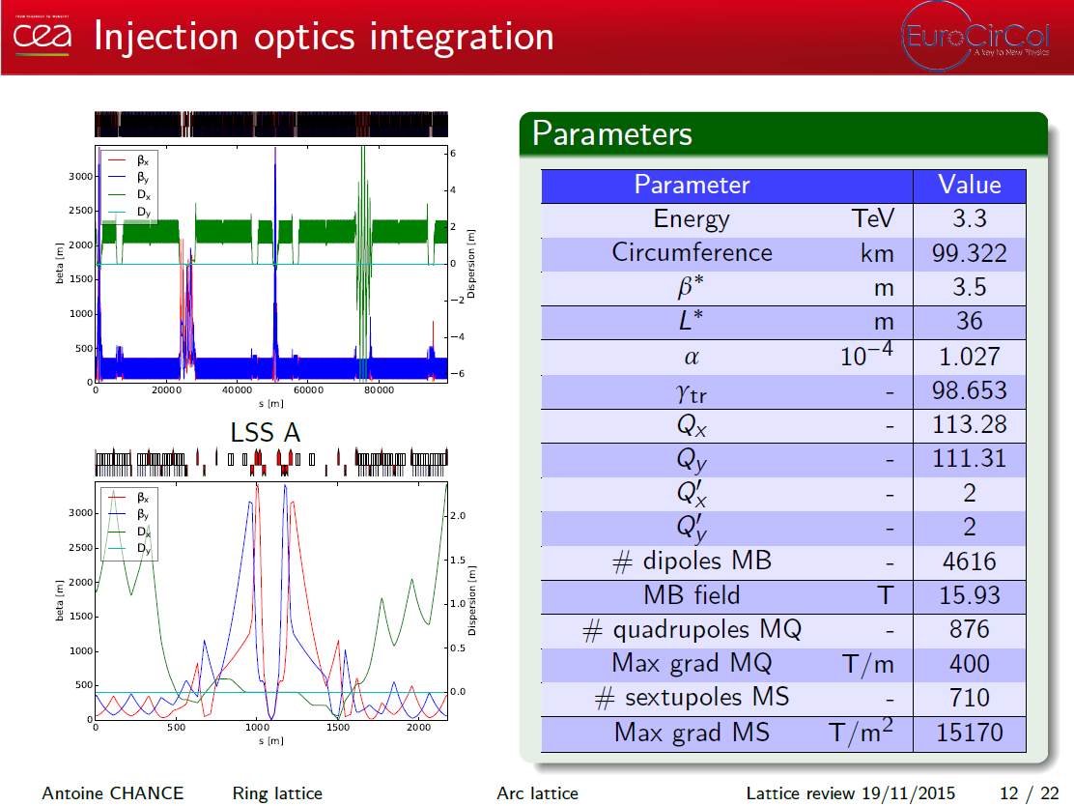
Injection optics integration

Slide 17
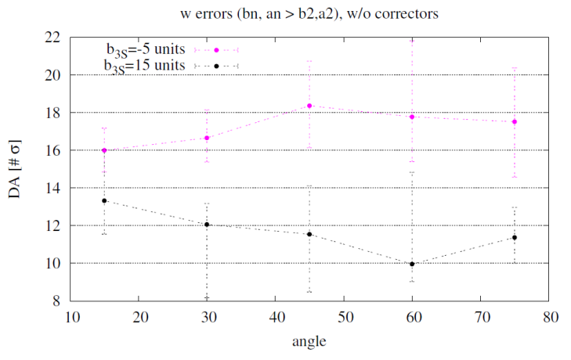
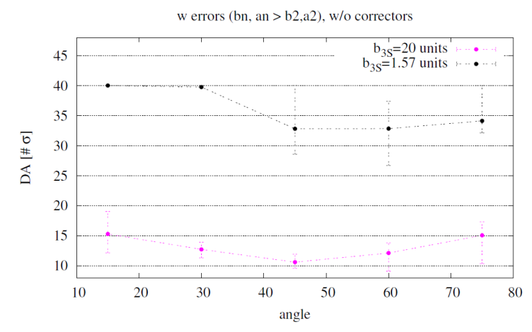
DA with errors and w/o correctors
injection β*=3.5 m
Inputs long-term DA study:
60 seeds
30 particle pairs
Emit norm 2.2e-6 m.rad
E₀ = 3.3 TeV, 50 TeV
Q’ = 2
dp/p = 0.00075 (LHC)
dp/p max = 0.002
σ step = 2, σ ϵ [2-40] explored
5 angles ϵ [0,90º]
“Systematic” b3 uncorrected (chromaticity due to b3 corrected)
collision β*=0.3 m
Courtesy: Barbara Dalena

Slide 18
Dipole field quality
  Tools to evaluate dynamic aperture developed and provided to the collaboration
      First evaluation of dynamic aperture due to dipole’s field quality:
      5 units of uncorrected b3 at injection are not a problem
      20 units of b3 in collision are too much, b3 less than 3 units has been specified for the moment with twice more b3 correctors strength (which seems feasible)
      The counterpart is that 10 units of b3 are to be expected at injection (E. Todesco)
  To be done:
      Implementing b3 correction scheme and verify DA (injection and collision) with correction and new b3 values
      Defining tolerances for the other main multipole errors

Slide 19
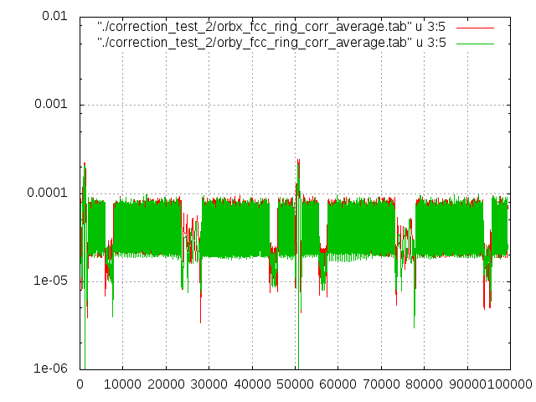
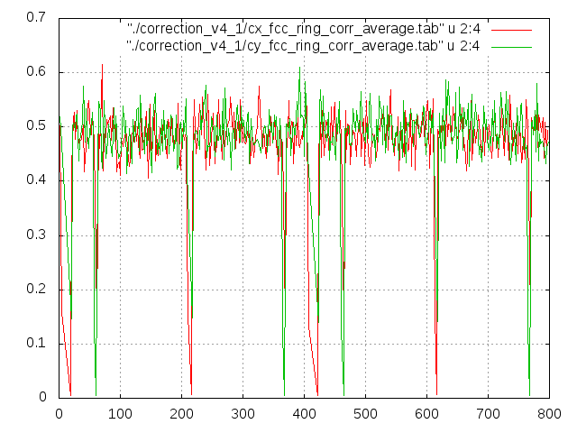


Tolérances sur l’alignement
  Effects of the magnet misalignements on the closed orbit and optics under study
  Here: example of the misalignment of the arc quadrupoles by 0,2 mm RMS (statistics on 100 samples).
Residual orbit
Strengthes RMS correctors
X or Y RMS
BL [T.m]
s [m]
# correcteur

Slide 20
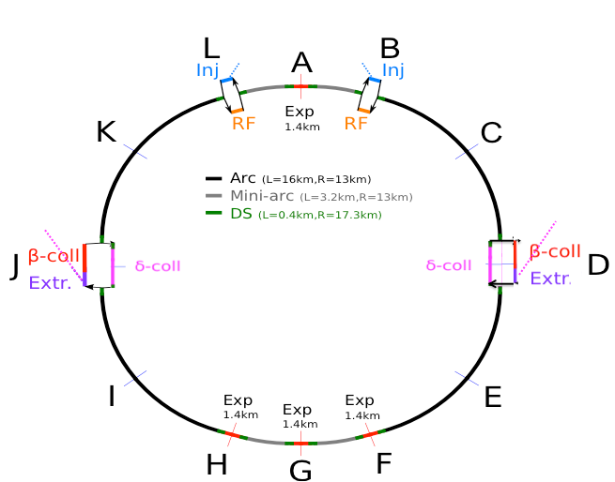
Status of Collimation
Design and consolidation of option 1 for collimation.
Option 1:
  Preparation of different options for momentum collimation optics :
  optics scaled from LHC momentum collimation section or new optics
  based on fodo cells.
  Exploration of different possibilities for dispersion management in
  momentum collimation section ( matching, chicane optimisation, phase
  advance tuning).
  First study of integration of 2 beams with their layout. Addition of dog-leg if needed to optimise beam separation, according to integration possibilities.
  Writing of a note before Rome’s FCC week to summarize option 1.
  Sixtrack debugging to enable Sixtrack running with FCC collimation system with active collimators
  Working on enhancements to Sixtrack post-processing tools for collimation.
  Found and ﬁxed working on more detailed beam pipe models
  First Loss map calculations with Sixtrack and Merlin and benchmarking of the codes (see next slide for some results, only betatron collimation)
  Working on an optic designs for an new energy collimation based on a scaling of LHC – IR7
Extraction followed by betatron collimation for beam 1
Momentum collimation for beam 2.

Slide 21
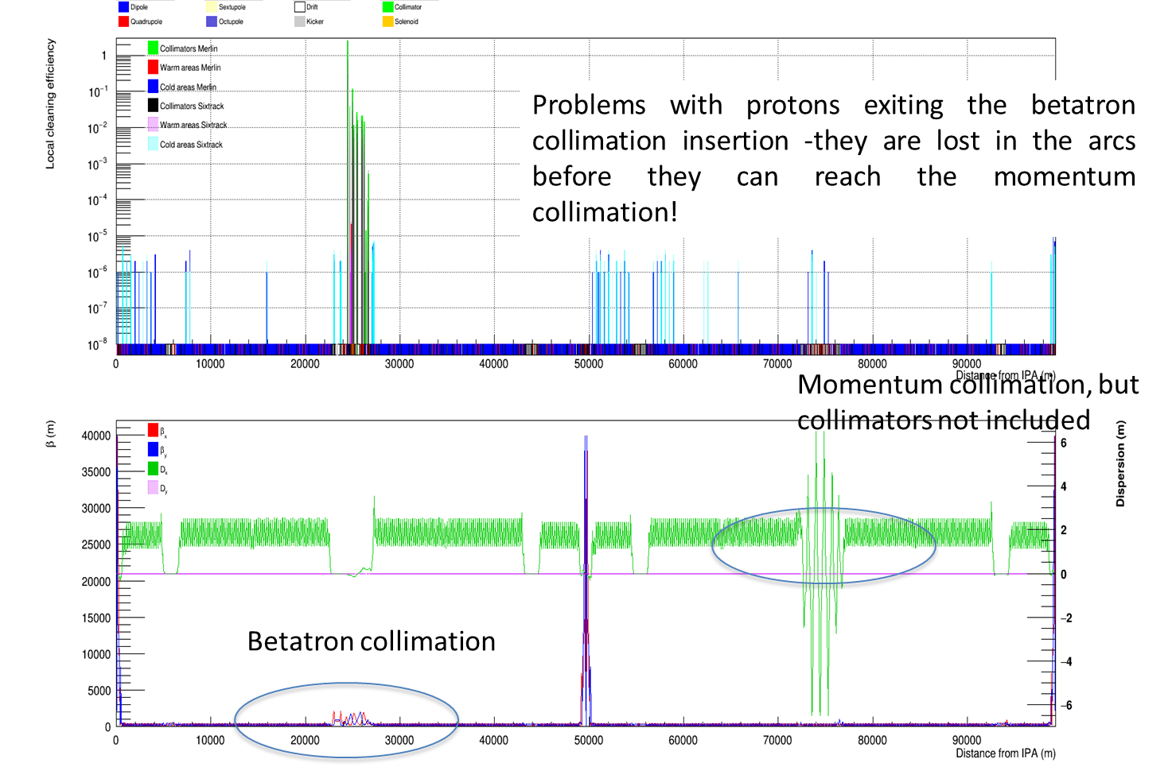
Loss map for FCC-hh V5
Courtesy: James Molson (LAL)

Slide 22
FURTHER STEPS
  Some issues are met on the design of the momentum collimation section. A working programme has been defined to be tuned at the FCC week 2016. James Molson agrees to help Antoine Lachaize scaling the LHC momentum collimation section.
  A new version on the whole lattice is under preparation but some information is still lacking to finalize the baseline optics:
      Distance between magnets, L* to be used, …
      Some naming convention for the arborescence of the different versions on the repository may be useful (to differentiate the different versions or alternatives).
  We have two baseline schemes and two alternatives. The lattice of the FCC ring must be made for all schemes to allow more detailed studies and steer our choices.
  Different extraction section schemes must be integrated : LHC scaled (presented here), SSC-like or asymmetric dump section.
  More detailed studies must be performed to choose the baseline.
  We have different schemes for ESS (extraction + β-collimation, extraction + δ-collimation, β-collimation + δ-collimation, or . . .)
  The collimation inefficiency must be evaluated with tracking studies.
  Some constraints on the dispersion suppressor or on the ESS are likely to appear for the machine protection.
  More advanced schemes must be explored. Example : chromaticity correction with several sextupole families (like the ATS scheme for HL-LHC).

