Slide 1

WP4 RF equipment needs 20160603 (updated 20160609)
eric.montesinos@cern.ch
frederic.killing@cern.ch
HL-LHC Integration meeting

Slide 2
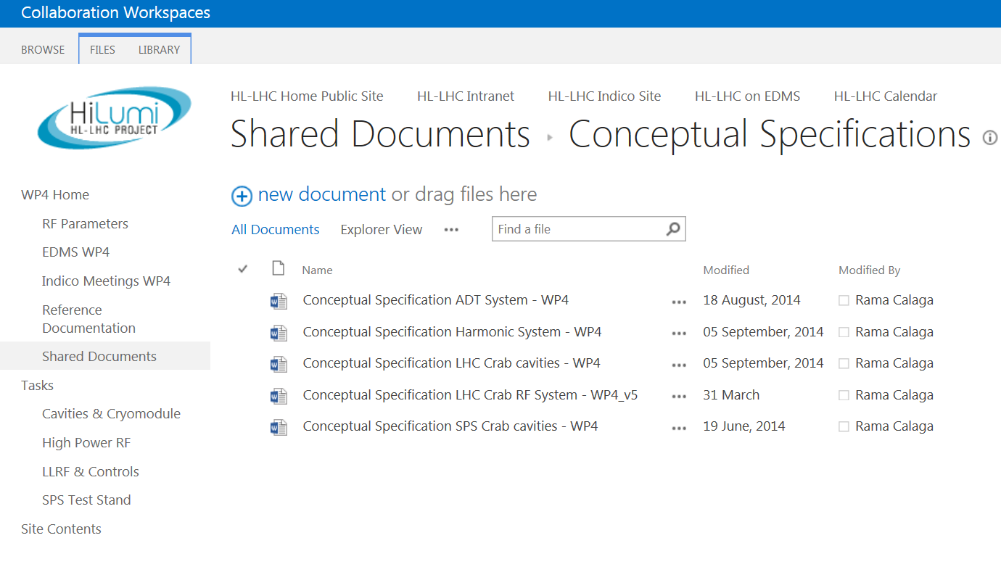
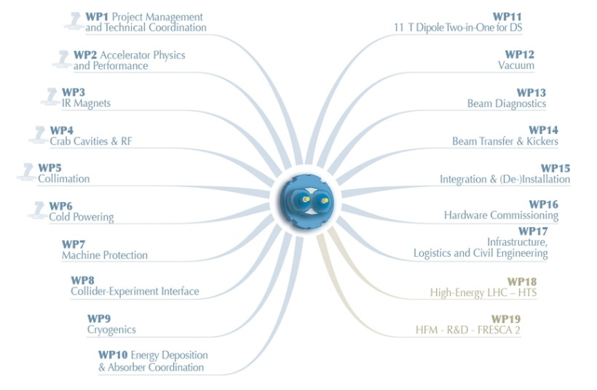
Conceptual specification
Reference document:
Conceptual specification updated 31st March 2016

Slide 3
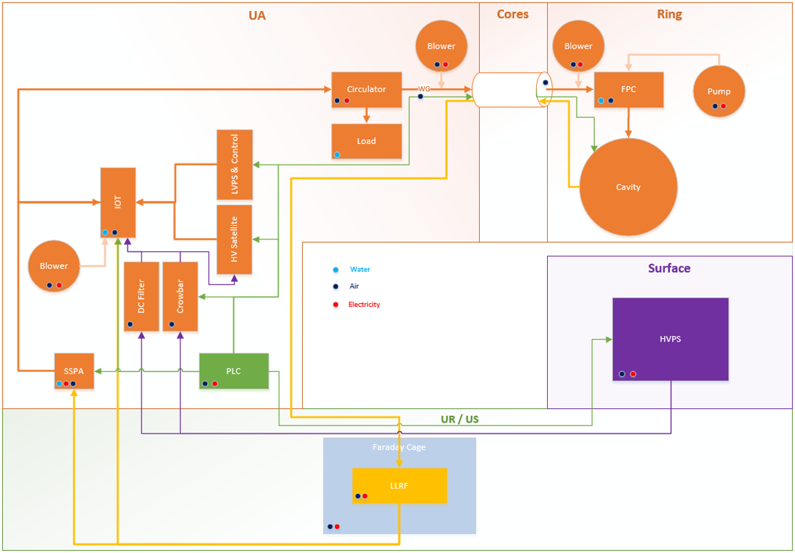
RF System Bloc Diagram per IP side
One Power unit per cavity (nor more combination of tubes)
Crowbar + HV filters in UA
HVPS moved to surface building

Slide 4
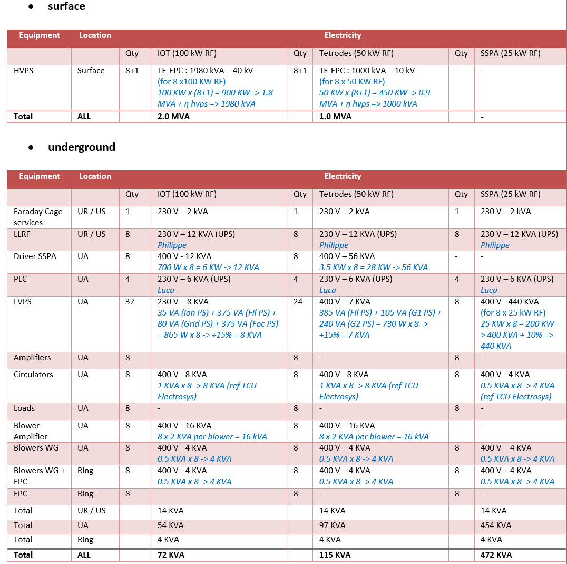
Table 4 : Electricity requirement : for one IP side RF system the following services are required

Slide 5
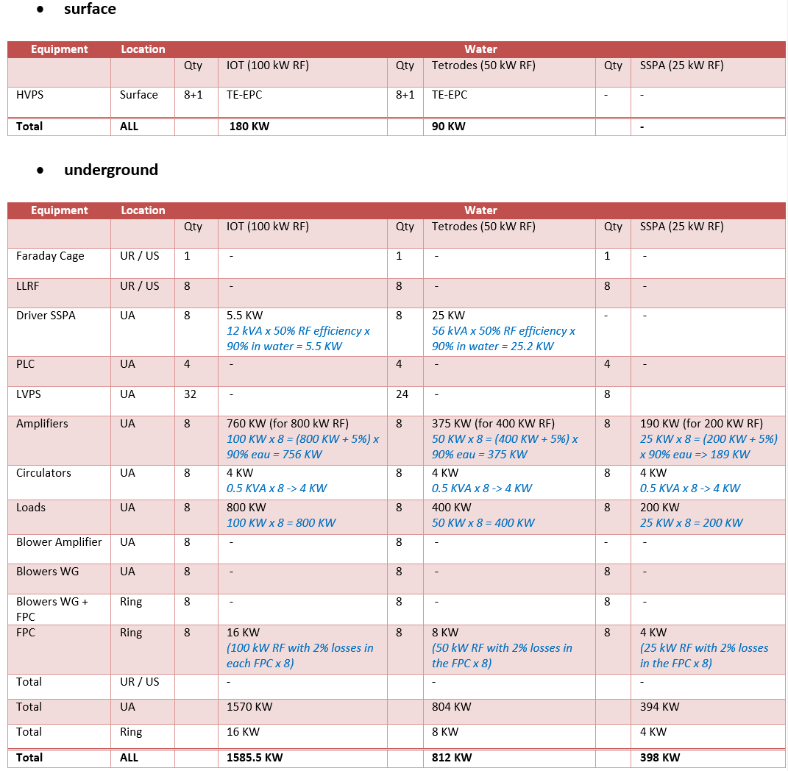
Table 5 : Water requirement : for one IP side RF system the following services are required

Slide 6
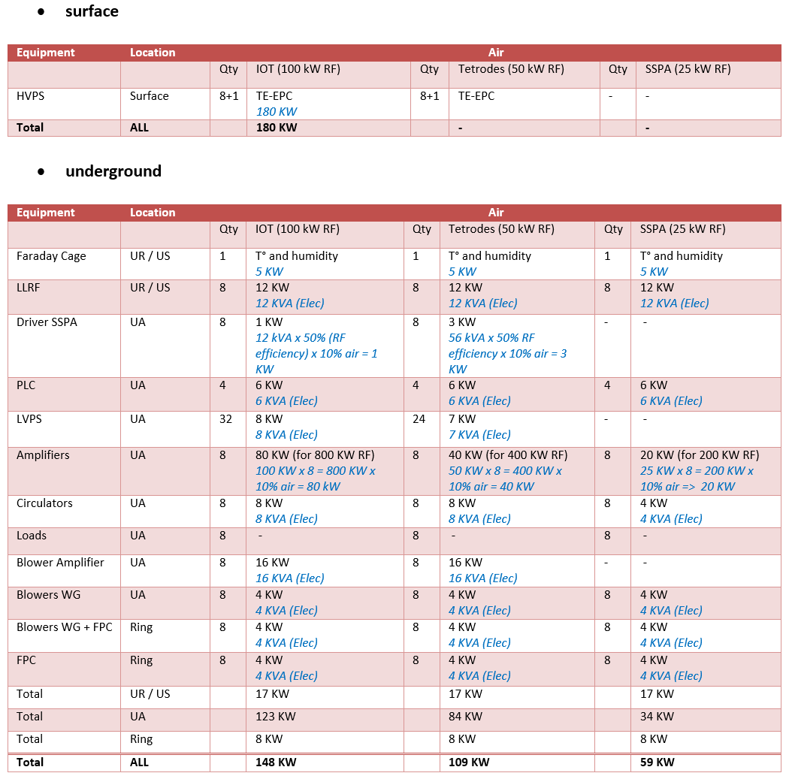
Table 6 : Air requirement : for one IP side RF system the following services are required

Slide 7
Losses summary
UR/US + UA | IOT 8 x 100 kW | Tetrode 8 x 50 kW | SSPA 8 x 25 kW
Water [kW] | 1570 | 804 | 394
Air [kW] | 140 | 96 | 46
Total losses in UR/US + UA [kW] | 1710 | 900 | 440
HVPS numbers NOT included, Surface building

Slide 8
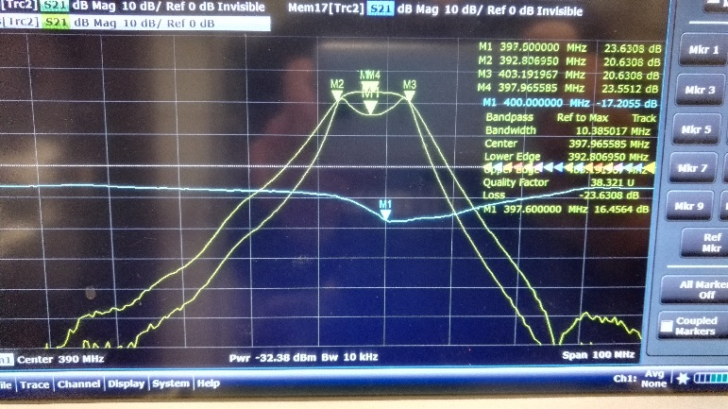
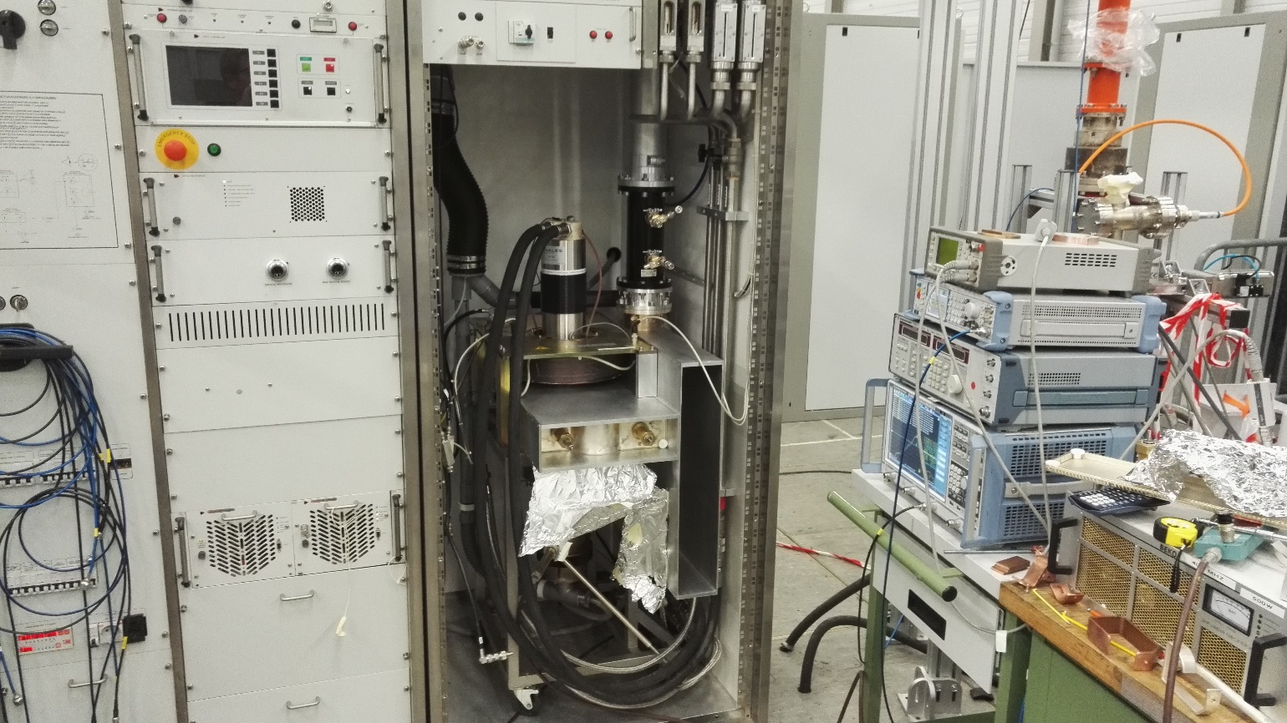
IOT : baseline option
Modification of the IOT station to be operated at 400 MHz, new output cavities & new coupling elements redesigned at CERN
58 kW CW tested
IOT as new baseline confirmed

Slide 9
Losses summary
Baseline
Optional
UR/US + UA | IOT 8 x 100 kW | SSPA 8 x 25 kW
Water [kW] | 1570 | 394
Air [kW] | 140 | 46
Total losses in UR/US + UA [kW] | 1710 | 440

Slide 10
Thanks

