Slide 1
Stave QA: Weekly Update
Carlos Vergel Infante / Boping Chen
Nov 2 – 2016
GO CUBS!

Slide 2
Last week…
We found something was going on wrong about moving the cart.
We found out that the motor of the linear stave gets hot, very hot (almost 70C).

Slide 3
What about temperature across the plate?
So we moved the cart away from the motor (not ideal solution).

Slide 4
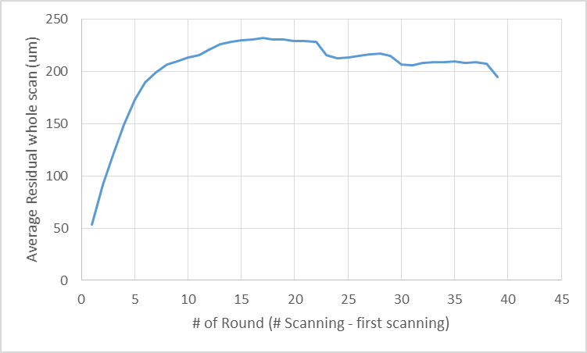
Let’s remember
In previous experiment, the max value was over 200 um
In the new position of the stave, the thermocouples do not change in temperature.

Slide 5
But the mean still changing
The problem stills there, but the maximum value is smaller than before, it is around 120 um.

Slide 6
Height (mean) as a function of motor’s temperature
The relation is not linear, but we also have to take into account the time for the heat to go from the motor to the stave (distance ~ 1 m)
Height (um)
Motor’s temperature (c)

Slide 7
Using vent for cool down the motor
The maximum value of the motor is 35 C, a reduction of almost half of our previous results.

Slide 8
Then, after scanning 17.5 cm x 12 cm we get
A reduction again of the maximum value of the mean, now is somewhere at 50 um. However, still increasing even a little bit.

Slide 9
Summary
We know the problem is related to the motor’s temperature.
We need to look into the motor more carefully (input voltage, other models, cooling system).
Measure the increase in height of the rail close to the motor. Roy gave us a meter for the height which we will use this week.

Slide 10
Early this morning….
I changed the move from 1/64 to 1/8 in the cart, and noticed two things.
The process was much, much faster. About 40 sec to scan an area of 10 cm and return to its original position.
After 5 measurements, the problem was not observed. This might be caused because the experiment was faster than the heat to affect the setup.

