Slide 1
ProtoDUNE
Cryostat Assembly : Plans & Constraints
Joint ProtoDUNE / Neutrino Platform Meeting
CERN – Geneva - Switzerland
23rd of February 2016

Slide 2
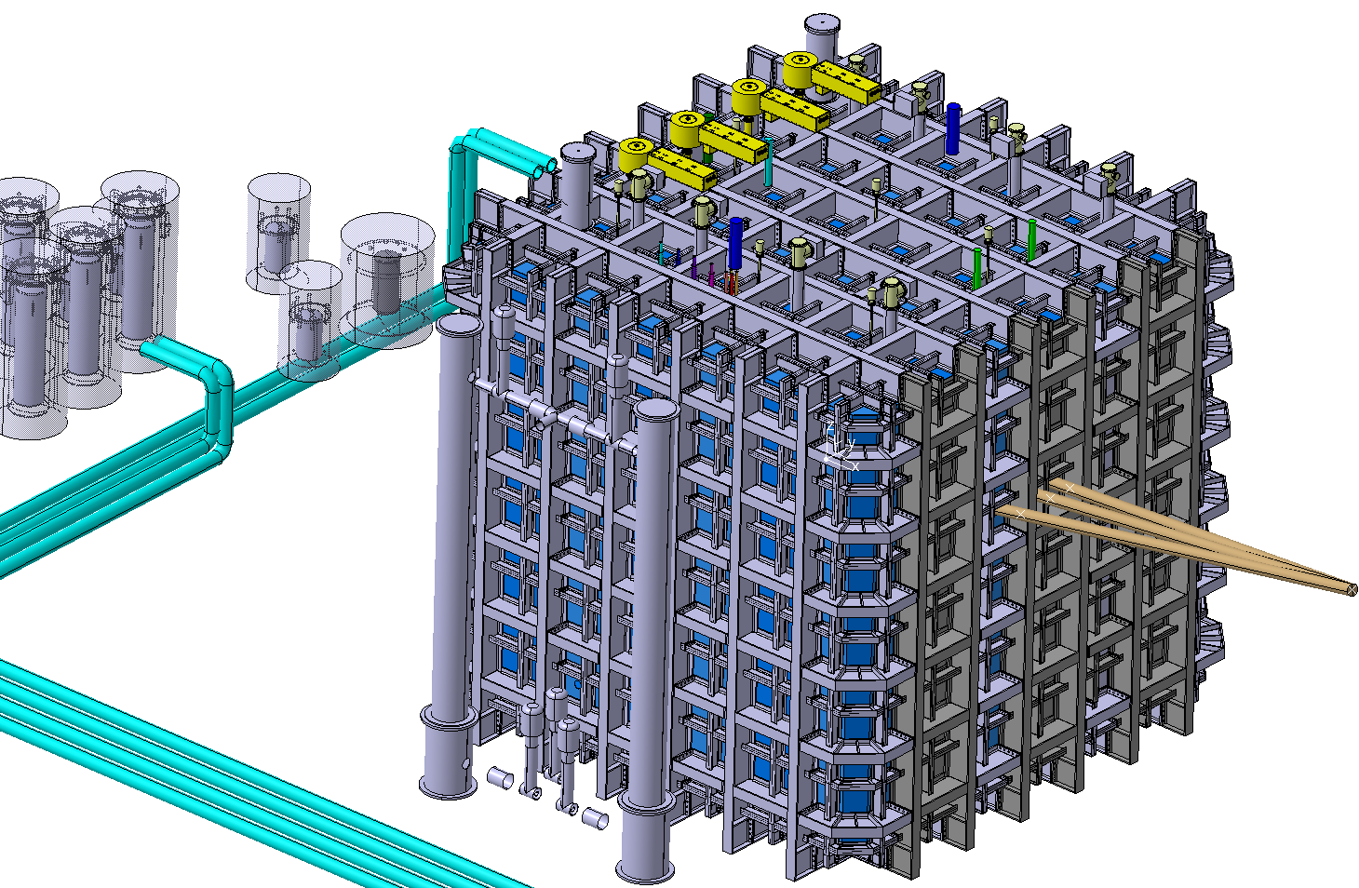
Design & Fabrication Status
Cryostat redesigned for 800mm insulation

Slide 3
Manufacturing Drawings Status
Manufacturing drawings redone and ready
Price enquiry is sent to the companies
Results expected in weeks
Manufacturing starting in April
First pieces arriving in June/July

Slide 4
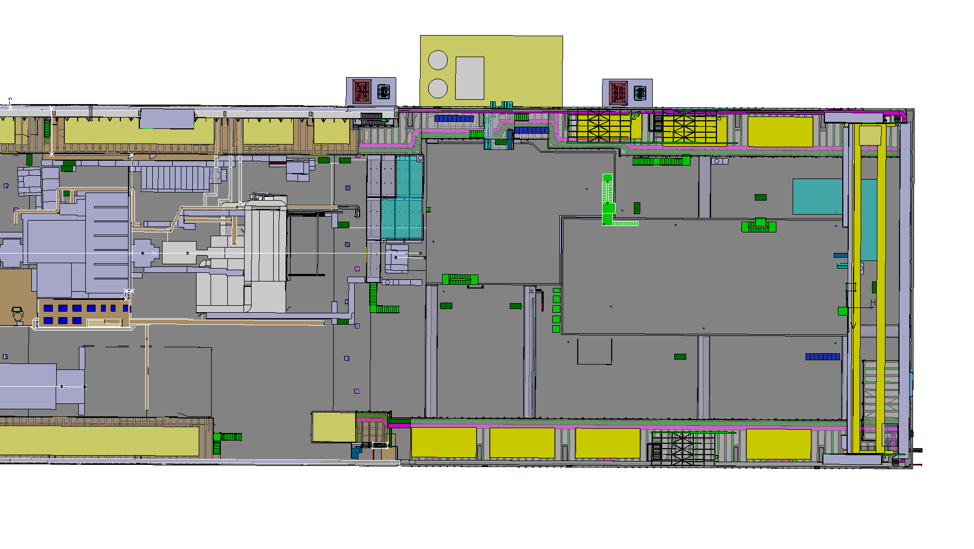
Cryostat Assembly

Slide 5
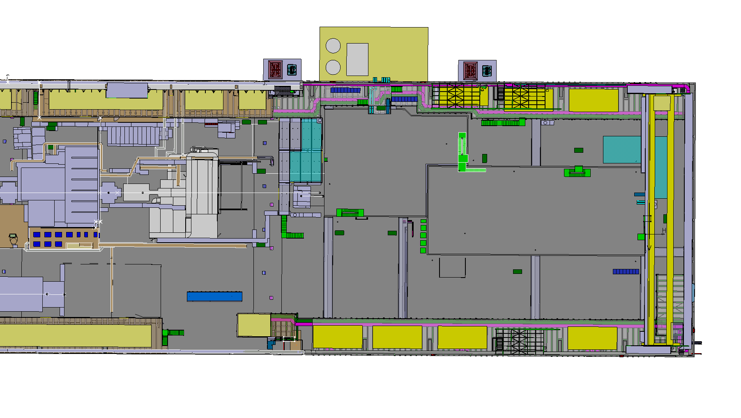

Slide 6


Slide 7


Slide 8
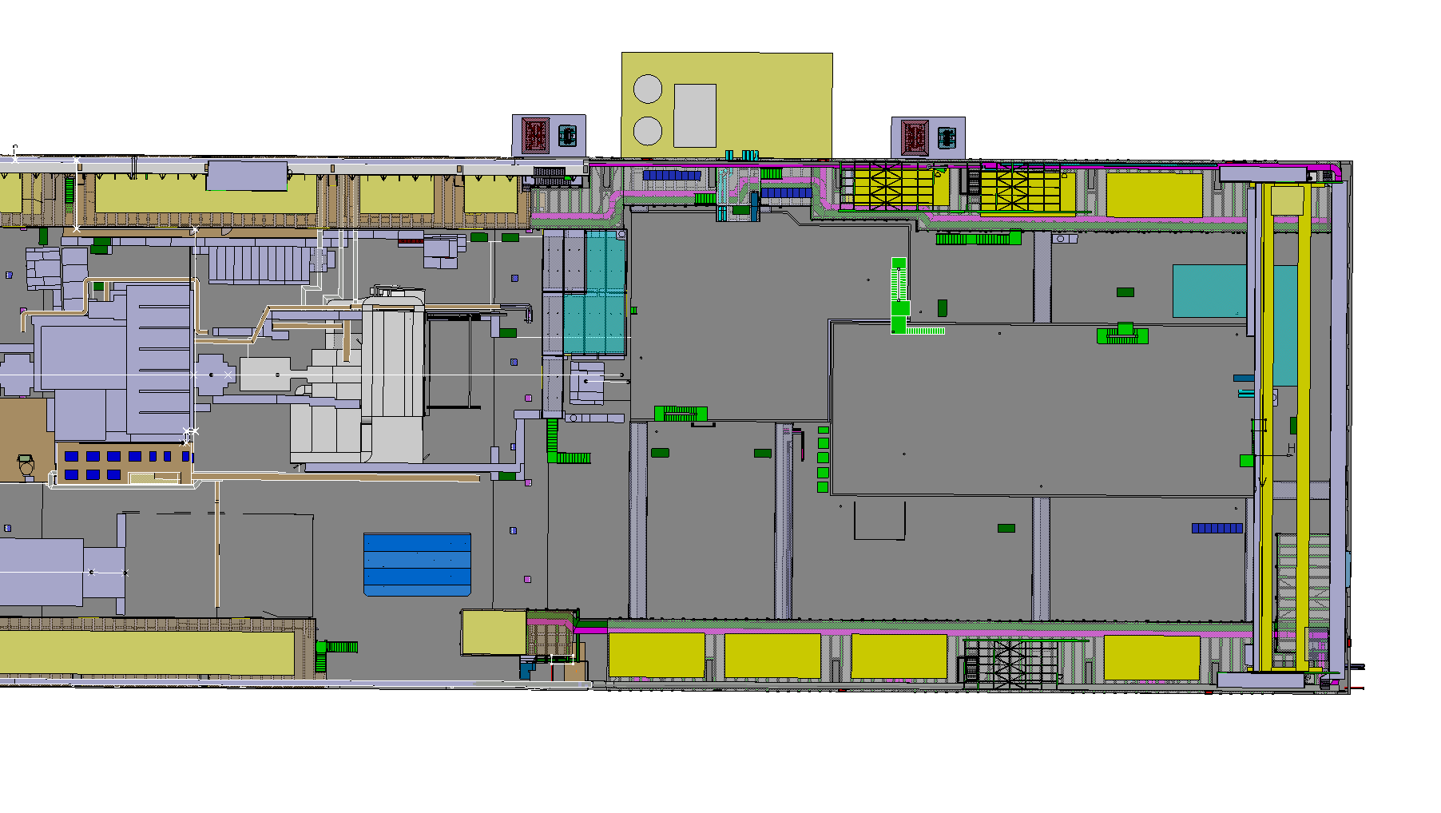

Slide 9
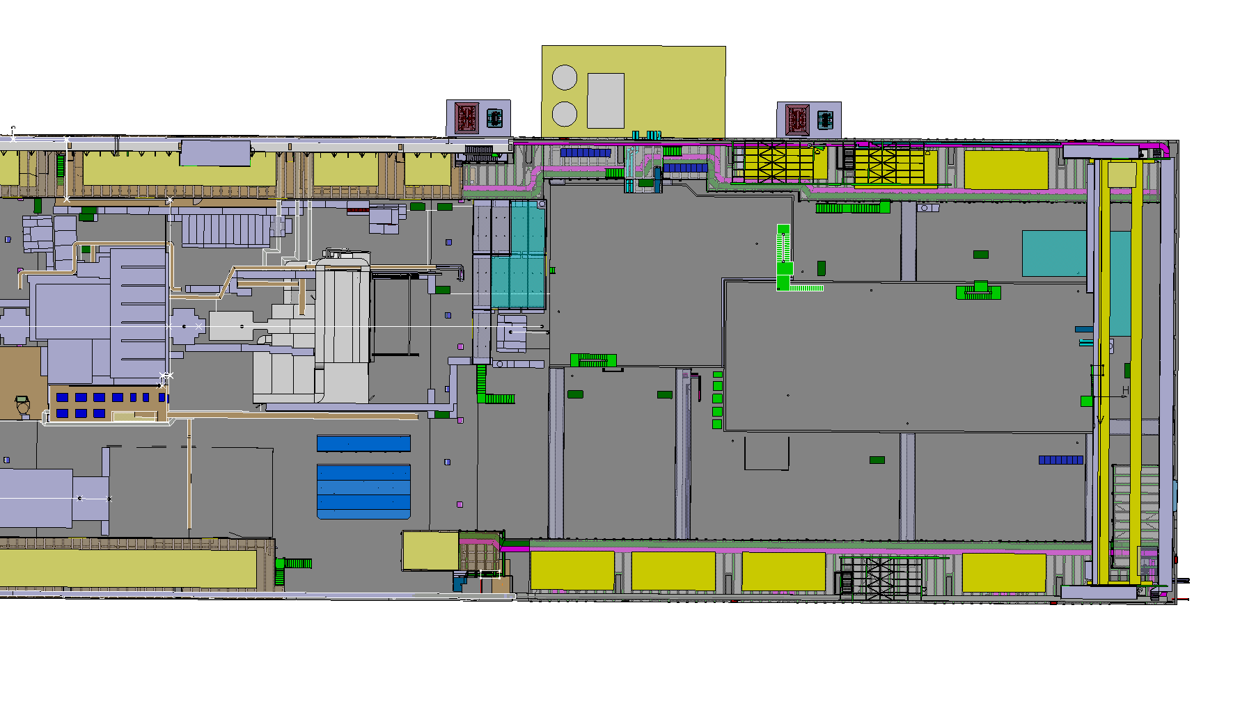

Slide 10
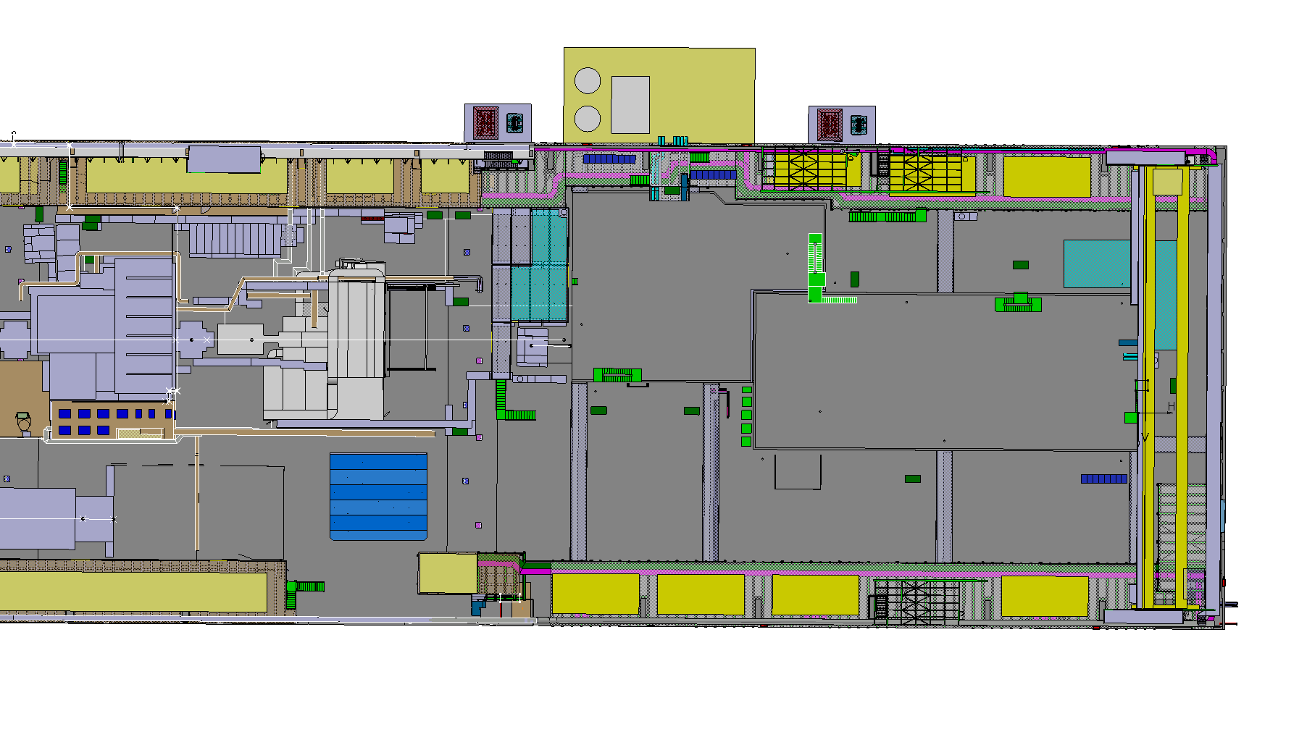

Slide 11
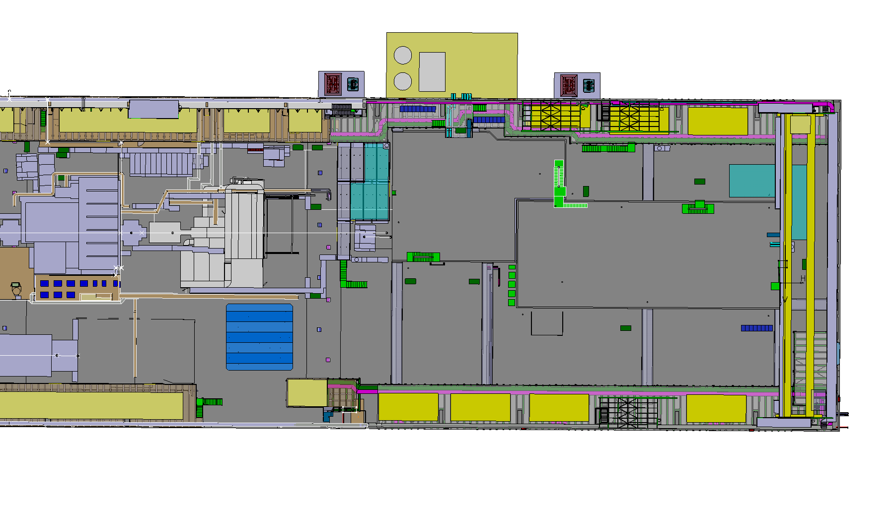

Slide 12
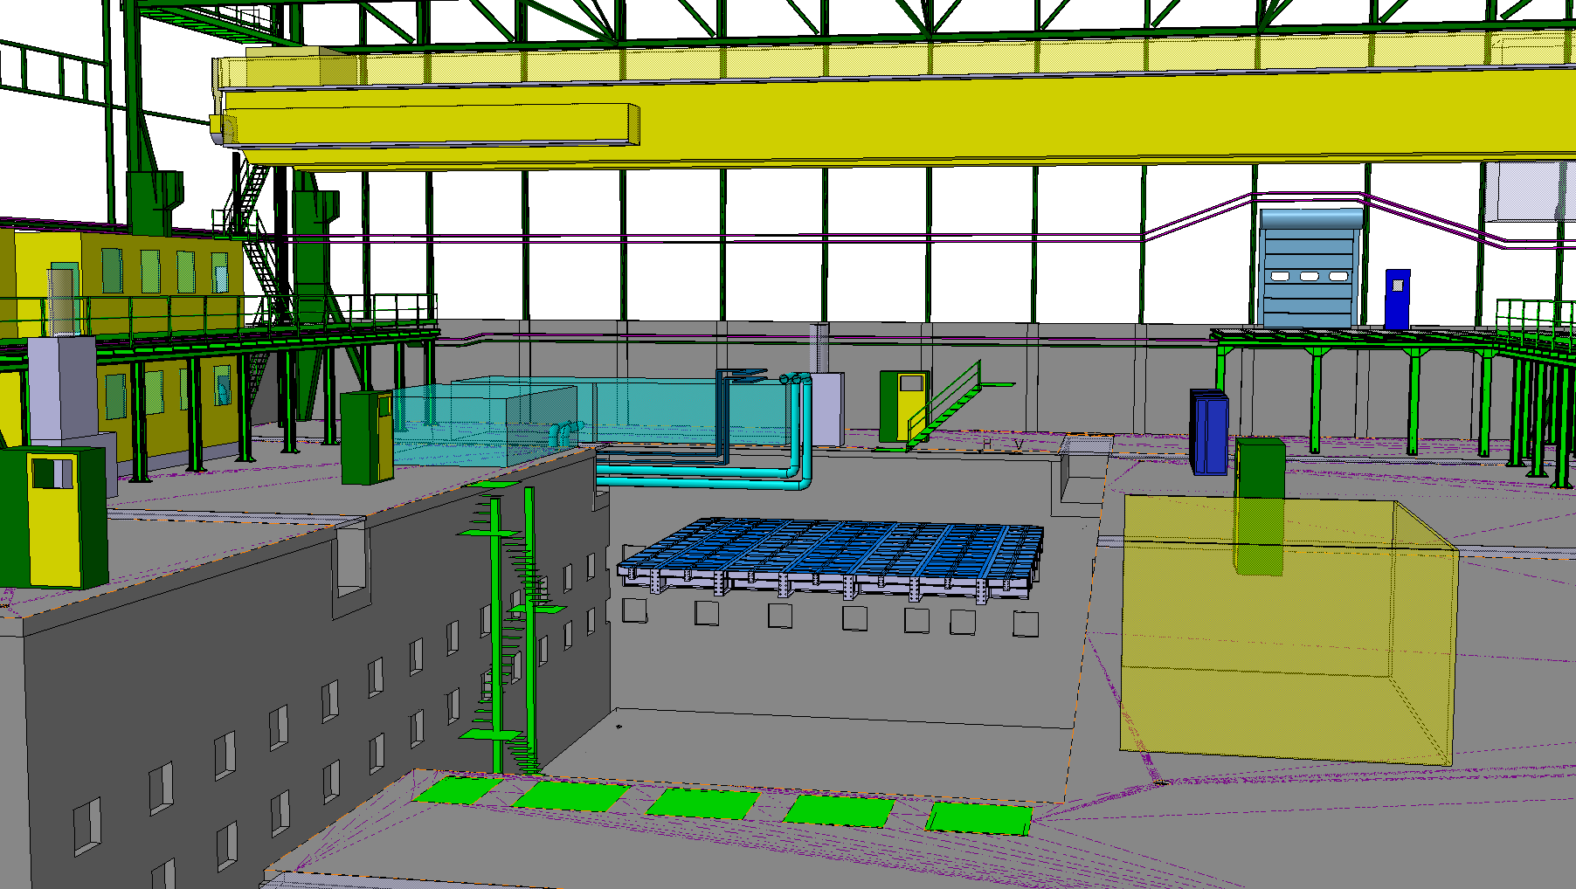

Slide 13
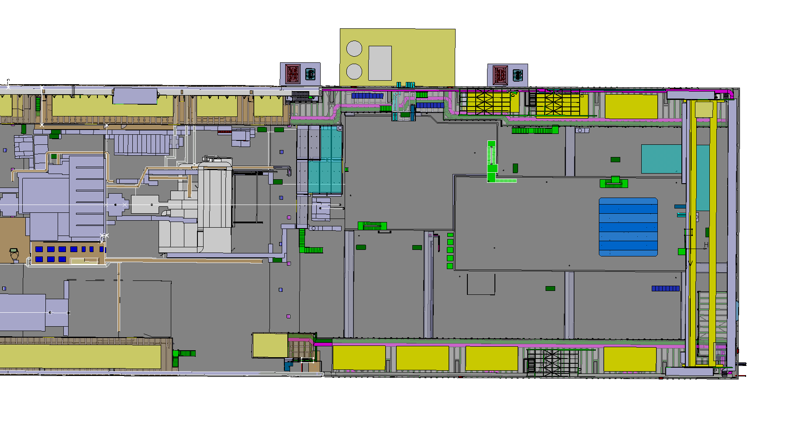

Slide 14
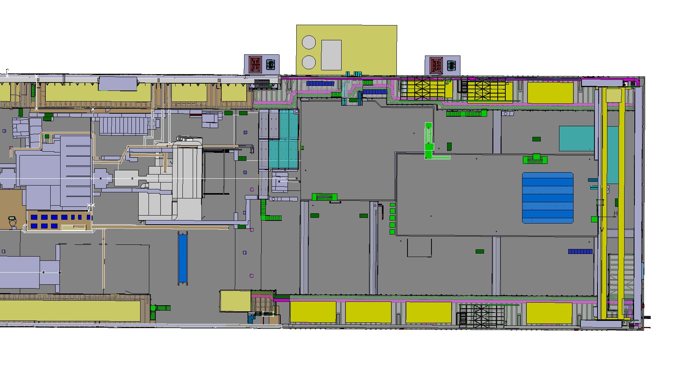

Slide 15
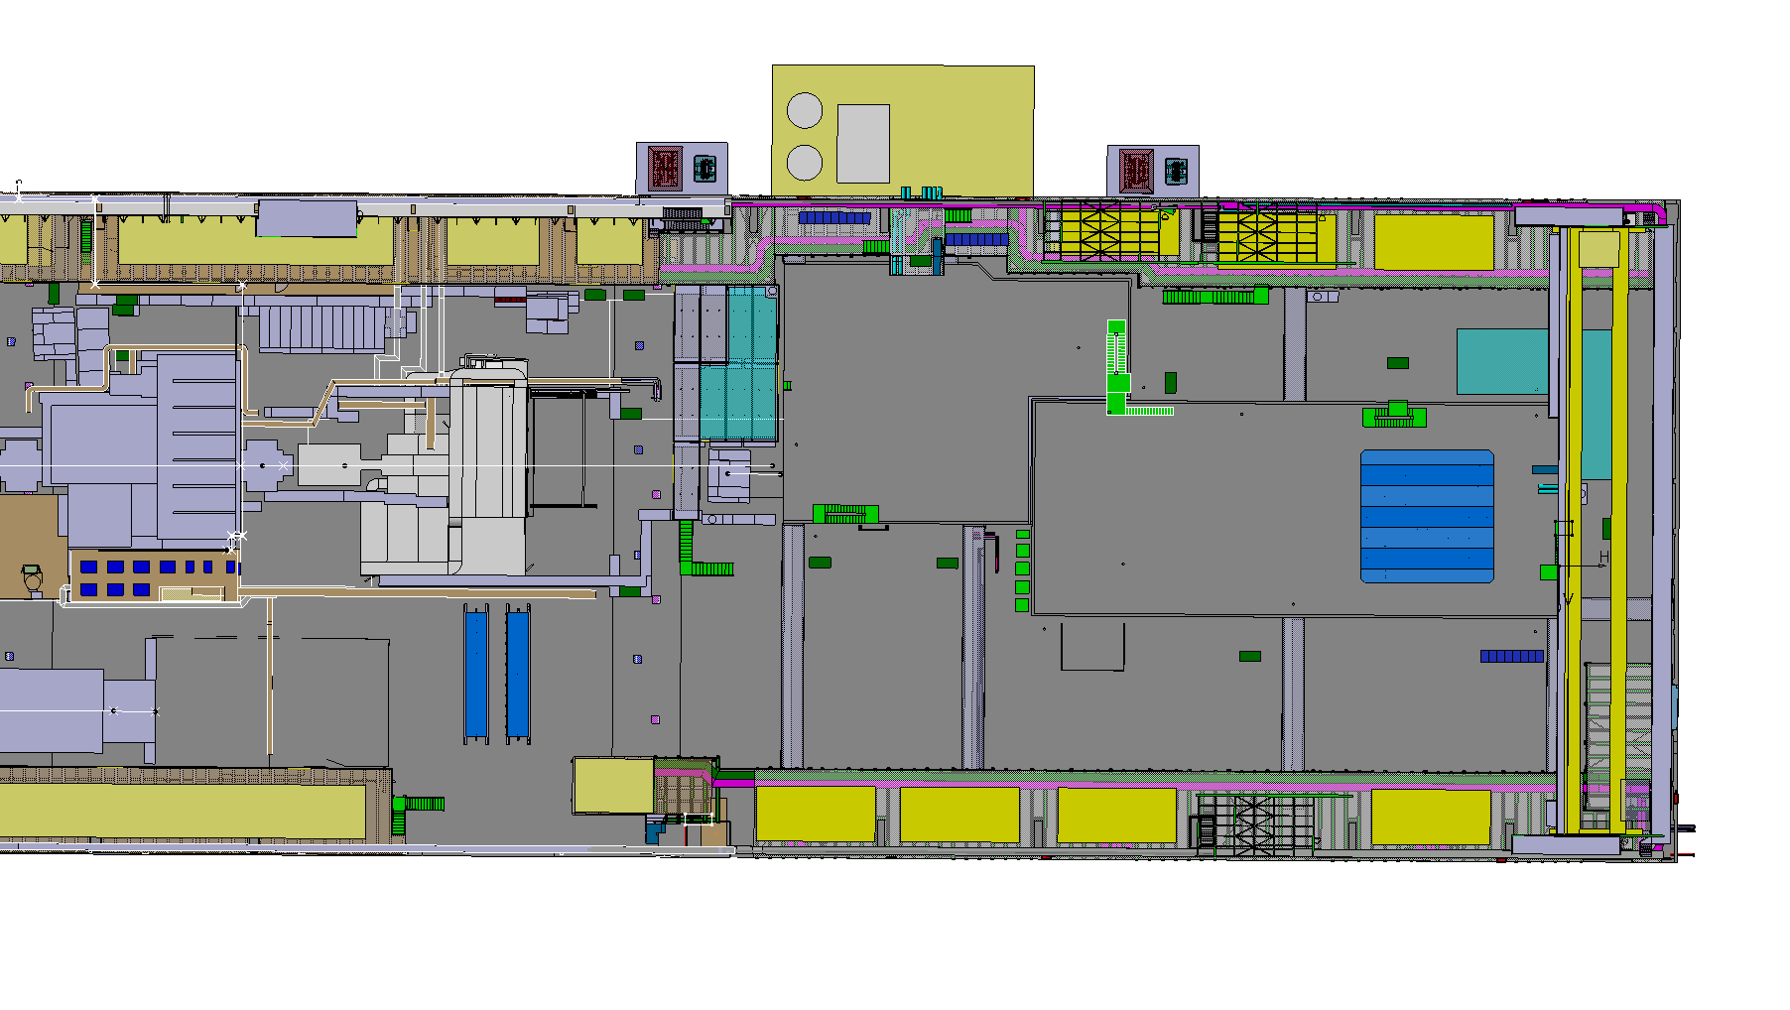

Slide 16
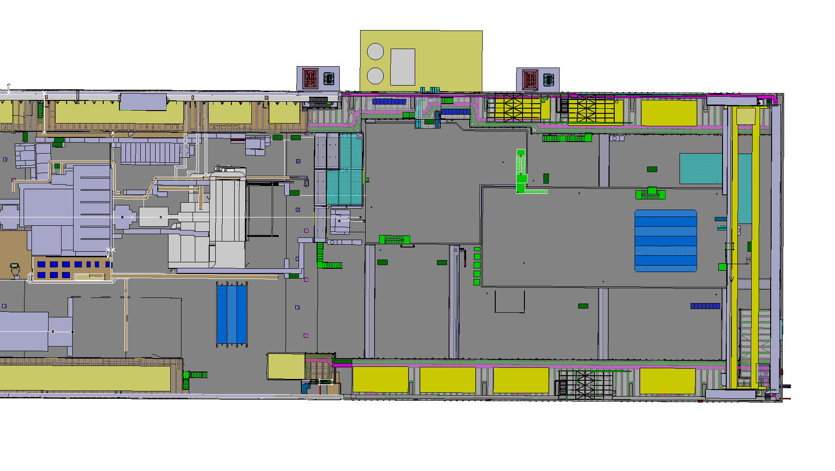

Slide 17
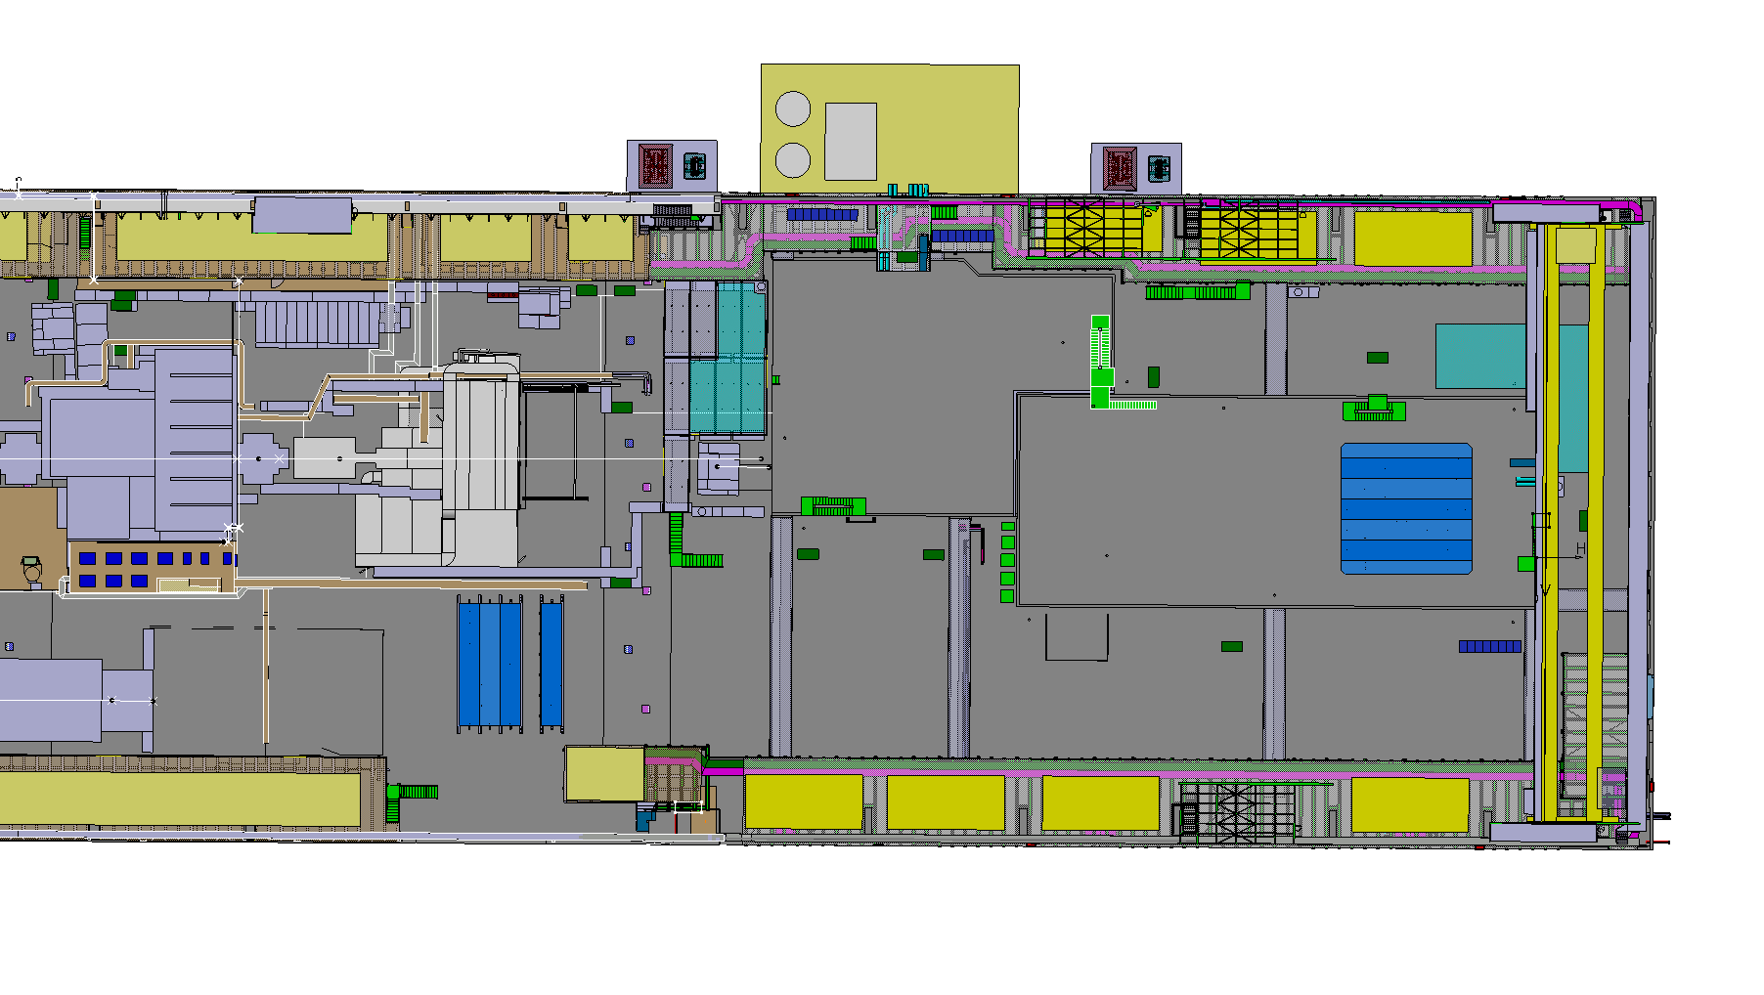

Slide 18


Slide 19
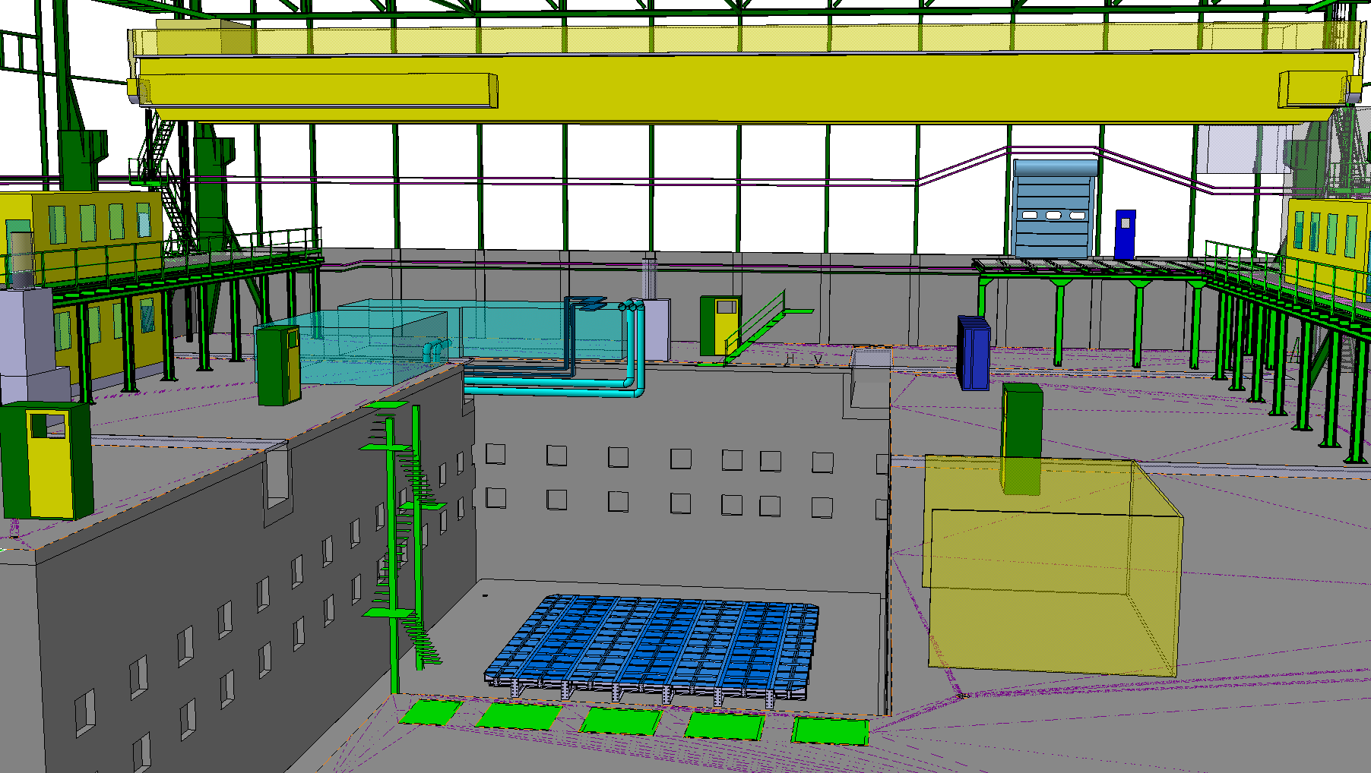

Slide 20
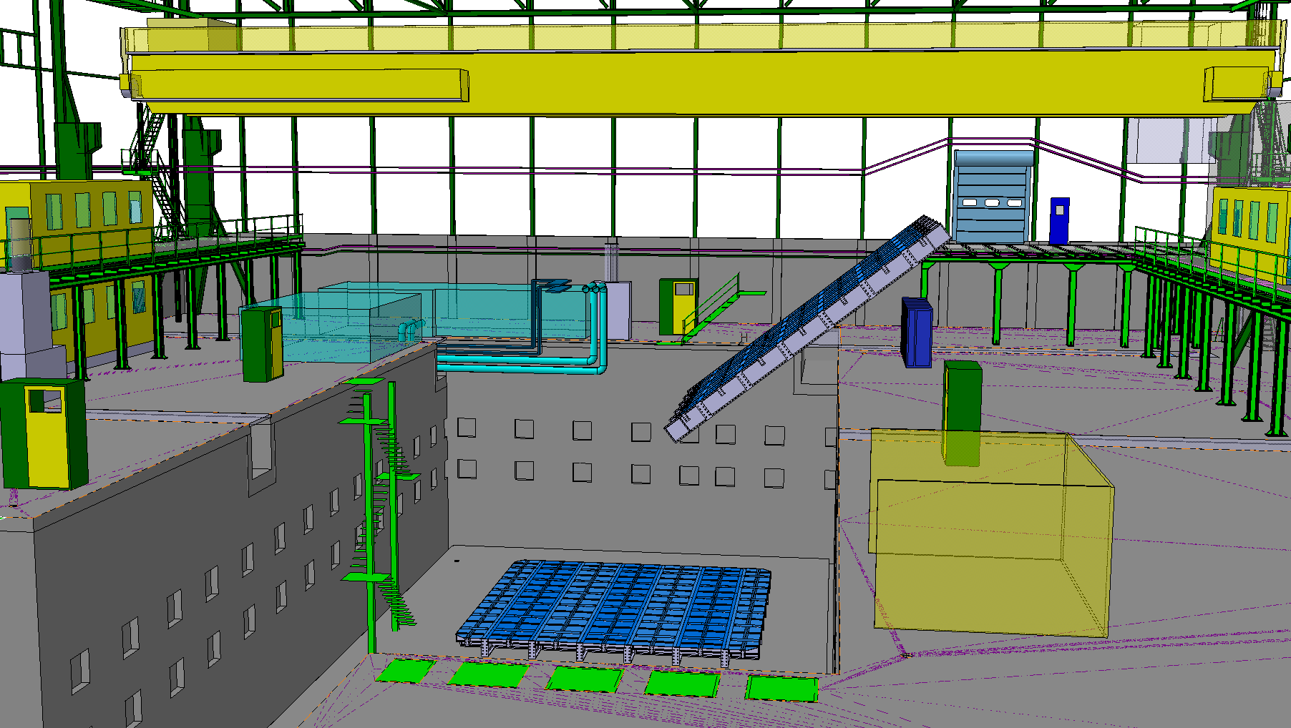

Slide 21


Slide 22


Slide 23
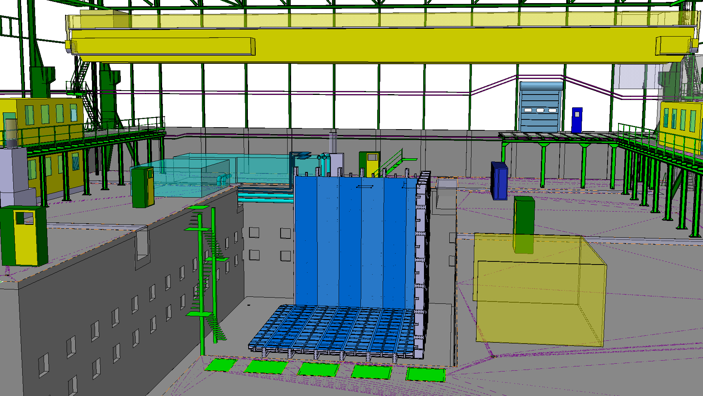

Slide 24


Slide 25
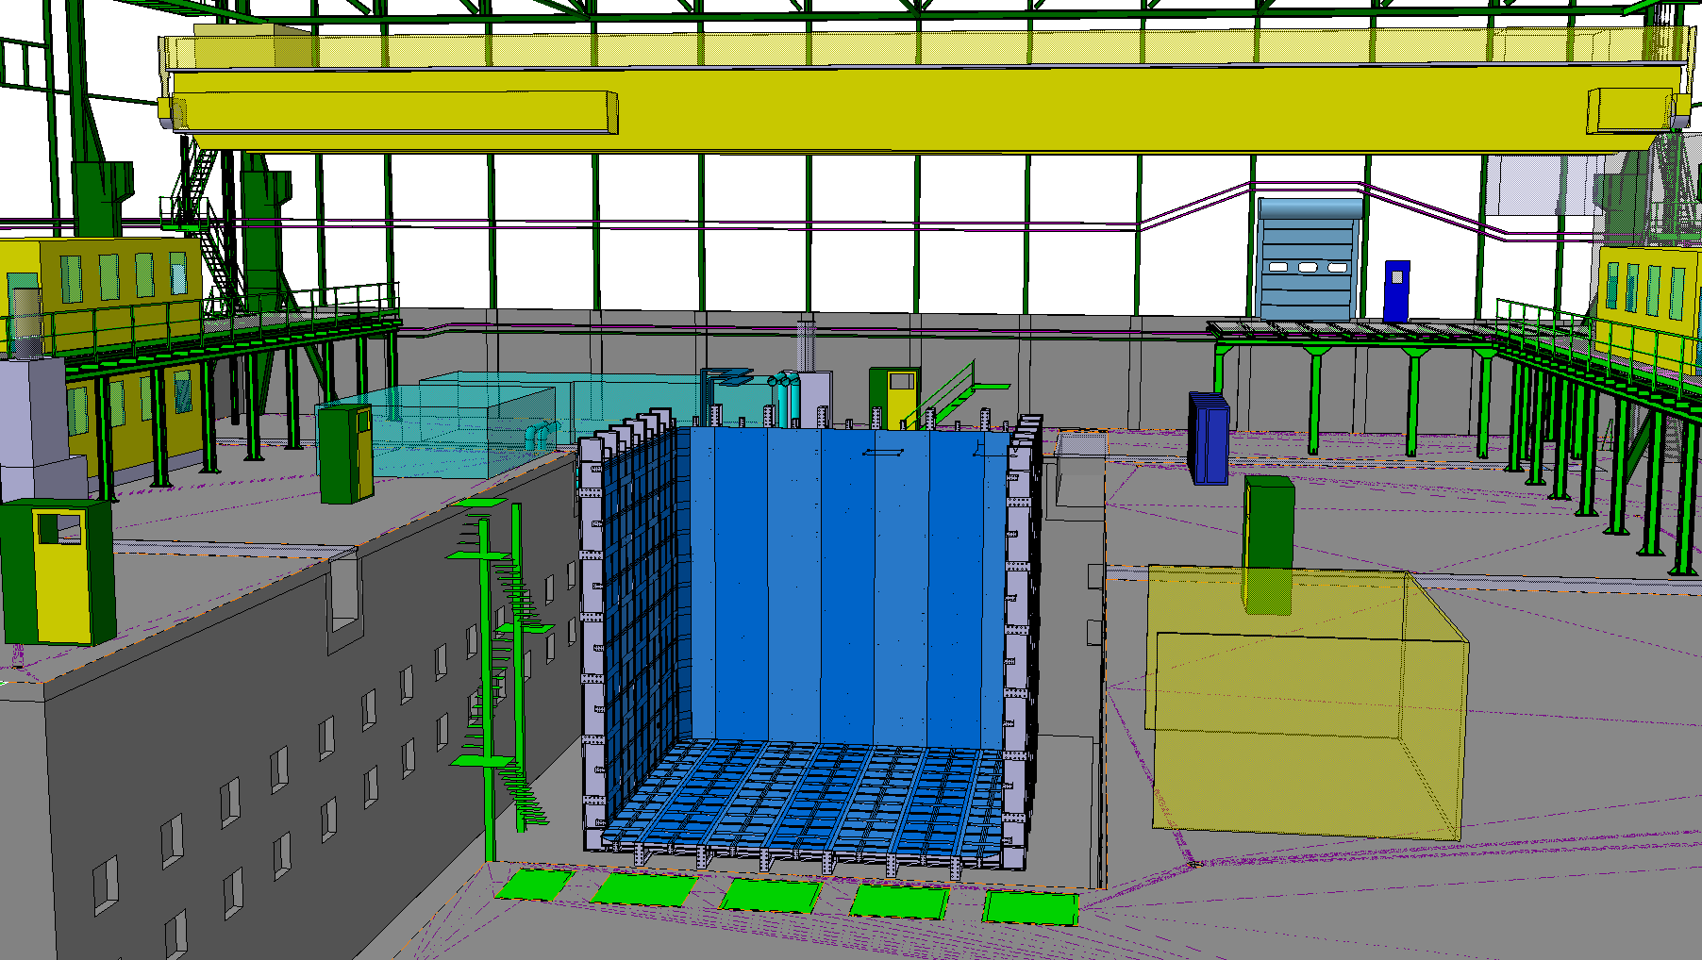

Slide 26
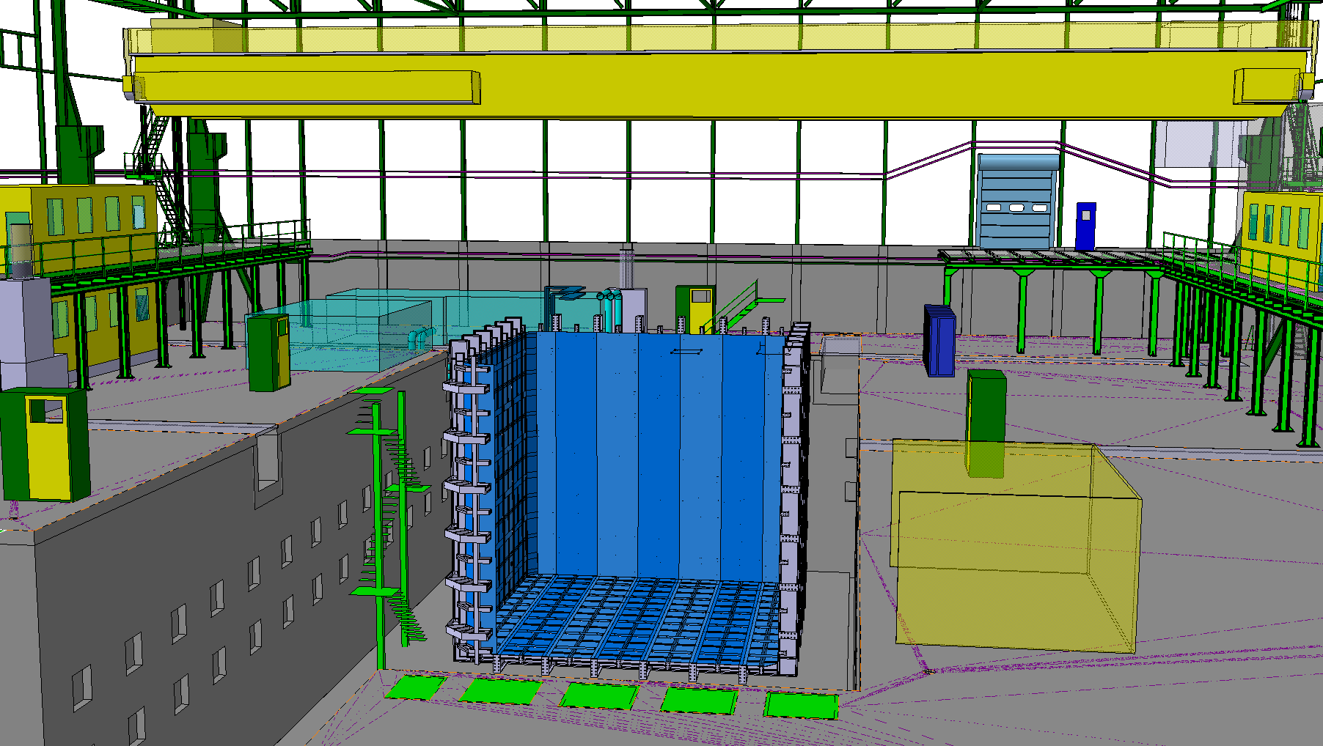

Slide 27
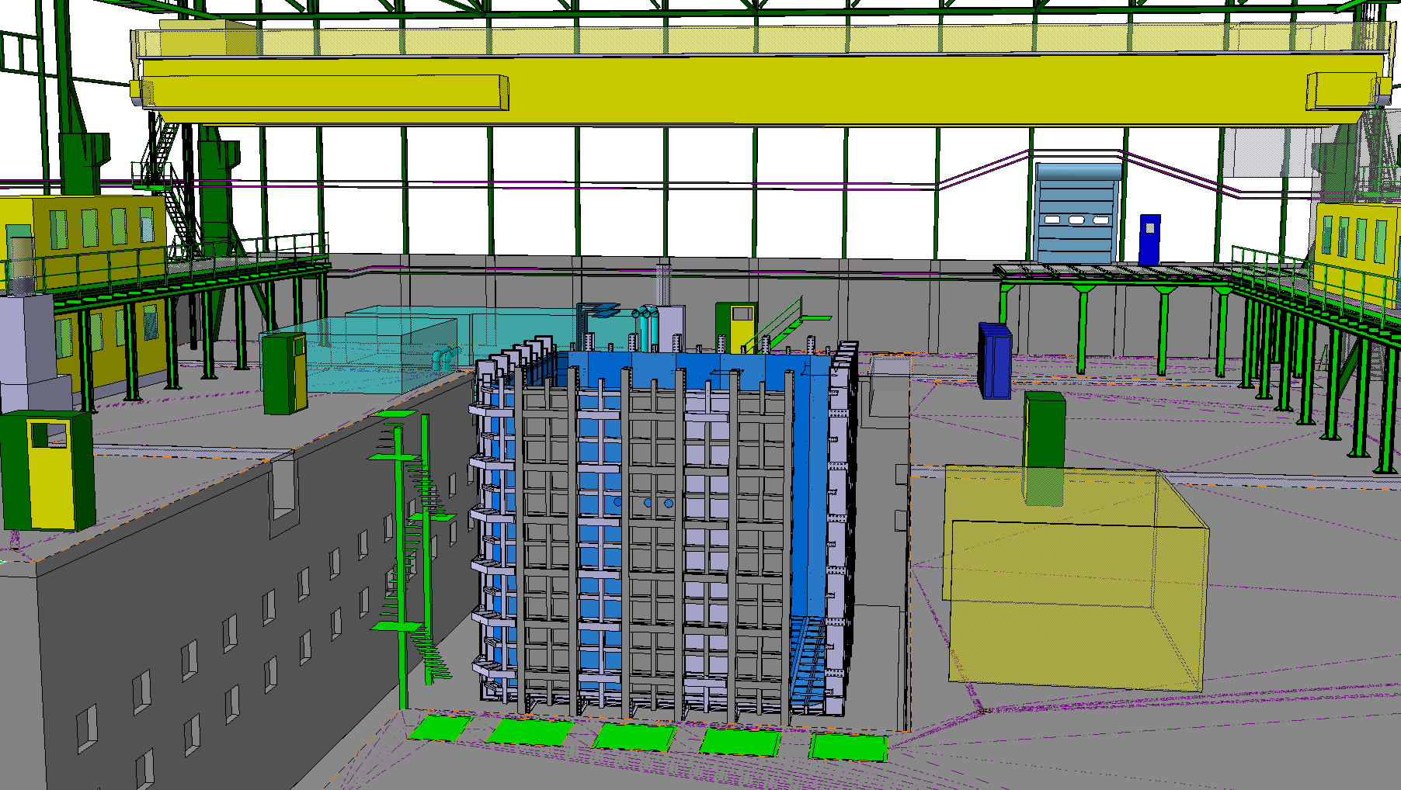

Slide 28
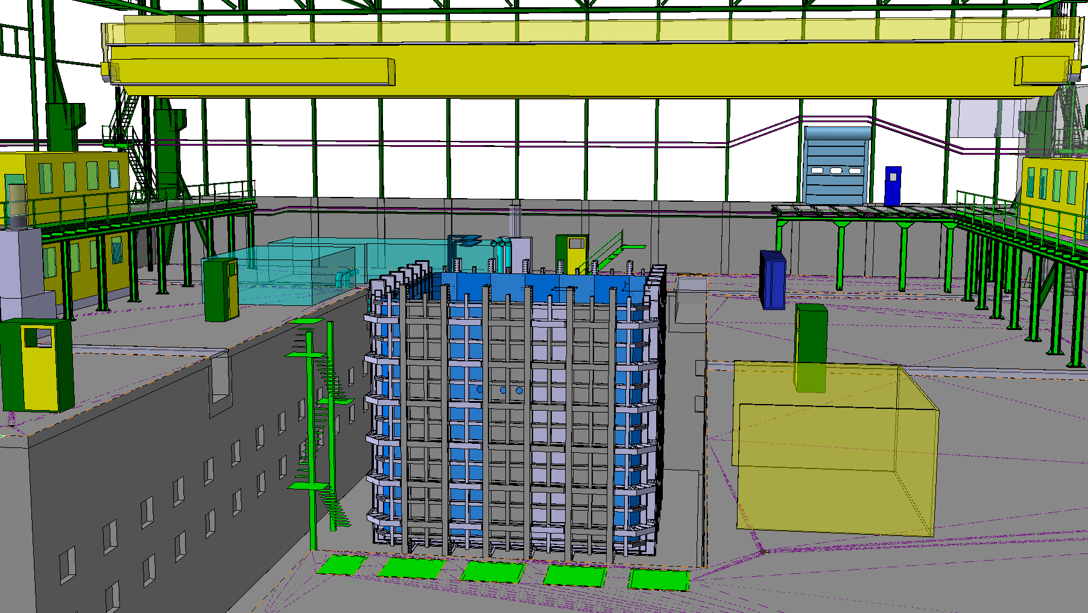

Slide 29
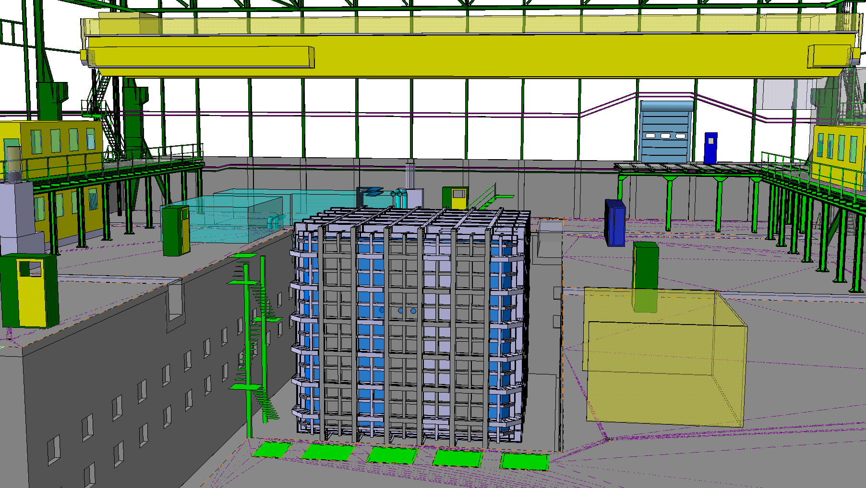

Slide 30
Thank you!

