Slide 1
CERN School of computing 09/09/2016
Cognitive Image Processing through dedicated hardware
Nicolò Vladi Biesuz

Slide 2
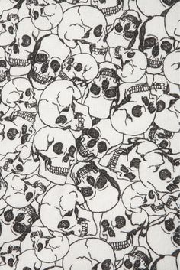

Slide 3


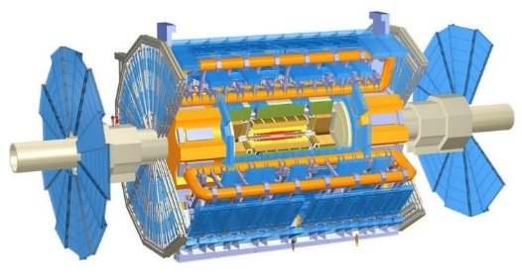
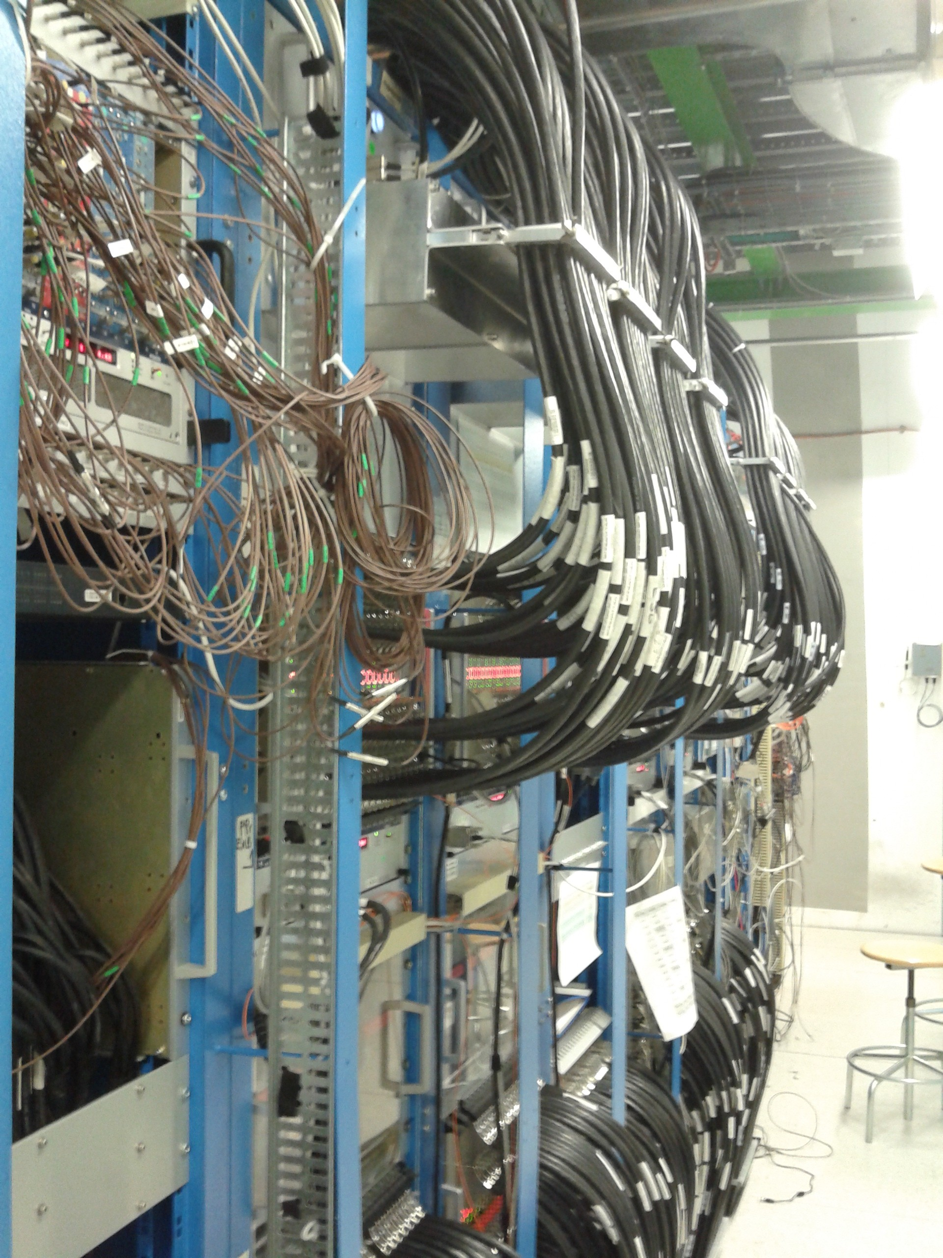
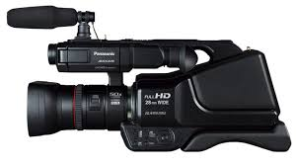
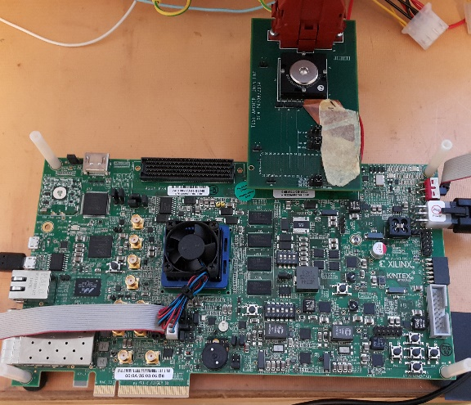
Brain simulation (Versione per bimbi)
We can use the same hardware (or part of it) for image processing.

Slide 4
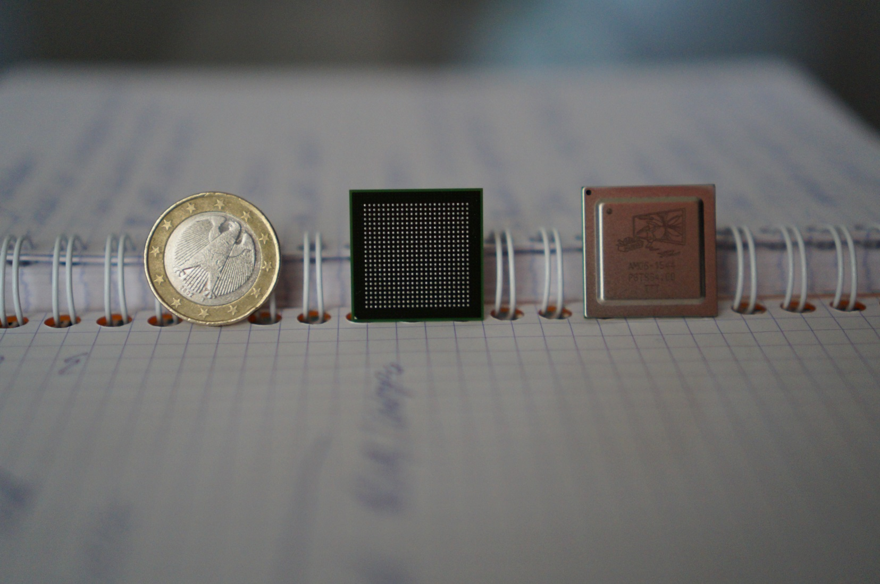
The Associative Memory chip

Slide 5
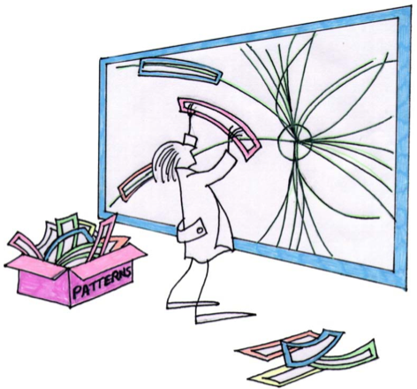
Amchip for dummies.

Slide 6

Amchip for dummies.

Slide 7
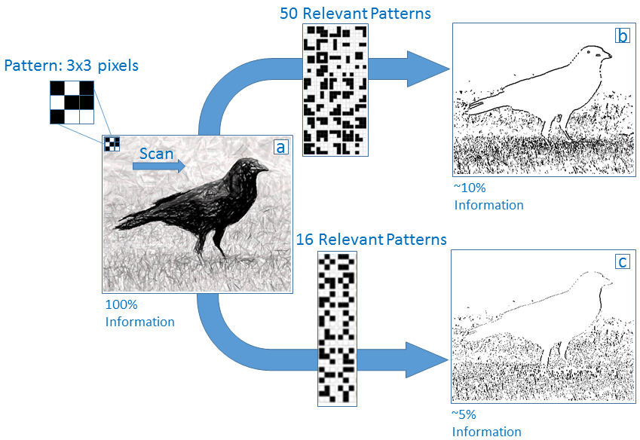

Slide 8
Something more useful then recognizing crows

Slide 9
It is over!
Wake up!

Slide 10
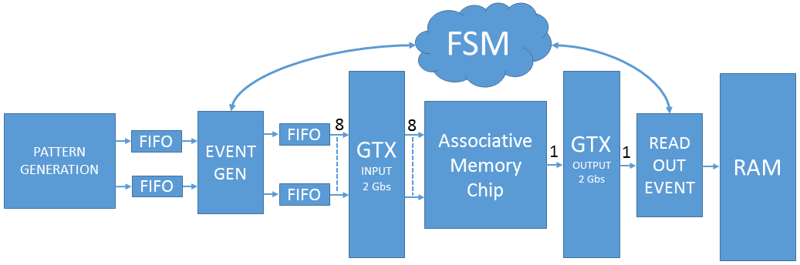
Real Time Pattern Matching System

Slide 11


Cognitive Image Processing:
Algorithm
Build small arrays of pixels (3x3 for static images or 3x3x3 for movies – 3rd dimension for time) that are AM patterns (M. Del. Viva, G. Punzi)
B/W 2⁹=512 patterns: 101-010-100, ……. , 111-011-001
4 gray level 2¹⁸= 256 Kpatterns: 00,00,01-00,01,00-11,00,10 …..
B/W + time 2²⁷= 128 Mpatterns: 111,000,000 - 000,111,000 - 000,000,000
Training: Calculate the frequency of each pattern in the sample images/frames
Compute Probability Density Histograms (PDHs) for different training image sets
Select the relevant patterns to be put in the AM bank
Running stage: Send the patterns to the AM chip to be filtered

Slide 12
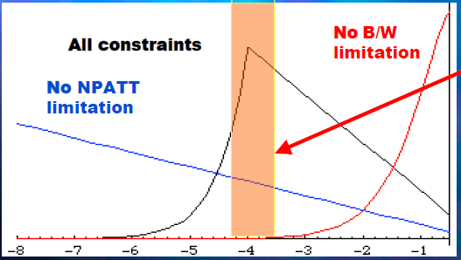
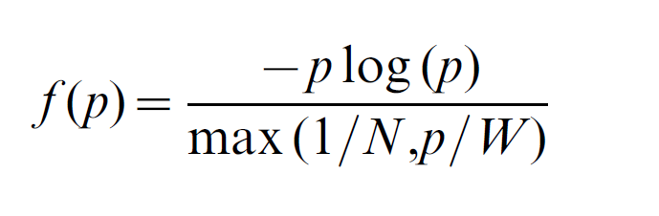
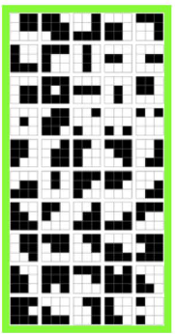

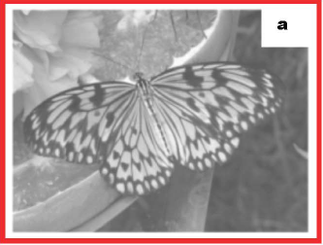
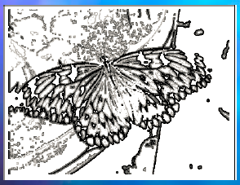
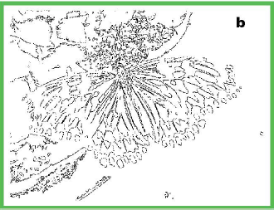
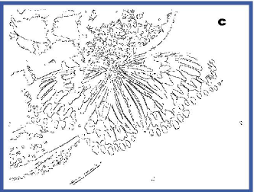
FTK for Image Filtering
Choice of relative patterns: Choose the pattern set that maximizes entropy H under real constraints
Patterns that are efficient carriers of information
given the bandwidth (W) & memory limits (N)
Accepting only
these 50 patterns
4 grey level:
2¹⁸ patterns
Stored N=2000
= 1/64 of 1 chip
= 50 mW
Accepting only
these 16 patterns
9.8%
5.5%

