Slide 1
Linac2 flash news
Giulia Bellodi, ABP group meeting 25/02/2016

Slide 2
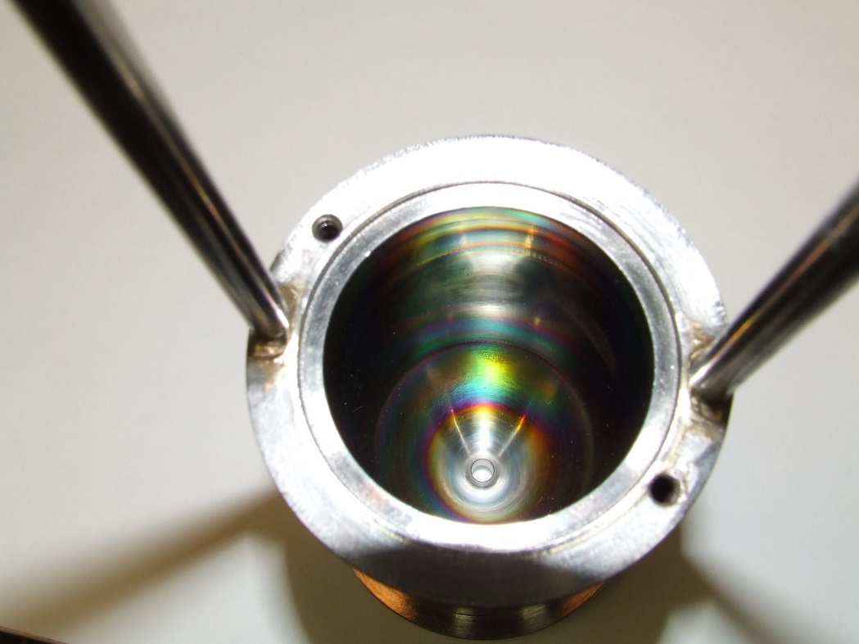
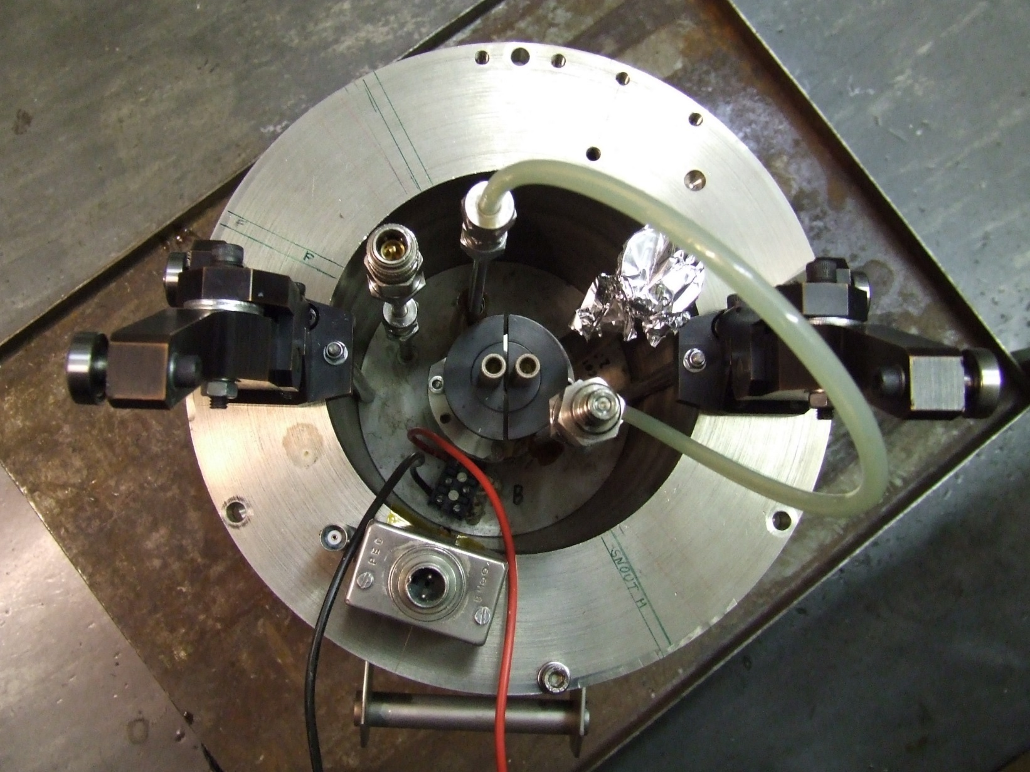
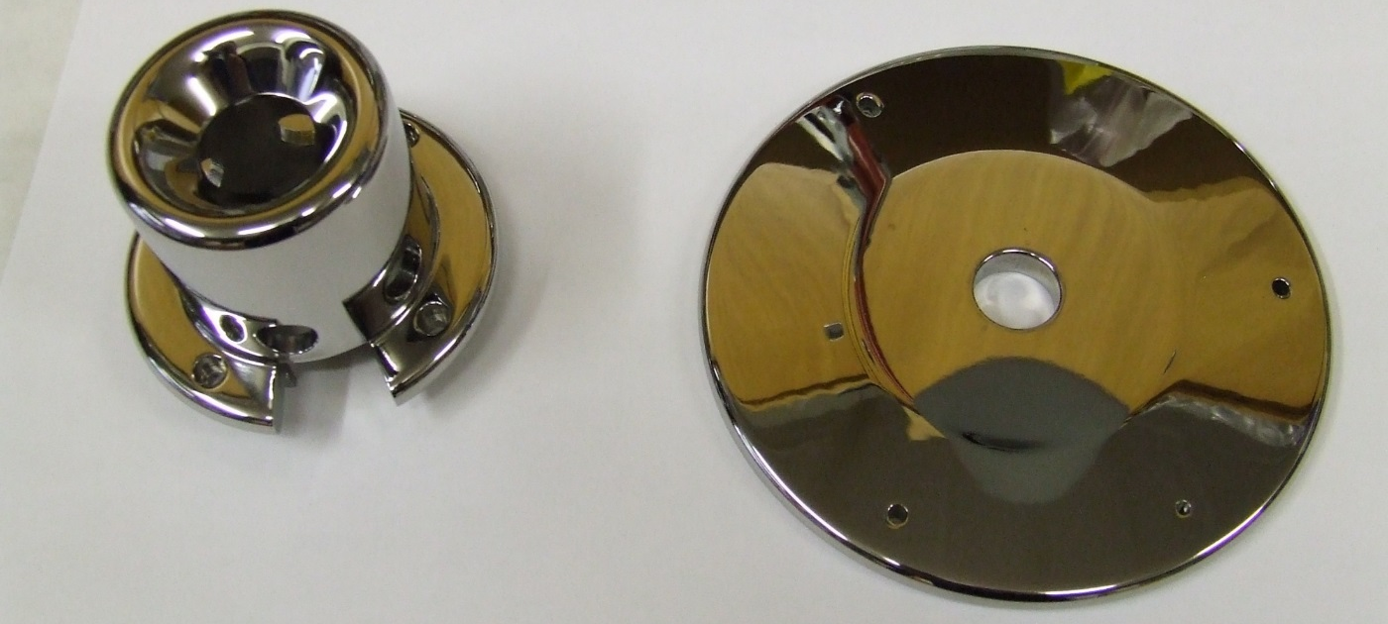
Linac2 source restarted on 15 January after YETS maintenance: all components dismantled, polished and cleaned
Plasma chamber
Expansion cup
electrode

Slide 3
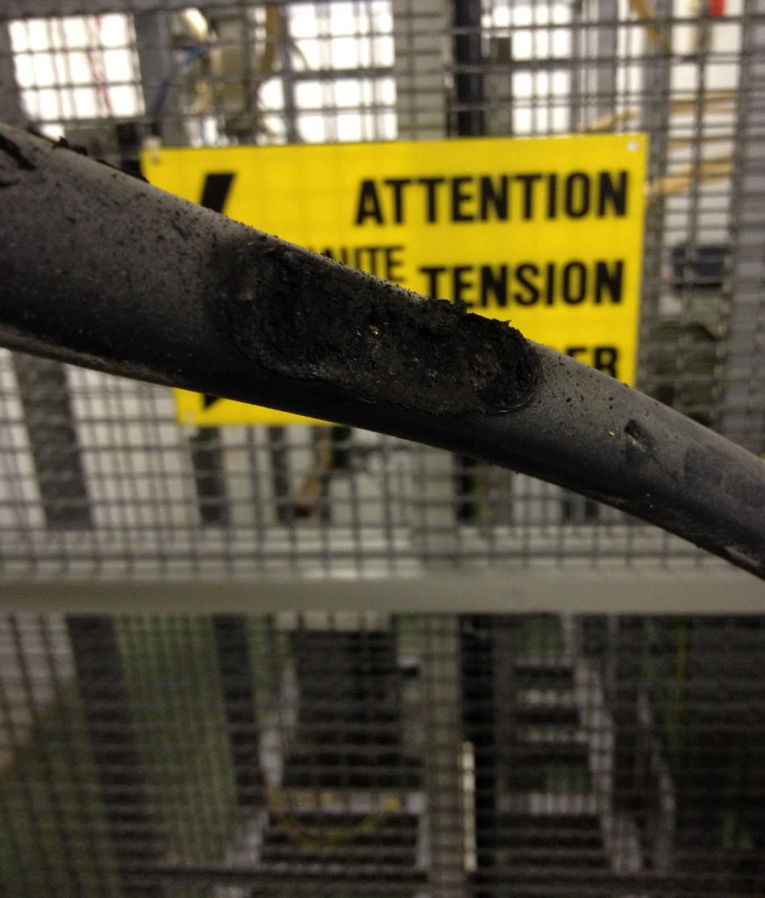
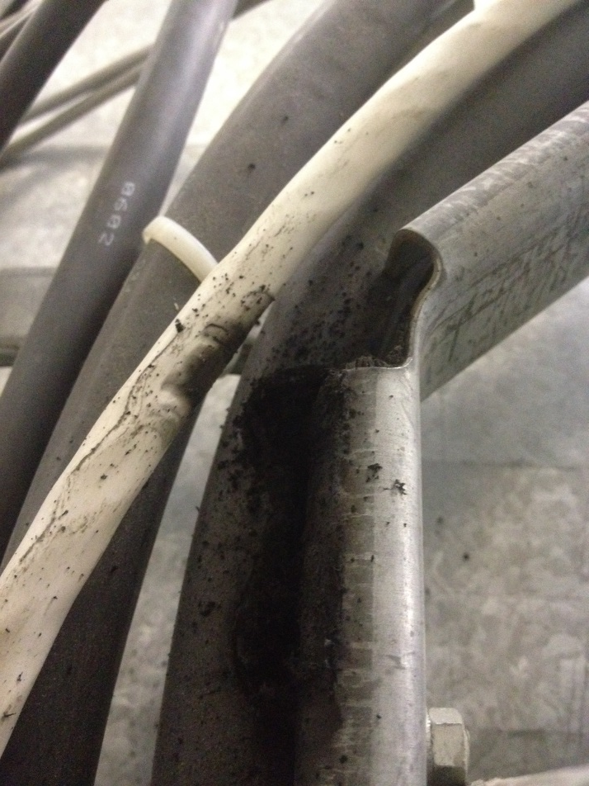
12 February : RF ON
Monday 15th - Fire brigade intervention at 17h : burning smell and flashes in RF gallery of Linac2
Problem of isolation of HV cable (output of the Hazemeyer connecting to the modulator from BE/RF)
Shielding to ground connection from the modulator side was missing
the faulty cable was disconnected and replaced with a spare on Thursday 18th
RF switched back on Friday afternoon

Slide 4
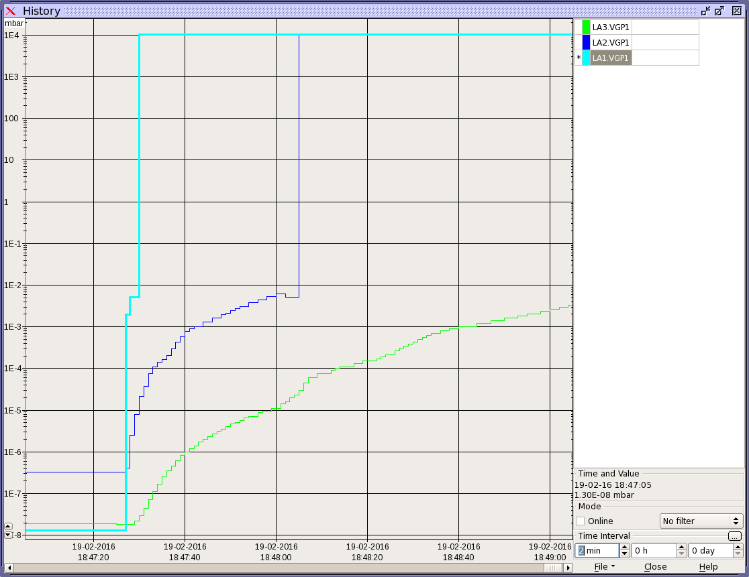
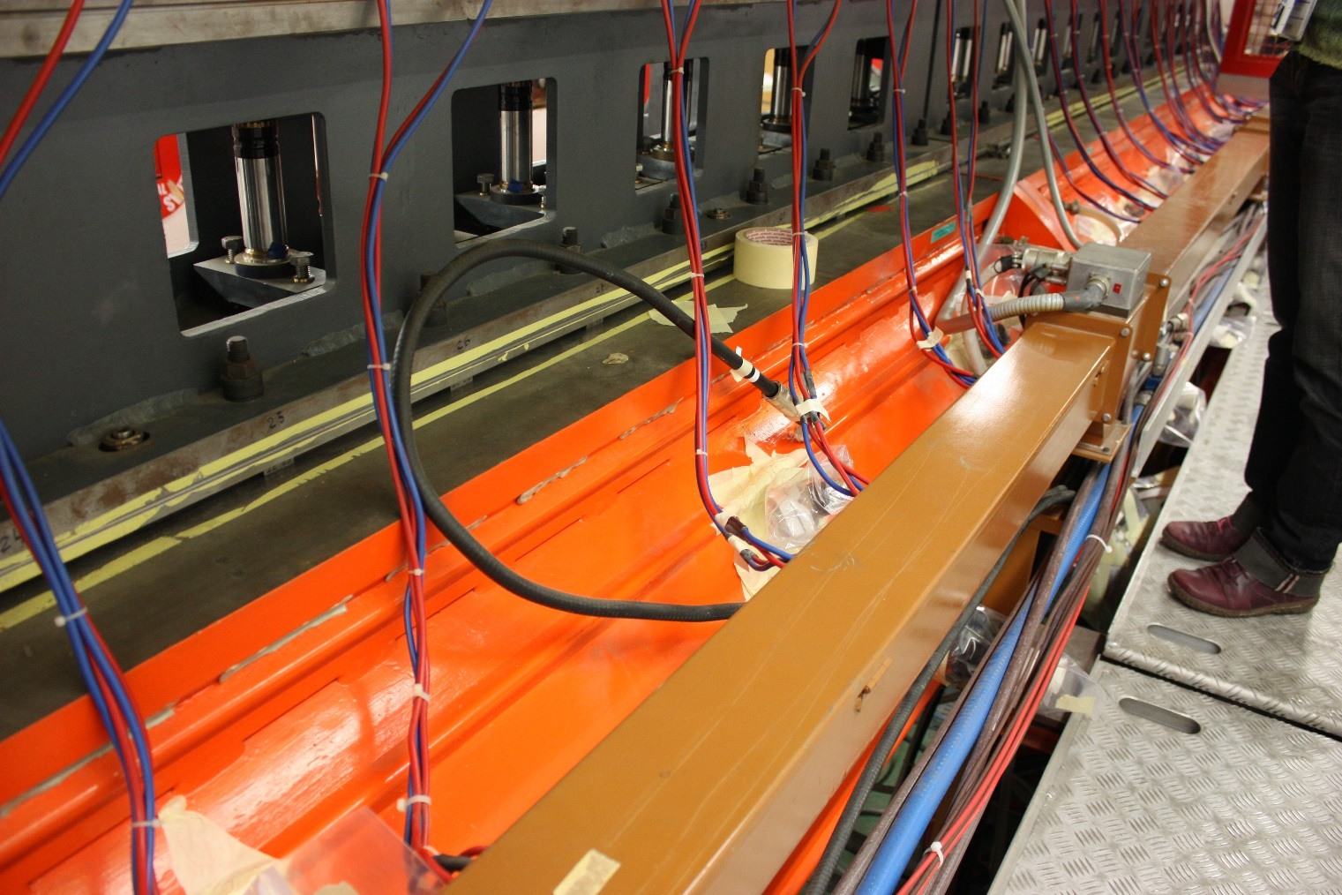
Friday 19/02 at 18:47
Vacuum leak on Tank1, domino propagation to Tank2 and Tank3
1mbar pressure in Linac2
Leak detected on Monday night near RF pick-up

Slide 5
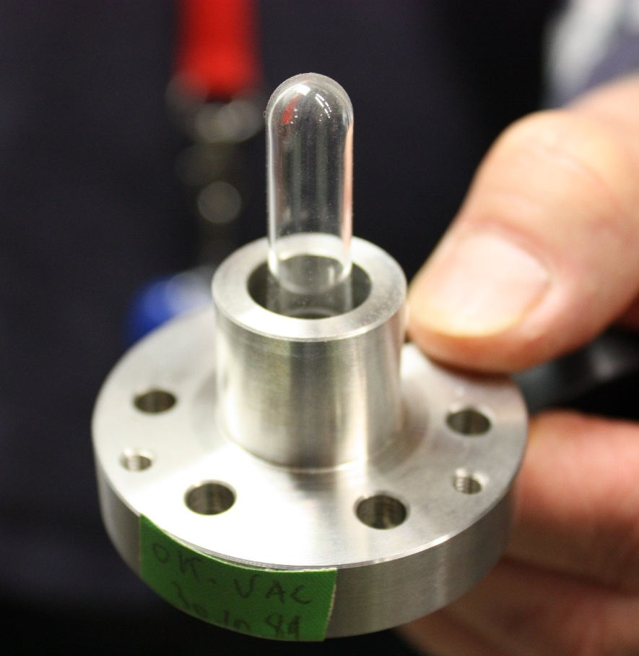
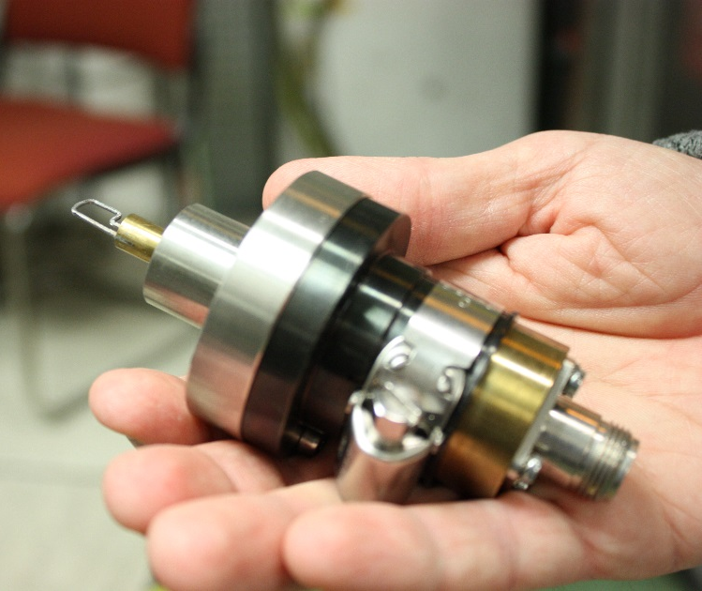
The culprit
1976 technical drawings dusted off
Inside
outside
Pick-up extraction deemed too risky
Cover installed on the pick-up and secondary vacuum created

Slide 6
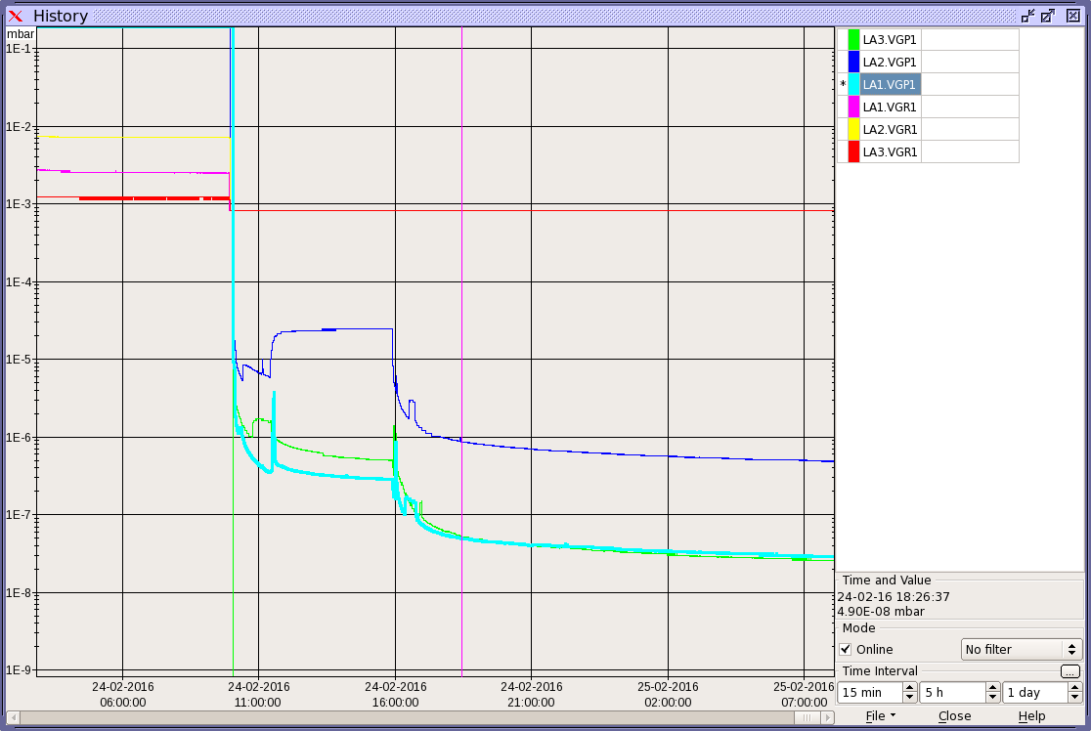
25/02/2016 at 08:00
Great thanks to the RF and vacuum team for their dedication and efficiency !
Excellent response and example of round-the-clock teamwork

