Slide 1
BE-ABP Information meeting – 25/02/2016

Slide 2
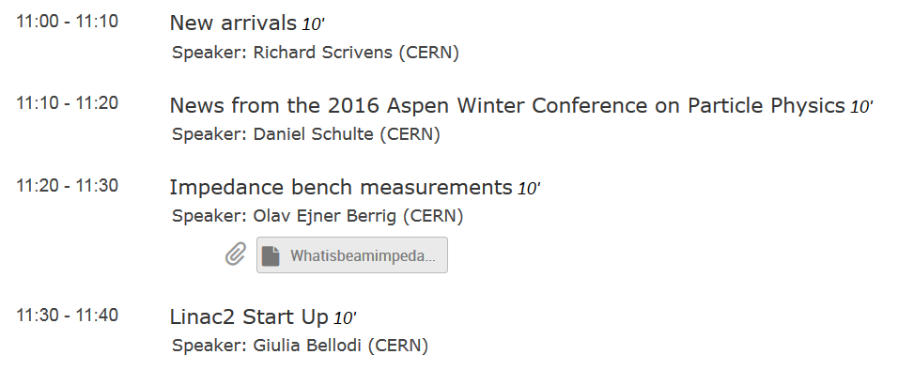
Agenda for Today

Slide 3
New Arrivals
Foteini ASVESTA HSI
Edoardo BONANNO HSC
Felix CARLIER LAT
Salim OGUR HSS

Slide 4
Next Meetings
ABP Information Meetings:
March: 31/03/2016

