Slide 1
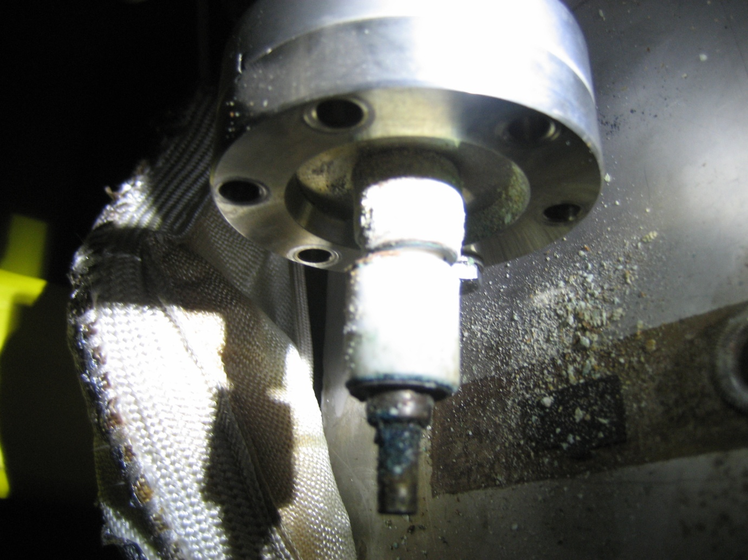
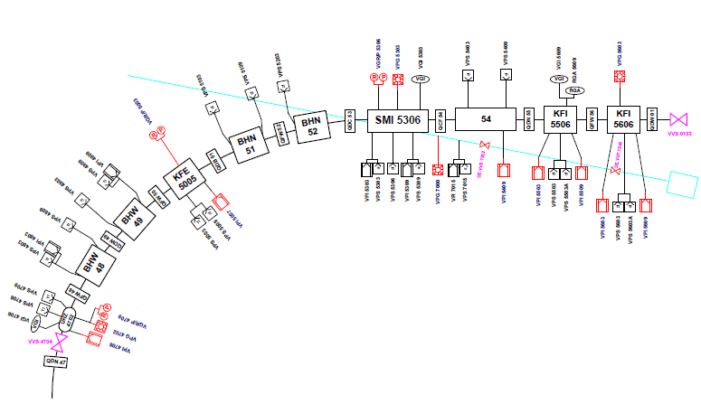
Vacuum leak in AD
Operator calls vacuum piquet on Friday evening for a pressure increase on vacuum sector 1A around septum SMI5306.
Vacuum sublimation pumps operated to maintain
vacuum during the week-end
Leak found on a HV connector of sputter ion pump VPI5309
This vacuum sector contains 3 kickers and 1 septum.
leak!
On Monday, venting, substitution of the corroded feedthrough, pumping and leak detection

Slide 2
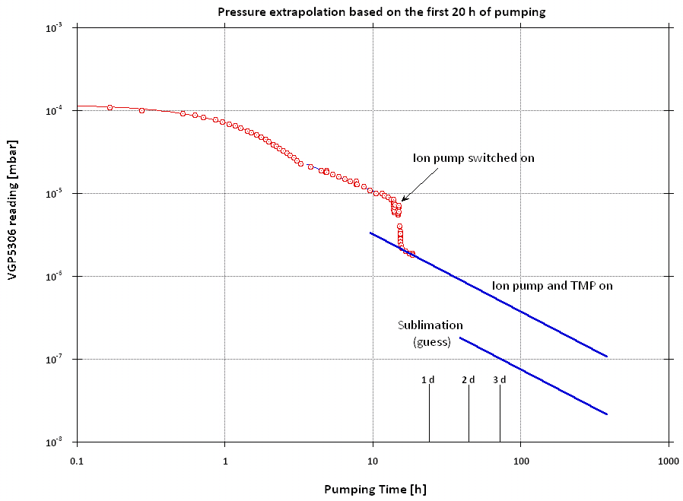
Pumpdown time
Pressure decrease is slow.
Decision taken to go for a bakeout of septum and kickers

Slide 3
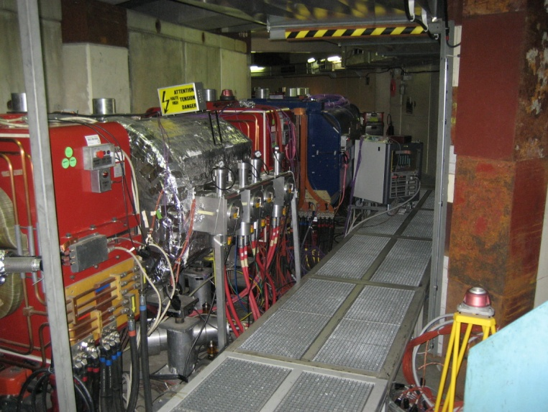
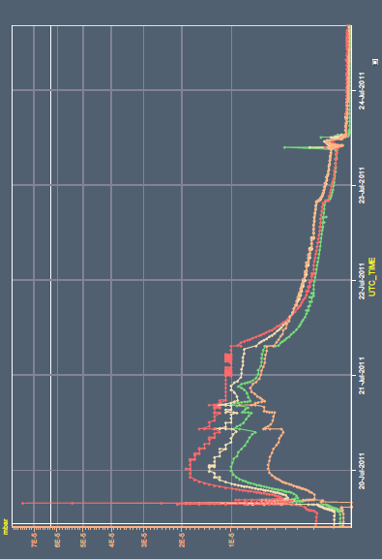
Bakeout of kickers and septum
Starting from Septum, 19th July
Kickers KFI, 12h00, 20th July
Kicker KFE, 14h00, 20th July
In total, 40h of bakeout
Leak detection on the 26th July, morning, then AD ready for operation for vacuum.
septum
kickers KFI
Visual inspection of all feedthroughs of VPIs on this sector, photographic archive and substitution of 2 power cables
kicker KFE
kickers KFI

