Slide 1
SPS - MKDV kickers failure
Wednesday 02-> Friday 04-Nov-2011

Slide 2
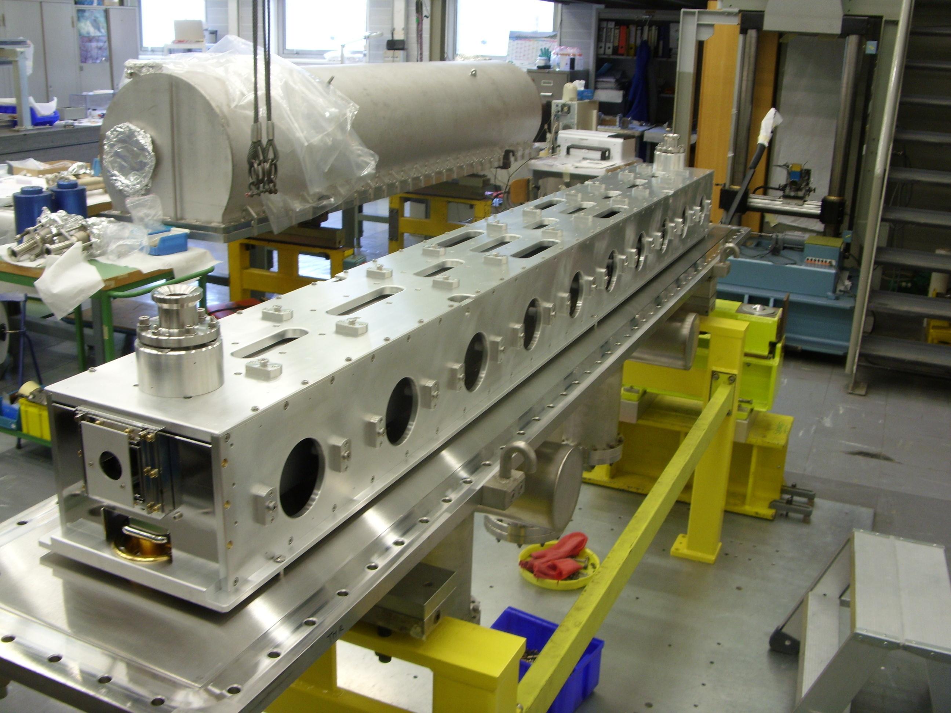
MKDV location in LSS1
Fault diagnosed on MKDV2 TMR

Slide 3
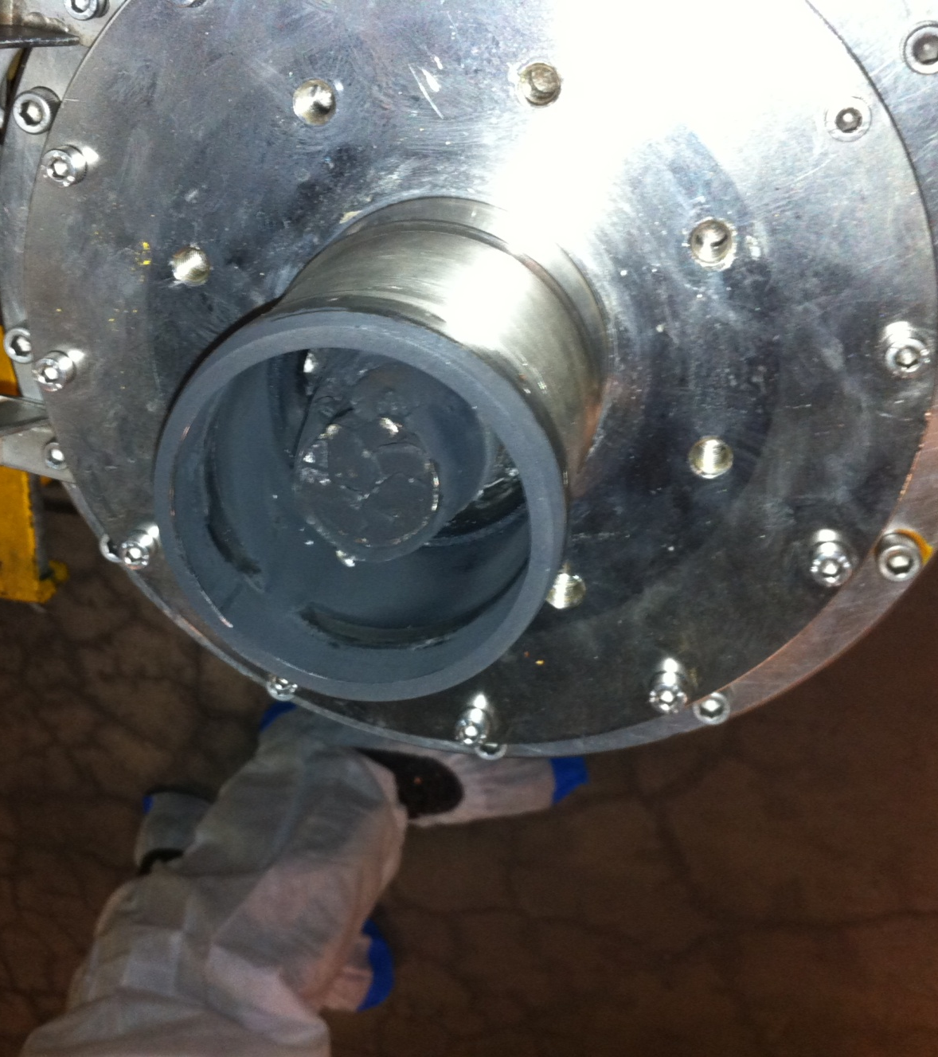
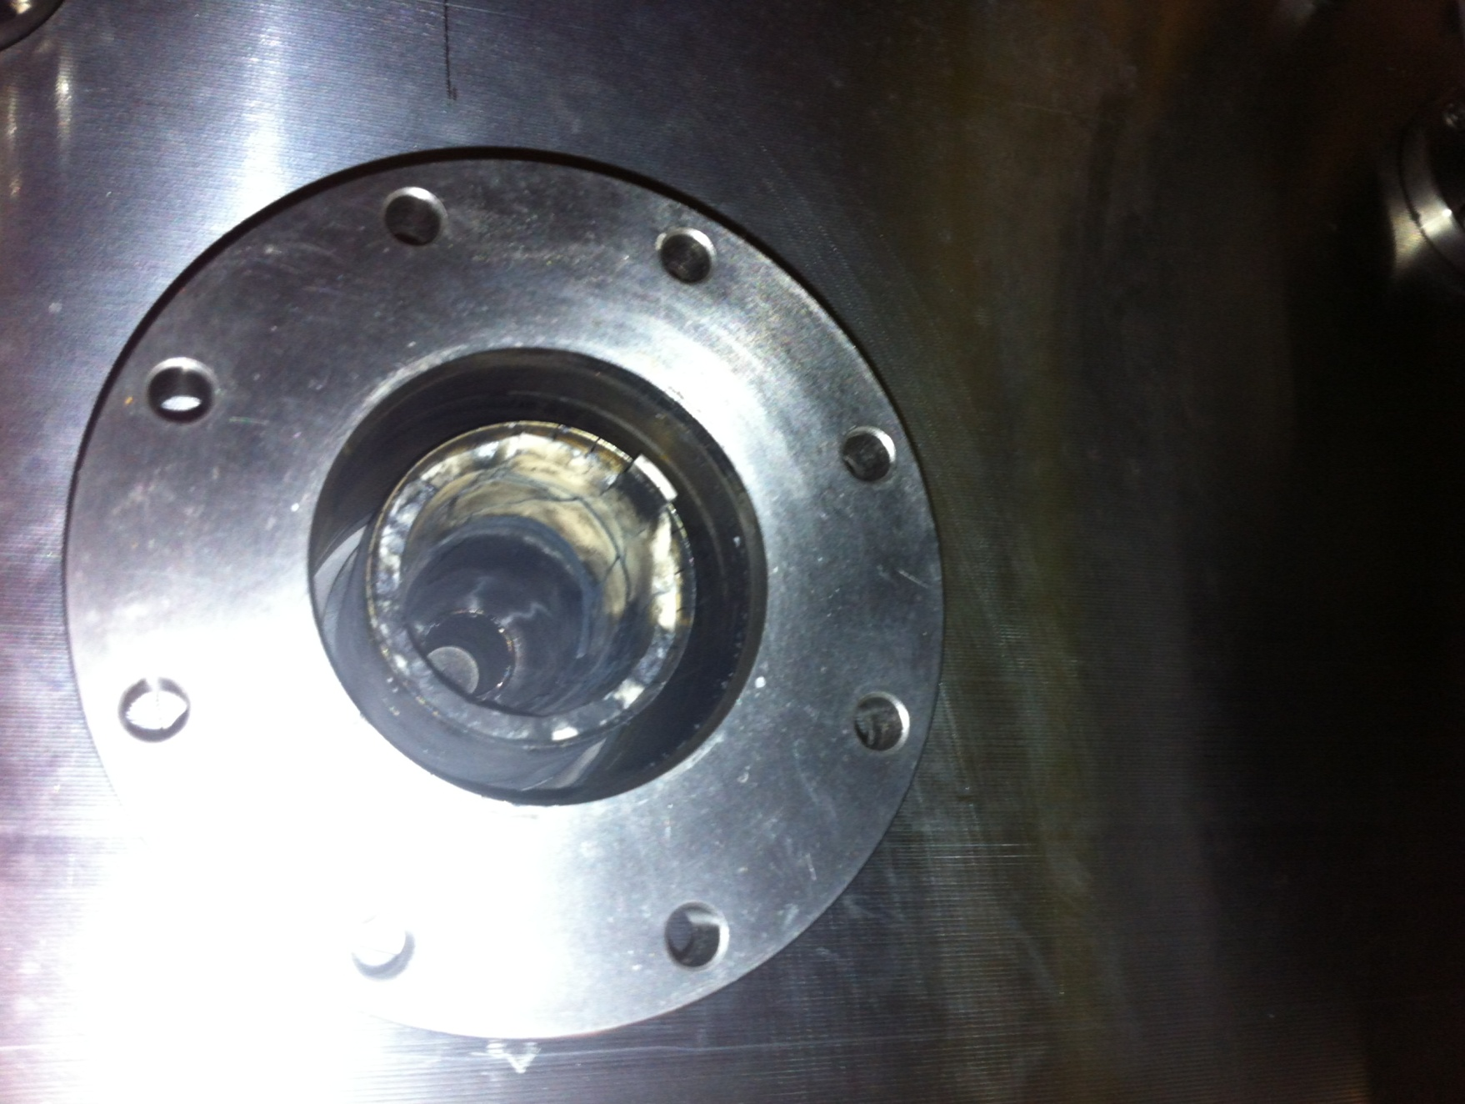
Failure on magnet feedthrough
Extra damage found on magnet feed-through
MKDV sector vented and feedthrough changed in-situ

Slide 4
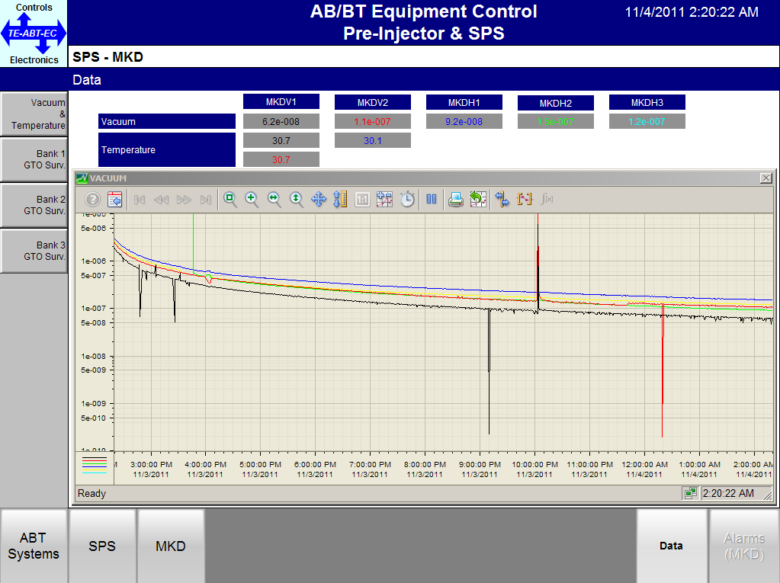
Vacuum recovery and magnet conditionning
Vacuum recovery were long because MKDH sector had to be vented to connect primary pumping group.
Conditioning slowed down by vacuum level and a magnet spark.
Decision was taken to operate MKDV with reduced voltage.

Slide 5
future plans
More conditioning during the end of year Christmas Stop.
Decided to accelerate the test and conditioning of the MKDV1 spare (however, this one has a smaller aperture).
MKDV2 magnet to be refurbished during LS1.
Vacuum equipment in tunnel to be consolidated to pump directly on the MKDV.

