Slide 1
Revised 2010 accelerator complex schedules
Mike Lamont

Slide 2
Motivation
Increase distance between technical stops
  less technical stops
  less disturbance to LHC operations
Increase length of stops from 3 to 4 days
  reduce impact of edge effects
    removable of RP veto, access, guardians etc
  more effective time for maintenance work
Cryogenics
  At present have around 23 days autonomy with regard to filters and need ~24 hours per stop
→ three 4 day technical stops between now and the Christmas stop, count one for recovery, tests and validation.
  5 -6 weeks between stops, 24 hours for cryo at the midpoint

Slide 3
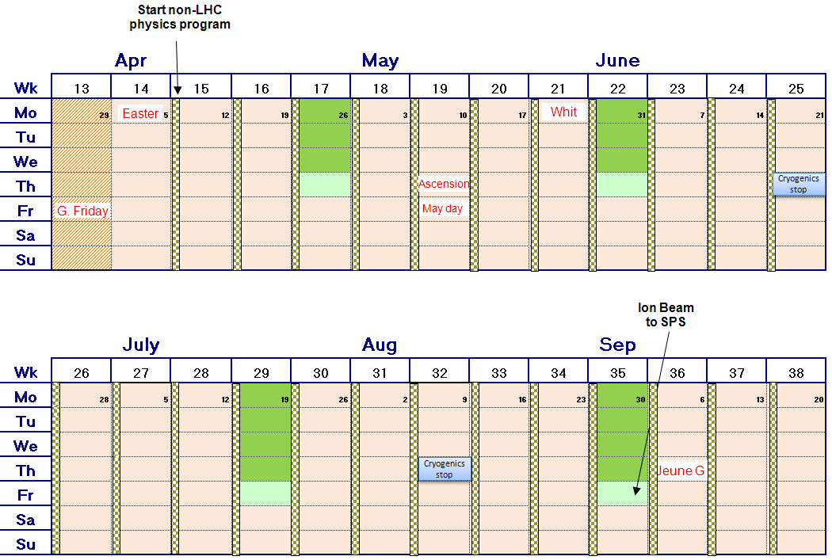
Revised schedule 1/2
Now
21 days
4 day technical stop
24 days
20 days
17 days
24 days

Slide 4
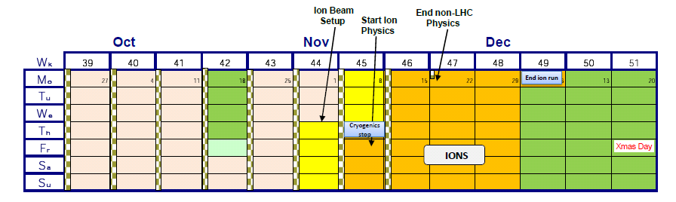
Revised schedule 2/2

Slide 5
Injectors
LHC beam delivery has priority
However a full program of machine development and programmed technical stops have to be accommodated
Technical stops and machine development programmed in shadow of LHC technical stops
Also take advantage of LHC cryogenics stops
Plus “floating MD”, taking advantage of either unforeseen LHC down-time or long periods of stable beam (here we have an effective 2 hour warning of needing beam again).

Slide 6
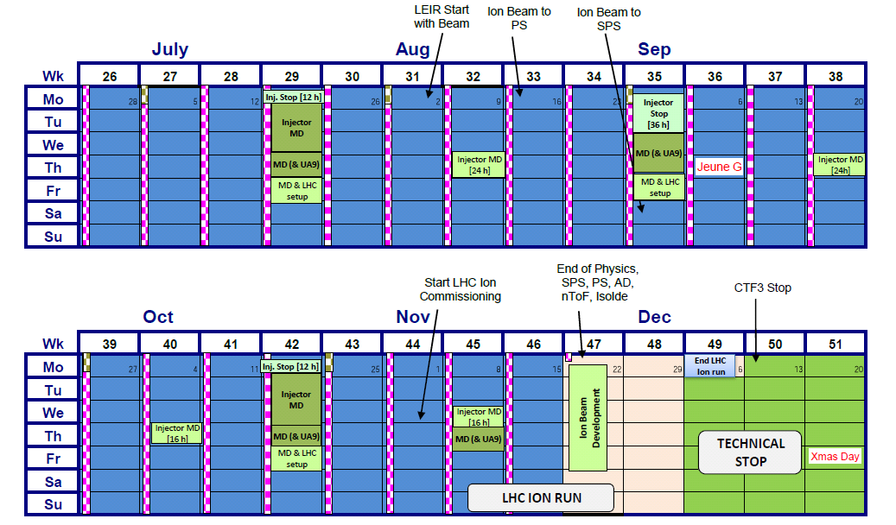
Injectors

