Slide 1
Technical Stop
LINAC 2 / PS Booster
Monday 30th/31st August 2010
EN-MEF-ABA

Slide 2
LINAC 2
Activities: | Names: | Duration
Maintenance colonne HT inspection source | S.BERTOLO | 2 Heures
Contrôle des circuits de refroidissement Linac2 et zone inflecteur "PS" | S.BERTOLO | 2 Heures
Remplacement des filtres Ventilation Linac 2 | S.Deleval | 2 Heures
Perturbation de l’eau glacée du PS | S.Deleval | 36 Heures
Installation d'un Pepper Pot sur la ligne LTE | R.SCRIVEN + (ABP, VSC, HE) | 36 Heures
Information provided by Sebastien Bertolo

Slide 3
PS Booster (1)
Request made by: | Phone number | Day of work | Names of people requiring access | Work to be done
Matthias Haase (BE/RF) | 163090 | Monday Afternoon | Matthias Haase Keith Richardson Gerard Lobeau | Repair and check the Tuning Transistor Bank C04 perhaps we can also change one bank with a modified Transistor Bank for higher reliability. In the ring: Check off the water system and air system. Time estimated 1 hour.
Thierry Masson (TE/ABT) | 164527 | Monday | Thierry MASSON Patrick BLAISE Robert BONTHOND | Inspection visuelle des striplines des septa BT.SMV10 et BT.SMV20 1 minute/aimant Remplacement si nécessaire des striplines des aimants BT.SMV10 et BT.SMV20 1 heure/aimant
Jan Hansen (TE/VSC) | 163779 | Tuesday morning | Jan Hansen Sophie Meunier Daniel Allard Esa Paju Berthold Jenninger Chistophe Jarrige Gael Girardot Robert Nambotin Damien Anderegg Henrik Vestergaard | I would like to enter the PSB to make a general inspection of our material. Advance on the new database for the transfer lines during the technical stop.
Delphine Gerard (BE/BI) | 164146 | Monday | Delphine GERARD Frederic CAMBA Sylvain LEBLANC William ANDREAZZA Roland SAUTIER Morad HAMANI Jonathan EMERY | Remplacement du FWS position 4 horizontal. Cette intervention nécessite l’intervention du groupe vide. Temps estimé : pour BE/BI : 15 min pour le démonter et 15 minutes pour remonter donc 30 minute au total.

Slide 4
PS Booster (2)
Request made by: | Phone number | Day of work | Names of people requiring access | Work to be done
Antony Newborough (TE-MSC) | 160429 | Several hours | A.Newborough M. STRUIK G. Perrin Bonnet D.Tommasini L. Moreno P. Vidales J. Charles Duffay D. BODART K. SAQI V. PRIETO P. Thonet M. ebbeni | Inspection of the magnets and interventions if needed.
Jocelyn Tan (BE/BI) | 163812 | Tuesday morning | Jocelyn Tan | The head amplifier of the Pick-up BT.UES30 needs to be replaced. Duration of the intervention 20mn.
Tobias Dobers (BE/ABP) | 160826 | Tuesday morning | Tobias DOBERS, Alexandre BEYNEL Laure SANDRI Elisabeth LACROIX Michel TRILLET | Intervention on the BT-Line (Booster Hall), on demand of Simone Gilardoni. -Measure some distances between magnets (quads 10, 30, 40 and dipole BHZ 10) -will take 1hour
Serge Pittet (TE/EPC) | 165205 | Monday 8AM-5PM, Tuesday 8AM-11AM | Vincent Barbet Benoit Favre Gerard Calegari Jacky Spiller | Canada power converter cooling improvement.

Slide 5
CV (Serge Deleval)
Réseau d’eau potable Meyrin et Prévessin
Chantier du TRAM : connexion de la nouvelle conduite d’alimentation en eau potable. (2 jours)
Conséquences : Réduction de la pression générale du réseau d’eau potable et incendie d’environ 0.5 bar. La génératrice du PS peut être perturbée.
Ventilation Linac 2 ;
Remplacement des filtres (2 heures )
Perturbation de l’eau glacée du PS (2 jours)
Conséquences : Perturbations de la ventilation du Linac 2
Linac 3 :
Source et station de refroidissement FTEF :
Perturbation de l’ eau glacée du PS. (2 jours ) Il y a la possibilité de basculement sur l’eau brute pour éviter les perturbations.
Conséquences : Variation de température sur le refroidissement
Ventilation Linac 3 :
Perturbation de l’eau glacée du PS (2 jours)
Conséquences : Perturbations de la ventilation du Linac 3 et température plus haute
BOOSTER :
Station de refroidissement du Booster :
Remplacement du démarreur sur pompe secondaire et test de fonctionnement. (maximum 3h)
Conséquences : coupures brèves de l’eau
Station de refroidissement du compensateur du Booster
Prise de mesure sur les pompes (2 heures)
Conséquences : Arrêt du compensateur du Booster

Slide 6
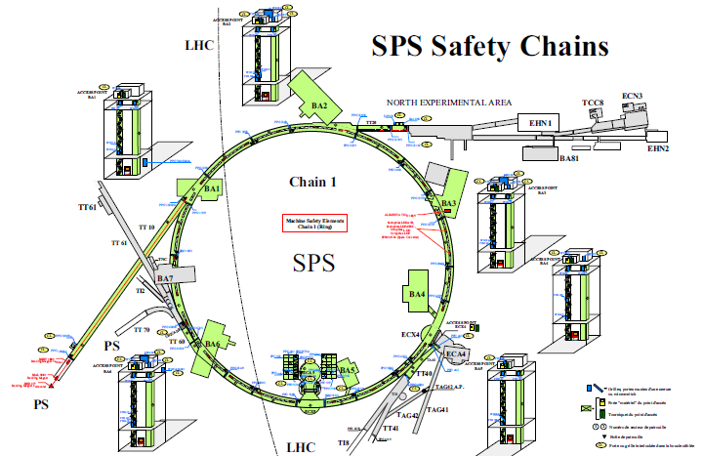
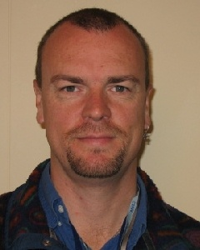
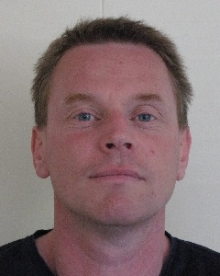
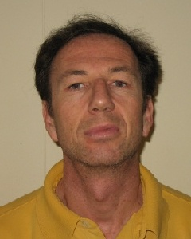
SPS Technical Stop
30th/31st August 2010
The New Technical Coordination Team.
David Mcfarlane
(David.Mcfarlane@cern.ch)
David Hay
(David.Hay@cern.ch)
Franck Baïs
(Frank.Bais@cern.ch)
SPS.Technical-Coordination@cern.ch

Slide 7
BA 1
Person Responsible | Contact Details | Starting when? | Duration of work | Description of work | Other factors to consider
Jean-Pierre LAPPE (EN/HE) | 160012 | Monday AM | 2 days | Standard lift maintenance | During this work the lift will only be out of service for a short period,

Slide 8
BA 2
Person Responsible | Contact Details | Starting when? | Duration of work | Description of work | Other factors to consider
Eric Montesinos (BE/RF/SR) | 164235 | Monday morning | 1 hour | Access to LSS2, to check SPS Dampers and possibly amplifier exchange (4 to 6 hours) | We have to wait the radiation cooling delay (Christophe Tromel) before access Usually our activities do not have impact to other teams. Otherwise we will inform you.
Daniel Valuch (BE/RF/FB) | 162080 | Tuesday | 1 Day | Modification of the transverse damper low-level system | If the intervention is not successful could be reverted to the old scheme
Bruno BALHAN TE-ABT | 160059 | Monday PM | 10 minutes if no leak... | Visual inspection of extraction equipment MST/MSE (Check for water leak ) in LSS2/4/6
Jean-Pierre LAPPE (EN/HE) | 160012 | Monday AM | 2 days | Standard lift maintenance | During this work the lift will only be out of service for a short period,

Slide 9
BA 3
Person Responsible | Contact Details | Starting when? | Duration of work | Description of work | Other factors to consider
Thomas BOHL (BE/RF) | 160365 | Monday 30th | 6 hours | Preparations in view of the I-LHC beam.
Urs WEHRLE & Thomas BOHL (BE/RF) | 164348 160365 | 09:00 (Monday) | 6 hours | Test of RADIAL Pick-Ups in LSS3
Eric Montesinos (BE/RF/SR) | 164235 | Monday morning | 1 hour | Check 200 MHz and 800 MHz cavities and possibly blower exchange (1 to 2 hours). | Usually our activities do not have impact to other teams. Otherwise we will inform you.
Jean-Pierre LAPPE (EN/HE) | 160012 | Tuesday PM | 2 hours | Standard lift maintenance | During this work the lift will only be out of service for a short period,

Slide 10
BA 4
Person Responsible | Contact Details | Starting when? | Duration of work | Description of work | Other factors to consider
Bruno BALHAN TE-ABT | 160059 | Monday AM | 10 minutes if no leak... | Visual inspection of extraction equipment MST/MSE (Check for water leak ) in LSS4
Jean-Pierre LAPPE (EN/HE) | 160012 | Monday AM | 2 days | Standard lift maintenance | During this work the lift will only be out of service for a short period,

Slide 11
BA 5
Person Responsible | Contact Details | Starting when? | Duration of work | Description of work | Other factors to consider
Jerome LENDARO (EN/STI) | 163942 | Monday morning | 12 hours | (UA9 Experiment) Installation of the Roman pot 2, in LSS5 | Vacuum work involved
Jerome LENDARO (EN/STI) | 163942 | Monday morning | 6 hours | (UA9 Experiment) Replacement of the crystal 2, in LSS5 | Vacuum work involved
Frederic LOPRETE (EN/STI) | 164535 | Monday morning | 2 days | (UA9 Experiment) Installation of pep detectors, in LSS5 | This works includes some cabling work that is being organized by Jerome Axensalva
Jeremie BAUCHE (TE/MSC) | 164332 | Monday Morning | 2 days | Removal and installation of 3 new coated magnets. (51470, 51530, 51550) and moving of 1 old coated magnet (51490 to 51550) | This work will involve the cooperation of the Magnet group, Transport, CV, Vacuum and Survey. (Access will be made via BA3 AND BA6)
Jean-Pierre LAPPE (EN/HE) | 160012 | Monday AM | 2 days | Standard lift maintenance | During this work the lift will only be out of service for a short period,

Slide 13
BA 6
Person Responsible | Contact Details | Starting when? | Duration of work | Description of work | Other factors to consider
Alexandre HABERT Serge CHALAYE (EN/EL) | 165661 164776 | Monday morning | 2 days | Removing all the cables attached to transformer EMT121/A6 New HV cables installation between HV cubicles EMD121/A6, EMD115/A6 and the new location of the transformers | Safety coordinator: Emmanuel Paulat, VIC already done (Surface works only)
Guillaume GROS (EN/EL) | 163920 | Tuesday | 4 Hours | BA 6, la passerelle du TA6 et dans le TT60 afin de finaliser les quelques interrogations que j’ai sur le cheminement des câbles Contrôle que je dois tirer dans ces zones pour Hiradmat.
K. Bestmann BE-ABP-SU | 160873 | Monday | 1 day | (TT66 project) Scan of an area of 15 m and marking on the floor of the position of the elements of TT66 in TT60 (15 m before the chicane at the end of TT60) | Access by the BA6. Preferably no other people working in the area during the scanning operation.
Bruno BALHAN TE-ABT | 160059 | Monday AM | 10 minutes if no leak... | Visual inspection of extraction equipment MST/MSE (Check for water leak ) in LSS6
Jean-Pierre LAPPE (EN/HE) | 160012 | Tuesday PM | 2 hours | Standard lift maintenance | During this work the lift will only be out of service for a short period,

Slide 14
BA 7
Person Responsible | Contact Details | Starting when? | Duration of work | Description of work | Other factors to consider
Jean-Pierre LAPPE (EN/HE) | 160012 | Monday AM | 2 days | Standard lift maintenance | During this work the lift will only be out of service for a short period,

Slide 15
TI 2
Person Responsible | Contact Details | Starting when? | Duration of work | Description of work | Other factors to consider

Slide 16
TI 8
Person Responsible | Contact Details | Starting when? | Duration of work | Description of work | Other factors to consider

Slide 17
Other Areas
Person Responsible | Contact Details | Location of Work | Starting when? | Duration of work | Description of work | Other factors to consider
Didier VAXELAIRE (GS/ASE) | 162498 | B-846 | 30/08/10 | 1 Day | Déplacement des capteurs de portes et de la boite de patrouille du Bat 846 vers l’intérieur du puits et test de fonctionement (validation). | Un test de fonctionnement (validation) ainsi qu’un test DSO devront être réalisé avant la remise en faisceau de la chaine 5. Cela représente la contrainte de disposer du BA7 et du TT61 sans personnes à l’intérieur durant environ 3 heures.
Alexandre HABERT (EN/EL) | 165661 | TT60 TCC6 TJ7 TNC | 30th Aug to 2nd Sept included | 4 Days | (HiRadmat project) Installation of new cables in TT60/TCC6/TJ7 Modification of cable trays in TJ7 Removing of lights system in TNC | Safety coordinator: Emmanuel Paulat
Brian JENSEN EN/CV | 163306 | B-855 | 1st Sept | 3 days | Replacement of control cubicle for TT70 air extraction (AOC-4427945) | The air extraction from tt70 will be stopped, the supply will continue to run, I expect the impact on the atmosphere in tt70 to be minor. After the 1st day the extraction can be started as needed (e.g. in the case of emergency), it will be started over night 1-2 sep and 2-9 sep. I will not e opening the casing for the ventilation so I am not depending on RP.

Slide 18
CV works (1)
Group responsible | Person responsible | Description of the work | Location of the work | Duration | Date | Time | Other information
EN/CV/OP | B.Bannister | Entretien annuel puisard FTDP-00544 | EHN1 | 1 j. | 30 | 8:00
EN/CV/OP | A.Avian | UACW2-00239 remplacement paliers | EHN2 | 1 j. | 30 | 8:00
EN/CV/OP | A.Avian | Réparation volets d'air frais | EHN2 | 1 j. | 30 | 8:00
EN/CV/OP | J.Lehtinen | Modification programme SUI8 EG | CNGS / SUI8 | 1 j. | 31 | 8:00
EN/CV/OP | J.Lehtinen | Changement vannes SUI8 EG | CNGS / SUI8 | 1 j. | 30 | 8:00 | L’arret ventilation CNGS
EN/CV/OP | J.Lehtinen | Modification pates de l’armoire | CNGS / TCV4 | 1 j. | 31 | 8:00
EN/CV/OP | J.Lehtinen | Vérification courroies extraction TCC4 | CNGS / SUI8 | ½ j. | 31 | 8:00
EN/CV/OP | J.Lehtinen | Mesure Dp filtres UUW1-00124 | CNGS / SUI8 | ½ j. | 31 | 8:00
EN/CV/OP | J.Lehtinen | Vérification boosters ventilation BA5 | BA5 tunnel | 1 j. | 30 | 8:00

Slide 19
CV works (2)
Group responsible | Person responsible | Description of the work | Location of the work | Duration | Date | Time | Other information
EN/CV/OP | B.Bannister | Réparation fuite ED | BEQ2 | 1 j. | 30 | 8:00
EN/CV/OP | B.Bannister | Nettoyage filtres | BE/BEQ2 | ½ j. | 30 | 8:00
EN/CV/OP | B.Bannister | Réparation fuite auto purgeur station de pompage ED | BA82 | 1 j. | 30 | 8:00
EN/CV/OP | B.Bannister | Changement débitmètre | TE80 | ½ j. | 30 | 8:00
EN/CV/OP | B.Bannister | Changement soupape | TE80 | ½ j. | 30 | 8:00
EN/CV/BE | R.MOLLAY | CLIMATISATION | UJ56 | 2 J. | 30/31 | 8:00
EN/CV/BE | R.MOLLAY | COOLING NTOF | 375-I75 | 1 J. | 30 | 9:00
EN/CV/BE | R.MOLLAY | NTOF CLASSE A | 803 | 1 J. | 1 | 9:00
EN CV/BE | B.DEDOBBELER | Tuyauteries | CNGS TAG 41 | 3 J. | 31/08 | 8:00 | Finition de chantier

Slide 20
EN/EL works
(Surface works only)
Id | Category | Title | Group | Location | Concerned equipment | Comments | Alarms to TI | Start date | End Date
1062 | New work | Deconnexion transfo | EN/EL/OP | BA7 - BA1 | Secours 3.3 kV reserve BA7, coupure 3.3 kV BA1 ! | R.Grimand | NO | 31-Aug-10 | 31-Aug-10
1270 | New work | Tirage de câbles HT | EN/EL/OP | BA6 | Tirage de câbles HT entre EMD121/A6 et EMt121/A6, et tirage câble contrôles | S. Chalaye | NO | 30-Aug-10 | 02-Sep-10
1298 | New work | Adjonction de départs | EN/EL/OP | SPS | Adjonction de départs GSM & ramses , tirage de câbles et raccordements | J. Gomes, R. Grimand | NO | 30-Aug-10 | 02-Sep-10
1257 | Preventive | Basculements des chargeurs 48V | EN/EL/OP | SPS | Basculements des chargeurs 48V MEP | S. DELARUE | YES | 30-Aug-10 | 31-Aug-10

