Slide 1
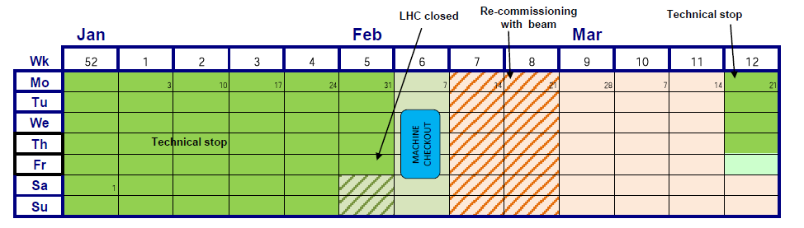
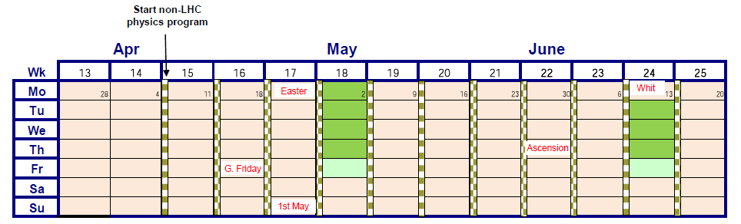
LHC 2011 Q1/Q2

Slide 2
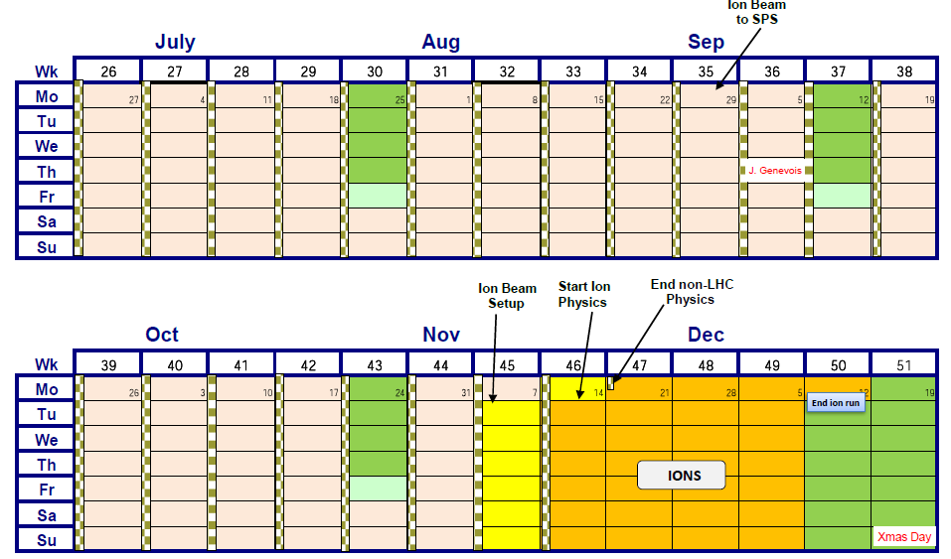
LHC 2011 Q3/Q4

Slide 3
Note
Final decision regarding 2 week extension of technical stop still pending
4 day technical stops every 6 weeks
5 week ion run (including setup time)
  will get squeezed
Late stop (12th December) anticipates 2012 shutdown

Slide 4
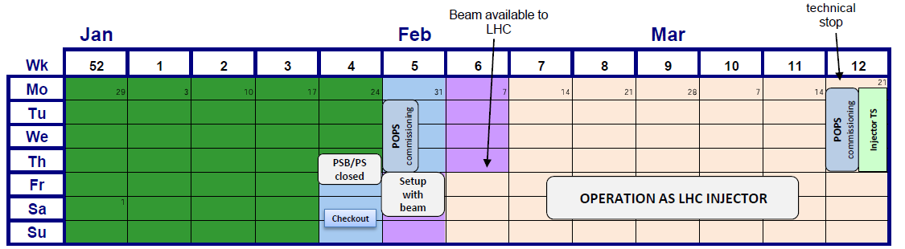
INJECTORS 2011 Q1

Slide 5
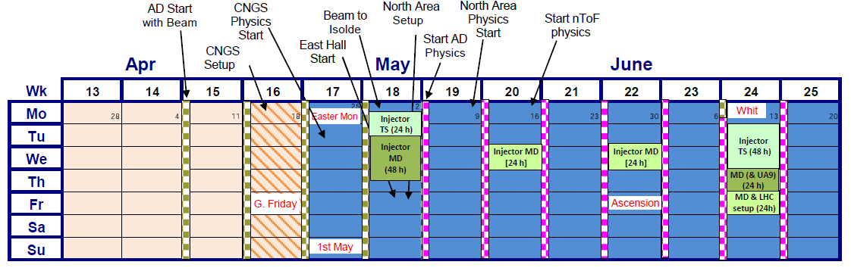
INJECTORS 2011 Q2
NB longer technical stops – to be confirmed

Slide 6
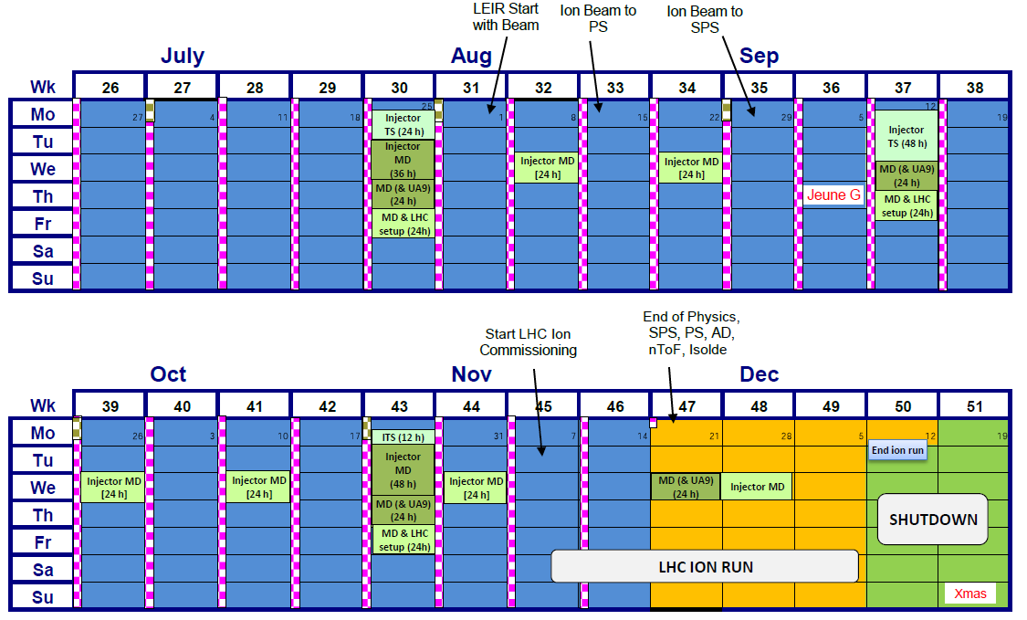
INJECTORS 2011 Q3/Q4

Slide 7
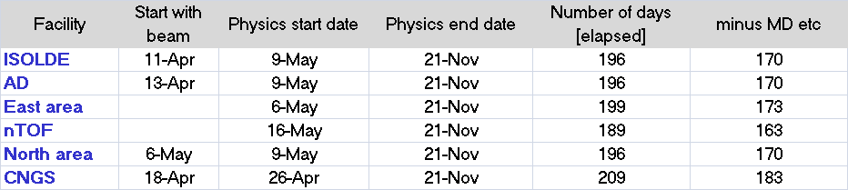
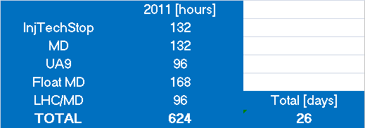
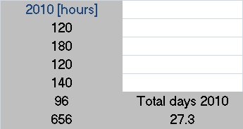

Provisional summary
plus

