Slide 1
Replacement of RD1/RD34 power converters for increased rejection of network perturbations
Hugues Thiesen
  LHC-MPP Meeting
  March, 4th 2016
Acknowledgements: M. Zerlauth, I. Romera Ramirez, G. Le Godec, I. Josifovic

Slide 2
AC network perturbations
Perturbations are < 100 ms and < 15%:
2011

Slide 3
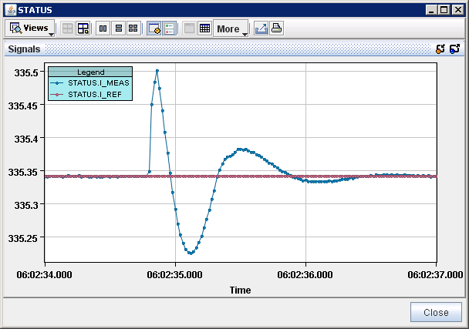
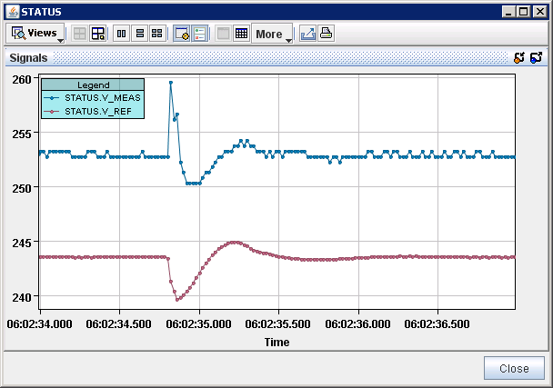
RPTG power converter
Today most sensitive circuits are supplied RPTG power converters
1s
∆I /I = 0.3 A/ 335 A = 8.95 E-4
(FMCM threshold = 3.5 E-4)
20 ms between 2 points
0.3A
335.35A
10V
1s
I_ref and I_out
FMCM: RD1.LR1 27/07/2011 at 06:03
E = 3.5 TeV
V_ref and V_out

Slide 4
New RPTG power converter
Current RPTG Thyristor Power Converters
New RPTG
Switch Mode Power Converters (Based on B8 Type)
Main characteristics:
Max Output voltage: 950V
Max Output current: 810A
Max RMS current: 810A
Output Power: 769.5kW
Input voltage: 3x18kV/50Hz
Main characteristics:
Max Output voltage: 700V
Max Output current: 810A
Max RMS current: 810A
Output Power: 567kW
Input voltage: 3x18kV/50Hz

Slide 5
New RPTG power converter
New RPTG
Switch Mode Power Converters (Based on B8 Type)
or
CB
FWD
Main characteristics:
Max Output voltage: 700V
Max Output current: 810A
Max RMS current: 810A
Output Power: 567kW
Input voltage: 3x18kV/50Hz

Slide 6
New RPTG power converter
New RPTG
Switch Mode Power Converters (Based on B8 Type)
101 [110mV_{rms}]
92 [40mV_{rms}]
Amplitude [dBµV]
50Hz
10kHz
78 [8mV_{rms}]
66 [2mV_{rms}]
150kHz
60 [1mV_{rms}]
500kHz
frequency [Hz]
Main characteristics:
Max Output voltage: 700V
Max Output current: 810A
Max RMS current: 810A
Output Power: 567kW
Input voltage: 3x18kV/50Hz
--- 1 mA peak-peak constraint
--- Output voltage ripple constraint

Slide 7
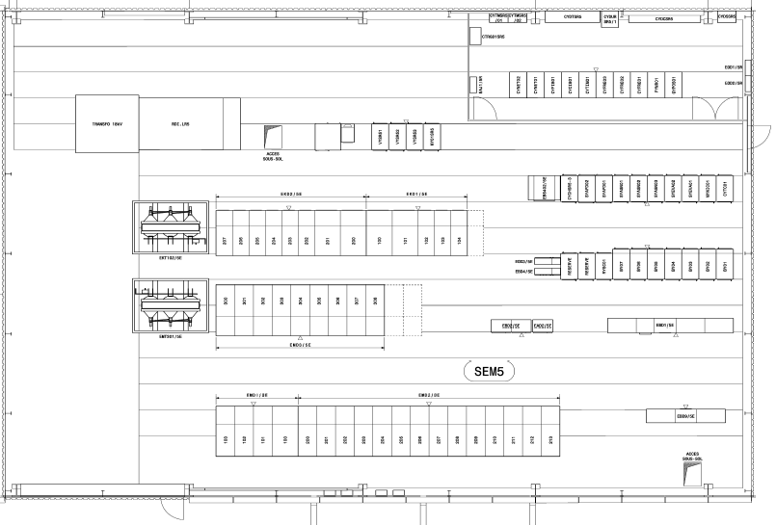
Installation
18kV TRAS
CVS
18kV TRAS
CVS
Interface Rack
Switch 18kV
Old_RPTG
New_RPTG

Slide 8
Installation
Interfaces with the safety systems
FMCM
WIC
EIS
CCC
EL

Slide 9
Planning
LS1
18 kV switch
2016
Production of the load switches abd power converters
EYTS
Installation and commissioning

