Slide 1
Follow-Up and Project Advancement Review NSW NJD, Hub and Structure (F)DR “UKZN” Sector Installation Tooling Introduction and Review Scope
Stephanie Zimmermann

Slide 2
NJD, Hub, NSW Structure

Slide 3
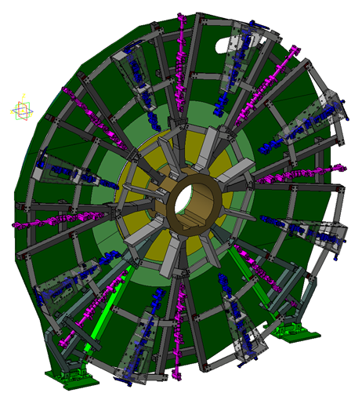
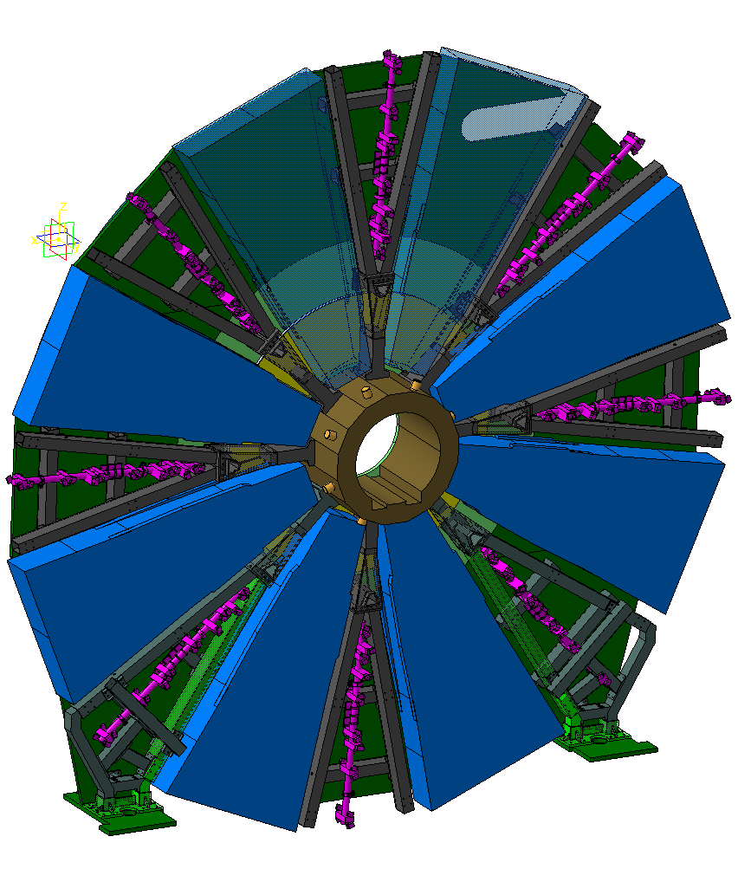
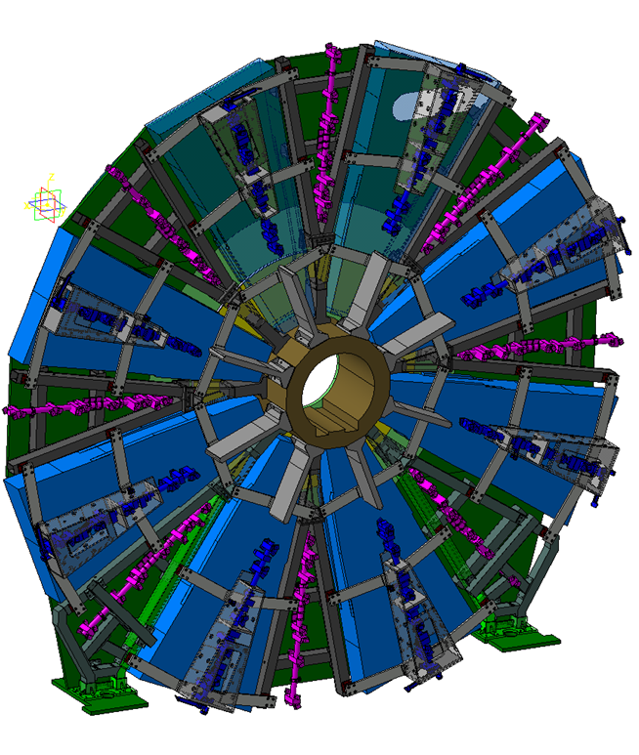
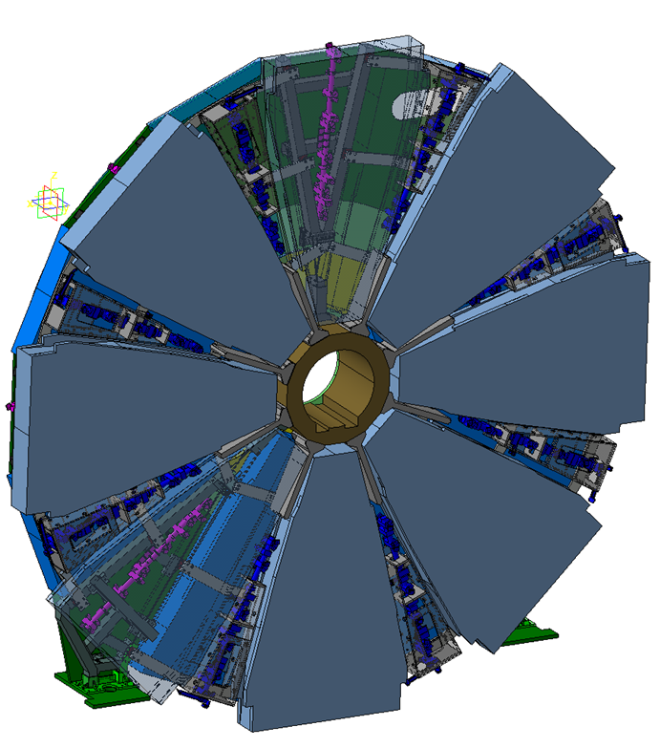
Terminology - Structure
Key terminology related to the NSW Mechanics
Hub
NJD Disk
NSW Structure
Alignment bars
There is no longer a separate plug
Assembly sequence incl. sector mounting

Slide 4
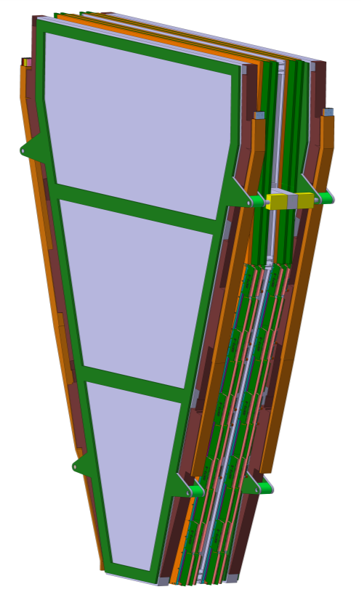
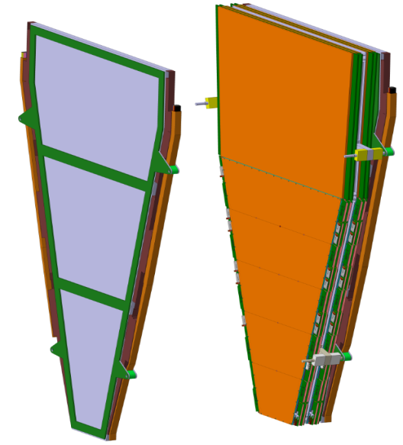
Terminology – Sector Elements
The New Small Wheel uses 2 detector technologies – MicroMegas (MM) and Small strip Thin Gap Chambers (sTGC)
Each of the 2 x 16 sectors contains 2x2 MM modules (chambers, quadruplets), and 2x3 sTGC modules (chambers, quadruplets), arranged in 2 wedges for each technology
Small and Large sectors have different size → 6 different sTGC quadruplet types, 4 different MicroMegas types, 32 chambers of each type
Within a sTGC wedge, the 3 chambers are glued to FR4 frame. The wedge is treated as single (rigid) body
For the MM, the 4 quadruplets of a sector are mounted on both sides of a central spacer frame.
The central spacer also supports the sTGC wedges via the sTGC kinematic mounts
The MM – sTGC package = sector is attached to the NSW structure by means of the sector KM
sector
sTGC and MM wedges

Slide 5
Documentation
The Hub, NJD and NSW Structure underwent its design review in November 2015
The slides from the November 2015 NJD/NSW Structure Engineering review can be found at https://indico.cern.ch/event/434757/
The documentation from the November 2015 NJD/NSW Structure Engineering review can be found at https://edms.cern.ch/project/ATL-0000010411
The reviewers report from the Nov review can be found at https://twiki.cern.ch/twiki/pub/Atlas/UpgradeReviewOffice/JDplug_report_9.pdf
Documentation for today’s review is mostly in the slides uploaded to this agenda. Additional supporting documents see
https://edms.cern.ch/project/ATL-0000010503

Slide 6
Scope and Charge of today’s review
The design review last November pointed out a number of items which needed follow-up and additional studies/analysis
The design presented in November since then underwent a series of optimisations w.r.t ease of production (reduction of welds, replacing welds by bolts, ….)
Hub, NJD and NSW structure Market Survey is closed, for the Tender (next) final production drawings are needed
Scope of today’s review:
Present answers to the points open in the Nov review and the missing calculations
Present the modifications/optimizations,demonstrate if and where they impact stability and stresses, proof safety factors and load case calculations remain valid
Understand if additional safety documentation is required and which
Checkpoint before moving to the tender
NB: Will not present any update on service routing today, well advanced and will have its dedicated review on July 19

Slide 7
Sector Installation Tooling

Slide 8
The UKZN sector installation tooling
For installing sectors and before the spokes of the NSW structure, a special tooling is needed.
The NSW tooling is a modified version of the old “Wisconsin tooling”; the new tooling is referred to “Grabber-Lifter-Rotator” or often as the “UKZN tooling”
Its design has been done by 2 students from South Africa in 2015, Shuvay Singh and Peter Sinclair, working for the Mechanical Engineering Department at UKZN under Prof. Clinton Bemont
Today’s review has the scope of being the Design Review for the UKZN tooling, before producing it.
Scope:
Assess the design of the UKZN tooling to be complete and consistent
Assess if the presented calculations and load case studies are sufficient incl. safety factors
Define/Assess if and what documentation is needed in addition w.r.t. safety
(Review production plans, schedule (and costing) for the UKZN tooling – outside of the review panel scope)

Slide 9
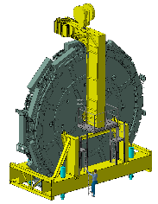
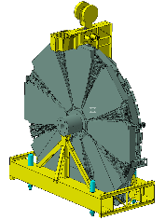
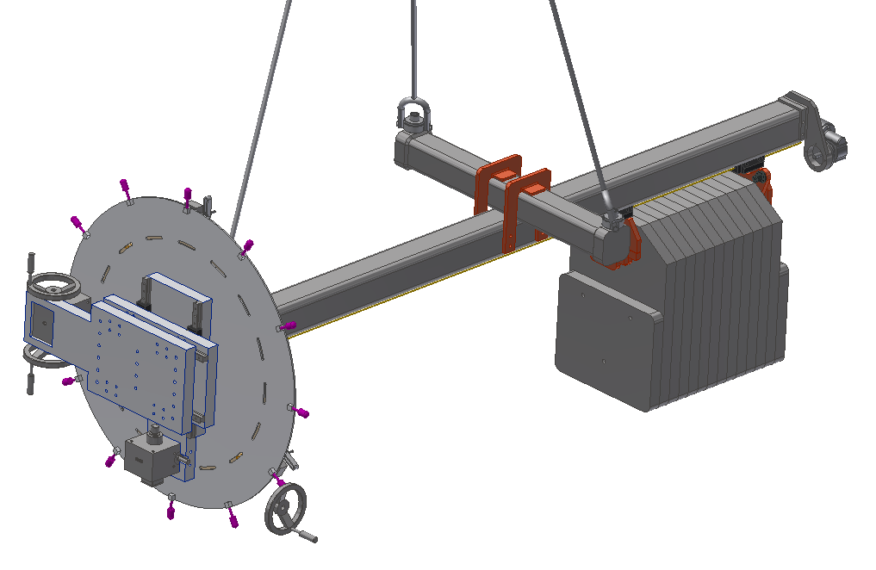
Other installation tooling
Today’s review originally was meant to cover also the installation tooling for the completed New Small WHEELS
Support stand
Lifting Arm
This review has been postponed on request of the Design office. It is not time critical and can be done in early 2017 as well.
1x Lifting Tool
2x Resting frame
1x UKZN Tool

