Slide 2
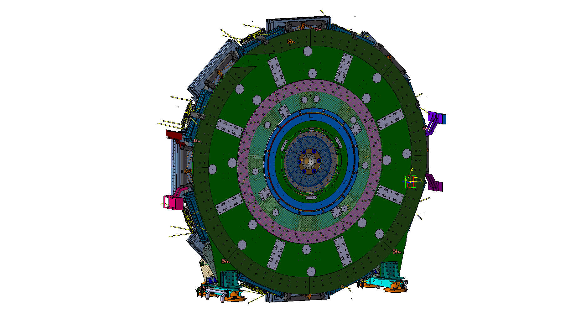
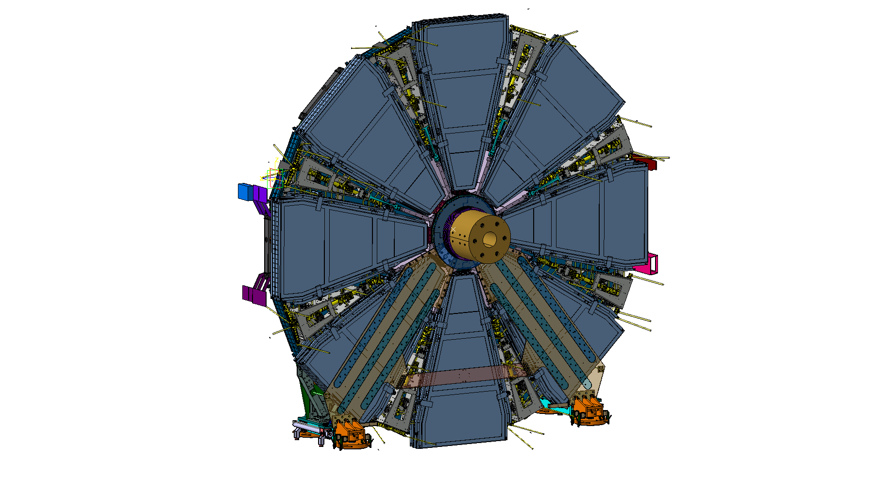
NSW structural improvements

Slide 3
Why ?
Modifications in the design were done after the FDR for the following reasons :
To relax some tight tolerances to decrease the production cost
To deduce the size of some pieces to ease the fabrication, transport and installation
To make some items standard for side A and C and to reduce the number of drawing and ease the production and assembly logistic.
To improve the positioning for a better control of the geometry shape.
To improve connection stiffness and ease their production and assembly

Slide 4
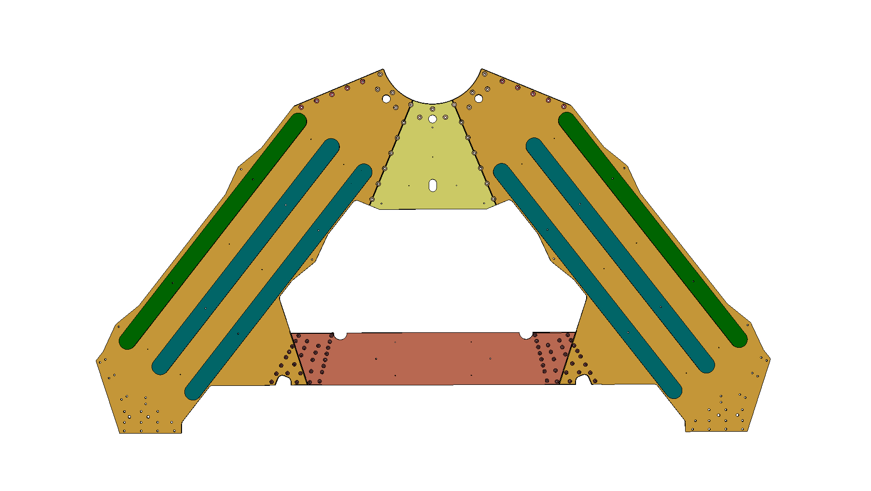
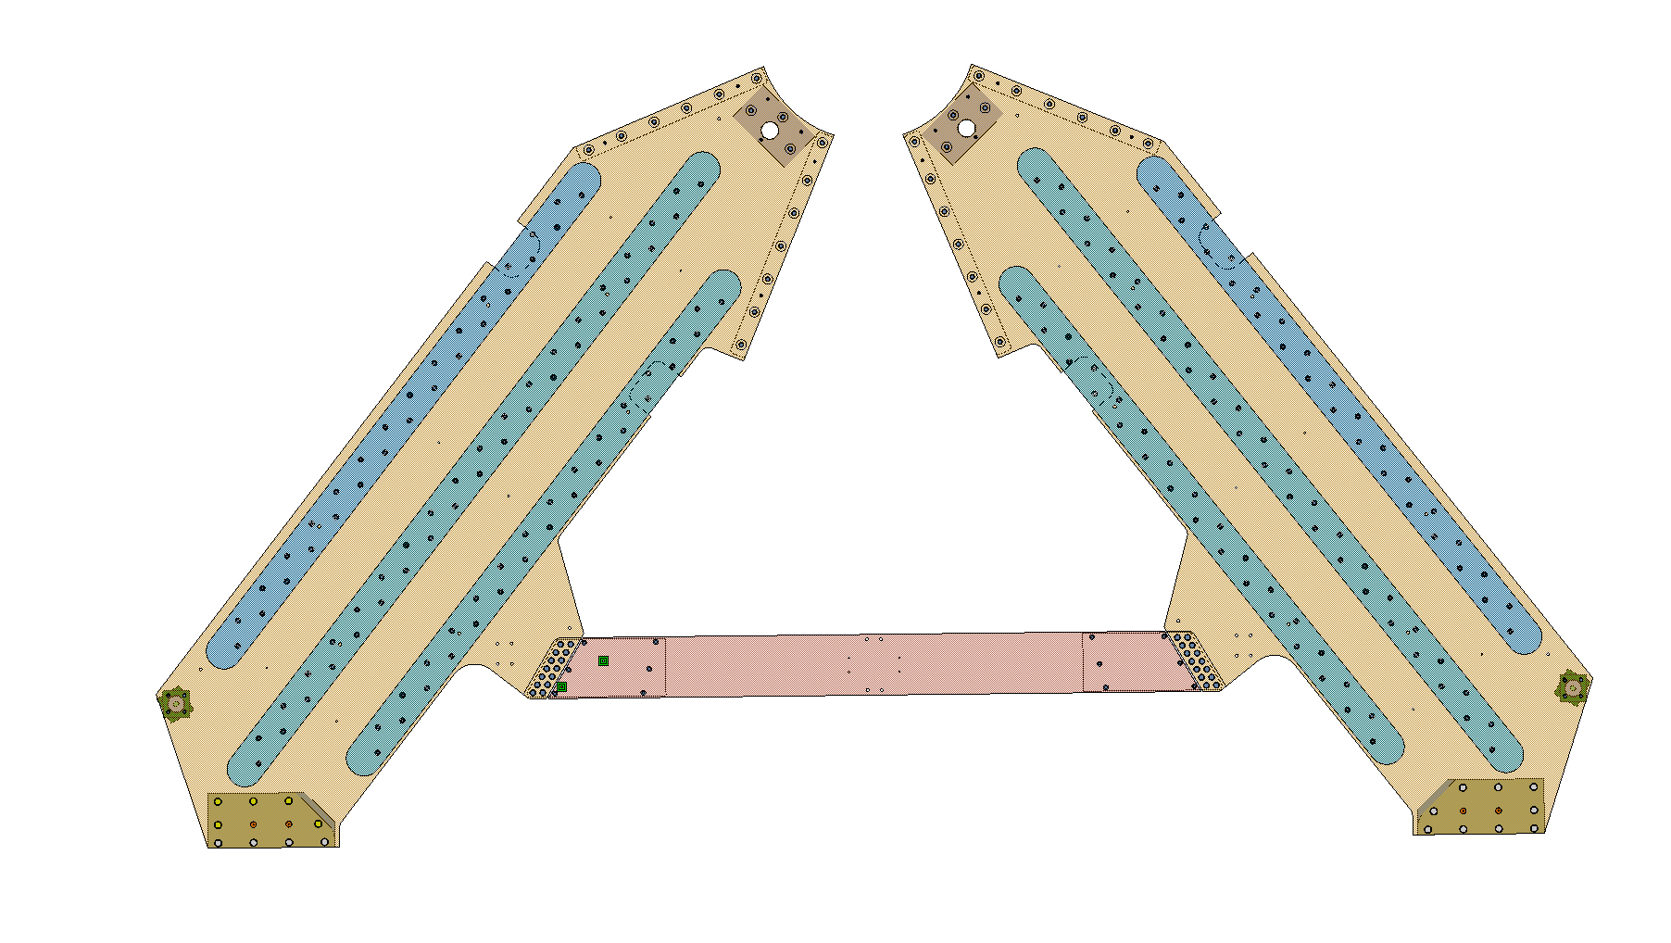
nSW A-plate
Old
New
sTGC Frame cut-out
Central plate mounted with slot holes
The old version of the A-plate was entirely welded and considered like a single part
The new version is fully bolted and not anymore welded with a bottom plate mounted with slot holes
We also remove the top middle plate so the lateral plates are now independant
The reinforcement ribs is now bolted and we add cut-out for the sTGC frame on the new version

Slide 5
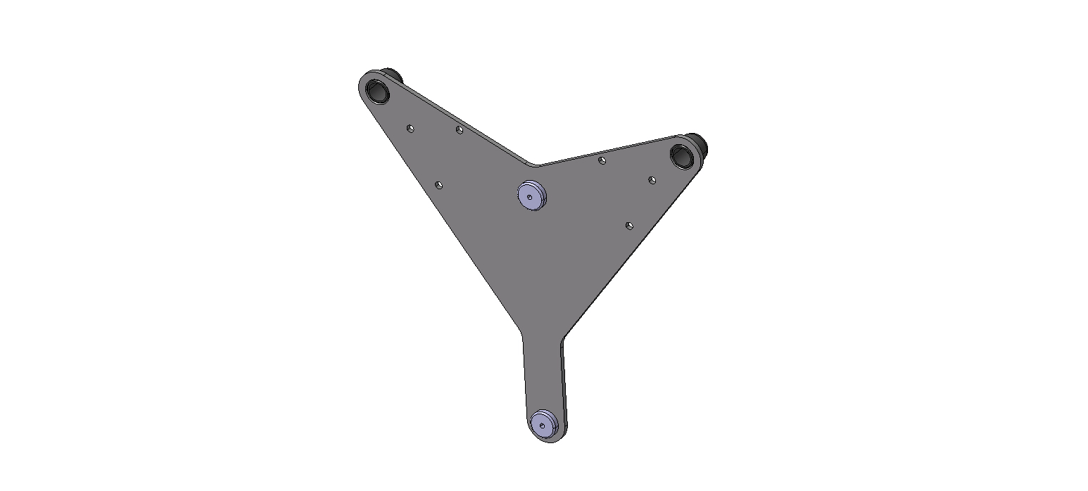
Inner area
HUB pins holes
Old
JIG
Jig Hole and slot Hole
The A-plate as a single part needed a jig to correctly locate the holes for the Hub pins
In the new design , the jig is not needed because the 2 lateral plates are independant (easier for transport, manufacturing and assembly)
As a conséquence
  it disconnects the dependancy between the production of the Hub and the A-plate
  It reduce the manufacturing tolerance and therefore shall decrease the production cost

Slide 6
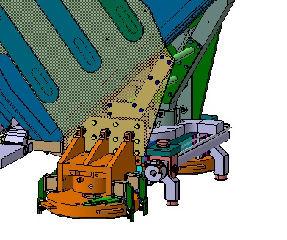
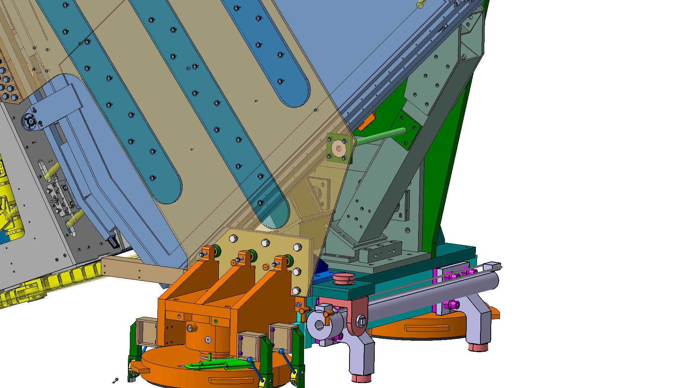
Outer area
Old
New
Fixed L-shaped anchorage
Adjustable anchorage
Couterdrilled pins
Couterdrilled pins
The anchorage is now adjustable => reduce the production tolerance for the same stiffness
The counterdrilled pins is not anymore in the same positions => better control and access

Slide 7
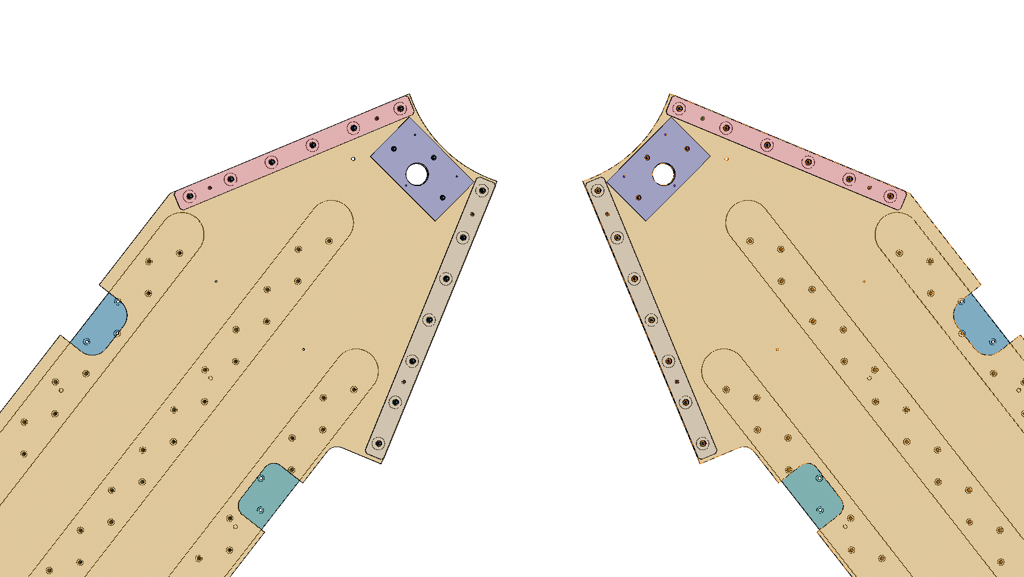
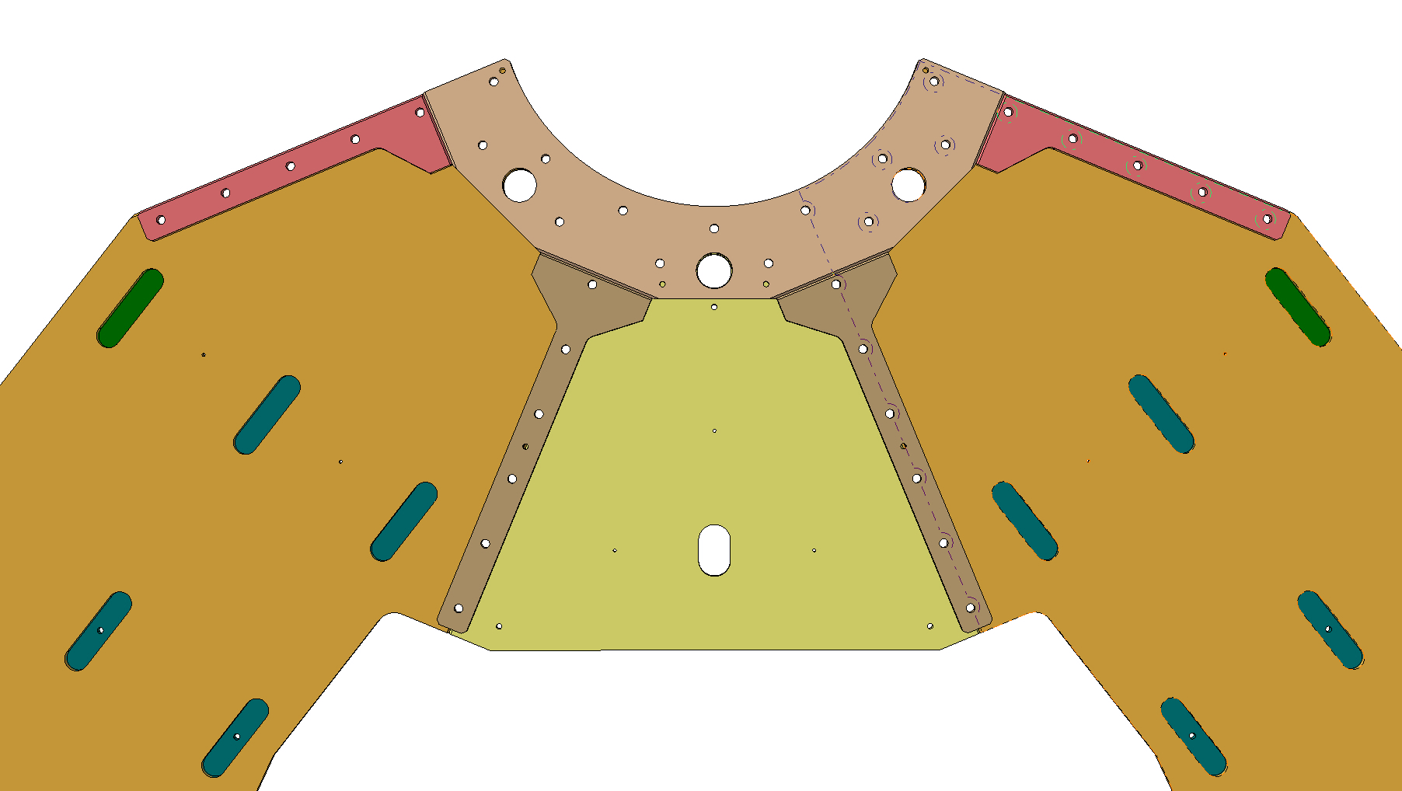
Shims and bolted design simplification
Old
New
Slot holes for welding
As you can see, the new shims shape are simpler and easier to install (screwed instead of welded) => less deformation are expected and production cost reduce
We also remove all the slotted holes all along the lateral plates. This slotted holes were there to weld the reinforcement ribs => less deformations are expected

Slide 8
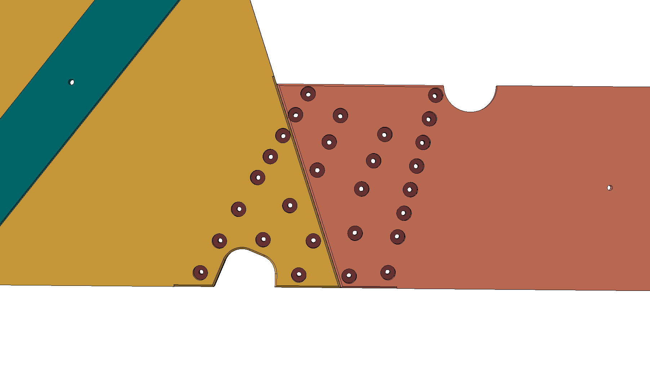
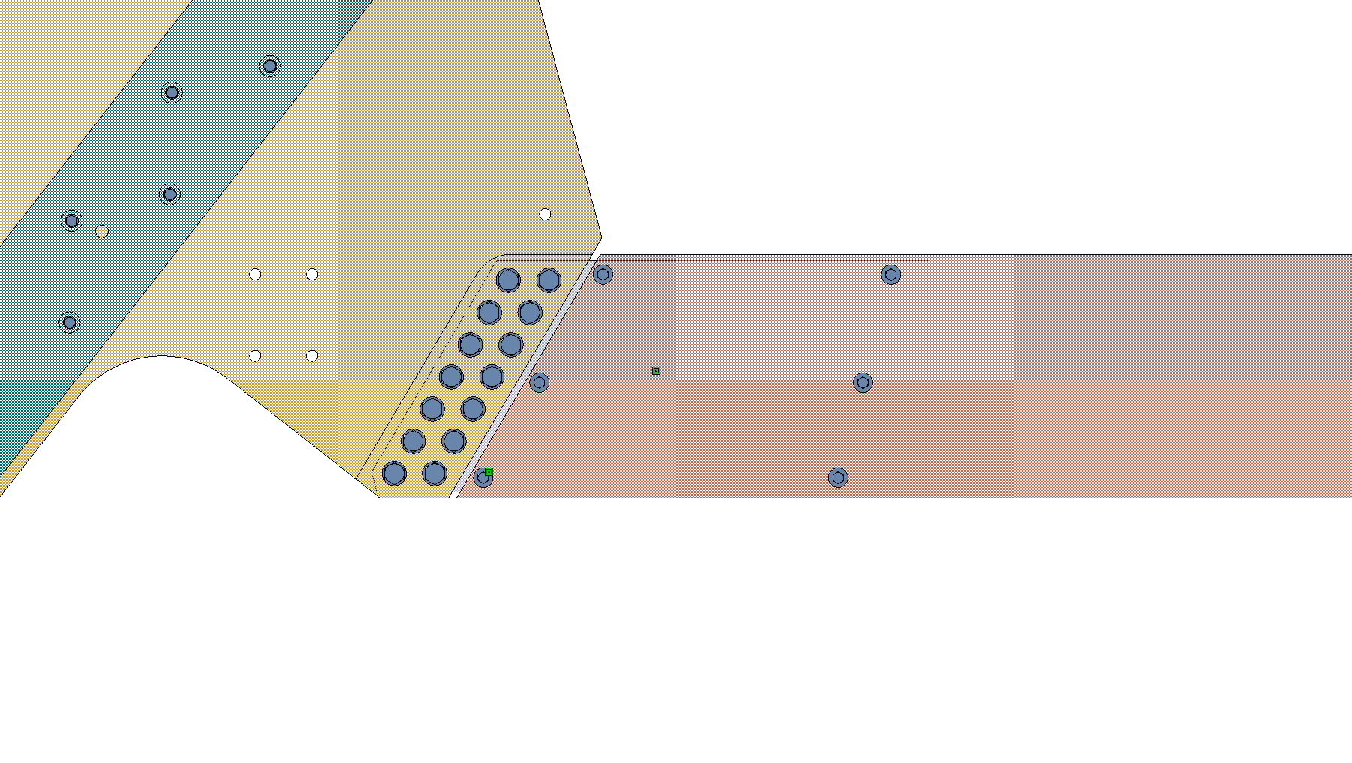
LS spoke links
Old
New
According with the FEA calculation, we discover that the A-plate is stiffer than the LS spoke itself so we decide to decrease the size and the numbers of holes (from 28 M12 to 6 M8 )
Note : we decreased also the size of the central plate as it has no influence on the stability (the scale on the two pictures are the same )

Slide 9
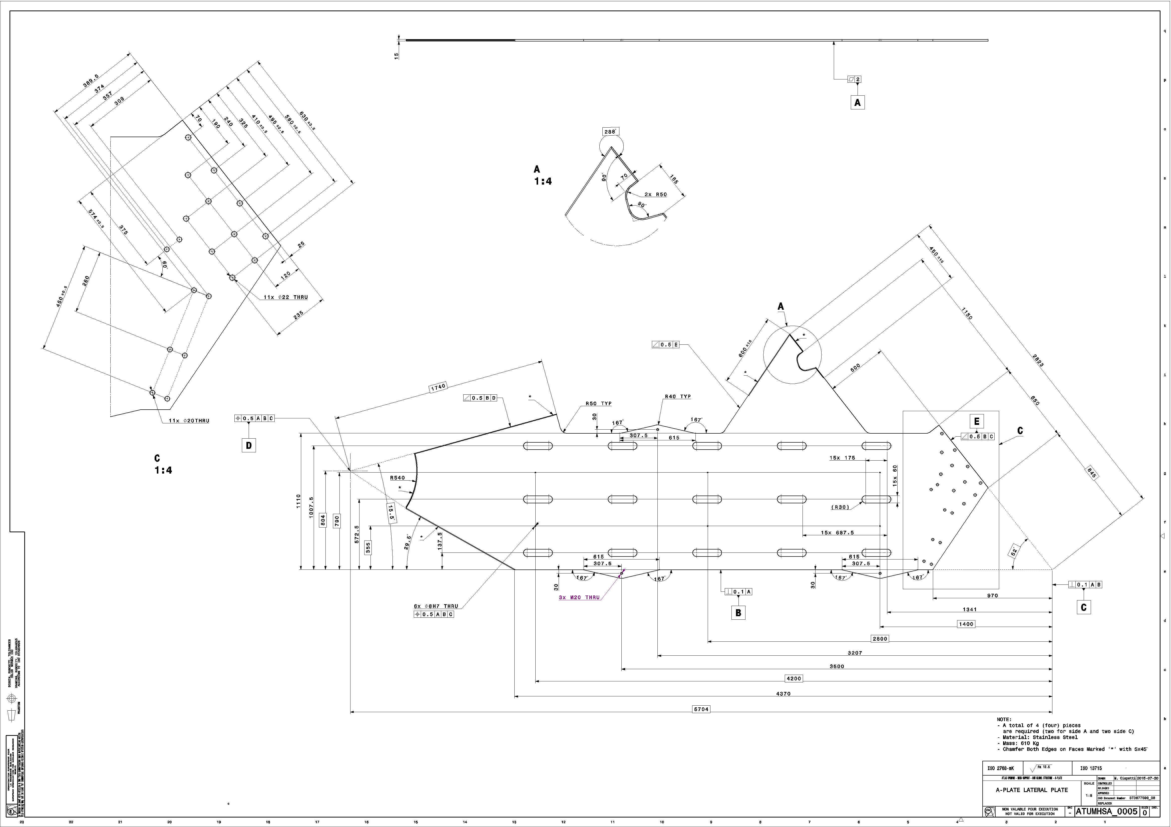
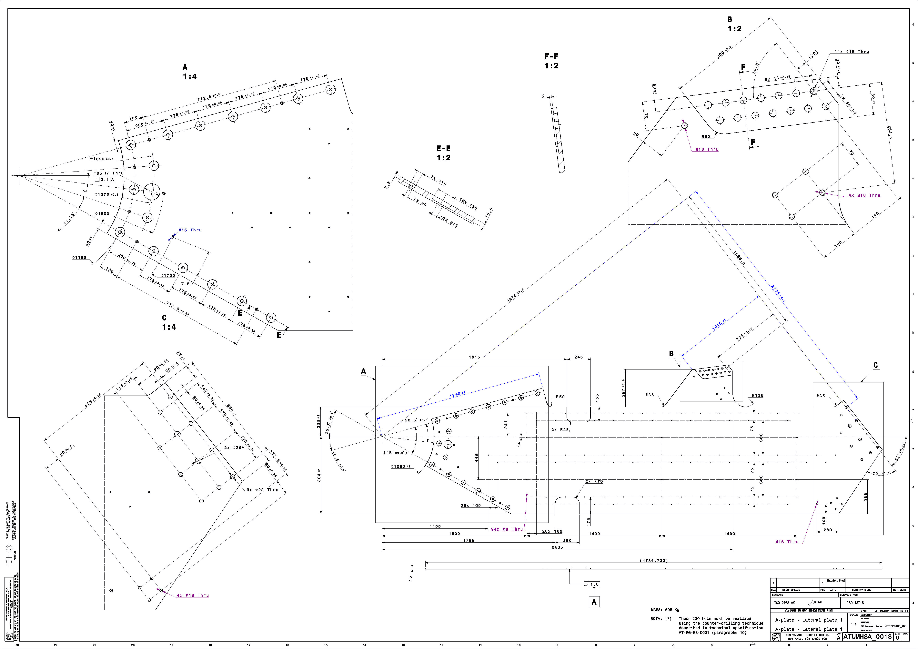
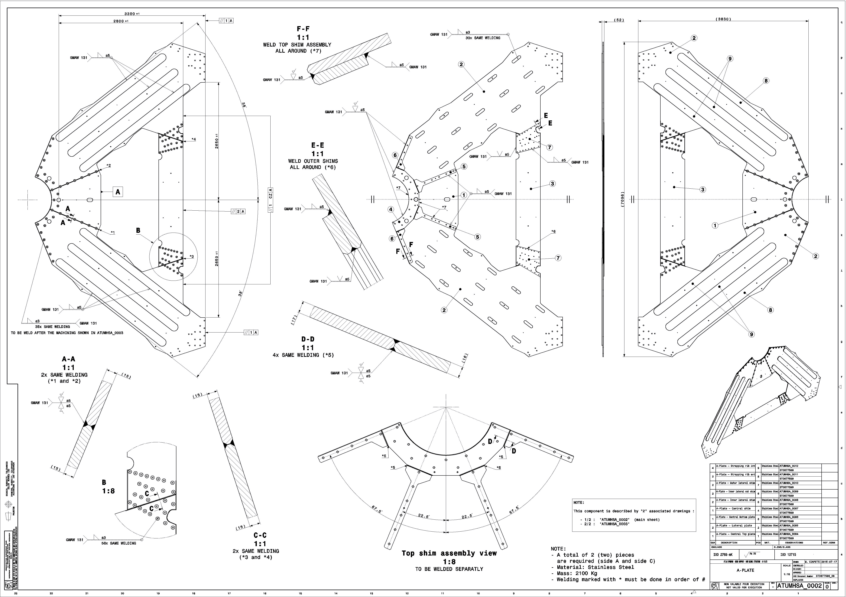
Let’s talk about drawings
Obsolete
According to the new design , we reduced the amount of drawings (put in obsolete 14 drawings and add 10)
We made a huge effort to relax the geometrical tolerances => cost reduction

Slide 10
A-plate - conclusion
We decreased the overall Weight to approx 350 Kg
We reduced at the minimum the welded connections to avoid out of plane deformation.
We avoided the need for a JIG to suppressed any dependency between the differents manufacturer.

Slide 11
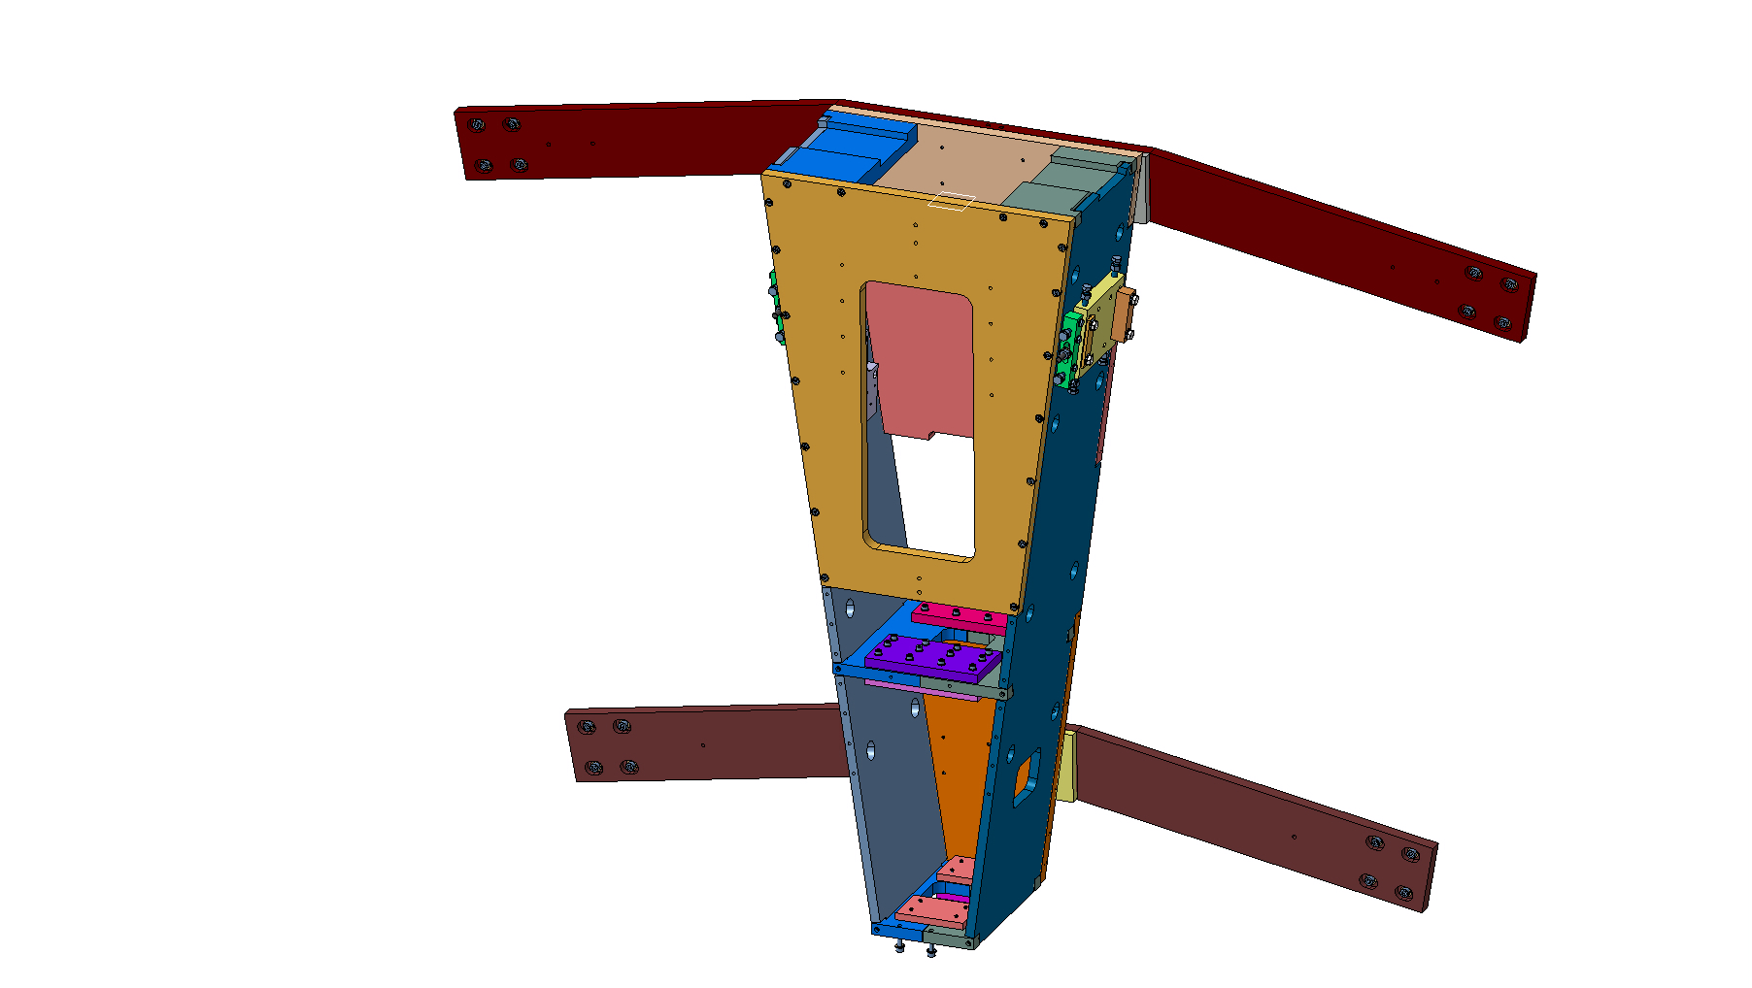
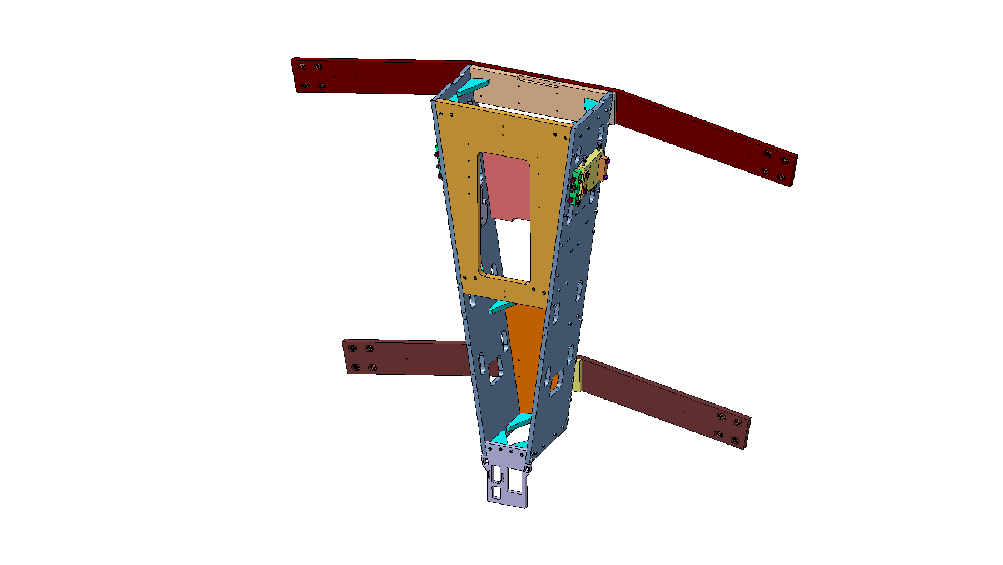
LS spoke outer part
Old
New

Slide 12
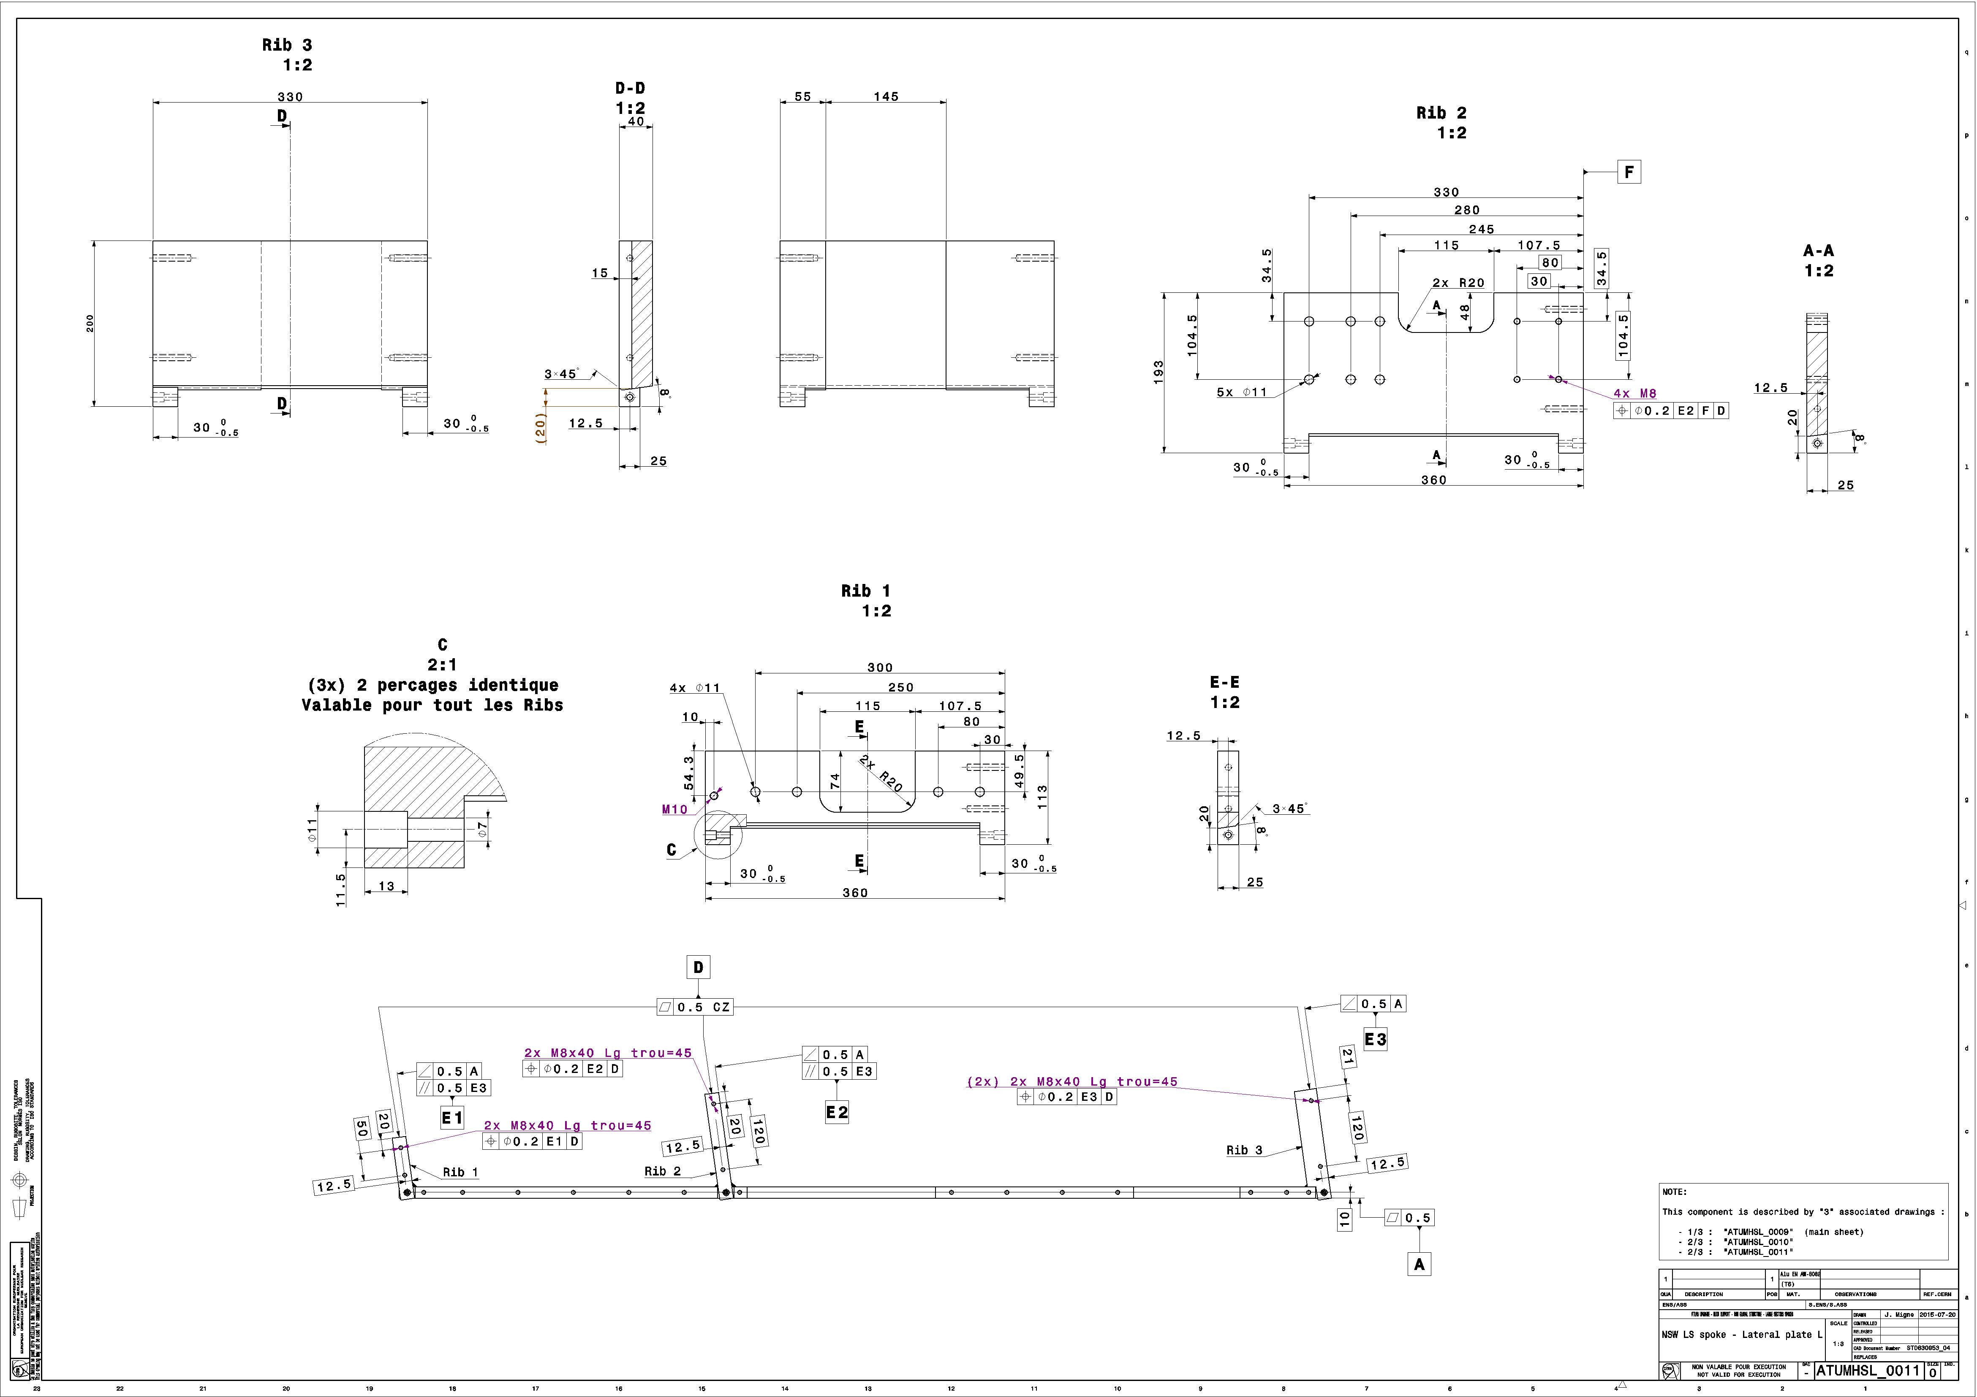
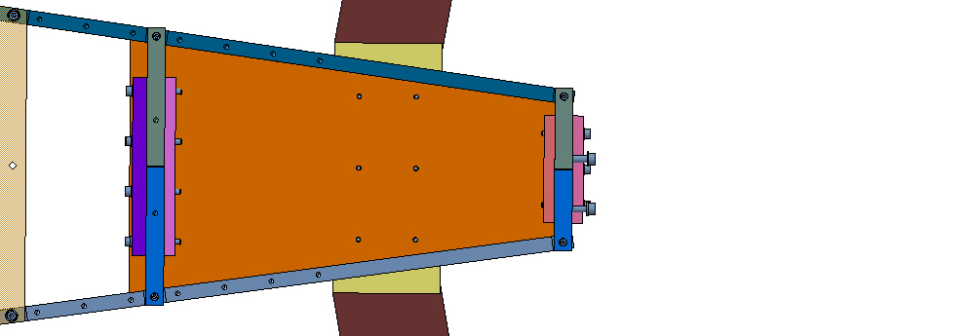
Plates connection 1/2
The old design requires 2 different lateral plates with 3 welded ribs on each
The positionning angle and tolerance between the plate and the ribs were very important to garanty the assembly, but were nearly impossible to reach without complex remachining
If these angle are not respected, the connecting plates can break the weld (FEA talk by Augusto)

Slide 13
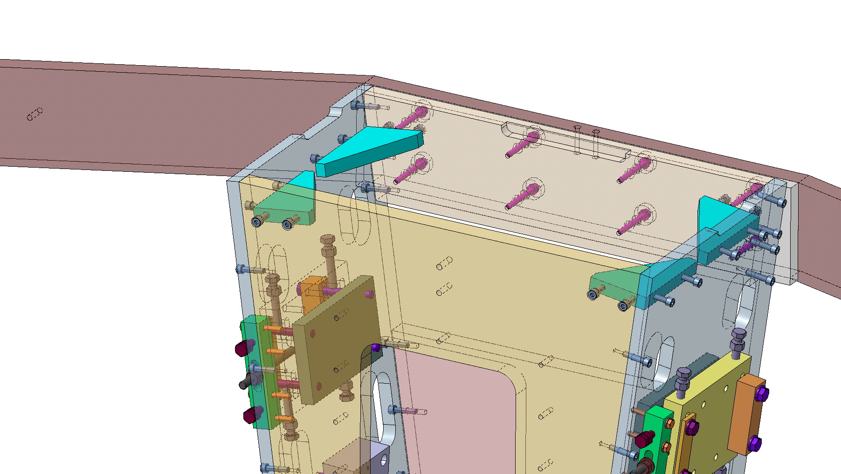
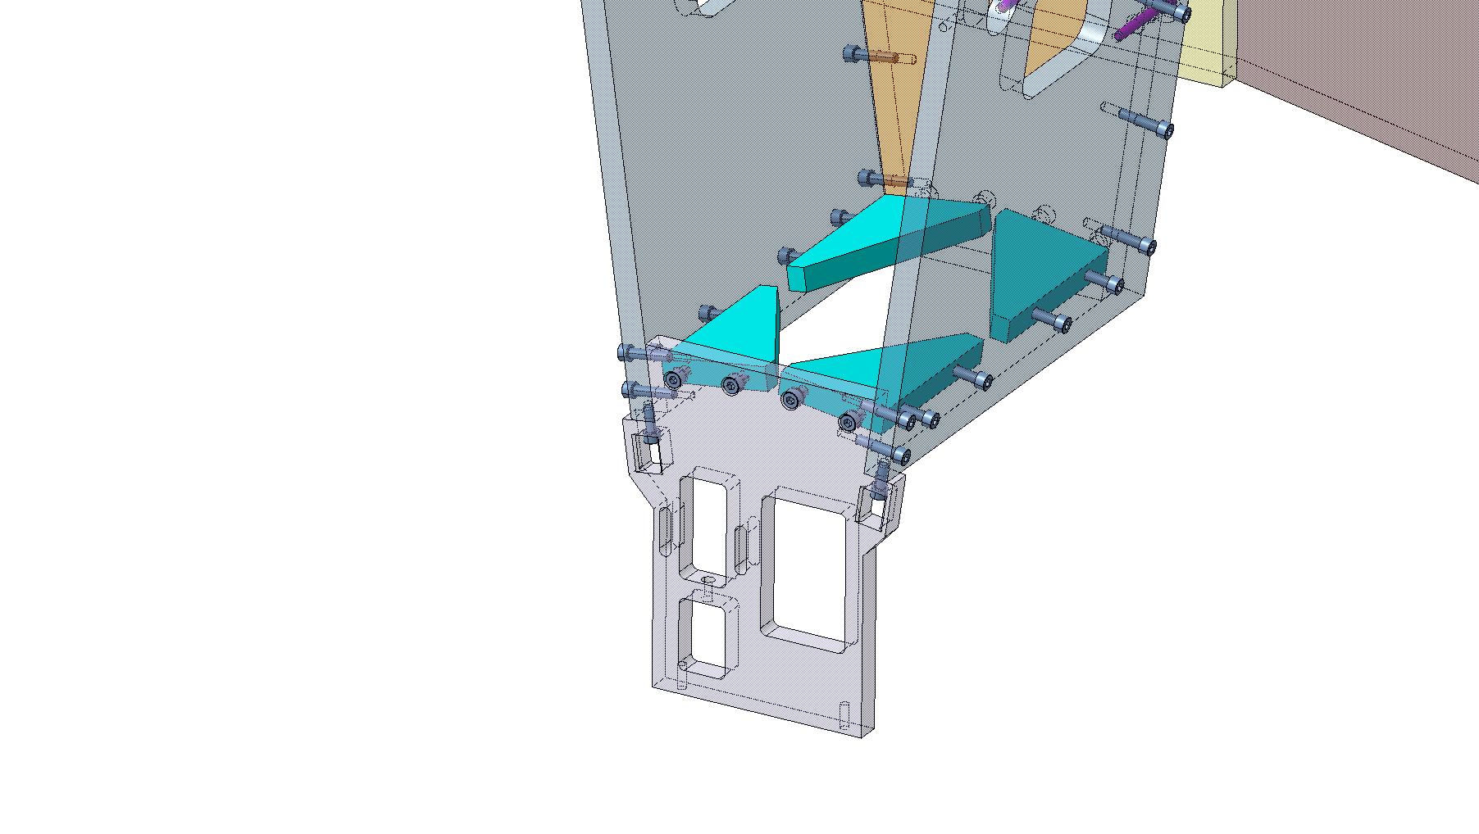
Plates connection 1/2
So we decided to completly change the design of the connecting plates between lateral plates by removing the old ribs and add several standard triangle ribs
There are not anymore welded parts and everything is bolted => less deformation and cost reduction
We added the KM plate as an angle reference for the full box
KM plate

Slide 14
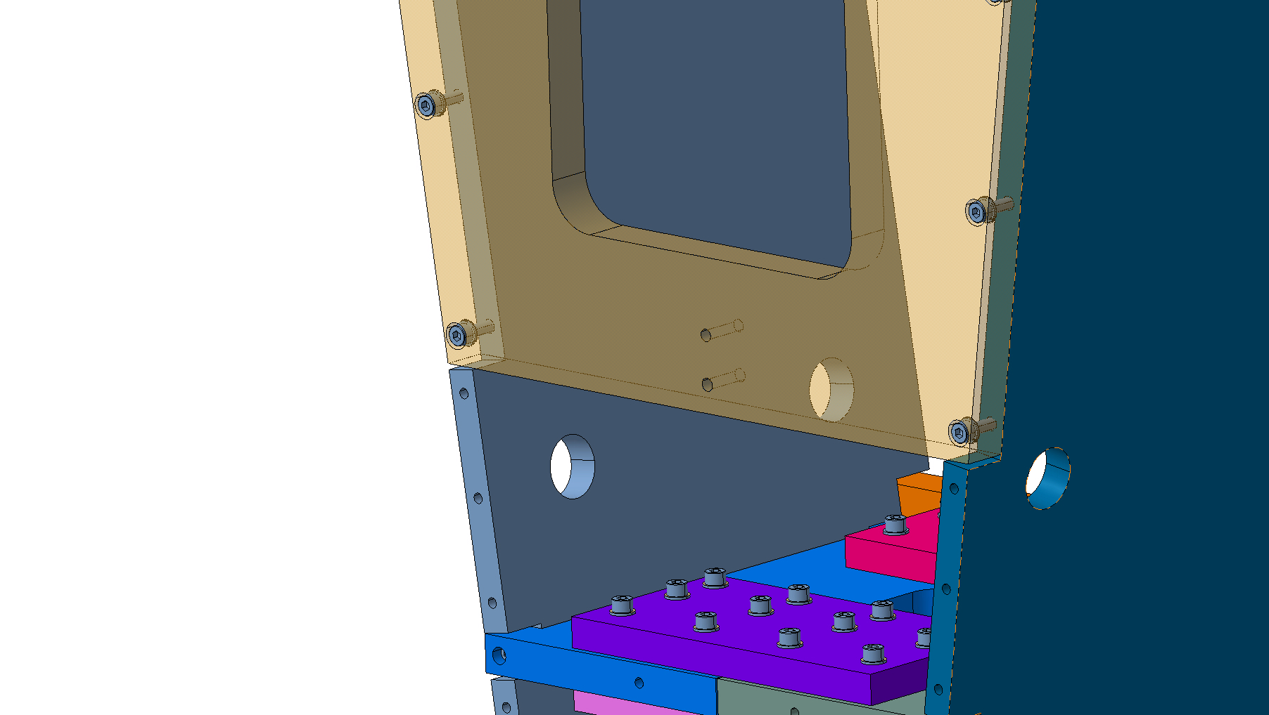
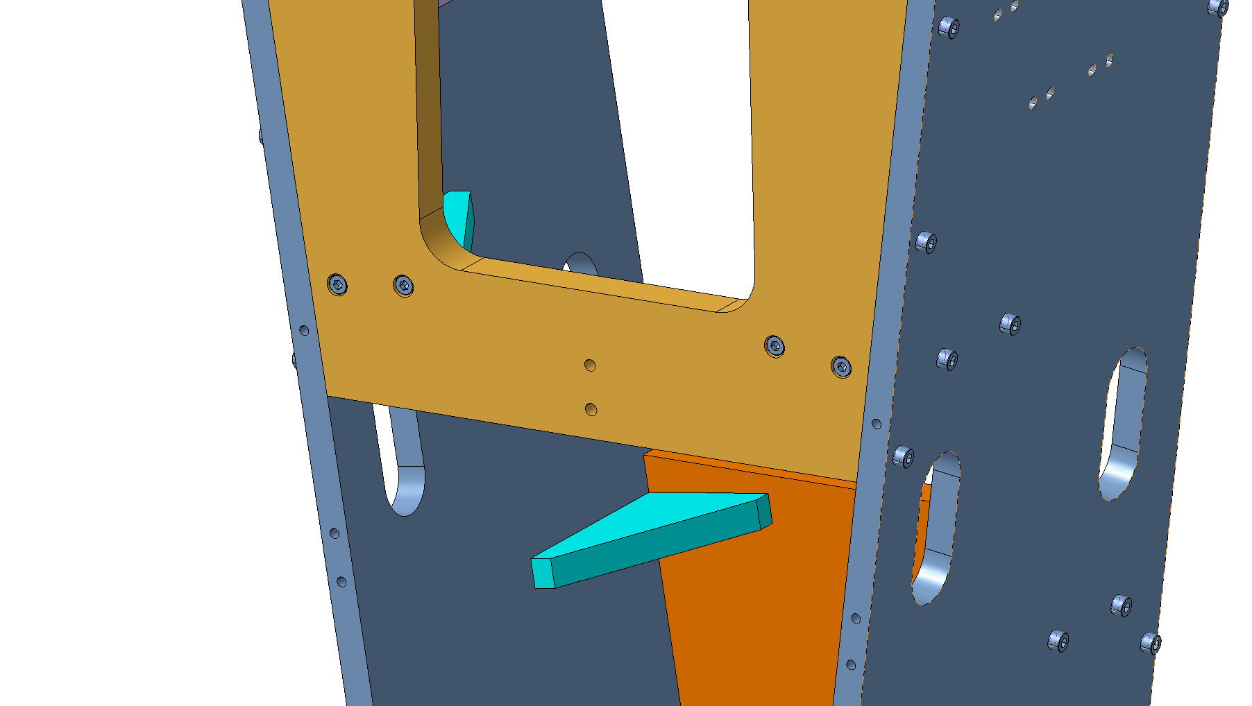
Plates connection 2/2
We changed how the connecting plate are linked (simpler)
On the old version, there were cut-outs on the lateral plate and screwed on the side
We changed the design to avoid this cut-out and concentrate the machining only on positioning surfaces
Finally, the lateral plate is now used on both sides (left-right) of each LS spokes

Slide 15
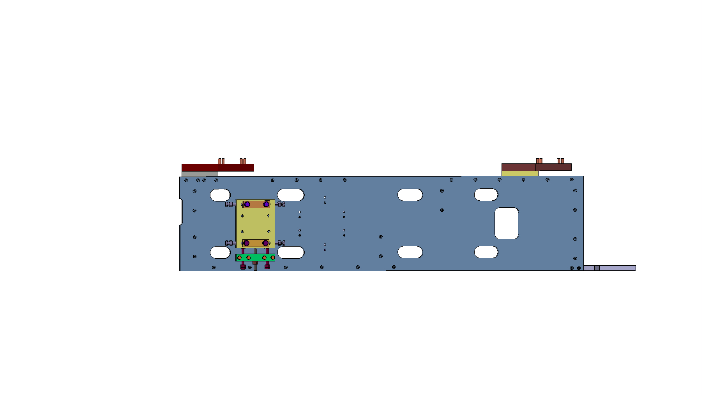
Lateral plate
The generic lateral plate is simpler and easier to realize
You can see now slotted holes in place of holes. This was done to use it both on Side C and side A => standardisation and cost reduction

Slide 16
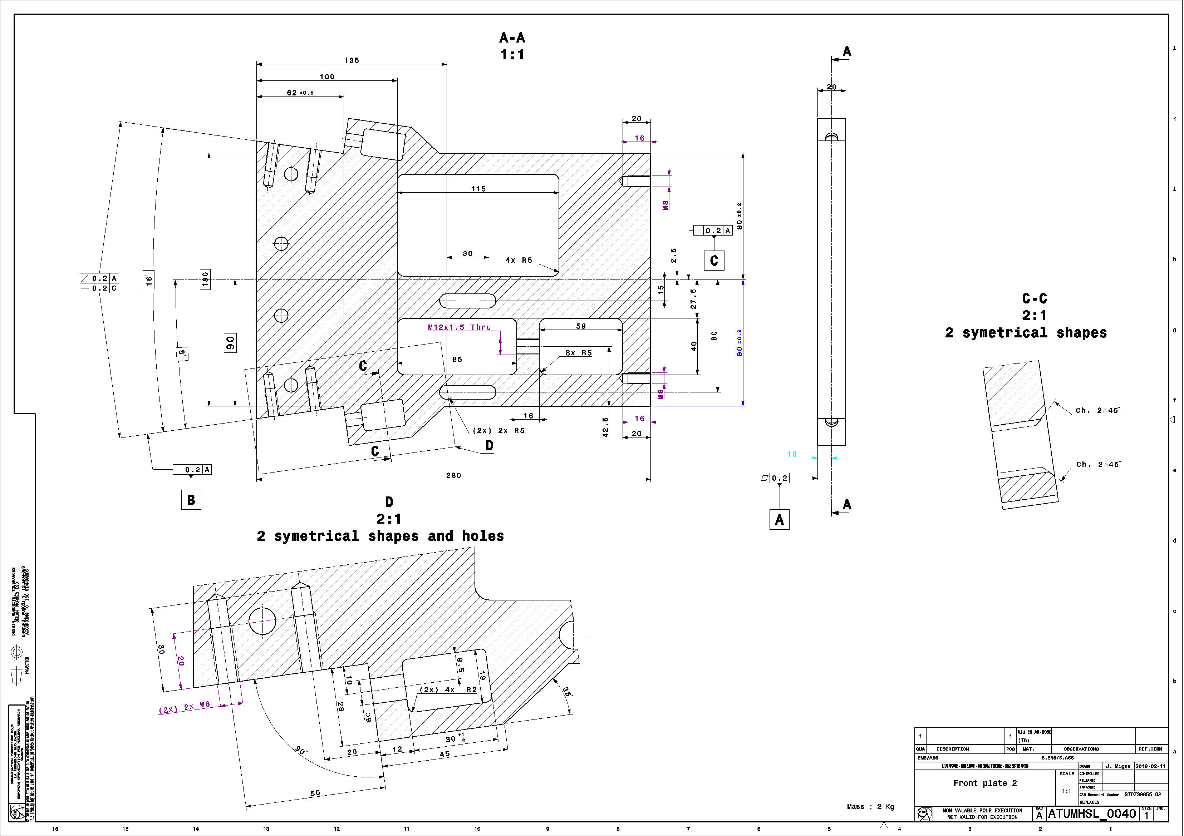
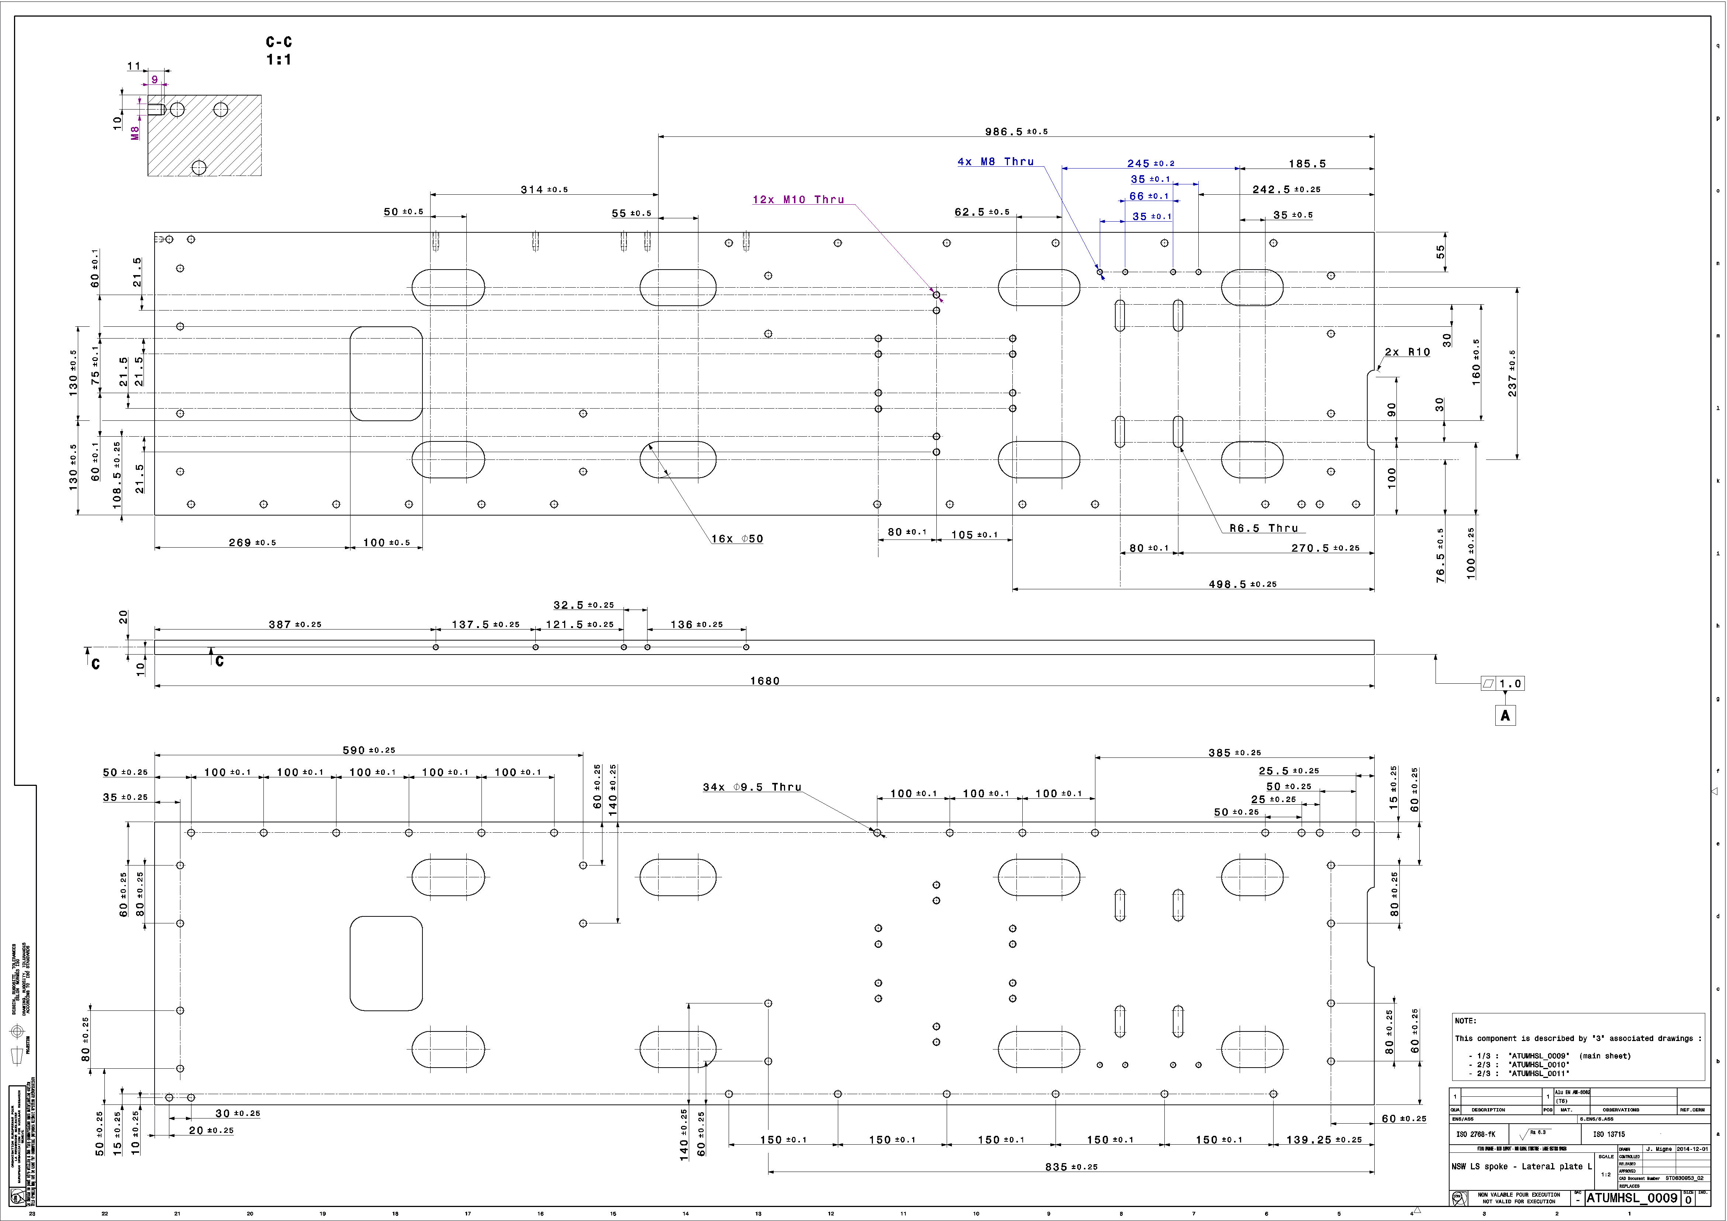
Let’s talk about drawings
Obsolete
According to the new design , we reduced the amount of drawings (we put in obsolete 16 drawings and add only 2)
We make a huge effort to make the design simpler to reduce costs and also release some tolerances

Slide 17
LS spokes outer part - conclusion
Decreased the number of parts and fasteners
We avoided welded parts
Standardisation all the way

Slide 18
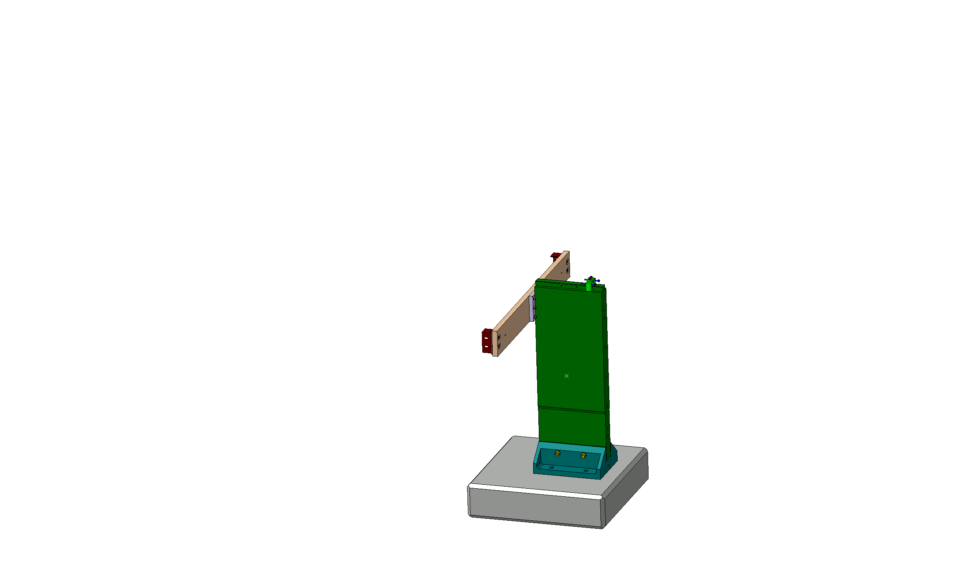
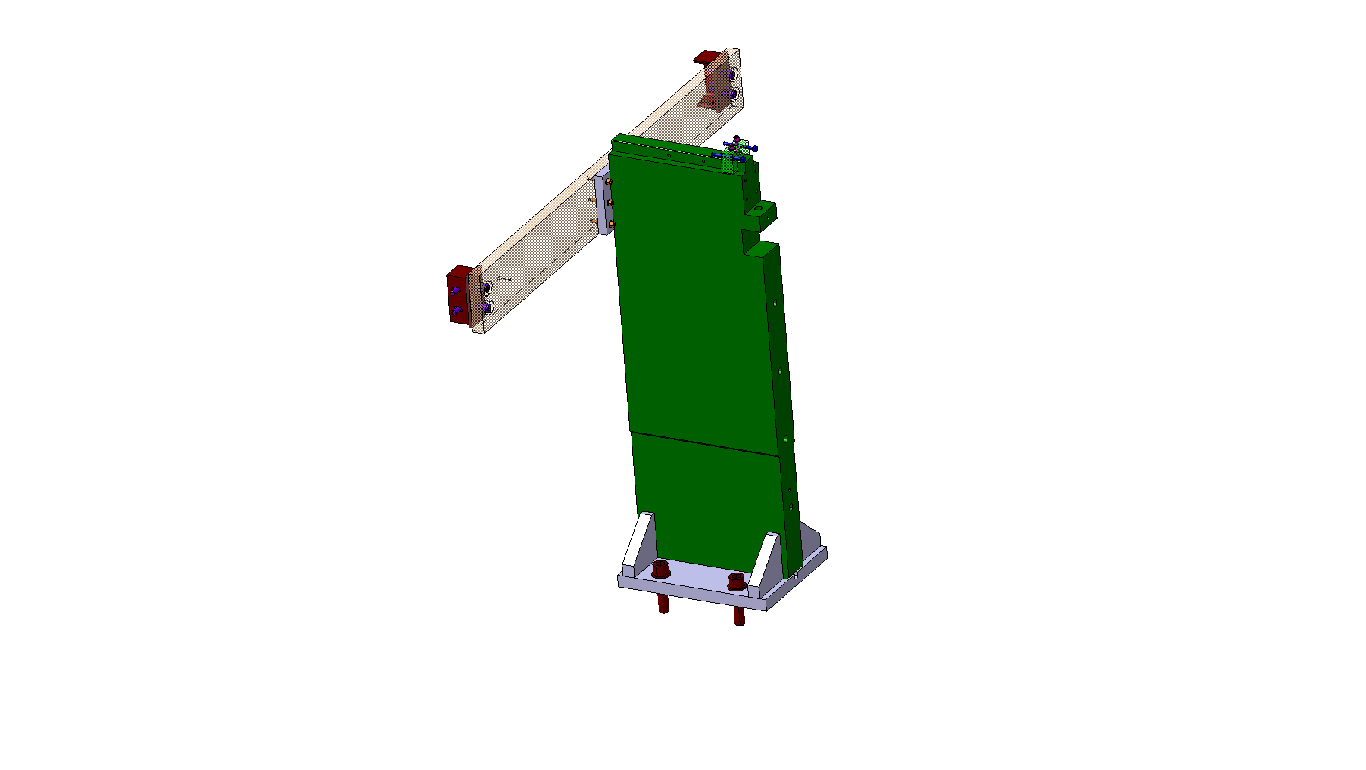
LS spoke inner part
Old
New

Slide 19
Base part
The old base part was bolted on the main part (bottom and side) and welded all along
We redisigned the base to avoid gaps between parts before welding for a better precision and rigidity while decreasing the production cost.
Screws + weld

Slide 20
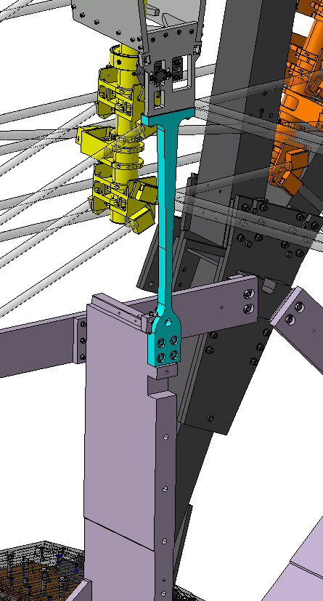
Main part
We added a cutout to connect the LSI-LSO connection bar => reduction of the deformation
We also changed the fillet on the side to a chamfer (easier to make)
Filet
Chamfer
LSI-LSO connection bar

Slide 21
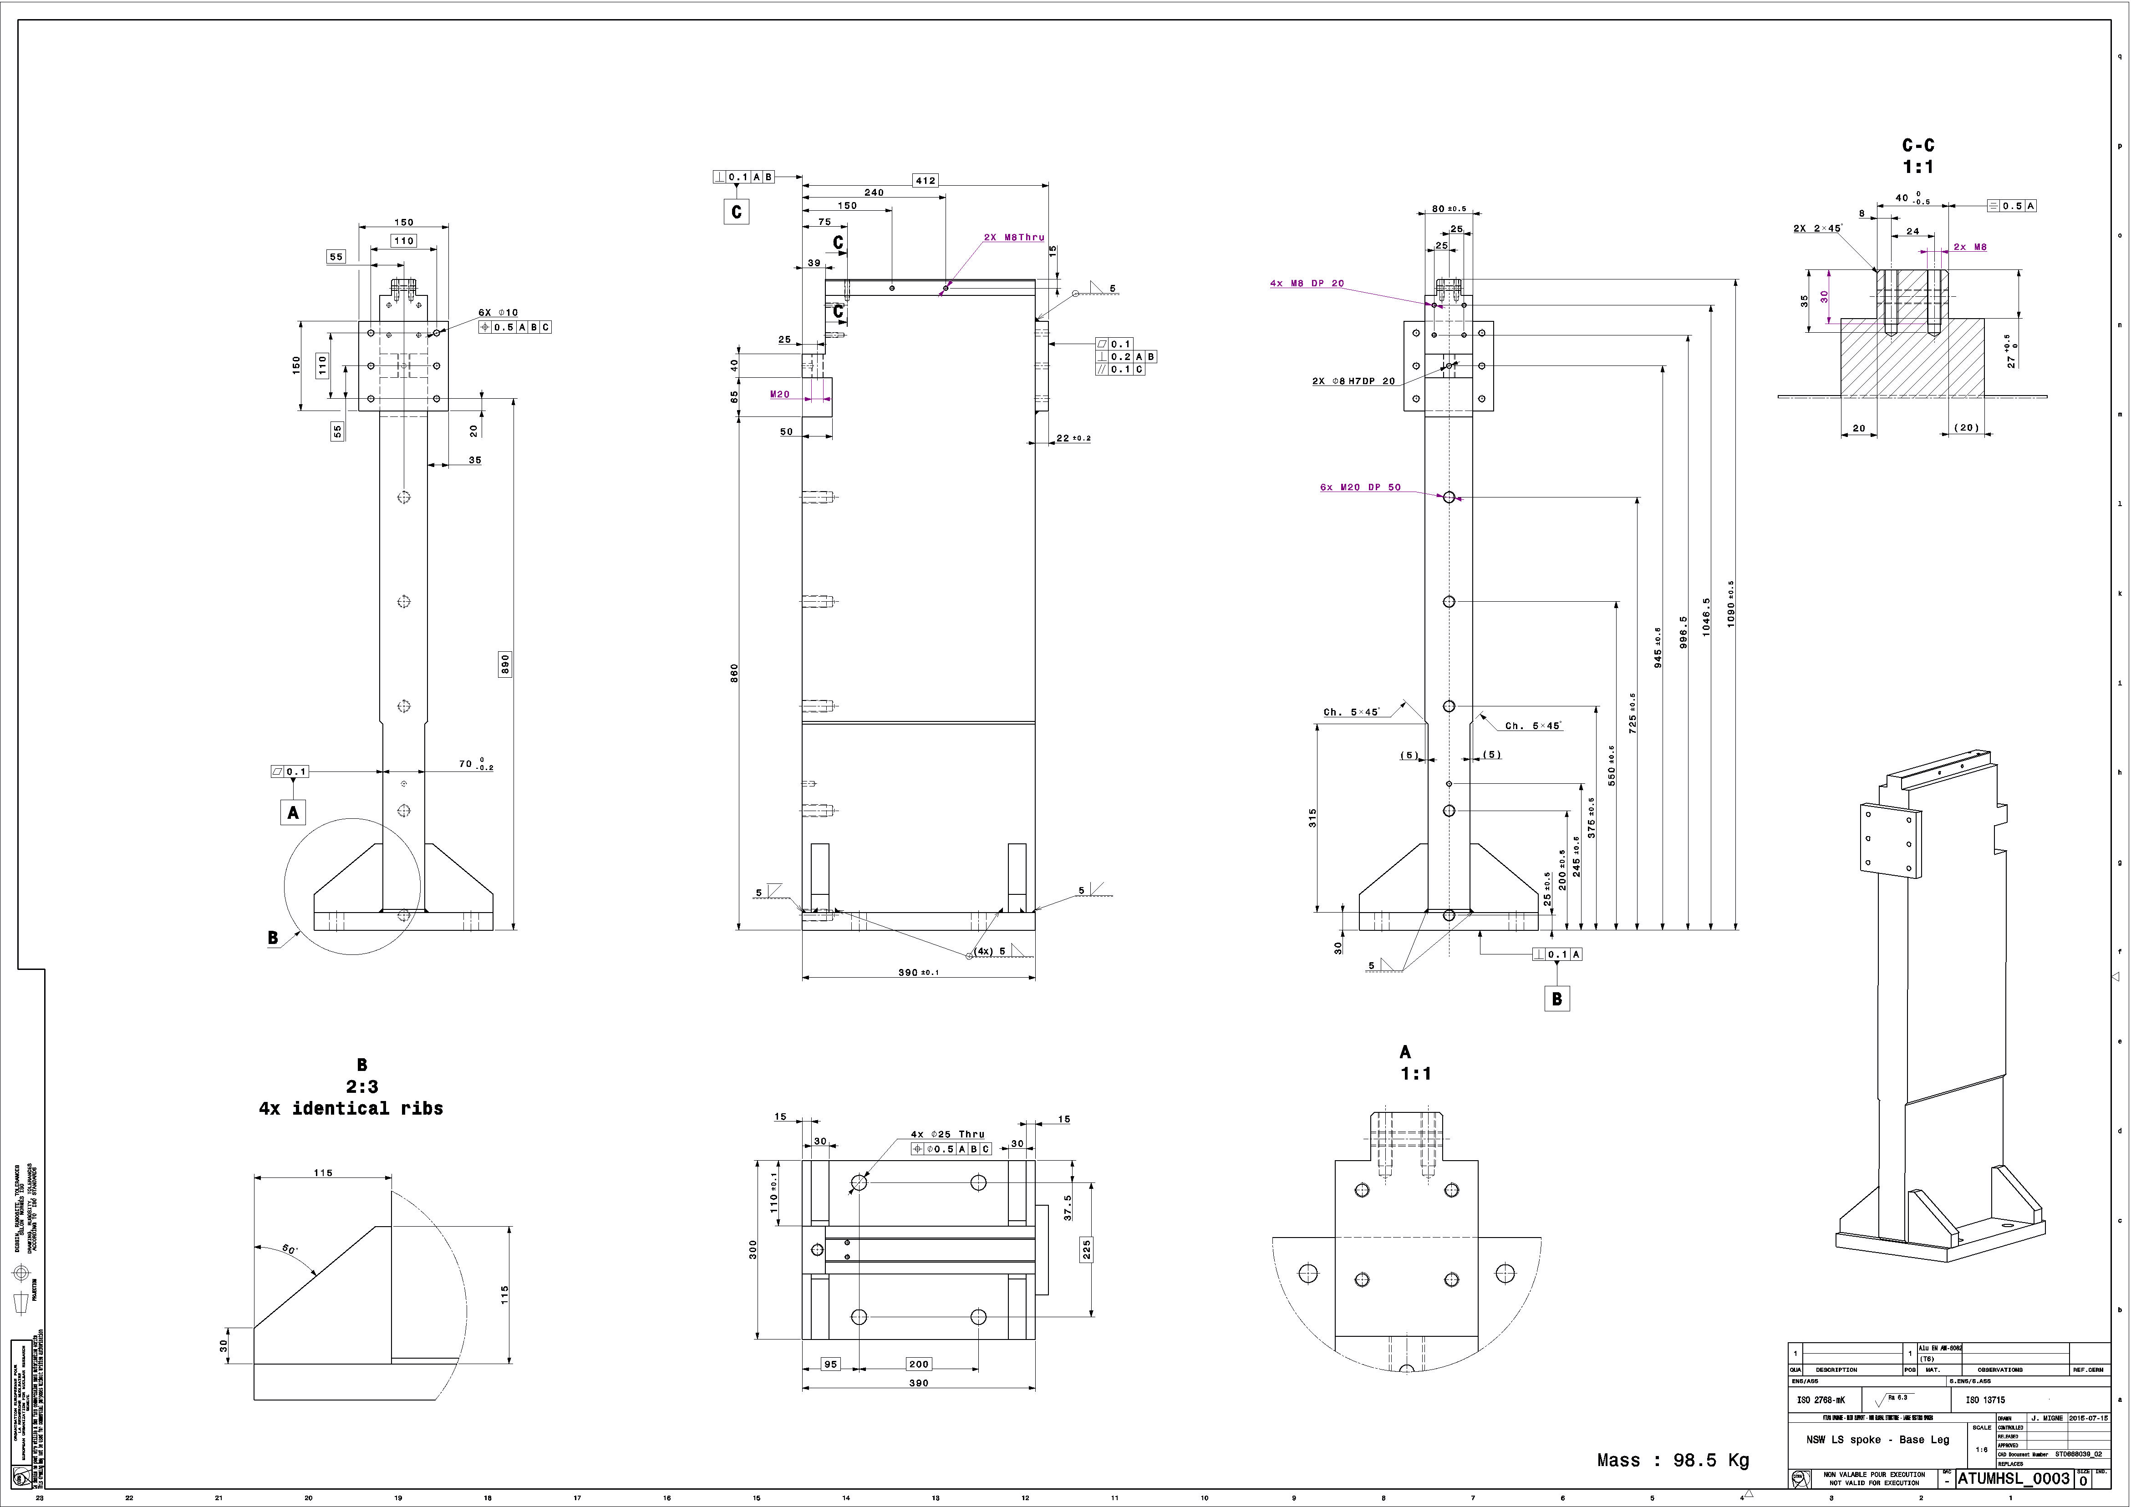
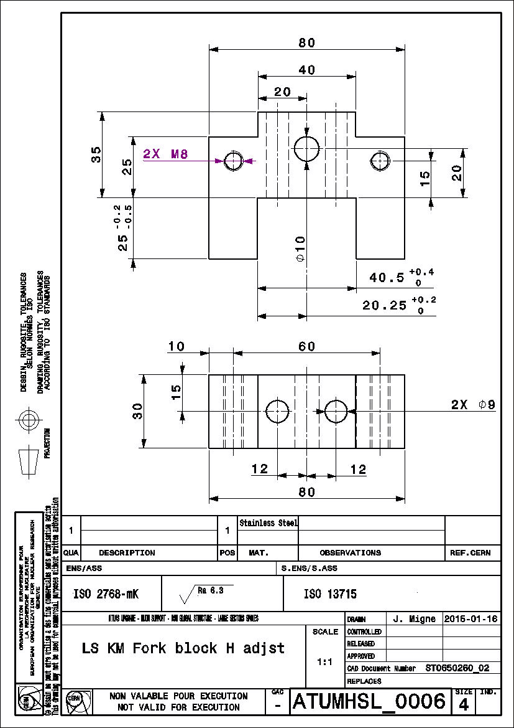
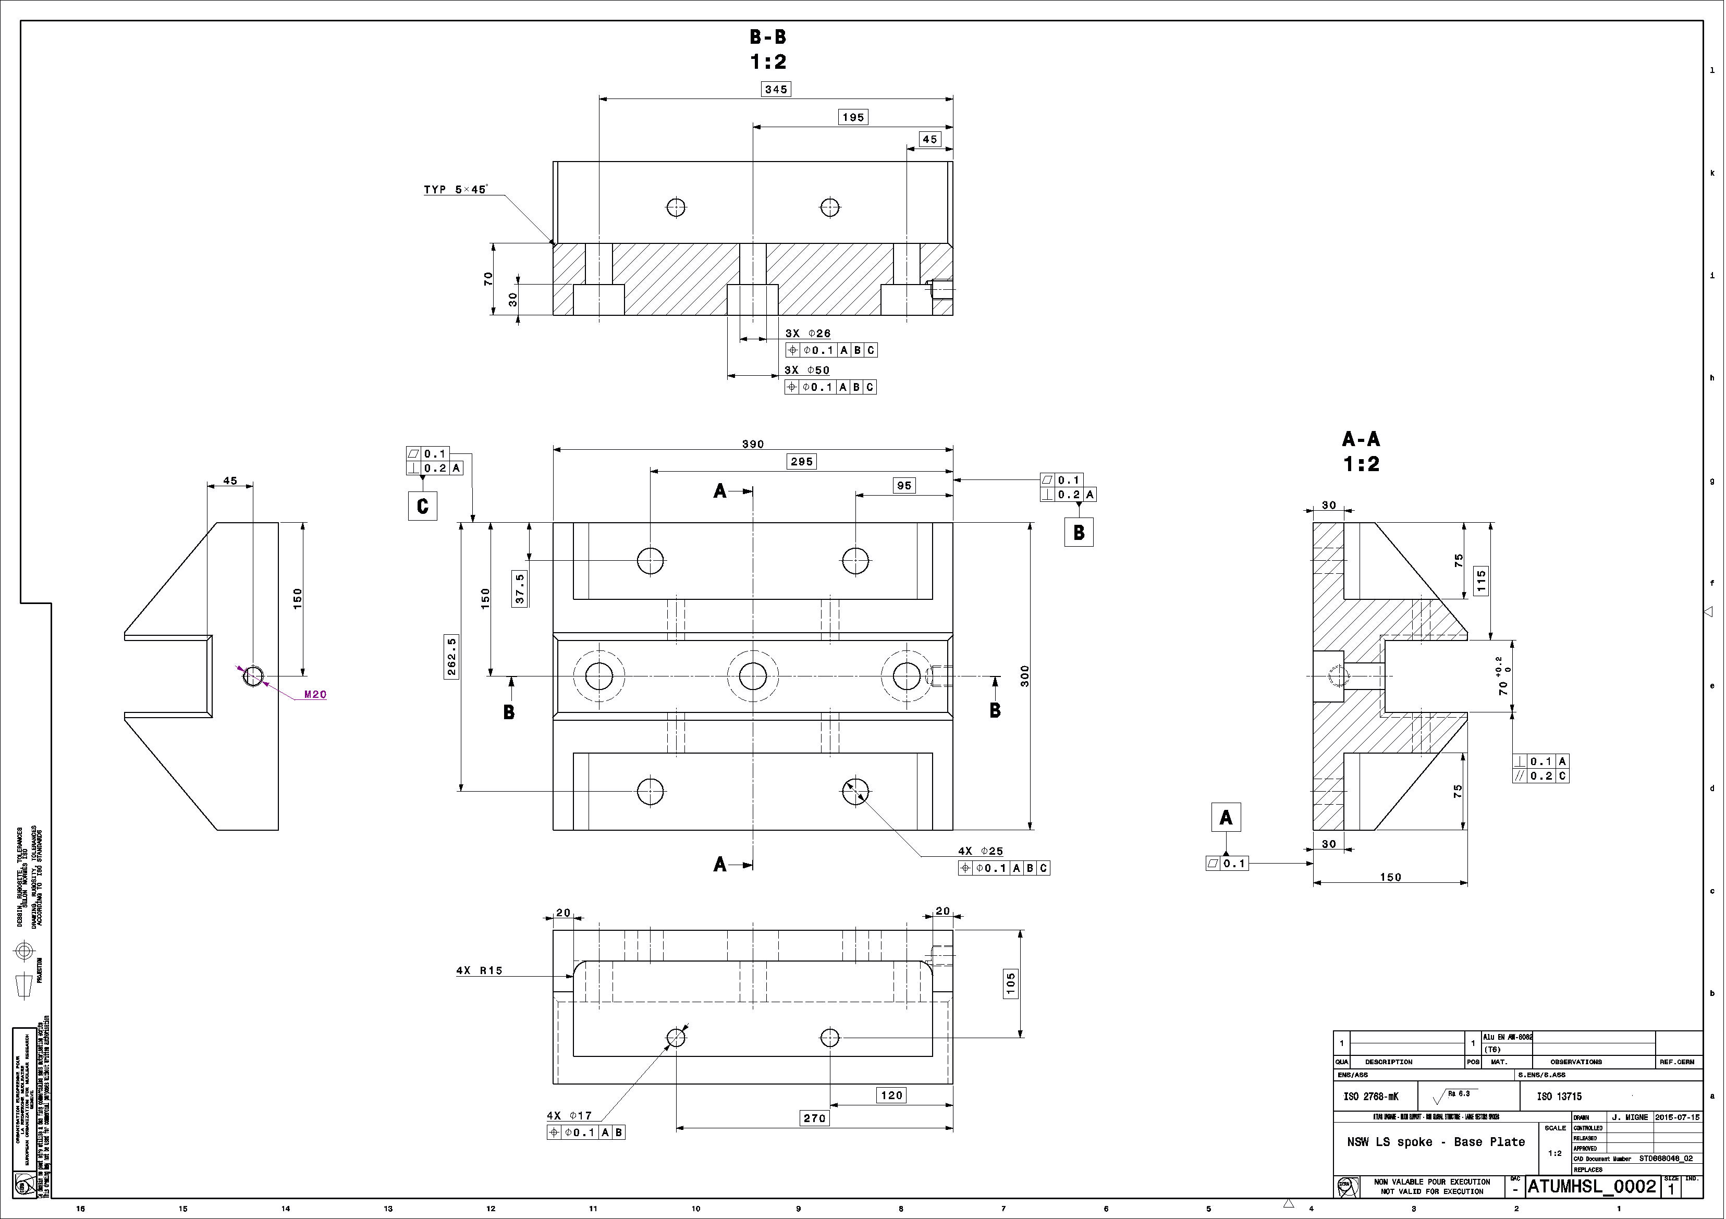
Let’s talk about drawings
Obsolete
According to the new design , we reduced the amount of drawings (we put in obsolete 1 drawings)
We made a huge effort to make the design simpler to reduce costs (filet > chamfer )
The result is a more precise and rigid base part

Slide 22
LS spokes inner part - conclusion
Simplifying the design
Stiffer base

Slide 23
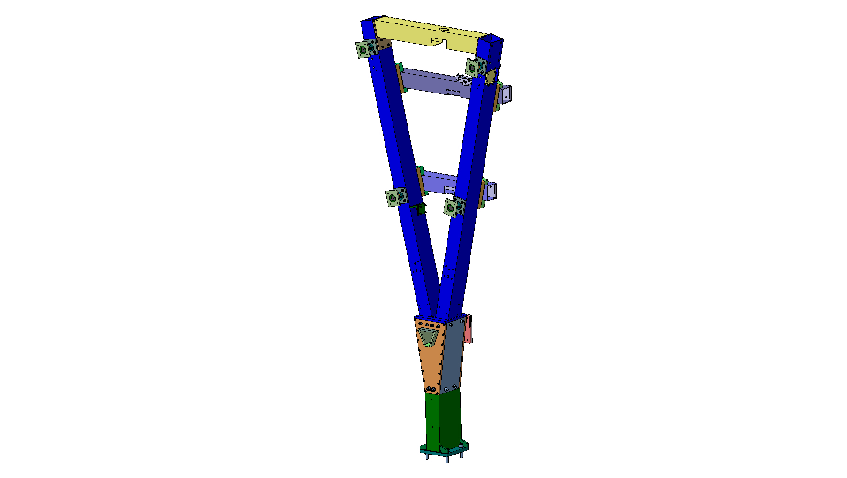
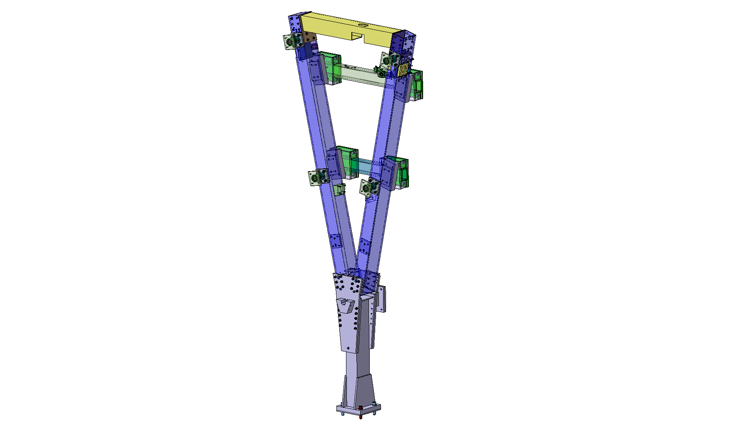
SS spoke
Old
New

Slide 24
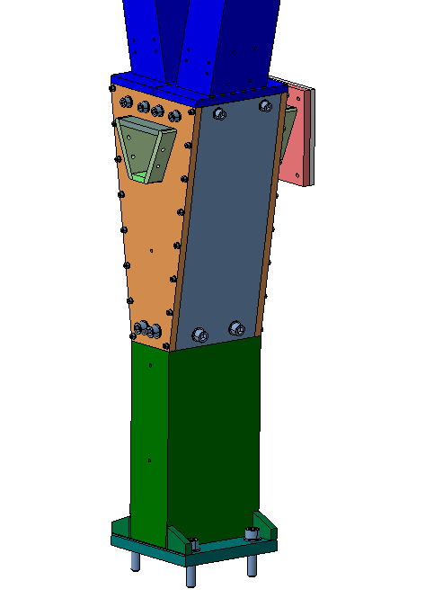
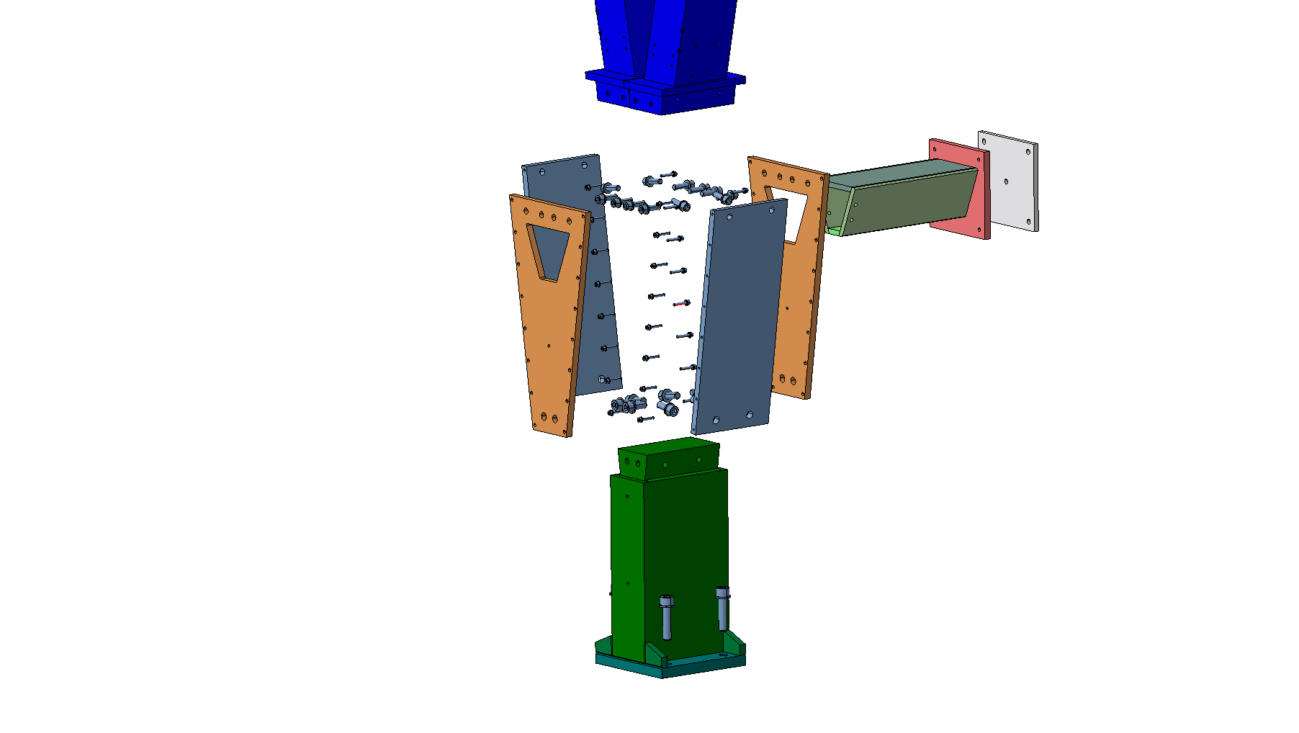
Base part 1/4
The old design was made with severals plates bolted togheter and also a welded beam, welded to these plates, the bending rigidity of this assembly was not optimum
Welded Beam
Welded all around

Slide 25
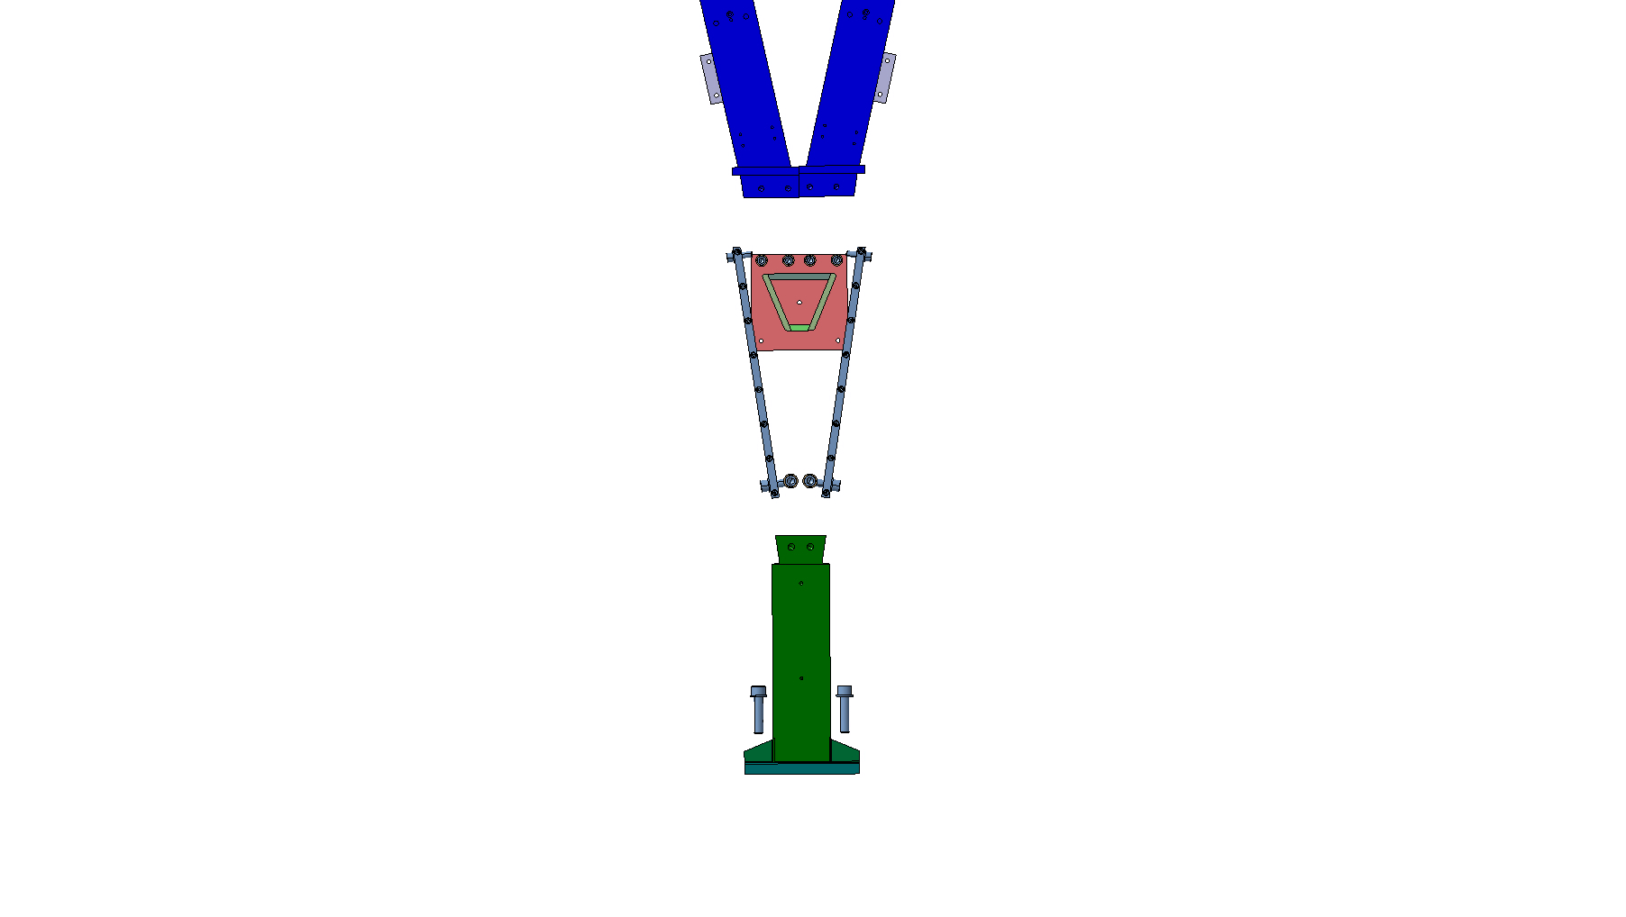
Base part 2/4
D
How the spokes angle was driven :
Angle is given by the base part (A)
Go through lateral straight plates (B)
Touching the Beam face (C)
Correct angle betwen C (D)
C
B
A

Slide 26
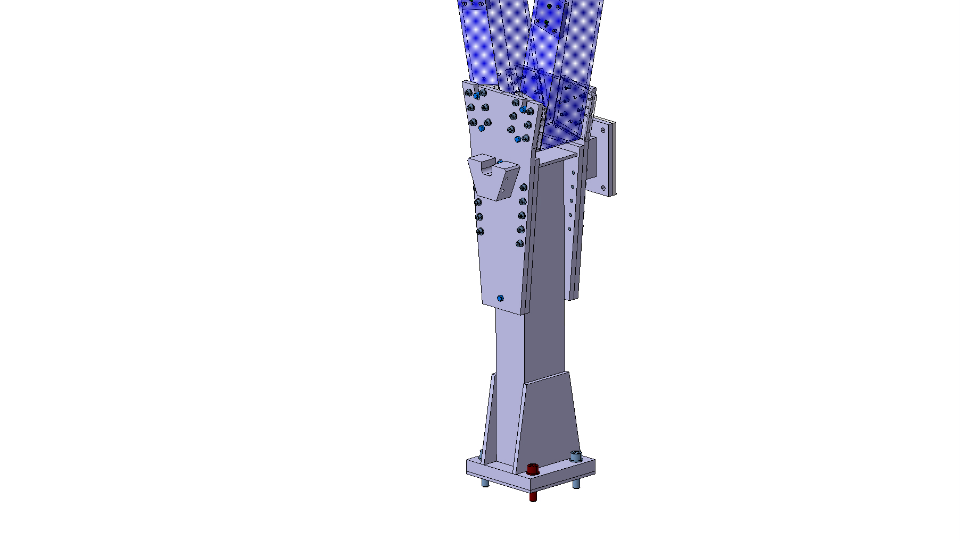
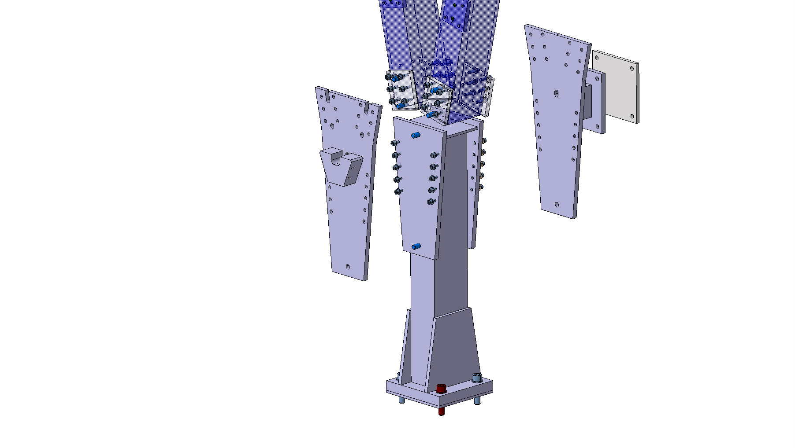
Base part 3/4
The new design is made with less plates and position pin between parts for a well defined positioning

Slide 27
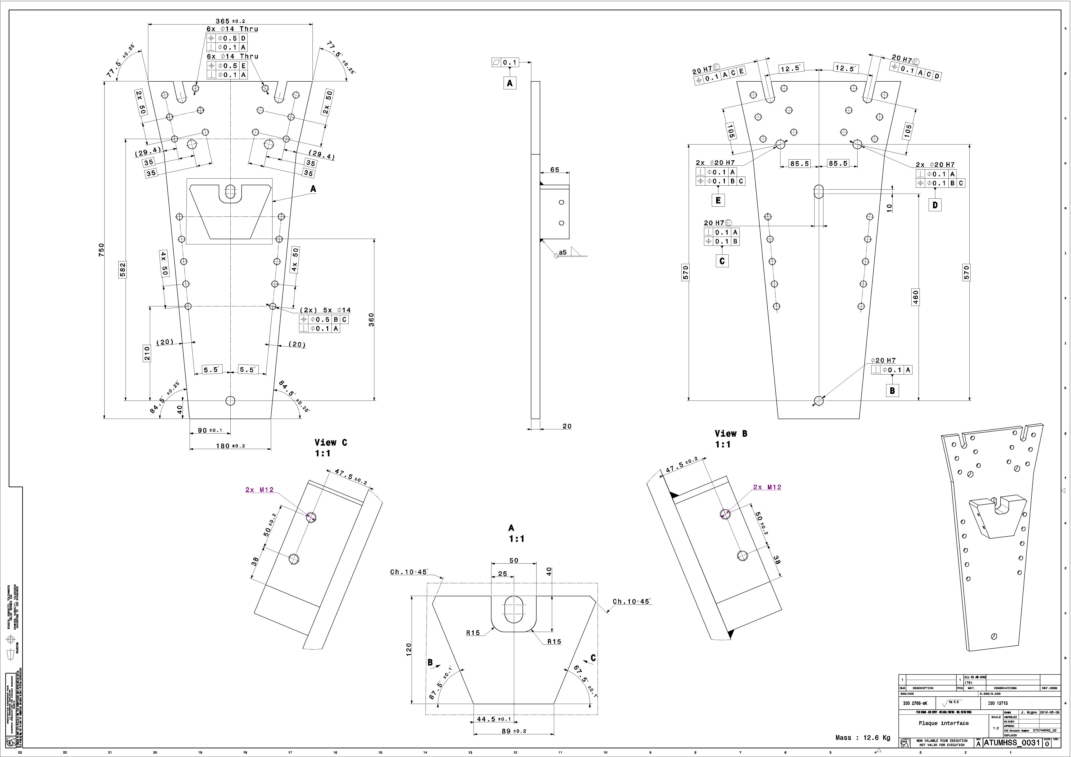
Base part 4/4
Pins (B)
How the spokes angle is now driven :
Angle is given by the interface plate (A)
With 3 pins and slot holes system
for more accuracy and more rigidity (B)
Interface plate (A)
Pins (B)

Slide 28
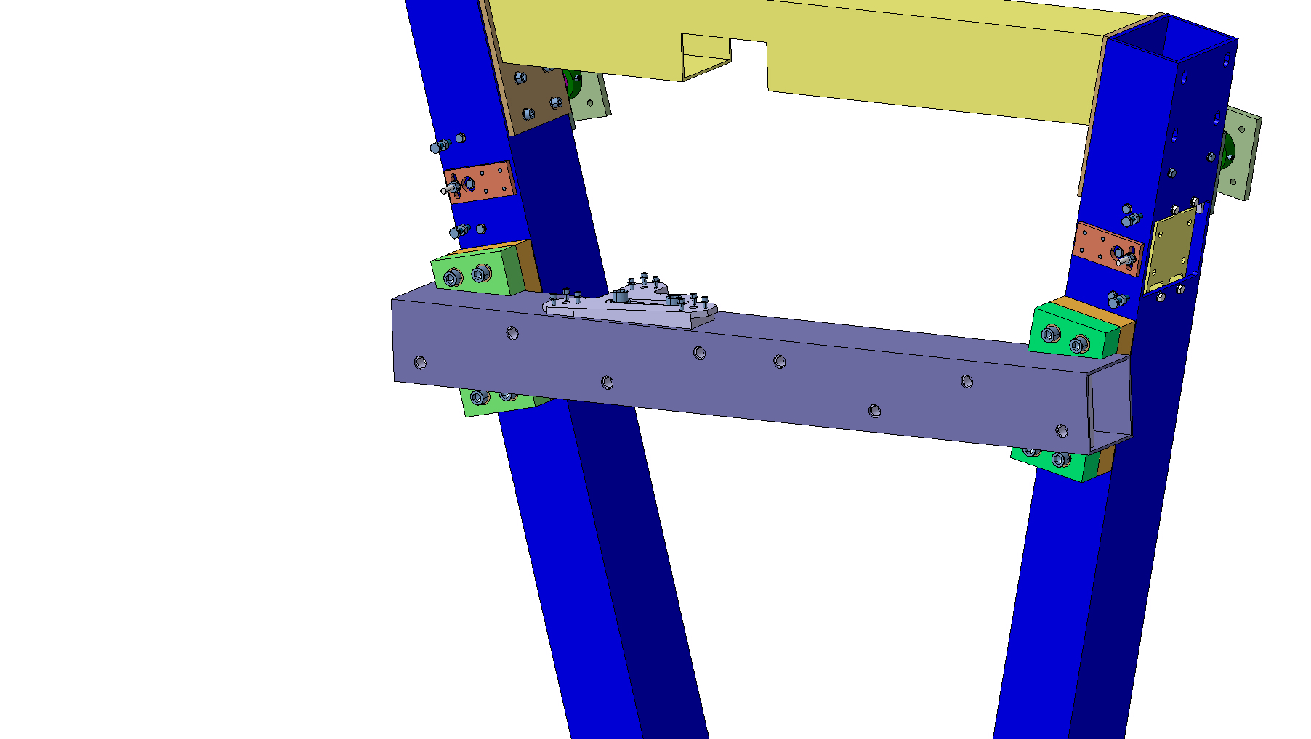
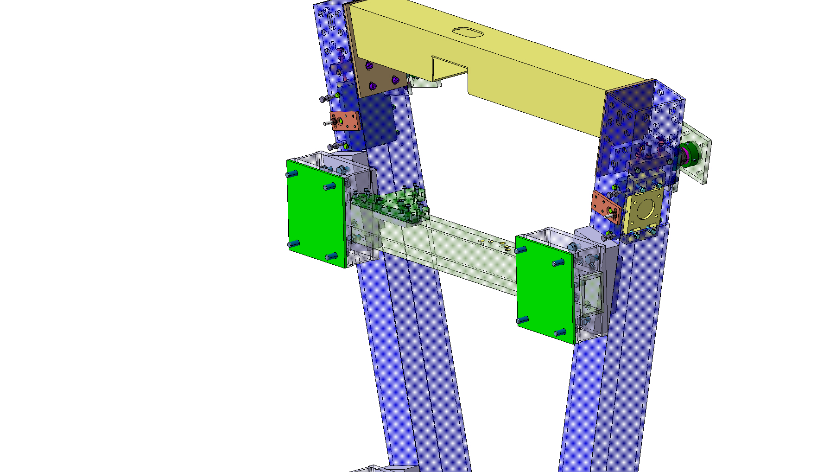
JD joint 1/3
Old
New

Slide 29
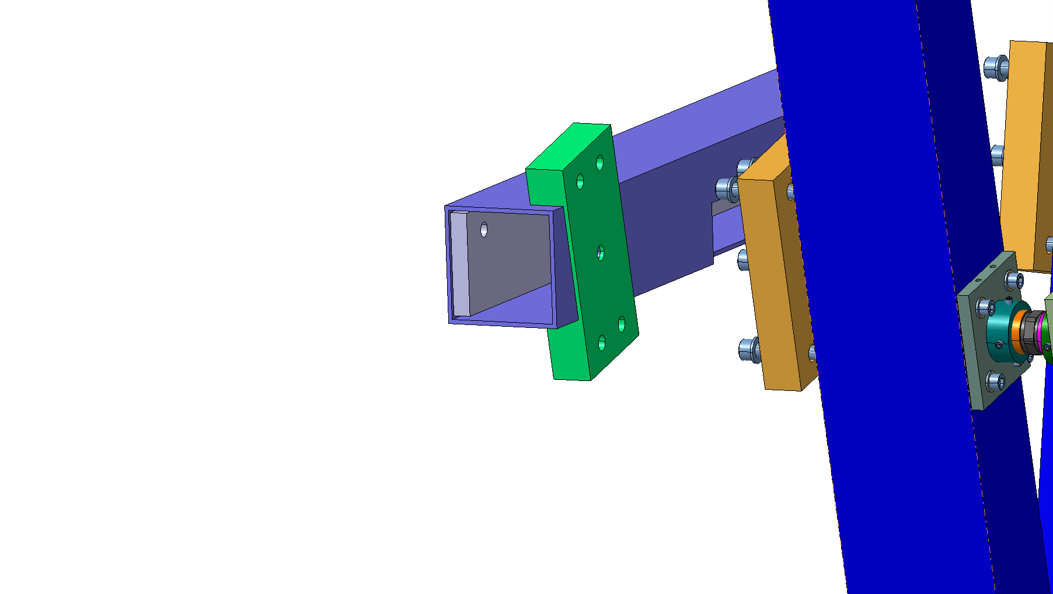
JD joint 2/3
C
The old design was made with :
Shim (A)
Support (B)
Square profile (C)
Threaded masselote (D)
D
B
A
The cutout on support B was very difficult to do and the thickness went down to 5 mm
This cutout was requiring also to be ajusted to the square prolife before welding them togheter

Slide 30
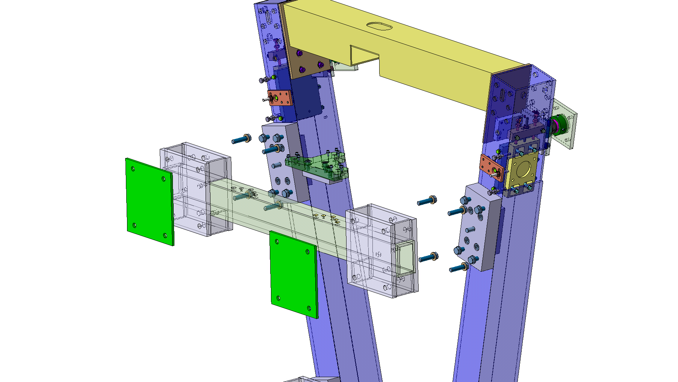
JD joint 3/3
The new design is made with:
Spacers (A)
JD-adjust shim (B)
JD joint (C)
Positions pins (D)
B
A
C
C
The JD joint itself is made with several plate welded on a standard rectangular profile for a better rigidity and a direct load transfer to JD

Slide 31
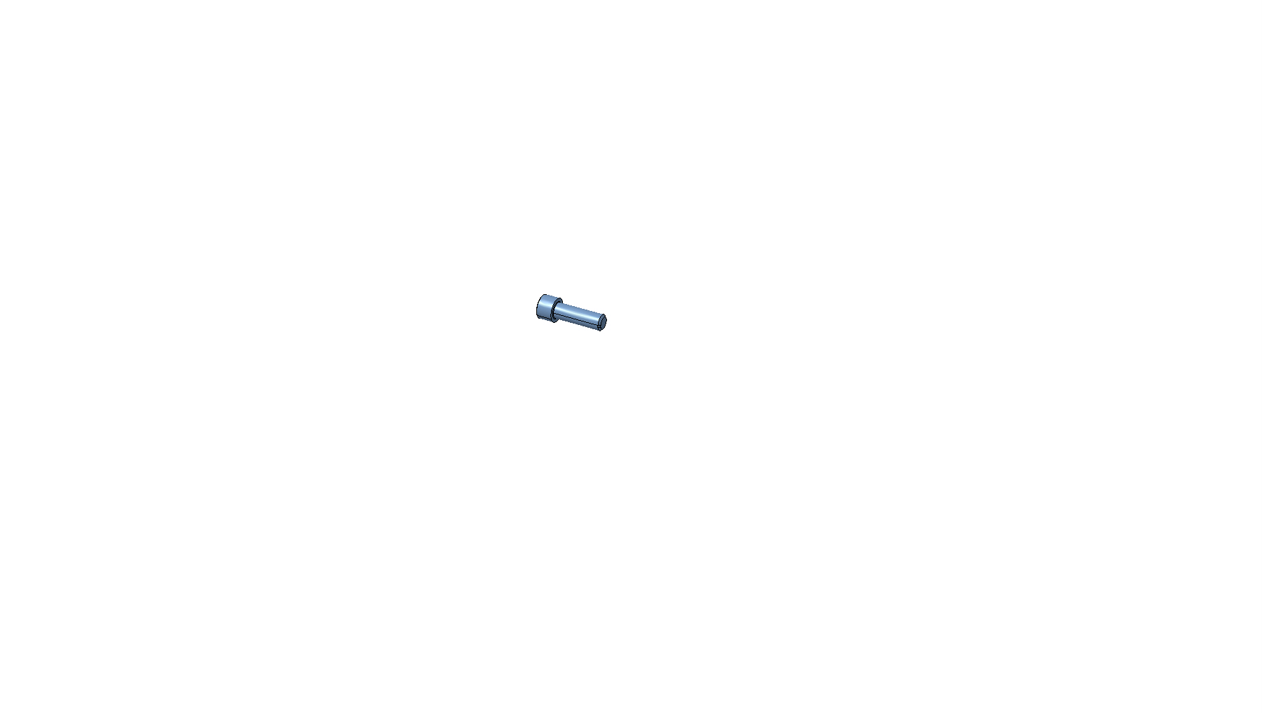
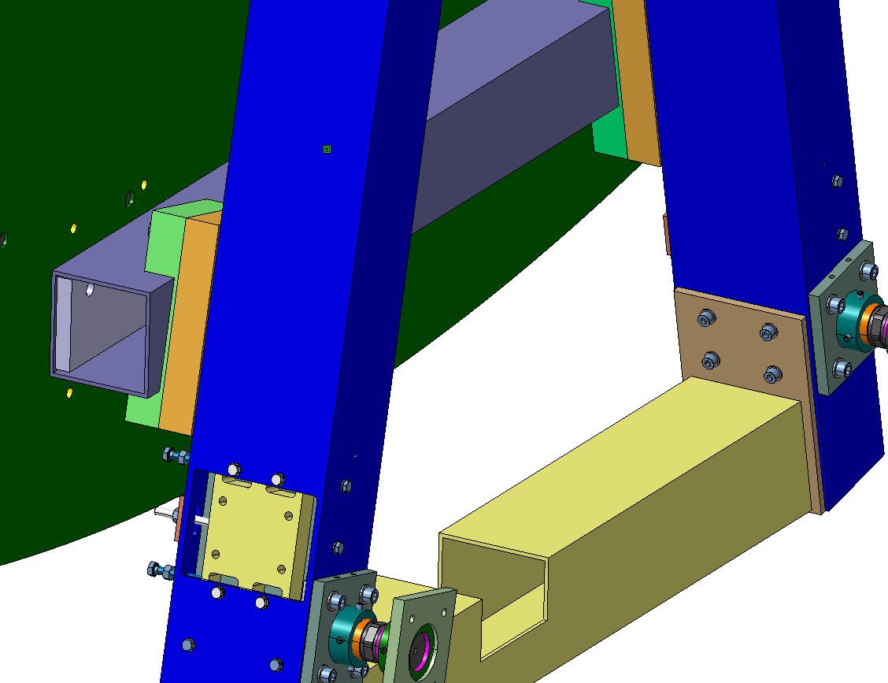
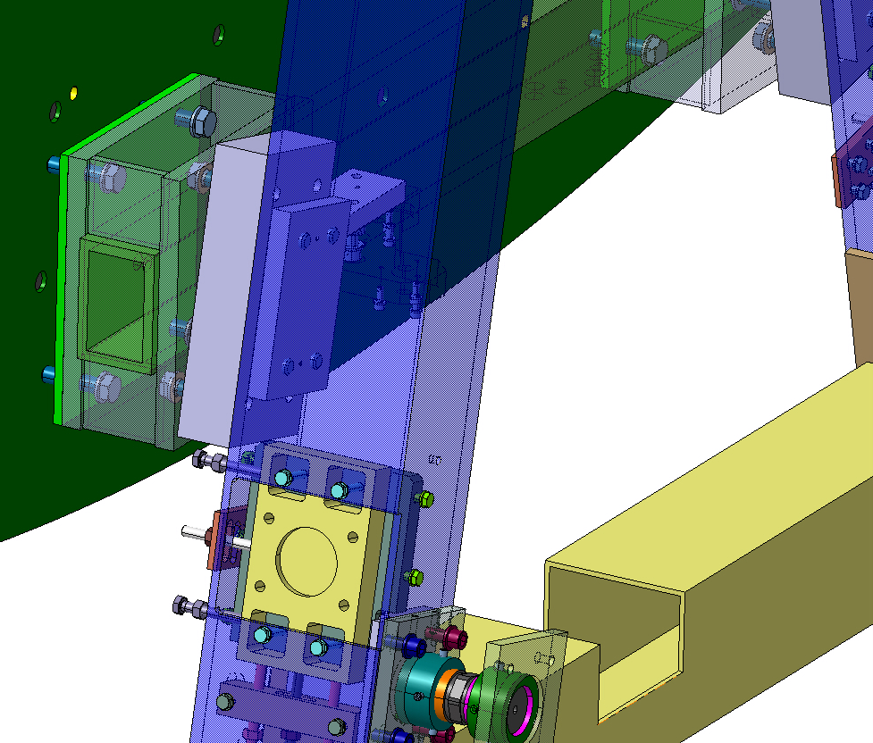
JD connection
old
new
On the old version , the JD was not threaded and the screws passthrough JD and go to the masselote
On the new design the JD is threaded and we don’t need to go on the other side to put the screws (all the assembly is done from HO face)

Slide 32
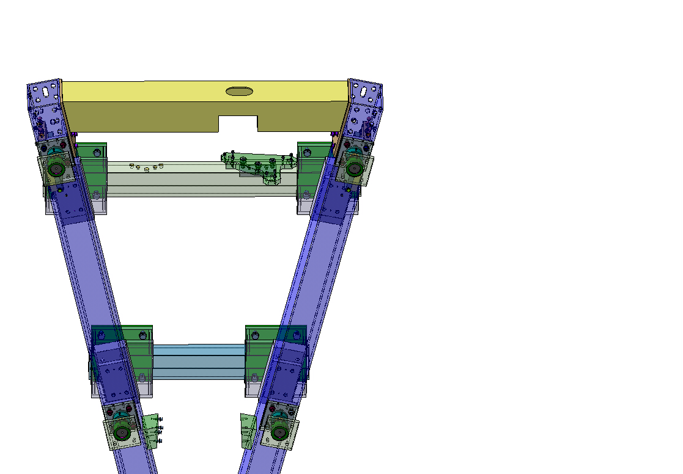
Other improvements
Generic Side C/side A JD joints
AL-KM supports
In order to maximize the standardization, we made few ajustement like adding the AL-KM on both side or adding holes on the JD joint to be used on side A as well

Slide 33
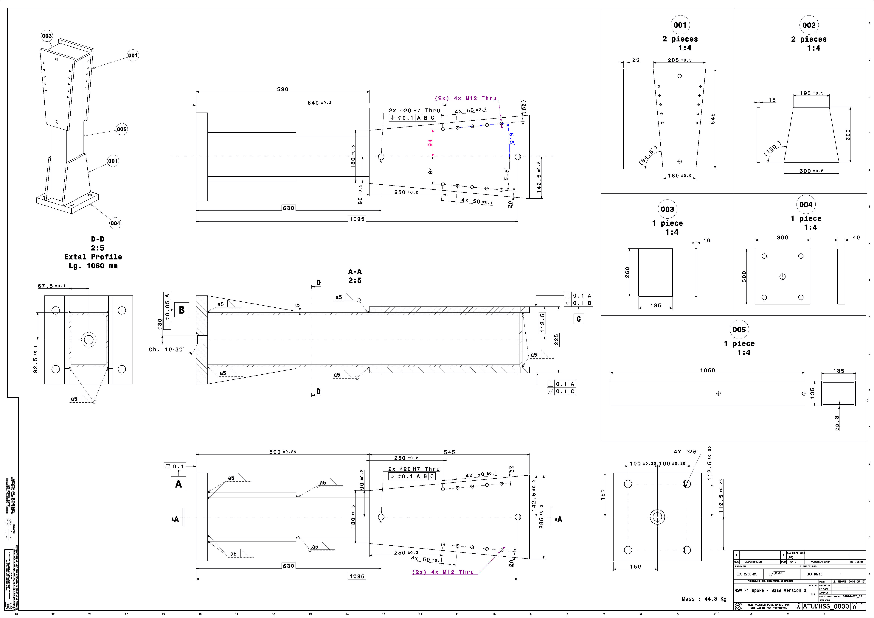

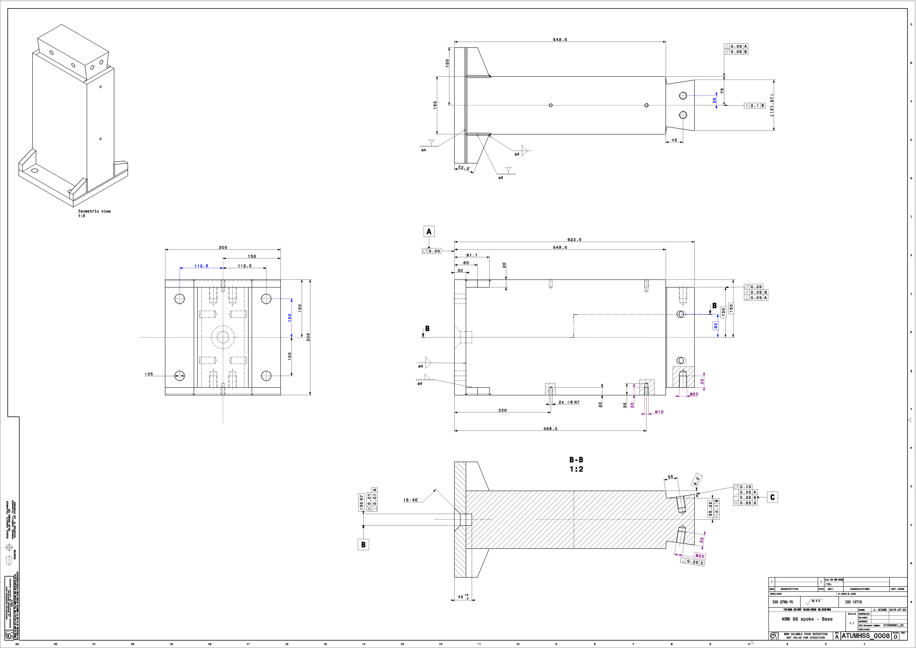
Let’s talk about drawings
Obsolete
According to the new design , we reduced the amount of drawings (we put in obsolete 13 drawings and add 10 drawings)
We made a huge effort to make the design simpler to reduce costs (filet > chamfer )

Slide 34
SS spokes - conclusion
Increased the accuracy of the spoke angle
Avoided difficult welded part
Simplified mounting opperation (Screws passthrough nJD)
More rigid JD-joints

Slide 35
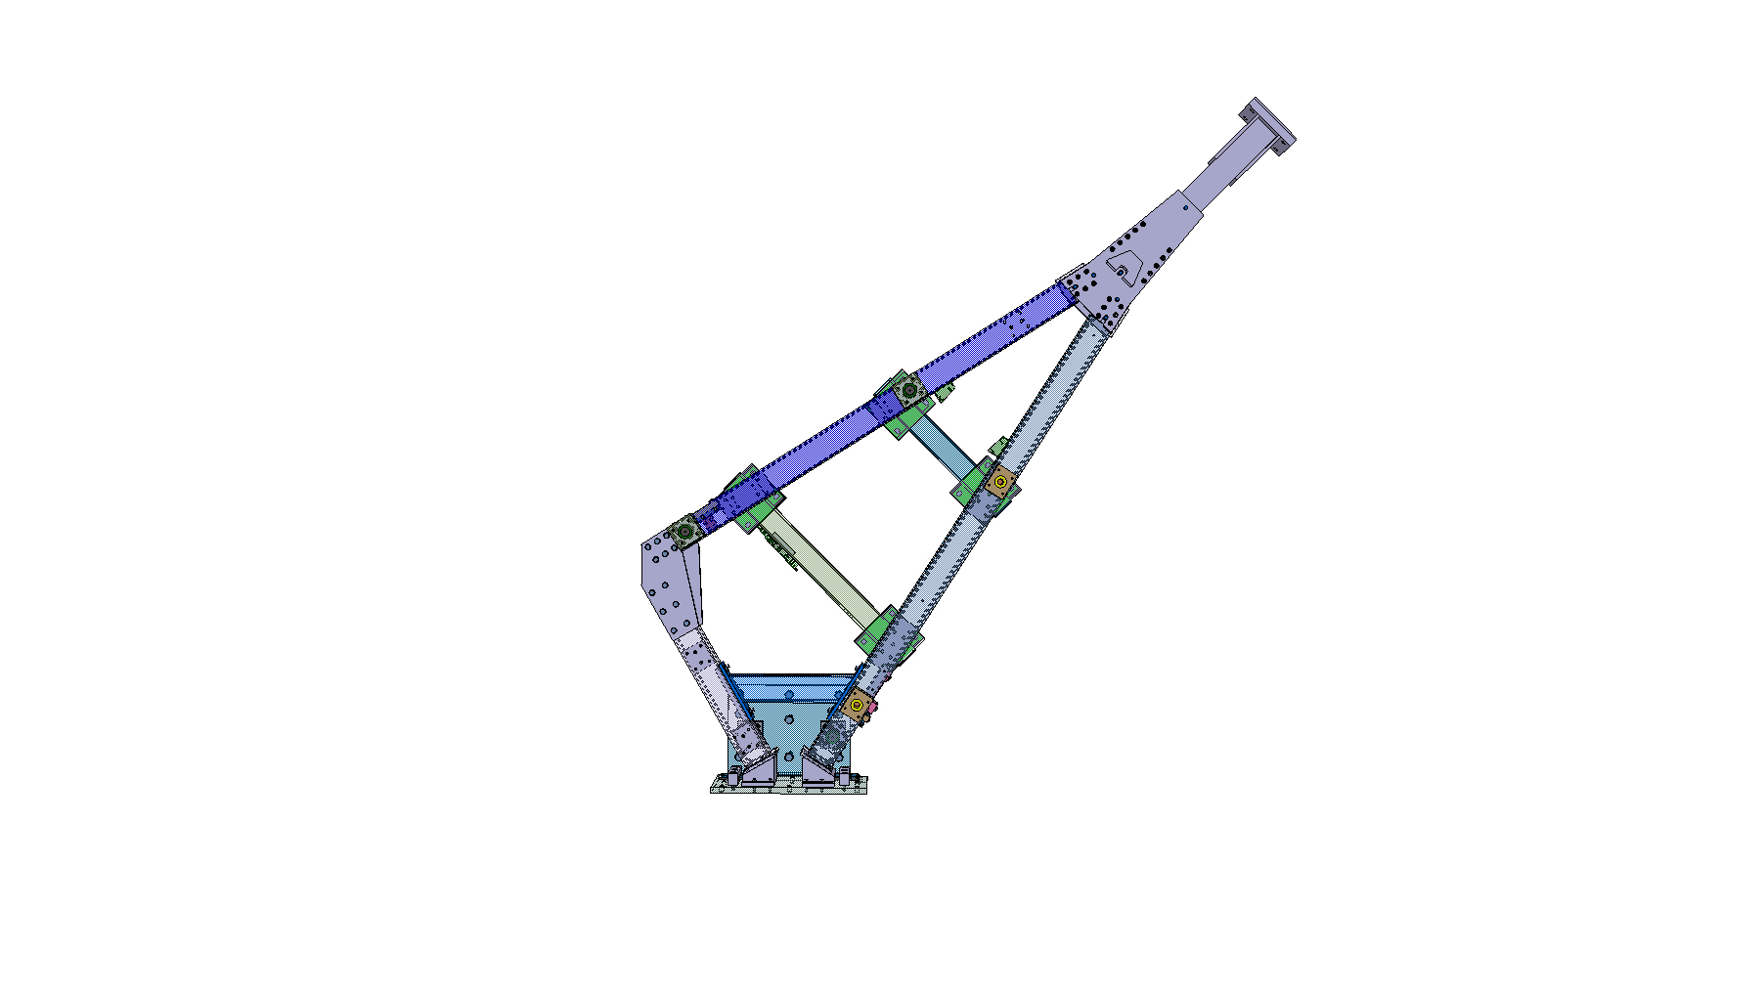



Feet spoke
Old
New

Slide 36


Bottom Plate 1/
Old
New
The old design was made with a very massive and difficult to adjust/machining parts
The new one is much easier and relys on standard joints and simple design wedges

Slide 37


Bottom Plate 2/
Bottom plate
Wedges
25 mm
The new design is made with parts much easier to manufacture and with a kinematic feature to escape the hub pins during the insertion sequence
The bottom plate can lift up to 25 mm from the NJD feet and when the spoke touch the NJD feet , there is enough room to insert the spoke below the hub

Slide 38


Hub connection
old
New
We made a huge effort for standardize the design and now the feet have the same hub connection like the SS spokes. Instead in the old design, feet spokes were connected to the hub using dedicated rails

Slide 39


Bottom legs 1/
Old
New
The old design was made with a full-single-body stainless steel extention with welded ajusting plate and bolted to the welded profile
This extention was very massive, hard to adjust inside the profile and difficult to machine
For the new design, we just extended the welded profile and use a wedge to adjust and de facto reduce the production tolerances.

Slide 40


Bottom legs 2/
Old
New
The old design was made with a full-single-body stainless steel extention with welded ajusting plate and bolted to the standard profile
This extention was very massive, hard to adjust inside the profile and difficult to machine
For the new design, we added a standard profile link with position pins plates

Slide 41

Bottom legs 3/
Old
New
The old design contains 3 differents reinforcement pipes and several shims
The new design relys on only 1 reinforcement pipe as the effort driven through this element is less than expected (verified with FEA model)

Slide 42

Other improvements
In order to maximize the standardization of the parts, some of them are used both in foot 1 and foot 2 and also in side C and side A
For exemple, the Foot 2 got only 2 detail drawings (bottom plate and welded profile) all the other parts are the same for SS spoke and Foot 1

Slide 43



Let’s talk about drawings
Obsolete
According to the new design , we reduced the amount of drawings (we put in obsolete 23 drawings and add 12 drawings)
We used more standard parts like JD joints

Slide 44
Feets spokes - conclusion
Decreased the number of parts and adjustment
Standardized the design according to the SS spokes
Released fabrication tolerances by adding adjusting wedges

Slide 45


Hub
Old
New

Slide 46
Pin dimension
Old
New
Pin Ø100
Pin Ø30
Feet rails
According to the FEA calculation, we changed the diameter of the spoke pins from Ø100 to Ø30 and we reduced the length
We also removed the rails for the Feet spoke (see slide 37) to standardize the Ø30 all around the hub

Slide 47




Pin dimension
Anti-rotation pin
Old
New
Washer and nut
The old design was made with six inserts inserted into one-meter precise (very tight tolerances) holes in the HUB
The new design allow gap between insert and hole with the addition of a anti-rotation pin and nut on the other side to ease both fabrication and installation operations

Slide 48


Lifting
The lifting interface can use the same threaded holes used for spoke fixation

Slide 49
Hub - conclusion
More realistic locking insert design
Standardized the design according to the SS spokes and feet spokes

Slide 50


nJD
Old
New
After several months of calculations, it has been agreed to remove the return flux ring

Slide 51



Contact faces
New
In order to be more precise and to guaranty the plane assembly, we decided to machine all interfaces surfaces in contact by removing 2 mm between them
All the positions according to IP are respetect

Slide 52

Other improvements
Spokes holes patterns
The NJD reflects the modification done on spokes and Hub

Slide 53
NJD - conclusion
More precise structure (fonctional faces are not raw anymore )
Lighter structure

