Slide 1
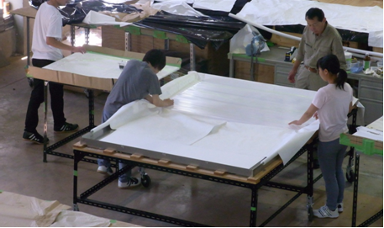
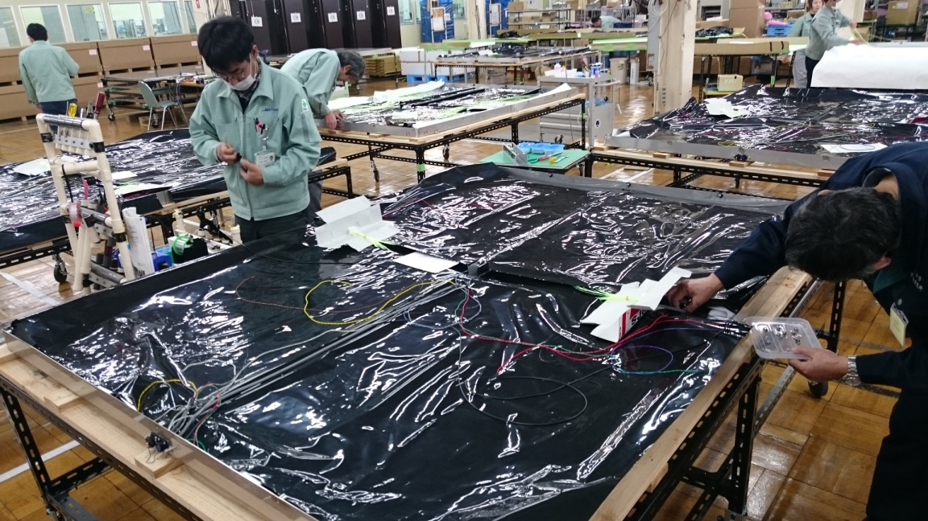

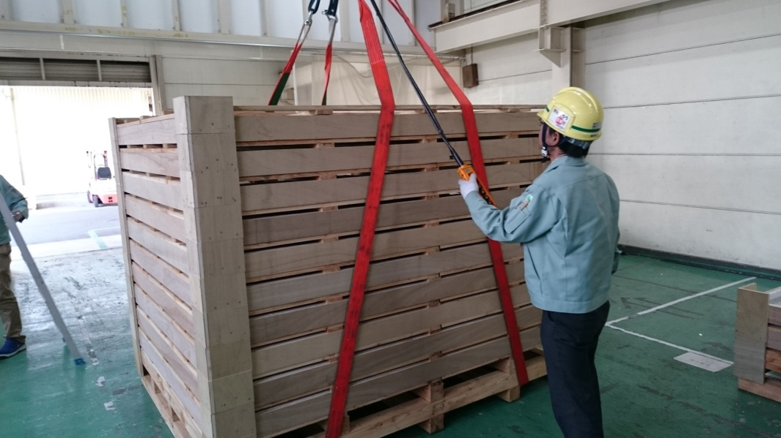
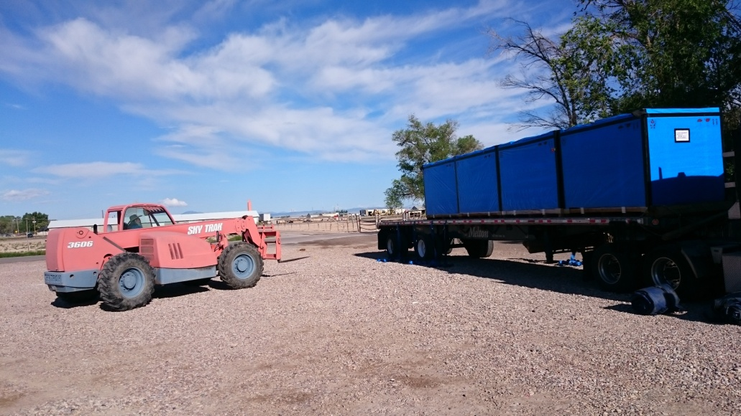
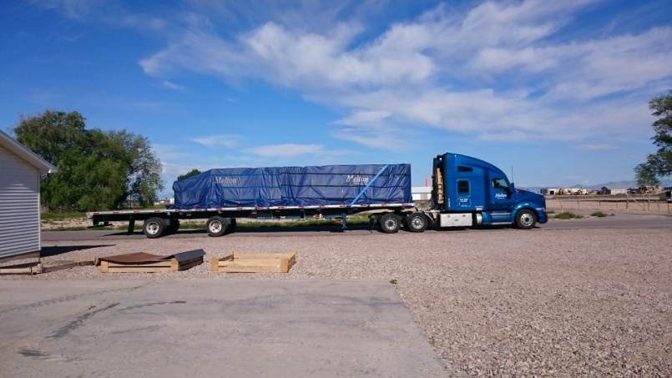
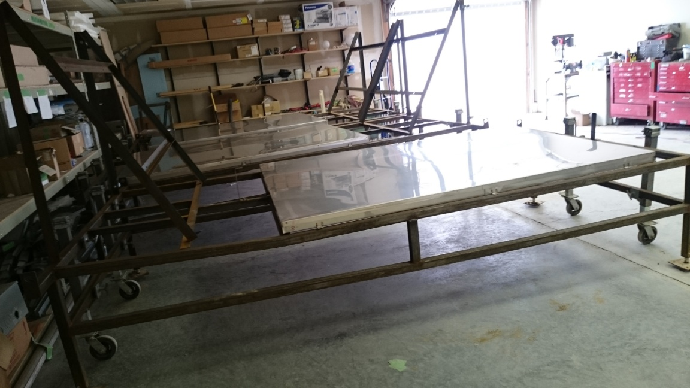
The TA×4 experiment
E. Kido for the Telescope Array Collaboration
Institute for Cosmic Ray Research, University of Tokyo
Kashiwa, Japan
Notes:
絵のサイズの調整をするか。

Slide 2
Outline
Motivation of the TA×4 Experiment
Design of the TA×4 Surface Detector (SD) Array
Design of TA×4 SDs
Construction of the SDs
Performance of the SDs
Future Prospects
Summary
Notes:
The?

Slide 3
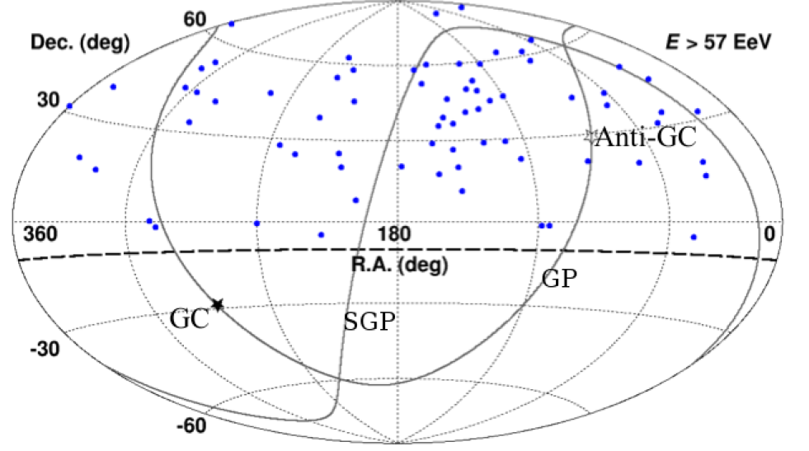
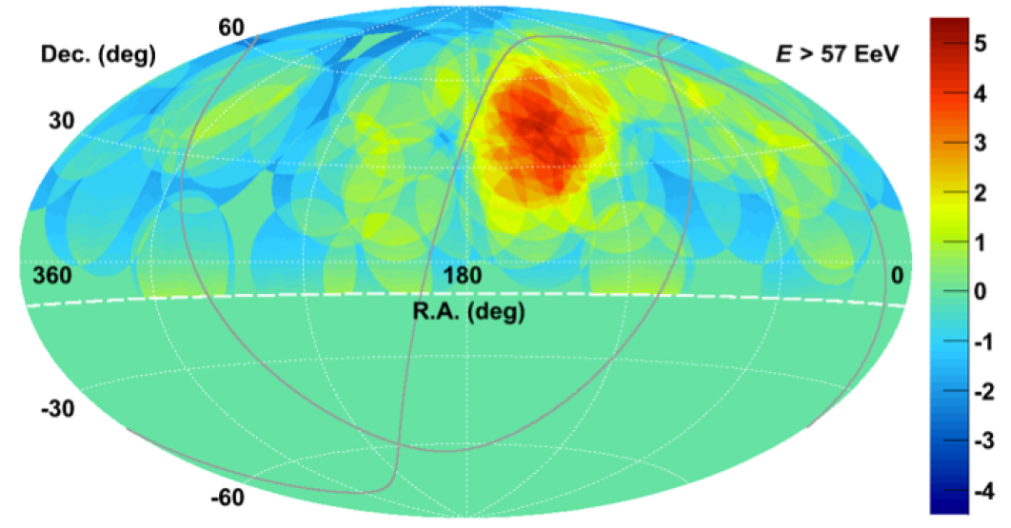
Indications of anisotropy: hotspot observed by the TA experiment
Arrival directions of E > 57 EeV cosmic rays
Significance map
Super galactic plane
20 degrees oversampling
from each event
Equatorial coordinate
Equatorial coordinate
ApJ 720, L21 (2014)
TA experiment 5 years observation, 72 events with E > 57 EeV
Max. local significance: 5.1 σ
Observed: 19 events, Expected from isotropy: 4.5 events in the direction
Chance probability to exceed the local significance 5.1 σ: 3.4 σ
First observation of anisotropy at the highest energies with high significance
Notes:
Significance map from isotropy… RA: 146.7°Dec: 43.2°
(including trials of searching 15, 20, 25, 30, 35 degrees)
Angular resolution: 1.5 degrees, local significanceという言葉はこれでよいのか?

Slide 4
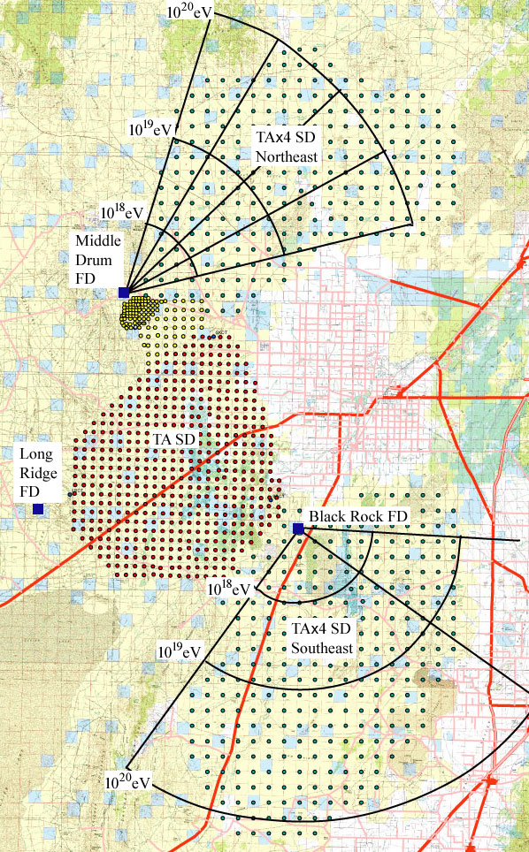
The TA×4 Experiment
500 SDs, 2.08 km spacing for
4×TA SD detection area (~3000 km²)
combined with TA SD
accepted by Japan in April 2015
first 100 SDs arrived at Utah
in spring 2016 Applied to build 2 FD station (4+8 HiRes Telescopes) to US NSF
  accepted in 2016
→ Take 19 years TA SD data
Take 16.3 years SD and FD hybrid data
Notes:
Efficiencyのこともここに書いておくか?, tale, などの場所についても書いておく, 最高エネルギーを詳しくしらべる計画です

Slide 5
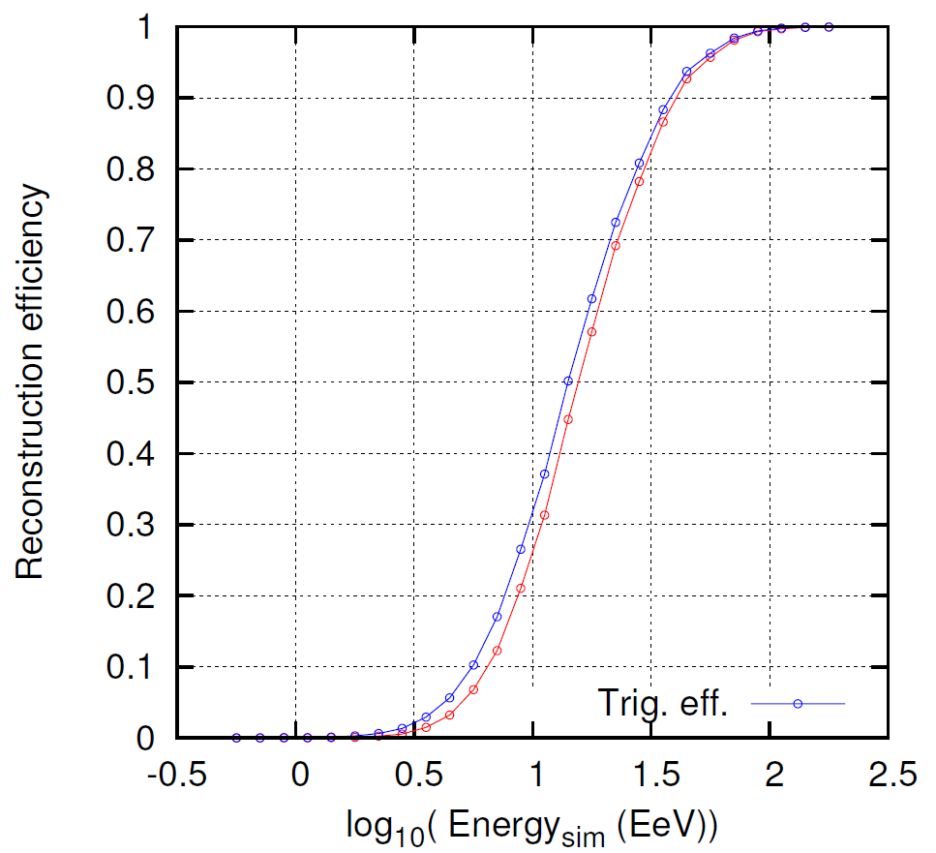
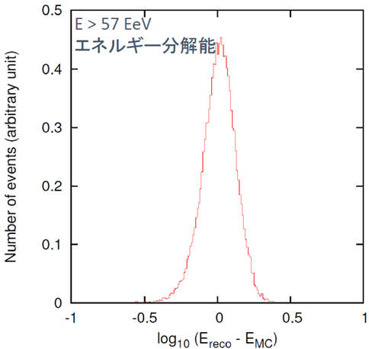
Design of the TA×4 SD array
57 EeV
E > 57 EeV: reconstruction efficiency > 95%
Angular resolution: 2.2°
Energy resolution: ～25%
Notes:
10 SDs×10 SDs array, core position of the air shower: center of the array
Conditions of the simulation を書け
Energy resolutionの図をできれば描き直し, condition of the simulation!!!

Slide 6
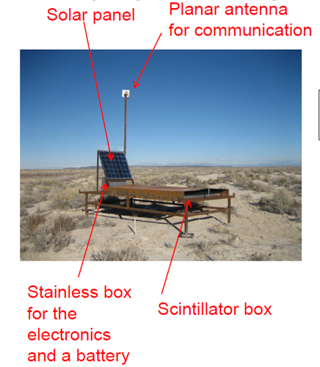
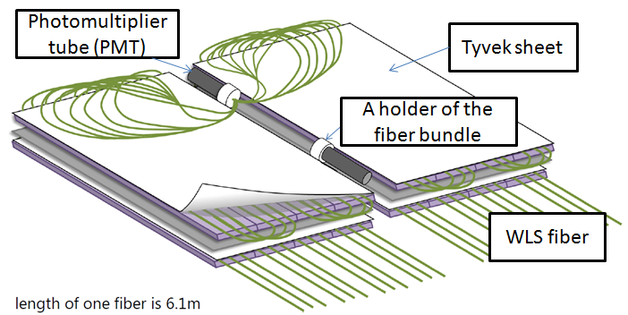
Design of TA×4 SDs
Inside of the scintillator box
2 layers 3 m² 1.2 cm thick plastic scintillators
→ Calibration of signals using single muon
DAQ with 2.4 GHz wireless communication
6 new communication towers
Notes:
2 Mbps (一応確認) ファイバーの取り回しはTA実験とは変更していて…, できれば右図は通信の図にしたい

Slide 7
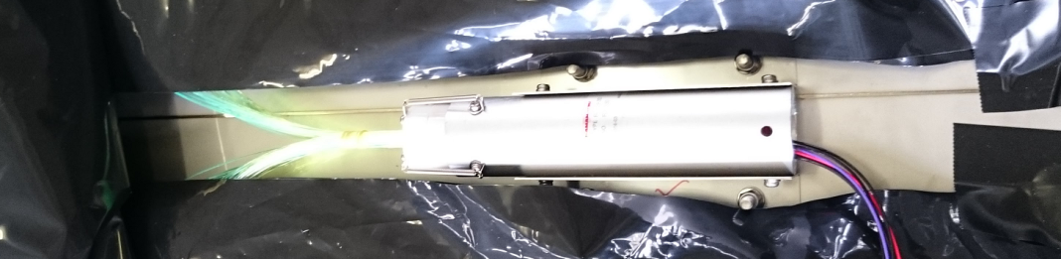
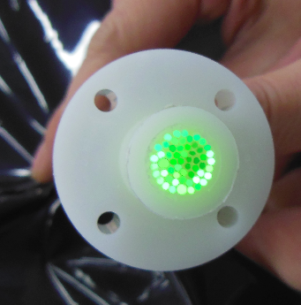
Design of TA×4 SDs
PMT: Hamamatsu R8619
(PMTs in TA SD: ET9124)
Quantum efficiency～20 % at 500 nm (～10% ET9124)
Pulse linearity ～50 mA (25 mA ET9124)
Position dependence of the output signal on the photo cathode < ～ 10%
→Change of the arrangement of wavelength shifting fibers
Total length of fibers～33% of TA SD
Optical grease
(Optseal: Shin-etsu Chemical Co. Ltd.)
b/w fibers and PMT
Notes:
Position dependenceは正しいのか?, 2 10^6 operation gain expected

Slide 8
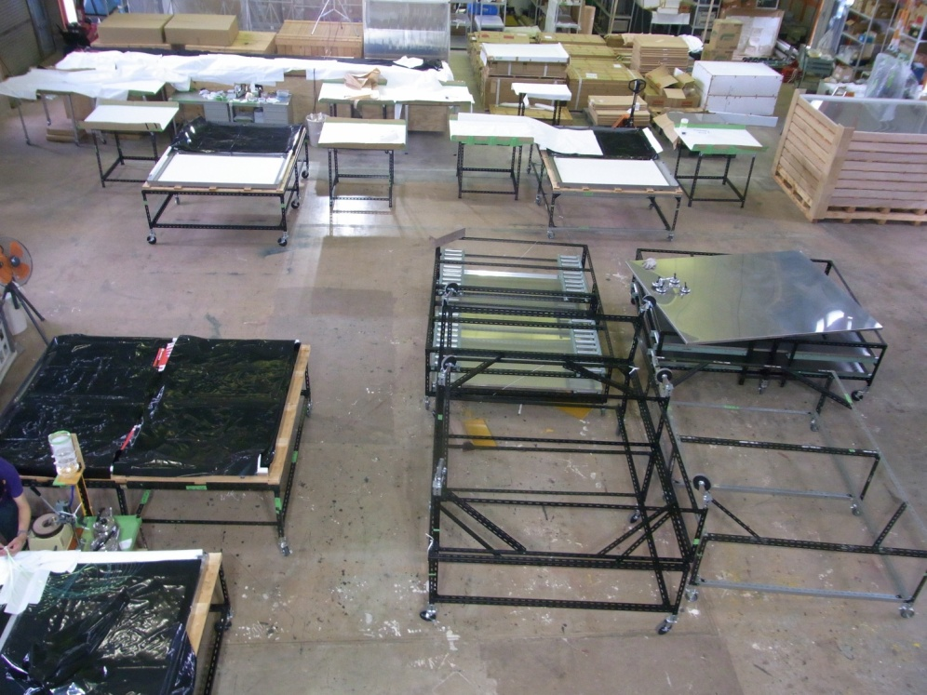
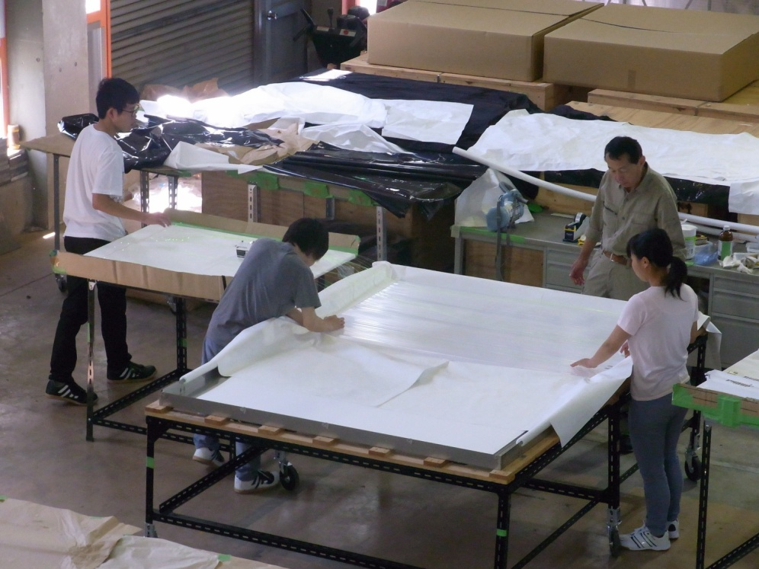
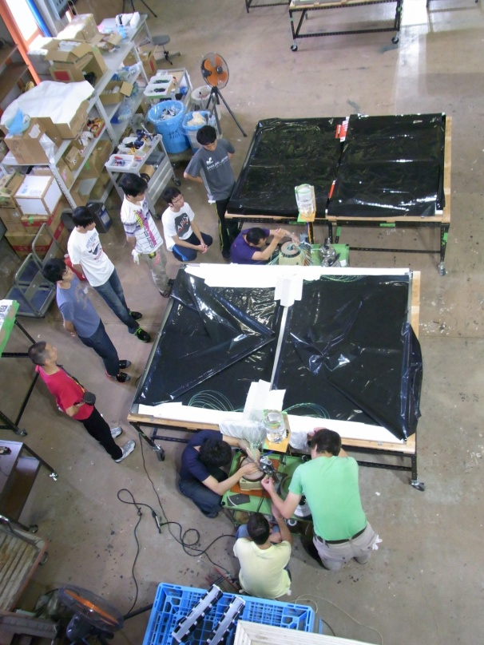
Construction of 173 TA×4 SDs
Fibers are
assembled
100 scintillator boxes were assembled in Meisei company (Japan) in winter 2015
73 scintillator boxes were assembled in Akeno Observatory (Japan) in summer 2016
3 supervisors + 6-7 company people/students/staffs
4-5 scintillator boxes were assembled per day.
polishing
fibers
Notes:
前回は明星電気で行ったのですが…

Slide 9
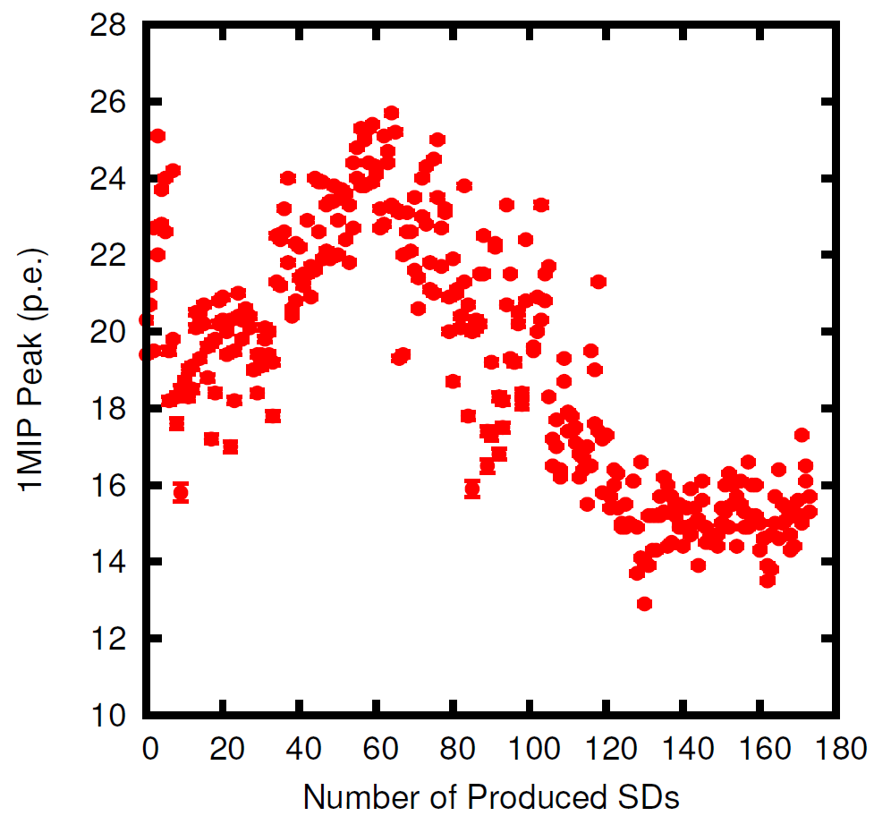
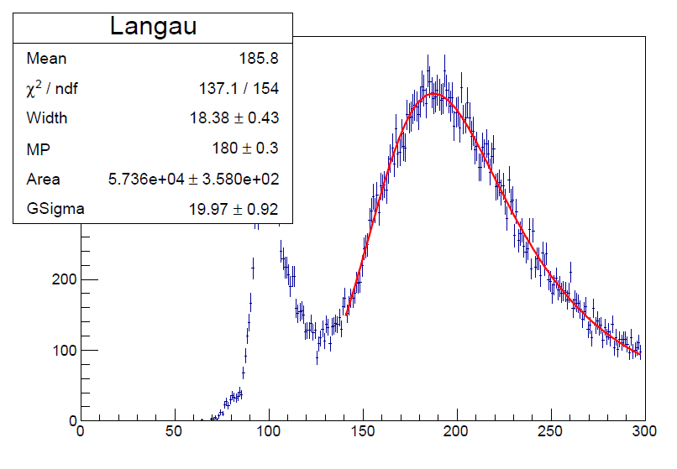
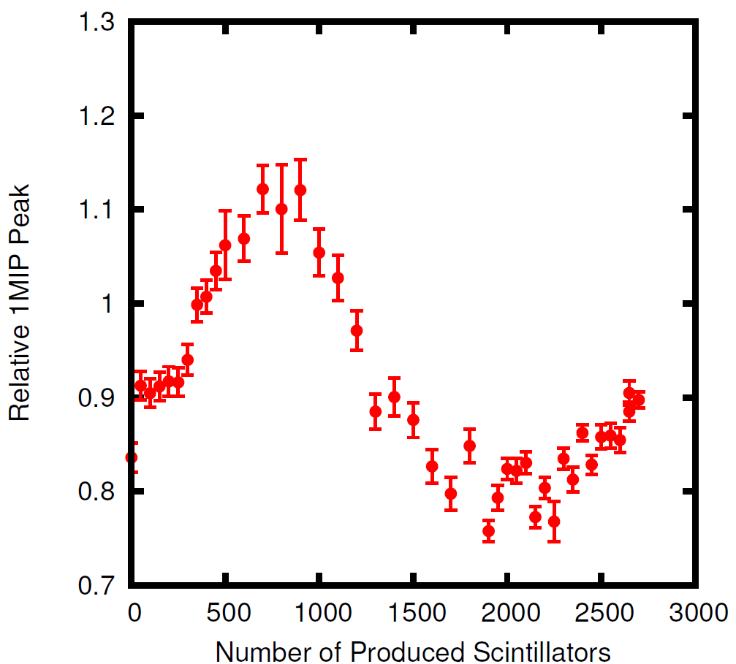
Calibration using single muon
Number of photo electrons corresponding to the single muon peak of each layer of SD :
19.0±3.3
All data points are inside of the distribution of TA SD
(24.6±7.2)
Mean value of the Gaussian
obtained by fitting ADC distribution of pedestal run
Relative single peak
of sampled scintillators
before the assembly
(1 sample per (50/100))
16 scintillators are used for 1 SD
Typical charge ADC distribution
obtained by taking coincidence of 2 layers of the SD
Notes:
Gainは5 10^6で浜松が全数測定している。全部を赤い点に修正 20°: 気温
10 bin sumだったと思うが、忘れた。80 +/- 4-5だから。 相関係数? 計算しよう。 ベースラインの情報も必要, 誤差もきちんといれないと
TA実験のSDの分布の範囲内の光電子数となっている。B106を後で確認する。(誤差?lowerのfitting)

Slide 10
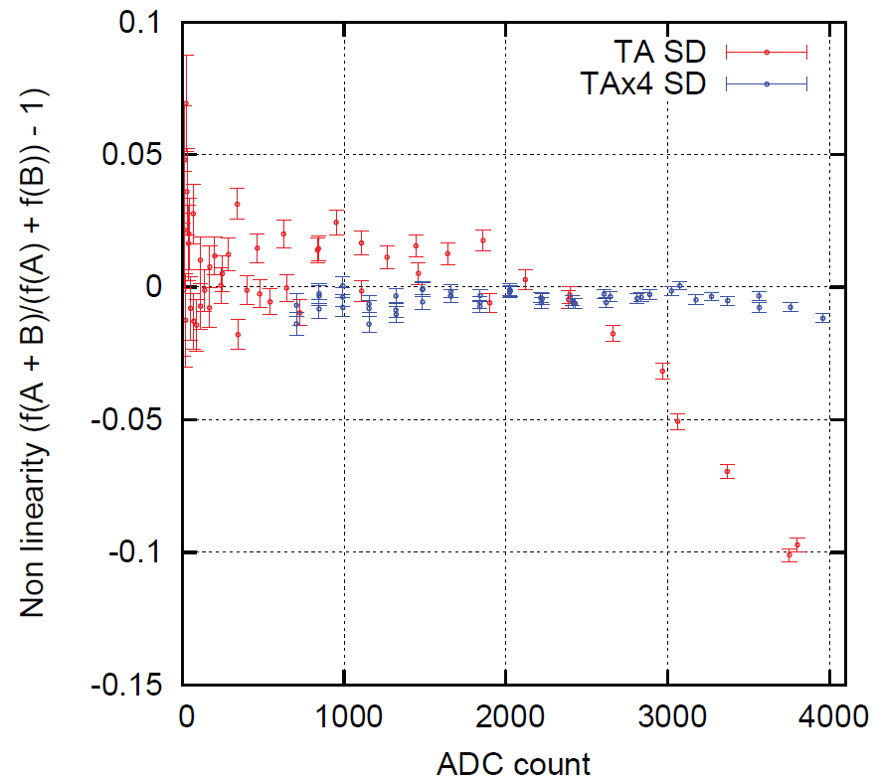
Linearity of PMTs
Linearity of PMTs were measured with 2 LEDs inside of SDs
Y-axis: Non-linearity of output current from PMTs
X-axis: Output current from PMTs (1 count～0.01 mA)
-5% non-linear
Linearity of all assembled PMTs
was checked.
Non-linearity < 10%
for ADC val. of SD elec. < 4095
Typical non-linearity of PMTs
SD electronics
Max. ADC value
Notes:
Augerとの比較? 基準とか? 5%のrangeを探す、一応, 2 PMTs more than 7%, 聞かれたらほとんとはless than 5%
TA SDは2900±650程度。急激に4095あたりで落ちることになるので、測定方法の関係上基準は緩めになっている。ADC値を減らして-5%以内とかにした方がいいと思う。
一部の詳細な試験結果によると50mA, 5000カウント<-5%程度 (質問があれば) もっといいsimulationで結果を出したい

Slide 11
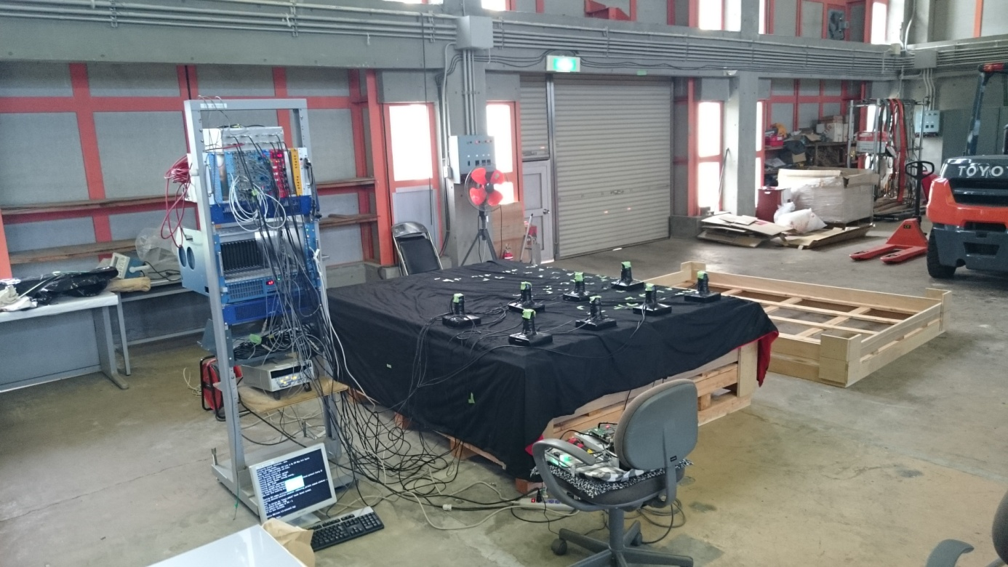
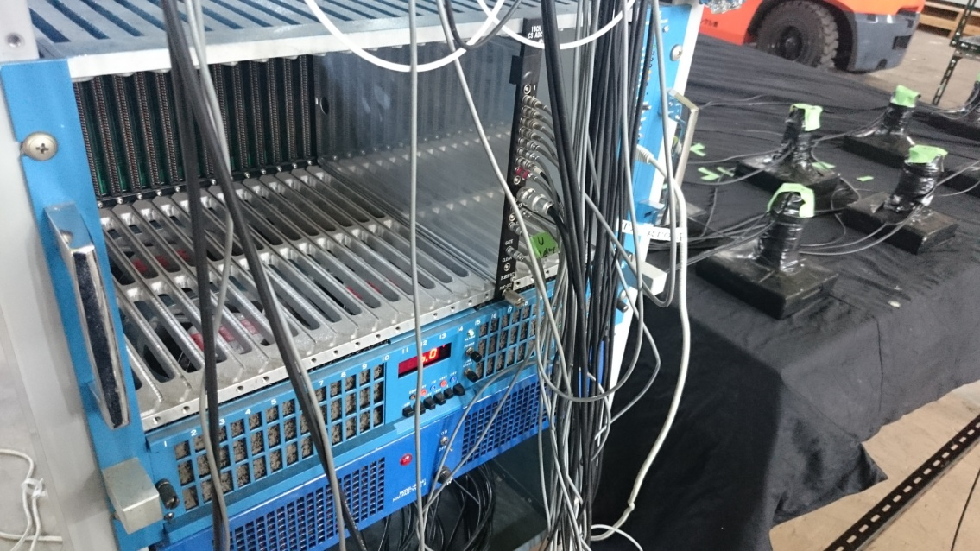
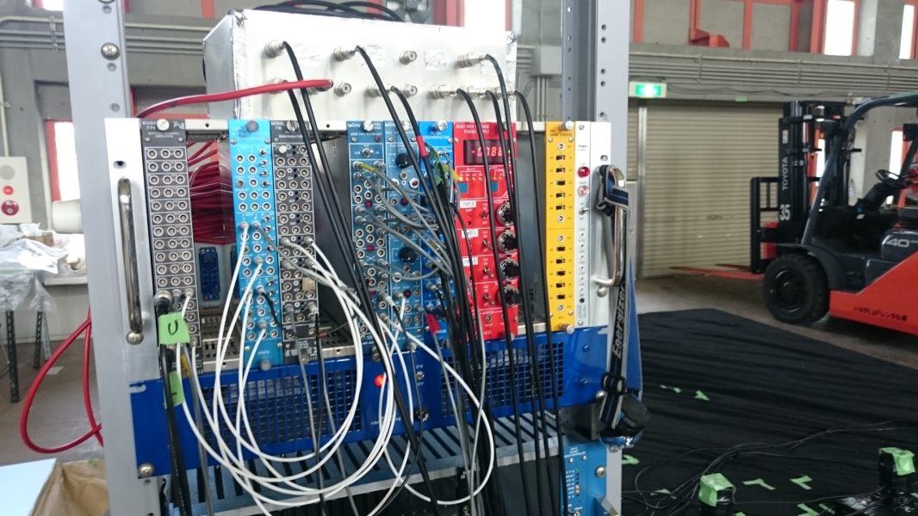
Position Dependence of the Signals
5 SDs measured
15 cm×15 cm trigger probes
8 positions are measured at the same time

Slide 12
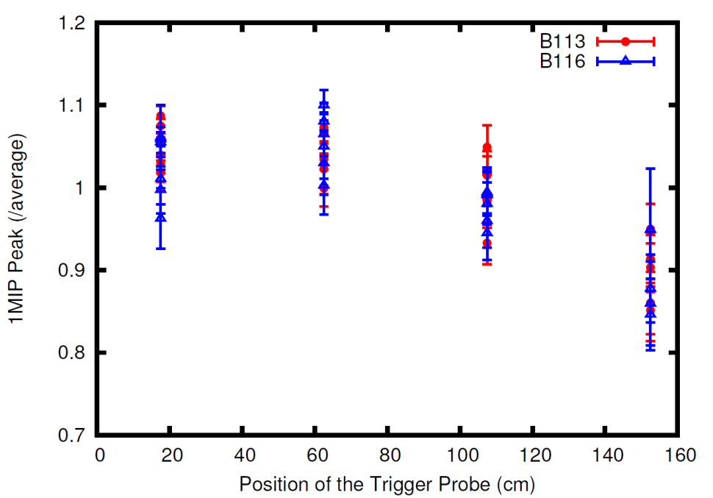
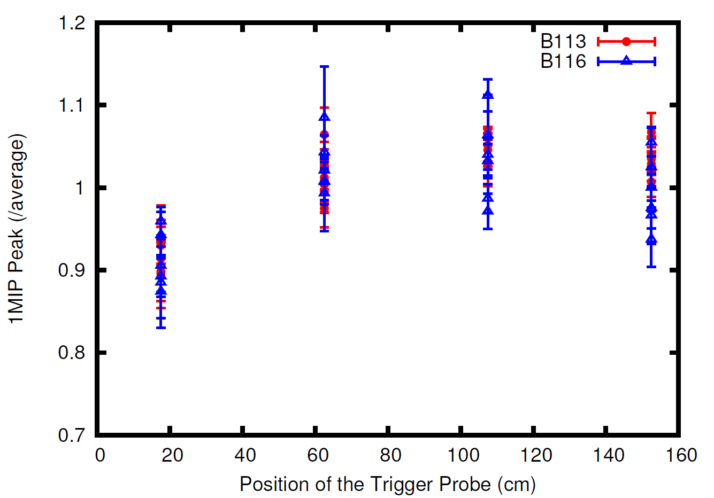
Position Dependence
of the Signals
X-axis
Preliminary
Preliminary
Average: 1
Upper layer
Average: 1
Lower layer
Max. difference from the average: ～20%
Main source of the position dependence: decay length in the WLS fibers
→ Max. difference from the average of (up + low) signals: ～15%
Notes:
減衰長>3.5m, 長さ? From the data points in this figure, … The errorbars of this figure is …

Slide 13
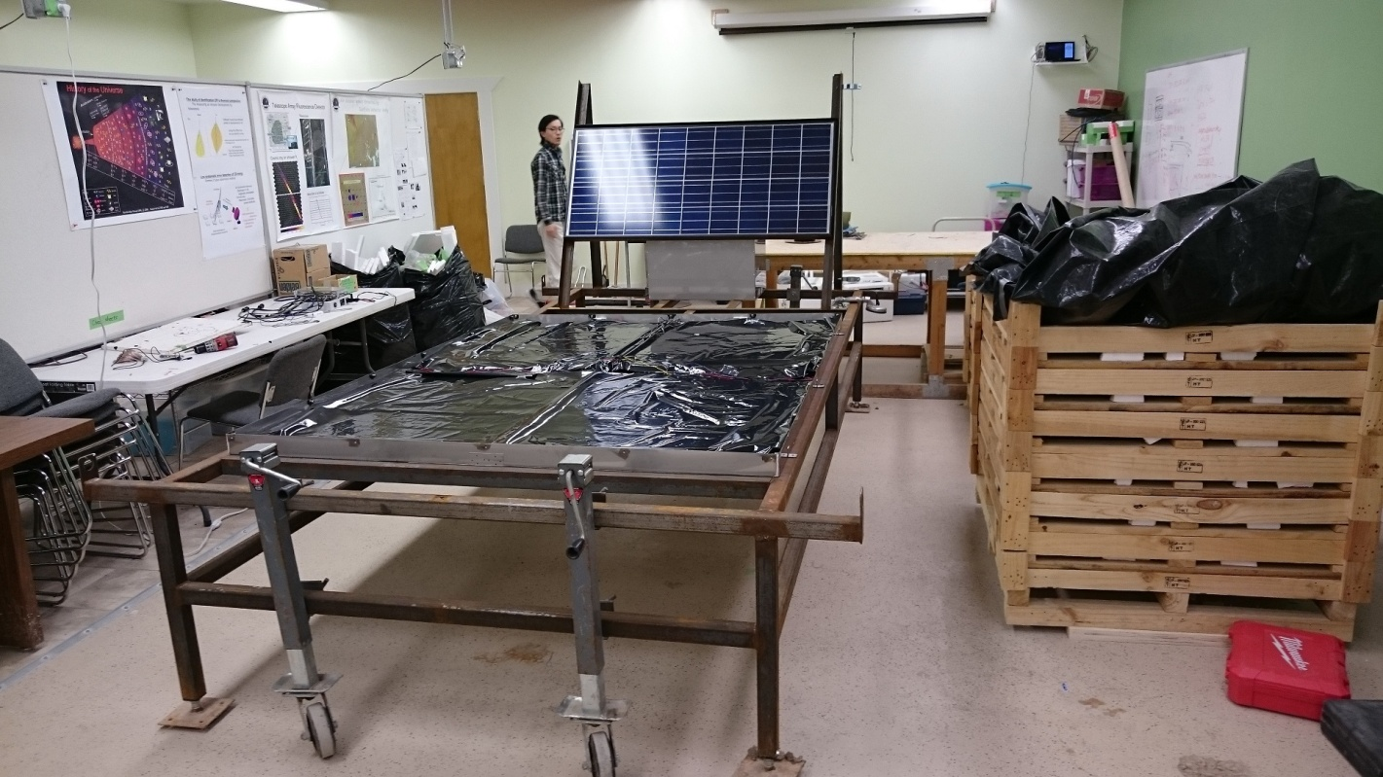
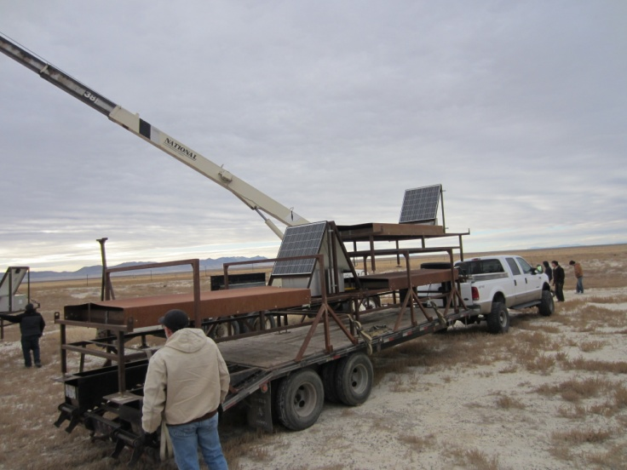
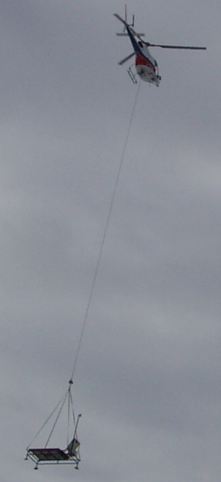
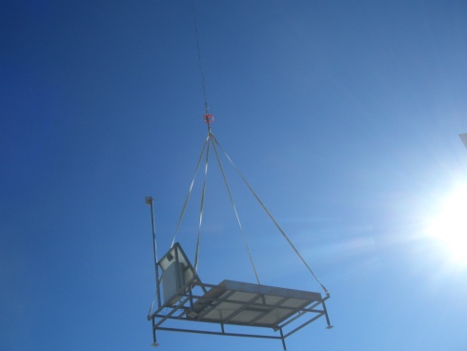
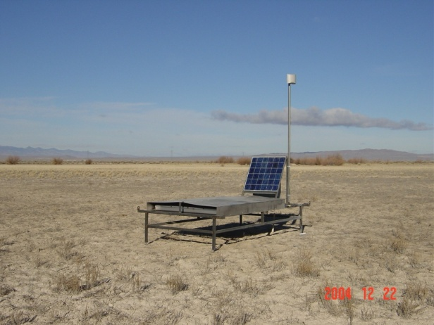
Future Prospects
May 2016
May 2016
Pictures
in 2011
picture
in 2004
Transportation of scintillator boxes, mass production of electronics
Assembly and deployment of SDs
Construction of FDs
Notes:
Waiting for the permision of the deployment of sds
If blm (the site owner??) accept…, mass production of electronics (next speaker will show)

Slide 14
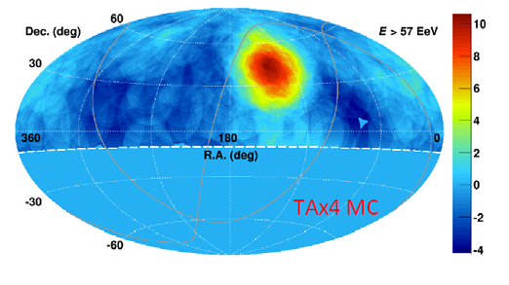
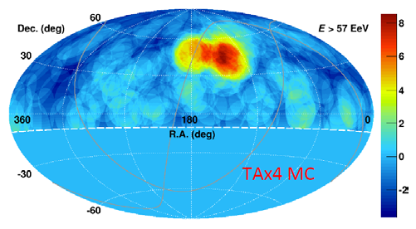
Future Prospects
Assumption:
The hotspot comes from 1 source with 10 deg. Gaussian σ.
Oversampling 20°radius circle
Assumption:
The hotspot comes from 2 separated sources with 1σ=10 deg. and with 1σ=5 deg..
Oversampling 15°radius circle
N_{total}: 305 events, 21 TA SD equivalent years
N_{BG}: 244 events isotropic background
N_{source}: 61 events (21 events and 40 events for 2 separated sources)
Notes:
21 events and 40 events

Slide 15
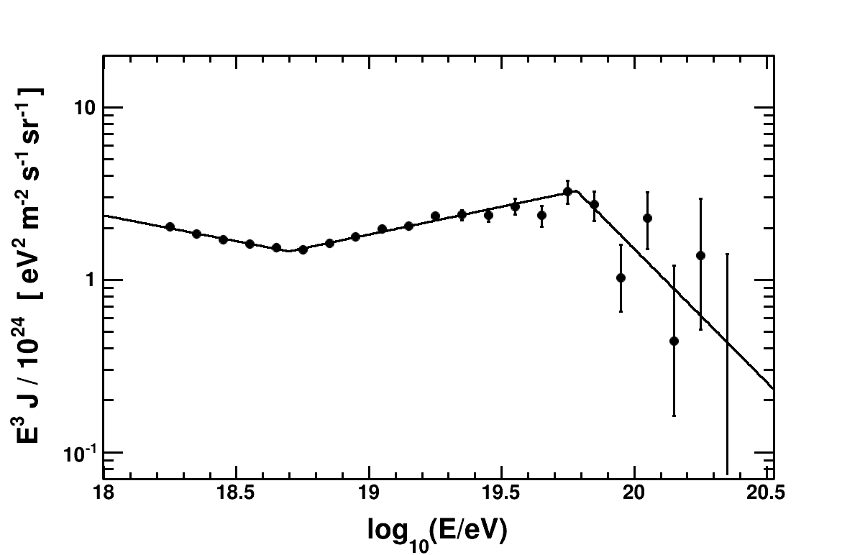
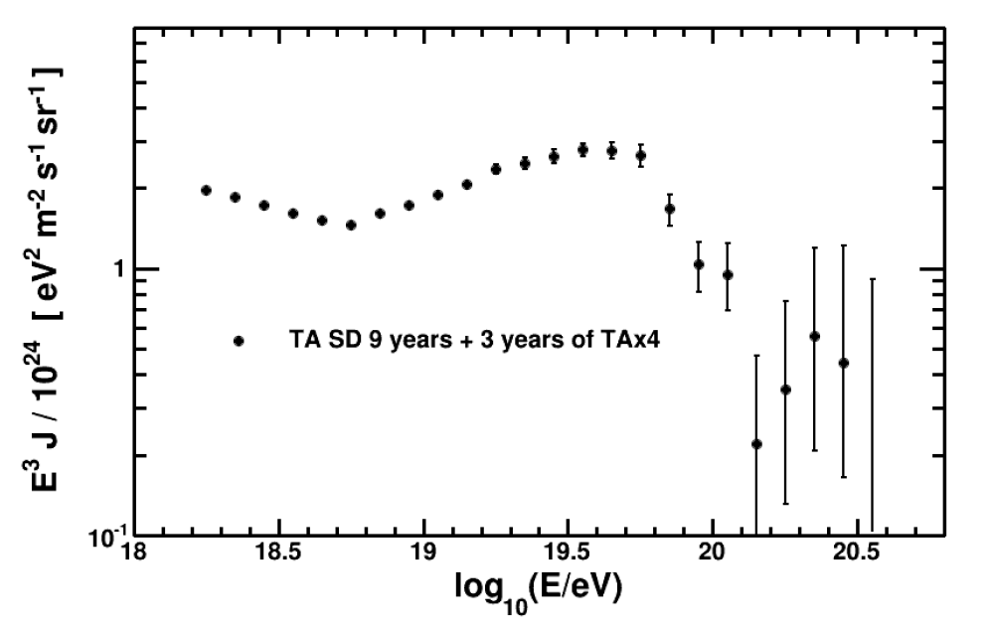
Future Prospects
TA SD energy spectrum (7 years data)
Log(E/eV) GZK
=19.78 ± 0.06
Power index
= −3.30 ± 0.03
Power index
= −2.68 ± 0.03
Log(E/eV) ankle
= 18.70 ± 0.02
Power index
= −4.55 ± 0.56
Energy spectrum: more detailed spectrum shape at the highest energies
with ～21 TA SD equivalent years data
Composition: Xmax using SDFD hybrid events with high statistics will be also provided.

Slide 16
Summary
Construction of TA×4 SDs and FDs was funded.
173 scintillator boxes of SDs were already assembled.
Number of photo electrons corresponding to the single muon peak is 19.0±3.3. The plastic scintillators determines the fluctuation.
In the range of SD electronics, non-linearity of all PMTs <10%.
Preliminary max. position dependence of up+low signals < ～15%
First 100 scintillator boxes arrived at Utah in spring 2016.
2 FD stations will be also constructed in the near future.
Notes:
Totalは19.0 +/- 3.3

Slide 17
Back Up

Slide 18
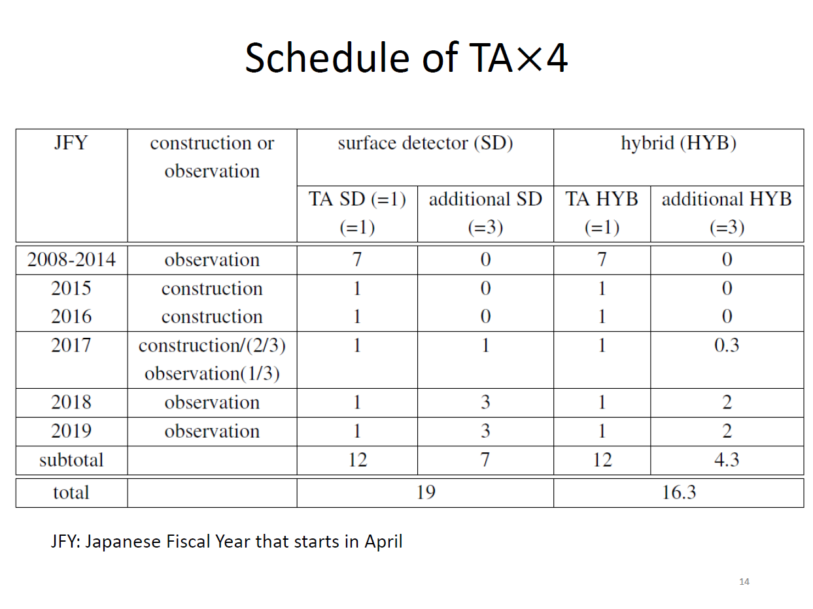

Slide 19
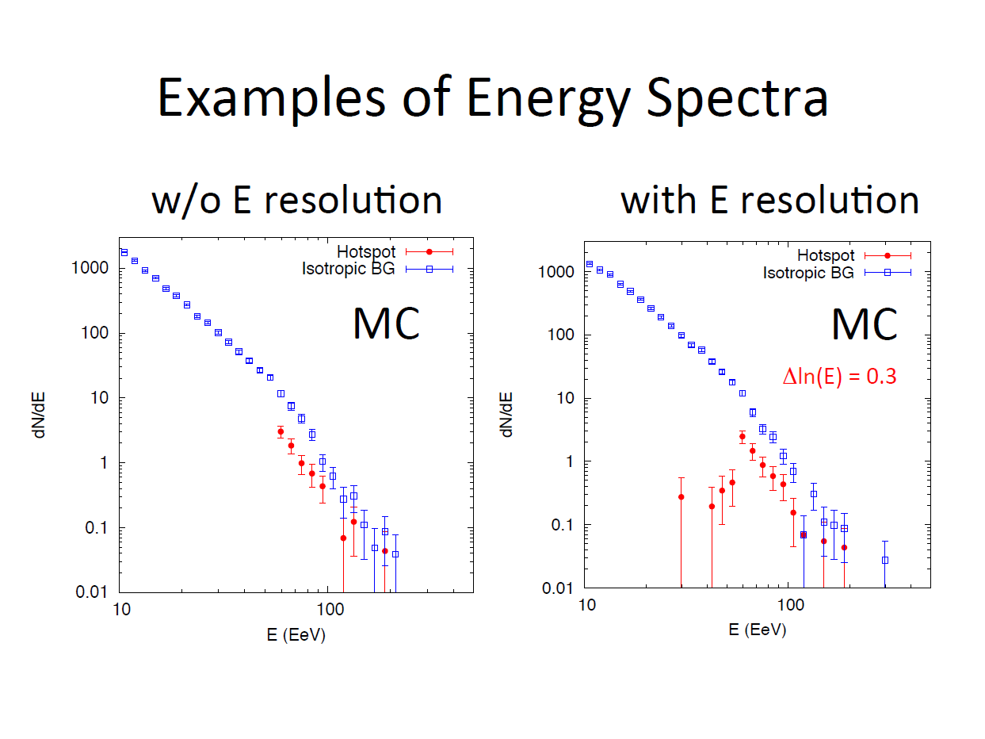

Slide 20
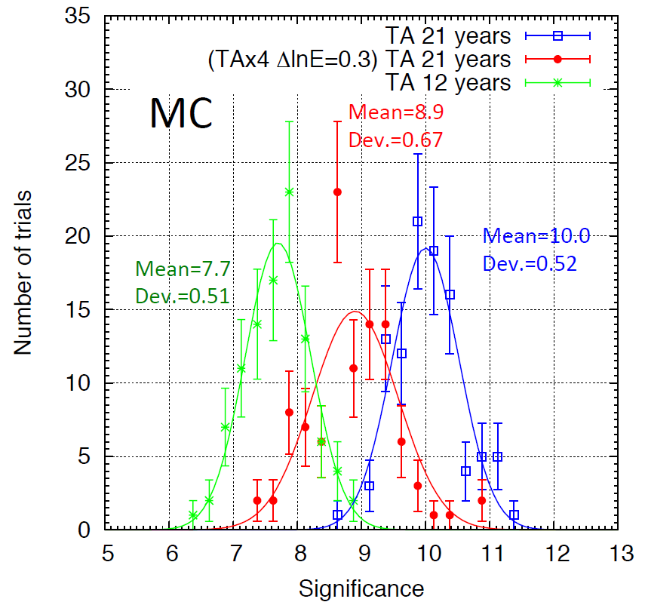
Expected significance of the hotspot considering energy resolution effect
Notes:
Post trial significance would be 10-1.6 sigma according to Kawata-san

Slide 21
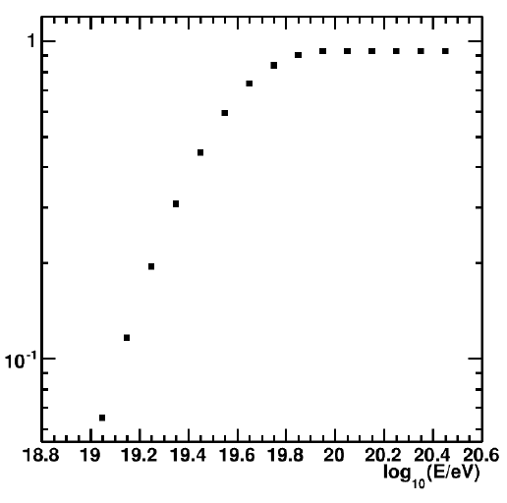
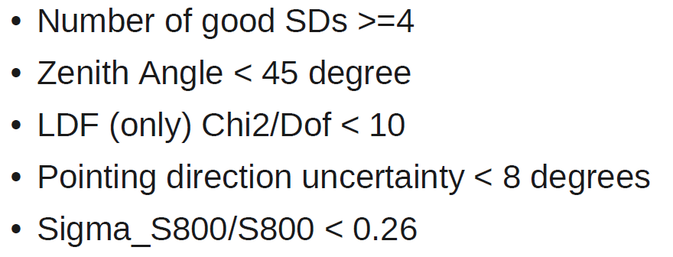
Efficiency for the energy spectrum analysis
Notes:
Check dmitri’s, about the boundary, it can be smaller than the full anisotropy cut, … that is true. Peak/Valley is about 4-5.

Slide 22
Resolution
Ta sd: E > 57 EeV 1-1.7 deg
15-20% energy resol.
Notes:
何か以前のanisotropy meetingのとか?

Slide 23
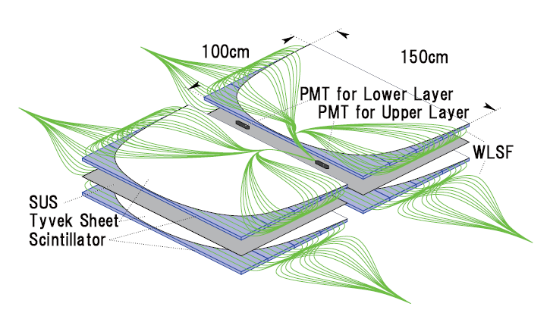
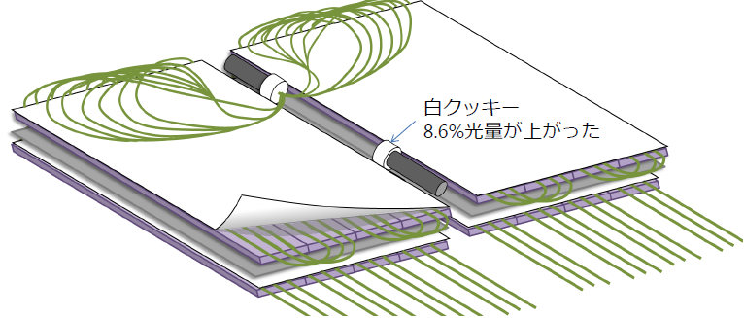
TAx4 SD arrangement of fibers
TA SD
2 layers of 1.2 cm thick
plastic scintillators
The distance b/w fibers:
2 cm → 4 cm
→ Number of photons from fibers
～1/2 of TA SDs
No problem in efficiency
Length of fibers: 5 m → 6.1 m
Arrangement of fibers is changed
Total length of fibers
5 m×(208 + spare)→ 6.1m×56
～33% of TA SD
TAx4 SD
PMT
Notes:
LEDがついているという話もする。

Slide 24
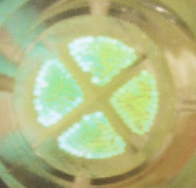
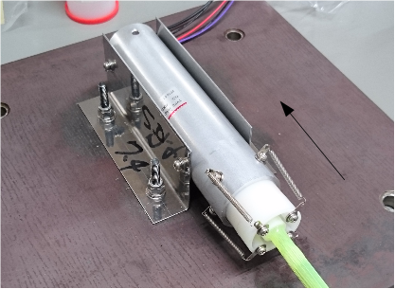
Connection of the surface of
TAx4 SD PMT with fibers
TA SD
TAx4 SD
20mm
8.7mmΦ
Holder of the fiber bundle:
transparent→white
～9% more number of photons
Size of the fiber bundle is smaller.
Diameter: ～20 mm→ 8.7mm
Optical grease (Optseal: Shin-etsu Chemical Co. Ltd.) is used

Slide 25
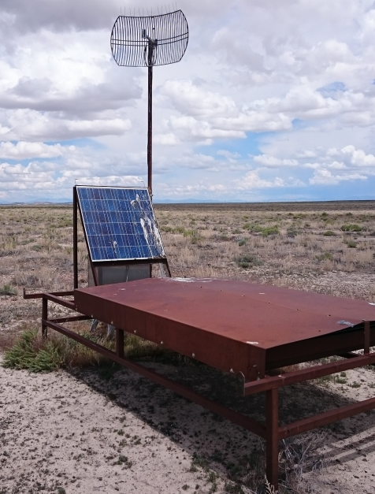
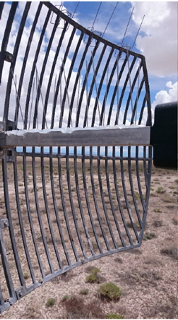
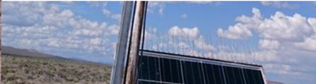
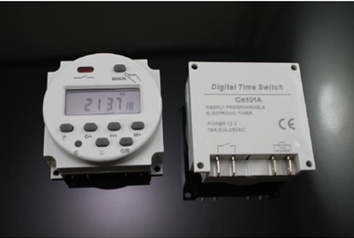
その他R&D
鳥の被害対策: バードスパイク，ケーブル保護チューブの検討
エレクトロニクス用リブートタイマー CN101A
全SDに設置予定、 週に一度自動リブート
現在TA実験の
SDアレイで試験中
→SDへのアクセスを軽減
Notes:
現在のSDアクセス回数: 1台に6台とか? それがどれぐらいになると見込まれるのか GPSケーブルの厚みは? 1.5mm

