Slide 1
Lightest Nuclei UHECR from nearby galactic and nearest AGN sources by D.Fargion, P.Oliva, Rome1,Italy presented by Marco Casolino, Rome 2, Italy

Slide 2

Sorry to not be here: but today it is
Kippur
We jew (D.F) have to avoid any activity and to not eat and drink asking forgiveness to the Big Boss for our mistakes
Therefore, assuming that this talk might be full of mistakes and it may be boring : Please forgive…

Slide 3
Back from a Jew religion to our Science religion:
UHECR sources hints
The absence of UHECR clustering toward Virgo,
the presence of a smeared hot spot toward CenA and M82, rare multiplet along our galactic plane,
stand in favor of a very light UHECR composition.
See Fargion et al. Arxiv 2008-2016

Slide 4
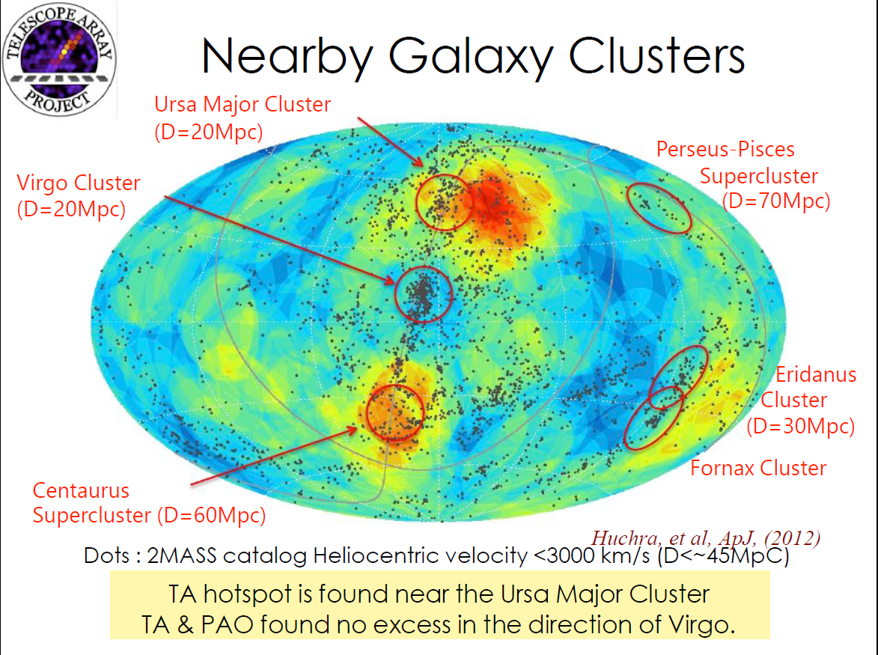
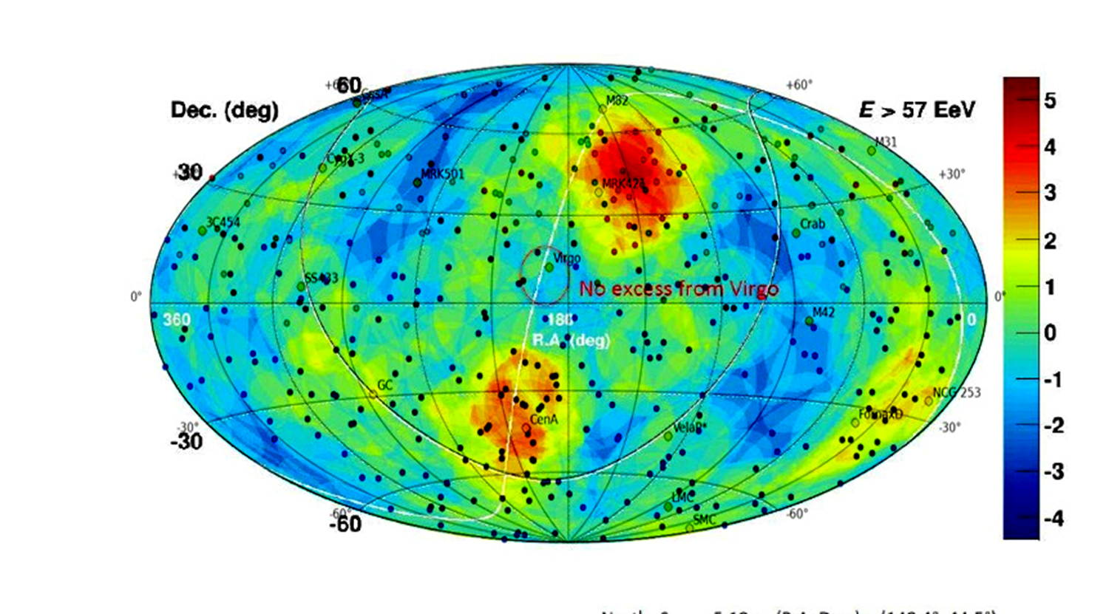
Last TA and AUGER events, versus expected GZK galaxies sources: The scandal of Virgo absence

Slide 5
Summary 1/3
UHECR He-like nuclei propagation from 20 Mpc Virgo is forbidden by photo-nuclear dissociation opacity, while it is allowed from nearby AGN within 2-4 Mpc.
This may explain surprising Virgo absence.
The UHECR charges are smeared by bending angles consistent with the observed ones in TA and AUGER Hot Spot; finally UHECR showering composition for light and lightest nuclei is recently very well confirmed by TA and Auger data.

Slide 6
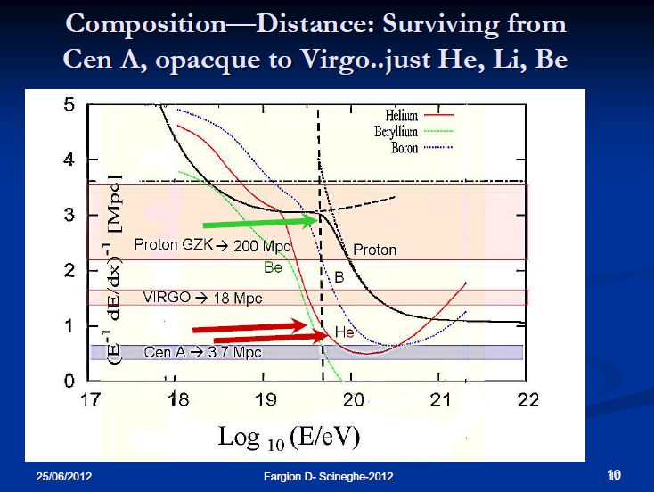
The lightest nuclei: the best filter to mask Virgo

Slide 7
Summary 2/3
North Hot Spot may be fed by near AGN M82,
South Hot Spot must be fed by Cen-A AGN.
Few galactic sources where very narrow UHECR cluster event occur might find-predicted 2014- (and found 2015) UHE gamma and UHE neutrino correlated event
TeVs-Gamma and CR anisotropy by Milagro-Argo-Hawc-Icecube might hint UHECR sources

Slide 8
Last Summary 3/3
Why UHECR rays might be correlated to tens TeV-PeV signal?
Because these UHECR are enough directional to keep memory of their sources, but only their few spread UHECR events and their abundant TeVs fragment (gamma-alfa-neutrons) of decay in flight may trace and hint their maps.
M82, NGC 253, Fornax A, Cen A are probale AGN sources; SS433 and other galactic sources are probable source too. Cygnus X3 , Vela, Crab are waited too.

Slide 9
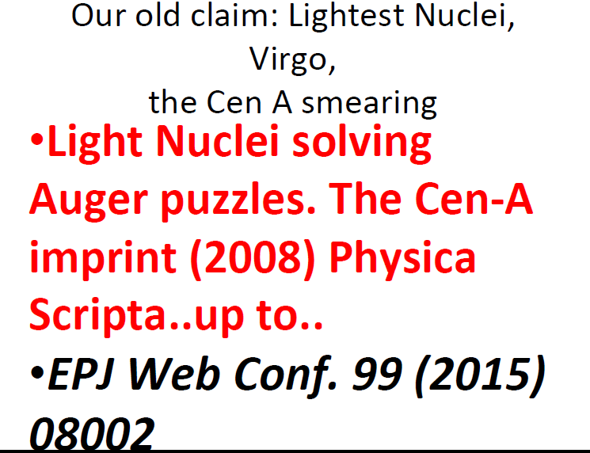

Slide 10
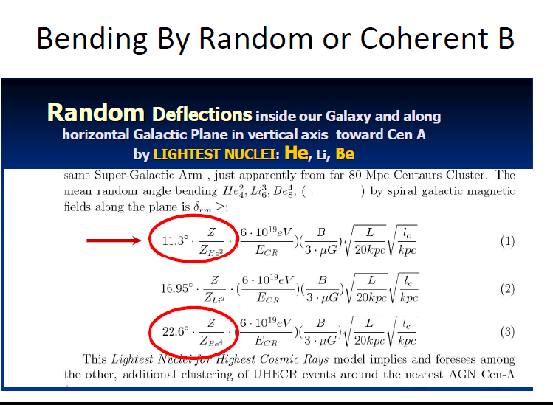
UHECR light nuclei bending well inside Hot Spot

Slide 11
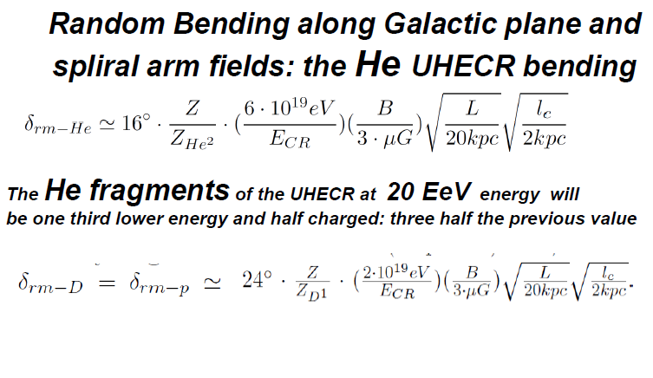
He-Li-B Fragility makes fragments

Slide 12
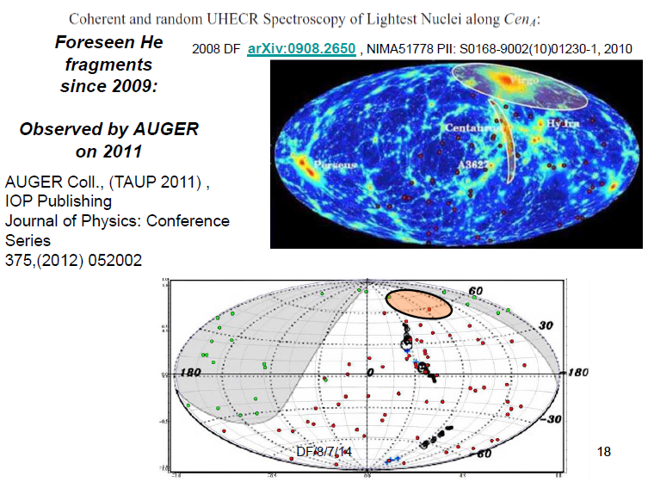
IR MAP→
Observed twenty
EeV multiplet-black
By AUGER 2011
Along foreseen
Clustering around
Cen A

Slide 13
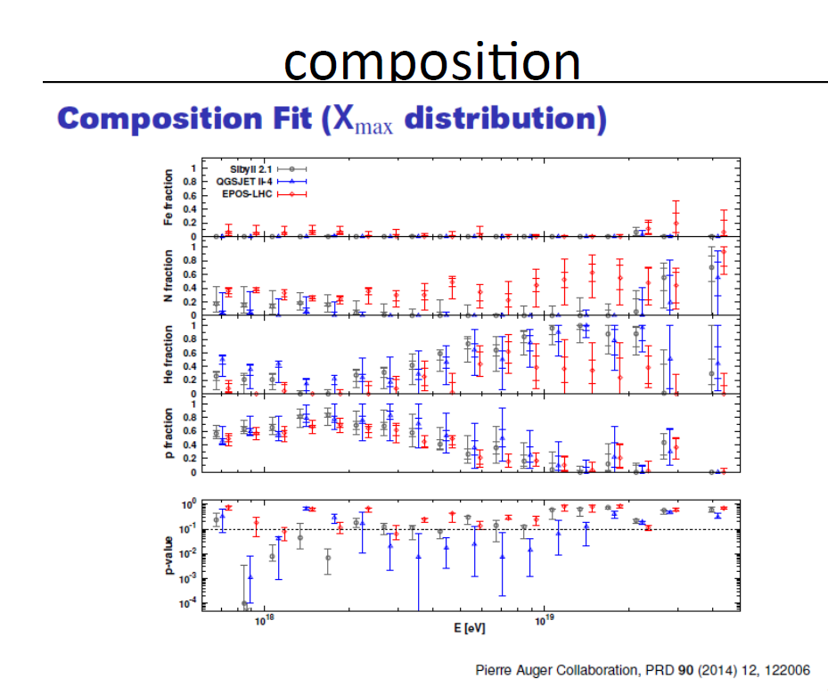
2015-2016 AUGER composition changed
From a proton+ iron to a Light Nuclei

Slide 14
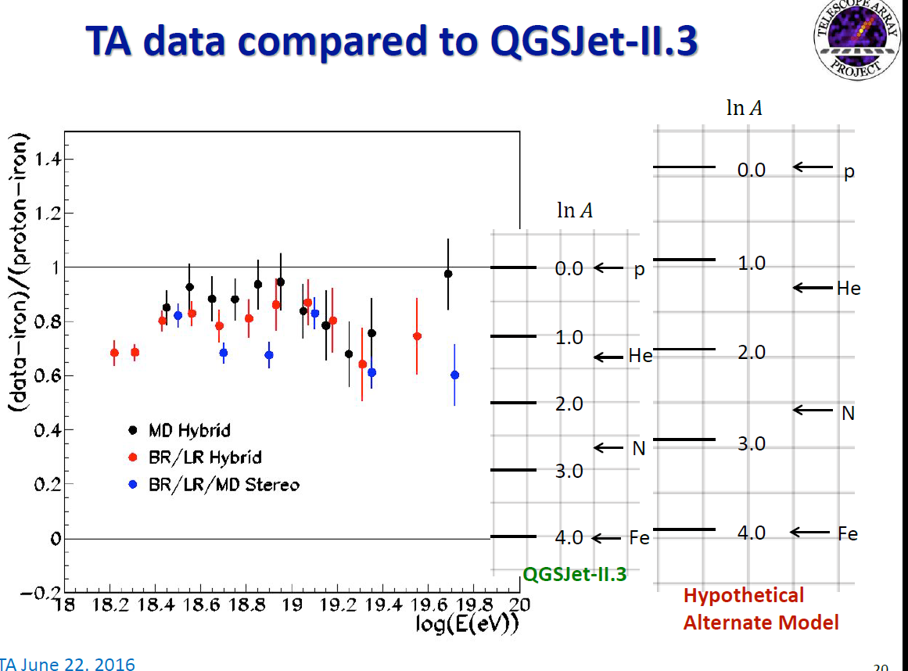

Slide 15
However ICRC 2015 while overlapping our PoS 2014 map anyway they ignored our few correlations:

Slide 16
However there are some common clustering at narrow scales
These clustering might be connected to a different (parental) anisotropy in TeVs CR-gamma maps (Milagro-Argo-Hawc)
Indeed the UHECR are almost certainly radioactive: their ultrarelativistic decay in flight at TeVs-PeVs energy may help to identify sources and correlations

Slide 17
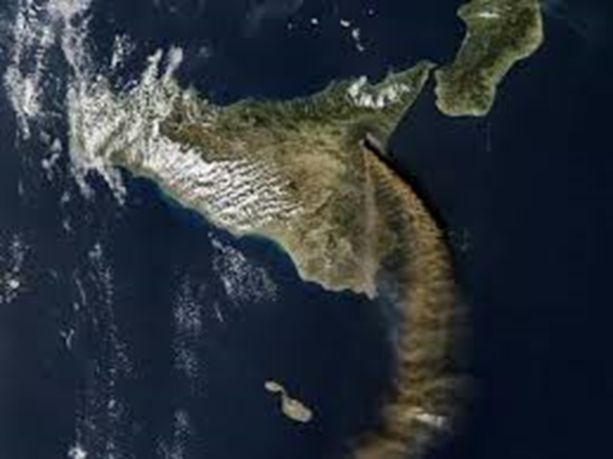
An Analogy: TAIL OF SMOKE from Etna
SIMILAR TO DIFFUSED RADIOACTIVE JET TAIL

Slide 18
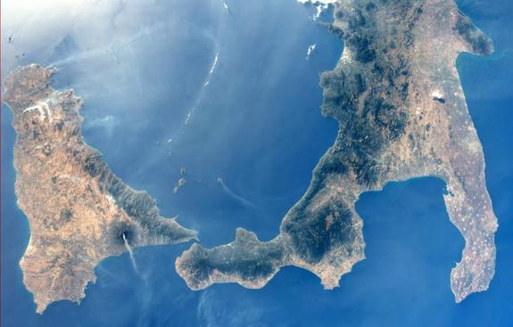
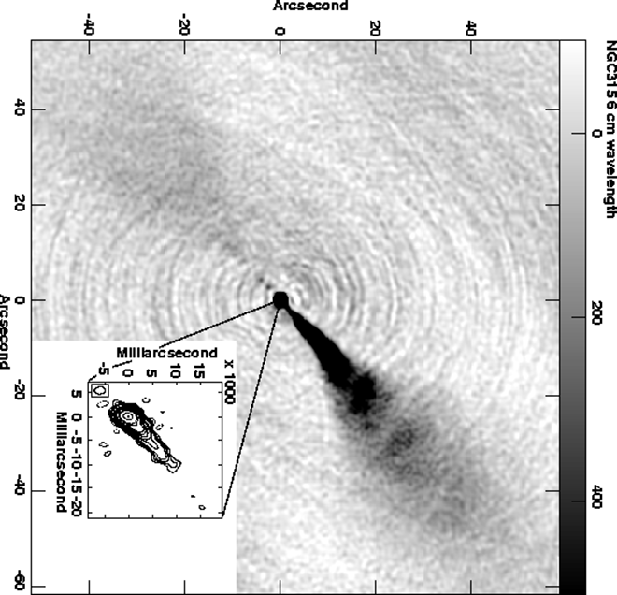
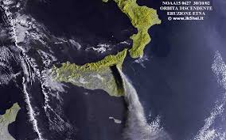
Etna view of a tail Jet as in
NGC 3156

Slide 19
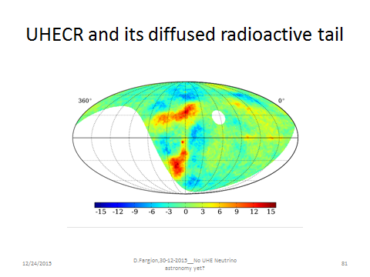
Crab as a source of TeVs tail anisotropy?
The Anticentric galactic map centred on CRAB
ARGO TEV map
In anti-centric CELESTIAL
Coordinates: CRAB in the
map CENTER; REGION
A just below

Slide 20
Last ICRC anisotropy map
Region A and the CRAB place
TeVs map
by Hawc
Note CRAB
At origin
region A

Slide 21
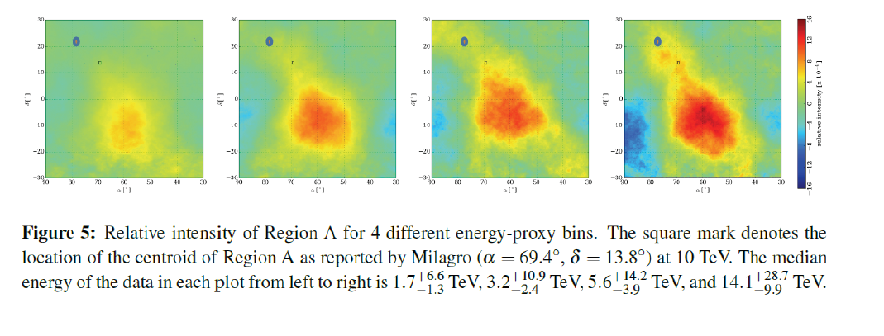
MILAGRO SUSPECTED HOT SPOT
Region A and the CRAB place
ZOOM map
TeV seen by ARGO
Note CRAB

Slide 22
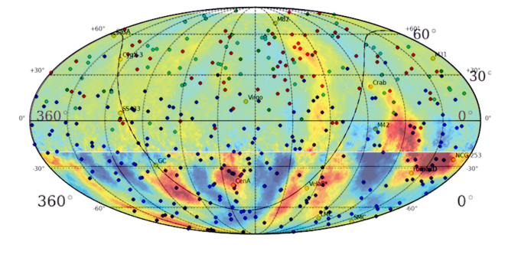
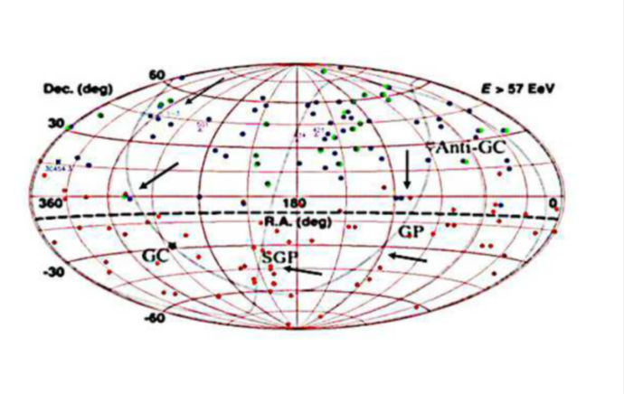
Possible UHECR location sources with UHE neutrinos:
Unveling Vela?
Continous arrow-observed; Dotted arrows are not yet revealed
Foreseen UHE neutrino regions

Slide 23
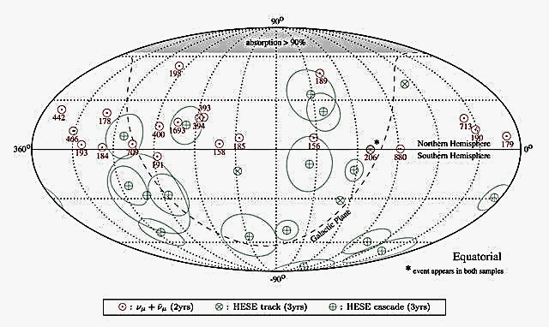
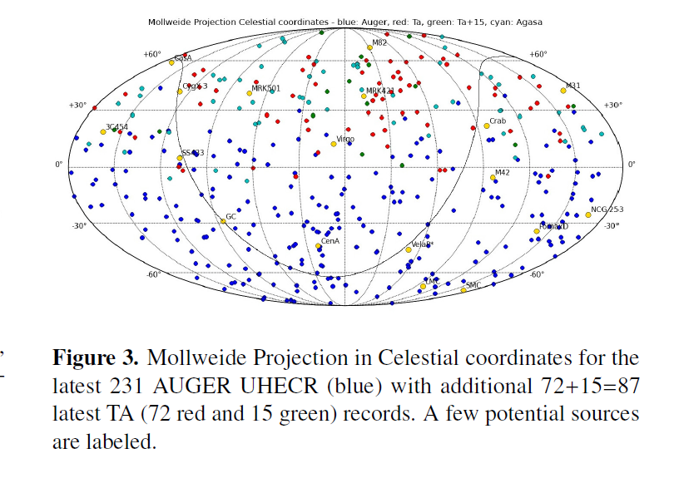
Crossing Muons: Connected to UHECR?
arXiv:1408.0227 [pdf, ps, other]
  UHECR and GRB neutrinos:
  an incomplete revolution?
Foreseen UHE neutrino-2014 DF
Observed Uhe
Continous
Green arrow

Slide 24
Conclusions
UHECR and UHE gamma and UHE neutrinos might sometimes correlate
Narrow clustering UHECR on galactic plane in two cases (over 5) followed predictions.
Hot Spot AGN might be too far and diluted in time to show UHE neutrino now.
Future Tau airshowers and UHE Trough going muons may be the key neutrino astronomy , possibly also parasite of UHECR narrow clustering

Slide 25

Thank you for the kind attention
References
The meaning of the UHECR Hot Spots: A Light Nuclei Nearby Astronomy - Fargion, D. Oliva P.et al. EPJ Web Conf. 99 (2015) 08002 arXiv:1412.1573
DF,PO;Tau Now, arXiv:1602.03497
DF,PO:Solving.. arXiv:1605.00177 ;Solving the missing GRB neutrino and GRB-SN puzzles
DF Discovering Tau airshower; The Astrophysical Journal, 570:909-925, 2002 ; Astrophys.J. 613 (2004) 1285

