Slide 1
Detector concepts for future colliders
SWHEPPS, Lake Aegeri, June 9, 2016
D. Contardo - IPN Lyon CNRS/IN2P3
Plans for future colliders
  Operation constraints for experiments
Detector concepts for future colliders
  Focus on HL-LHC ATLAS and CMS upgrade designs
  Overview of technical solutions, limitations and trends for future R&D
Discussion of new techniques in P. Allport’s presentation

Slide 2
Plans for future colliders

Slide 3
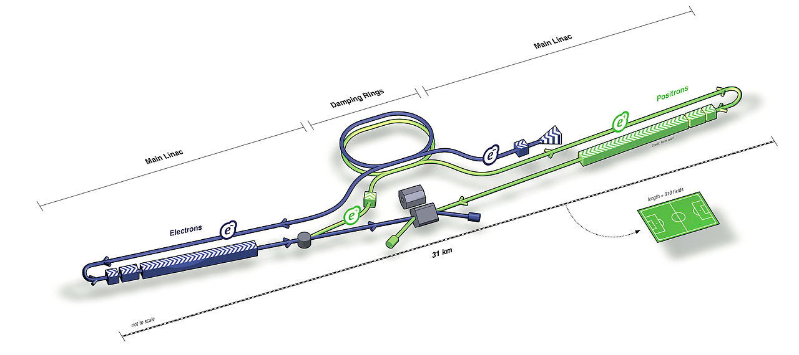
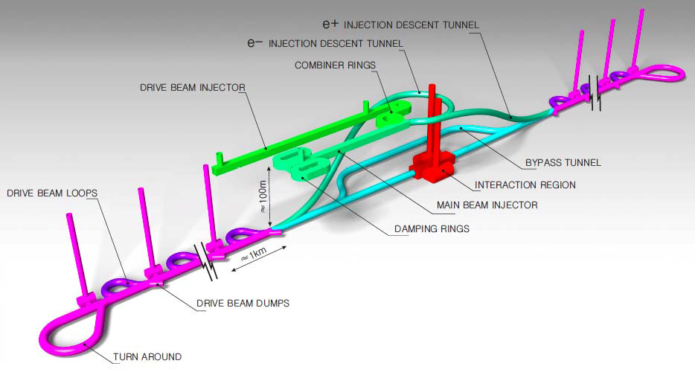
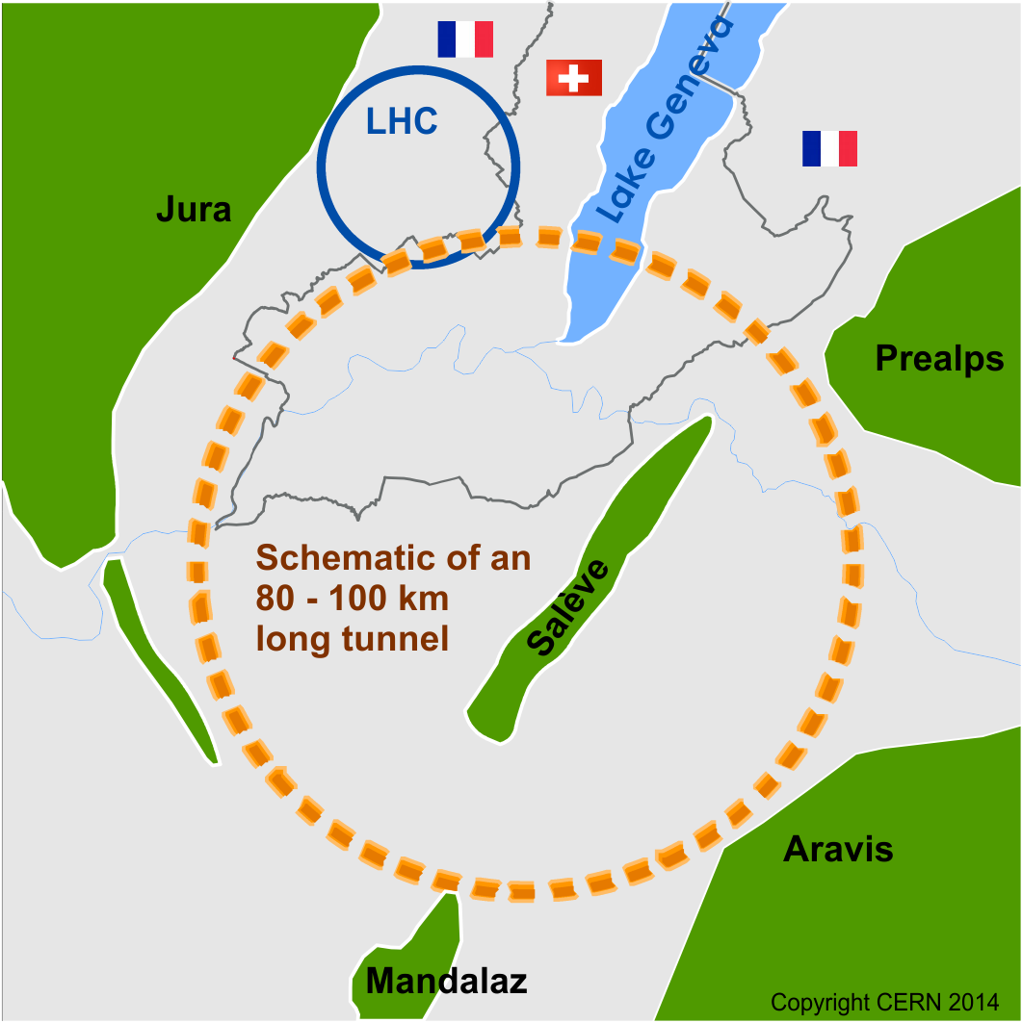
Future Colliders
ILC: 2x11 km (Japan), 1.3 GHz SCRF cavities, 30 MV/m ≃ 500 GeV
CLIC: 2x21 km (Geneva,) drive beams provide RF power, 12 GHz, 100 MV/m ≃ 3 TeV
2 push-pull experiments
31 km (500 GeV)
50 km (3 TeV)
Future Circular Collider (FCC)
FCC-hh: pp-collider 80-100 km (Geneva) 16 T magnets ≃ 100 TeV (in 100 km)
FCC-ee: e⁺e⁻ collider potential first step, Z, WW, ZH, tt energies max ≃ 350 GeV
FCC-he: p-e option ≃ 3.5 TeV
HE-LHC: with FCC-hh technology ≃ 30 GeV
2 Experiments (Interaction Regions)
And similar China project SPPC/CEPC

Slide 4
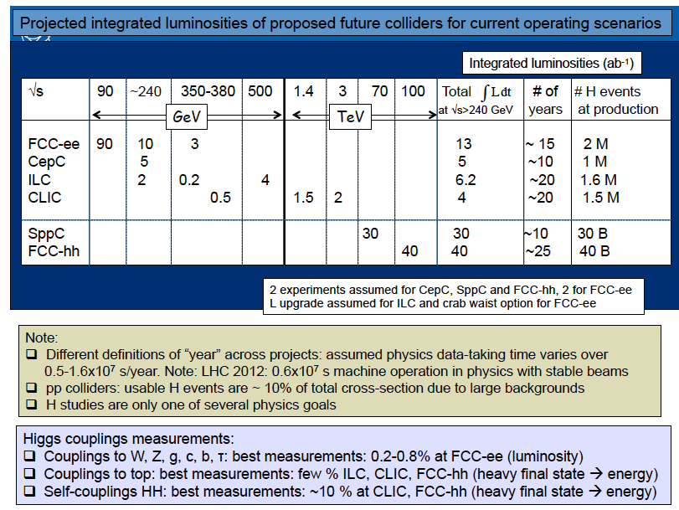
F. Gianotti’s at FCC week in Rome, Apr. 2016
Luminosities x 10 ³⁴ cm⁻² s⁻¹
New
particles
mass range
≃ 1.5 TeV
≃ 50 TeV
HL-LHC 3000 ab⁻¹ ≃ 200 M Higgs
≃ 8 TeV → 16 TeV at 30 TeV HE-LHC

Slide 5
Future Colliders broad-brush planning
1980
1985
1990
1995
2000
2005
2010
2015
2020
2025
2030
2035
2040
Design
Proto
Construction
Physics
LHC
Design
LS2 19-20
LS3 24-mid26
HL-LHC
Top priority European Strategy (2013) and US P5 (2014) - ATLAS and CMS TDRs in 2016-2017
Physics
Des. Techno. R&D ≃ 10 yrs - engin. ≃ 3-4 yrs
Cons.Ins. 4/5+2 yrs
ATLAS - CMS
End of LHC Run 2 → 2019-20 recommendation from ES, others? US P5, Japan JAHEP, China
ILC TDR in 2013 → Japan MEXT creates ILC taskforce
Design
Prep.
phase
Construction
Physics
CLIC CDR in 2012 Proj. Imp. Plan end 2018
Design
Prep. phase
Construction
Physics
FCC-hh/ee CDR end 2018 - CEPC/SPPC
Design
Pep. phase
Construction
Physics
20-25 yrs

Slide 6
p-p collider beam parameters
parameter | FCC-hh |  | SPPC | HE-LHC* | (HL) LHC
collision energy cms [TeV] | 100 |  | 71.2 | >25 | 14
bunch spacing [ns] | 25 | 25 (5) | 25 | 25 | 25
luminosity/IP [10³⁴ cm⁻²s⁻¹] | 5 | 20 - 30 | 12 | >25 | 5 (7.5)
Mean collisions/crossing (PU) | 170 | <1020 (204) | 400 | 850 | 140 (200)
5 x 10³⁴ cm⁻²s⁻¹ (170 PU):
  → Similar conditions as for HL-LHC upgrades (can overcome present limitations)
30 x 10³⁴ cm⁻²s⁻¹ 1020(204) PU:
≳ O(10) x radiation tolerance compared to HL-LHC, a major challenge
x 5 pileup will require high granularity (≃ linear increase) and both charged and neutral particles high timing precision measurement for collision (vertex) association
5 ns bunch spacing would still require high granularity (to avoid out of time pileup in same channel), and also good timing precision

Slide 7
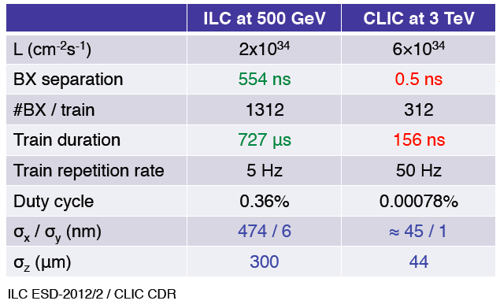
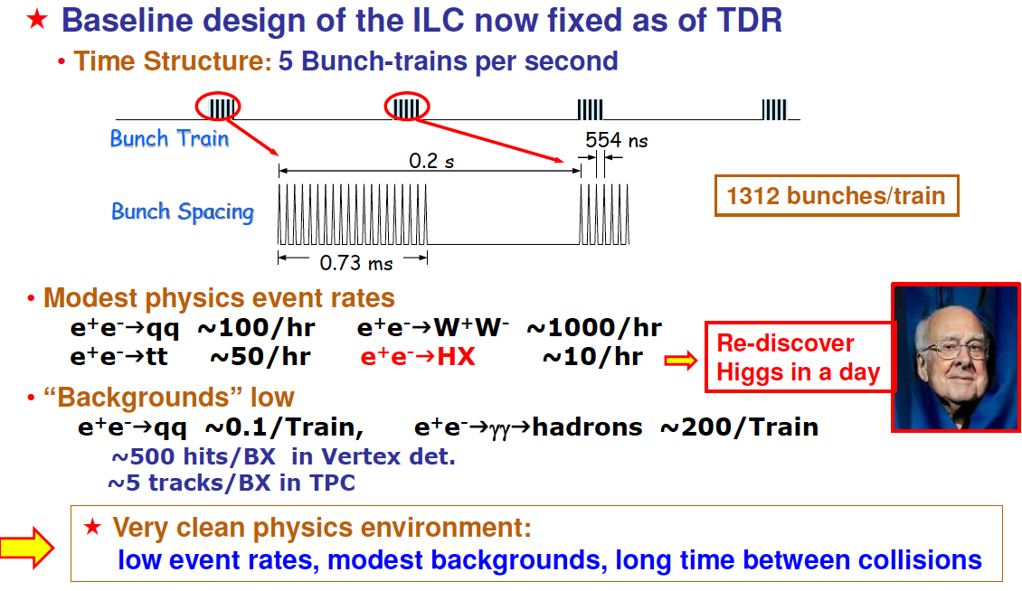
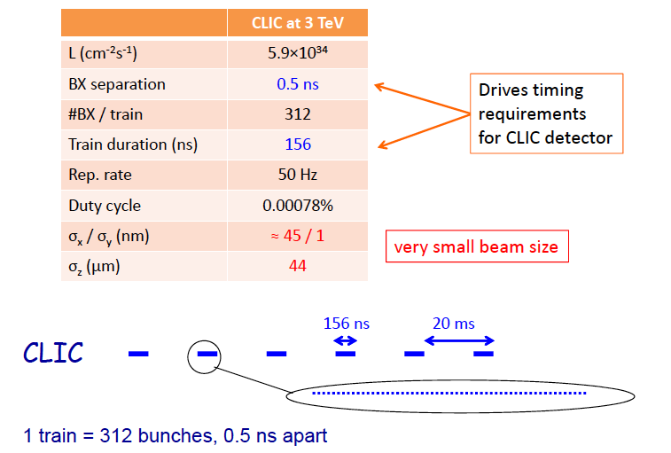
e⁺e⁻ colliders beam parameters
ILC
CLIC
ILC - CLIC:
    No pileup but large beam background
    No radiation tolerance issues
    Low integrated rates (duty cycle) allows full reconstruction event selection (triggerless) and power pulsing for low mass in tracker and high channel density in calorimeters
    CLIC requires time stamps and short reconstruction windows
FCC-ee:
high lumi. at Z mass requires 100kHz to register all Zs
power pulsing not possible

Slide 8


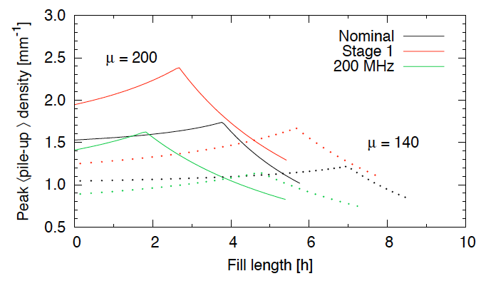
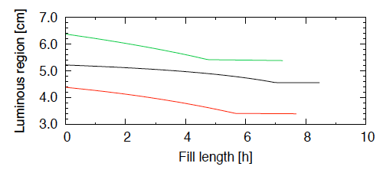
HL-LHC beam parameters
Max luminosity at beginning of fills is 5 x 10³⁵ Hz/cm² , operating scenarios are:
  Nominal luminosity leveling at 5 x 10³⁴ Hz/cm² , ≃ 140 PU
  Design for luminosity leveling 7.5 x 10³⁴ Hz/cm², ≃ 200 PU
  Integrated luminosity 2.5 ab⁻¹ in 10 years
Different scenarios/options considered:
  Full Crab-Crossing (nominal)
  ½ Crab-Cavities installed (stage 1) up to LS4
  200 MHz RF (option to mitigate e-could)
  Crab-Kissing (option to mitigate pileup effect through smaller z-density
Integrated luminosity (fb⁻¹/year) 140 PU (top) and 200 PU (bottom)

Slide 9
Detector concepts for future colliders

Slide 10
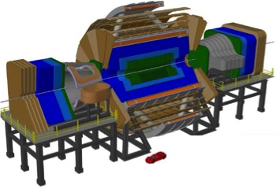
FCC-hh detector Concept
  Min bias event similar to HL-LHC: 5.4 → 8 charged/η - <Pt> 0.6 → 0.8 GeV/c
Higgs (highly boosted), HH, VBF/S process, and heavy new resonances:
  ECAL 30 X₀ and HCAL 12 λ_{i}
  Precise tracking ≲ 10% at p_{T} = 10 TeV
  Calorimeter resolution EM(Had) 10(50)% (sampling) + ≃ % (constant), up to eta = 4
  Extend coverage up to η = 6 for jets (eg calorimeters and tracking)
Baseline design:
Twin solenoid ≃ 6T (12 m, no yoke) assuming same tracker resolution as current HL-LHC detectors
Dipoles ≃ 6T in forward region
Detector concepts at an early stage based on ATLAS & CMS Phase II designs
m
15
≃ x 2 CMS size
10
5
10
20
30
m

Slide 11
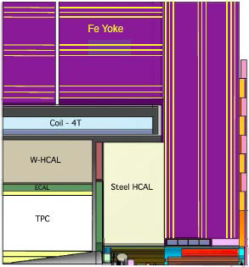
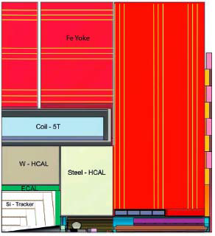
ILC-CLIC detector concepts
Requirements for Higgs width, precise couplings, Z/W di-jet mass resolution
  Vertex: resolution at IP of ≃ 5 µm (10 GeV tracks in barrel)
  Tracking: σ(pt)/pt² ≃ 2 x 10⁻⁵ GeV⁻¹
  Jets: σ(E)/E ≃ 3.5% (in the range 50 - 250 GeV)
  LC: 2 detector concepts
    SiD: 5 T solenoid - full Si-tracker 1.2 m - High Granularity Calorimeter
    ILD: 3.4 T solenoid, Pixel vtx - Si + TPC/MPGD tracker 1.8 m - Calorimeter as for ILD
  Note: FCC-ee detector concept similar to LC but smaller detector with 2T field
ILD
SiD
7 m
6.5 m

Slide 12
ILC-CLIC detector concepts
Pixels extremely accurate and light - resolution at IP ≃ /4 current LHC
  Target ≲ 0.2% X₀ per layer and ≃ 3 µm hit resolution with ≲ 25 µm² pixels, thin sensors ≃ 50 µm, airflow cooling with lower power consumption (first layer close to IP ≲ 2 cm)
  Time window at CLIC ≃ 10 ns
  Technologies:
    Hybrid with thin sensors ≃ 50 µm and thinned ASIC ≃ 50 µm (fast for CLIC)
    MAPs (ILC) - HV-CMOS sensor + amplifier with capacitive coupling to digital ASIC through glue (fast for CLIC?) - also allows smaller pixel size for reduced occupancy although not improving resolution
Tracking, Pt resolution ≃ /10 HL-LHC
  Small strip pitch or macro pixels, target 1% X₀ and ≲ 10 µm hit resolution (needs charge sharing)
Calorimetry resolution ≳ /3 HL-LHC (with PU)
  High Granularity PFlow concept
    ECAL ≃ 23 X₀ , ≃ 30 layers, ≃ 0.5 x 0.5 cm² W/Si
    HCAL ≃ 7.5 λ_{i}, ≳ 50 layers, AnalogHCAL 3 x 3 cm² scintillator + SiPM or Semi-DigitalHCAL 1 x 1 cm² RPCs pads with multi-thresholds
    ≃ 80 M channels (x 12 CMS HGC)
    Time window at CLIC ≃ 10 ns (EM) 100ns (Had.) and precision of ≃ 1 ns
  Muons with scintillator strips + WLS + SiPM or RPCs

Slide 13
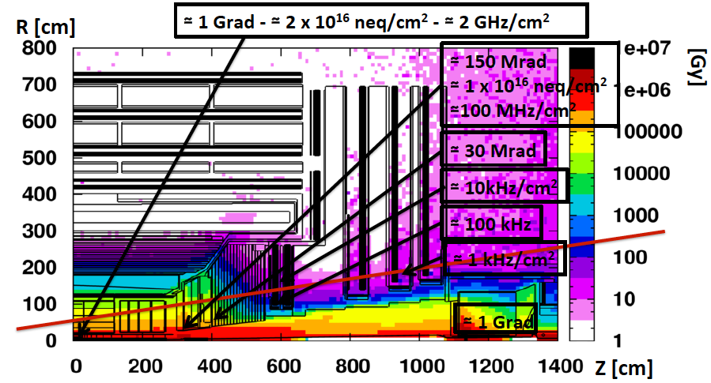
ATLAS and CMS Phase II (HL-LHC) upgrades
Radiation and particle rates:
Require new trackers, and also endcap calorimeters in CMS, new forward muons
And replacement of most of the readout systems
Roughly reaching limits of current techniques in several systems below this line
CMS radiation dose map, neutron equivalent fluence and particle rates for luminosities of 3000 fb⁻¹ (integrated) and 5 x 10³⁴ Hz/cm² (instantaneous)

Slide 14
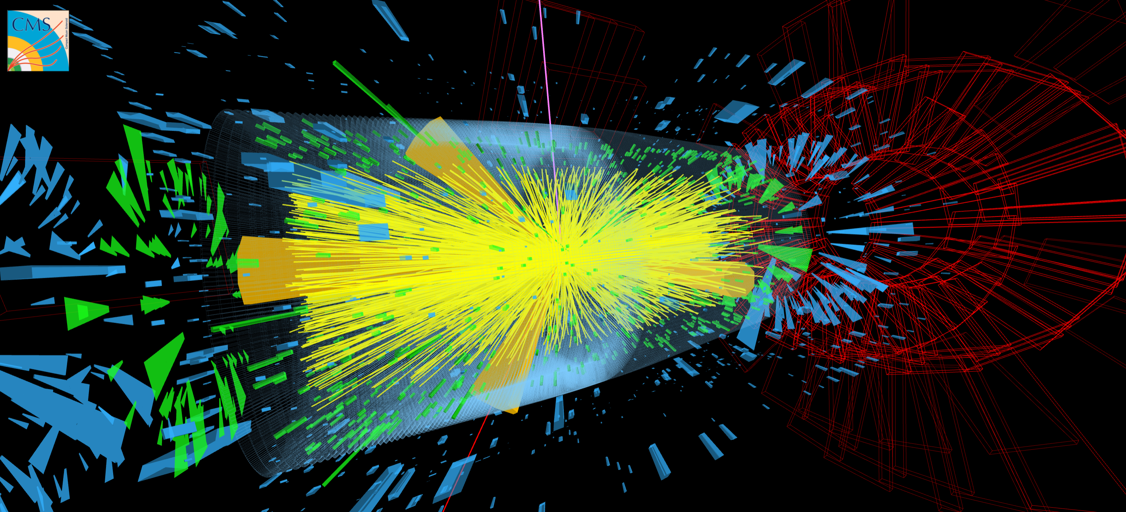
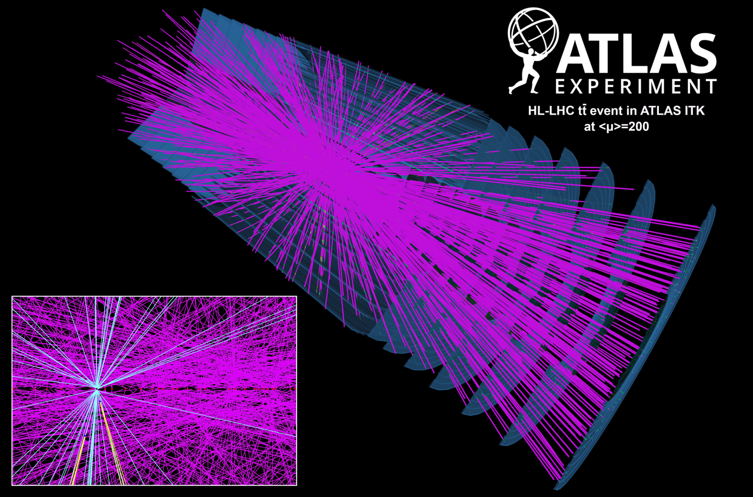
ATLAS and CMS Phase II upgrades
Upgrades designed to maintain Phase I (50 PU) performance at 140 PU - able to operate at 200 PU with smooth performance degradation
Displays of a tt event (left) and of a VBF H → ττ (right) in 200 p-p collisions

Slide 15
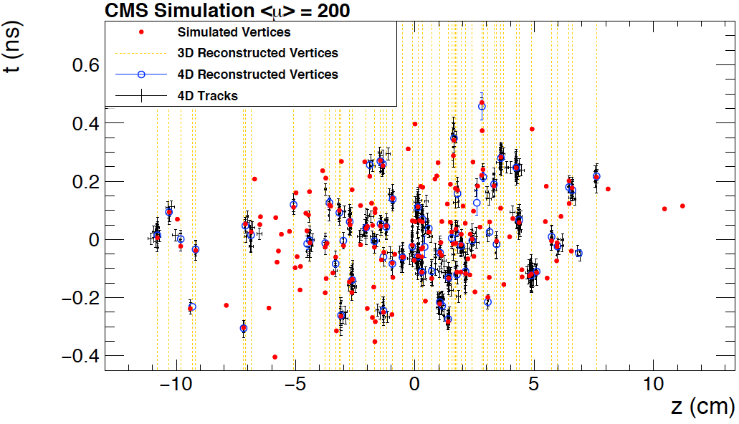
ATLAS and CMS pileup mitigation
High tracking efficiency is crucial for pileup mitigation and tracks are needed at hardware (trigger) event selection, as well as the full calorimeter granularities
Ultimate PU mitigation would need precise timing measurement (of MIP and neutrals) to unambiguously associate both tracks and neutral energy clusters to each vertex (within precision limits)
t (ns)
z-t structure of sim. and reco. vertices in a 200 PU event, 3D uses the CMS Phase II tracker (w/o timing) and 4D includes an investigated timing layer with MIP precision of 20 ps

Slide 16
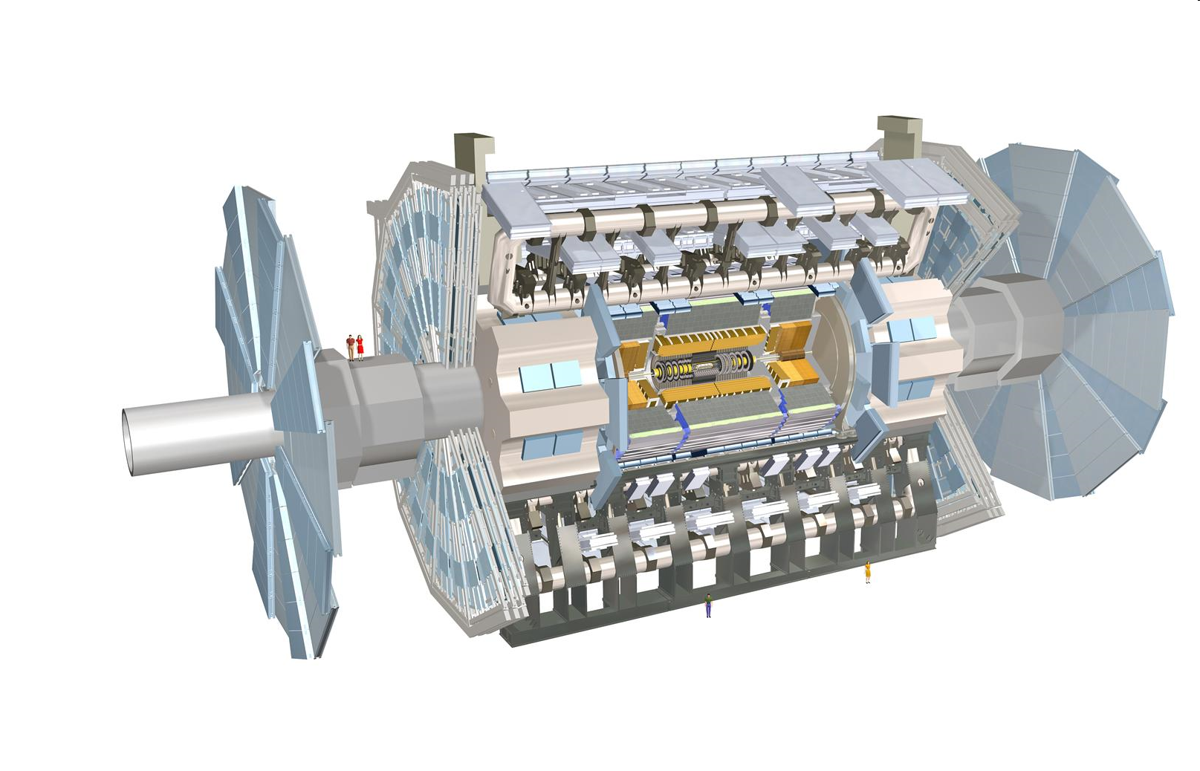
ATLAS upgrades for Phase-II
Trigger/DAQ
1 MHz Tracker readout w or w/o Region of Interest after 6 µs latency
Full read-out at ≃ 400 kHz with track-trigger after ≃ 30 µs latency
Register up to ≃ 10 kHz after computing selection (30 GB/s)
Muon systems
New electronics
Some chambers replaced to improve resolution
Muon tagging to η ≃ 4
Forward calorimeter
Possibly new sFCAL with x 4 granularity
5D Si/W to cover 2.4 ≲ η ≲ 4
New Tracker
Rad. tolerant, high granularity and light
Extend coverage to η ≃ 4
Liquid Argon and Tile calorimeter
New electronics

Slide 17
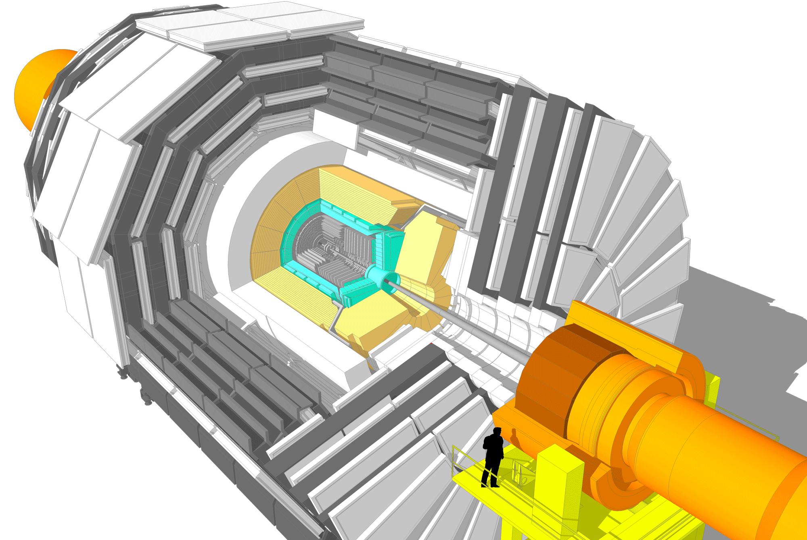
CMS Phase-II upgrades
Barrel EM calorimeter
New FE/BE electronics with improved time resolution
Lower operating temperature (8∘)
Trigger/HLT/DAQ
Track information in L1-Trigger (hardware)
Trigger latency 12.5 µs - readout rate 750 kHz
HLT output 7.5 kHz
Muon systems
New DT & CSC FE/BE electronics
Complete RPC coverage 1.6 < η < 2.4
Muon tagging 2.4 < η < 3
New Endcap Calorimeters
Rad. tolerant - increased transverse and longitudinal segmentation -precise timing capability
Beam radiation and luminosity
Common systems and infrastructure
Investigating hermetic MIP timing layer
New Tracker
Rad. tolerant - increased granularity - lighter
40 MHz selective readout in Outer Tracker for Trigger
Extended coverage to η ≃ 3.8

Slide 18
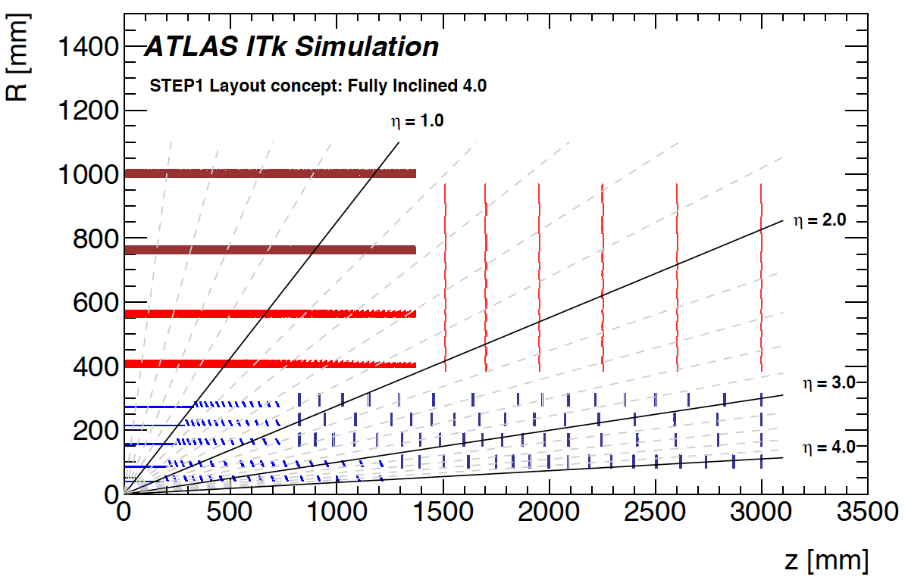
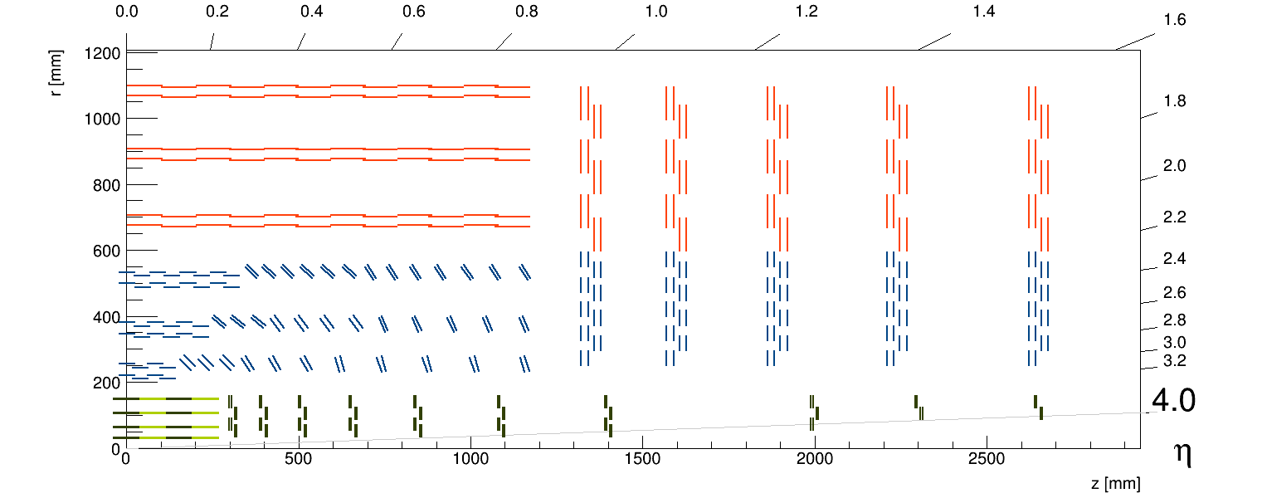
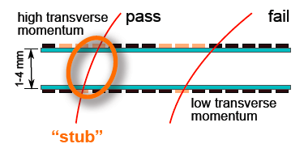
ATLAS and CMS Silicon Trackers
High granularity (≃ 4 to 6 x present trackers):
  Pixel sizes in range ≃ 50 x 50 - 25 x 100 µm² - first layer(s) replaceable
  Strip pitch ∼ 75 to 90 µm and length ∼ 2.5 to 5 cm length
Light (improve resolution & reduce interactions and γ-conversions):
Design, new materials - new cooling (CO₂) - DC/DC, serial powering
Implementation of tracking information in hardware trigger
Extension of pixel coverage from η ≃ 2.4 to η ≃ 4
CMS
2-sensor module concept for trigger Pt selective readout
long pixels in inner layers for z
Other layout layouts still considered

Slide 19
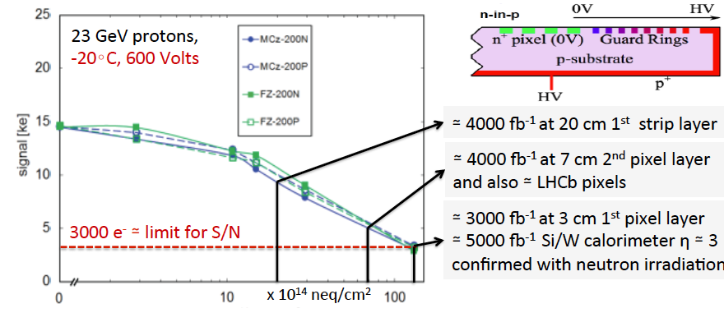
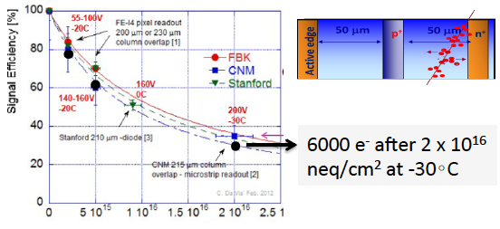
Silicon sensor R&D trends
HL-LHC:
Thin planar sensors with improved bulk material n-in-p
Recent progress in 8” wafers and physically thin (200 µm) sensors
3D sensors alternative for higher radiation tolerance - good candidate for 1st pixel layer - (more expensive, 1st layer likely needs replacement due to ASIC rad. tol.)
pp and ee future colliders:
Higher granularity - lighter, with thinner sensors, smaller pitch, and fast
    Hybrid technology need to improve bump bonding for size & cost
    Monolithic (MAPS, HR/HV CMOS) light, not yet enough rad. tol., also relatively slow
    3D integration of sensors and electronic functions through SLID to sensors and TSV between ASICs functions analog/digital (good compromise for ee and pp colliders?)
    Note this could also apply to Si-HGC (although lightness is not a criteria)

Slide 20
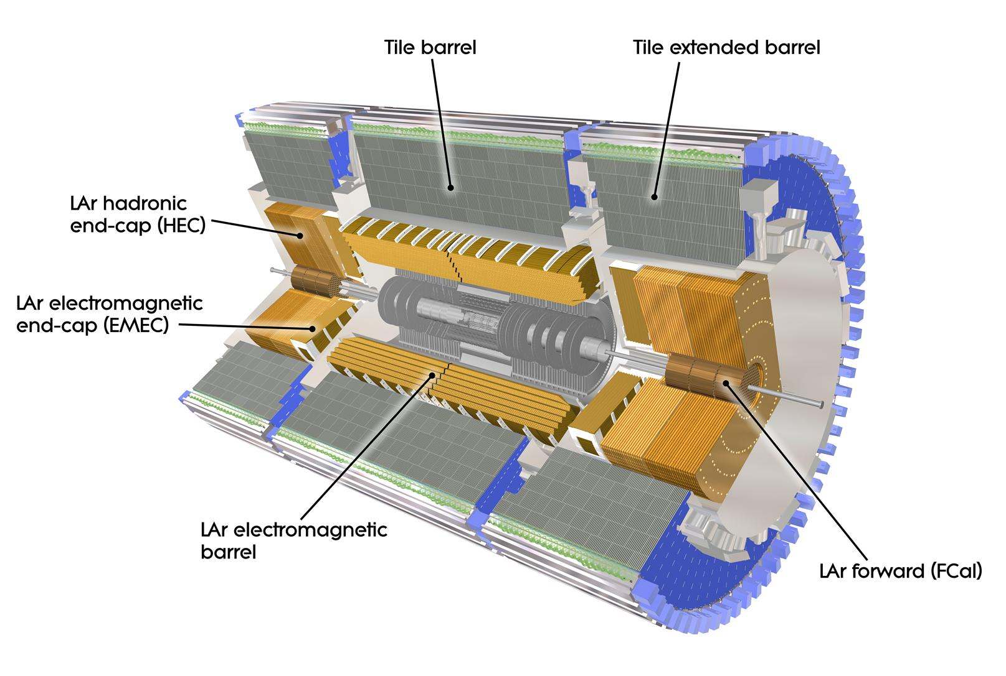
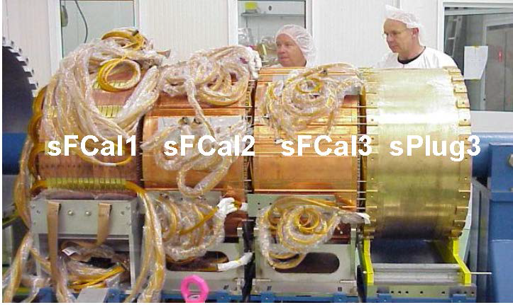
ATLAS Calorimeter upgrades
ATLAS LAr calorimeters & Scint. Tile
need new readout electronics - full granularity at hardware trigger
Forward CALorimeter (3 ≲ η ≲ 5)
Ion space charge effect (due to peak luminosity) is investigated - option to replace with sFCAL - lower gap ≃ 100 µm and x 2 better segmentation in η & Φ, or add mini-FCAL in front of current FCAL
Thin High Granularity Si/W(Cu) Calo.
(2.5 ≲ η ≲ 4) is being investigated to further mitigate PU, including precise timing measurement (≲ 50 ps)
LAr is a good candidate for FCC-hh with higher granularity and rad. tol.

Slide 21
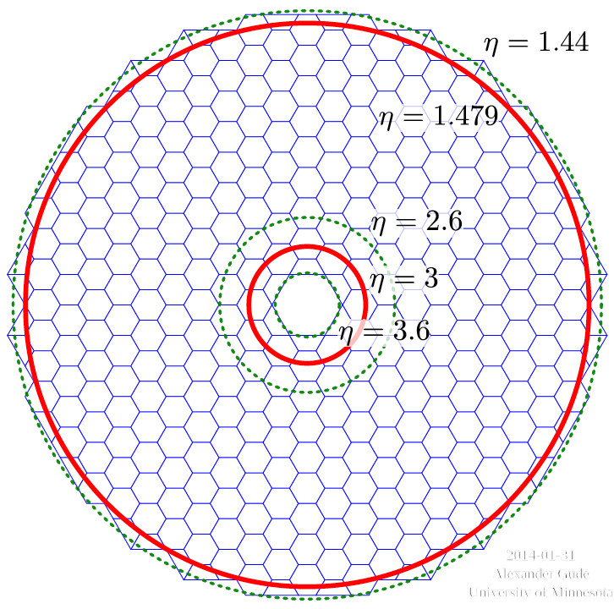
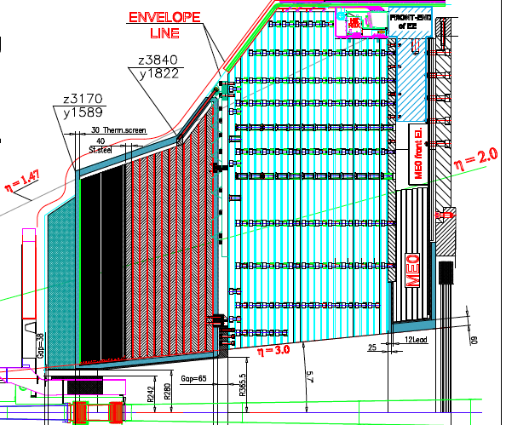
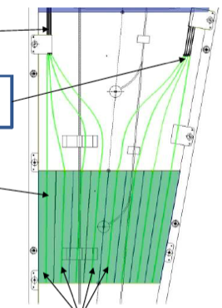
CMS Calorimeter upgrades
  High Granularity Si-Calorimeter inspired from CALICE with 5D shower measurement
      Electromagnetic 28 layers of Si-W/Cu - 25 X_{0,} 1λ_{i}
      Front Hadronic 12 layers of Si/Brass - 3.5 λ_{i}
    Could also be candidate for FCC-hh (yet expensive)
Hexagonal sensors - 3 active thicknesses depending on radius 100/200/300 µm -
0.5 - 1 cm² pads for 100 - 200/300 µm
EE: 380 m² - 4.3 Mch - 13.9k modules
FG: 209 m² - 1.8 Mch - 7.6k modules
  Back Hadr. 12 layers scintillator tiles/Brass - 5.5 λ_{i}
      Finger concept reduce light path to WLS
      R&D in plastic scintillators (5-10 Mrad), complex depend on material, environment, rates
      SiPM - would benefit from higher rad. tol. an quantum efficiency)

Slide 22
Front End electronics ASIC R&D
HL-LHC:
Chip complexity/design increased - benefit from deep-submicron technologies for lower pixel sizes, lower power consumption limited by radiation tolerance. - eg TSMC 65 nm technology more sensitive than 130 nm, needs specific design rules for analog functions and may only sustain 500 MRads (half HL-LHC innermost pixel layer)
ATLAS/CMS Pixel ASIC TSMC 65 nm
Smaller Pixel size
Larger chips (≳ 2 x 2 cm²)
Hit rates up ≃ 2-3 GHz/cm²
Rad. Tol. up to 1 Grad, 10¹⁶ n/cm²
High trigger rate and latency up to 1 MHz and ≳ 10 µs
Low power budget ≲ 1 W/cm²
Low noise ≃ 1000 e⁻
CMS HGCal FE ASIC TSMC 130 nm
Shaping ≃ 15 ns - noise ≃ 2000 e⁻ (after 3000 fb⁻¹)
Low power ≲ 10 mW/ch
Dynamic range 10 pC - 10 bit ADC ≤ 100 fC and Time over Threshold (ToT) ≥ 80 fC
Channel calibration better than 1%
ToT time resolution ≲ 50 ps
pp future colliders:
Radiation tolerance is a complex issue - deeper sub-micron technologies may not work? (and need long lead-time to learn and characterize) - 3D integration to separate analog and digital functions may help?

Slide 23
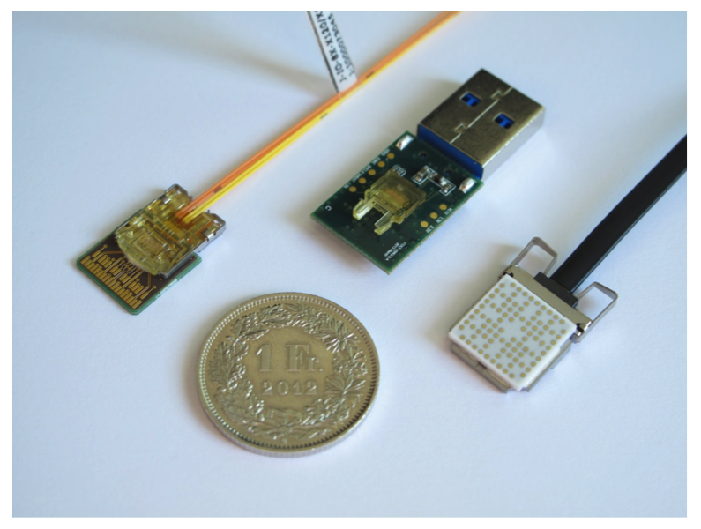
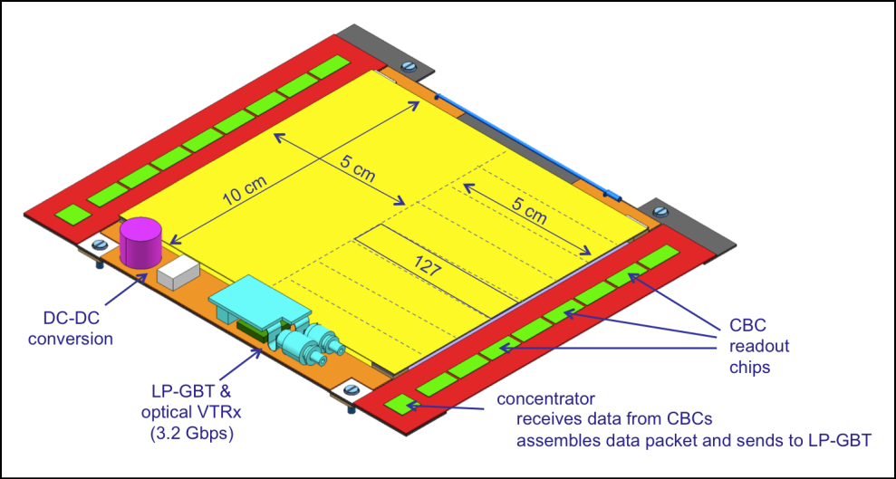
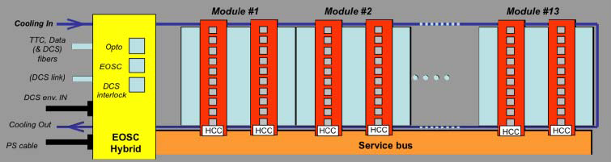
Front End Data transmission R&D trends
HL-LHC:
GigBitTranciever (GBT) & Versatile Link
R&D on low power GBT (≃ 0.5 W) in 65 nm TSMC with 10 Gb/s data transmission
Still limiting factor in tracker readout for trigger purpose - size is also important
Rad. tol. of Versatile Link insufficient for inner radii (1st pixel layer, CMS HGC)
  Need light high BW electrical link before OL transfer (twinax cables…)
CMS module
ATLAS stave
pp future colliders:
Increased bandwidth is highly desirable for trigger with outer trackers, pixels, HGC (full pixel readout at FCC max lumi. not possible would need 1000 TB/s (40 PB/s evt builder)
  Silicon photonics (laser, wave guide, modulator, electronics grown on same Silicon )
  Wireless transmission
  Needs to be radiation tolerant

Slide 24
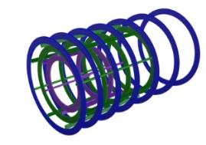
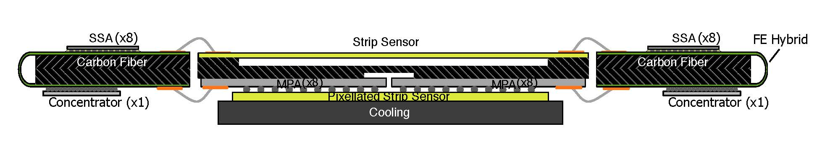
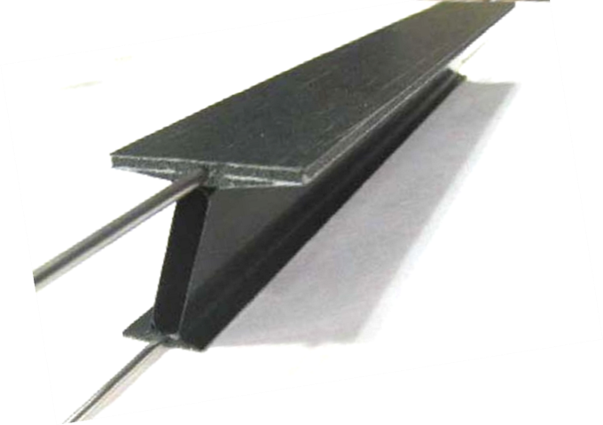
Cooling and Mechanics R&D trends
Present:
Two-Phase CO₂ cooling ≃ 50 kW and ≃ -35∘ plants
  Low-T operation crucial to mitigate radiation damage - low mass material needed
Light mechanics with high conductive CF polymer skins and thermal foam core…
  Low-weight crucial for multiple scattering, interactions & photon conversions (ALICE ITS (MAPs) is ≲ 1% X0 per layer) (also needs serial powering to minimize cabling)
ATLAS
pixel CF plate, foam, Ti pipes and barrel CF mechanics
CMS PS-module AlCF frame
pp and ee future colliders:
Cooling
  Air-cooling (for low power ILC)- Micro-channel embedded in sensors (LHCb VELO) for pp colliders?
New materials, glues, and assembly technics
  CFRPs adhesive bonding, new thermal foams, phase change adhesives - 3D printing

Slide 25
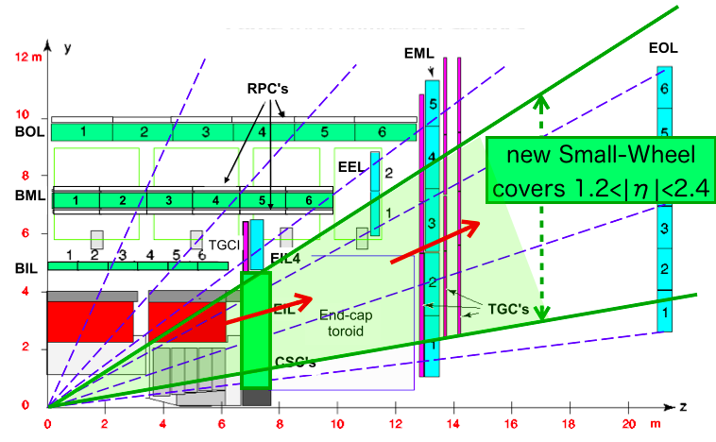
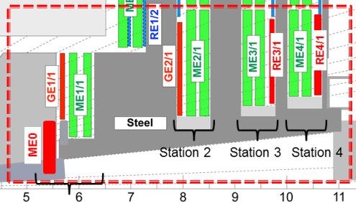
ATLAS and CMS Muon upgrades
Muon systems are expected to sustain 3000 fb⁻¹
  Increased granularity, higher rate capabilities exploiting MPGDs in endcaps, new readout electronics (for trigger), coverage extended for µ-tagging to η ≲ 4
  R&D
  Tests at GIF++ to confirm margins and select eco-friendly gas mixtures x 3 HL-LHC currents
  New multi-gap technics to improve timing precision (both GEMs and RPCs)
  GEM and Micro-Megas for ILD TPC readout 1x6 mm² pads (GEMs for ALICE TPC upgrade)
ATLAS
CMS
New Small Wheels - small Thin Gap Chambers strips 2 cm → 3.2 mm (3mm pitch), thinner gap and Micro-Megas (0.5 mm pitch)
Monitoring Drift Tubes - reduced diameter 30 mm & 200 Hz/cm² → 15 mm & 2 kHz/cm²
Triple GEM - 140 µm pitch, single mask and new assembly technique
iRPC’s - few kHz/cm² low-ρ Bakelite/Glass - multi-gap - thinner electrodes - higher gain FE - time resolution ≲ 100 ps

Slide 26
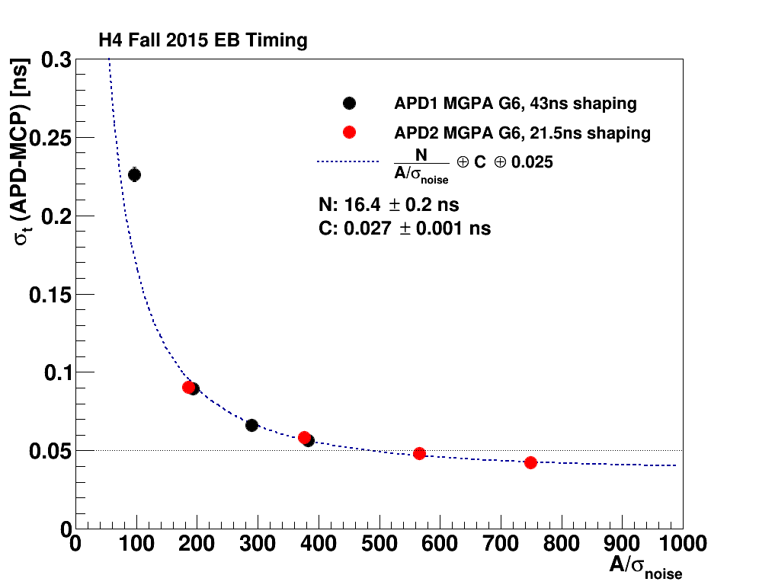
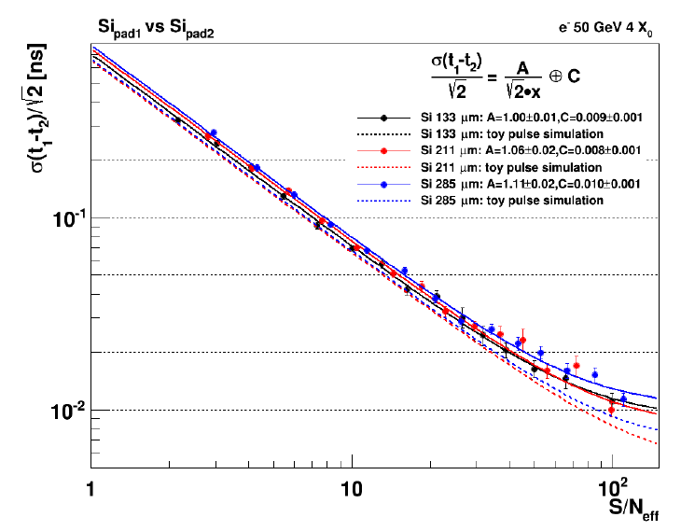
Precise timing devices R&D trends
  HL-LHC:
  ATLAS investigate Si/W calorimeter with Low Gain Avalanche Diodes (LGAD)
  CMS improves barrel ECAL FE, Si-HGC intrinsic precise timing - Investigate MIP timing layer
CMS Crystals+ APDs preliminary
CMS HGC Si-pad preliminary
≳ 50 ps for ≳ 25 GeV elec
≳ 30 ps at S/N ≳ 20
50 GeV elec.
HL-LHC and pp future colliders:
Radiation tolerant technology with ≃ 10 ps precision
Crystals (LYSO…) + SiPMs appears feasible for rad. tol and precision
Low Gain Avalanche Diodes (LGAD) - High Gain APDs, Micro-Megas with photo-cathods, MCP-PMT (w-cerenkov radiator or sec. emission) rad. tol. limited, final precision still to be demonstrated
FE/TDC and large clock distribution with precision and stability ≃ 10 ps

Slide 27
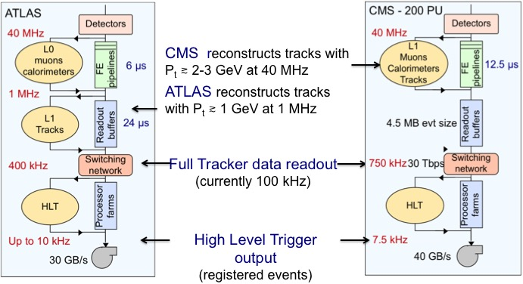
ATLAS and CMS Trigger upgrades
Backend electronics - follow COTs progress in FPGA, high bandwidth links, and ATCA
Custom ASIC developments - Associative Memories (track trigger pattern recognition) interest in 3D integration with FPGA (event cleaning and parameter fit)
Computing - follow commercial progress, slower by O(10) compared to increase in CPU needs - R&D see back-up (ideal detectors would select event based on full reco.)

Slide 28
Conclusion
HL-LHC:
  Baseline technologies for HL-LHC detectors are identified/demonstrated, several innovations compared to current detectors - large scale and harsh environment operation experience will be useful for future experiments
  R&D now focused on finalizing specifications and prototyping/engineering - 2 to 4 years effort by start of production - little room for new technologies (but opportunity for test)
FCC-hh:
  Large scale detectors - likely need an order of magnitude in granularity and radiation tolerance to fully benefit from accelerator luminosity potential - major R&D effort needed, technology choices could depend on η-r to optimize performance versus radiation tolerance and cost (also needs large effort of simulation studies)
ILC-CLIC-FCC-ee:
  Detectors require high granularity and highest possible resolution - several R&D beneficial to HL-LHC and FCC-hh (although rad. tol. is not an issue)

Slide 29
Additional information

Slide 30
HL-LHC ATLAS and CMS Online/Offline/Computing R&D
CPU need for online/offline reconstruction and analyses is expected to be roughly 30/80 times larger than for Run 2 at 140 PU
→ Anticipating x 8 gain at constant resources (25%/year improvement) another factor of ≃ 4/10 gain (online/offline) would be needed at 140 PU
R&D focuses on:
    Low power ARM processors, high performance GPU systems…
    Develop multi-threaded code - data oriented for memory usage
    More broadly distributed resources to access opportunistic computing
      Develop portable kernels of reconstruction and simulation code
      Use cloud provisioning tools
    More efficient use of storage and data distribution
      Develop dynamic data placement to use remote services through Content Delivery Network techniques

Slide 31
ALICE upgrades in LS2

Slide 32
LHCb upgrades in LS2

Slide 33
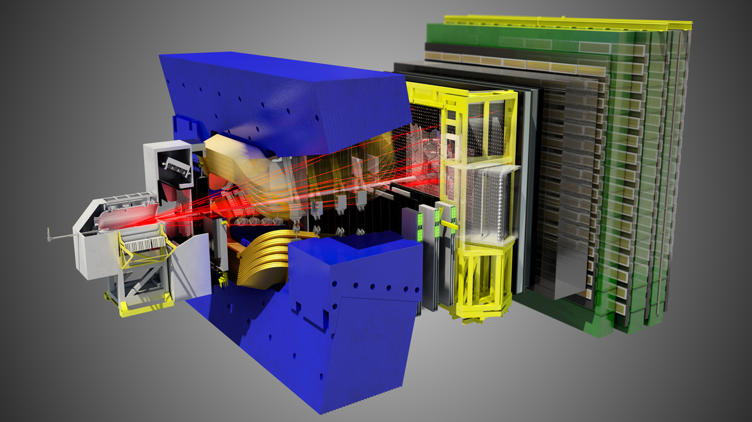
LHCb will upgrade already in LS2 and collect 50 fb-1 at 2 x 10³³ cm-² s-¹ in runs 3 and 4
Software trigger operating at 40 MHz for 20 kHz of p-p events registered
→ Trigger/DAQ throughput at 4 TB/s (≃ ATLAS/CMS at HL-LHC)
New electronics for all detectors and
other major innovations:
New Vertex Locator with pixels at 5.1 mm from beam - 55 x 55 µm² pixels - fluence of 8 x 10¹⁵ n_{eq}/cm² - 2 Tbit/s data rate - light mechanics with micro-channels cooling
Tracking with scintillating fibers (10000 km) and cooled SiPMs (-40∘)

Slide 34
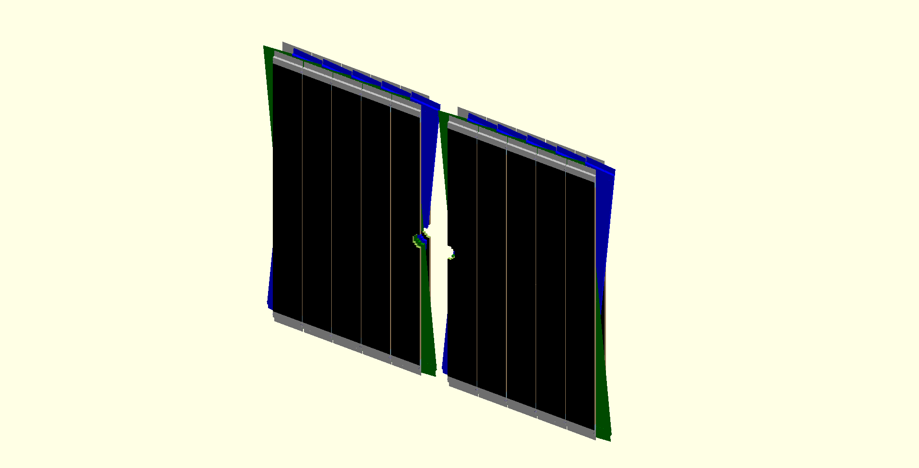

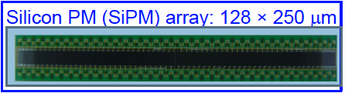
LHCb Scintillating Fiber Tracker R&D
3 stations, each 2.5% X/X0 - 4 plans (X-U-V-X) with ± 5∘ stereo angle - 50-75 µm resolution
3 M fibers Φ 250 µm x 2.5 m (10 000 km)
→ Development for 3 Mrad in inner region
→ High precision assembly of fiber mats
Readout with 128 SiPM array 250 µm pitch
→ -40∘C cooling to sustain 1.2·10¹² neq. /cm2
→ Work to improve Photo-Detection Efficiency
2x 2.5 m
2x 3m

Slide 35
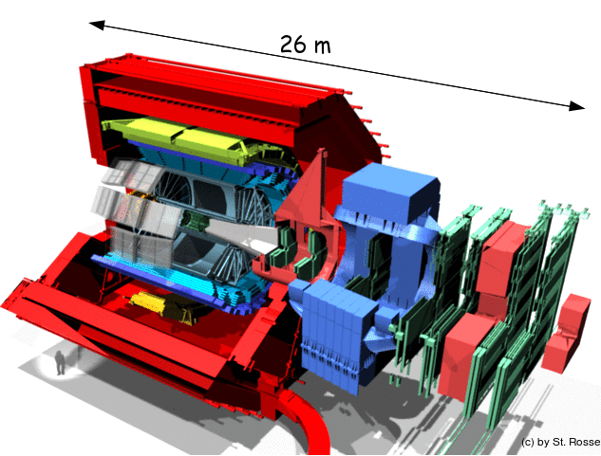
ALICE will upgrade already in LS2 to integrate ∼ 10 nb⁻¹ at 6 x 10²⁷ cm⁻²s⁻¹ in runs 3 and 4
Register all Pb-Pb collisions ≃ 50 kHz → Fast online calibration and reconstruction with FPGAs and GPUs for data compression, from
1 TBps to 50 GBps storage (storage ≃ ATLAS/CMS at HL-LHC)
New electronics for all detectors and
other major innovations:
New Internal Tracker System using Monolithic Active Pixels - 12.5 Gpix. 30 x 30 µm² - ultra-light mechanics
Use Micro-Pattern Gas Detectors for TPC readout (GEM and/or Micro-Megas)
Trigger timing ≃ 20 ps resolution quartz Cerenkov with MCP-PMT

Slide 36
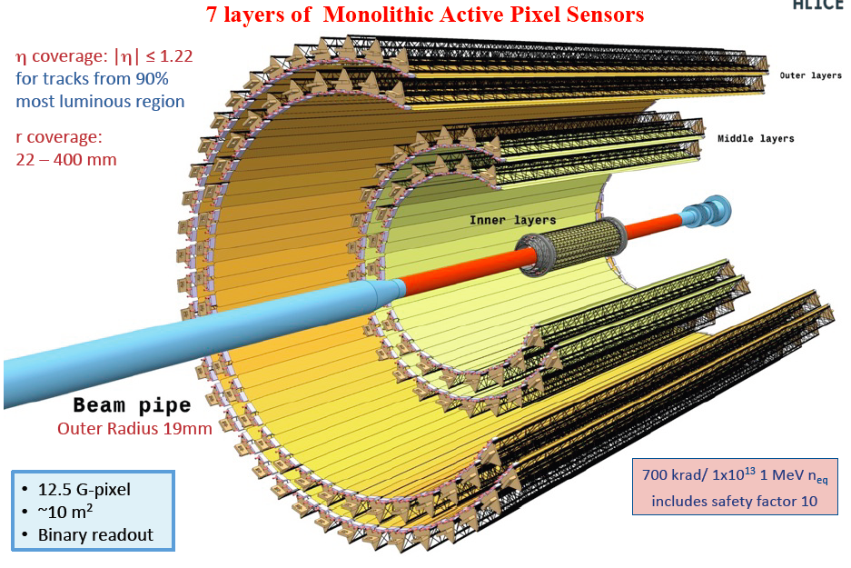
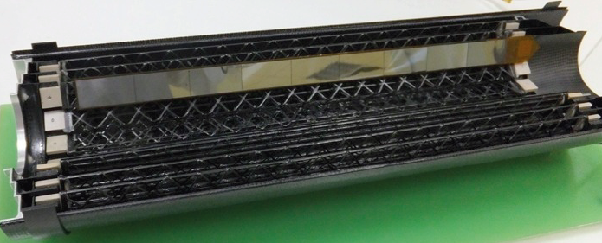
ALICE Inner Tracker System R&D
Ultra light system to improve IP resolution by a factor ≃ 3
7 layers of Monolithic Active Pixels
≃ 10m² with 12.5 Gpix
  3 inner layer each 0.3% X/X0 from 20 to 40 mm
  4 outer layers of 1% X/X0 up to 400 mm
MAPs Technology
Tower Jazz Technology (0.18 μm)
Thin sensors ≃ 50 µm
Pixels ≃ 30 x 30 µm²
Radiation tolerance 10¹³ neq/cm²
Binary readout

