Slide 1
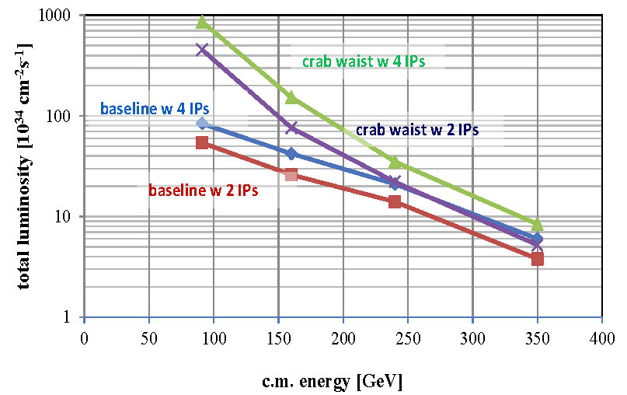

luminosity vs c.m. energy
analytical parameters confirmed by simulation
Z
WW
HZ
$$t\overline{t}$$
beam-beam simulations by K. Ohmi (tunes not optimized)

Slide 2
parameter | FCC-ee crab waist (4 IPs)
 | Z | W | H | t
E_{beam} [GeV] | 45 | 80 | 120 | 175
current [mA] | 1450 | 152 | 30 | 6.6
P_{SR,tot} [MW] | 100 | 100 | 100 | 100
no. bunches | 59581 | 3143 | 625 | 68
N_{b} [10¹¹] | 0.5 | 1.0 | 1.0 | 2.0
ε_{x} [nm] | 0.13 | 0.42 | 0.94 | 2
ε_{y} [pm] | 1.0 | 1.0 | 1.0 | 2
β∗_{x} [m] | 0.5 | 0.5 | 0.5 | 0.5
β∗_{y} [mm] | 1 | 1 | 1 | 1
σ∗_{y} [nm] | 32 | 29 | 31 | 45
σ∗_{x} [μm] | 8 | 14 | 22 | 31

Slide 3
parameter | FCC-ee crab waist (4 IPs)
 | Z | W | H | t
RF frequency [MHz] | 400 | 400 | 400 | 400
RF voltage [GV] | 0.3 | 1.0 | 3.6 | 11
circumference [km] | 100 | 100 | 100 | 100
momentum compaction [10⁻⁵] | 0.5 | 0.5 | 0.5 | 0.5
synchrotron tune | 0.030 | 0.035 | 0.053 | 0.070
σ_{z,SR} [mm] | 0.97 | 2.08 | 2.08 | 2.31
σ_{z,tot} [mm] (w beamstr.) | 3.24 | 3.49 | 2.58 | 2.80
σ_{δ,SR} [%] | 0.037 | 0.092 | 0.139 | 0.202
σ_{δ,tot} [%] (w beamstr.) | 0.124 | 0.155 | 0.172 | 0.245
hourglass factor F_{hg} | 0.94 | 0.87 | 0.81 | 0.75
beam-beam par. ξ_{y}/IP (4 IPs) | 0.04,0.137 | 0.04,0.143 | .0124,.097 | 0.03,0.092
L/IP [10³⁴ cm⁻²s⁻¹] (4 Ips) | 215 | 38 | 8.7 | 2.1
τ_{beam} [min] (4 IPs) | 38 | 23 | 20 | 18

Slide 4
parameter | FCC-ee crab waist (2 IPs)
 | Z | W | H | t
E_{beam} [GeV] | 45 | 80 | 120 | 175
current [mA] | 1450 | 152 | 30 | 6.6
P_{SR,tot} [MW] | 100 | 100 | 100 | 100
no. bunches | 45154 | 2382 | 474 | 51
N_{b} [10¹¹] | 0.66 | 1.3 | 1.3 | 2.6
ε_{x} [nm] | 0.13 | 0.42 | 0.94 | 2
ε_{y} [pm] | 1.0 | 1.0 | 1.0 | 2
β∗_{x} [m] | 0.5 | 0.5 | 0.5 | 0.5
β∗_{y} [mm] | 1 | 1 | 1 | 1
σ∗_{y} [nm] | 32 | 29 | 31 | 45
σ∗_{x} [μm] | 8 | 14 | 22 | 31

Slide 5
parameter | FCC-ee crab waist (2 IPs)
 | Z | W | H | t
RF frequency [MHz] | 400 | 400 | 400 | 400
RF voltage [GV] | 0.3 | 1.0 | 3.6 | 11
circumference [km] | 100 | 100 | 100 | 100
momentum compaction [10⁻⁵] | 0.5 | 0.5 | 0.5 | 0.5
synchrotron tune | 0.030 | 0.035 | 0.053 | 0.070
σ_{z,SR} [mm] | 0.97 | 2.08 | 2.08 | 2.31
σ_{z,tot} [mm] (w beamstr.) | 3.33 | 3.12 | 2.61 | 2.83
σ_{δ,SR} [%] | 0.037 | 0.092 | 0.139 | 0.202
σ_{δ,tot} [%] (w beamstr.) | 0.127 | 0.139 | 0.174 | 0.248
hourglass factor F_{hg} | 0.94 | 0.87 | 0.81 | 0.75
beam-beam par. ξ_{y}/IP (2 IPs) | 0.06,0.21 | 0.04,0.16 | 0.03,.124 | 0.04,0.118
L/IP [10³⁴ cm⁻²s⁻¹] (2 IPs) | 277 | 38 | 11.0 | 2.6
τ_{beam} [min] (2 IPs) | 60 | 41 | 31 | 28

Slide 6
Parameters
 | Z | Z | W | H | tt
Beam energy [GeV] | 45.6 |  | 80 | 120 | 175
Beam current [mA] | 1450 |  | 152 | 30 | 6.6
Bunches / beam | 30180 | 91500 | 5260 | 780 | 81
Bunch spacing [ns] | 7.5 | 2.5 | 50 | 400 | 4000
Bunch population [10¹¹] | 1.0 | 0.33 | 0.6 | 0.8 | 1.7
Horizontal emittance [nm] Vertical emittance [pm] | 0.2 1 | 0.09 1 | 0.26 1 | 0.61 1.2 | 1.3 2.5
Momentum comp. [10⁻⁵] | 0.7 | 0.7 | 0.7 | 0.7 | 0.7
Betatron function at IP Horizontal [m] Vertical [mm] | 0.5 1 | 1 2 | 1 2 | 1 2 | 1 2
Crossing angle at IP [mrad] | 30
Bunch length [mm] Synchrotron radiation Total | 0.9 6.7 | 1.6 3.8 | 2.0 3.1 | 2.0 2.4 | 2.1 2.5
Energy loss / turn [GeV] | 0.03 |  | 0.33 | 1.67 | 7.55
Total RF voltage [GV] | 0.4 | 0.2 | 0.8 | 3 | 10
RF frequency [MHz] | 400
Synchrotron tune Q_{s} | 0.036 | 0.025 | 0.037 | 0.056 | 0.075
Interaction region length L_{i} [mm] | 0.66 | 0.62 | 1.02 | 1.35 | 1.74
Hourglass factor H (L_{i}) | 0.92 | 0.98 | 0.95 | 0.92 | 0.88
Luminosity/IP for 2IPs [10³⁴ cm⁻²s⁻¹] | 207 | 89.4 | 19.1 | 5.1 | 1.3
Beam-beam parameter Horizontal Vertical | 0.025 0.16 | 0.05 0.13 | 0.07 0.16 | 0.08 0.14 | 0.08 0.12
Luminosity lifetime [min] | 94 | 185 | 90 | 67 | 57

