Slide 1
News and progress of turn-around time studies
Apollonio (TE-MPE), W. Bartmann (TE-ABT),
X. Buffat (BE-ABP), A. Niemi (BE-ICS),
D. Schulte (BE-ABP), M. Solfaroli (BE-OP),
L. S. Stoel (TE-ABT), R. Alemany (BE-OP)
END of SB
Turn-around time
START of SB
SB: Stable Beams

Slide 2
FCC-HH operational cycle (≈ LHC)
Energy
Setup
Adjust
Beam dump
Ramp down
Beam dump
Injection Probe
Injection Physics
Stable Beams
Prepare Ramp
Ramp-Squeeze
Turn-around time
t

Slide 3
INJECTION PHASE IN FCC
Opt | LINAC4 | PSB | PS | SPS | 100 km HEB | LHC | FCCinj | Tinj (min)
 | Flattop beam energy (GeV)
OPT1 | 0.160 | 2 | 26 | 450 |  | 3300 | 3300 | 36
 |  |  | 72 b | 9 PS->SPS = 648b |  | 2x4 SPS->LHC = 2592 b/ring | 4 LHC->FCC = 10368 b/ring
OPT2 | 0.160 | 2 | 26 | 450 | 3300 |  | 3300 | 29
 |  |  |  | 10 PS->SPS=720b | 15 SPS->HEB =10800 b |  | 1 HEB->FCC = 10800 b/ring
OPT3 | 0.160 | 2 | 45 | 1550 |  |  | 1550 | 34
 |  |  | 80 b | 8 PS->SPS=640 b |  |  | 2x17 SPS->FCC =10880 b/ring
Assumptions:
Bunch intensity 1e11 p+
SPS extraction kicker and HEB injection kicker flattops long enough to inject all SPS trains at once
HEB single ring; extraction in packets assuming no significant delay
SPS cycle time = 10.8 + n x PS cycle time for n PS batches (except for OPT3)
          Tinj = filling time + ramp up/ramp down + 10 s.
              No extra possible overheads.
Results by Linda Stoel and Florian Burkart

Slide 4
INJECTION PROBE & INJECTION PHYSICS BEAM IN LHC: what we do
Injection of pilot bunch per beam (~1e10 p+) (could be that reinjection of pilots is required)
Measure and correct: Q, Q’, C, orbit, phase error
Injection of 2x12 bunch train per beam:
  check transfer line and injection oscillations
  If not good ➔ transfer line steering (needs time in LHC)
  If good ➔ measure emittance
Injection of the rest of the physics beam
Once machine full ➔ PREPARE RAMP

Slide 5
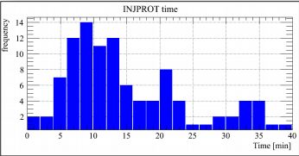
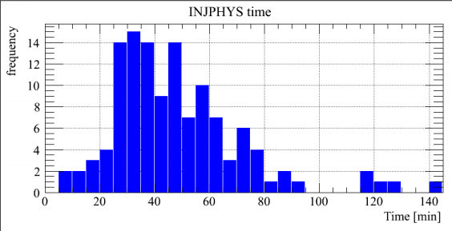
INJECTION PROBE & INJECTION PHYSICS BEAM in lhc: theory vs reality
The theoretical minimum injection time in LHC is defined by the number of injections required x SPS super cycle length:
      Average number of injections per fill = 22
      SPS SC length = 59 s (not optimized for a dedicated LHC filling!)
      Minimum injection time in LHC = 22 minutes
LHC 2015
LHC 2015
~ 25 min
~ 50 min
M. Solfaroli, EVIAN 2015

Slide 6
INJECTION PROBE & INJECTION PHYSICS BEAM in lhc: what can go wrong
Unavoidable
Beam Setup at injectors
Transfer Line steering
Software issues
Timing system latency
IQC latency
Beam Quality issues
BQM rejected 20% of the injection request
SPS SC
Beam measurements/
correction
IQC unreliability
Many clients
Different SC needed for physics fill
Hardware limitations
Cryogenics heat load
TDI.B2 vacuum
Beam dynamics
Beam instabilities
Losses & blow up
D. Jacquet EVIAN 2015
SC: Super Cycle
BQM: Beam Quality Monitor
BS: Beam Screen

Slide 7
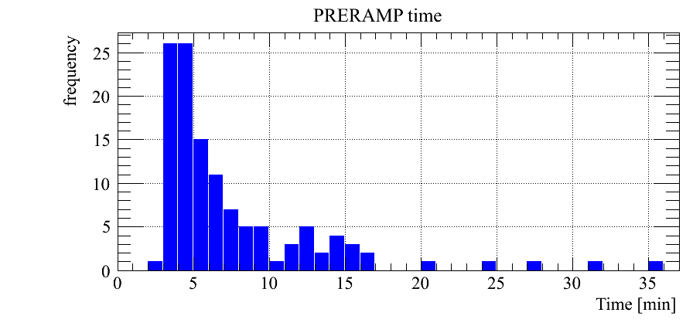
PREPARE RAMP
PREPARE RAMP IN LHC:
Injection protection collimators to parking
Settings incorporation in the ramp function
Load settings in RF, PC, collimators, transverse dampers
Feedbacks being prepared to follow the ramp
Energy
Setup
Adjust
Ramp down
Injection Probe
Injection Physics
Beam dump
Ramp-Squeeze
Stable Beams
Beam dump
t
Prepare Ramp
AVG = 5.0 min
BUT!
Cryo stabilization
M. Solfaroli, EVIAN 2015

Slide 8
RAMP-SQUEEZE
Energy
Setup
Adjust
RAMP-SQUEEZE IN LHC:
Function playing (no human intervention)
Q, Orbit and Transverse Feedbacks follow
Ramp down
Injection Probe
Injection Physics
Beam dump
Prepare Ramp
Stable Beams
Beam dump
Ramp-Squeeze
t
Ways of improving this number:
Optimized sectorization
Optimized inductance distribution
Assuming same equivalent LHC configuration
RAMP TIME:
  LHC energy factor from 450 GeV to 7 TeV is 15.5
  FCC-hh energy factor from 3.3 TeV to 50 TeV is 14
  Since both factors are equal ➔ same ramp time for FCC = 20 minutes
SQUEEZE TIME:
  LHC squeeze from 11 m to 0.8 m (IP1&5) = 12.5 minutes
  FCC-hh baseline squeeze from 5 m to 1.1 m ➔ half of the LHC squeeze ➔ 6 minutes
  Since combined with the ramp, remains in the shadow

Slide 9
RAMP-SQUEEZE
Energy
Setup
Adjust
RAMP-SQUEEZE IN LHC:
Function playing (no human intervention)
Q, Orbit and Transverse Feedbacks follow
Ramp down
Injection Probe
Injection Physics
Beam dump
Prepare Ramp
Stable Beams
Beam dump
Ramp-Squeeze
t
LHC up to 2015: RAMP, FLAT TOP, SQUEEZE ➔ from 2016: RAMP-SQUEEZE (11 m ➔ 3 m), FLATOP, SQUEEZE (3 m ➔ 0.x m)
FLAT TOP: several actions are performed sequentially by the operator; takes ~ 5 minutes
But with appropriate control system everything could be done automatically until the end of the squeeze, therefore RAMP-SQUEEZE mode would be enough
Mode | Time (min)
RAMP | 20
FLAT TOP | 5
SQUEEZE | 6
TOTAL | 20+5

Slide 10
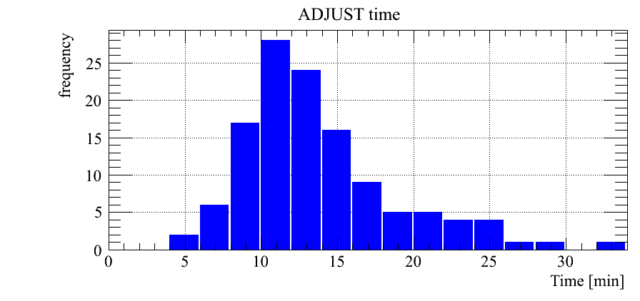
ADJUST
ADJUST IN LHC:
Settings incorporation
Functions playing (no human intervention)
Experiments luminosity optimization
Energy
Setup
Ramp down
Injection Probe
Injection Physics
Beam dump
Prepare Ramp
Stable Beams
Beam dump
Ramp-Squeeze
t
Mode | Time (min)
ADJUST | 10
Adjust
M. Solfaroli, EVIAN 2015

Slide 11
BEAM DUMP - RAMP DOWN
Energy
Setup
Adjust
BEAM DUMP – RAMP DOWN IN LHC:
Handshake for beam dump ~ 5 min (done in SB)
Beams are dumped and the ramp down starts in parallel to many other tasks to prepare the rest of the machine for the next injection
But the time is driven by the magnet circuits ramp down
Ramp down
Injection Probe
Injection Physics
Beam dump
Prepare Ramp
Stable Beams
Beam dump
Ramp-Squeeze
t
RAMP DOWN TIME:
  If all main power converters are four-quadrant ➔ ramp down = ramp = 20 min
  In LHC is not the case and the ramp down is ~ 40 min (2xramp)

Slide 12
FCC-hh THEORETICAL TURN-AROUND TIME
Mode | Time (min)
PRE-INJECTION TO INJECTION | 10
INJECTION | 36
PREPARE RAMP | 5
RAMP-SQUEEZE-FLAT TOP | 20+5
ADJUST | 10
RAMP DOWN | 20
TOTAL | 106 (1.8 hours)

Slide 13
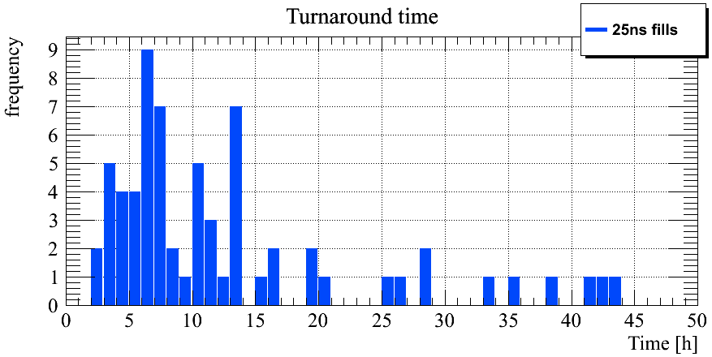
LHC TURN AROUND TIME IN 2015
LHC 2015
Distribution is a function of the AVAILABILITY/RELIABILITY
M. Solfaroli, EVIAN 2015
Only two fills made the theoretical minimum!

Slide 14
CONCLUSIONS
We propose a FCC-hh nominal cycle a la LHC
Theoretical times have been calculated to estimate the theoretical TURN-AROUND TIME: 1.8 hours
Real machines behave different, e.g. injection phase is more than beam production at the injectors and transfer into FCC
Next: The turn-around time NEEDS TO BE CORRECTED BY THE AVAILABILITY-RELIABILITY ESTIMATED FOR FCC-hh
Energy
Setup
Adjust
Ramp down
Injection Probe
Injection Physics
Beam dump
Prepare Ramp
Stable Beams
Beam dump
Ramp-Squeeze
t

Slide 15
BACK UP

Slide 16
INJECTION PROBE & INJECTION PHYSICS BEAM in lhc: what can go wrong
A very detailed break down of the reason for such a LONG INJECTION TIME IN LHC in 2015 was made by D. Jacquet at EVIAN 2015. Below a brief summary from her presentation:
SPS SC has many clients
Timing system latency ➔ 3-4 seconds before a new injection request can be processed
If filling one beam at the time, Injection Quality Check analysis latency up to 10 s
Many different LHC beams requested in 2015 ➔ 28 hours assigned to injector setting up
Pilot, indiv, 12 b and nominal trains requires use of two to three different SC within the same fill ➔ switching from one to the other needs few minutes
20 % of the nominal beam requests rejected by SPS BQM
Transfer line steering (though much efficiently done in 2015 than previous years) requires time
Unreliability of the IQC in 2015 slows down the injection, it can even screw it up
Some beam measurements in LHC are still manual ➔ slow
Cryogenics: injection of high intensity beams upsets cryogenics temperature stabilization in the BS; 24 hours down time assigned to this.
TDI.B2 vacuum issues; 3 hours down time, 5 dumps at injection, forced us to inject one beam at the time and limited the number of bunches per train
Beam instabilities and blow up at injection (e-cloud, others)
SC: Super Cycle
BQM: Beam Quality Monitor
BS: Beam Screen

