Slide 1
Status of FCC-hh extraction
W. Bartmann, D. Barna, F. Burkart, B. Goddard, A. Lechner, T. Kramer, L. Stoel, R. Ostojic
FCC-hh general design meeting, 3rd March 2016

Slide 2
Outline
Overall ESS layout
Extraction – collimation in separate ESS
Extraction followed by collimation
Energy deposition studies
Dilution system studies

Slide 3
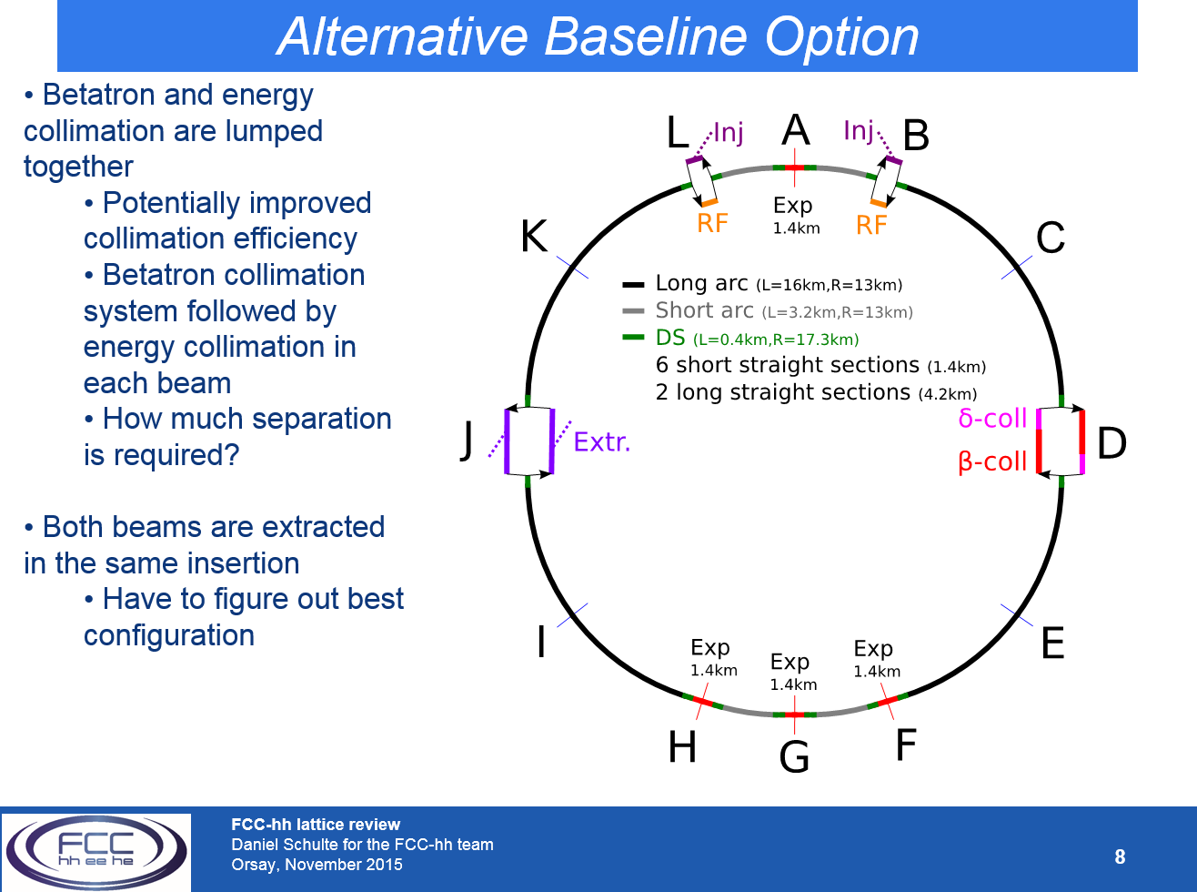
General layout
After lattice review in Orsay, Nov-2015 worked on ‘alternative baseline’ with extraction and collimation separated into the two ESS

Slide 4
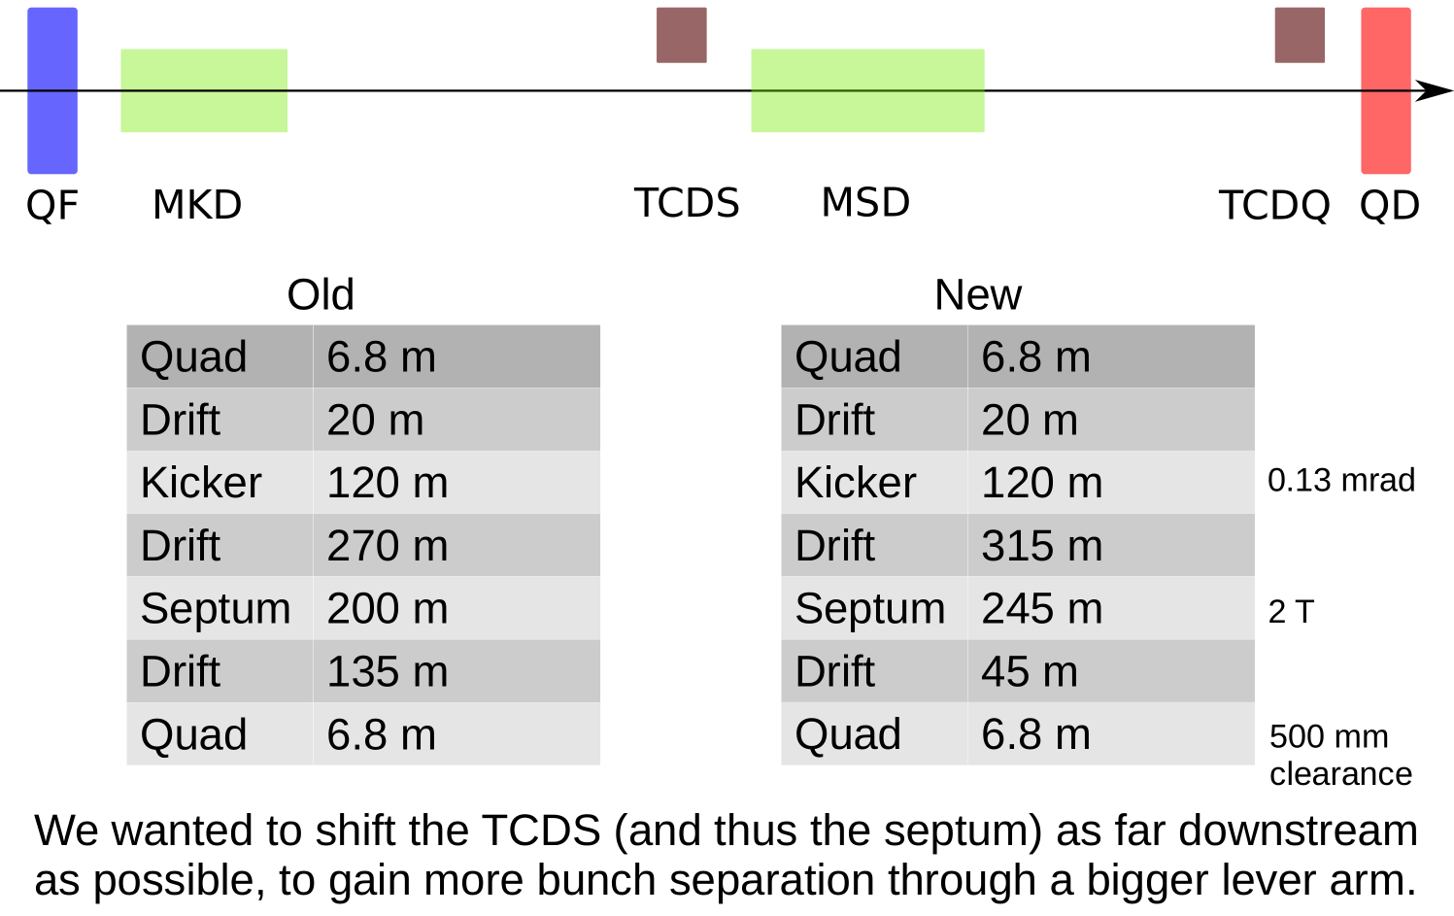
Both extractions in one ESS - layout
L. Stoel, FCC dump meeting, 20th Jan. 2016

Slide 5
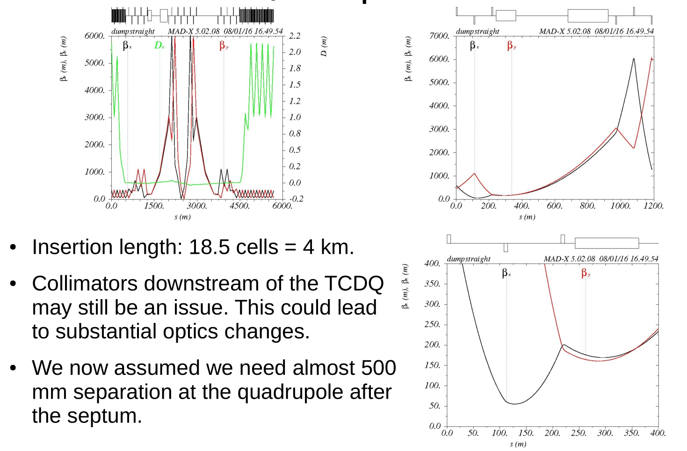
Both extractions in one ESS - optics

Slide 6
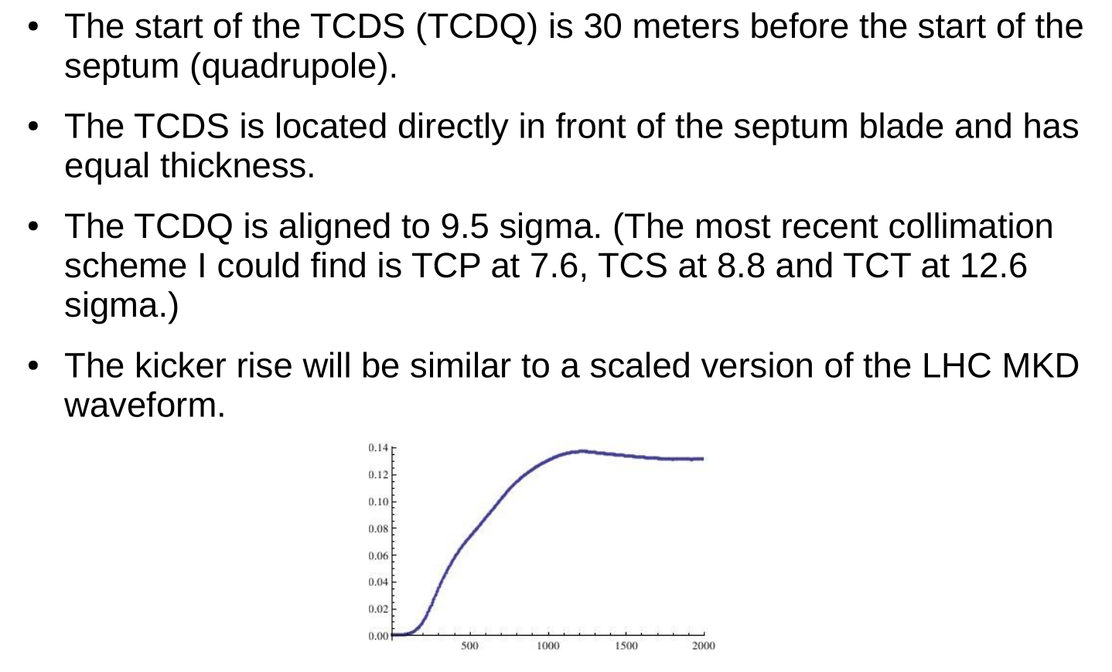
Extraction protection elements - assumptions

Slide 7
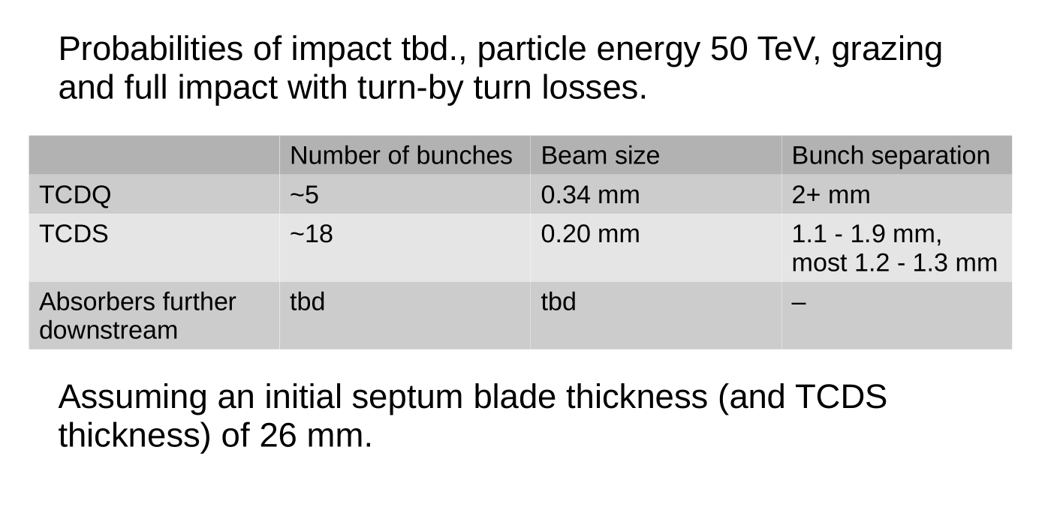
Extraction protection elements – input for FLUKA

Slide 8
Extraction system with downstream collimation
Can find a solution if one of the collimation systems is downstream of and on the same beam as extraction
Problem with present baseline: Momentum collimation showers impacting on extraction kicker electronics

Slide 9
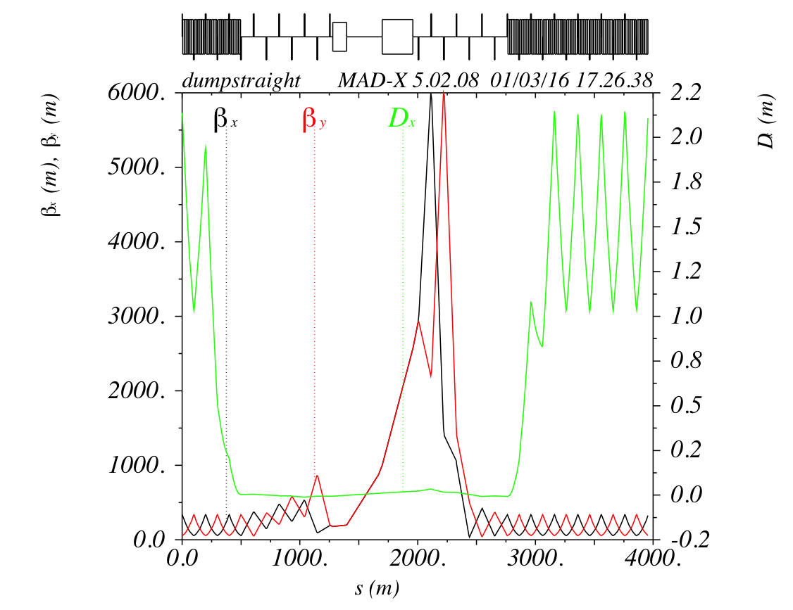
Extraction followed by collimation system - optics
F. Burkart, FCC dump meeting, 2nd March 2016
About 2 km including optics matching and extraction protection
Still issue with showers on dilution system – two options:
Bend into separate tunnel
Pass collimation and add dilutions system after arc separation

Slide 10
Bend into separate tunnel
Need about one arc cell bending
Dilution system and dump absorber in parallel to ESS
2.5 km extra tunnel
2.5 km dump line / extra tunnel
Kicker
Septum
10 mrad bend
Dilution
Absorber

Slide 11
Feed dump line through collimation area
Bigger tunnel required or separation in between
  Beam separation due to septum 8.5 m after 2.8 km
  2.5 km added tunnel for dilution and dump absorber as soon as arc starts
5.3 km dump line
2.5 km extra tunnel
Kicker
Septum
Dilution

Slide 12
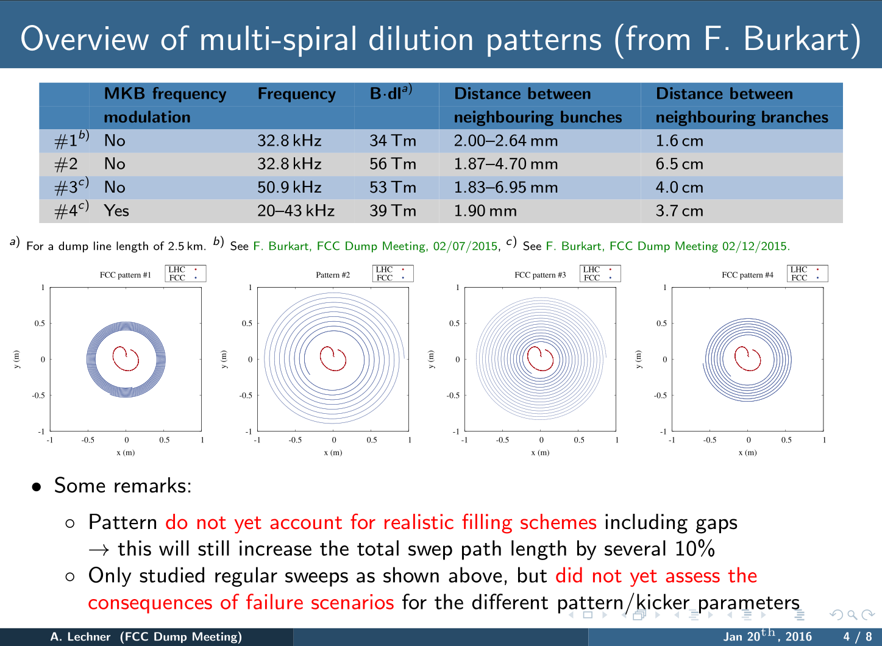
Energy deposition studies on the dump absorber
A. Lechner, FCC dump meeting, 20th Jan. 2016

Slide 13
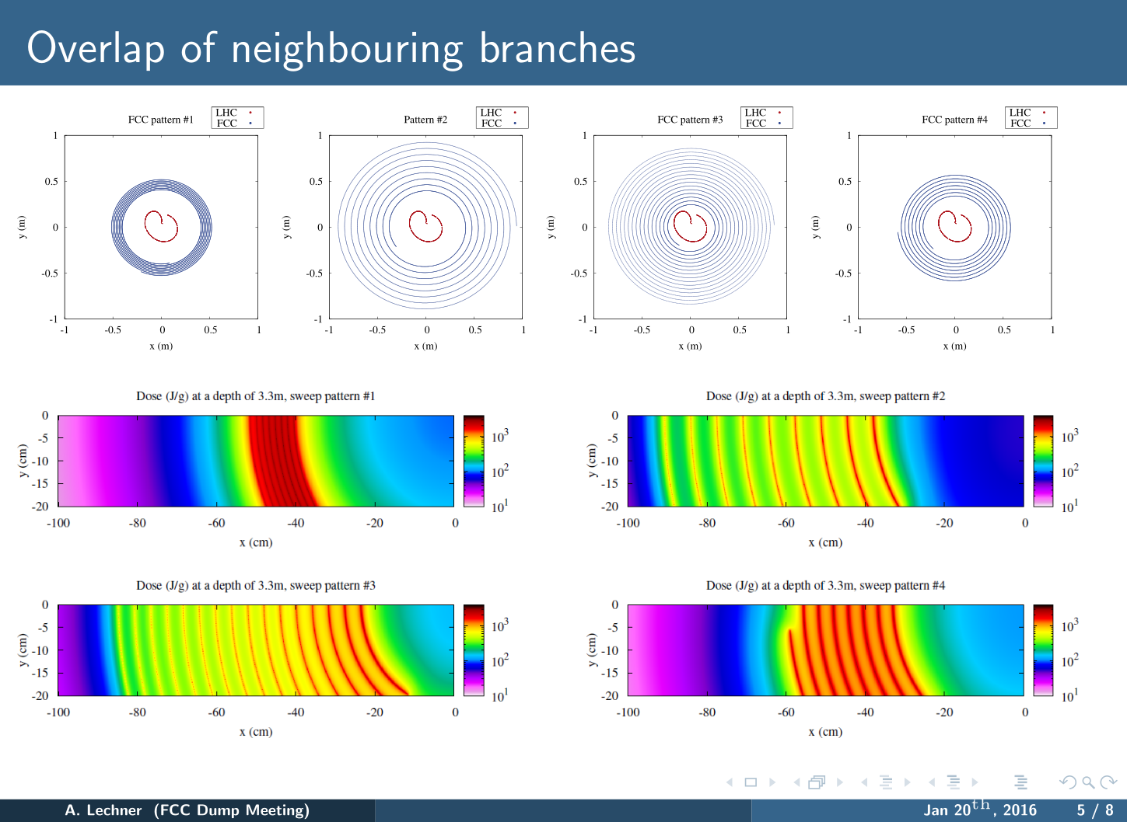

Slide 14
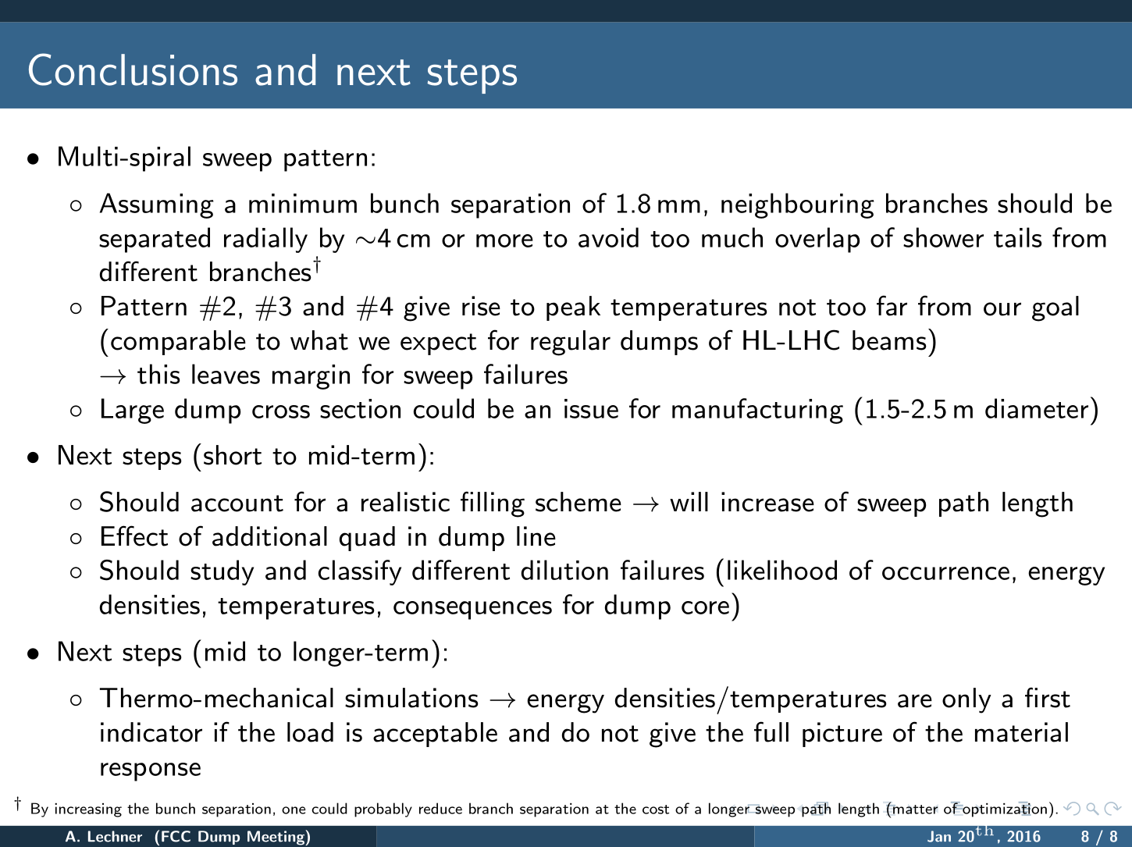

Slide 15
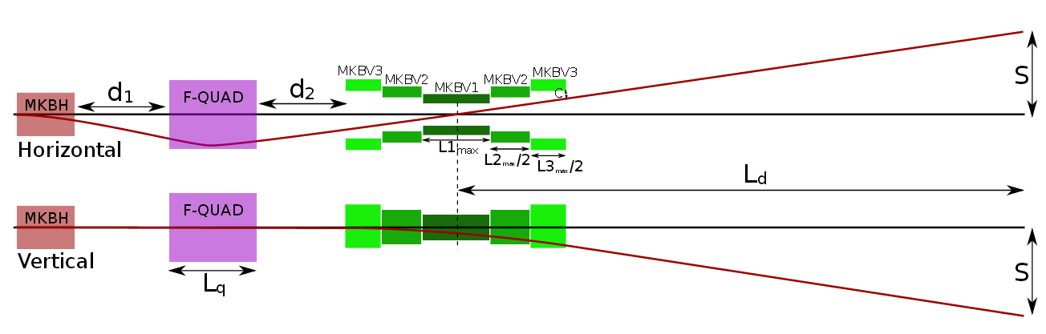
Dilution system
D. Barna, FCC dump meeting, 2nd March 2016
Initial studies showed that the dilution kicker system is highly demanding (B.dl, rise time, frequency, aperture)
Studied overfocussing quadrupole

Slide 16
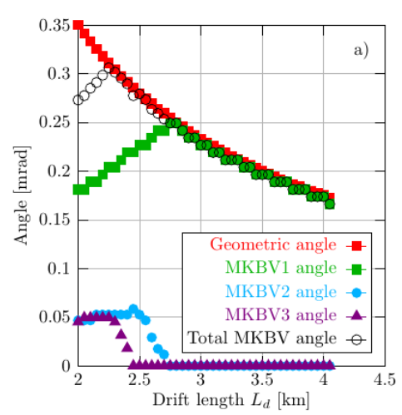
Dilution system
With three different kicker types 2.5 km dump line

Slide 17
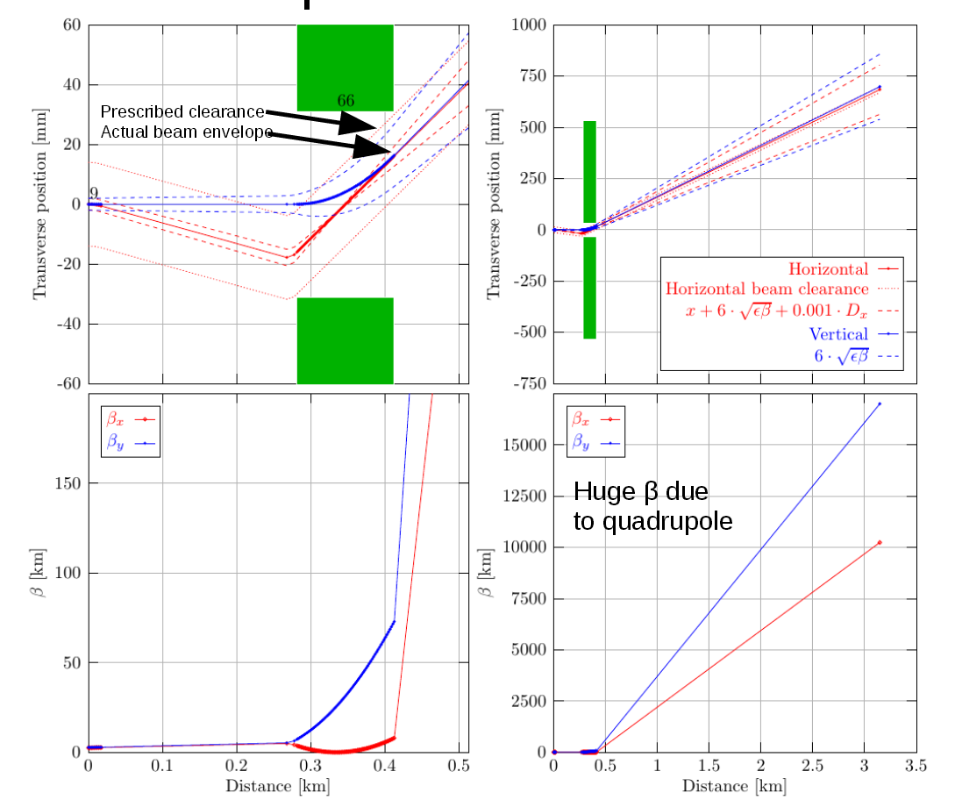
Dilution system
Beta functions at dump block become huge
→ to be iterated with FLUKA simulations – overlap vs peak

Slide 18
Conclusions
Present baseline layout does not work for extraction system → request change of this baseline
  Two extractions in one straight OK – preferred solution
  Collimation system on same beam downstream extraction OK
Single extraction system including optics matching and extraction protection of about 2 km
From this concept prepared table of beam parameters for extraction protection – under study by Anton Lechner
Initial dilution patterns were simulated by Anton → defined minimum bunch and spiral spacing
Rigorous analysis of dilution concept
  2.5 km dump line length
  Consider overfocussing quadrupole to support kickers – need to study failure scenarios
  Huge beta functions at dump to be studied by FLUKA – initial parameters might be iterated

