Slide 1
The detector read-out in ALICE during Run 3 and 4
Filippo Costa
CHEP 2016 Conference, San Francisco, October 8-14, 2016

Slide 2
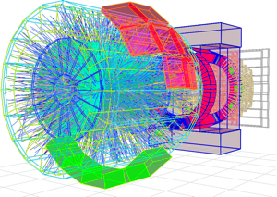
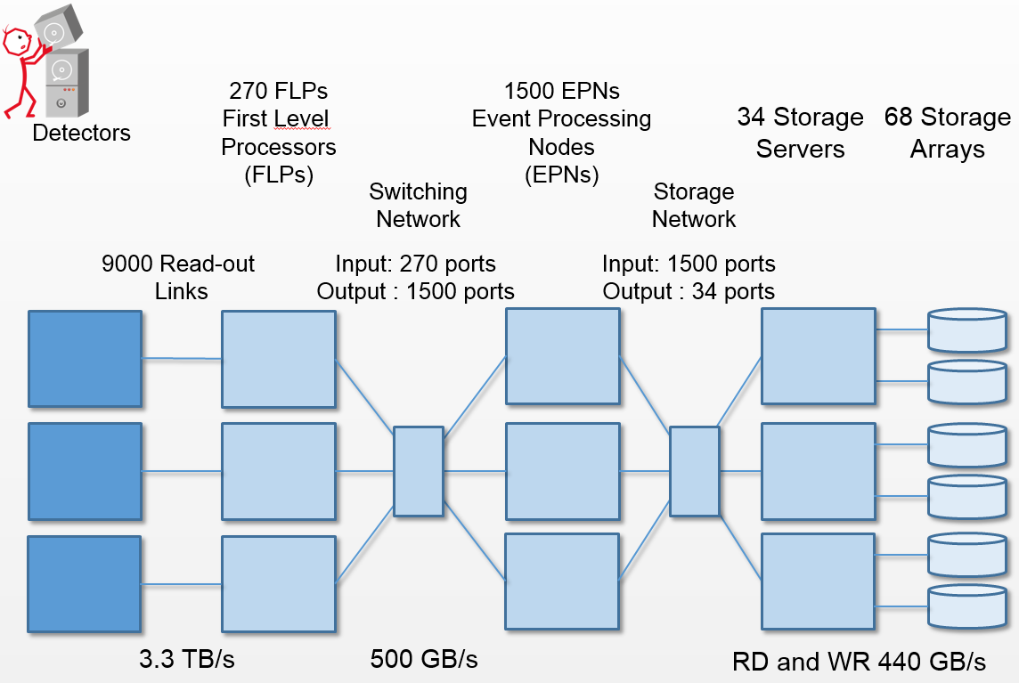
ALICE UPGRADE
O² computing farm:
~ 100 k CPU cores
~ 5000 GPUs and ~500 FPGAs
~ 60 PB of storage
The hardware facility
3.6 TByte/s into PC farm
Partial calibration and reconstruction online, replacing the original raw data with compressed data
O² (Online Offline) System
Acq rate:
Pb-Pb 50 kHz
pp and p-Pb up to 200 kHz
Complete change in detector readout
continuous
triggered
New DAQ - HLT - OFFLINE systems.
STORAGE
90 GB/s

Slide 3
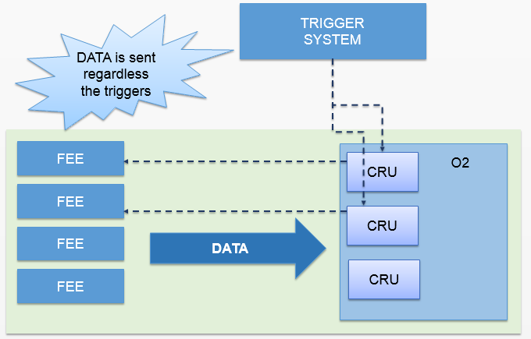
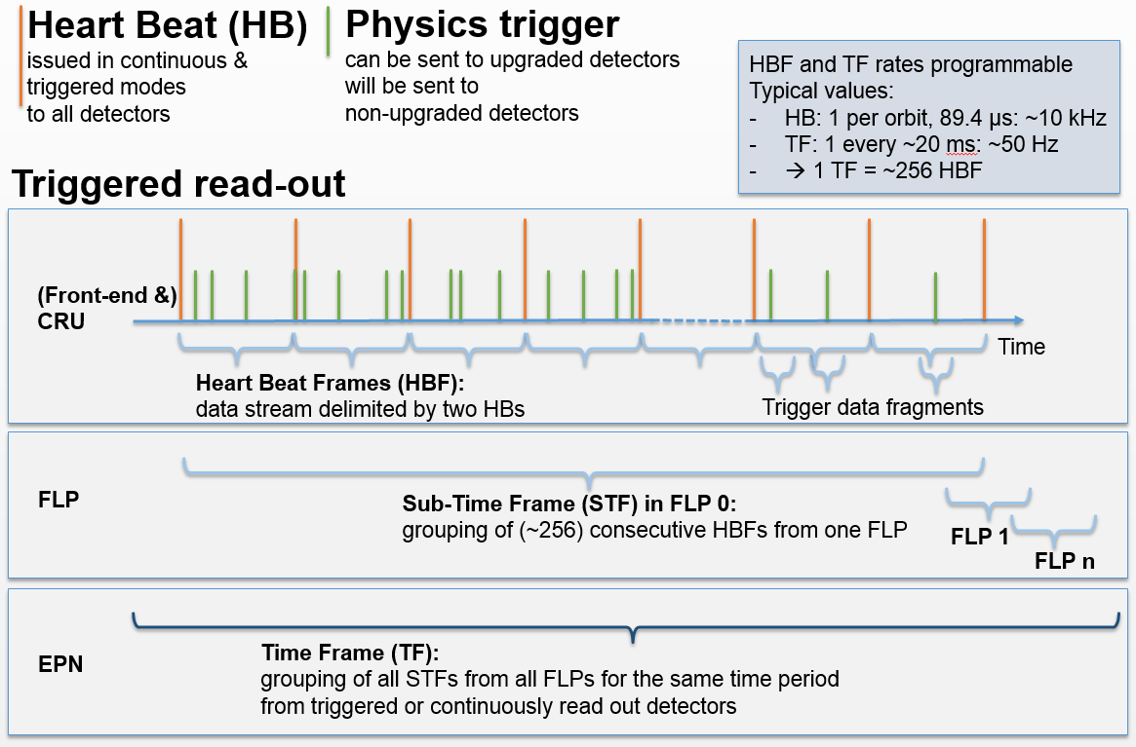
Detectors readout in continuous mode

