Slide 1
The detector read-out in ALICE during Run 3 and 4
Filippo Costa
ALICE O2/CRU for the ALICE collaboration
CHEP 2016 Conference, San Francisco, October 8-14, 2016

Slide 2
OUTLINE
1st PART: INTRODUCTION TO ALICE UPGRADE
  Motivation.
  Requirements.
2nd PART : THE DETECTOR READOUT
  Main difference from the current readout schema.
  System operation in triggered mode.
  System operation in continuous mode.
3rd PART : RESULT and CURRENT STATUS

Slide 3
INTRODUCTION TO
ALICE RUN3

Slide 4
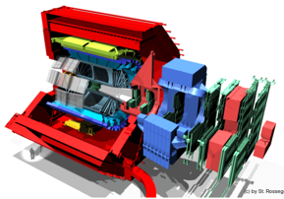
ALICE Upgrade Strategy
GOAL:
High precision measurements of rare probes at low p_{T} which cannot be selected with a trigger. Target a recorded Pb-Pb luminosity > 10 nb⁻¹ => 9x10¹⁰ events to gain a factor 100 in statistics over the Run1 + Run2 programme.
Significant improvements of vertexing and tracking capabilities
DETECTOR:
Read-out all Pb-Pb interactions at a maximum rate of 50kHz (i.e. L = 6x10²⁷ cm⁻¹s⁻¹) upon a minimum bias trigger
Read-out all pp and p-Pb interaction at a maximum rate of 200 kHz.
Perform online data reduction based on reconstruction of cluster and tracks
Improve vertexing and tracking at low p_{T} => New Inner Tracking System (ITS)
TPC continuous readout to keep up with 50 kHz interaction rate, to deal with event pile-up and avoid trigger generated dead time.

Slide 5
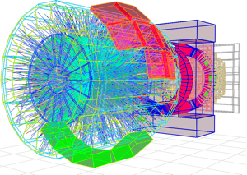
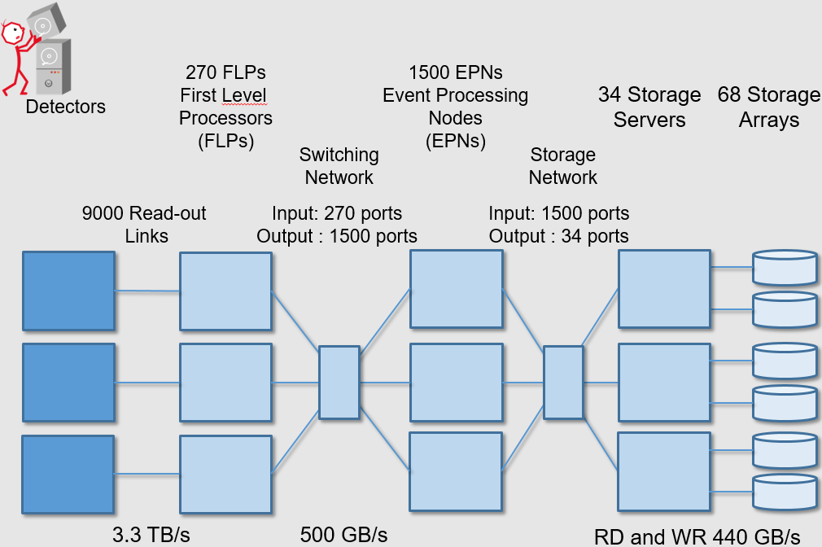
ALICE UPGRADE
O² computing farm:
~ 100 k CPU cores
~ 5000 GPUs and ~500 FPGAs
~ 60 PB of storage
3.6 TByte/s into PC farm
Partial calibration and reconstruction online, replacing the original raw data with compressed data
O² (Online Offline) System
Acq rate:
Pb-Pb 50 kHz
pp and p-Pb up to 200 kHz
Complete change in detector readout
continuous
triggered
New DAQ - HLT - OFFLINE systems.
STORAGE
90 GB/s

Slide 6
Main differences
between
RUN2 & RUN3

Slide 7
RUN2
TRIGGER
SYSTEM
Trigger connected to the FEE
Triggered readout mode
1 readout link, DDL (Detector Data Link)
FEE
CRORC
DAQ
FEE
DATA
CRORC
FEE
RORC
FEE

Slide 8
RUN3
TRIGGER
SYSTEM
Trigger connected to the FEE and CRU
Triggered and Continuous readout mode
2 readout link, DDL and GBT
Detector that receives trigger and clock from CRU
TPC
MCH
MID
MFT
TOF
FIT
ZDC
CRU:
CommonReadout
Unit
FEE
CRU
DAQ
FEE
CRU
FEE
CRORC
FEE
DATA

Slide 9
The detector readout
during RUN3

Slide 10
TRIGGERED MODE
TRIGGER
SYSTEM
BUSY
Upon reception of a trigger signal, each detectors respond and send the corresponding data.
BUSY
FEE
CRU
DAQ
FEE
CRU
FEE
Readout
card
FEE
DATA

Slide 11
CONTINUOS MODE
TRIGGER
SYSTEM
DATA is sent regardless the triggers
FEE
CRU
O2
FEE
CRU
DATA
FEE
CRU
FEE
Data are not delimited by physics trigger, but are composed by several data streams

Slide 12
Heart Beat (HB)
issued in continuous &
triggered modes
to all detectors
HBF and TF rates programmable
Typical values:
HB: 1 per orbit, 89.4 µs: ~10 kHz
TF: 1 every ~20 ms: ~50 Hz
→ 1 TF = ~256 HBF
Continuous read-out
(Front-end &)
CRU
Time
Heart Beat Frames (HBF):
data stream delimited by two HBs

Slide 13
Heart Beat (HB)
issued in continuous &
triggered modes
to all detectors
Physics trigger
can be sent to upgraded detectors
will be sent to
non-upgraded detectors
HBF and TF rates programmable
Typical values:
HB: 1 per orbit, 89.4 µs: ~10 kHz
TF: 1 every ~20 ms: ~50 Hz
→ 1 TF = ~256 HBF
Triggered read-out
(Front-end &)
CRU
Time
Heart Beat Frames (HBF):
data stream delimited by two HBs
Trigger data fragments

Slide 14
Heart Beat (HB)
issued in continuous &
triggered modes
to all detectors
Physics trigger
can be sent to upgraded detectors
will be sent to
non-upgraded detectors
HBF and TF rates programmable
Typical values:
HB: 1 per orbit, 89.4 µs: ~10 kHz
TF: 1 every ~20 ms: ~50 Hz
→ 1 TF = ~256 HBF
Triggered read-out
(Front-end &)
CRU
Time
Heart Beat Frames (HBF):
data stream delimited by two HBs
Trigger data fragments
FLP
Sub-Time Frame (STF) in FLP 0:
grouping of (~256) consecutive HBFs from one FLP
FLP 1
FLP n
EPN
Time Frame (TF):
grouping of all STFs from all FLPs for the same time period
from triggered or continuously read out detectors

Slide 15
Time Frames/Heart Beat Frames
FLP .. First Level Processor
EPN .. Event Processing Node
STF .. Sub Time Frame
TF .. Time Frame
HB .. Heart Beat Trigger
HBF .. Heart Beat Frame
HB header
HB header
Payload (if no hits empty)
Deleted HBF (no or partial data)
HB trailer
HB trailer
HB2
HB3
HB4
HB5
HB6
HB7
HB8
..
HB0
HB1
..
HB0
HB1
HB9
HB255
HB2
HB3
HB4
HB5
HB6
HB7
HB8
HB9
HB255
STF @ FLPn
STF @ FLP2
STF @ FLP1
STF @ FLP0
TF0 @ EPN
TF1 @ EPN

Slide 16
What happens if CRU buffers get full?
FLP .. First Level Processor
EPN .. Event Processing Node
STF .. Sub Time Frame
TF .. Time Frame
HB .. Heart Beat Trigger
HBF .. Heart Beat Frame
HB header
HB header
Payload (if no hits empty)
No or partial HBF data
HB trailer
HB trailer
..
HB2
HB3
HB4
HB5
HB6
HB7
HB8
..
HB0
HB1
HB2
HB3
HB4
HB5
HB6
HB7
HB8
HB9
HB255
HB0
HB1
HB9
HB255
STF @ FLPn
STF @ FLP2
STF @ FLP1
STF @ FLP0
TF0 @ EPN
TF1 @ EPN
The main goal is to collect one complete TF or at least one or more HBFs

Slide 17
What happens if CRU buffers get full?
FLP .. First Level Processor
EPN .. Event Processing Node
STF .. Sub Time Frame
TF .. Time Frame
HB .. Heart Beat Trigger
HBF .. Heart Beat Frame
HB header
HB header
Payload (if no hits empty)
No or partial HBF data
HB trailer
HB trailer
..
HB2
HB3
HB4
HB5
HB6
HB7
HB8
..
HB0
HB1
HB2
HB3
HB4
HB5
HB6
HB7
HB8
HB9
HB255
HB0
HB1
HB9
HB255
STF @ FLPn
STF @ FLP2
STF @ FLP1
STF @ FLP0
TF0 @ EPN
TF1 @ EPN

Slide 18
What happens if CRU buffers get full?
  CRU will autonomously abort the read-out of corresponding HBF
  Delete HBF data from buffer
  Send negative HB acknowledge to CTP
  Send negative acknowledge to FLP in the HB header/trailer pair
  Read-out continues
  Counter and state machine
  stay consistent
In nominal conditions occurrence assumed to be negligible

Slide 19
What happens if CRU buffers get full?
CTP
CTP FLP
HB Map
1 1 1 0 1
1 0 1 1 1
HB Map
1 1 1 0 1
1 0 1 1 1
6
HB Map
HBF/trigger acknowledge/
message
1
HB trigger/message
3b
FLP
CRU
HBF/Trigger
Transmitted ?
HBF Header
(Payload)
Trailer
Readout
Links
2
3a
4
Delete HBF from buffer
5
Delete HBF from
memory

Slide 20
Current status of
the development
&
RESULTS

Slide 21
Current status
Several detectors have a readout chain using GBT to test their FEE prototype. The readout modes are triggered and continuous
Detector | number of GBT | readout mode
TOF | 2 | triggered
ITS | 1 | triggered
FIT | 1 | triggered
MCH | 1 | triggered
MID | 1 | continuous
TPC | 2 | continuous

Slide 22
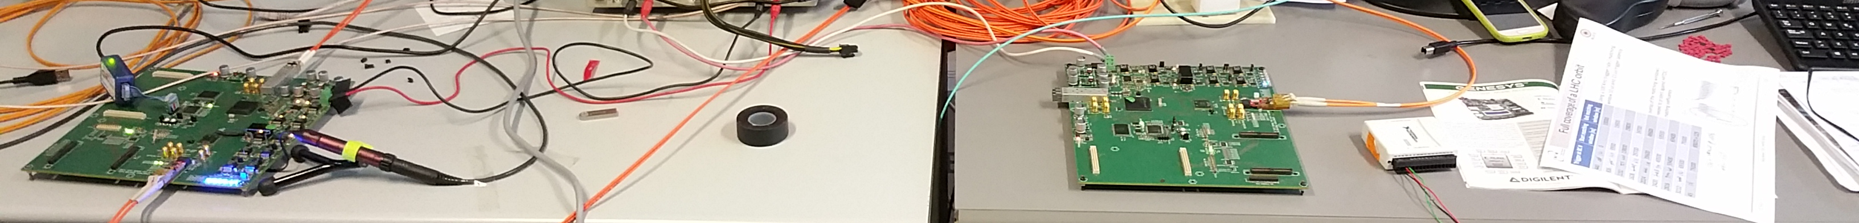
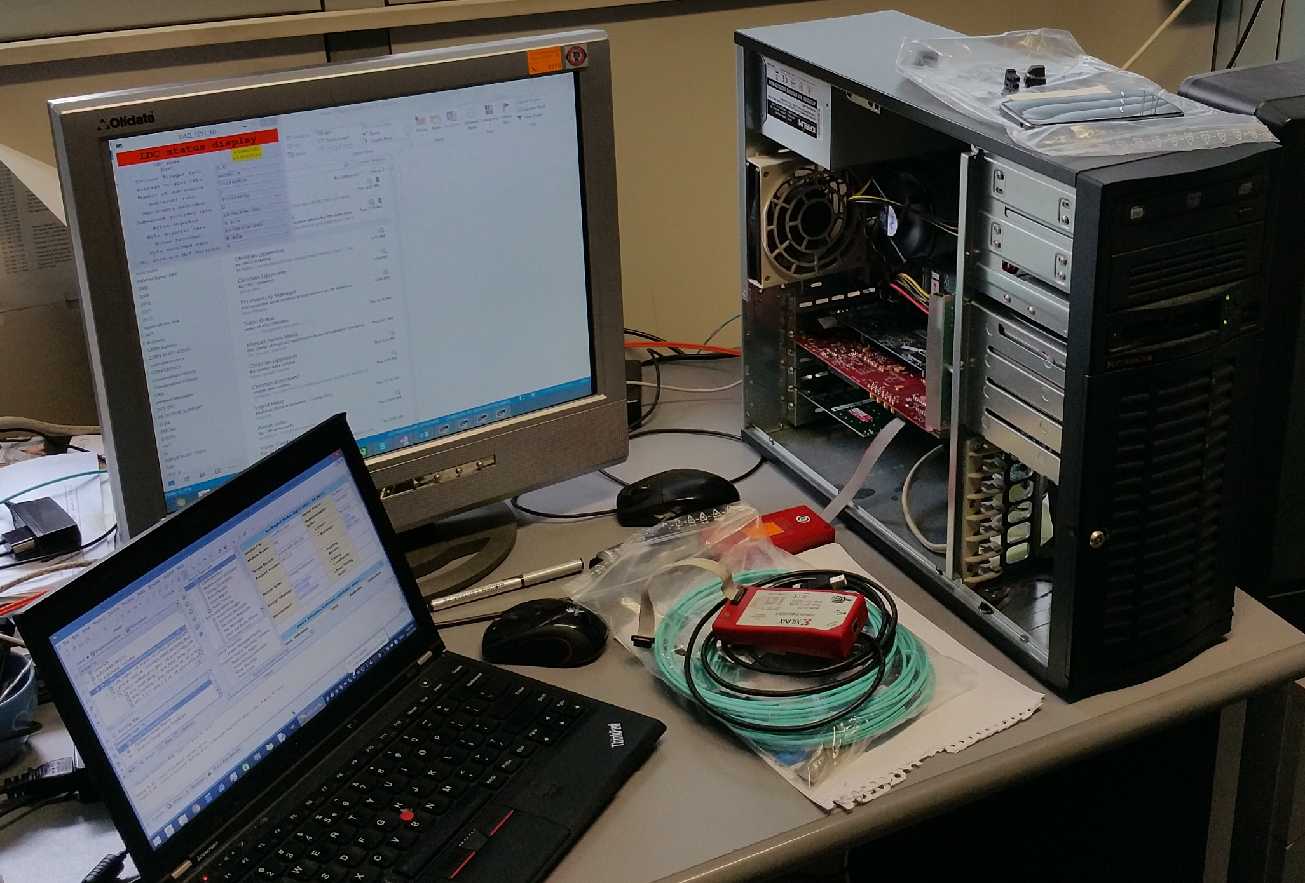
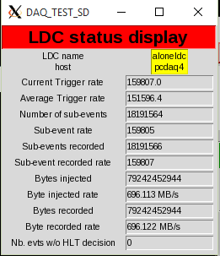
TOF setup
2 GBT links connected to the readout system
FEE # 1
FEE # 2
160 kHz
DAQ
700 MB/s

Slide 23
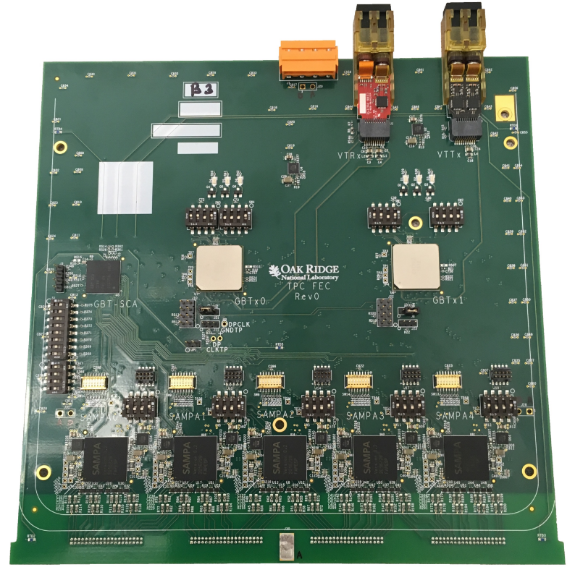
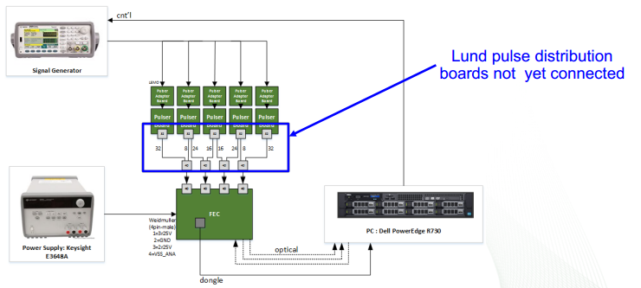
TPC setup
Readout system used to collect data in continuous mode and to configure the FEE electronics using the GBT protocol

Slide 24
QUESTIONS?
THANK YOU

Slide 25

Schedule
2012-2013
2014-2015
2016-2017
2018-2019
2020-2021
High-Level Design
R&D
Project organization
Design
R&D
Demonstrators
TDR
Products selection
Detailed design
R&D
Prototyping
Development
Products selection
Prototypes
Detailed design
R&D
Prototyping
Development
Products selection
Prototypes
Final components
Deployment
Commissioning
Development
Products selection
Final components
Deployment
Commissioning
Production
https://cds.cern.ch/record/2011297/files/ALICE-TDR-019.pdf

Slide 26
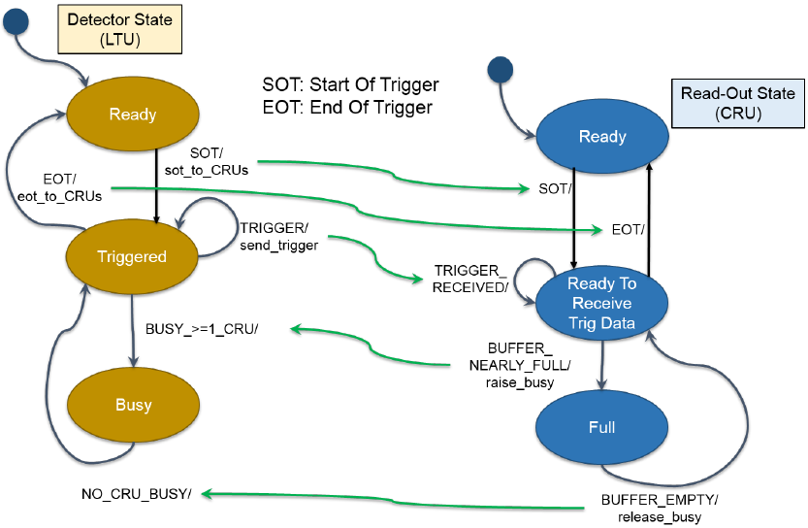
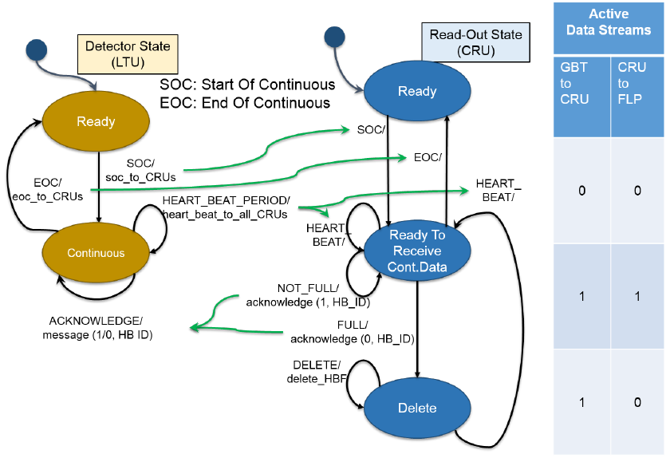
Busy, throttle schema

