Slide 1
HEP Track Finding with the Micron Automata Processor and Comparison with an FPGA-based Solution
Michael Wang, Gustavo Canelo, Christopher Green, Ted Liu, Ted Zmuda (presented by John Freeman for the authors)
Fermilab
22nd International Conference on Computing in High Energy and Nuclear Physics, San Francisco, California, October 10-14, 2016

Slide 2
Introduction
Outline of Talk
  Motivation for investigating the Micron Automata Processor (AP)
  What is the Automata Processor?
  Brief description of a proof-of-principle application to investigate the AP’s feasibility in HEP track recognition
  Comparison with CPU, single and multi-threaded
  Comparison with Content-Addressable-Memory based FPGA implementation
Motivation for Exploring the Micron AP
  Trend in HEP experiments, towards more complex event topologies and higher particle densities, makes fundamental task of pattern recognition in HEP more challenging
  Conventional CPU/GPU architectures becoming less effective as we enter post-Moore’s law era.
  Need to find other off-the-shelf solutions based on novel architectures tuned for high-speed search applications like those in the Internet search industry.
  Micron’s AP is a good candidate

Slide 3
What is the Micron Automata Processor?
Hardware realization of a Non-deterministic Finite Automata (NFA)
Interesting adaptation of conventional SDRAM architecture
8-bit input
generates the
“row address”
Routing matrix
Provides the
“column address”

Slide 4
From regular expressions to particle trajectories
An obvious application of the Automata
Processor is in performing high-speed searches
on input data streams for regular expression
matching or finding words in a dictionary.
r
t
However, the symbols need not be
limited to characters in a string.
For example, they could be replaced
by wire, strip, or pixel addresses in
a HEP tracking detector.
In this example, the input string “susy” is
matched to a dictionary entry in exactly 4
symbol cycles no matter how big the dictionary.
a
r
g
r
a
s
u
s
“
s
u
s
y
”
s
symbol A -
hit address 1
y
symbol B -
hit address 2
v
h
i
t
symbol C -
hit address 3
symbol D -
hit address 4

Slide 5
Basic operating principle of an automata track finder
Addresses of detector “hits” read out by layer:
15,17,23,25,31,32,35,36,41,45
Layer 1
Layer 2
Layer 3
Layer 4
{15}
{25}
{35}
{45}
L1
L2
L3
L4
R
The idea is to create a pattern bank containing every possible track pattern. Each pattern is represented by an
Automata network like the one showed above (with latch attributes enabled). Detector hits are fed into the AP
sequentially by layer and all hit combinations with matching patterns in the bank are found.

Slide 6
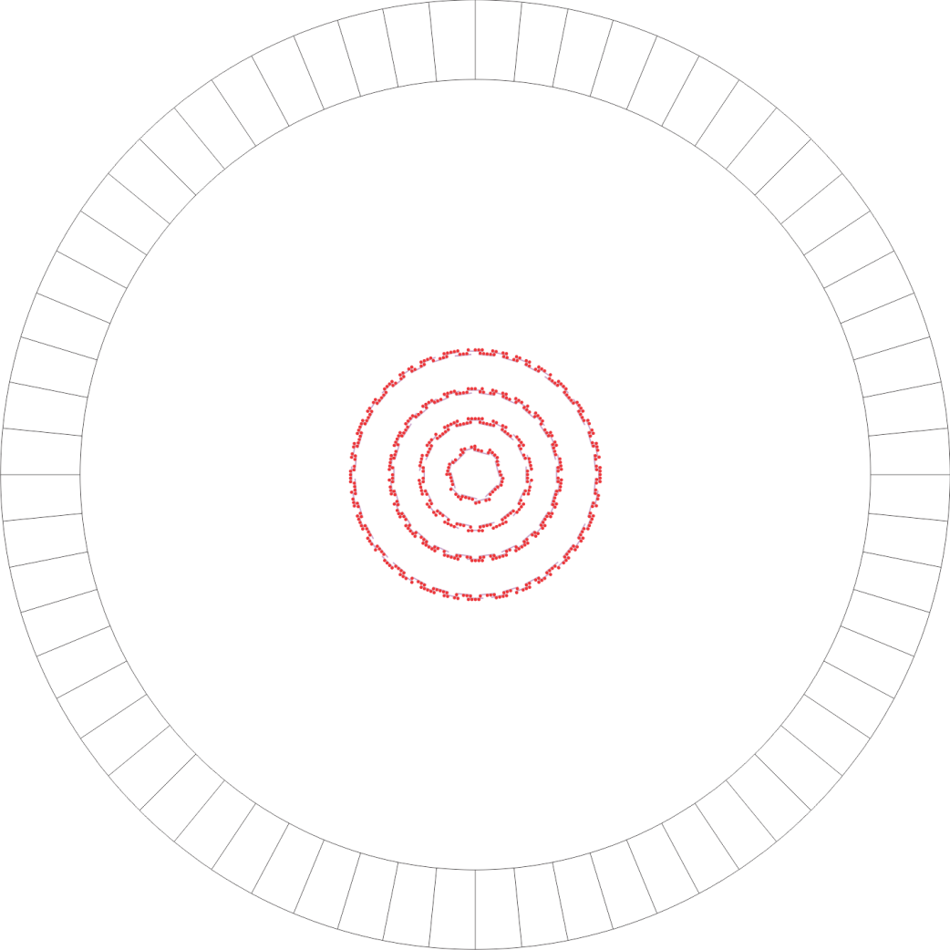
Proof-of-principle application with “toy” CMS Detector
R-Ø
R-z
Proof of principle application: Implement a hypothetical pixel detector based electron track
confirmation trigger on a “toy” CMS detector

Slide 7
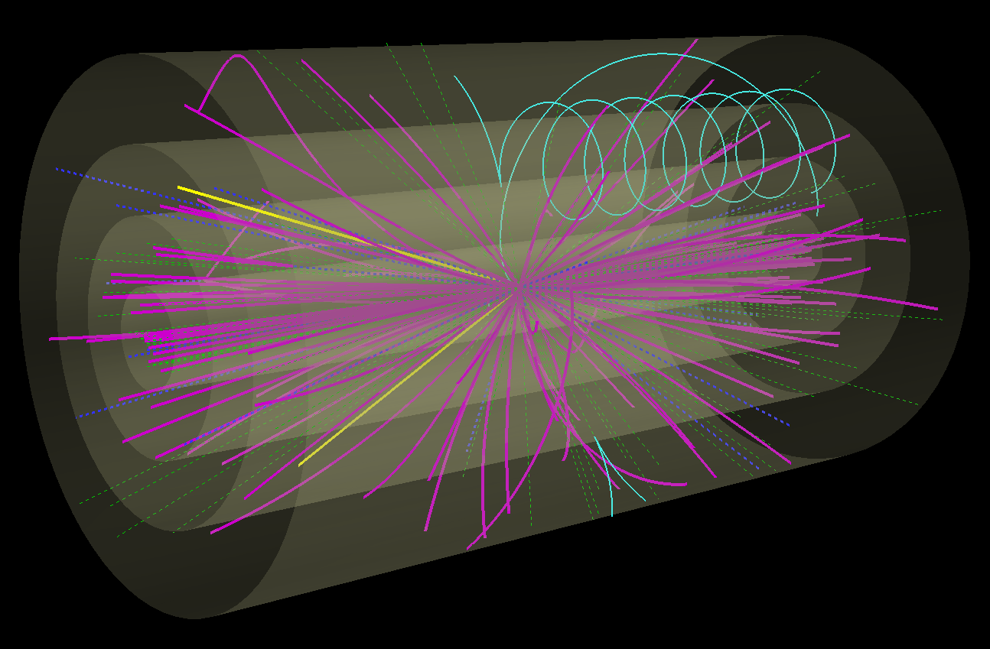
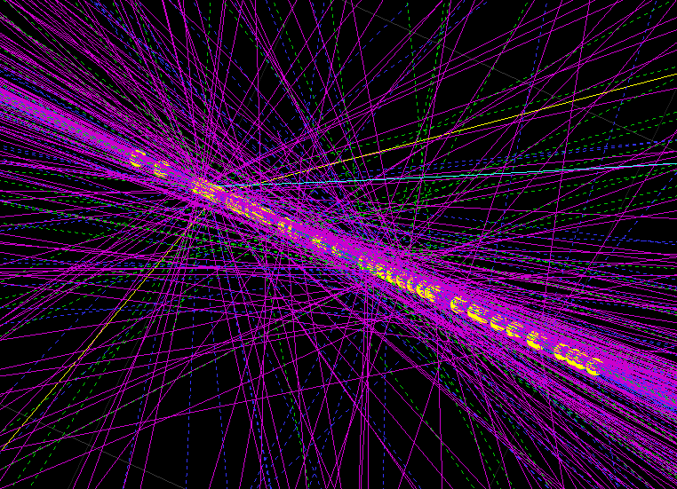
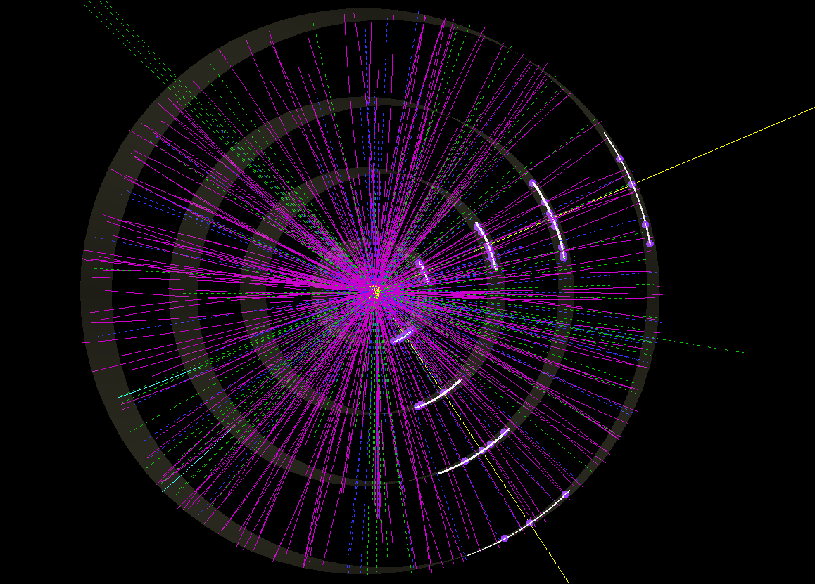
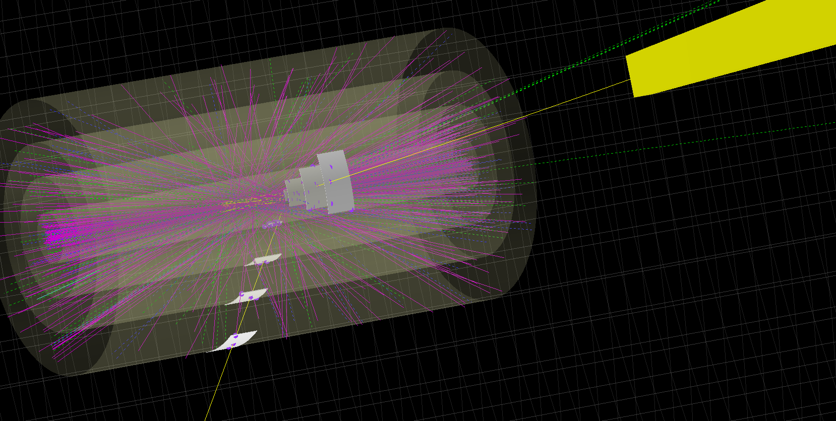
Simulated Events in Toy CMS pixel detector
Single Z→ee event
Z→ee event with pileups
Region-Of-Interest readout
Match EM cluster to pixel tracks in ROI

Slide 8
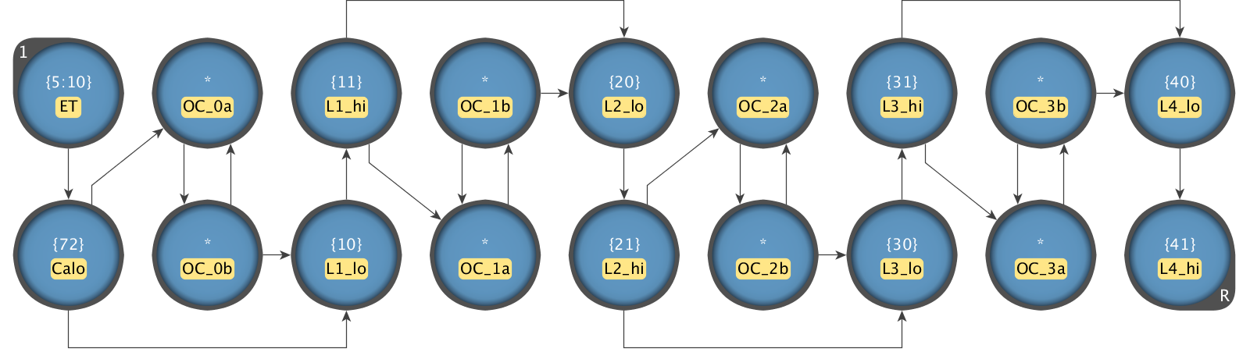
Basic “automaton” for track finder requiring all 4 hits
Basic “automaton” for track finder requiring all 4 hits
Energy range constraint on calorimeter cluster
Latches to enable appropriate half of 16-bit STE pair on odd or even cycle
STE pairs representing 16-bit hit addresses in the 4 layers
EM cluster coordinate (phi or eta depending on view)
Reporting STE

Slide 9
Results for Electron identification and photon rejection

Slide 10
Processing time on automata processor
Additional step, in external logic, needed to find coincident matches in both views.

Slide 11
Processing time on x86 CPU
CPU Cycles vs # of Pileups

Slide 12
Processing Time on Automata Processor vs x86 CPU
Used the simulated sample with 140 pileups
Micron Automata Processor at 133 MHz
  3.25 us + 0.37 us external processing time = 3.62 μs
Intel i7, 5th generation at 3.3 GHz
  Single core: 32.1 μs
  OpenMP on 6 cores: 17.5 μs

Slide 13
Comparison with CAM-based FPGA implementations
We look at the FPGA-based PRM (Pattern Recognition Module) developed at Fermilab as a demonstrator for the VIPRAM ASIC and for optimizing its design (Ted Liu et al.)
PRM firmware has been tested extensively and its behavior, down to clock-cycles, is deterministic and well understood.
Possible to get very good idea of its performance relative to Micron AP without actually running it on the same data.
With knowledge of its architecture and characteristics, we calculated the number of PRM cycles it would take to match pixel tracks to EM clusters:
  on the same 1K event sample with 140PU used to test the Micron AP
  using same definition of ROI associated with each EM cluster to provide same set of pixel hits as input

Slide 14
PRM Block Diagram
Calculate timing from the instant the first pixel hit is fed into the
module up to instant the last “road id” is output from AM stage

Slide 15
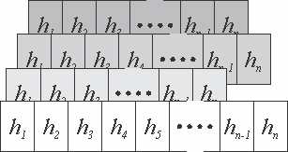

PRM Timing Calculation
Incoming “local” hits
Lyr 4
Ncycles
= # of hits in layer with most # of hits
+ 4 cycles: local to ssid conversion
Lyr 3
+ 8 cycles: road Id generation
Lyr 2
+ # of roads found
Lyr 1
Local to “superstrip” translation
End-of-Event
4 cycles
Road Id’s
8 cycles

Slide 16
Processing Time on FPGA-PRM
Average # hits in ROI in layer with largest number of hits: ~37.7
Average # “roads” found in ROI: ~5.66
Total number of cycles: 37.7 + 4 + 8 + 5.66 = 55.4 cycles
For 250MHz clock: 0.2 us
> 10x faster than automata processor

Slide 17
Conclusion
Overview of Micron AP described architecture & capabilities.
Demonstrated feasibility in HEP track recognition with a proof-of-principle application.
Compared performance with commodity CPU and custom FPGA solution.
Currently, AP bridges the gap between traditional CPU/GPUs and ASIC/FPGA solutions for fast pattern recognition applications.
Areas of improvement in current AP architecture that can make it more competitive:
  Larger symbol sizes, > 8 bits
  Higher clock rates (> 133MHz)
  More STEs per chip (> 48K)
  More efficient readout architecture
AP still in its infancy, improvements like those listed above in the next version will further enhance its suitability for HEP pattern recognition.
Some of the results shown in this presentation are described in detail in:
  NIM A 832 (2016) 219-230.

Slide 18
End

