Slide 1

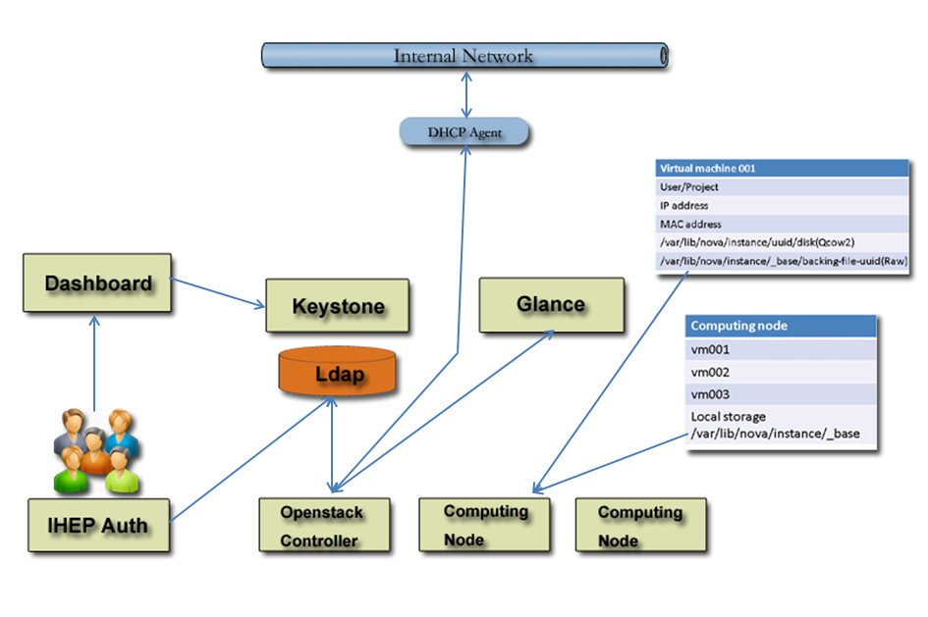
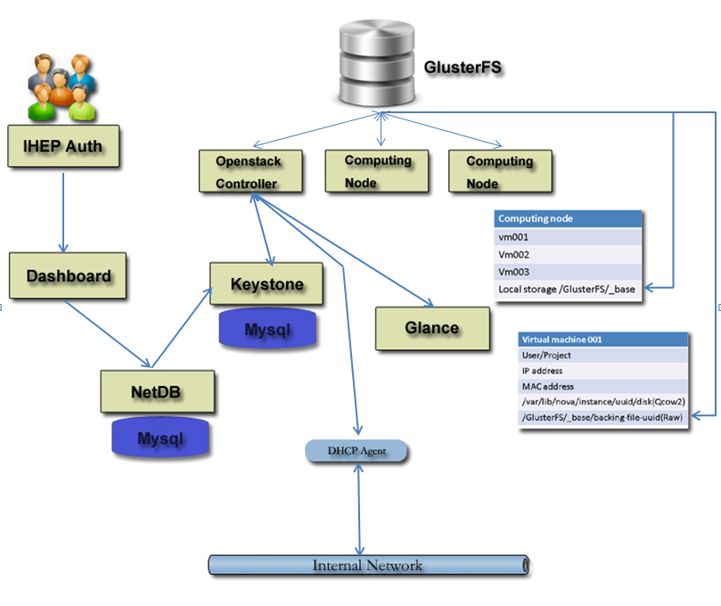
Research on an universal Openstack upgrade solution
Tao Cui, Yaodong Cheng
IHEP, 19B Yuquan Road, Beijing, 100049 China
IEHP Cloud : The IHEP private cloud was deployed at Nov 2014. Users and virtual machines grow fast. The Cloud system was scaled at the end of 2015. The resources increased from 8 compute nodes to 24 compute nodes. There are 496 cores and max 350 virtual machines at IHEP Cloud. More than 100 users of unified certification use this system. The IHEP cloud only provides virtual machine service, not provides volumes and not allows user create their own network and storage. The cloud provides UI nodes of IHEP local computing system for local computing system users and Linux testing machines for all users. The infrastructure is like Figure 1.
The problem of the old IHEP Cloud
The IHEP Cloud was deployed based on Openstack Icehouse. With the development of the Openstack, the old version was end of life. The system should be upgraded to new version.
The old Cloud infrastructure was limited and some new technical need to be applied to this system. Such as not perfect SSO and unified certification.
Upgrade from Icehouse to Kilo, The OS need to upgrade a major version from SL6.5 to SL7.
Figure 1: Old IHEP Private Cloud Architecture
Openstack universal Upgrade Solution: we adopted a new approach to achieve major version upgrade in Openstack . That approach is to deploy a new version Openstack Cloud and migrate network, virtual machine, users/project, secgroup rules and so on. IHEP Cloud use the solution to upgrade from Icehouse to Kilo and about 135 virtual machines and more than 100 users had been migrated. The process costs 45 hours.
The Goal of upgrade:
To upgrade IHEP cloud from Openatack Icehouse to Kilo
To achieve shared storage and instance copy on write;
To achieve unified certification both IHEP unified auth users and local users and maintain privilege users such as admin and services or special users;
To maintain all users virtual machines
The step of Upgrade
new Cloud deployed
1.To install a new Cloud based on Openstack Kilo.
2.To install a GlusterFS to support shared storage.
3.To modify policies to limit user privilege
4.To modify dashboard to achieve IHEP-SSO and
unified certification.
Cloud configuration
1.Configure network as same as Old Cloud and
stop old DHCP
2.Import images like old Cloud,
3.Configure flavors like old one
4.Create users with a local password, and import
quota and secgroup rules.
Figure 2: New IHEP Private Cloud Infrastucture
Migrate virtual machines
1.Create a new virtual machine with the same ip, mac, flavor, image, project, user
2.Stop the new virtual machine and the old one
3.Copy increasing image from old Cloud to new location and modify
backing file path(the same backing image but not same file name)
4.Start the new virtual machine
5.Repeat the process until all virtual machines are migrated.
Others
Install unified certification database and system, modify dashboard.

