Slide 1
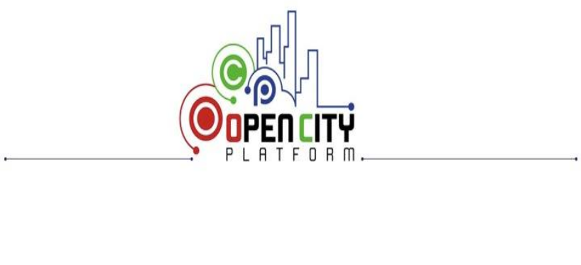
Cloud Environment Automation: from infrastructure deployment to application monitoring
Smart Cities and Communities and Social Innovation
Bando MIUR
D.D. 391/Ric. del 5 luglio 2012
Cristina Aiftimiei, Alessandro Costantini, Diego Michelotto et al.
INFN-CNAF, IT
{cristina.aiftimiei, alessandro.costantini, diego.michelotto}@cnaf.infn.it

Slide 2
Overview
Open City Platform (OCP) project
OCP platforms’ architecture
OCP IaaS installation scenarios and Automation
OCPs Cloud Environment Automation Architecture
Conclusion & Future Work

Slide 3
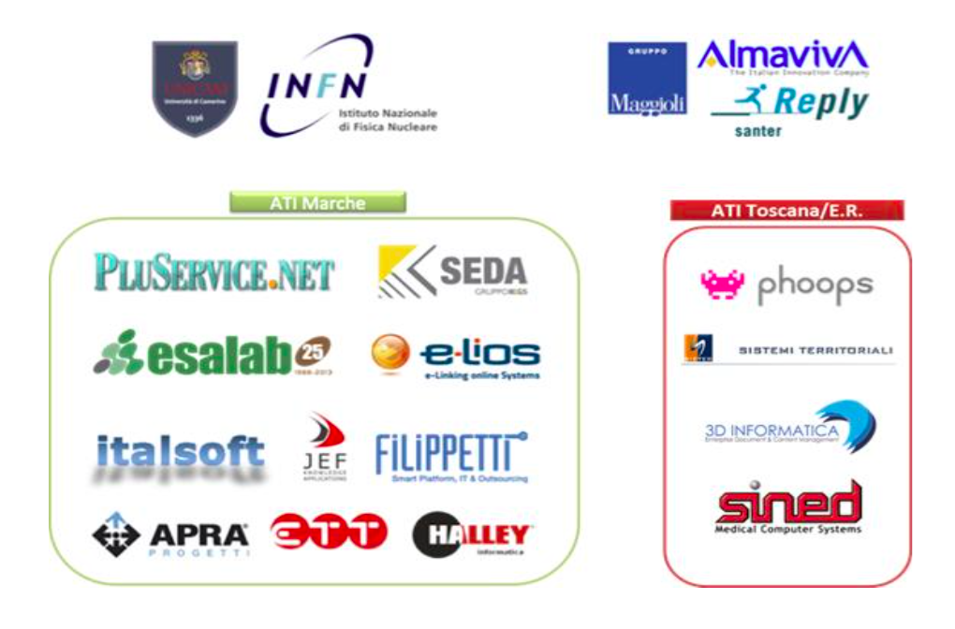
OpenCityPlatform (OCP) project
Industrial research project
  Funded by the Italian Ministry of University and Research (MIUR)
    Started in 2014
    Duration 42 months (1 Jan. 2014 – 30 June 2017)
  Participants
    7 partners
    20 beneficiaries
    2 Universities/research institutes
    3 big private companies
Project intends to research, develop and test
  new technology solutions
    open,
    interoperable and usable on-demand on the Cloud,
  innovative organizational models
    sustainable over time
  delivery of services
    from Local Government and Regional Administrations to Citizens and Companies

Slide 4
Overview
Open City Platform (OCP) project
OCP platforms’ architecture
OCP IaaS installation scenarios and Automation
OCPs Cloud Environment Automation Architecture
Conclusion & Future Work

Slide 5
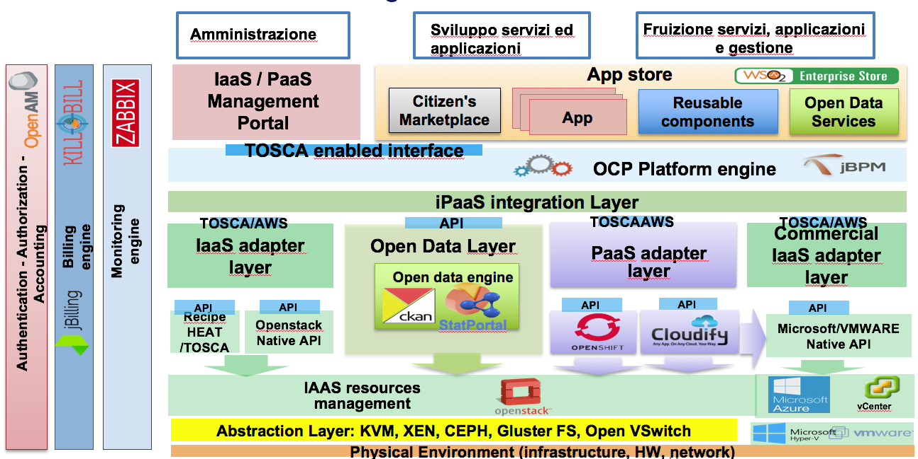

OCP platforms’ architecture

Slide 6
OCP platforms’ architecture – IaaS layer

Slide 7
Overview
Open City Platform (OCP) project
OCP platforms’ architecture
OCP IaaS installation scenarios and Automation
OCPs Cloud Environment Automation Architecture
Conclusion & Future Work

Slide 8
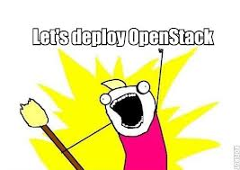

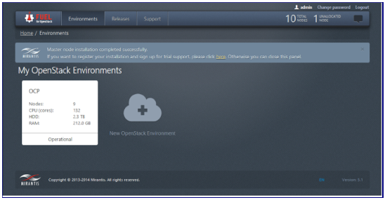
IaaS installation scenarios
Manual installation and configuration (“hardcore”)
  Pros
    better understanding of OpenStack dependencies between components
    more control over configurations
  Cons
    requires basic knowledge of Linux OS, bash and
    network configuration
    error-prone and time-consuming
Full-automated installation via Fuel
  Pros
    Easy installation through the graphical interface
    Enables subsequent changes and new deployments
  Cons
    Initial configuration cannot be changed
    Custom configuration difficult to be applied.

Slide 9
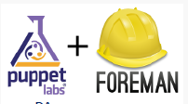
“Automation make it better”
A semi-automatic installation method
  Designed to take the advantages of the methods presented
    More control over configurations
    Easy installation through the graphical interface
  Flexible
    to meet the architectural requirements of Data Centers
Leverage on automation tools
  Foreman and Puppet

Slide 10
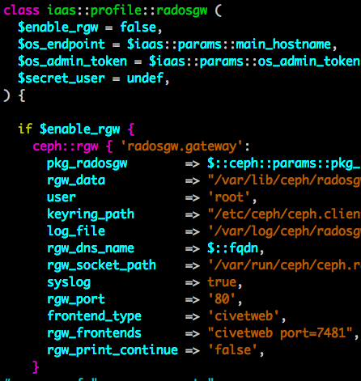
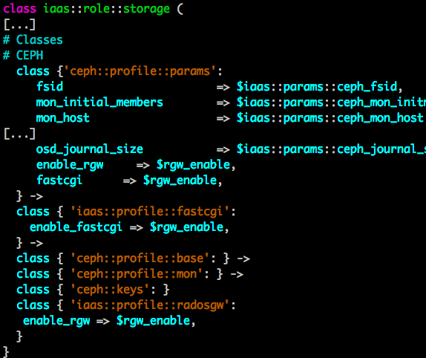
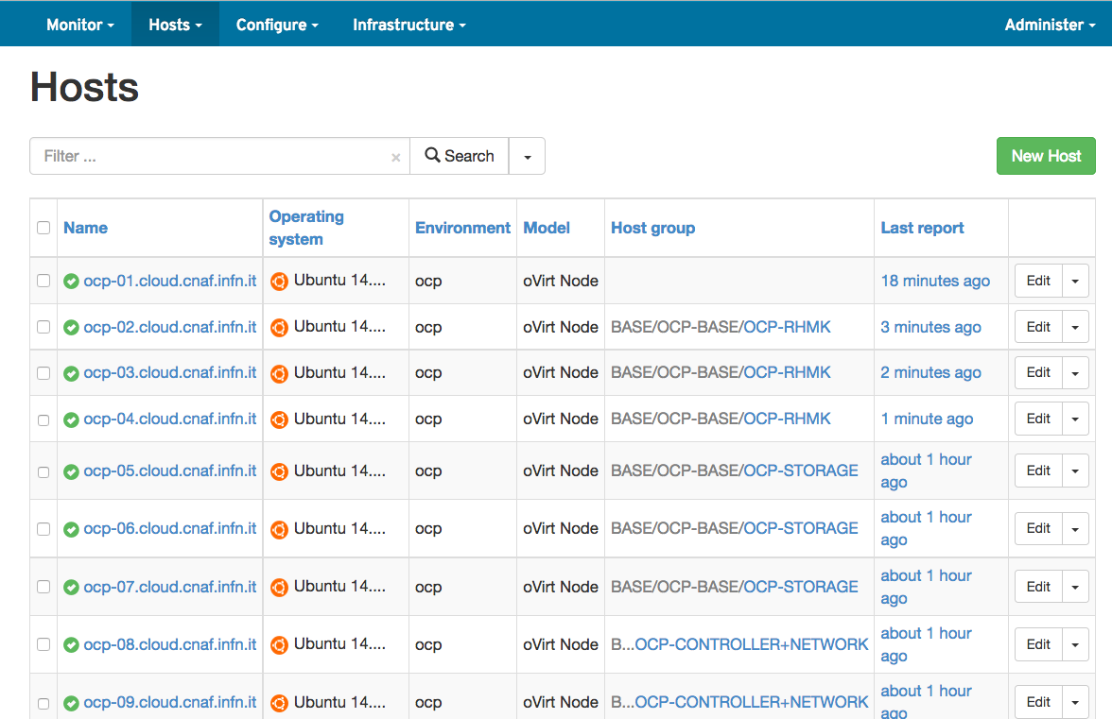
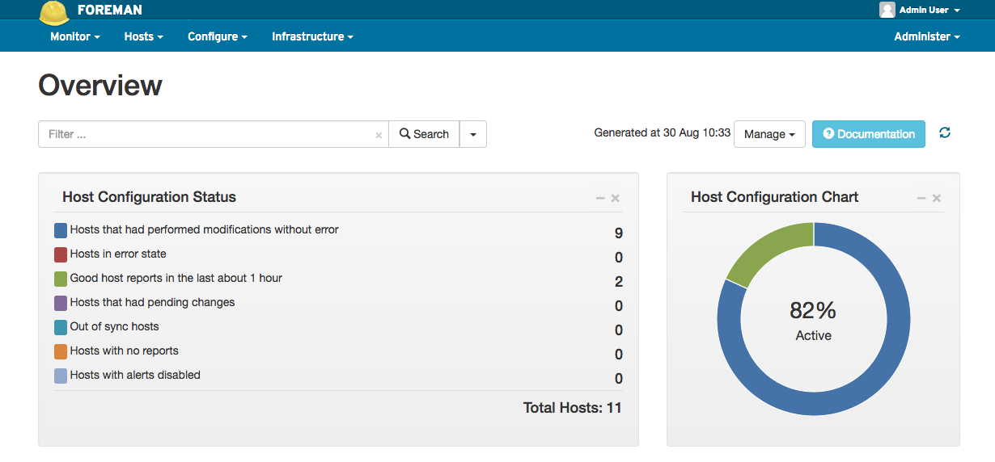
Automation Tools
Puppet
  Framework open source for the management and configuration of ICT systems
    Roles and profiles model
      based on a similar module of Quentin Machu
    Profiles: technology-specific wrapper classes
      Database, Horizon, Keepalived, Nova-compute, …
    Roles: business-specific wrapper classes
      Every node is classified with one role!
Foreman
  Framework for the lifecycle management of virtual and physical server
    Rapid deployment of services and applications
    Easy automation of repetitive actions
    Proactive Management of servers
10

Slide 11
Overview
Open City Platform (OCP) project
OCP platforms’ architecture
OCP IaaS installation scenarios and Automation
OCPs Cloud Environment Automation Architecture
Conclusion & Future Work

Slide 12
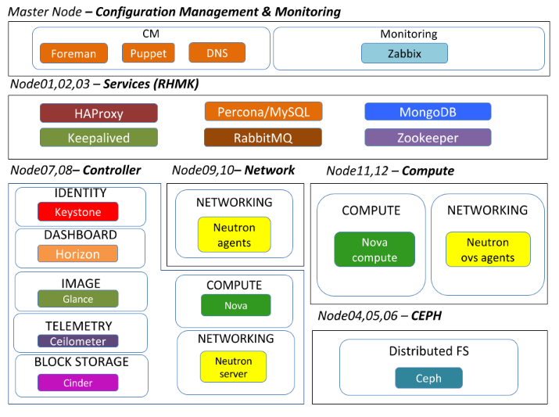
Cloud Environment Automation Architecture

Slide 13
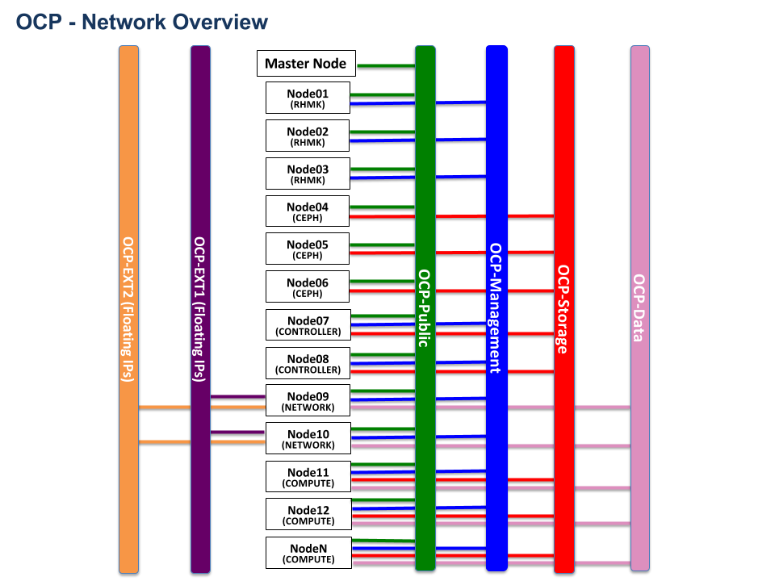
Network Architecture

Slide 14
Overview
Open City Platform (OCP) project
OCP platforms’ architecture
OCP IaaS installation scenarios and Automation
OCPs Cloud Environment Automation Architecture
Conclusion & Future Work

Slide 15
Conclusions & Future Work
Cloud Environment Automation
  A new semi-automatic method for IaaS installation and configuration
  Developed in the OCP industrial research project
  Addresses the different requirements and realities
    Flexible IaaS configuration and management
    High Availability and Network management support
    Ceph adopted as block and object storage backend
    Fine grain variable configuration
    Graphical User Interface support

Slide 16
Conclusions & Future Work
New Features
  Full support to the OpenStack Identity API v3
  Automatic upgrade of the OCP-IaaS layer to a new OpenStack version
  Automatic methods and tools for the installation and configuration of the PaaS layer
    CloudFormation as a Service

