Slide 1
CERN openlab Knowledge Transfer and Innovation Projects
Fons Rademakers, CERN openlab Chief Research Officer
CHEP’16, San Fransisco, 10-Oct-2016.

Slide 2
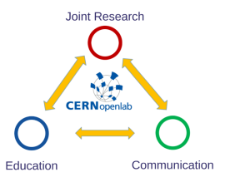
CERN openlab
CERN openlab, a science – industry partnership to drive R&D in IT
CERN openlab is a driver of innovation, education and entrepreneurship in IT
Working on multi-disciplinary projects exploiting the latest IT techniques
Development of educational projects
Dissemination of results

Slide 3
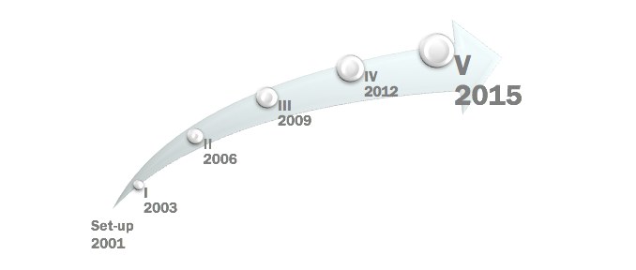

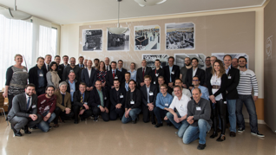
15 Years of Successful Collaborations

Slide 4
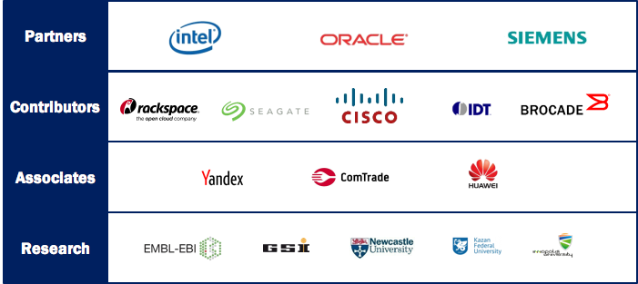
Current CERN openlab Members

Slide 5
CERN openlab Knowledge Transfer and Research Projects
New line of CERN openlab activities
Investigate how HEP knowledge, methodology and technology can benefit projects in other sciences
Involve our industry members where possible

Slide 6

The Human Brain Development Project

Slide 7
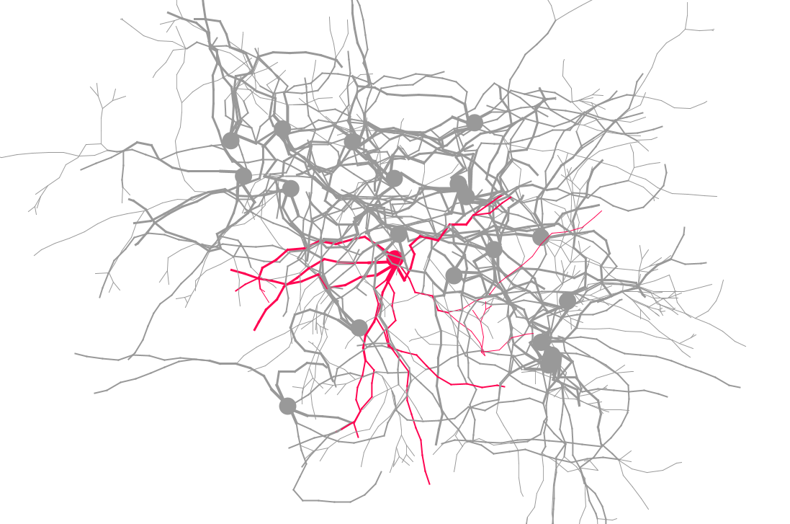
Why Simulate Brain Development
Neuro scientific insights
  How does the brain develop?
  How do genetic and environmental cues interact?
  How do neurons and brain regions communicate?
  How does cognition, planning and memory work?
Medicine
  Understanding of brain diseases (epilepsy)
  Tumor growth
  Drug development
Technology
  Artificial intelligence, neural computations, intelligent systems

Slide 8
BioDynaMo — The Biology Dynamic Modeller
Platform for high-performance computer simulations of biological dynamics
Involves detailed physical interactions in biological tissue
Highly optimised and parallelised code
To be run both on HPC and Cloud environments
  Cortical column: 10k neurons - brain cancer (multi-core)
  Cortical sheet: 10m neurons - epilepsy (HPC)
  Cortex: 100m - 10bn neurons - schizophrenia (HPC on Cloud?)

Slide 9
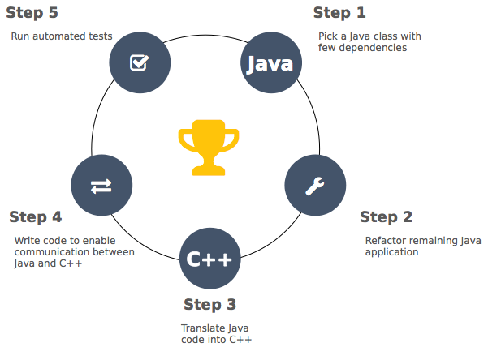
From Cx3D to BioDynaMo
Original Cx3D code in Java (20 kLOC)
Ported to C++
Scalar, serial optimisations
Vectorisation
Parallelisation
Co-processor and GPU optimisations
ROOT for I/O and graphics

Slide 10

Neurite Growth Simulation with Cx3D

Slide 11
State of the Art Software Engineering Environment
C++14
Google C++ coding standards
Doxygen for source code documentation
cmake for configuration and building
GitHub for source code management and issue tracking
GitBook for documentation
Travis CI for continues building and testing
Slack for instant communication and CERN e-groups for mailing lists

Slide 12



Vectorisation & Parallelisation
Evaluation of options
  Auto vectorisation, intrinsics library
  Compared Vc and Eigen
Implementation uses abstraction to plugin different Vector Backends (Vc, UMESimd, …)
Memory Layout Transformations AOSOA
Scalar version implemented with ScalarBackend
OpenMP on operation level

Slide 13
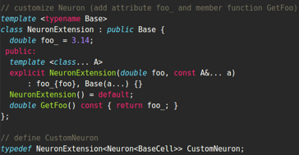
Refactoring
Extension and modification of classes solved
with mixins and variadic templates
Removed separation of Cell, CellElement,
Physical
Introduced abstraction of an operation e.g. calculation of mechanical forces, neighbours, biological behaviours, …
Scientist defines operation graph, runtime figures out dependencies and schedules accordingly (to be implemented)

Slide 14
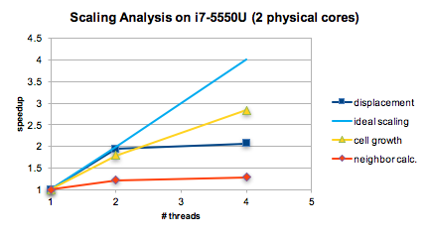
Preliminary Results
Example of cell growth, calculation of mechanical forces and neighbours
Comparison of SSE vs AVX showed a speedup of
  1.6x for displacement calculation
  1.5x for cell growth

Slide 15
CERN openlab BioDynaMo Technology Transfer Benefits
Ideal project for code modernisation effort, code not too large but very relevant
CERN openlab provides technical student who gains valuable experience
Experience very valuable for much larger CERN code modernisation projects
BioDynaMo code will boost the neuroscience brain simulation capabilities
Project is joint effort between CERN openlab, CERN medical applications group, Newcastle University, Kazan University, Innopolis University and Intel

Slide 16
Using ROOT for Genomics Data Analysis

Slide 17
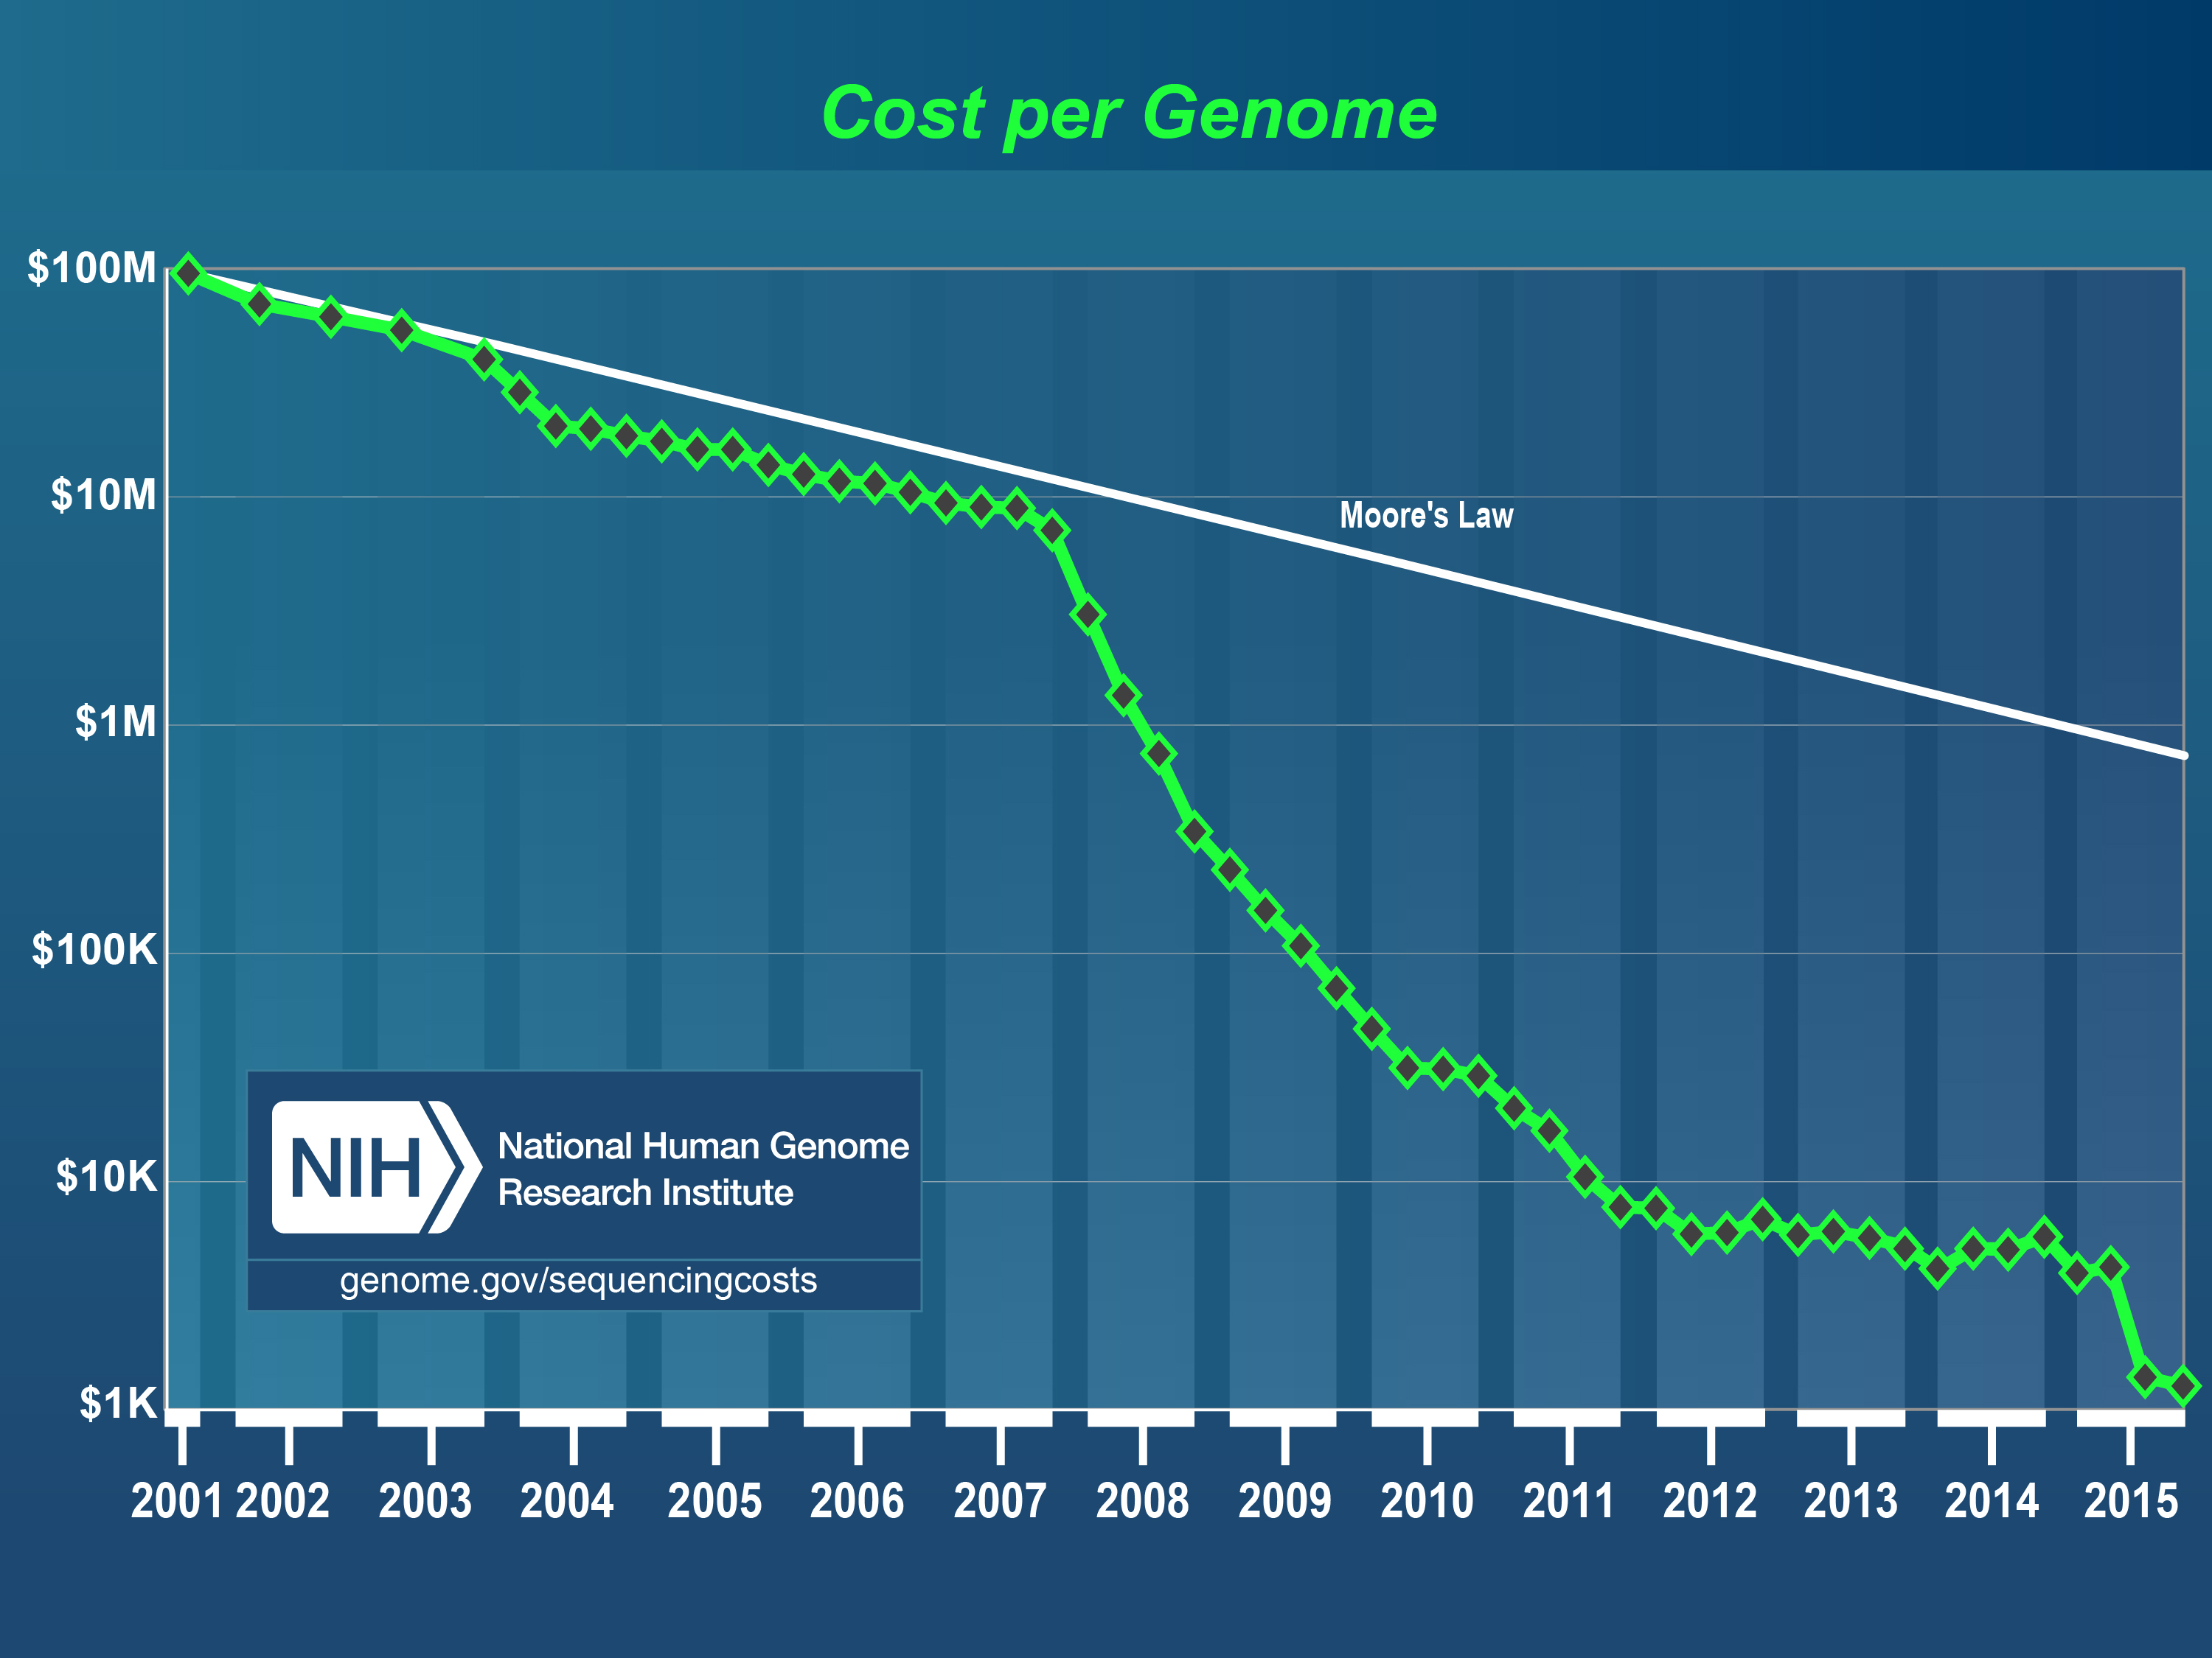
Rapidly Increasing Amount of Genomics Data
Next generation Sequencing (NGS)
  Dramatic increase in the amount of data
  Improved data confidence
NGS is enabler for more sophisticated
research questions in Genomics
Issue: Leaps in sequencing technology have outperformed advances in computing
Source https://www.genome.gov/sequencingcosts/

Slide 18
The TwinsUK Project
The TwinsUK resource is the biggest UK adult twin registry (more than 11000 twins, 300 TB genomics data)
Evaluate if the optimised ROOT file format and analysis features are more efficient for this type of studies than BAM and standard genomic analysis tools
Evaluate Seagate Kinetics key/value storage facility
Partners
  Formal interface: King’s College London
  Behind KCL: entire consortium working on Twins UK (~ 50 institutes)
https://www.twinsuk.ac.uk/

Slide 19
CERN openlab TwinsUK Technology Transfer Benefits
Additional use case for CERN’s ROOT and Seagate’s Kinetics technologies
Return flow of know-how benefiting the ROOT User community
Entire Omics community would benefit from improved analysis tools to handle rapidly growing amounts of data
Project is joint effort between CERN openlab, CERN medical applications group, King’s College London and Seagate

Slide 20
EXECUTIVE CONTACT
Alberto Di Meglio, CERN openlab Head
alberto.di.meglio@cern.ch
TECHNICAL CONTACTS
Maria Girone, CERN openlab Chief Technology Officer
maria.girone@cern.ch
Fons Rademakers, CERN openlab Chief Research Officer
fons.rademakers@cern.ch
COMMUNICATION CONTACT
Andrew Purcell, CERN openlab Communications Officer
andrew.purcell@cern.ch
ADMIN CONTACT
Kristina Gunne, CERN openlab Administration Officer
kristina.gunne@cern.ch

