Slide 1


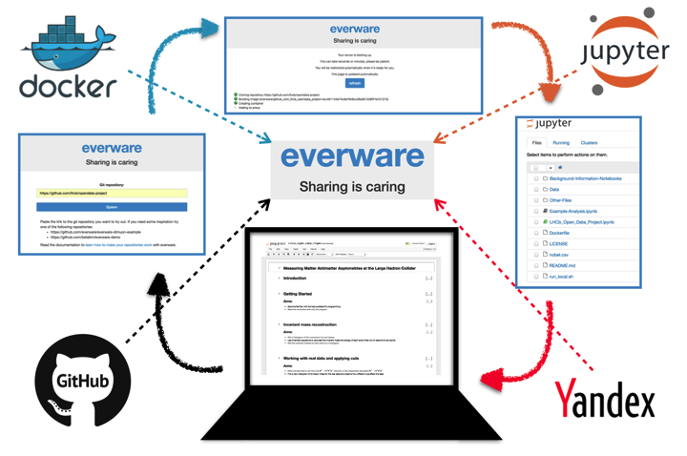
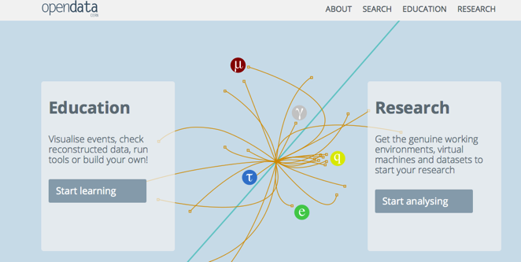
Particle Physics Analysis for the
CERN Open Data Portal:
“Measuring Matter Antimatter asymmetries at the LHC”
C.Parkes, S.Amerio, A.Rogozhnikov, M.Gersabeck, Andrey Ustyuzhanin, G.Gilliver, T.Head, M.Litwinski, S.Dallmeier-Tiessen, D.Derkach, C.Burr, I.Babuschkin on behalf of LHCb

Slide 2
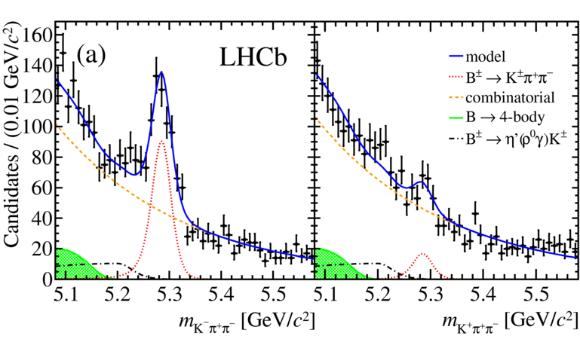
Project – Background – CPV
Very Large CP Violation observed in local regions of phase space
Hence, ideal mode for this project
  Neglecting subtleties, CP Violation can still be observed by users

Slide 3
Project - Technology
Jupyter Notebooks
  Instructions, hints, user code
Docker
  Environment
GitHub
  Code storage
CERN open data portal
  Data (to appear, for the moment use cernbox)
Everware
  Bridge between Github/Docker/Jupyter
Entirely web-based
  remove OS dependency, user IT requirements
Hosting provided by Yandex

Slide 4

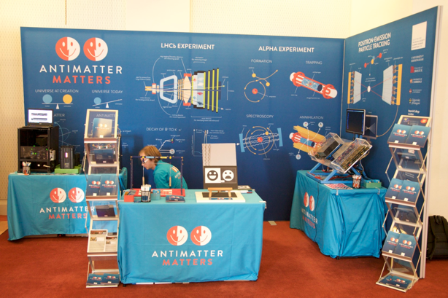
Summary
Novel Particle Physics Analysis Project Developed
  Allows users to conduct a guided analysis
  Embedded instructions and coding cells
First launched summer 2016 for UK Royal Society summer Science Exhibition
  Try Beta release here,
  to appear on CERN open data portal
  See also outreach materials
  at Antimatter-matters.org
More technical everware talk on
Thu 12:15, Track 5
  https://indico.cern.ch/event/505613/contributions/2228351/
Thanks to: CERN open data portal team

