Slide 1
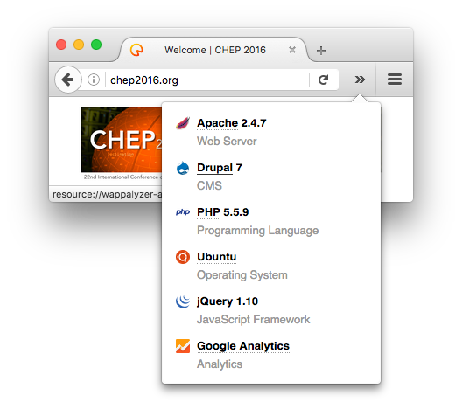

Web technology detection (WAD) author: Sebastian Lopienski (CERN Computer Security Team)
WAD is an open-source tool developed at CERN
for detecting applications and technologies behind a website
  OS, webserver, CMS, programming language, web framework, JS libraries etc.
Motivation: web asset inventory + vulnerability management
Using detection rules from a public
browser plugin Wappalyzer
  ~900 technologies, thousands of rules
WAD is available on GitHub, and via PyPI
$ pip install wad
$ wad -u http://chep2016.org
{ "http://chep2016.org": [
{ "type": "operating-systems", "app": "Ubuntu", "ver": null },
{ "type": "web-servers", "app": "Apache", "ver": "2.4.7” },
{ "type": "programming-languages“, "app": "PHP", "ver": "5.5.9” },
{ "type": "cms", "app": "Drupal", "ver": "7" },
{ "type": "javascript-frameworks", "app": "jQuery", "ver": "1.10" }
] }

