Slide 1
Unified Monitoring Architecture for IT and Grid Services
CHEP 2016 San Francisco
10-14 October 2016
Edward Karavakis on behalf of the CERN IT-CM-MM monitoring team

Slide 2
Monitoring
Data Centre Monitoring
Monitoring of DC at CERN and Wigner
Hardware, operating system, and services
Data Centres equipment (PDUs, temperature sensors, etc.)
Used by service providers in IT, experiments
Experiment Dashboards
Sites availability, data transfers, job information, reports
Used by WLCG, experiments, sites and users
Both hosted by CERN IT, in different teams
Mandate for 2016
  Regroup monitoring projects

Slide 3
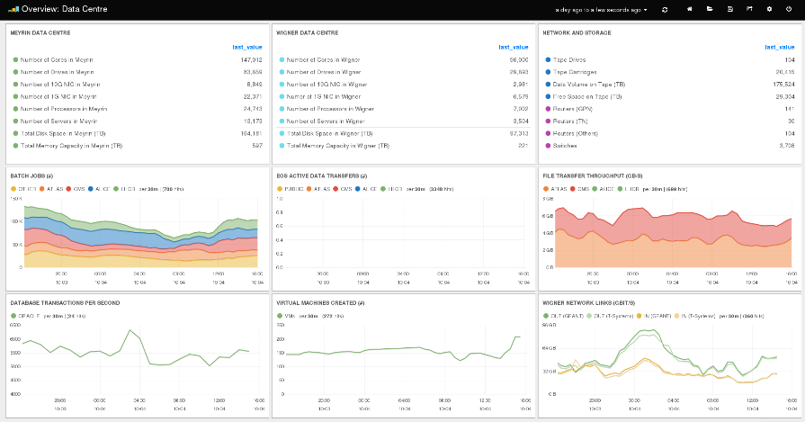
Data Centres Monitoring

Slide 4
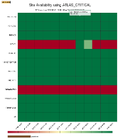
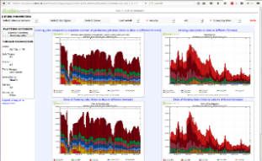
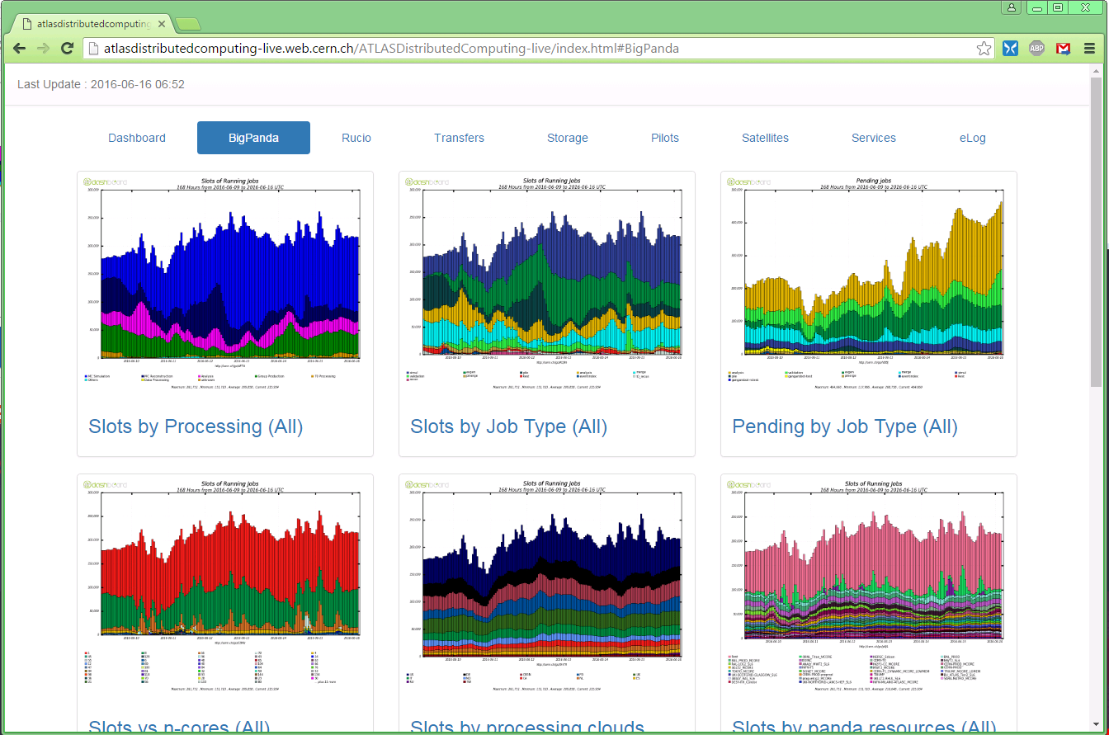
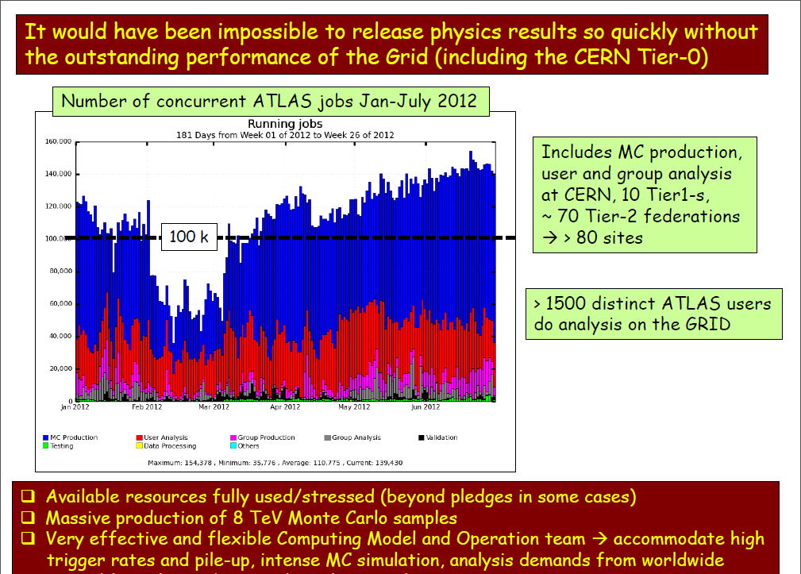
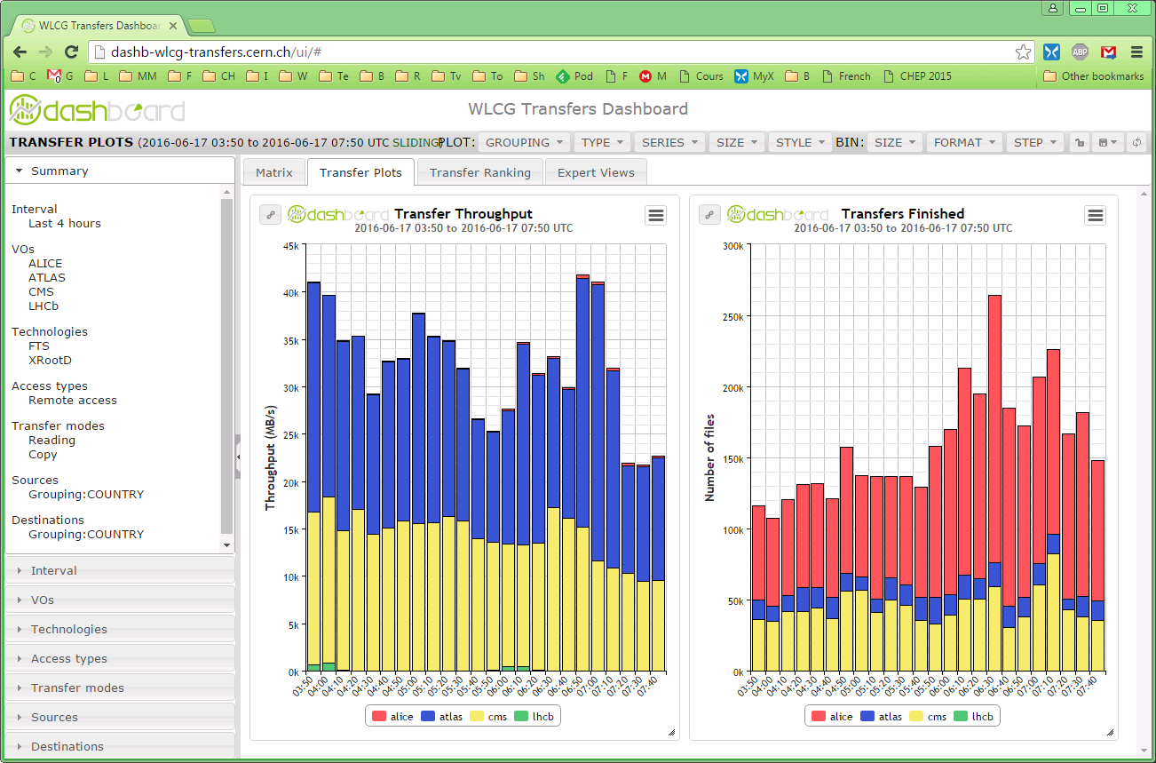
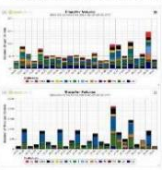
Experiment Dashboards
Job monitoring, sites availability, data management and transfers
Used by experiments operation teams, sites, users, WLCG
ATLAS Distributed Computing
Higgs Seminar

Slide 5
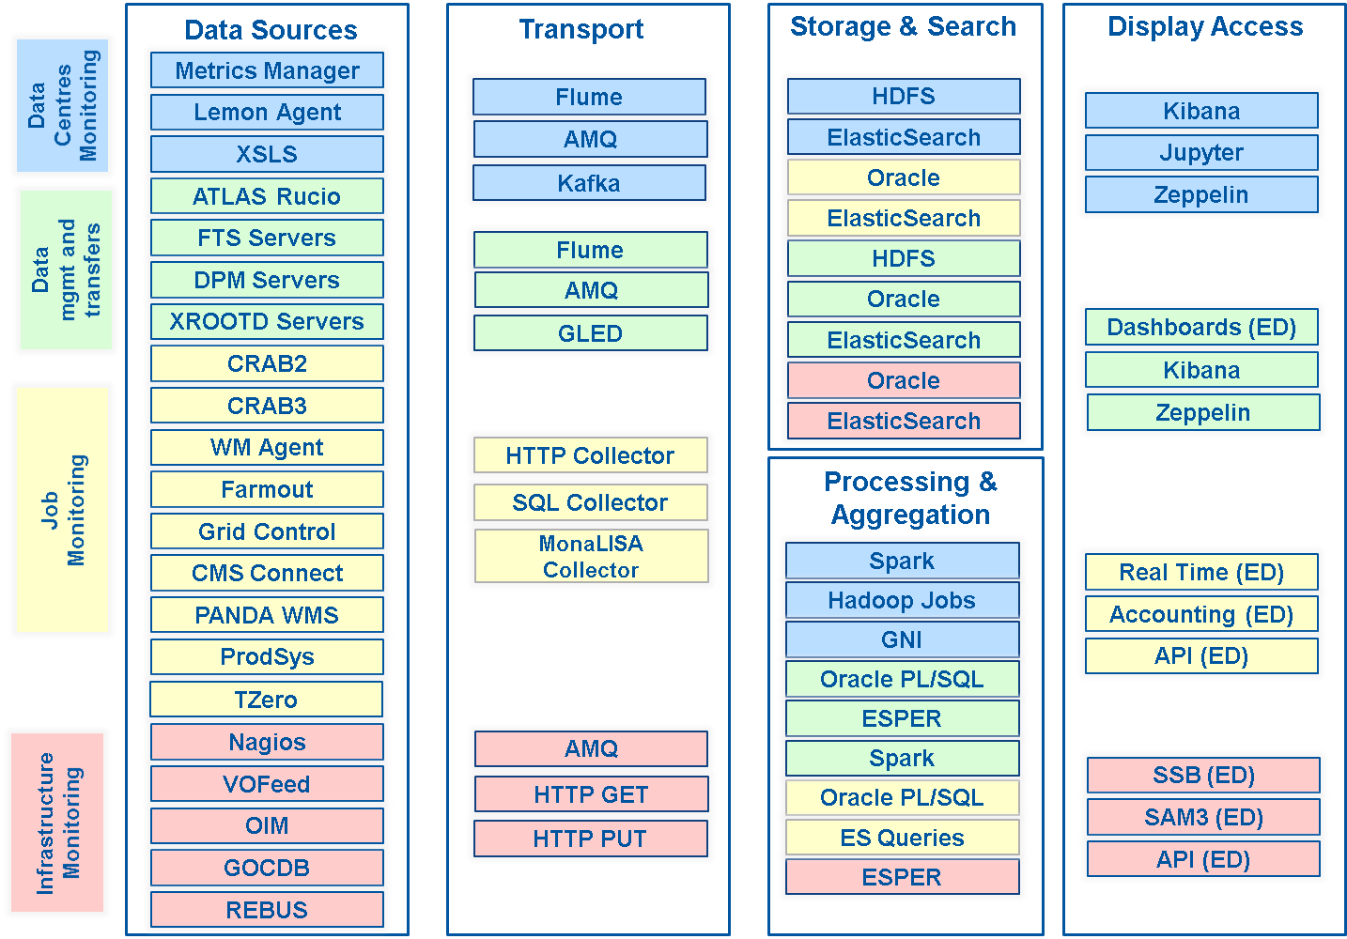
Current Monitoring

Slide 6
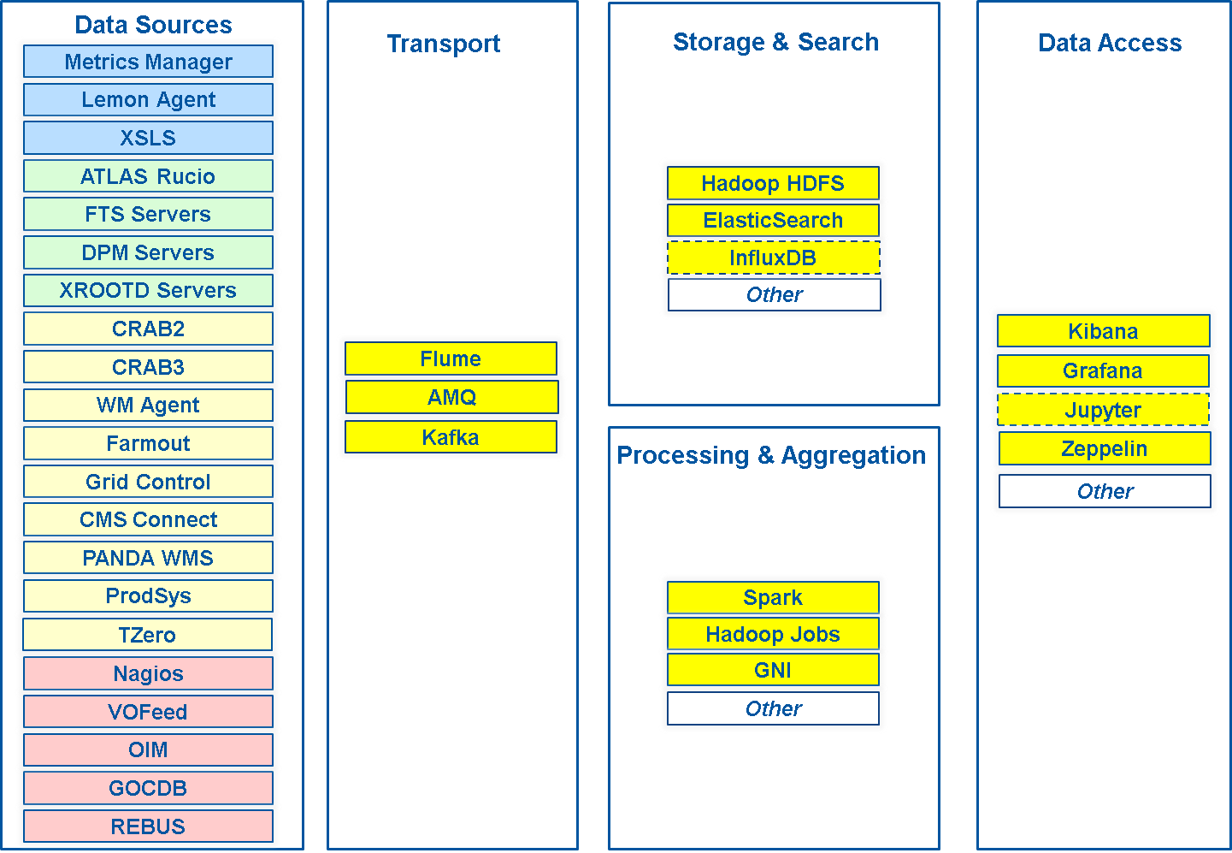
Unified Monitoring

Slide 7










Unified Monitoring Architecture
Data
Sources
Transport
Storage/Search
Data
Access
Data
Centres
Processing
WLCG
kafka

Slide 8
Unified Data Sources
Data
Sources
AMQ
Flume
AMQ
Transport
Data is channeled via Flume, validated and modified if necessary
Adding new Data Sources is documented and fairly simple
FTS
DB
Flume
DB
Flume
Kafka sink
Rucio
XRootD
HTTP feed
Flume
HTTP
Jobs
…
Logs
Flume
Log GW
Lemon
syslog
Lemon metrics
Flume
Metric GW
app log

Slide 9
Unified Processing
Transport
Flume
Kafka sink
Flume
sinks
Kafka cluster
(buffering)*
Processing
On the fly
Data enrichment
Data aggregation
Data correlation
Batch
Reprocessing, reports, ..
* Current retention period 12 h, at scale 24 h

Slide 10
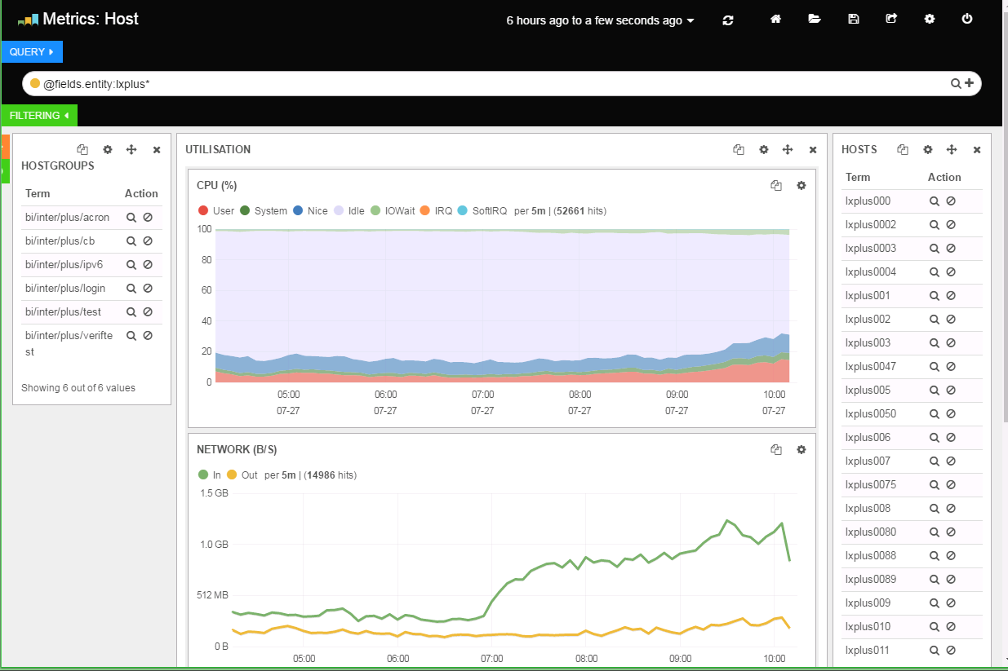
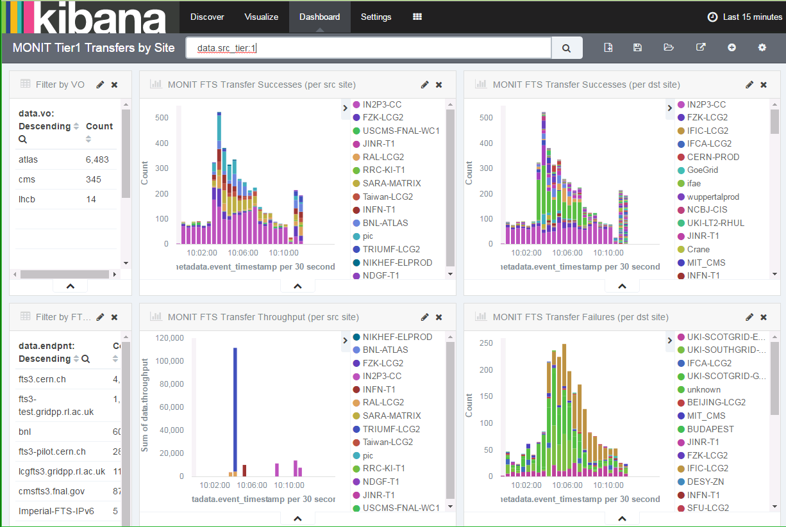

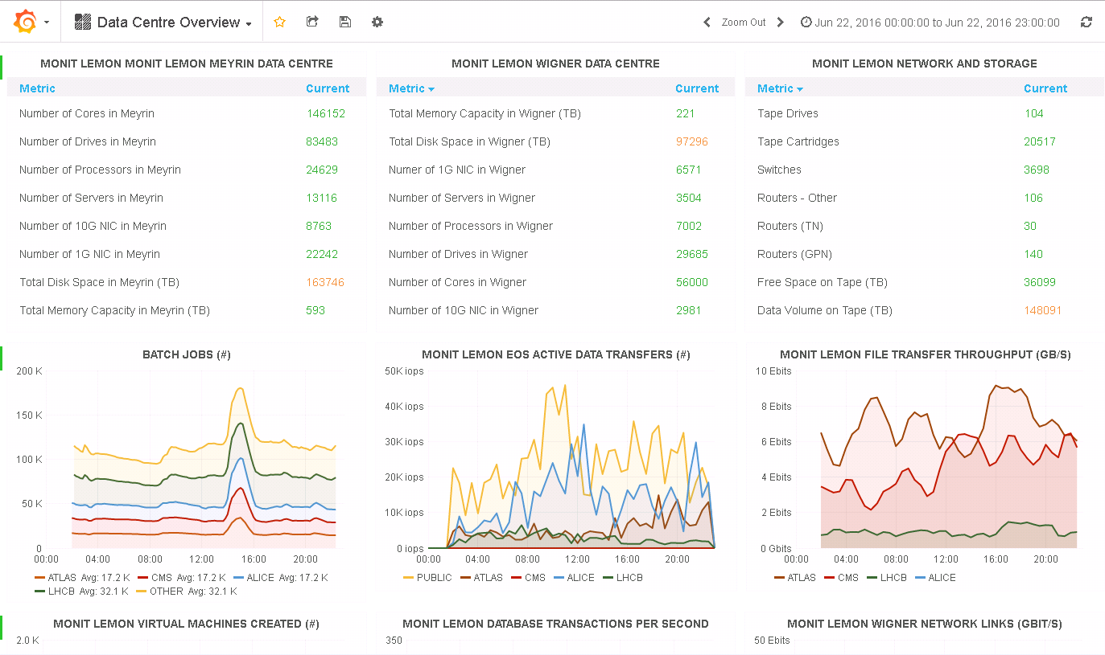

Unified Access
Storage &
Search
Data
Access
HDFS
Multiple data access methods (dashboards, notebooks, CLI)
Mainstream and evolving technologies
Flume
sinks
ElasticSearch
Plots
…
Reports
Scripts
Others
CLI, API

Slide 11
Status since January
Data size ~200 GB/day (~500 GB/day at full scale)
~200M documents/day with spikes at 10KHz
Relying on VMs complaint to the CERN IT AI standards (Openstack/Puppet)
20 nodes Kafka cluster
23 nodes Flume input and output gateways
9 nodes Mesos/Spark cluster
Scaled down version for QA environment
Centrally provided by IT
  Dedicated Elasticsearch cluster: ~30 nodes
  Shared Hadoop/HDFS cluster: ~40 nodes

Slide 12
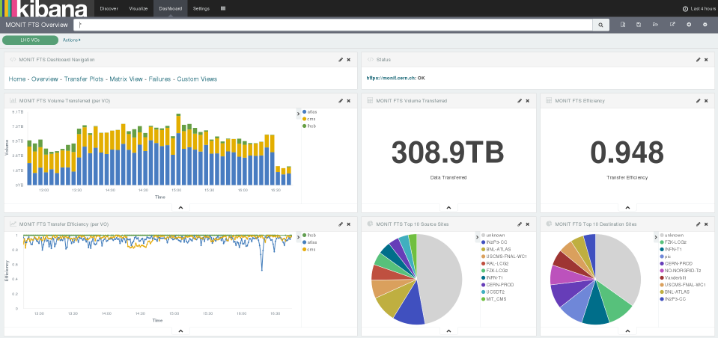
Interactive Visualisations

Slide 13
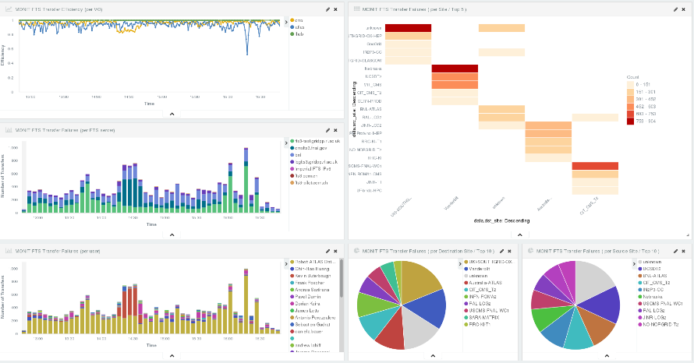
Interactive Visualisations

Slide 14
Conclusions
Merged Monitoring projects
Same team, technologies, practices and infrastructure
Unified monitoring infrastructure for CERN Data Centres and WLCG
Moving all data via new transport (Flume, AMQ, Kafka)
Data in ES and Hadoop (and soon in InfluxDB)
Aggregation and processing via Spark
Visualization with Kibana, Grafana, Zeppelin
Service Proposed
Collect, process, aggregate, visualise and raise alarms
Cover metrics and logs
Operate and scale the infrastructure
Support interfacing new data sources, custom processing, building dashboards and reports

Slide 15
Reference and Contact
Dashboard Prototypes
monit.cern.ch
Feedback/Requests (SNOW)
  cern.ch/monit-support
Early-Stage Documentation
  cern.ch/monitdocs

Slide 16
Backup slides

Slide 17


Monitoring Processing Platform
Gitlab repo
Mesos Marathon/Chronos
(for job orchestration)
Reliable and scalable job execution (Spark)
Job orchestration (Marathon / Chronos)
Lightweight deployment (Docker)
Spark
job
#> docker run spark-submit […]
Build &
Push
-
Manually
or GitlabCI
Puppet
Puppet
Puppet
Mesos cluster
Docker image
Mesos worker
Spark
job
Docker Repo
@CERN
CERN IT
Hadoop/HDFS cluster

