Slide 1
CERN openlab Researched Technologies That Might Become Game Changers in Software Development
Fons Rademakers, CERN openlab Chief Research Officer
CHEP’16, San Fransisco, 12-Oct-2016.

Slide 2
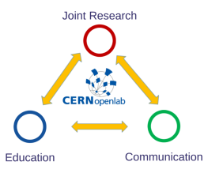
CERN openlab
CERN openlab, a science – industry partnership to drive R&D in IT
CERN openlab promotes innovation, education and entrepreneurship in IT
Working on multi-disciplinary projects exploiting the latest IT techniques
Development of educational and KT projects
Dissemination of results

Slide 3
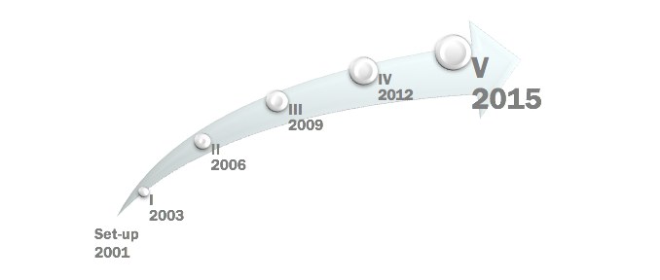

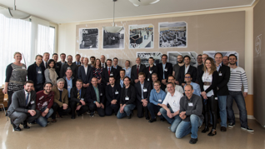
15 Years of Successful Collaborations

Slide 4
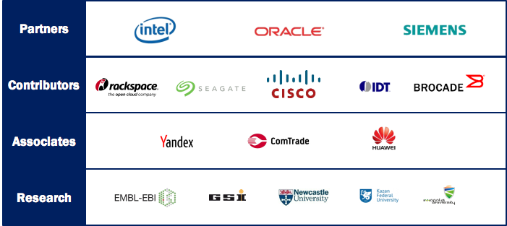
Current CERN openlab Members

Slide 5
Game Changing Technologies

Slide 6
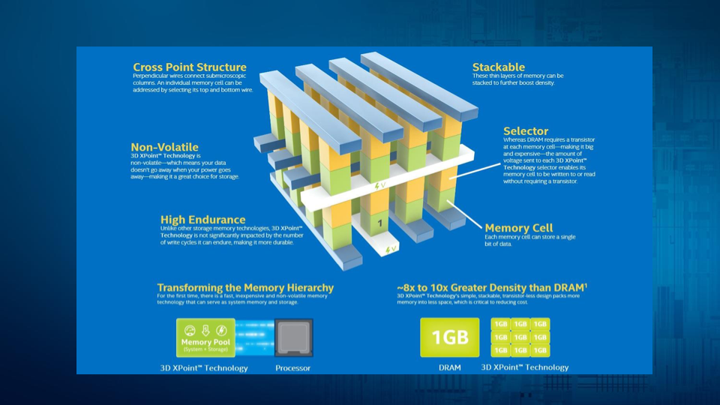
3D XPoint NVRAM Technology

Slide 7
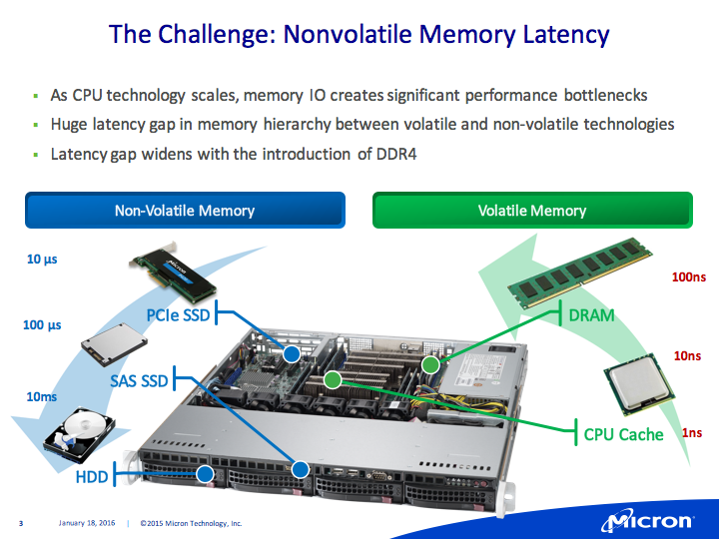

Slide 8
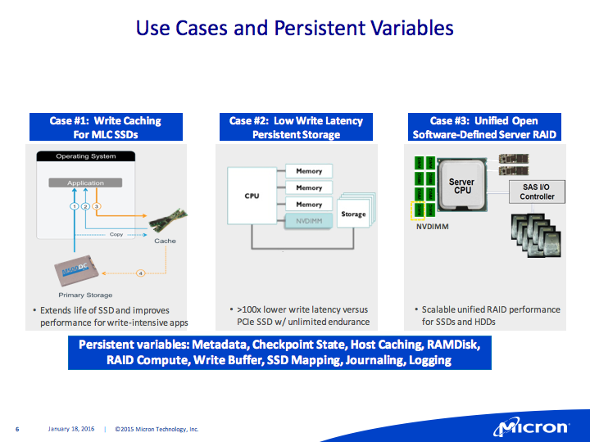

Slide 9
3D XPoint Game Changer
The x’es:
  1000x lower latency than NAND SSD
  10x denser than DRAM
  1000x durability of NAND
  1x cost of DRAM

Slide 10
3D XPoint Game Changer
Forces rethinking of several areas in the software stack:
  On the OS level:
    No more need for disk buffer caches
    File access, still via Posix and/or DMA or some new protocol
  On the program and framework level:
    No more need for caching or read-ahead
    Different ROOT file layout to allow direct mapping of branches
    Storage of run-time caches (xrootd caches, EOS name server tables)
  Programming languages:
    Even Java can become a bottleneck as the I/O latency disappears (Apache Big Data stack)

Slide 11
Many-Core Co-Processors and Code Modernization
Intel Xeon-Phi (KNL) co-processor
NVidia GPU’s
Both offer a lot of potential already for quite some years
Current generations are making a jump in performance
Especially now that our software and frameworks become multi-core aware we can start reap the benefits

Slide 12
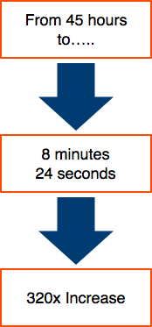
A Very Successful Example of Multi-Core Speedup
A 700 line kernel from a brain cell growth simulation program was optimised for a coding competition
This kernel took 45 hours to run with the target set
of parameters on a single KNC 7120A CPU
The winner achieved a running time of 8m24 using
all 61 cores of the KNC
A speedup of 320x

Slide 13
The Code Changes and Optimisations
Custom memory allocator, reuse memory for many small memory allocations
Change from AoS to SoA to allow vectorisation and improved cache layout
Use OpenMP for parallelisation over all Xeon-Phi cores
Use icc Cilk+ scatter/gather intrinsics

Slide 14
AoS to SoA
// create 3D concentration matrix
float**** Conc;
Conc = new float***[L];
for (i1 = 0; i1 < 2; i1++) {
Conc[i1] = new float**[L];
for (i2 = 0; i2 < L; i2++) {
Conc[i1][i2] = new float*[L];
for (i3 = 0; i3 < L; i3++) {
Conc[i1][i2][i3] = new float[L];
for (i4 = 0; i4 < L; i4++) {
Conc[i1][i2][i3][i4] = zeroFloat;
}
}
}
}
// create 3D concentration matrix
float* Conc;
Conc = new float[L*L*L*2];
void* tempMemory=malloc(std::max(L*L*L*2*sizeof(float),finalNumberCells*3*sizeof(int)));
float* tempConc=(float*)tempMemory;
memset(Conc,0,L*L*L*2*sizeof(float));
for (c=0; c<n; c++) {
posAll[c][0] = posAll[c][0]+currMov[c][0];
posAll[c][1] = posAll[c][1]+currMov[c][1];
posAll[c][2] = posAll[c][2]+currMov[c][2];
// boundary conditions: cells can not move out of the cube [0,1]^3
for (d=0; d<3; d++) {
if (posAll[c][d]<0) {posAll[c][d]=0;}
if (posAll[c][d]>1) {posAll[c][d]=1;}
}
}
for (int c=0; c<n*3; c++) {
posAll[c] = posAll[c]+currMov[c];
// boundary conditions: cells can not move out of the cube [0,1]^3
if (posAll[c]<0) {posAll[c]=0;}
if (posAll[c]>1) {posAll[c]=1;}
}

Slide 15
OpenMP
for (int c=0; c<n*3; c++) {
posAll[c] = posAll[c]+currMov[c];
// boundary conditions: cells can not move out of the cube [0,1]^3
if (posAll[c]<0) {posAll[c]=0;}
if (posAll[c]>1) {posAll[c]=1;}
}
#pragma omp parallel for simd default(none) firstprivate(posAll,n,currMov)
for (int c=0; c<n*3; c++) {
posAll[c] = posAll[c]+currMov[c];
// boundary conditions: cells can not move out of the cube [0,1]^3
if (posAll[c]<0) {posAll[c]=0;}
if (posAll[c]>1) {posAll[c]=1;}
}
for (int c=0; c< n; c+=size) {
int i[size*3];
int localSize=MIN(size,(n-c))*3;
for (int k = 0; k < localSize; k++)
i[k] = std::min((int)floor(posAll[c*3+k]/sideLength),(L-1));
for (int j = 0; j < localSize/3; ++j) {
int position = position((-typesAll[c+j]+1)/2,i[j*3+0],i[j*3+1],i[j*3+2],2,L,L,L);
Conc[position]=MIN(Conc[position]+0.1,1.f);
}
}
#pragma omp parallel for default(none) firstprivate(size,posAll,sideLength,L,n,Conc,typesAll)
for (int c=0; c< n; c+=size) {
int i[size*3];
int localSize=MIN(size,(n-c))*3;
for (int k = 0; k < localSize; k++)
i[k] = std::min((int)floor(posAll[c*3+k]/sideLength),(L-1));
#pragma omp simd
for (int j = 0; j < localSize/3; ++j) {
int position = position((-typesAll[c+j]+1)/2,i[j*3+0],i[j*3+1],i[j*3+2],2,L,L,L);
Conc[position]=MIN(Conc[position]+0.1,1.f);
}
}
Bulk of the speedup
due to OpenMP

Slide 16
Intel icc Cilk+
#pragma omp parallel for default(none) firstprivate(size,posAll,sideLength,L,n,Conc,typesAll)
for (int c=0; c< n; c+=size) {
int i[size*3];
int localSize=MIN(size,(n-c))*3;
for (int k = 0; k < localSize; k++)
i[k] = std::min((int)floor(posAll[c*3+k]/sideLength),(L-1));
#pragma omp simd
for (int j = 0; j < localSize/3; ++j) {
int position = position((-typesAll[c+j]+1)/2,i[j*3+0],i[j*3+1],i[j*3+2],2,L,L,L);
Conc[position]=MIN(Conc[position]+0.1,1.f);
}
}
#pragma omp parallel for default(none) firstprivate(size,posAll,sideLength,L,n,Conc,typesAll)
for (int c=0; c< n; c+=size) {
int i[size*3];
int localSize=MIN(size,(n-c))*3;
#ifdef USE_CILK
i[0:localSize] = std::min((int)floor(posAll[c*3:localSize]/sideLength),(L-1));
#else
for (int k = 0; k < localSize; k++)
i[k] = std::min((int)floor(posAll[c*3+k]/sideLength),(L-1));
#endif
#pragma omp simd
for (int j = 0; j < localSize/3; ++j) {
int position = position((-typesAll[c+j]+1)/2,i[j*3+0],i[j*3+1],i[j*3+2],2,L,L,L);
Conc[position]=MIN(Conc[position]+0.1,1.f);
}
}
Cilk+ added another
10% speedup
Code Modernisation Can Payoff Big Time

Slide 17
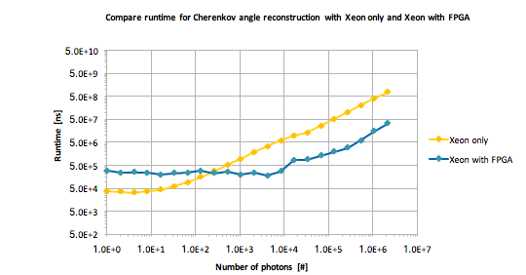
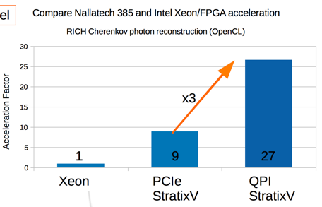

Tightly Integrated Xeon/FPGA Systems
Xeon/FPGA have an advantage over PCIe based accelerators (both FPGA and GPGPU) because of the cache-coherent, low-latency access to main-memory and CPU (no PCIe bottle-neck) using QPI
More applicable in TDAQ environments, tuned to a specific task
Courtesy of the HTCC project,
for more see talk 13-Oct, 14:15 in Sierra A
Acceleration of factor up to 35 with Xeon/FPGA

Slide 18
Conclusions
CERN openlab, a science–industry partnership that drives R&D and innovation
A number of very interesting projects underway, with a lot of potential
Several game changing technologies being researched
Very interesting times, indeed… no need for doom and gloom

Slide 19
EXECUTIVE CONTACT
Alberto Di Meglio, CERN openlab Head
alberto.di.meglio@cern.ch
TECHNICAL CONTACTS
Maria Girone, CERN openlab Chief Technology Officer
maria.girone@cern.ch
Fons Rademakers, CERN openlab Chief Research Officer
fons.rademakers@cern.ch
COMMUNICATION CONTACT
Andrew Purcell, CERN openlab Communications Officer
andrew.purcell@cern.ch
ADMIN CONTACT
Kristina Gunne, CERN openlab Administration Officer
kristina.gunne@cern.ch

