Slide 1



ROOT and new programming paradigms
Philippe Canal, Fermilab
Axel Naumann, CERN
For the ROOT TEAM
2016-10-10, CHEP 2016 / San Francisco

Slide 2
A long long time ago in a distant land …
Early days of C++
  No class templates or function templates
  No standard containers
  No standard smart pointer
  No practical exception handling (significant performance penalty)
  No threading model, no filesystem abstraction
  No move semantic, no initializer-lists
  Not even a standard string
  OO and virtual functions on the high of hype
So ROOT
  Provided Collections, Strings
    e.g TClonesArray implemented ‘emplace_back’ 15 years before it appeared in the standard.
  Had to rely on polymorphism
  To implement shared ownership had to rely on (implicit) global registries
  TThread, TSystem
  Interface relying heavily on pointer and statics
  Error handling via nullptr and error/warning message handler.
Notes:
Design patterns and interface tricks that were appropriate in the early days of C++ are often no longer the best choices for API design.
it still creates an object, where TCA re-uses an existing one. (It does prevent the creation of a *temporary second* object.) –
slide 2: you could be fair and mention that this was also the early days of OO and TObject and virtual functions was the crave. See Java, today. - you can mention that instead of exceptions, ROOT uses NULL pointers and sometimes just error messages, hiding error states from callers.

Slide 3
C++ nowadays
C++11 own goals
Improve Robustness
Improve Speed
Improve Code clarity
Standard libraries with very efficient collections, smart pointers
Fast exception handling
Threading model (and a filesystem abstraction in C++17)
Move semantic, Initializer-list
Efficient templates, template alias, perfect forwarding
Reliable static analysis tools
And a standard string …

Slide 4
C++ IS STILL evolving
From Stroustrup: “Within C++ is a smaller, simpler, safer language struggling to get out”
  Code can be simpler
  as efficient as ever
  as expressive as ever
Based on a combination of
  Using standard features
  Zero cost abstraction ( gsl::owner<T> )
  Static analysis tool to verify that those features and abstractions are used consistently
See Stroustrup’s ROOT Workshop presentation “Writing Good C++14” filmed at CppCon
and "The Evolution of C++ Past, Present and Future"
Notes:
One of the best example of this being the “C++ Core Guidelines” which purports to get a “smaller, simpler and safer language” out of C++. At the same time new tools and techniques are being developed to facilitate proving and testing the correctness of software programs, as exemplified by the C++ Guideline Support Library, but those require the tool to be able to understand the semantic of the interfaces.
"The Evolution of C++ Past, Present and Future"
https://www.youtube.com/watch?v=_wzc7a3McOs
CppCon 2015: Bjarne Stroustrup “Writing Good C++14”
https://www.youtube.com/watch?v=1OEu9C51K2A

Slide 5
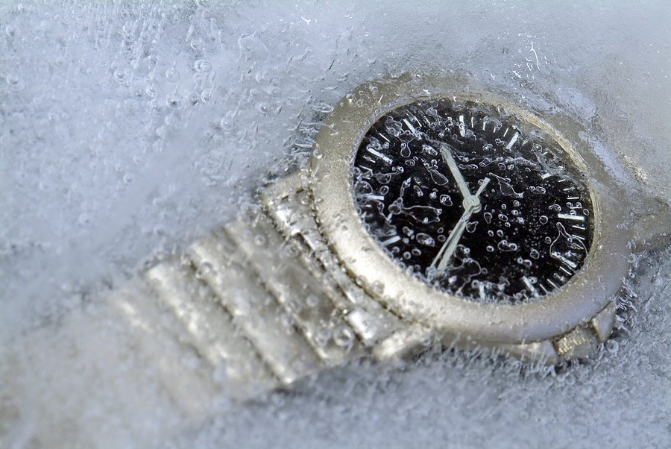
Backward Compatibility
For 20 years now, ROOT macros “just” worked across ROOT versions:
  TFile* f = new TFile(“hist.root”);
  hpx->Draw();
Dated interface personality
Functionality changes impossible
That’s Good, Right?

Slide 6

Typical ROOT Script, short and simple, isn’t
TFile *f = TFile::Open(fname,”NEW”);
TH2D *h1 = new
TH2D(name1,title1,100,10,20,50,-5,5);
double binsy[5] = {0., 1., 5., 10., 50.};
TH2D *h2 = new
TH2D(name2,title2,50,10,20,4,binsy);
for(long i = 0; i < kN ; ++i)
{
h1->Fill(x[i],y[i]);
h2->Fill(x[i],y[i]);
}
f->Write();
delete h2;
delete h1;
delete f;

Slide 7
But what about this variation?
TFile *f = TFile::Open(fname,”NEW”);
TH2D *h1 = new
TH2D(name1,title1,100,10,20,50,-5,5);
double binsy[5] = {0., 1., 5., 10., 50.};
TH2D *h2 = new
TH2D(name2,title2,50,10,20,4,binsy);
for(long i = 0; i < kN ; ++i)
{
h1->Fill(x[i],y[i]);
h2->Fill(x[i],y[i]);
}
f->Write();
delete h2;
delete h1;
delete f;
TH1D *h1 = new
TH1D(name1,title1,10.0,20.0,50);
TFile *f = TFile::Open(fname,”Recrate”);
double binsy[5] = {0., 1., 5., 10., 50.};
TH2D *h2 = new
TH2D(name2,title2,50,10,20,5,binsy);
for(long i = 0; i < kN ; ++i)
{
h1->Fill(x[i],y[i]);
h2->Fill(x[i],y[i]);
}
f->Write();
delete f;
delete h1;
delete h2;

Slide 8
But what about this variation?
TFile *f = TFile::Open(fname,”NEW”);
TH2D *h1 = new
TH2D(name1,title1,100,10,20,50,-5,5);
double binsy[5] = {0., 1., 5., 10., 50.};
TH2D *h2 = new
TH2D(name2,title2,50,10,20,4,binsy);
for(long i = 0; i < kN ; ++i)
{
h1->Fill(x[i],y[i]);
h2->Fill(x[i],y[i]);
}
f->Write();
delete h2;
delete h1;
delete f;
TH1D *h1 = new
TH1D(name1,title1,10.0,20.0,50);
TFile *f = TFile::Open(fname,”Recrate”);
double binsy[5] = {0., 1., 5., 10., 50.};
TH2D *h2 = new
TH2D(name2,title2,50,10,20,5,binsy);
for(long i = 0; i < kN ; ++i)
{
h1->Fill(x[i],y[i]);
h2->Fill(x[i],y[i]);
}
f->Write();
delete f;
delete h1;
delete h2;
Can you spot 6 mistakes?
The compiler can NOT!

Slide 9
Details on the mistakeS
Storing only one of the two histograms
1D histo has the wrong number of bins and wrong range.
File opened read-only
Not enough bin border (“bins out of order”)
1D histo filled with y-coord as weight
double delete
TH1D *h1 = new
TH1D(name1,title1,10.0,20.0,100);
TFile *f = TFile::Open(fname,”Recrate”);
double binsy[5] = {0., 1., 5., 10., 50.};
TH2D *h2 = new
TH2D(name2,title2,50,10,20,5,binsy);
for(long i = 0; i < kN ; ++i) {
h1->Fill(x[i],y[i]);
h2->Fill(x[i],y[i]);
}
f->Write();
delete f;
delete h1;
delete h2;

Slide 10
Behind the scene
TFile *f = TFile::Open(fname,”NEW”);
TH2D *h1 = new
TH2D(name1,title1,100,10,20,50,-5,5);
double binsy[5] = {0., 1., 5., 10., 50.};
TH2D *h2 = new
TH2D(name2,title2,50,10,20,4,binsy);
for(long i = 0; i < kN ; ++i)
{
h1->Fill(x[i],y[i]);
h2->Fill(x[i],y[i]);
}
f->Write();
delete h2;
delete h1;
delete f;
Global variable gDirectory used in TH2D constructor
Global list of objects interested in being told about *every* object deletions
(gROOT->GetListOfCleanups()).
Flat long list of arguments:
TH2D(const char*,const char*,Int_t,Double_t,Double_t,
Int_t,Double_t ,Double_t);
[Compiler can not check semantic of variable name]
Int_t Fill(Double_t x,Double_t y);
Int_t Fill(Double_t x,Double_t y,Double_t w);

Slide 11
In v7 ….
TH2D h1({100, 10.0, 20.0},
{ 50, -5.0, 5.0});
TH2D h2({50, 10.0, 20.0},
{{0., 1., 5., 10., 50.}});
for(long i = 0; i < kN ; ++i)
{
h1.Fill({x[i],y[i]});
h2.Fill({x[i],y[i]});
}
TFilePtr file = TFile::Create(fname);
file->Write( name1, h1 );
file->Write( name2, h2 );

Slide 12
In v7 …. Failure caught/Prevented by the compiler
TH1D h1({10.0,20.0,50});
TH2D h2({50, 10.0, 20.0},
{{0., 1., 5., 10., 50.}});
for(long i = 0; i < kN ; ++i)
{
h1.Fill({x[i],y[i]});
h2.Fill({x[i],y[i]});
}
TFilePtr file = TFile::Create(fname);
file->Write( name1, h1 );
file->Write( name2, h2 );
error: type 'float' cannot be narrowed to 'int' in initializer list
… TH1D h1({10.0,20.0,50})
^~~~
error: excess elements in struct initializer
h1.Fill({x[i],y[i]});
^

Slide 13
Better syntax + better performance

Slide 14
New Interfaces for ROOT
Goals:
Simplicity, Robustness
  Clear ownership, type-safety, compiler-checkable options
Interoperability, Task Parallelism
Design for change: abstraction, separation of public and implementation details
Improve speed where possible
Be used in experiment code developed for CERN Run 3
Means:
Current C++
  including smart pointers
Reduce global state
  Make any global state alteration explicit
TFilePtr f =
TFile::OpenForRead(“hist.root”);
auto hist = f->Get<TH1F>(“hpx”);
canv->Draw(hist);
Notes:
separation of ROOT:: (use!) and ROOT::Internal (don't!) and ROOT::Detail

Slide 15
The plan
Gradual Transition
  New prototype interfaces in ROOT::Experimental and header ending in .hxx
  Released one by one by moving into ROOT::
  Glue new interfaces to rest of ROOT 6
  Later: ROOT 6 interfaces use ROOT 7 ones
Design with care, take time: these interfaces should survive for the next 20 years!
Allow reading old data into new ROOT
Interact with YOU, early and continuously
  take what worked well for ROOT 6

Slide 16
Current state
TFile interface
  Name now part of the connection with container rather than within the object
Histogram including read/write to file.
  Can customize what kind of statistics is being gathered without any run-time penalty
Starting with TPad/TCanvas
  On going discussion on how to express Draw options such that it is intuitive, flexible and compile time checked while remaining easy to code and read.

Slide 17

Conclusion
The world (and C++) has changed, ROOT needs to adapt
Successful maintenance, yet need for evolution
Can only convince through features, robustness, simplicity: usability
Small steps enable organic growth and has enabled feed-back loop
V7 needs YOU
both physicists and
computing aficionados
Get involved by signing up at https://cern.ch/root7-signup for mailing list and semi-regular Wednesday meeting!
Discussions have already produced better interfaces and implementation and lead to contribution of patches and pull requests!

