Slide 1


Application of econometric and ecology analysis methods in physics software
CHEP 2016
10-14 October 2016, San Francisco, CA, USA
Maria Grazia Pia, INFN Genova, Italy
M. C. Han, G. Hoff, C. H. Kim, S. H. Kim, E. Ronchieri, P. Saracco
Hanyang University, Seoul, Korea - INFN CNAF, Bologna, Italy - CAPES, Brasilia, Brazil
Foreword
Due to limited time allocation, there is room only to highlight some basic concepts and to illustrate them in a few examples of application

Slide 2



Treat a software system as a sociosystem/ecosystem
Apply data analysis concepts, methods and techniques developed in economy/ecology
[adapt]
Software development environment
multiple perspectives
Observables produced by the software
Quantitative analysis:
Inference
Measures

Slide 3
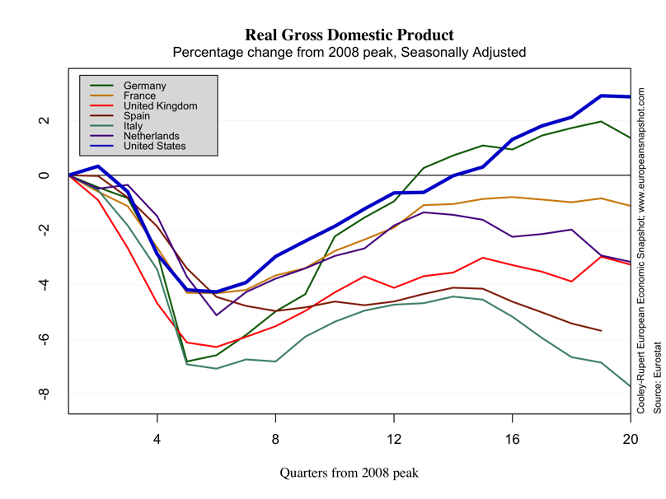
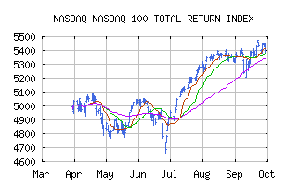
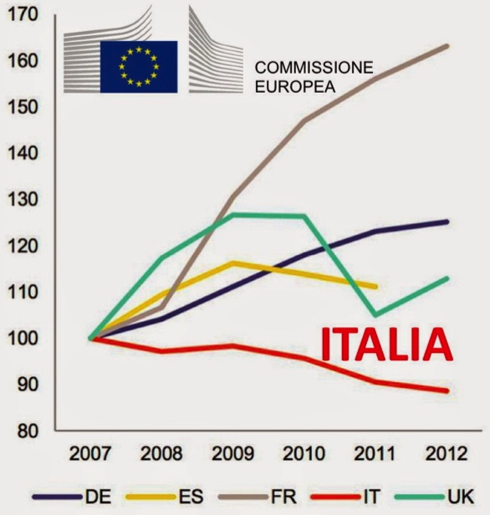
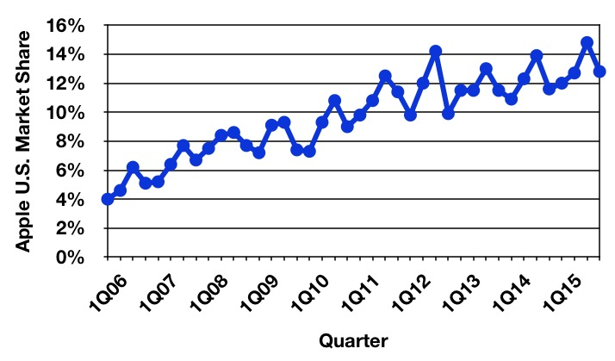
Trend
Government expenditure for tertiary education

Slide 4
Trend analysis
Statistical techniques to identify patterns in a series of data
  Ability to deal with noise
Used to forecast the future (although it does not predict the future)
  But also to analyze past events
Tests for statistical inference: parametric and non parametric
  Test for randomness: H₀ = random, H₁ = monotonic trend/upward/downward
  Mann-Kendall test, Cox-Stuart test, Bartels test etc.
Related: change point detection

Slide 5
Lehman laws
M. M. Lehman,
Programs, Life Cycles, and Laws of Software Evolution,
Proc. IEEE, vol. 68, no. 9, pp. 1060-1076, 1980
Continuing Change
  A program that is used and that as an implementation of its specification reflects some other reality, undergoes continual change or becomes progressively less useful. The change or decay process continues until it is judged more cost effective to replace the system with a recreated version.
Increasing Complexity
  As an evolving program is continually changed, its complexity, reflecting deteriorating structure, increases unless work is done to maintain or reduce it.

Slide 6
Coupling between classes
Chidamber and Kemerer CBO
Excessive coupling between object classes
is detrimental to modular design and prevents reuse
A high coupling has been found to indicate fault-proneness
High CBO is undesirable
Leaf
H₀: random
H₁: downward
Abstract
H₀: random
H₁: upward
Mann-Kendall test
p-value < 0.01
p-value < 0.01
How high is too high? CBO>14
H. Sahraoui et al., “Can Metrics Help to Bridge the Gap Between the Improvement of OO Design Quality and Its Automation?”
Proc. Int. Conf. Software Maintenance, pp. 154-262, 2000

Slide 7
Do I really need a statistical test to see a trend?
I can see a trend just by looking at the plot!
What about seeing trends in 26581 plots?
How to objectively quantify what different eyes see?
How to aggregate the trends observed in various plots?

Slide 8
Chidamber and Kemerer
OO metrics
Abstract classes
H₀: random
H₁: upward
p-value < 0.01

Slide 9
H₀: random – H₁: upward
p-value < 0.01

Slide 10
Trends in software functionality
Electron backscattering simulation with Geant4
Trend of compatibility with experiment as a function of Geant4 version for different physics configurations
H₀: randomness
H₁: upward trend
Mann-Kendall test
p-value = 0.003
H₀: randomness
H₁: downward trend
Mann-Kendall test
p-value = 0.002
Helpful guidance in algorithm development, optimization, regression testing, software maintenance…

Slide 11
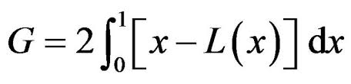
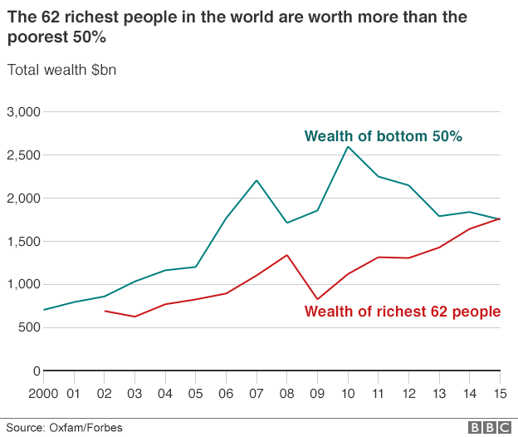

Income inequality measures
Gini index
The 62 richest people in the world are worth more than the poorest 50%
L_{perfect equality}
Cumulative fraction of wealth
½ Gini
Lorenz
0 ≤ P ≤ 1
Cumulative fraction of population
0
more unequal society
1
C. Gini, Variabilità e mutabilità : contributo allo studio delle distribuzioni e delle relazioni statistiche, 1912

Slide 12
Pietra index
AKA Ricci-Schutz index, Hoover index
0 ≤ P ≤ 1
P = max(L_{pe}(x) – L(x))
L_{perfect equality}
Cumulative fraction of wealth
Pietra
Used in derivative markets as a benchmark measure of statistical heterogeneity
Lorenz
Cumulative fraction of population
Counterpart of Kolmogorov-Smirnov statistic
It can be interpreted as the proportion of income that has to be transferred from those above the mean to those below the mean in order to achieve an equal distribution
  Emphasis on individual-mean interaction

Slide 13
Other inequality measures
Theil index
s_{i} = share of the i^{th} group in total income
n = total number of income groups
∞
0
The same as redundancy in information theory:
the maximum possible entropy of the data minus the observed entropy
More equal society
Atkinson index
e = sensitivity parameter
0 ≤ I ≤ 1
Used to calculate the proportion of total income that would be required to achieve an equal level of social welfare as at present, if incomes were perfectly distributed
Theil I, Theil II, Kolm index, coefficient of variation, generalized entropy
and more…

Slide 14
Halstead mental effort
Measure of the number of elemental mental discriminations necessary to create or understand
a class
Gini
Pietra
Atkinson
Theil II

Slide 15
Gini = 0.90
Gini = 0.37
concentrated
software complexity
distributed
software complexity
evolution of concentration
Gini = 0.87
Gini = 0.25

Slide 16

Gini and galaxies
Aggregate the capabilities of Geant4 PhysicsLists to reproduce experimental observables

Slide 17

Other econometric analysis methods:
Concentration, Change point
Relation with methods used in ecology
(e.g. analysis of diversity)
Information theory background
Comparative evaluation
of measures and tests
Decomposition of inequality measures by subgroups
Methods, applications to physics software and results will be documented in forthcoming papers

Slide 18
Conclusion
Statistical methods commonly used in other disciplines
can be valuable in software and physics analysis
Rich variety of econometric/ecology concepts and techniques
  Trend, inequality, concentration, diversity, changepoint…
Ongoing R&D to explore applications in physics software
  To characterize software properties
  To evaluate the behaviour of physics models
A few highlights, no time for extensive presentation

