Slide 1
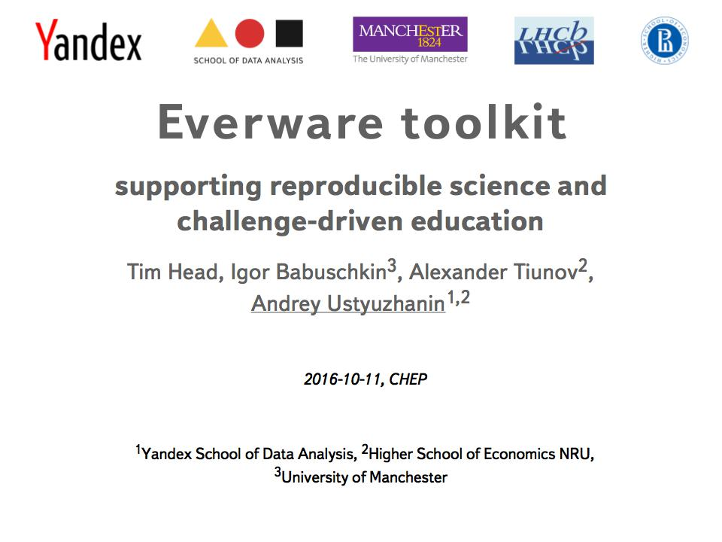

Slide 2
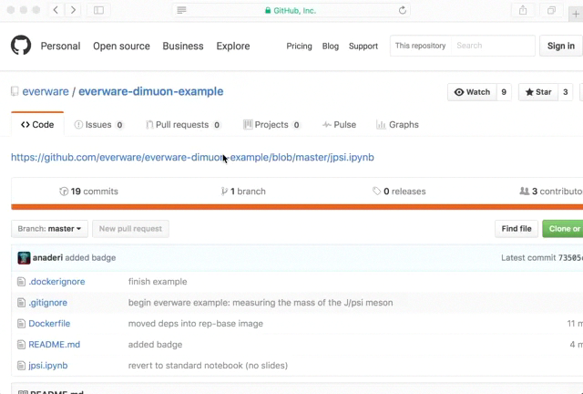

Slide 3
Everware is ...
... about re-usable science, it allows people to jump right into your research code. Lets you launch Jupyter notebooks from a git repository with a click of a button.
〉 https://github.com/everware
〉 https://everware.rep.school.yandex.net (Yandex instance)
Examples:
〉 algorithm meta-analysis, https://github.com/openml/study_example
〉 gravitational waves, https://github.com/anaderi/GW150914
〉COMET, https://github.com/yandexdataschool/comet-example-ci
How it works:
  〉 resources: wherever everware is installed (Yandex)
  〉 data: CERNBOX
  〉 environment management:
  〉 conda or virtualenv
  〉 docker
  〉 github: analysis code versioning
  〉 Jupyter(Hub): runs the code interactively (a-la workflow)
  〉 continuous integration: intermediate results checks & report

Slide 4
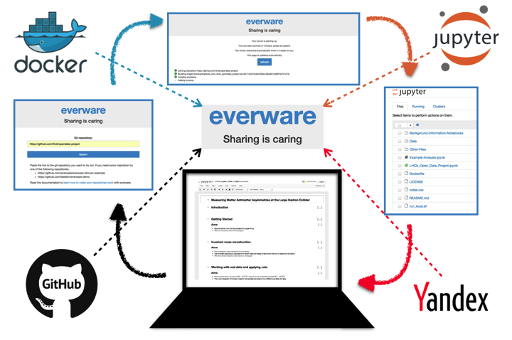
Highlights
〉 Reproducibility is not easy, but possible;
〉 everware works for research and education
〉 easy to try;
〉 WIP, https://github.com/everware (open-source, care to join?);
〉 feature requests are welcome
〉 pull requests are most welcome
〉 See talk on LHCb open data masterclass for an extensive example.

