Slide 1
High Performance Data Transfer
Les Cottrell^{SLAC} Chin Fang^{Zettar}, Andy Hanushevsky^{SLAC}, Wilko Kreuger^{SLAC}.
Wei Yang^{SLAC}
Presented at CHEP16, San Francisco

Slide 2
Agenda
  Data Transfer Requirements Challenges at SLAC
  Solution Proposed to tackle Data Transfer Challenges
  Testing
  Conclusions

Slide 3

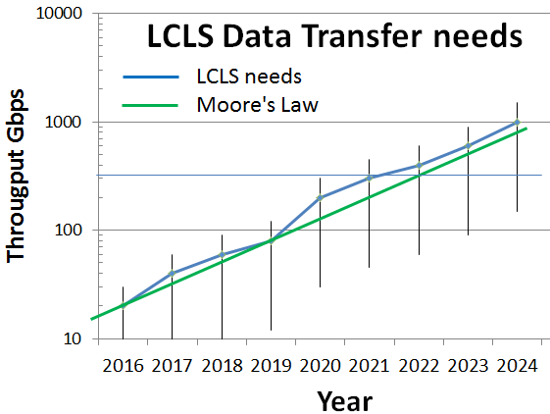

Requirement
Today 20 Gbps from SLAC to NERSC =>70Gbps 2019
  Experiments increase efficiency & networking
2020 LCLS-II online, data rate 120Hz=>1MHz
  LCLS-II starts taking data at
  increased data rate
2024 1Tbps:
  Imaging detectors get faster
LHC Luminosity increase 10 times in 2020 SLAC ATLAS 35Gbps=>350Gbps
Notes:
“Note we won't scale up to 1MHz: the imaging experiments (which are the heavier ones, data wise) will be limited at about 100KHz. Also we plan to do feature extraction before sending to NERSC. In the end, I expect we'll be moving data at around 1Tb/s.” Amedeo Perazzo

Slide 4
Joint project with Zettar Start-up &
Provide HPC data transfer solution (i.e. SW + transfer system reference design):
  state of the art, efficient, scalable high speed data transfer
Over carefully selected demonstration hardware

Slide 5
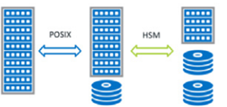
Design Goals
Focus on LCLS-II needs
  SLAC=>NERSC(LBL) over ESnet link
High availability (peer-to-peer SW, cluster with failover for multi NICs, servers )
Scale out (fine granularity of 1U for storage, multi cores, NICs)
Highly efficient (low component count, low complexity, managed by software)
Low cost (inexpensive SSDs for read, more expensive for write, careful balancing of needs)
Forward looking (uses 100G IB EDR HCAs & 25GbE NICs, modern design)
Small form factor (6Us)
Energy efficient
Storage tiering friendly (supports tiering)
Hi-perf
storage
Capacity
storage
DTN
HSM
SSDs
Notes:
LCLS, the link is between SLAC (Menlo Park) and NERSC (Berkeley). So, high-bandwidth, high link quality, low competing traffic are the pre-conditions.
The peers in a cluster work together to slice a data set, regardless of data types (numerous small files, mix-sized files, or large files) into an appropriate number of logical “pieces”, to be transferred to a destination, under the guidance of a “data transfer controller” peer.

Slide 6
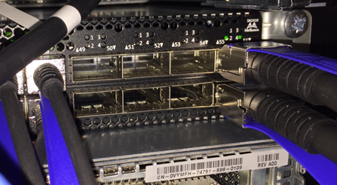
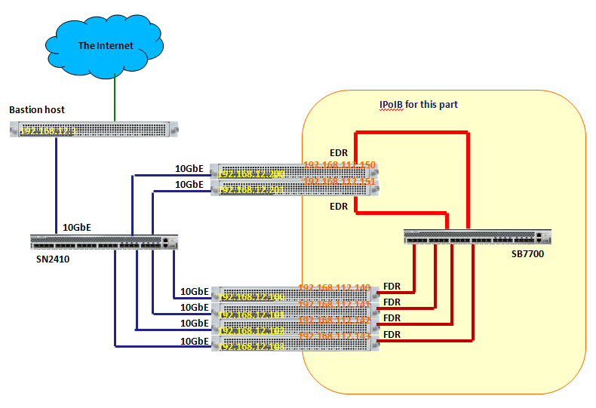







NG demonstration
2x100G LAG
Other cluster
or High speed Internet
IP over InfiniBand IPoIB)
Storage servers
> 25TBytes in 8 SSDs
100Gbps
n(2)*100GbE
100Gbps
4* 56 Gbps
Data Transfer Nodes (DTNs)
4* 2 * 25GbE
Notes:
Note that the High Performance Storage Tier is composed of NVMe SSDs. This tier is designed for performance, not for capacity. It is also a major reason why we use an AIC SB122A-PH all-NVMe SSD 1U storage server, rather than say a SuperMicro SuperServer 2028U-TN24R4T+:
It is an 1U storage server, rather than the more conventional 2U unit
It does not use a performance sapping PCIe switch in the system.
It reduces the costs since a fully populated SuperMicro model consists of 24 NVMe SSDs, while two fully populated AIC servers have 20 NVMe SSDs - so lower cost.
There are 8*25Gbps NICS (=200Gbps)

Slide 7
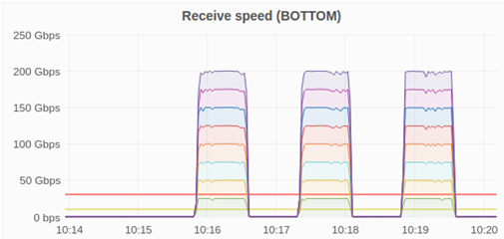
Memory to Memory between clusters with 2*100Gbps
No storage involved just DTN to DTN mem-to-mem
Extended locally to 200Gbps
  Here repeated 3 times
  Note uniformity of 8* 25Gbps interfaces.
Can simply use TCP, no need for exotic proprietary protocols
Network is not a problem
Notes:
Also tested with latency injection and OSCARS ESnet 70Gbps dedicated link over 5000mile circuit.
For LCLS will use ESnet high performance, low loss well managed network
Uses TCP Fast Open https://en.wikipedia.org/wiki/TCP_Fast_Open <https://en.wikipedia.org/wiki/TCP_Fast_Open

Slide 8
Storage
On the other hand, file-to-file transfers are at the mercy of the back-end storage performance.
Even with generous compute power and network bandwidth available, the best designed and implemented data transfer software cannot create any magic with a slow storage backend

Slide 9


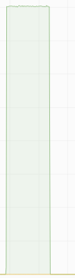
XFS READ performance of 8*SSDs in a file server measured by Unix fio utility
Queue Size
Read Throughput
SSD busy
800%
3500
20GBps
600%
2500
15GBps
400%
1500
10GBps
200%
15:16
15:18
15:16
15:18
5GBps
Data size = 5*200GiB files similar to typical LCLS large file sizes
0GBps
15:16
15:18
Note reading SSD busy, uniformity, plenty of objects in queue yields close to raw throughput available

Slide 10






XFS + parallel file system WRITE performance for 16 SSDs in 2 file servers
SSD write throughput
SSD busy
10GBps
Queue size of pending writes
50
Write much slower than read
File system layers can’t keep queue full (factor 1000 less items queued than for reads)

Slide 11
Speed breakdown
SSD speeds | Read | Write | Write/Read | % Intel Read | % Intel Write | IOPS read | IOPS write | IOPS write / read
Intel sequential | 2.8 GBps | 1.9 GBps | 68% | 100% | 100% | 1200 | 305 | 25%
XFS | 2.4 GBps | 1.5 GBps | 63% | 86% | 79%
XFS/Intel | 85% | 79%
Raw Intel sequential write speed 68% of read speed
Limited by IOPS
XFS 79%(write)-85%(Read) of Raw Intel sequential speed
File speeds | Read | Write | Write/Read
XFS | 38GBps | 24GBps | 63%
BeeGFS+XFS | 21GBps | 12GBps | 57%
BeeGFS+XFS/XFS | 55% | 50%
Parallel file system further reduces speed to 55%(read) - 50% (write) of XFS
Net read 47% of raw write 38% of raw

Slide 12
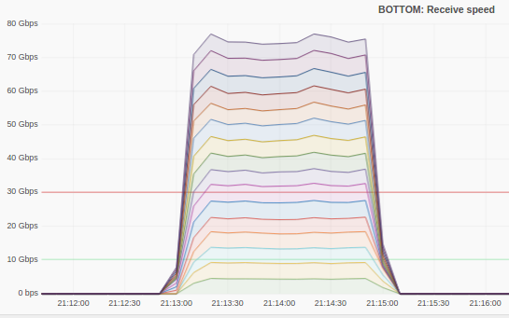
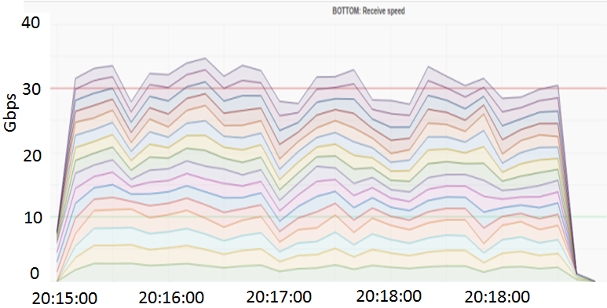
Results from older demonstration: LOSF
2 mins
80Gbps
40Gbps
60Gbps
40Gbps
20Gbps
Elephant File-to-file transfer with encryption
LOSF File-to-file transfer With encryption
Copyright © Zettar Inc. 2013 - 2016

Slide 13

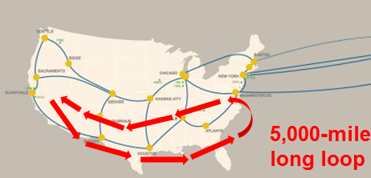
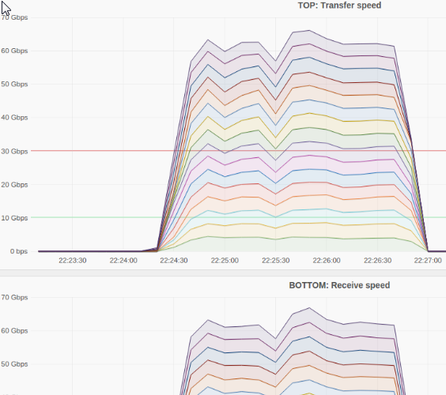







Over 5,000 mile ESnet OSCARs circuit with TLS encryption
70Gbps
Transmit Speed
50Gbps
30Gbps
10Gbps
22:24
22:25
22:26
22:27
Degredation of 15% for 120ms RTT loop.
70Gbps
Receive Speed
50Gbps
Notes:
TLS refers to Transport Layer Security, a cryptographic protocol designed to provide communications security over a computer network. It uses X.509 certificates and hence asymmetric cryptography to authenticate the counterparty with whom it is communicating, and to negotiate a symmetric key. This session key is then used to encrypt data flowing between the parties. Transport Layer Security from Wikipedia, see http://en.wikipedia.org/wiki/Transport_Layer_Security

Slide 14
Conclusion
Network is fine, can drive 200Gbps, no need for proprietary protocols
Insufficient IOPS for write < 50% of raw capability
    Today limited to 80-90Gbps file transfer
Work with local vendors
State of art components fail, need fast replacements
  Worst case waited 2 months for parts
Use fastest SSDs
We used Intel DC P3700 NVMe 1.6TB drives
Biggest also fastest but also most expensive
  1.6TB $1677 vs 2.0TB $2655 ; 20% improvement 60% cost increase
Need to coordinate with Hierarchical Storage Management (HSM), e.g. Lustre + Robin Hood
We are looking to achieve achieve 80-90Gbps = 6 PB/wk by SC16
Parallel file system is bottleneck
Needs enhancing for modern hardware & OS
Notes:
Modern hardware include: SSDs, multi-cores, multi-cpus, modern OS (multi-request in parallel, e.g. blk-mq)
GridFTP achieved 90+Gbps in 2013, however footprint, price, energy consumption, single point of failure, not using parallel file system so hard to scale out. Do not need external web service (globus) or usability.
Zettar provides a solution; software + transfer system design.
GridFTP is a pure software offering + a for fee Web services (Globus). GridFTP is tough to install and to configure. Globus doesn't do anything in that regard.
We also successfully tested BBCP which is trivial to install and requires no configuration and for the lustre to lustre transfer achieved similar performance to Zettar in 2016.
The globus support fee needs to be paid annually. It’s actually for a fixed set of users (~$90K/20 users), so if there are e.g. 100 users on support contract, then the cost becomes ~$90/20 users/year x 100 users ~ $450/year
As to what hardware are good for deploying GridFTP, that's all up to the deployment side. Our design is well developed, well-documented with design rationales, mature (in its 3rd generation), and is forward looking, among the other benefits mentioned in the project report. N.b. there are > 2000 LCLS users
Advances in computing systems are hard to predict their impact at this stage (e.g. hardware RAID ).
Today LCLS wants to be able to look at the data as it arrives at its destination but before the transfer is complete. This shows how important it is to make the data available at the destination with the minimum delay. Buffering to store and forward the data over a slower link not only involves costs for the buffer, but also adds extra delays

Slide 15


More Information
LCLS SLAC->NERSC 2013
  http://es.net/science-engagement/case-studies/multi-facility-workflow-case-study/
LCLS Exascale requirements, Jan Thayer and Amedeo Perazzo
  https://confluence.slac.stanford.edu/download/attachments/178521813/ExascaleRequirementsLCLSCaseStudy.docx
Questions

