Slide 2
That this presentation about ?
Some remarks on the team, funding and high level objectives.
Managing the system
  Full High Availability Functionality
  Managing underlying storage; delegate storage (CEPH)
  Managing system configuration and monitoring (REST)
Managing your storage
  Quality of storage management
    New Resilient Manager
    New APIs (REST API for QoS translated to CDMI)
Cloud access
  ownCloud © interface
  New authentication and authorization mechanisms

Slide 3
The Technology Cheat Sheet

Slide 4
dCache Cheat-sheet
Combines heterogeneous storage nodes under a common virtual file system tree and scales into 100PB region.
Provides access to data via a variety of protocols, e.g. NFS4.1, WebDAV, GridFTP, etc.
Provides a variety of authentication mechanisms, like User/Pass, X509 Certificates, Kerberos, in preparation SAML and OpenID Connect, Macaroons.
Multi Tier support: moves data around between different media types, like Tape, Spinning Disks and SSDs.
  By user request.
  Automatically based on the access profile, hot spot.
Provides resiliency, e.g. through multiple automatically managed copies.

Slide 5
Some strategic considerations

Slide 6



The dCache.org collaboration
HTW
Berlin
(University)
Uni
Hamburg

Slide 7


Funding and roadmap
EOSC
???
Standardization
Deploying new technologies into
Production and exploring new communities
INFRA-12-2017
2010
2013
2015
2018
NFS 4.1 / pNFS
Deployment
Interoperability
Reducing Costs
HTTP / WebDAV
Data Life Cycle
Contributing to the
Dynamic Federation
Multi Tier Storage
AAI
Quality of Service
Migration Archiving

Slide 8
Improved System Management I
Full High Availability
With the
increasing size of dCache installations,
the usage beyond WLCG, with more challenging SLAs and with
the pressure to run ‘operator less’ for days
  Weekends
  Dark Data Centers
  Reduce Costs
High Available functionality became inevitable.

Slide 9



High Availability
Redundant Doors
(Protocol Engines)
NFS
NFS
https
https
Headnodes :
Filesystem, Pool Management
Single Point of Failures
Redundant Pools
(Replica Manager)
Multiple File Copies

Slide 10
High Availability
Mainly the following issues need to be fixed for dCache HA
The dCache core “message passing system” had to be fixed to overcome failures on single path segments: ‘rerouting’
dCache sub-services needed to become redundant
  Single point of failure services
  state-less services

Slide 11
High Availability: Message Passing
Any single component can fail, w/o breaking the service
Stolen from Gerd Behrman, NDGF

Slide 12
High Availability
Stateless services : use publish subscribe
Stateless Service
Stateless Service
Randomize
Singletons (build quorums, e.g. using Zookeeper)

Slide 13
Result (With 3.0)
At any point in time, one internal service (node) can fail without consequences for the overall service.
Essential for a huge 24/7 installations.

Slide 14
Improved System Management II
Delegating low level storage functionality

Slide 15
Delegating work to external Storage Layers
Provides a single-rooted namespace.
Metadata (namespace) and data locations are independent.
Uniquely handles different Authentication mechanisms, like x509, Kerberos, login+password, auth tokens.
Provides access to the data via variety of access protocols (WebDAV, NFSv4.1/pNFS, xxxFTP. DCAP, Xrootd, DCAP).
Provides data migration between multiple tiers of storage (DISK, SSD, TAPE).
Aggregates multiple storage nodes into a single storage system.
Manages data movement, replication, integrity.
Can be delegated
Slide stolen from Tigran Mkrtchyan

Slide 16
Integrating low level storage technologies
Unlimited hierarchical Storage Space
NFS 4.1, WebDAV, GriFTP
X509, user/passwd, OIDC, Kerberos
See Tigrans Talk Today 14:00 at GG C3
SSDs
Spinning Disks
Tape, Blue Ray …
Benefits: Best of two worlds
Low maintenance CEPH functionality
High level dCache functionality : access protocols and authentication mechanisms

Slide 17
Moving to managed storage or
Quality of Service in Storage
Why ?
Storage has different qualities and different prices.

Slide 18
Pre-requisite for
”Support for Quality of Service in Storage”
Integrated support for different storage media
Transparent transition between media types based on
  Internal rules
  APIs for remote “Platform as a Service” systems
  Manual intervention (Operator , User)
Consistent and transparent management of replica
  System must be aware of media attributes (Speed, Latency, Price)
  System must be aware of locations (Rack, Power supply group, Buildings)
Management API’s (SRM, REST, CDMI)
Graphical Interfaces

Slide 19
Integrated Media Technology Support
Technology | Driver
Spinning Disk | POSIX Driver
SSD | POSIX Driver
Shingled (SMR) | POSIX (disable remove)
 | TAPE Driver
Removable devices | TAPE Driver
CEPH | New CEPH Block Driver

Slide 20


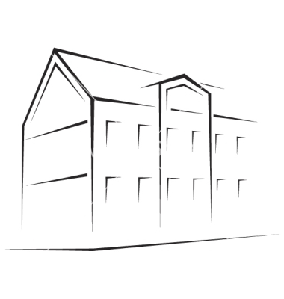
Directory Based Storage Quality selection
Your Home
Disk replicas managed by “Replica Manager” see Poster

Slide 21
Storage Management GUI
Locality
QoS
DISK
TAPE

Slide 22
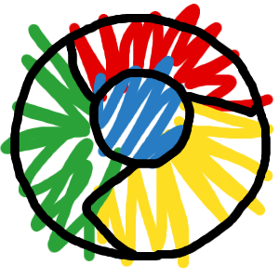
QoS Management interfaces
Frame
Works
&
PaaS
e.g.
INDIGO
OneData
SRM
Migration Engine &
Replica Manager
REST
CDMI
GUI
For details see Pauls presention tomorrow 11:15.

Slide 23
Managed Storage II
Managing data flows in federated systems.

Slide 24
Federating Storage
The Michigan Setup
Ann Harbor, MI Campus
100 Km
3 ms
WRITE
Either AH or LN
Depending on Space
READ
Always from ‘local’
Possibly cache copy
Lansing, MI Campus
Provided by Shawn McKee

Slide 25
Progress of supporting x-site federation.
Federation Mechanisms in place for long time.
Remote component secure connection with 3.0
Remote component authentication and authorization following soon.

Slide 26
The Cloud Part

Slide 27
The cloud feeling, The Sharing
My Home
Your Home
Share this one with you

Slide 28
We decided to go for ownCloud © to get this done.

Slide 29



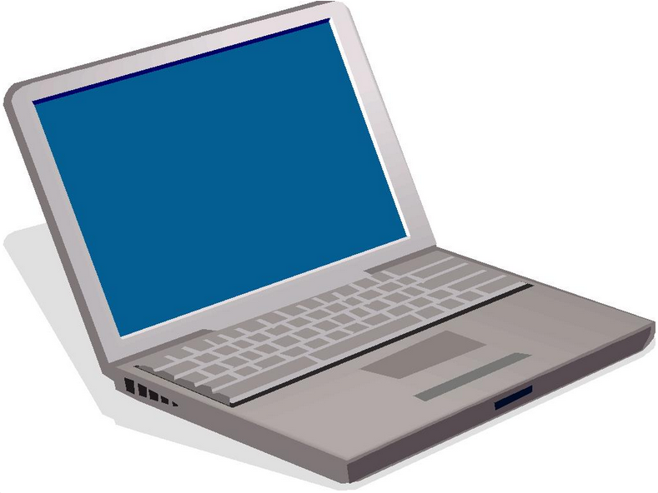
The Hybrid System

Slide 30
Putting it all together …..

Slide 31

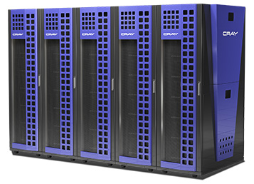


The scientific Data Cloud
High Speed
Data Ingest
Fast Analysis
NFS 4.1/pNFS
Wide Area Transfers
(Globus Online, FTS)
by GridFTP
Visualization
& Sharing
by WebDAV, OwnCloud

Slide 32
Conclusion
Well on the way for new strategic direction on storage:
Bringing costs down for operations
  Using ‘low maintenance’ storage backends (e.g. CEPH)
  Introducing High Availability mechanisms to support ‘dark data centers’
Allowing Quality of Service in storage to be defined by sysadmins and users.
  With GUI
  Remotely : SRM, REST, CDMI
Introducing Cloud mechanisms (e.g. sharing) not only for home directory type data but as well for experiment data.
Implementing the “Scientific Storage Cloud”
Stick with industry standards
  Allow sharing resources at sites
  Benefit from development and fast turnaround in security components and mechanisms.

Slide 33
The END further reading www.dCache.org

