Slide 1
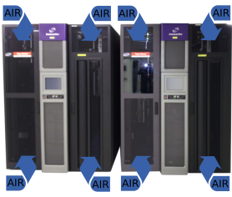


DATA CENTER ENVIRONMENTAL SENSOR
for safeguarding (not only!) the CERN Data Archive
J Leduc, Q Genoud, G Cancio Melia, D Kruse, E Cano, S Murray and V Bahyl - CERN IT
WHY DCES?
    Tape libraries are highways for airflows and bits on tapes are now smaller than bacteria
    Commercially available solutions are too expensive or too slow and do not physically fit inside tape libraries
PERFORMANT AND VERSATILE
    DCES samples the traversing airflow at 100Hz and sends measurements every 2 seconds
    DCES quantifies small dust particles, temperature, humidity and detects large particles (dangerous for data on tape)
    DCES is versatile:
DCES in a tape drive tray
DCES in an ATX PSU
Contact: Julien.Leduc@cern.ch Page 1

Slide 2
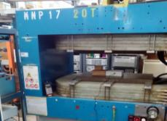
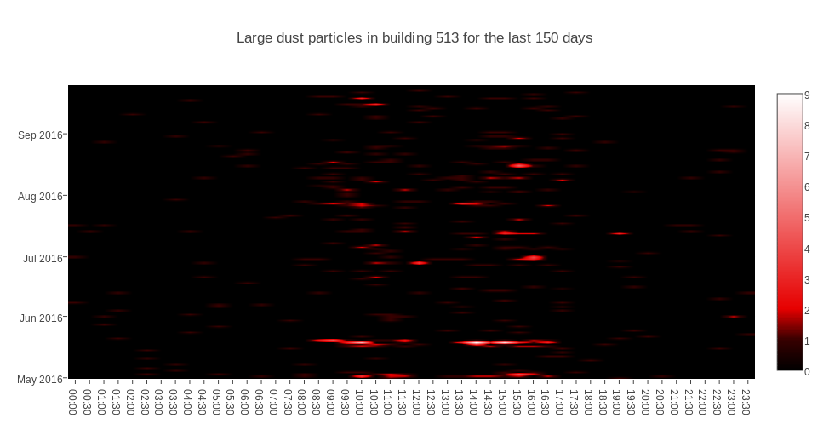
DATA CENTER ENVIRONMENTAL SENSOR
for safeguarding (not only!) the CERN Data Archive
J Leduc, Q Genoud, G Cancio Melia, D Kruse, E Cano, S Murray and V Bahyl - CERN IT
HARDENED DESIGN
    DCES is built with industrial grade components and designed to be maintenance free
    Its electronics has been tested up to 0.5 Teslas for rough physics experiments use
EASY INTEGRATION
    DCES is fully opensource: CERN open hardware license and firmware is GPLv3
    DCES is used outside CERN IT and outside CERN
    Easy to integrate in any monitoring environment
Example Jupyter dust alert reporting in CERN Computer Center:
350A magnet torturing of DCES electronics:
Contact: Julien.Leduc@cern.ch Page 2

